Slide 1
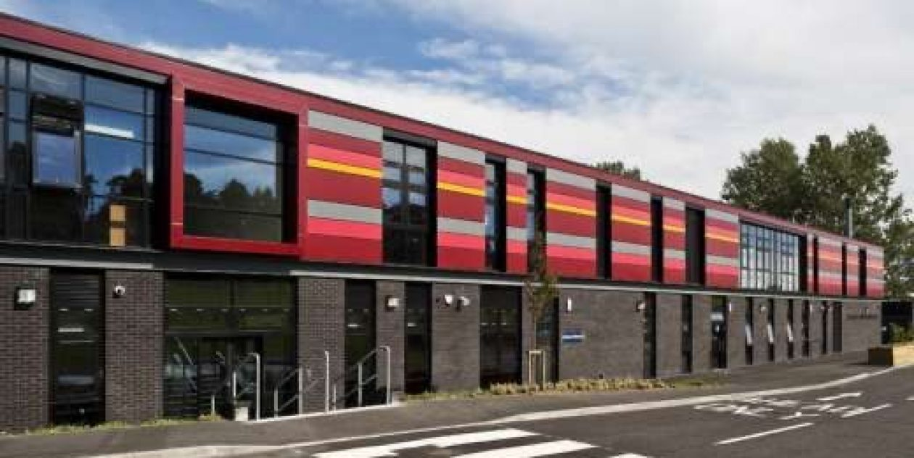
Welcome to St Cadoc’s
A short introduction to starting school

Slide 2
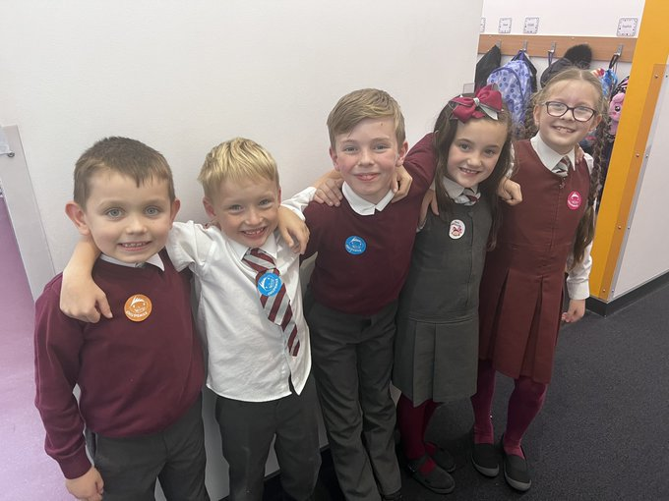
Uniform
Burgundy or grey jumpers/cardigans
White shirt and tie
Grey trousers or skirt
Burgundy blazer
School shoes
Can be purchased from BE Uniforms in
Argyle Street
Preloved uniforms available

Slide 3
P.E. kit
Black or navy shorts
White polo shirt
Black soft indoor shoes
P.E kit is brought on a Monday and returned home on Friday
Please label all items!

Slide 4
Wet weather kit
Puddle suit
Wellies
OPAL

Slide 5
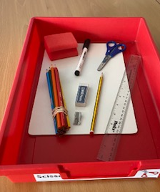
Resources
Water bottle – plain water only
School bag
All clearly labelled
Homework bag and PE bag provided

Slide 6
Snacks and lunches
Breakfast Club runs from 8.15am
School dinners
Packed lunch option
Dietary requirements

Slide 8
Free school meals and clothing grants
If you are in receipt of Housing Benefit and/or Council Tax Reduction there is no need for you to apply to South Lanarkshire as free school meals and/or clothing grants will be provided automatically
If you are in receipt of benefits you can apply for free meals – SLC website
If you are in receipt of certain benefits, you and your family may qualify for a leisure concession card giving you up to 50% off the cost activities with South Lanarkshire Leisure. Full details can be found on the South Lanarkshire Leisure and Culture website.

Slide 9
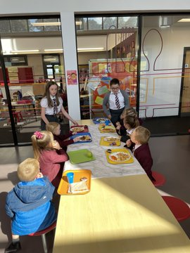
First days
Getting used to school routines

Slide 10
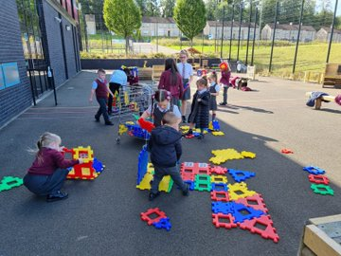
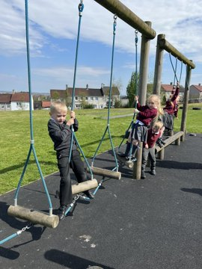
First days
We learn to line up properly
And play in our playground

Slide 11
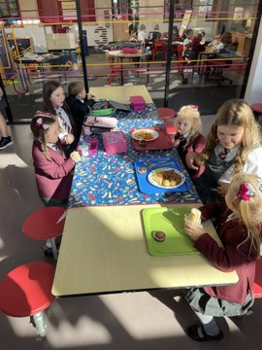
First days
We meet our ‘Big Buddies’

Slide 12
House System
Rose
Wood
Ivy
Lily

Slide 13
Primary 1 Curriculum

Slide 14
Our curriculum
Heggarty phonological awareness programme
Active literacy systematic synthetic phonics
Decodable readers initially
Book banding
Talk for Writing
Maths Recovery
IDL Project based learning

Slide 17
Primary 1 teachers
Mrs Coleman will be one of the Primary 1 teachers next year
Second Primary 1 teacher will be allocated as soon as possible
Miss Dowds is the Primary 1 support staff member

Slide 18
The first week
For the first week, start and end times will be slightly different to make the process easier
Pick up and drop off from class door, this is only for the initial
settling in period
Please refer to the August Parental Guide

Slide 19
Communication
Email - gw14stcadocspsoffice@glow.sch.uk
Twitter - @stcadocsPCambus
Website - https://blogs.glowscotland.org.uk/sl/stcadocsprimary
Phone -0141 6413088

Slide 20
Parentsportal

Slide 21
Parent Council

