Slide 1
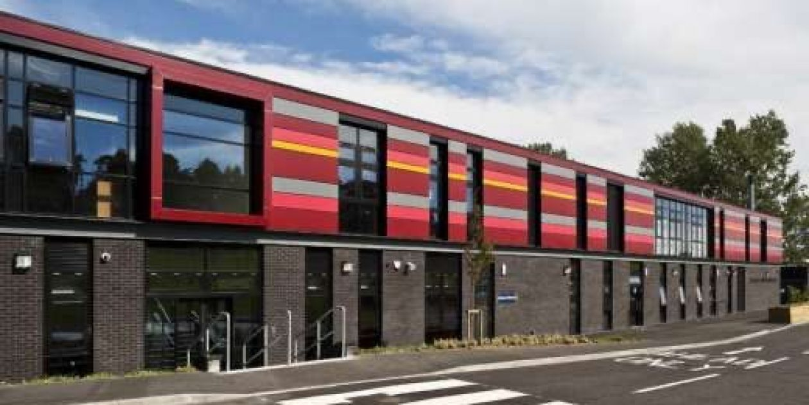
Welcome to St Cadoc’s
A short introduction to starting school

Slide 2
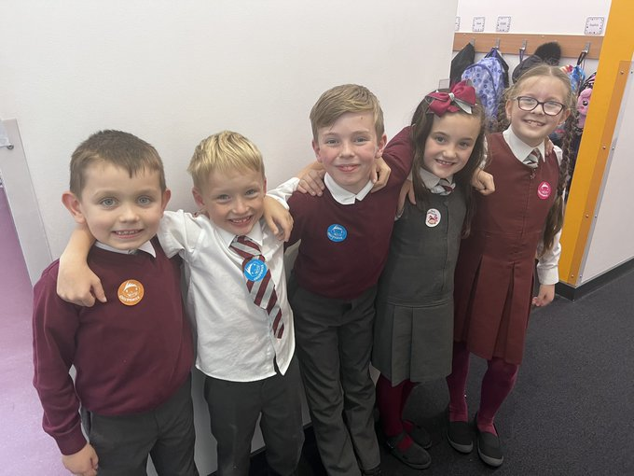
Uniform
Burgundy or grey jumpers/cardigans
White shirt and tie
Grey trousers or skirt
Burgundy blazer
School shoes
Can be purchased from BE Uniforms in
Argyle Street
Preloved uniforms available

Slide 3
P.E. kit
Black or navy shorts
White polo shirt
Black soft indoor shoes
P.E kit is brought on a Monday and returned home on Friday
Please label all items!

Slide 4
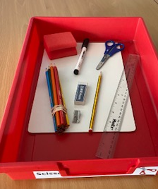
Resources
Water bottle – plain water only
School bag
All clearly labelled

Slide 5
Snacks and lunches
Breakfast Club runs from 8.15am
School dinners
Packed lunch option
Dietary requirements

Slide 6
Free school meals and clothing grants
If you are in receipt of Housing Benefit and/or Council Tax Reduction there is no need for you to apply to South Lanarkshire as free school meals and/or clothing grants will be provided automatically
If you are in receipt of benefits you can apply for free meals – SLC website
If you are in receipt of certain benefits, you and your family may qualify for a leisure concession card giving you up to 50% off the cost activities with South Lanarkshire Leisure. Full details can be found on the South Lanarkshire Leisure and Culture website.

Slide 7
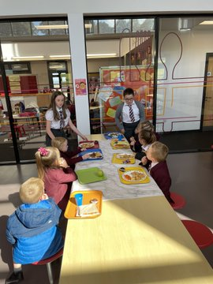
First days
Getting used to school routines

Slide 8
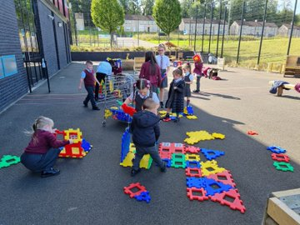
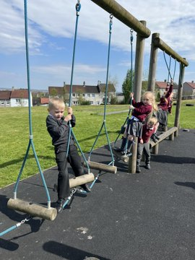
First days
We learn to line up properly
And play in our playground

Slide 9
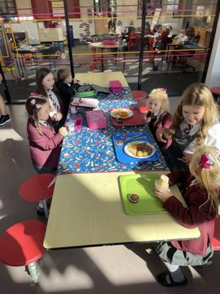
First days
We meet our ‘Big Buddies’

Slide 10
Primary 1 Curriculum

Slide 11
Primary 1 teachers?
You will receive a letter letting you know the name of your child’s Primary 1 teacher
The teacher(s) will send a video to introduce themselves

Slide 12
The first week
For the first week, start and end times will be
slightly different to make the process easier
Pick up and drop off from class door, this is only for the initial
settling in period
Please refer to the August Parental Guide

Slide 13
Communication
Email - gw14stcadocspsoffice@glow.sch.uk
Twitter - @stcadocsPCambus
Website - https://blogs.glowscotland.org.uk/sl/stcadocsprimary
Phone -0141 6413088

Slide 14
Parent Council

