Slide 1
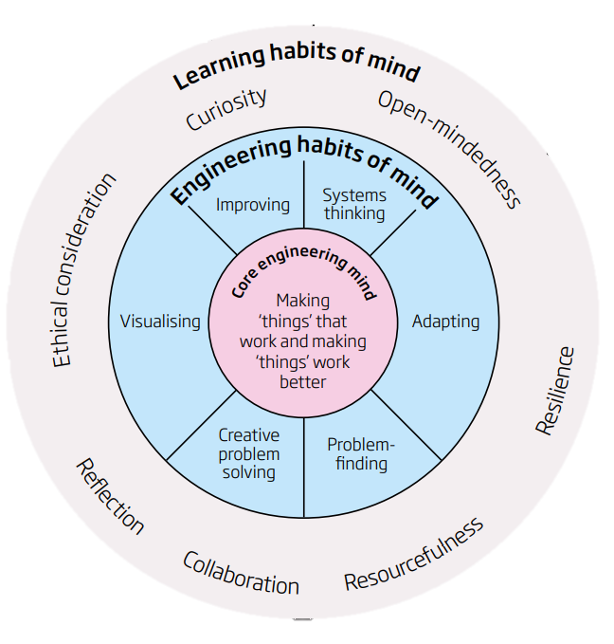

Engineering Habits of Mind Toolkit
Click on the Engineering Habit of Mind to find out more…
Click below for the Engineering Habits of Mind overview…

Slide 2




Engineering Habits of Mind: Overview
Ask
Imagine
Plan
Create
Test
Improve
Engineering Habits of Mind have been developed my The Royal Academy of Engineering to outline the skills and attributes employed by Engineers across disciplines. When used along side the design process, they can be used to develop pupils’ STEM skills and skills that can be used across the curriculum.
More information about Engineering Habits of Mind can be found in these documents:
Thinking Like an Engineer
Learning to be an Engineer
Click here to return to the home page.

Slide 3
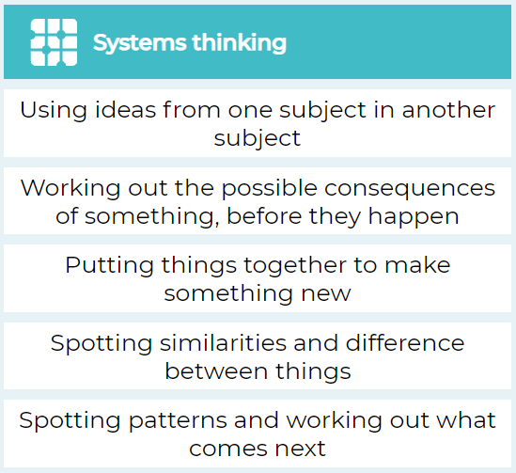
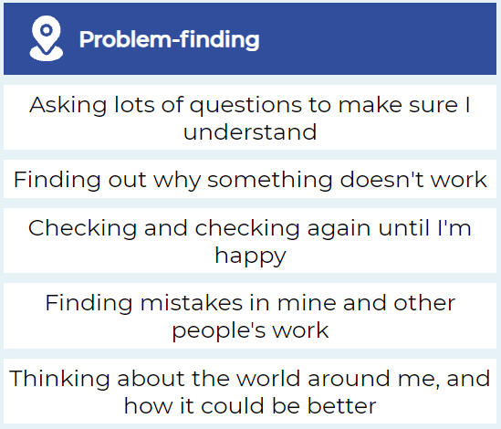
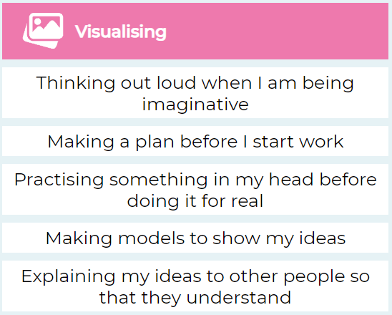
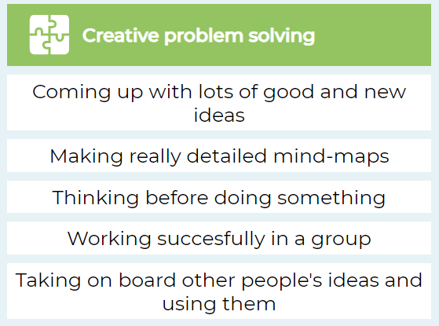
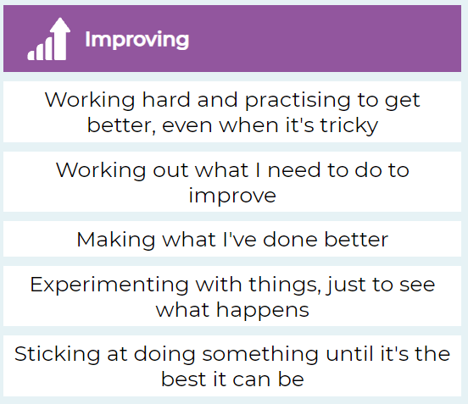
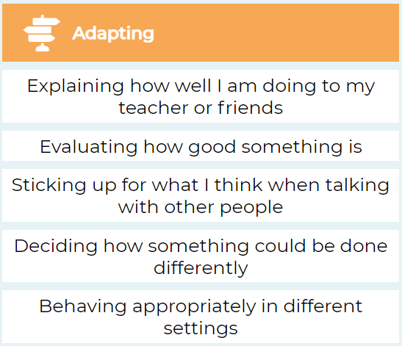
Click here to return to the home page.

Slide 4

Systems Thinking
Click here to return to the home page.

Slide 5
Systems Thinking: Overview
Systems Thinking, as defined by the Royal Academy of Engineering, involves seeing whole systems and parts and how they connect, pattern seeking, recognising interdependencies and synthesising. The pupil friendly definition can be seen opposite.
The following slides provide some simple examples of how the attributes of Systems Thinking can be developed across the curriculum.
Click here to return to the home page.

Slide 6
Level | Es and Os | Learning Activities | Stimulus
Early Level Theme: Systems Thinking Can be adapted to Second Level for algebra | I have spotted and explored patterns in my own and the wider environment and can copy and continue these and create my own patterns. MTH 0-13a I explore everyday materials in the creation of pictures/models/concepts TCH 0-10a | Extend the Pattern Resources: Tessellation tiles (or Lego bricks, beads… anything that you can make a pattern with!) Key Questions: What is a pattern? Where might we see patterns? Systems Thinking Skill: Pattern Making | https://nrich.maths.org/8933 https://www.bbc.co.uk/bitesize/clips/zthsb9q https://www.topmarks.co.uk/Search.aspx?q=sequences+and+patterns
Click here to return to the home page.

Slide 7
Extend the Pattern
You will need: Tessellation tiles (or Lego bricks, beads… anything that you can make a pattern with!)
Activity: Can pupils continue a pattern for a certain number of steps? Can pupils create their own patterns?
Time to Think: What is a pattern? Where might we see patterns? Can we find any patterns in the room/space around us?
Time to Make: Working as part of a small group show learners a pattern. Have them discuss what they see (shapes, sizes, colours, textures – whatever is relevant to the objects you have used to create the pattern). Have learners suggest ways to carry on the pattern. Once learners are confident in extending the patterns, can they create their own and explain why it is a pattern.
Extension: Can learners identify patterns in numbers? E.g. counting in 2s, odd/even numbers…
Click here to return to the home page.

Slide 8
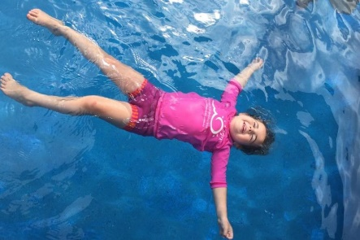
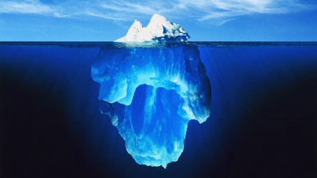
Level | Es and Os | Learning Activities | Stimulus
Early Level Theme: Systems Thinking | Through creative play, I explore different materials and can share my reasoning for selecting materials for different purposes. SCN 0-15a Extension Task: Create a graph I can collect objects and ask questions to gather information, organising and displaying my findings in different ways. MNU 0-20a I can match objects, and sort using my own and others’ criteria, sharing my ideas with others. MNU 0-20b | Sink or Float? Resources: Basin of water, whiteboard & whiteboard pen, a range of different objects (e.g. stone, leaf, stick, ball, tinfoil ball, Lego brick…) Key Questions: What are the properties of the objects? Why do some objects float better than others? Can you identify any more objects around the classroom that might float or sink? Systems Thinking Skill: Connecting | Can use the following images to prompt discussion:
Click here to return to the home page.

Slide 9
Sink or Float?
You will need: Basin half filled with water, recording equipment (e.g. whiteboard & whiteboard pen) and an assortment of objects (e.g.
Activity: Can pupils determine whether an object will float or sink?
Time to Think: Use stimulus pictures to prompt discussions. Why do learners think some objects float better than others?
Time to Test: Pupils to test objects one at a time to determine whether they sink or float. Allow time for discussion as to why they think certain objects float and others don’t. If required give pupils prompts such as: Do you think it is to do with the size? Is it to do with the weight? Is it to do with the volume?
Rules/Suggestions
Have pupils make all their predictions before they begin testing any of the objects
Extension: Create a physical graph with the objects showing if they sink or float
Click here to return to the home page.

Slide 10
Level | Es and Os | Learning Activities | Stimulus
First Level Theme: Systems Thinking | I can explore and comment on processes in the world around me making use of core computational thinking concepts and can organise information in a logical way TCH 1-13a I understand the instructions of a visual programming language and can predict the outcome of a program written using the language. TCH 1-14a I enjoy creating texts of my choice and I regularly select subject, purpose, format and resources to suit the needs of my audience. LIT 1-20a / LIT 2-20a | If, Then… Resources: Simple board game (e.g. snakes & ladders, connect 4), paper, pencils Key Questions: When in real-life do we use If___, Then____? Activity: Link to Coding: Make real world connections when teaching if then statements to beginners. If then statements are conditionals. A conditional is an action that occurs if something specific happens. If then statements are used in programming to trigger a set of instructions. https://www.technokids.com/blog/teaching-strategies/teaching-if-then-statements/ Systems Thinking Skill: Connecting | Real-life Scenarios. Use these to prompt discussion: if the fire alarm rings then ___ if the teacher is talking then ___ if the referee blows the whistle then ___ if a time limit is reached then ___ if a racer crosses the finish line first then ___ if the catcher touches someone during tig then ___ if it is rainy then wear___ if the SHIFT key is pressed when typing a letter then ___ Can pupils create their own? What is Debugging? https://www.bbc.co.uk/bitesize/topics/zkcqn39/articles/ztkx6sg
Click here to return to the home page.

Slide 11


If_, Then_
You will need (per group): Simple board game (e.g. Snakes and Ladders), paper and pencils
Optional if wanting to link to Scratch Coding: Scratch Coding Block Cut-outs – scan QR code
Activity: Create a set of instructions for a board game using ‘If_, Then_’ statements
Time to Think: Allow pupils time to play the board game through to familiarize themselves with any rules and identify any ‘if_, then_’ scenarios within the game
Time to Make: Pupils create a clear set of instructions (in-line with Genre targets) on how to play the game, including the ‘if_, then_’ statements (e.g. Snakes and Ladders: If you land on a ladder then move your counter to the top). If using the Scratch coding cut outs, pupils will make a visual representation of the ‘if_, then_’ statements. Learners with more Scratch experience can attempt to ‘code’ the game using the cut outs.
Rules/Suggestions
Have different groups test out the instructions to see if they are coherent
Extension: Have learners put some instructions in the wrong order for other groups to ‘debug’ and correct. What is Debugging? Watch a BBC Bitesize video by scanning the QR code
Click here to return to the home page.

Slide 12
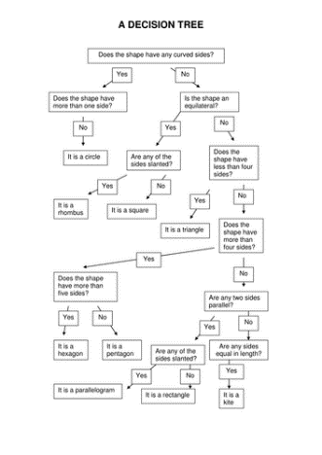
Level | Es and Os | Learning Activities | Stimulus
Second Level Theme: Systems Thinking | I understand the operation of a process and its outcome. I can structure related items of information. TCH 2-13a I can display data in a clear way using a suitable scale, by choosing appropriately from an extended range of tables, charts, diagrams and graphs, making effective use of technology. MTH 2-21a / MTH 3-21a | Decision Charts Resources: Decision chart template (flowchart), writing implements Key Questions: How can we sort different criteria? How can we structure related items of information? Activity: Create a ‘decision chart’ to help people come to a conclusion Systems Thinking Skill: Connecting | Decision Chart/Tree Classification Tree Link to Literacy The Accidental Diary of B.U.G (resource pack available https://www.puffinschools.co.uk/resources/ks2-3-activity-pack-the-accidental-diary-of-b-u-g/)
Click here to return to the home page.

Slide 13
Decision Charts
You will need (individual or partner work): Blank paper or decision chart/flowchart template, writing implements
Activity:
Time to Think:
Identify the question you want to ask people (e.g. What is your ideal pet?)
Make up some yes/no questions for them to answer in order to help discover their answer (e.g. Do you like going on long walks? Do you like the company of others?
Think of the animals your answers could lead to (e.g. Do you like going on long walks? YES – Then the ideal pet could be a dog. Do you like the company of others? NO – Then their ideal pet could be a tortoise)
Make up further questions to continue the chart, each eventually leading to a final answer
Time to Make:
Illustrate your decision chart with appropriate doodles.
Ask your friend to test it for you.
Rules/Suggestions
Have learners map out their whole chart on a whiteboard or scrap paper before committing to their final piece
Click here to return to the home page.

Slide 14
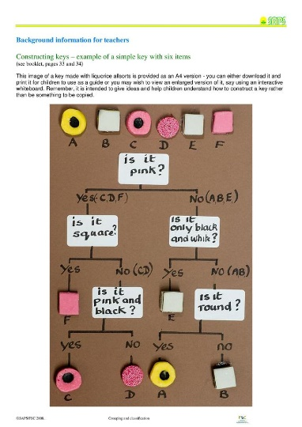
Level | Es and Os | Learning Activities | Stimulus
Second Level Theme: Systems Thinking | I understand the operation of a process and its outcome. I can structure related items of information. TCH 2-13a I can display data in a clear way using a suitable scale, by choosing appropriately from an extended range of tables, charts, diagrams and graphs, making effective use of technology. MTH 2-21a / MTH 3-21a I can identify and classify examples of living things, past and present, to help me appreciate their diversity. I can relate physical and behavioural characteristics to their survival or extinction. SCN 2-01a | Classification Tree Resources: Licorice Allsorts, Classification tree template or whiteboard pens to write on desks Key Questions: How can we sort different criteria? How can we structure related items of information? What is meant by the term ‘classification’? What are ‘characteristics’ or ‘properties’? Activity: Create a classification tree to sort living or non-living things Systems Thinking Skill: Connecting, Pattern Making | Classification Tree Activity taken from: https://www.stem.org.uk/resources/elibrary/resource/34255/grouping-and-classification-suitable-home-teaching What are Classification Trees? https://www.bbc.co.uk/bitesize/topics/zxjj6sg/articles/z9cbcwx#:~:text=A%20key%20is%20a%20set,required%20to%20view%20this%20activity.
Click here to return to the home page.

Slide 15
Classification Keys
You will need (individual or partner work): Liquorice Allsorts, Classification tree template or whiteboard pens to write on desks
Activity:
Explain to the children that we will be classifying or sorting sweets according to their characteristics. Discuss what is meant by characteristics: shape; size; colour; texture; patterns etc.
Liquorice allsorts have differences and similarities that are easy to see and observe and only a simple vocabulary is needed to describe them. The characters include shape, colour and arrangement of the layers. As a starter, this is a good way to establish the principles of making and using a key, before going ahead with more complex material such as plants.
You need a packet of liquorice allsorts from which you can make selections of different kind of sweets. It is best for the children to use the real thing in the activity, but you can use pictures if you have difficulty in obtaining liquorice allsorts.
The children work in small groups. Choose four liquorice allsorts and give each group of children a set of these four sweets. Ask the children to look at the characteristics (features) of their four sweets, then begin to collect their descriptions on the ‘board’ (in whatever form is suitable).
Next ask the children to sort the sweets into two groups. Then the children need to find a question that gives a reason for the separation into groups. An example could be “Is it round?” They can group the YES (Group A) sweets together, separate from the NO (Group B) sweets. They then find a question that can separate A and B groups. Possible questions can include “Is it blue?”, “Is it black and white?”…
Let the children check the pathway through (to ‘identify’ a sweet). They pick one of the sweets. Check by starting with the first question at the top.
Extension: You can extend the activity by using more sweets. Put the children into small groups and give six different sweets to each group. Soon they would see that this key works only for the four sweets used. If they want to add more sweets, they have to think of more questions. See if they can make their own key. They will probably find it helpful if they name each sweet, say with a letter or the name of a person.
Rules/Suggestions
Have learners map out their whole chart on a whiteboard or scrap paper before committing to their final piece
Click here to return to the home page.

Slide 16
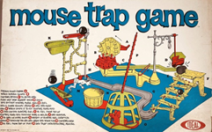
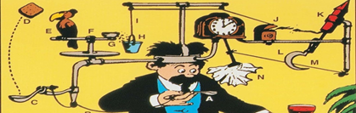
Level | Es and Os | Learning Activities | Stimulus
Second Level Theme: Systems Thinking See also: Visualising | I can use my knowledge of the sizes of familiar objects or places to assist me when making an estimate of measure. MNU 2-11a I can use the common units of measure, convert between related units of the metric system and carry out calculations when solving problems. MNU 2-11b I can explain how different methods can be used to find the perimeter and area of a simple 2D shape or volume of a simple 3D object. MNU 2-11c I can develop and communicate my ideas, demonstrating imagination and presenting at least one possible solution to a design problem. EXA 2-06a By investigating how friction, including air resistance, affects motion, I can suggest ways to improve efficiency in moving objects. SCN 2-07a I can discuss why people and events from a particular time in the past were important, placing them within a historical sequence. SOC 2-06a can extend my knowledge and understanding of engineering disciplines to create solution. TCH 2-12a | Create a Rube Goldberg machine Rube Goldberg, byname of Reuben Lucius Goldberg, (born July 4, 1883, San Francisco, California, U.S.—died December 7, 1970, New York, New York), American cartoonist who satirized the American preoccupation with technology. His name became synonymous with any simple process made outlandishly complicated. Goldberg received many honors in his lifetime, including a Pulitzer Prize for political cartooning in 1948, the National Cartoonists Society's Gold T-Square Award in 1955,^{[1]} and the Banshees' Silver Lady Award in 1959.^{[1][2]} He was a founding member and first president of the National Cartoonists Society,^{[3]} which hosts the annual Reuben Award, honoring the top cartoonist of the year and named after Goldberg, who won the award in 1967.^{[4]} He is the inspiration for international competitions known as Rube Goldberg Machine Contests, which challenge participants to create a complicated machine to perform a simple task. Resources: https://glowscotland-my.sharepoint.com/:f:/g/personal/wlnicola_connor_glowmail_org_uk/Ekbzs2JkTVZPl-5YgPmgui0B1fUsKwz5mabMNWQwcyMspg?e=gf5tUZ | The Page Turner https://www.youtube.com/watch?v=GOMIBdM6N7Q Rube Goldberg and kinetic energy https://www.youtube.com/watch?v=Eg4KbgAoA0o Kids teaching Kids https://www.youtube.com/watch?v=hxMNvyylRSY
Click here to return to the home page.

Slide 17

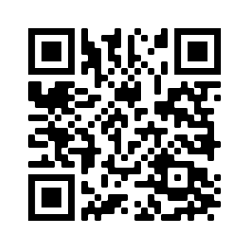
Create a Rube Goldberg machine (Second Level)
You will need
Loose parts, resources from around your classroom
Ping pong ball/cup to catch
Activity
Time to Think
Rube Goldberg, byname of Reuben Lucius Goldberg,
(born July 4, 1883, died December 7, 1970)
He was an American cartoonist who satirized the American preoccupation with technology.
His name became synonymous with any simple process made outlandishly complicated
Watch The Page Turner
You are going to create your own Rube Goldberg machine...the aim will be to put the ping pong ball into a cup, only using objects/items from around the classroom. If you want to visualise your sequence first, draw it out and record it.
Time to Make
Pupils should have time to tinker, play with their machine and solve/debug any problems in the chain.
Rules/Suggestions
You can limit how many reactions with their sequence, change the purpose of the machine or use as family learning challenge to make using home items or bring in items from home to support build.
Teacher Information
Record machines to present or share with other groups or classes, sharing the science behind the engineering process.
Click here to return to the home page.

Slide 18
Adapting
Click here to return to the home page.

Slide 19
Adapting: Overview
Adaptability as defined by the Royal Academy of Engineering involves testing, analysing, reflecting, rethinking and changing in both a physical sense and mentally. The subset of skills opposite also infer the requirement of a degree of resilience and the ability to transfer knowledge and skills to a different context or setting. The pupil friendly definition can be seen opposite.
The following slides provide some simple examples of how the attributes of Adaptability can be developed across the curriculum.
Click here to return to the home page.

Slide 20
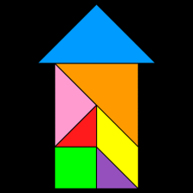
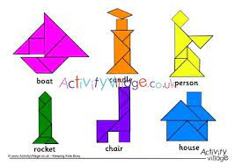
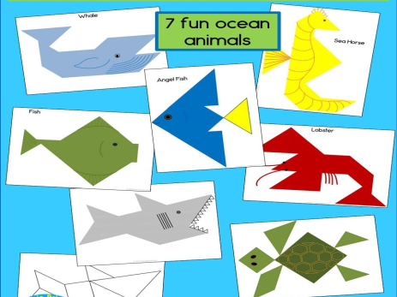
Level | Es and Os | Learning Activities | Stimulus
Early Level Theme: Adapting | I have spotted and explored patterns in my own and the wider environment and can copy and continue these and create my own patterns. MTH 0-13a I can create a range of visual information through observing and recording from my experiences across the curriculum. EXA 0-04a Working on my own and with others, I use my curiosity and imagination to solve design problems. EXA 0-06a Through creative play, I explore different materials and can share my reasoning for selecting materials for different purposes. SCN 0-15a I explore ways to design and construct models. I explore everyday materials in the creation of pictures/models/concepts. I explore and discover different ways of representing ideas in imaginative ways. | Seaside Tangrams Use Bare foot resource: Summer of Fun PdF’s here: Adapting Early PDF Cut out the shapes for the houses and lighthouse. Don’t make a copy of what they have– adapt and use the shapes to make your own seaside or house picture.
Click here to return to the home page.

Slide 21

Seaside Tangrams
You will need
Adapting PDF files with cut outs here:
Activity
Time to Think
Cut out the shapes for the houses and
lighthouse. Don’t make a copy of what
they have– adapt and use the shapes to make your own seaside or house picture.
Time to Make
Pupils should have time to trial and error, play with shapes and move/manipulate them around to make different styles of picture.
Teacher Information
Take pictures of tangrams created and display for other pupils to use as stimulus or discussion points…what shapes have been used? How many … shape can you find in this picture?
Click here to return to the home page.

Slide 22
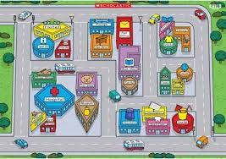
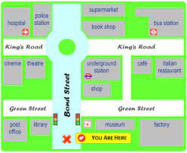
Level | Es and Os | Learning Activities | Stimulus
Early Level Theme: Adapting | In movement, games, and using technology I can use simple directions and describe positions. MTH 0-17a I can create a range of visual information through observing and recording from my experiences across the curriculum. EXA 0-04a Working on my own and with others, I use my curiosity and imagination to solve design problems. EXA 0-06a I can explore computational thinking processes involved in a variety of everyday tasks and can identify patterns in objects or information. | Maps Use either the Town Map or the Treasure Map. Files here: Adapting Early Maps An architect and Engineer have been working on a new town plan. However, their map doesn’t seem quite right and needs adapting. Ask pupils to adapt the maps according to your instructions. For example using the town map, can the park be moved to the right of the house? Can the school be moved above the park etc. Pupils can use their positioner/ directional language to ask in pairs to adapt the maps accordingly. Can they then create their own maps to be adapted. Pupils may decide they know how to make the town plan better and adapt themselves, but must give reason for their thinking.
Click here to return to the home page.

Slide 23

Maps
You will need
Use either the Town Map or the Treasure Map.
Activity
Time to Think
An architect and Engineer have been working on a new town plan.
However, their map doesn’t seem quite right and needs adapting.
Ask pupils to adapt the maps according to your instructions. For
example using the town map, can the park be moved to the right of
the house? Can the school be moved above the park etc.
Time to Make
Pupils can use their positioner/ directional language to ask in pairs to
adapt the maps accordingly. Can they then create their own maps to
be adapted.
Teacher Information
Pupils may decide they know how to make the town plan better and
adapt themselves however, they must give reason for their thinking.
Click here to return to the home page.

Slide 24
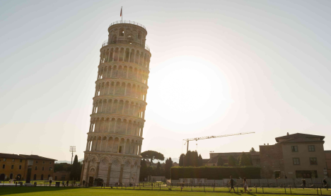
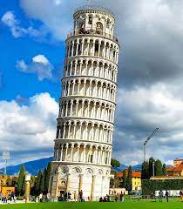
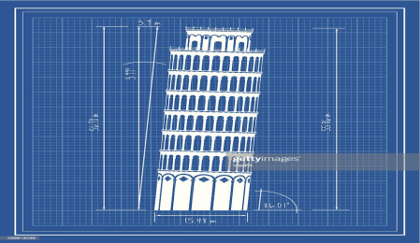
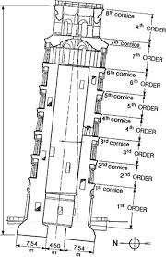
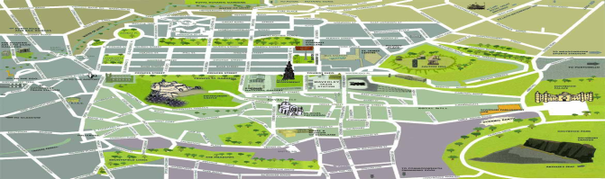
Level | Es and Os | Learning Activities | Stimulus
First Level Theme: Adapting | To help me develop an informed view, I am learning to recognise the difference between fact and opinion. LIT 1-08a I can estimate the area of a shape by counting squares or other methods. MNU 1-11b I have developed an awareness of where grid reference systems are used in everyday contexts and can use them to locate and describe position. MTH 1-18a Through exploring properties and sources of materials, I can choose appropriate materials to solve practical challenges. SCN 1-15a Having explored the landscape of my local area, I can describe the various ways in which the land has been used. SOC 1-13a I can take appropriate action to ensure conservation of materials and resources, considering the impact of my actions on the environment. TCH 1-06a I can explore and experiment with sketching, manually or digitally, to represent ideas in different learning contexts. TCH 1-11a I explore and discover engineering disciplines and can create solutions. TCH 1-12a | Leaning Tower of Pisa An architectural engineer has had a design sent for a new leaning tower of pisa to be built as a tourist attraction in Edinburgh during the Edinburgh Fringe Festival. The engineer isn’t sure the design is sturdy enough or functional to attract tourists Can you take the design and adapt it to be sturdy enough to lean and create functional ideas of best place to build it temporarily in Edinburgh to attract tourists.
Click here to return to the home page.

Slide 25
Leaning Tower of Pisa
You will need
Blueprints and photos of the Leaning Tower of Pisa - pupils can research and find these online.
Activity
Time to Think
An architectural engineer has had a design sent for a new Leaning Tower of Pisa to
be built as a tourist attraction in Edinburgh during the Edinburgh Fringe Festival.
The engineer isn’t sure the design is sturdy enough or functional to attract tourists
Time to Make
Can you take the design and adapt it to be sturdy enough to lean and
Create functional ideas of best place to build it temporarily in
Edinburgh to attract tourists.
Teacher Information
Ask pupils to create corporate presentations to share their learning- they must clarify their thinking and reasoning. Also, summarising their key points to consider when building.
Click here to return to the home page.

Slide 26
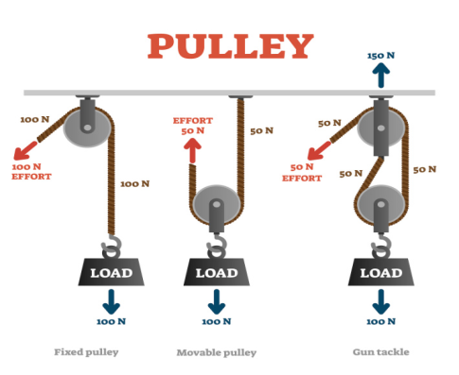
Level | Es and Os | Learning Activities | Stimulus
First Level Theme: Adapting | I explore and discover engineering disciplines and can create solutions. TCH 1-12a I can design and construct models and explain my solutions. TCH 1-09a By investigating forces on toys and other objects, I can predict the effect on the shape or motion of objects. SCN 1-07a I can estimate how long or heavy an object is, or what amount it holds, using everyday things as a guide, then measure or weigh it using appropriate instruments and units. MNU 1-11a | Build a pulley system https://www.youtube.com/watch?v=rc0cpp3i8GA https://www.youtube.com/watch?v=FJz4iraFVQI Resources: cardboard, scissors, glue, string, wooden skewer, a plastic bottle and bottle cap. Design and build a simple pulley machine, consider what forces/numeracy and mathematics are needed. Once your pulley has been built, adapt your pulley to take a number of different weights/objects (up to classroom teacher and pupils what these will be) What did you have to change/adapt to suit your items? Did the weight or volume affect your adaptations?
Click here to return to the home page.

Slide 27
Build a pulley system
You will need
Resources:
cardboard, scissors, glue, string, wooden skewer, a plastic bottle and bottle cap.
Activity
Time to Think
Design and build a simple pulley machine, consider what forces/numeracy
and mathematics are needed.
Time to Make
Once your pulley has been built, adapt your pulley to take a
number of different weights/objects (up to classroom teacher
and pupils what these will be)
Teacher Information
Ask pupils what did you have to change/adapt to suit your
items? Did the weight or volume affect your adaptations?
Click here to return to the home page.

Slide 28
Level | Es and Os | Learning Activities | Stimulus
Second Level Theme: Adapting | I can use my knowledge of the sizes of familiar objects or places to assist me when making an estimate of measure. MNU 2-11a I can explain how different methods can be used to find the perimeter and area of a simple 2D shape or volume of a simple 3D object. MNU 2-11c By investigating floating and sinking of objects in water, I can apply my understanding of buoyancy to solve a practical challenge. SCN 2-08b I can extend and enhance my design skills to solve problems and can construct models. TCH 2-09a I can recognise basic properties and uses for a variety of materials and can discuss which ones are most suitable for a given task. TCH 2-10a I can extend my knowledge and understanding of engineering disciplines to create solution. TCH 2-12a | Buoyancy Challenge Your challenge is to build a boat that can hold the most pennies or small coins before it sinks. Resources: Tin foil One pence piece (as many as you can gather/collect) Cut two 8 inch squares of tin foil for each boat. Then build your small boat from the foil. Place 15 pennies on a separate 8 inch square of tin foil (not the boat) and ask the pupils to ball it up and place it in the water. What happens? It sinks! Place your boat in the water and see if it floats. Adapt if it doesn’t. Then slowly add the pennies one at a time. How many pennies can you count before it sinks? How did you adapt your boat to float/take more pennies? Buoyancy: You may have noticed that you saw two different results when you used the same amount of pennies and the same size piece of foil. Both items weighed the same. There’s one big difference, size. The ball of foil and pennies take up less room so there is not enough upward force pushing up on the ball to keep it afloat. However, the tinfoil boat you made takes up a greater surface area so it has more force pushing up on it!
Click here to return to the home page.

Slide 29
Buoyancy Challenge
You will need
Resources:
Tin foil
One pence piece (as many as you can gather/collect)
Activity
Time to Think
Your challenge is to build a boat that can hold the most pennies or small coins before it sinks.
Time to Make
Cut two 8-inch squares of tin foil for each boat. Then build your small boat
from the foil. Place 15 pennies on a separate 8-inch square of tin foil (not the
boat) and ask the pupils to ball it up and place it in the water. What happens? It
sinks! Place your boat in the water and see if it floats. Adapt if it doesn’t. Then slowly
add the pennies one at a time. How many pennies can you count before it
sinks? How did you adapt your boat to float/take more pennies?
Teacher Information
Buoyancy: You may have noticed that you saw two different results when you used the same number of pennies and the same size piece of foil. Both items weighed the same. There’s one big difference, size.
The ball of foil and pennies take up less room so there is not enough upward force pushing up on the ball to keep it afloat. However, the tinfoil boat you made takes up a greater surface area, so it has more force pushing up on it!

Slide 30
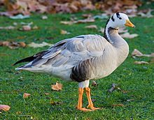
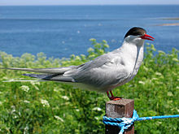
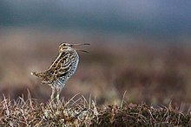
Level | Es and Os | Learning Activities | Stimulus
Second Level Theme: Adapting | I can extend my knowledge and understanding of engineering disciplines to create solution. TCH 2-12a I can extend and enhance my design skills to solve problems and can construct models. TCH 2-09a I can recognise basic properties and uses for a variety of materials and can discuss which ones are most suitable for a given task. TCH 2-10a By investigating how friction, including air resistance, affects motion, I can suggest ways to improve efficiency in moving objects. SCN 2-07a I can use my knowledge of the sizes of familiar objects or places to assist me when making an estimate of measure. MNU 2-11a I can use the common units of measure, convert between related units of the metric system and carry out calculations when solving problems. MNU 2-11b | Wings Challenge You’re in charge of designing an aeroplane that can travel further using less energy. You know that some birds can travel very far, so you want to see how the size and shape of their wings could help you choose the best wings for your own aeroplane. 1. Cut out all the pieces of the glider and put it together 2. Test how far it can go. Write your results in the table. You could use a spreadsheet or a table in Word to record your results. 3. Make an adaptation to the wings on your glider. For example: make the wings bigger or smaller change the shape of the wings 4. Test again and record your results. Did it fly further? 5 Make another change and test again. Which design makes your glider go the furthest? RESULTS Look at the designs from other groups. Whose can go the furthest? What is different about their design that makes it so effective? What happened when you adapted your wings to different shapes and sizes? | Bar headed geese are the highest flying migratory birds, flying at 5.5 miles above sea level! The Arctic Tern flies an enormous 44,000 miles a year! Over its lifespan of 30 years, that is roughly the same as three trips to the moon, and back. The Great Snipe flies for 4,200 miles at around 60 miles per hour, seemingly without using the wind to assist it.

Slide 31
Wings Challenge
You will need
Paper, Cardboard, scissors
Activity
Time to Think
You’re in charge of designing an aeroplane that can travel further using less energy. You know that some birds can travel very far, so you want to see how the size and shape of their wings could help you choose the best wings for your own aeroplane.
Time to Make
1. Cut out all the pieces of the glider and put it together
2. Test how far it can go. Write your results in the table. You could use a spreadsheet or a table in Word to record your results.
3. Make an adaptation to the wings on your glider. For example: make the wings bigger or smaller change the shape of the wings
4. Test again and record your results. Did it fly further?
5 Make another change and test again. Which design makes your glider go the furthest?
Teacher Information
Look at the designs from all groups. Whose can go the furthest?
What is different about their design that makes it so effective? What happened when you adapted your wings to different shapes and sizes?
Click here to return to the home page.

Slide 32
Creative Problem Solving
Click here to return to the home page.

Slide 33
Creative Problem Solving: Overview
Creative Problem Solving, as defined by the Royal Academy of Engineering, involves applying techniques from different disciplines, generating ideas and solutions with others, constructive criticism and team work. The pupil friendly definition can be seen opposite.
The following slides provide some simple examples of how the attributes of Creative Problem Solving can be developed across the curriculum.
Click here to return to the home page.

Slide 34
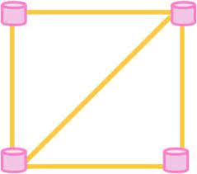
Level | Es and Os | Learning Activities | Stimulus
Early Level Theme: Creative Problem Solving | I have spotted and explored patterns in my own and the wider environment and can copy and continue these and create my own patterns. MTH 0-13a I enjoy investigating objects and shapes and can sort, describe and be creative with them. MTH 0-16a I have had fun creating a range of symmetrical pictures and patterns using a range of media. MTH 0-19a I explore ways to design and construct models. TCH 0-09a I explore a variety of products covering a range of engineering disciplines. TCH 0-12a Through everyday experiences and play with a variety of toys and other objects, I can recognise simple types of forces and describe their effects. SCN 0-07a | Strong Shapes You will need (per group) Toothpicks (or broken dried spaghetti) Jelly sweets - midget gems work well – or mini marshmallows Activity Make a variety of shapes, such as a square or a triangle, from the sweets and toothpicks/spaghetti by placing one sweet in each of the corners. Discussion and ‘Thinker’ Questions Which shape is the strongest? Which shape do you think would be best to use to construct a building? Pupils should find that the triangle is the strongest shape as it does not tend to bend or buckle. The square is quite weak as it often breaks at the joints but can be strengthened with the addition of a diagonal support (therefore creating two triangles). A lot of buildings use triangles in their structures, such as the roof and walls, because they are so strong.
Click here to return to the home page.

Slide 35

Strong Shapes
You will need (per group)
Toothpicks (or broken dried spaghetti) Jelly sweets - midget gems work well – or mini marshmallows
Activity
Make a variety of shapes, such as a square or a triangle, from the sweets and toothpicks/spaghetti by placing one sweet in each of the corners.
Discussion and ‘Thinker’ Questions
Which shape is the strongest?
Which shape do you think would be best to use to construct a building?
Useful Teacher Information
Pupils should find that the triangle is the strongest shape as it does not tend to bend or buckle.
The square is quite weak as it often breaks at the joints but can be strengthened with the addition of a diagonal support (therefore creating two triangles).
A lot of buildings use triangles in their structures, such as the roof and walls, because they are so strong.
Strong Shapes and Spaghetti Towers
(based on ‘Vertically Challenged’ resources from STEM.org.uk)
Click here to return to the home page.

Slide 36
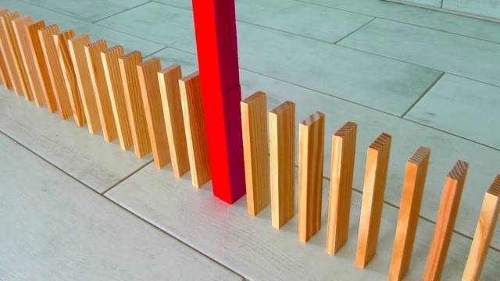
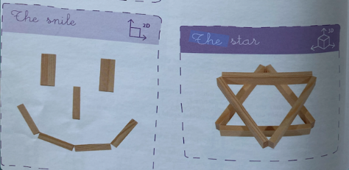
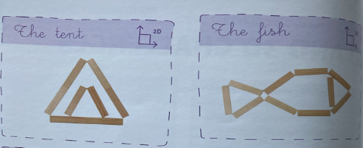
Level | Es and Os | Learning Activities | Stimulus
Early Level Theme: Creative Problem Solving | I have spotted and explored patterns in my own and the wider environment and can copy and continue these and create my own patterns. MTH 0-13a I enjoy investigating objects and shapes and can sort, describe and be creative with them. MTH 0-16a I have had fun creating a range of symmetrical pictures and patterns using a range of media. MTH 0-19a I explore ways to design and construct models. TCH 0-09a I explore a variety of products covering a range of engineering disciplines. TCH 0-12a Through everyday experiences and play with a variety of toys and other objects, I can recognise simple types of forces and describe their effects. SCN 0-07a | You will need (per group) Kapla blocks (or equivalent) Floor space (or plenty of flat surface) Activity Create different 2D patterns with the Kapla blocks to explore symmetry and pattern. Create different designs using the Kapla as dominoes (as per picture above) and trigger a chain reaction
Click here to return to the home page.

Slide 37
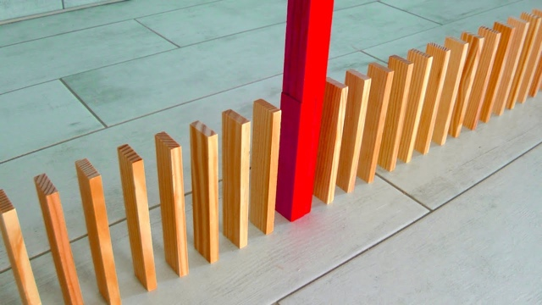
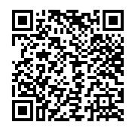
Kapla Dominoes and Pattern
Kapla Dominoes
You will need (per group)
Kapla blocks (or equivalent)
Floor space (or plenty of flat surface)
Activity
Create different 2D patterns with the Kapla blocks to explore symmetry and pattern.
Create different designs using the Kapla as dominoes (as
per picture above) and trigger a chain reaction. Scan the
QR code for some ideas.
Discussion and ‘Thinker’ Questions
How far apart such each Kapla block be?
Does the Kapla need to ‘stand tall’ or does the domino effect still work if the block is ‘on its side’?
Useful Teacher Information
Introduce the ‘domino effect’ using straight line before encouraging pupils to explore curves, turns and other elements of design.
Click here to return to the home page.

Slide 38
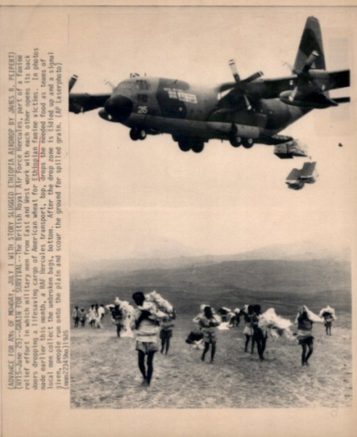
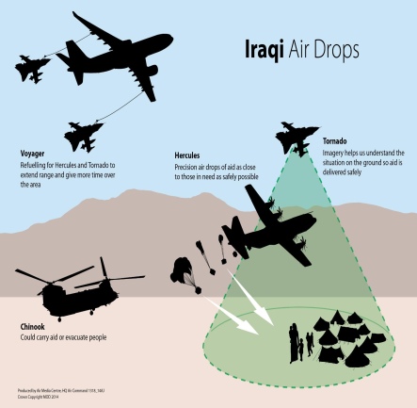
Level | Es and Os | Learning Activities | Stimulus
First Level Theme: Creative Problem Solving | I have explored a variety of ways in which data is presented and can ask and answer questions about the information it contains. MNU 1-20a I have used a range of ways to collect information and can sort it in a logical, organised and imaginative way using my own and others’ criteria. MNU 1-20b Using technology and other methods, I can display data simply, clearly and accurately by creating tables, charts and diagrams, using simple labelling and scale. MTH 1-21a I can use appropriate vocabulary to describe the likelihood of events occurring, using the knowledge and experiences of myself and others to guide me. MNU 1-22a I can contribute to a discussion of the difference between my needs and wants and those of others around me. SOC 1-16a When I engage with others, I know when and how to listen, when to talk, how much to say, when to ask questions and how to respond with respect. LIT 1-02a Using what I know about the features of different types of texts, I can find, select, sort and use information for a specific purpose. LIT 1-14a I can use a range of tools and equipment when working with textiles TCH 1-04b I understand how technologies help provide for our needs and wants, and how they can affect the environment in which we live. TCH 1-07a I can design and construct models and explain my solutions. TCH 1-09a I can recognise a variety of materials and suggest an appropriate material for a specific use. TCH 1-10a I have contributed to discussions of current scientific news items to help develop my awareness of science. SCN 1-20a | Disaster Relief (Activity based on Royal Academy of Engineering ‘Aiming for Awesome’ resource) You will need (per group) Disaster Relief support sheet (QR code 1) Egg/Egg box (or equivalent) Various materials for building an egg lander, for example: plastic bags, string, fabric. IT + Internet access for research activity (optional) The RAF has been asked to support after an earthquake in Nepal. In groups, students should identify some of the things people need but don't have access to after an earthquake. Using the cards provided in Disaster relief support sheet, ask students to discuss each item that is needed and to put them in order of importance as to what is needed first. Discuss as a class, not all groups will agree on an order - use it is an opportunity for groups to argue their point of view. Sometimes it isn't possible for aircraft to land to deliver aid, so aid has to be dropped from the craft while it is still in flight. Students should work in teams to design a lander for an egg to ensure it doesn't break when it hits the floor. Students need to consider how they can reduce the impact force when the egg lands hence ensuring that essential equipment dropped from an aircraft will land safely without being damaged.
Click here to return to the home page.

Slide 39
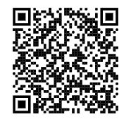
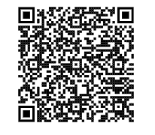
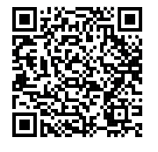
Disaster Relief
(Activity based on Royal Academy of Engineering ‘Aiming for Awesome’ resource)
You will need (per group)
Disaster Relief support sheet (QR code 1)
Egg/Egg box (or equivalent)
Various materials for building an egg lander, for example: plastic bags, string, fabric.
IT + Internet access for research activity (optional)
Time to Think
The RAF has been asked to support after an earthquake in Nepal.
In groups, students should identify some of the things people need but don't have access to after an earthquake. Using the cards provided in Disaster relief support sheet, ask students to discuss each item that is needed and to put them in order of importance as to what is needed first. Discuss as a class, not all groups will agree on an order - use it is an opportunity for groups to argue their point of view.
Time to Make
Sometimes it isn't possible for aircraft to land to deliver aid, so aid has to be dropped from the craft while it is still in flight. Students should work in teams to design a lander for an egg to ensure it doesn't break when it hits the floor. Students need to consider how they can reduce the impact force when the egg lands hence ensuring that essential equipment dropped from an aircraft will land safely without being damaged.
Support Sheet
Student Guide
Teacher Guide
Click here to return to the home page.

Slide 40
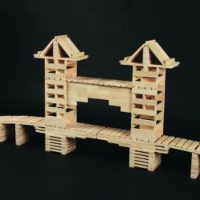
Level | Es and Os | Learning Activities | Stimulus
First Level Theme: Creative Problem Solving | When I engage with others, I know when and how to listen, when to talk, how much to say, when to ask questions and how to respond with respect. LIT 1-02a I can estimate how long or heavy an object is, or what amount it holds, using everyday things as a guide, then measure or weigh it using appropriate instruments and units. MNU 1-11a I can use appropriate vocabulary to describe the likelihood of events occurring, using the knowledge and experiences of myself and others to guide me. MNU 1-22a By exploring the ways in which we use and need rules, I can consider the meaning of rights and responsibilities and discuss those relevant to me. SOC 1-17a I can design and construct models and explain my solutions. TCH 1-09a By investigating forces on toys and other objects, I can predict the effect on the shape or motion of objects. SCN 1-07a | Kapla Challenge – Bridge Building Relay (Activity based on suggestion from KEVA educator’s guide) You will need (per group) Kapla blocks (or equivalent) Floor space (or plenty of flat surface) Activity Groups must build, deconstruct, and rebuild a build design using a set number of Kapla blocks.
Click here to return to the home page.

Slide 41
Kapla Challenge – Bridge Building Relay
(Activity based on suggestion from KEVA educator’s guide)
You will need (per group)
Kapla blocks (or equivalent)
Floor space (or plenty of flat surface)
Activity
Groups must build, deconstruct, and rebuild a build design using a set number of Kapla blocks.
Rules/Suggestions
Give each team an equal number of Kapla Blocks e.g. 100
Each team should double check they have the correct number of blocks before starting teacher checkpoint
Each team can build a bridge of any shape but all blocks must be used.
The bridge must span at least three columns.
Once their bridge is complete, the group will dismantle it in a controlled manner i.e. without allowing it to topple, and reassemble it on the opposite side of the room (or equivalent) teacher checkpoint
The reassembled bridge must follow the same design as bridge 1.
The group may use only their hands to carry the planks.
No shirts can be used as ‘buckets’ and no pinning planks against their bodies.
The first team to complete the second bridge is the winner.
Teacher Information
Pupil will be most successful if they work as a team to build, disassemble, and carry the Kapla blocks. Consider allowing time for pupils to discuss roles (e.g. time keeper, quality control, captain etc) before they begin. Consider finishing the activity with a reflective discussion about skills, qualities and links to careers.
Click here to return to the home page.

Slide 42
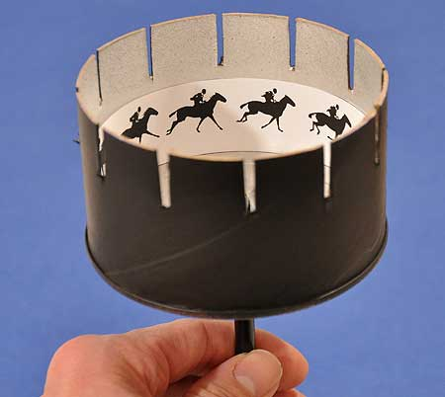
Level | Es and Os | Learning Activities | Stimulus
Second Level Theme: Creative Problem Solving | I have investigated the everyday contexts in which simple fractions, percentages or decimal fractions are used and can carry out the necessary calculations to solve related problems. MNU 2-07a I can use my knowledge of the sizes of familiar objects or places to assist me when making an estimate of measure. MNU 2-11a I have worked with others to explore, and present our findings on, how mathematics impacts on the world and the important part it has played in advances and inventions. MTH 2-12a I can compare and contrast a society in the past with my own and contribute to a discussion of the similarities and differences. SOC 2-04a I have the opportunity to choose and explore an extended range of media and technologies to create images and objects, comparing and combining them for specific tasks. EXA 2-02a I can create and present work that shows developing skill in using the visual elements and concepts. EXA 2-03a I can investigate how product design and development have been influenced by changing lifestyles. TCH 2-05a I can extend and enhance my design skills to solve problems and can construct models. TCH 2-09a I can recognise basic properties and uses for a variety of materials and can discuss which ones are most suitable for a given task. TCH 2-10a By investigating how friction, including air resistance, affects motion, I can suggest ways to improve efficiency in moving objects. SCN 2-07a Through research and discussion I have an appreciation of the contribution that individuals are making to scientific discovery and invention and the impact this has made on society. SCN 2-20a | The Magic Drum (Activity based on Royal Academy of Engineering ‘Engineering at the Movies’ resource) You will need (per group) Thick Card (black works well) Pritt stick Scissors Ruler Paper plate Low heat glue gun (or equivalent such as stapler/tape) Wooden dowel rod (or equivalent such as pencil) Camera + Printer (optional) Originally a vintage toy from the 1830s, a zoetrope (translated from the Greek ‘wheel of life’) applies the same principles filmmakers have used since the start of cinema. This principle is the illusion of motion from the rapid succession of static pictures. Every film you have ever watched is made up of individual pictures speeding by in quick succession. A zoetrope is just an early version of that. A movie is traditionally made from 24 frames of individual images played per second to create the moving picture. This led to animation classics such as Pinocchio, The Lion King and Cars.
Click here to return to the home page.

Slide 43



The Magic Drum
(Activity based on Royal Academy of Engineering ‘Engineering at the Movies’ resource)
You will need (per group)
Thick Card (black works well)
Pritt stick
Scissors
Ruler
Paper plate
Low heat glue gun (or equivalent such as stapler/tape)
Wooden dowel rod (or equivalent such as pencil)
Camera + Printer (optional)
Background
Originally a vintage toy from the 1830s, a zoetrope (translated from the Greek ‘wheel of life’) applies the same principles filmmakers have used since the start of cinema.
This principle is the illusion of motion from the rapid succession of static pictures. Every film you have ever watched is made up of individual pictures speeding by in quick succession. A zoetrope is just an early version of that. A movie is traditionally made from 24 frames of individual images played per second to create the moving picture. This led to animation classics such as Pinocchio, The Lion King and Cars.
Teacher Information
Consider using the template and guide (QR code 3) and build to the pupils creating their own animation via the Magic Drum RAE guide. Consider finishing the activity with a reflective discussion about skills, qualities, and careers.
Non RAE template
RAE Support Video
Teacher Guide
Click here to return to the home page.

Slide 44
Level | Es and Os | Learning Activities | Stimulus
Second Level Theme: Creative Problem Solving | I can manage money, compare costs from different retailers, and determine what I can afford to buy. MNU 2-09a I can use my knowledge of the sizes of familiar objects or places to assist me when making an estimate of measure.MNU 2-11a I have carried out investigations and surveys, devising and using a variety of methods to gather information and have worked with others to collate, organise and communicate the results in an appropriate way. MNU 2-20b By investigating how friction, including air resistance, affects motion, I can suggest ways to improve efficiency in moving objects. SCN 2-07a I can discuss, debate and improve my ideas with increasing confidence and clear explanations. TCH 2-04d I can extend and enhance my design skills to solve problems and can construct models. TCH 2-09a | Kapla Challenge – ‘Mind the Gap’ You will need (per group) Kapla blocks (or equivalent) Floor space (or plenty of flat surface) Activity Using the Kapla blocks provided, groups should design and build a structure which will allow the ball/marble to ‘jump’ the largest gap.
Click here to return to the home page.

Slide 45

Kapla Challenge – ‘Mind the Gap’
You will need (per group)
Kapla blocks (or equivalent)
Floor space (or plenty of flat surface)
Activity
Using the Kapla blocks provided, groups should design and build a structure which will allow the ball/marble to ‘jump’ the largest gap.
Rules/Suggestions
Each Kapla block is valued at £1; you have a total budget of £100 (i.e. 100 blocks)
You do not need to use all of the blocks
Your budget and design must include a landing area for your ball/marble to land on with a backstop (i.e. something to stop the ball/marble/object moving)
Groups have set time limit (e.g. 30mins)
The winning team will be the group with the largest gap ‘jumped’ compared to overall cost (equation below)
Teacher Information
The winning design is calculated using the following equation:
In other words
Gap Distance (in cm) ÷ Total Cost Gap Distance (in cm) ÷ Number of Blocks used
Units = cm per block
The bigger the value, the more efficient/cost effective the design.
Consider allowing time for pupils to discuss roles (e.g. time keeper, quality control, captain etc) before they begin,
Consider finishing the activity with a reflective discussion about skills, qualities and links to careers (specifically engineering).
Click here to return to the home page.

Slide 46
Visualising
Click here to return to the home page.

Slide 47
Visualising: Overview
Visualising, as defined by the Royal Academy of Engineering, involves moving from abstract to concrete, manipulating materials, mental rehearsal of physical space and practical design solutions. The pupil friendly definition can be seen opposite.
The following slides provide some simple examples of how the attributes of Visualising can be developed across the curriculum.
Click here to return to the home page.

Slide 48
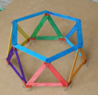

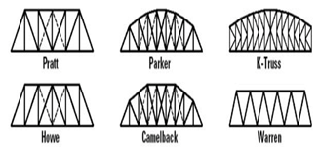
Level | Es and Os | Learning Activities | Stimulus
Early Level Theme: Visualising | I enjoy investigating objects and shapes and can sort, describe and be creative with them. MTH 0-16a I can create a range of visual information through observing and recording from my experiences across the curriculum. EXA 0-04a Through creative play, I explore different materials and can share my reasoning for selecting materials for different purposes. SCN 0-15a I explore ways to design and construct models. I explore everyday materials in the creation of models/concepts. I explore a variety of products covering a range of engineering disciplines. TCH 1-09, TCH 1-10, TCH 1-12 | Shape Challenge Resources: Photo stimulus- recognise/highlight 2D and 3D shapes. Lolly sticks Wooden Pegs Binder Clips Thinking about the photo stimulus you have seen and discussed, can you visualise what a triangle, square or rectangle would look like made of lolly sticks? What do you think those shapes could build? Visualising Skill: Model Making Using the resources, build a tower/house/bridge using only triangles (change shape according to focus in class) How many sticks will you need for sides? What patterns do you see?
Click here to return to the home page.

Slide 49
Shape Challenge
You will need (per group)
Photo stimulus- recognise/highlight 2D and 3D shapes.
Lolly sticks
Wooden Pegs
Binder Clips
Activity
Time to Think
As a group, look at the stimulus and discuss what shapes you can see. What do you think is the strongest shape to build with and why?
Discuss predictions, linking to reading skills, about what shape will be the strongest and then as a group try out different ideas.
Time to Make
Using the lolly sticks, wooden pegs and binder clips what can you build. Use the lolly stick stimulus picture, discuss shape used- try that first and see what it leads to.
Rules/Suggestions
Start as an adult initiated activity with small groups but can leave stimulus and resources in area for pupils to play/trial in free play time. You should find pupils will discover triangles are the strongest
Teacher Information
The triangle is the strongest to as it holds it shape and has a base which is very strong. It also has a strong support. The triangle is common in all sorts of building supports and trusses
Click here to return to the home page.

Slide 50
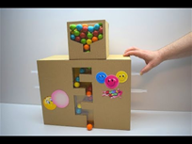
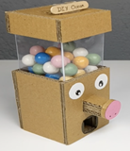
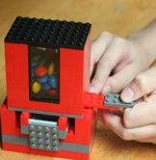
Level | Es and Os | Learning Activities | Stimulus
Early Level Theme: Visualising | I can share out a group of items by making smaller groups and can split a whole object into smaller parts. MNU 0-07a I can create a range of visual information through observing and recording from my experiences across the curriculum. EXA 0-04a Through creative play, I explore different materials and can share my reasoning for selecting materials for different purposes. SCN 0-15a I explore ways to design and construct models. I explore everyday materials in the creation of models/concepts. I explore a variety of products covering a range of engineering disciplines. TCH 1-09, TCH 1-10, TCH 1-12 | Sweet Dispenser Machine Imagine you had a machine that could dispense m&ms or a small sweet! Can you design and draw what that might look like and what resources you would need to build a prototype? You can find step by step instructions on this site- with visuals if you want to be more adult led in the activity. Resources: Woodwork Cardboard Lego Loose parts Small Sweets (easy to roll) https://frugalfun4boys.com/build-lego-candy-dispenser/
Click here to return to the home page.

Slide 51
Sweet Dispenser Machine
You will need (per group)
A building materials such as woodwork, cardboard or Lego
You may wish to use a variety of loose parts to allow pupil choice in trialing
different materials for their build.
Small Sweets (easy to roll)
Activity
Time to Think
Look at the stimulus photos, what do you think we are going to be creating in our engineering area? What is the main mechanism/movement of a sweet dispenser machine...what does it look like? Can you visualise what it would look like- mark make what they can visualise to help support.
Time to Make
Leave items in area for pupils to build their own sweet dispenser...this can be returned to, worked on by individuals/pairs or groups depending on pupil choice.
Rules/Suggestions
Time should be given for tinkering, trial and error, celebrating learning (a shelf/display of creations) and evaluating the design process.
Teacher Information
There is no right/wrong build, as long as the mechanism releases a sweet when pulled/pushed. The sweet can easily roll out/doesn't get stuck.
Click here to return to the home page.

Slide 52
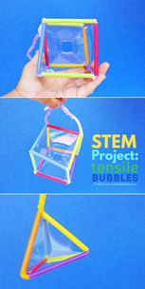
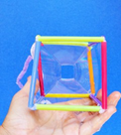
Level | Es and Os | Learning Activities | Stimulus
First Level Theme: Visualising | I can design and construct models and explain my solutions. TCH 1-09a I can recognise a variety of materials and suggest an appropriate material for a specific use. TCH 1-10a I explore and discover engineering disciplines and can create solutions. TCH 1-12a Through exploring properties and sources of materials, I can choose appropriate materials to solve practical challenges. SCN 1-15a I have explored simple 3D objects and 2D shapes and can identify, name and describe their features using appropriate vocabulary. MTH 1-16a | Tensile Bubbles Resources: Pipe cleaners Straws Bubble solution Can you create and build 3D nets and make the shape a bubble? Links in document. Visualising Skill: Manipulating materials https://www.youtube.com/watch?app=desktop&v=Y0ZtYNNgUgE https://babbledabbledo.com/science-engineering-kids-tensile-bubbles/
Click here to return to the home page.

Slide 53
Tensile Bubbles
You will need (per group)
Pipe cleaners
Paper (or plastic to withstand water/soap) Straws
Bubble solution
Activity
Time to Think
Did you know you know you can make a square bubble?
Time to Make
Step One Cut your straws. First cut each straw in half, then cut in half again. You will get 4 straw sections from each straw.
Step Two Thread a pipe cleaner through one straw and bend the end of the pipe cleaner to secure it at the end.
Step Three Thread two more straws onto the pipe cleaner.
Step Four Bend the long end of the pipe cleaner back to meet the starting point and twist the two ends around each other.
Step Five Add two more straw sections onto the end of the pipe cleaner.
Step Six Thread the pipe cleaner through one of the adjacent straw sections.
Step Seven Add one more straw section and bend it back to one of the straw joints to form a pyramid.
Step Eight Thread the pipe cleaner through an adjacent straw section to secure everything in place. If desired, add a straight section of straw onto the end of the pipe cleaner to form a handle.
Rules/Suggestions
starting with a pyramid shape for your first geometric bubble wand, step by step guide above. Use this technique to then create other 3d shape nets/bubbles.
Teacher Information
This learning activity is linked to structural engineering by building 3-dimensional bubble wands and making an inverted bubble cube that mimics and helps to visualise a tensile structure.
Click here to return to the home page.

Slide 54
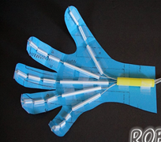
Level | Es and Os | Learning Activities | Stimulus
First Level Theme: Visualising | I can estimate how long or heavy an object is, or what amount it holds, using everyday things as a guide, then measure or weigh it using appropriate instruments and units. MNU 1-11a I can use exploration and imagination to solve design problems related to real-life situations. EXA 1-06a By researching, I can describe the position and function of the skeleton and major organs of the human body and discuss what I need to do to keep them healthy. SCN 1-12a Through exploring properties and sources of materials, I can choose appropriate materials to solve practical challenges. SCN 1-15a I can design and construct models and explain my solutions. TCH 1-09a I explore and discover engineering disciplines and can create solutions. TCH 1-12a | Create a moving hand Resources: Cardboard 6 Straws Wool or String Ruler Scissors You are going to create a model with moving parts. You are going to make a moving hand- this will be a prototype for a prosthetic/robotic hand. Draw a design of what your hand will look like- labelling resources and then build your prototype. Visualising Skill: Moving from Abstract to Concrete, Model Making Link to real world- prosthetics or robotic arms/hands for manufacturing. https://www.youtube.com/watch?v=Cl8ijPGEKO8
Click here to return to the home page.

Slide 55
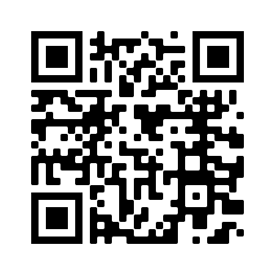

Create a moving hand
You will need (per group)
A4 cardboard or A4 coloured card
Pen/Pencil
6 Straws
Wool or String
Ruler
Scissors
Activity
Time to Think
Why is understanding the skeletal system of the hand important to companies who create
prosthetic hands to help people? Scan the QR code to watch how our learning is relevant.
Time to Make
Step by Step Guide
Click here to return to the home page.

Slide 56

Level | Es and Os | Learning Activities | Stimulus
Second Level Theme: Visualising | I can use my knowledge of the sizes of familiar objects or places to assist me when making an estimate of measure. MNU 2-11a I can use the common units of measure, convert between related units of the metric system and carry out calculations when solving problems. MNU 2-11b I can explain how different methods can be used to find the perimeter and area of a simple 2D shape or volume of a simple 3D object. MNU 2-11c I can develop and communicate my ideas, demonstrating imagination and presenting at least one possible solution to a design problem. EXA 2-06a When preparing and cooking a variety of foods, I am becoming aware of the journeys which foods make from source to consumer, their seasonality, their local availability and their sustainability. HWB 2-35a By investigating how friction, including air resistance, affects motion, I can suggest ways to improve efficiency in moving objects. SCN 2-07a can explain how the physical environment influences the ways in which people use land by comparing my local area with a contrasting area. SOC 2-13a can extend my knowledge and understanding of engineering disciplines to create solution. TCH 2-12a | Squashed tomato STEM challenge The problem: In Nepal many farmers living on the mountainside grow fruit and vegetables, including tomatoes. To earn a living they need to sell these at the local market. The problem is getting to market involves a long, dangerous walk down the mountain side and over a river, at the end of which the tomatoes may well be a bit squashed. The challenge: To design, build and test a way of moving tomatoes that won't squash them! Resources: https://glowscotland-my.sharepoint.com/:f:/g/personal/wlnicola_connor_glowmail_org_uk/Eh2airpH175Gl9L19Zf0YiMB3d8gMlzCVRwCTPWTVppkmQ?e=KaRstA
Click here to return to the home page.

Slide 57

Practical Action Squashed Tomato STEM challenge :
Imagine you are a group of engineers working together on Global Goal 11. You need to find a way to help farmers in Nepal transport their tomatoes down the mountain to market.
You will need:
The Practical Action teacher information, student handbook and power point found here
Resources suggested by Practical Action to build a prototype (also in OneDrive folder)
Activity
Time to Think
Many families living in the mountainous areas in Nepal grow crops to feed their families and to sell at local markets. Suchana Mijar is 20 and lives in the village of Mana, in the far west of Nepal, with her daughter Sonisa. Like many rural women, Suchana had to carry heavy loads to market whilst she was pregnant and once, she slipped, falling around 25 metres. Look at the pictures of where Suchana lives and think about some of the problems she might have living in the mountains. Think of all the different ways Suchana’s life may be improved if she can move her tomatoes to the market more safely and more quickly. Looking at the SDGs sheet, how do you think this change in her life will help achieve the Global Goals?
Time to Make
Pupils should be given time to design, create and build their ideas. There should be time given to record their design process and create a presentation at the end to share with the rest of the class.
Rules/Suggestions
The tomatoes must be transported a minimum of one metre, not touching the ground.
The tomatoes cannot be touched whilst they are moving, catapulted or ‘flown’ in any way! They must be moved in a controlled way.
Click here to return to the home page.

Slide 58
Level | Es and Os | Learning Activities | Stimulus
Second Level Theme: Visualising | I can use my knowledge of the sizes of familiar objects or places to assist me when making an estimate of measure. MNU 2-11a I can use the common units of measure, convert between related units of the metric system and carry out calculations when solving problems. MNU 2-11b I can explain how different methods can be used to find the perimeter and area of a simple 2D shape or volume of a simple 3D object. MNU 2-11c I can develop and communicate my ideas, demonstrating imagination and presenting at least one possible solution to a design problem. EXA 2-06a By investigating how friction, including air resistance, affects motion, I can suggest ways to improve efficiency in moving objects. SCN 2-07a I can discuss why people and events from a particular time in the past were important, placing them within a historical sequence. SOC 2-06a can extend my knowledge and understanding of engineering disciplines to create solution. TCH 2-12a | Create a Rube Goldberg machine Rube Goldberg, byname of Reuben Lucius Goldberg, (born July 4, 1883, San Francisco, California, U.S.—died December 7, 1970, New York, New York), American cartoonist who satirized the American preoccupation with technology. His name became synonymous with any simple process made outlandishly complicated. Goldberg received many honors in his lifetime, including a Pulitzer Prize for political cartooning in 1948, the National Cartoonists Society's Gold T-Square Award in 1955,^{[1]} and the Banshees' Silver Lady Award in 1959.^{[1][2]} He was a founding member and first president of the National Cartoonists Society,^{[3]} which hosts the annual Reuben Award, honoring the top cartoonist of the year and named after Goldberg, who won the award in 1967.^{[4]} He is the inspiration for international competitions known as Rube Goldberg Machine Contests, which challenge participants to create a complicated machine to perform a simple task. Resources: https://glowscotland-my.sharepoint.com/:f:/g/personal/wlnicola_connor_glowmail_org_uk/Ekbzs2JkTVZPl-5YgPmgui0B1fUsKwz5mabMNWQwcyMspg?e=gf5tUZ | The Page Turner https://www.youtube.com/watch?v=GOMIBdM6N7Q Rube Goldberg and kinetic energy https://www.youtube.com/watch?v=Eg4KbgAoA0o Kids teaching Kids https://www.youtube.com/watch?v=hxMNvyylRSY
Click here to return to the home page.

Slide 59
Create a Rube Goldberg machine
You will need
Loose parts, resources from around your classroom
Ping pong ball/cup to catch
Activity
Time to Think
Rube Goldberg, byname of Reuben Lucius Goldberg,
(born July 4, 1883, died December 7, 1970)
He was an American cartoonist who satirized the American preoccupation with technology.
His name became synonymous with any simple process made outlandishly complicated
Watch The Page Turner
You are going to create your own Rube Goldberg machine...the aim will be to put the ping pong ball into a cup, only using objects/items from around the classroom. If you want to visualise your sequence first, draw it out and record it.
Time to Make
Pupils should have time to tinker, play with their machine and solve/debug any problems in the chain.
Rules/Suggestions
You can limit how many reactions with their sequence, change the purpose of the machine or use as family learning challenge to make using home items or bring in items from home to support build.
Teacher Information
Record machines to present or share with other groups or classes, sharing the science behind the engineering process.
Click here to return to the home page.

Slide 60
Problem Finding
Click here to return to the home page.

Slide 61
Problem Finding: Overview
Problem finding as defined by the Royal Academy of Engineering involves clarifying needs, checking existing solutions, investigating contexts and verifying. The pupil friendly definition can be seen opposite.
The following slides provide some simple examples of how the attributes of Problem Finding can be developed across the curriculum.
Click here to return to the home page.

Slide 62
Asking lots of questions to make sure I understand
What kind of vehicle?
How big does it have to be?
Example: Design Challenges
As part of the design process pupils are encouraged to ask questions to clarify needs.
Challenge:
Design and build a moving vehicle.
Constraints:
The vehicle must be able to move at least 30cm under its own propulsion.
Ask
Imagine
Plan
Create
Test
Improve
Does it need to have wheels?
Can I push it to make it move?
What materials can I use?
Can I make a paper plane?
Can use electrical components?
Click here to return to the home page.

Slide 63

Finding out why something doesn’t work (Debugging)
Example: Spot the difference
Example: Jumbled sentences
went park to for walk. a Rosie
Example: Syntax errors
It was a sunny day so Rosie went a for walk in the park.
Click here to return to the home page.

Slide 64




Finding out why something doesn’t work (Debugging)
Example: Odd One Out
1)
2)
Click here to return to the home page.

Slide 65
Finding out why something doesn’t work (Debugging)
Example: Maths problems
1. 12 – 4 = 9
2. 256
129
133
3. 12 x 6 + 8 ÷ 2 – 1 = 39
What has gone wrong in these calculations?
3
127
75
Click here to return to the home page.

Slide 66
Finding out why something doesn’t work (Debugging)
Example: Budgeting
1.
Example: Timetabling
1.
Click here to return to the home page.

Slide 67
Finding out why something doesn’t work (Debugging)
Example: Electrical Components
Checking the circuit to find faulty components:
?
?
?
M
?
?
?
Click here to return to the home page.

Slide 68

Finding out why something doesn’t work (Debugging)
Example: Electrical Components
1.
Click here to return to the home page.

Slide 69








Finding out why something doesn’t work (Debugging)
Example: ‘Broken’ board games
Click here to return to the home page.

Slide 70



Finding out why something doesn’t work (Debugging)
Example: Coding
I’m freezing!
I know! It is so cold!
No wonder I became extinct!
Storyboard
Code
Debug the programme.
Click here to return to the home page.

Slide 71




Checking and checking again until I am happy
Example: Design Challenges
As part of the design process pupils are encouraged to test and improve their solutions.
Challenge:
Build the tallest tower.
Constraints:
The tower must be freestanding and support the weight of an object placed at the top.
Ask
Imagine
Plan
Create
Test
Improve
Click here to return to the home page.

Slide 72
Checking and checking again until I am happy
Example: Find the most efficient method
1000 - 9999
1000
-999
9999 + 1 = 1000
Example: Proof reading, editing and redrafting
Rosie took the dog for a walk in the in the forest.
9
9
1
1
1
It was a beautiful summer morning and sunlight poured in the window waking Rosie from a deep sleep. Rosie got dressed and decided to take Bryn, her sprightly golden retriever, for a walk along the river.
As the walked they along the gravel path by the river, the water glittered like gold and there was barely a whisper of a breeze to rustle the leaves of the silver birches and oak trees that lined the path…
1
Click here to return to the home page.

Slide 73


Checking and checking again until I am happy
Example: Mazes
Click here to return to the home page.

Slide 74
Finding mistakes in mine and other people’s work
Example: Punctuation
rosie went to the park for a walk_
holly and christy went for a walk in the park because it was a sunny day they were both very hot would you like to get an ice cream asked christy
yes that would be lovely replied holly
look there is an ice cream van over there by the river exclaimed christy
Example: Spelling
Holly and Christy went for a walk in the park becuase it was a suny day. They were both very hot. “would you like to get an ice cream?” asked Christy.
“Yes that would be loveley.” replied Holly.
“Lock their is an ice scream van over there buy the river!” ecsclaimed Christy.
Click here to return to the home page.

Slide 75
Finding mistakes in mine and other people’s work
Example: Research, Fact Checking and misconceptions
Scotland is the biggest country in the world and the capital of Scotland is Glasgow. The population of Scotland is 6000 people. In World War two Scotland was at war with England. The president of Scotland is David Tennant.
The sun is the biggest planet.
The sun is the biggest star.
Baking soda and vinegar makes volcanoes erupt.
Spiders are insects.
Only birds lay eggs.
Click here to return to the home page.

Slide 76
Finding mistakes in mine and other people’s work
As part of the design process pupils are encouraged to imagine and plan possible solutions to a problem. They should be encouraged to provide constructive feedback on each others ideas before deciding on the solution they want to take forward.
Similarly when testing their solutions pupils may find faults or problems that require the design must to be improved upon, members of the team should be encouraged to provide and accept constructive criticism.
Ask
Imagine
Plan
Create
Test
Improve
Click here to return to the home page.

Slide 77



Thinking about the world around me and how it could be better
Primary Engineer Leaders Award
Click here to return to the home page.

Slide 78
Improving
Click here to return to the home page.

Slide 79
Improving: Overview
Improving, as defined by the Royal Academy of Engineering, involves: Making things better by experimenting, designing, sketching, guessing, conjecturing, thought-experimenting and prototyping. The pupil friendly definition can be seen opposite.
The following slides provide some simple example of how the attributes of Improving can be developed across the curriculum.
Click here to return to the home page.

Slide 80
Working hard and practising to get better even when it is tricky.
Example: Growth Mindset
Example: Resilience
Click here to return to the home page.

Slide 81
Working out what I need to do to improve.
Example: Self Assessment
Click here to return to the home page.

Slide 82


Making what I have done better.
Example: Rough sketching and concept drawing
Example: Proof reading, editing and redrafting
Rosie took the dog for a walk in the in the forest.
It was a beautiful summer morning and sunlight poured in the window waking Rosie from a deep sleep. Rosie got dressed and decided to take Bryn, her sprightly golden retriever, for a walk along the river.
As the walked they along the gravel path by the river, the water glittered like gold and there was barely a whisper of a breeze to rustle the leaves of the silver birches and oak trees that lined the path…
Click here to return to the home page.

Slide 83


Making what I have done better.
Example: Trial and error
Example: Testing and improving
Find the shortest route:
Slime Stretchiness
 | Length stretched before breaking
Attempt 1 | 16cm
Attempt 2 | 20cm
Attempt 3 | 29cm
Click here to return to the home page.

Slide 84

Making what I have done better.
Example: Scientific Enquiry Skills
Click here to return to the home page.

Slide 85




Experimenting with things just to see what happens.
Example: Experimenting with natural indicators
Example: Mixing safe kitchen chemicals
Red cabbage
Lily
Orchid
Click here to return to the home page.

Slide 86
Experimenting with things just to see what happens.
Example: Forming a hypothesis
Example: Predicting and testing
Hypothesis: I think the steepest ramp will make the car travel the furthest.
Diagram:
Solid | Prediction | Test
Salt | Soluble | Soluble
Sand | Insoluble | Insoluble
Flour | Soluble | Insoluble
30cm
car
20cm
10cm
ramp
MEASURING TAPE
Click here to return to the home page.

Slide 87
Sticking at doing something until it is the best it can be.
Example:
Click here to return to the home page.

Slide 88


Slide 89


Slide 90


