Slide 1







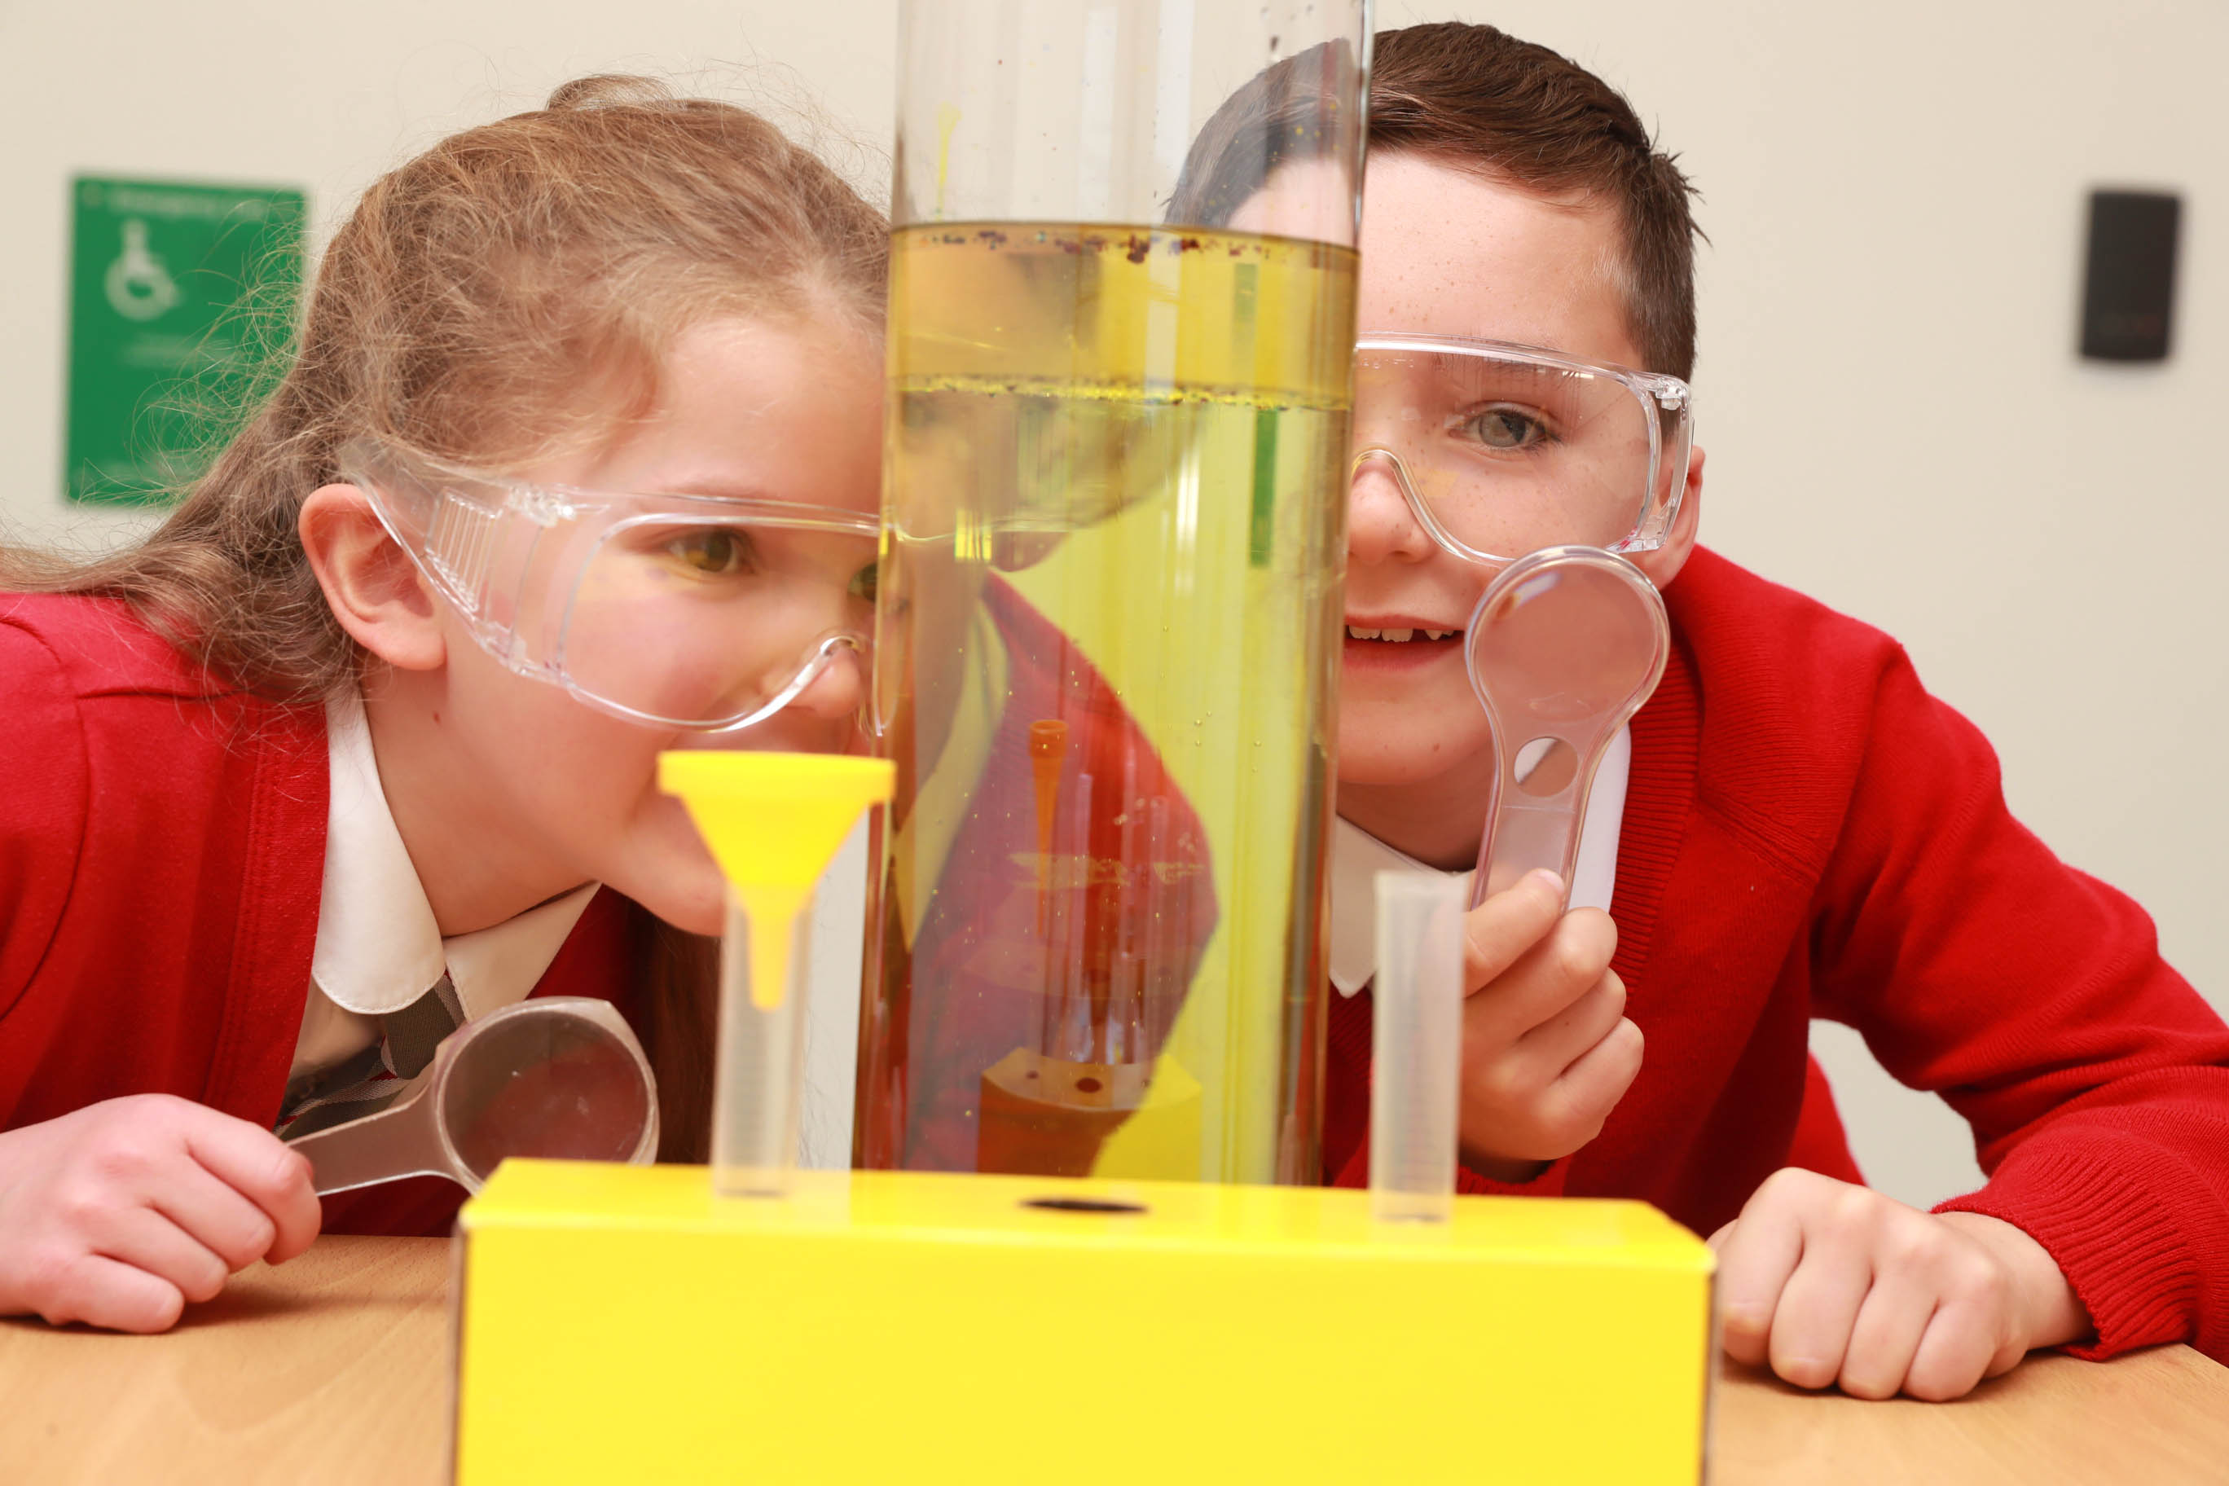

South Lanarkshire Council
Science Skills Framework
The framework for Sciences has been organised by level and arranged in a 3- year rolling programme. Within each year, there are suggested bundles of Curriculum for Excellence Experiences and Outcomes. These E’s & O’s are then supported by:
Education Scotland Sciences Planning Tool
Benchmarks for Assessment
Resources to support learning
Exemplar IDL planners
TAPS Scotland planners
Links to UN’s Sustainable Development Goals
Note: Topical Science should be taught every year
SCN 1-04a Education Scotland Sciences Planning Tool
Benchmarks for Assessment
Resources to support learning
TAPS Scotland planners
Links to UN’s Sustainable Development Goals
This framework is a working document and will be updated regularly. Please be flexible in your approach and keep up to date with developments to ensure you can best plan for excellent learning and teaching.
Contact us:
Email: gillian.reilly2@southlanarkshire.gov.uk

Slide 2



Early Level
Level Overview
Planet Earth
Space
I have experienced the wonder of looking at the vastness of the sky, and can recognise the sun, moon and stars and link them to daily patterns of life. SCN 0-06a
Forces, Electricity &waves
Toys/Forces
I have experienced, used and described a wide range of toys and common appliances. I can say ‘what makes it go’ and say what they do when they work. SCN 0-04a
Through everyday experiences and play with a variety of toys and other objects, I can recognise simple types of forces and describe their effects. SCN 0-07a
Body Systems and cells
The Human Body
I can identify my senses and use them to explore the world around me. SCN 0-12a
I am aware of my growing body and I am learning the correct names for its different parts and how they work. HWB 0-47b
Year One
Biodiversity and interdependence
Living Things
I have observed living things in the environment over time and am becoming aware of how they depend on each other. SCN 0-01a
I have helped to grow plants and can name their basic parts. I can talk about how they grow and what I need to do to look after them. SCN 0-03a
Properties and uses of substances
Materials
Through creative play, I explore different materials and can share my reasoning for selecting materials for different purposes. SCN 0-15a
Electricity
I know how to stay safe when using electricity. I have helped to make a display to show the importance of electricity in our daily lives. SCN 0-09a
Year Two
Processes of the planet
Water
By investigating how water can change from one form to another, I can relate my findings to everyday experiences. SCN 0-05a
Vibrations and Waves
Sound
Through play, I have explored a variety of ways of making sounds. SCN 0-11a
Year Three
Topical Science-SCN 0-20a
I can talk about science stories to develop my understanding of science and the world around me.

Slide 3




Early Level
Level Overview
Planet Earth
Space
SCN 0-06a
Forces, Electricity & Waves
Toys/Forces
SCN 0-04a
SCN 0-07a
Body Systems and Cells
The Human Body
SCN 0-12a
Links with HWB 0-47a & HWB 0-47b
Year One
Biodiversity and Interdependence
Living Things
SCN 0-01a
SCN 0-03a
Properties and uses of Substances
Materials
SCN 0-15a
Electricity
SCN 0-09a
Year Two
Processes of the Planet
Water
SCN 0-05a
Vibrations and Waves
Sound
SCN 0-11a
Year Three
Topical Science-SCN 0-20a
I can talk about science stories to develop my understanding of science and the world around me.
Science Skills Passport- Early Level
.

Slide 4
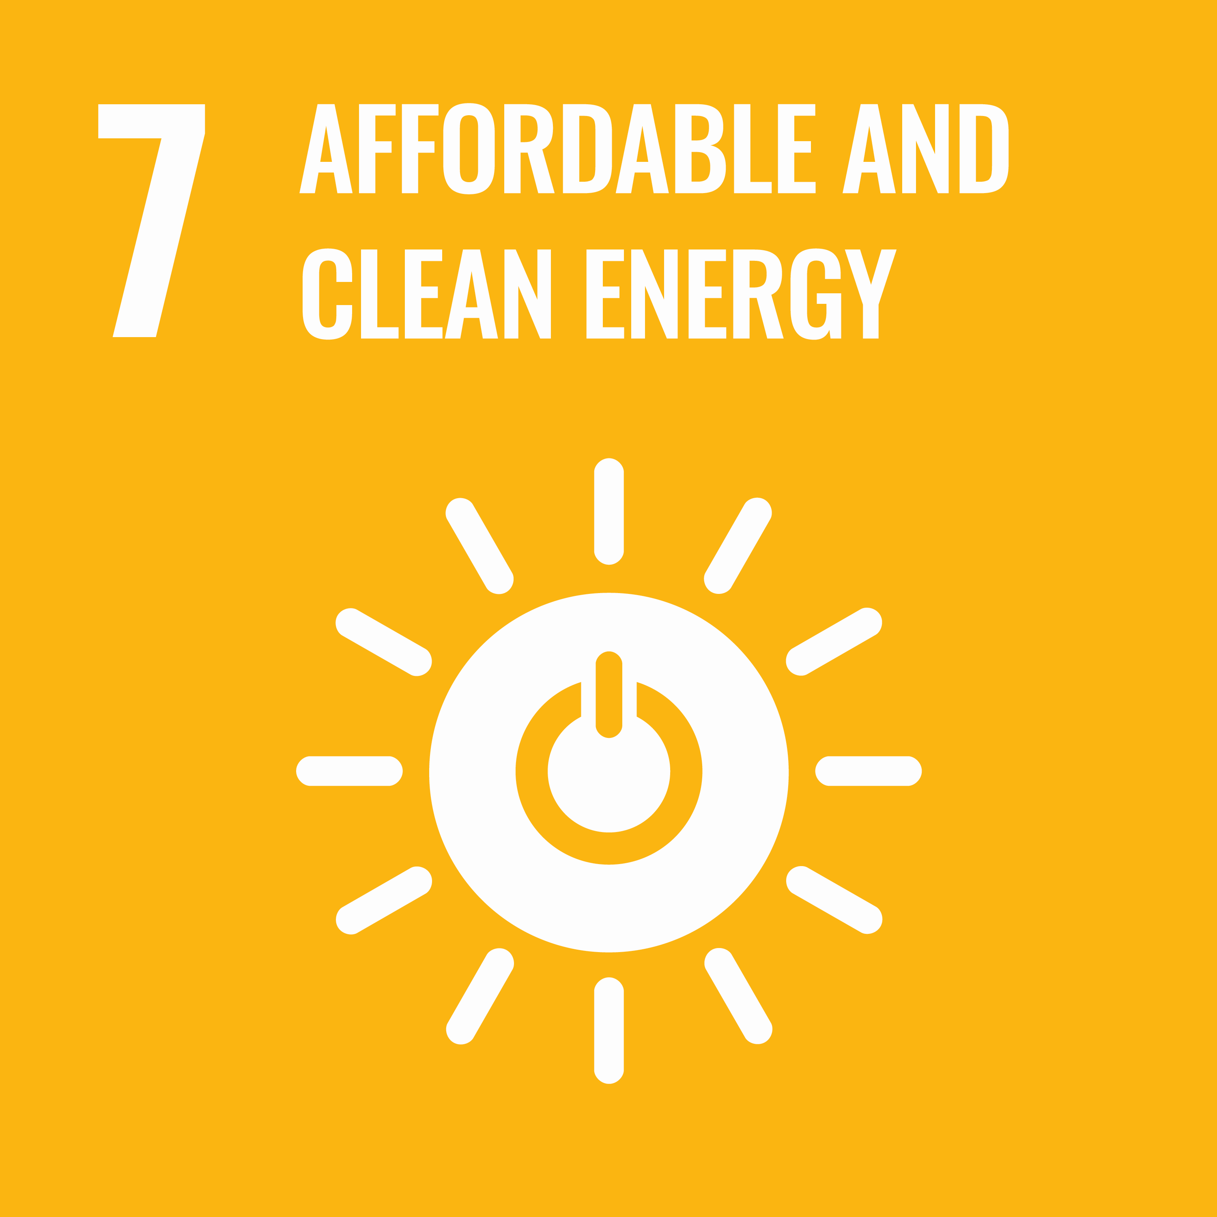








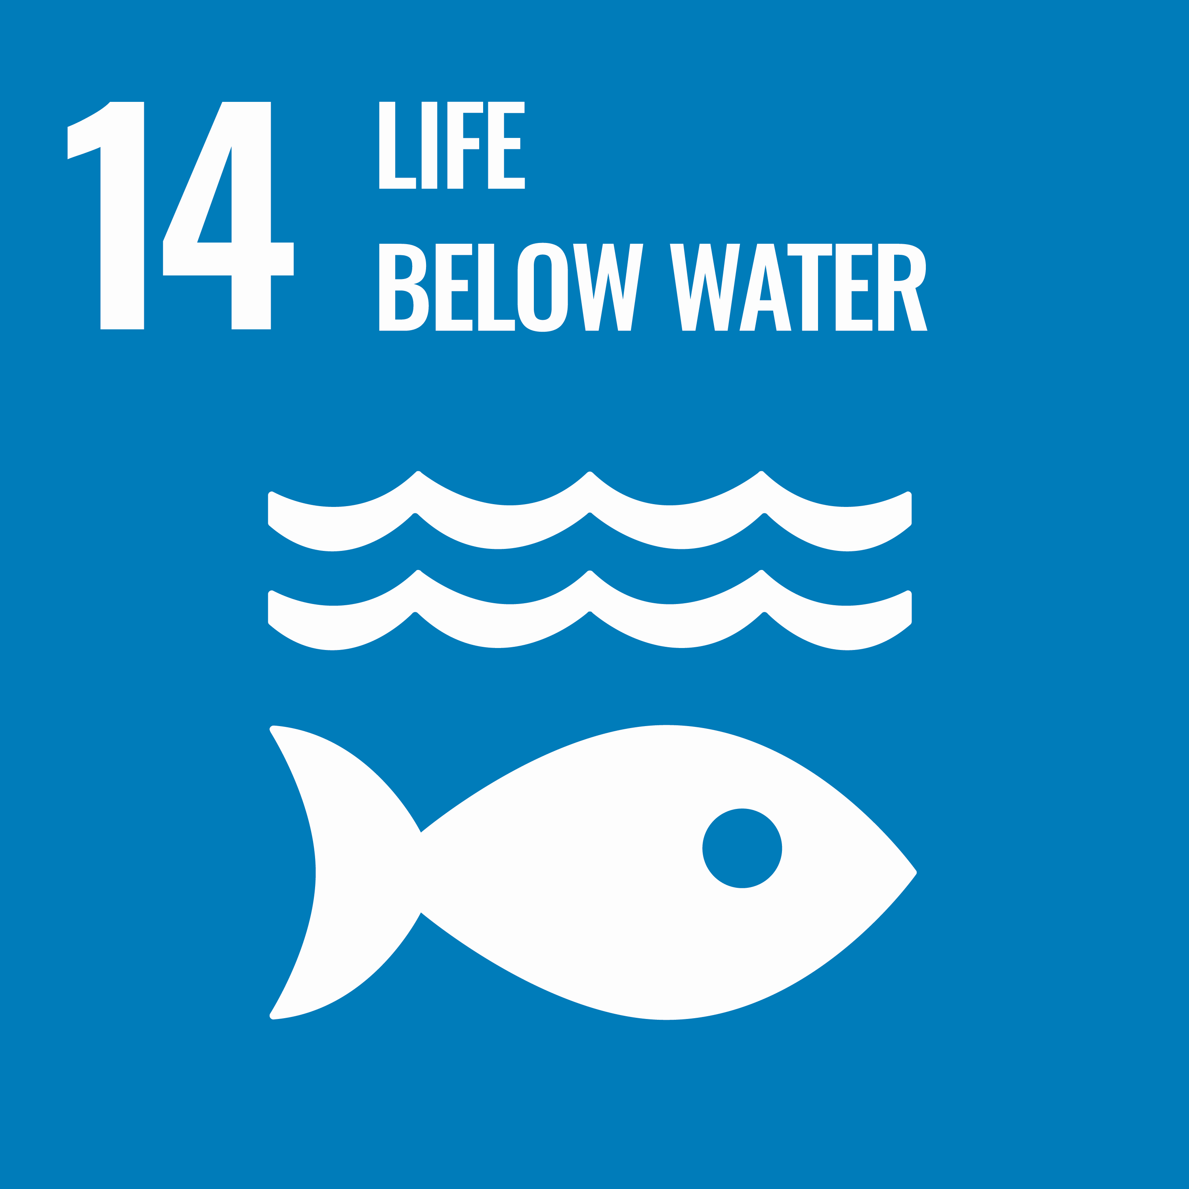
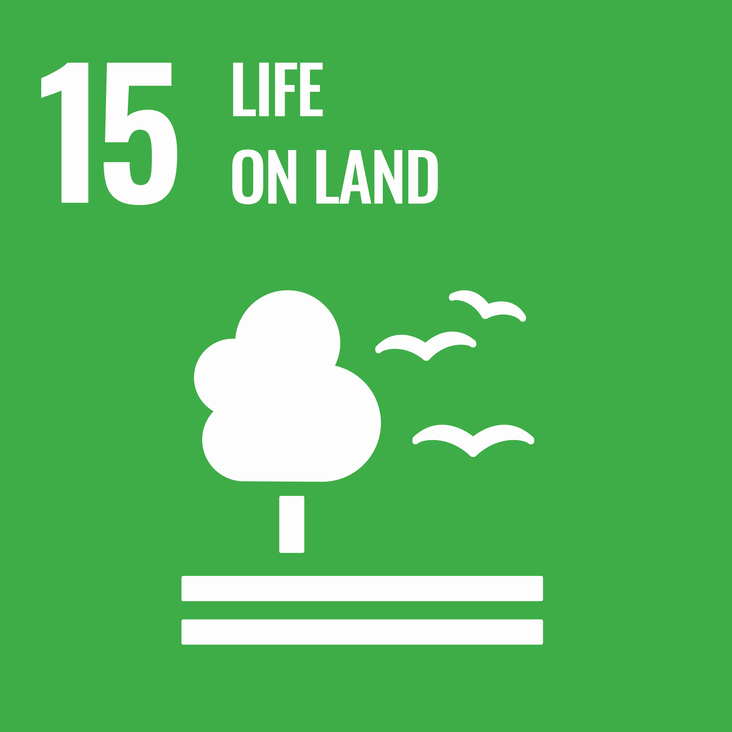
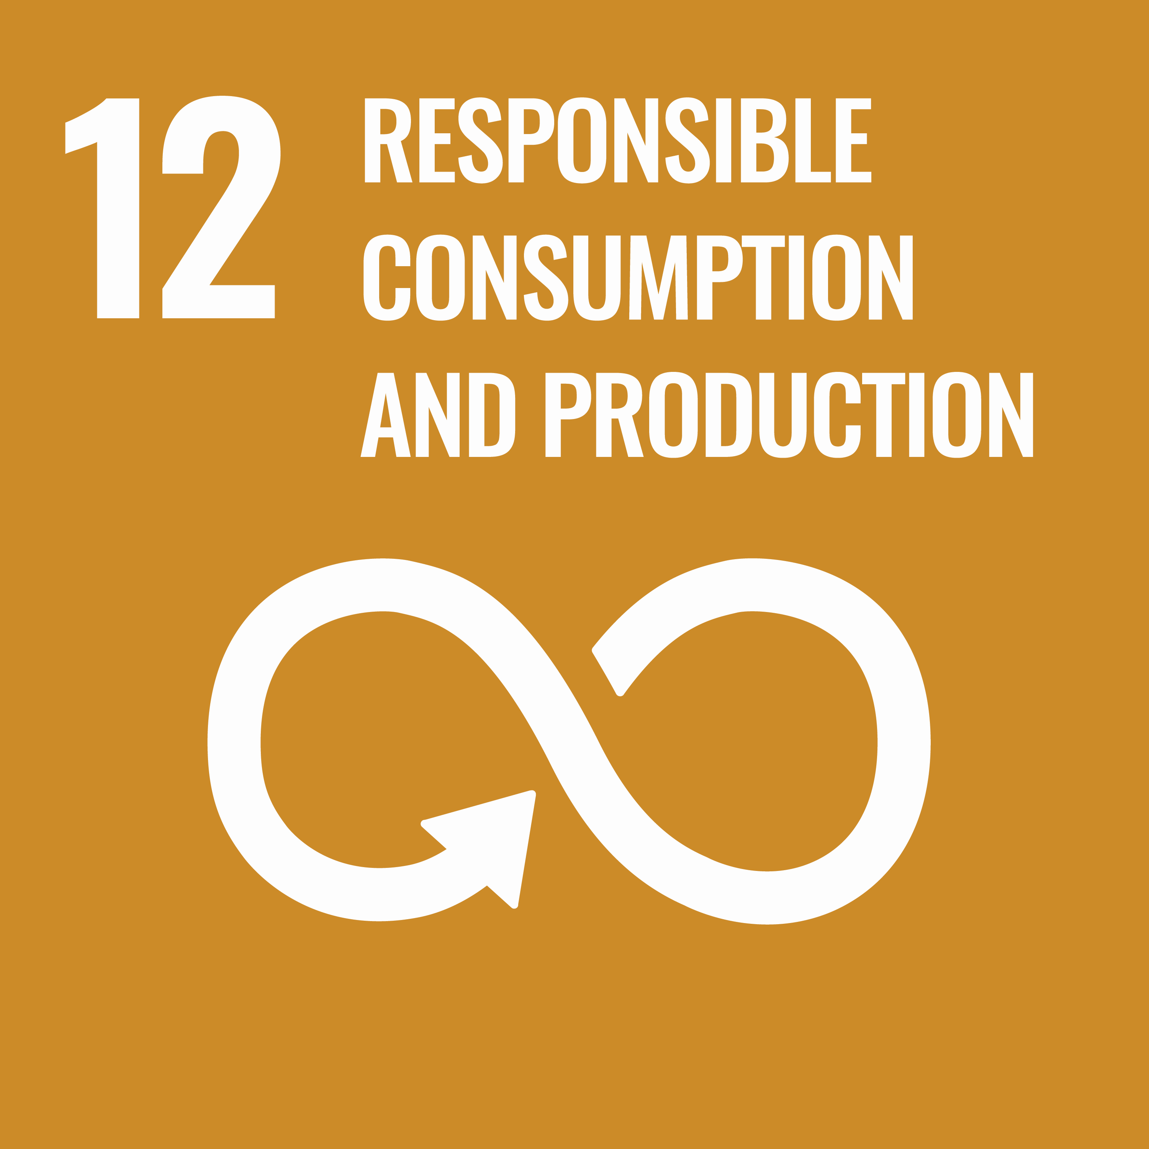






Early Level
Level Overview
Planet Earth
Space
SCN 0-06a
Forces, Electricity &waves
Toys/Forces
SCN 0-04a
SCN 0-07a
Body Systems and Cells
The Human Body
SCN 0-12a
Links with HWB 0-47a & WB 0-47b
Year One
Human Rights & Lives
Biodiversity and interdependence
Living Things
SCN 0-01a
SCN 0-03a
Properties and uses of substances
Materials
SCN 0-15a
Electricity
SCN 0-09a
Year Two
Biodiversity
Plastic
Processes of the planet
Water
SCN 0-05a
Vibrations and Waves
Sound
SCN 0-11a
Year Three
Water
Carbon
Topical Science-SCN 0-20a
Depending on the topic, will determine what SDGs are addressed.
Science Skills Passport- Early Level
.

Slide 5
First Level
Level Overview
Planet Earth
Space
By safely observing and recording the sun and moon at various times, I can describe their patterns of movement and changes over time. I can relate these to the length of a day, a month and a year. 1-06a
Forces, Electricity &waves
Forces
By investigating forces on toys and other objects, I can predict the effect on the shape or motion of objects SCN 1-07a
By exploring the forces exerted by magnets on other magnets and magnetic materials, I can contribute to the design of a game. SCN 1-08a
Body systems and cells
The Human Body
By researching, I can describe the position and function of the skeleton and major organs of the human body and discuss what I need to do to keep them healthy. SCN 1-12a
I have explored my senses and can discuss their reliability and limitations in responding to the environment. SCN 1-12b
I know the symptoms of some common diseases caused by germs. I can explain how they are spread and discuss how some methods of preventing and treating disease benefit society. SCN 1-13a
Year One
Biodiversity and interdependence
Living Things
I can distinguish between living and non-living things. I can sort living things into groups and explain my decisions. SCN 1-01a
I can explore examples of food chains and show an appreciation of how animals and plants depend on each other for food. SCN 1-02a
I can help to design experiments to find out what plants need in order to grow and develop. I can observe and record my findings and from what I have learned I can grow healthy plants in school.SCN 1-03a
By comparing generations of families of humans, plants and animals, I can begin to understand how characteristics are inherited. SCN 1-14a
Electricity
I can describe an electrical circuit as a continuous loop of conducting materials. I can combine simple components in a series circuit to make a game or model. SCN 1-09a
Properties and uses of substances
Materials and Conservation
Through exploring properties and sources of materials, I can choose appropriate materials to solve practical challenges. SCN 1-15a
Using digital technologies responsibly I can access, retrieve and use information to support, enrich or extend learning in different contexts. TCH 1-02a
Year Two
Processes of the planet/ Properties and use of substances
Water
By investigating how water can change from one form to another, I can relate my findings to everyday experiences. SCN 1-05a
I can make and test predictions about solids dissolving in water and can relate my findings to the world around me. SCN 1-16a
Vibrations and waves
Sound
By collaborating in experiments on different ways of producing sound from vibrations, I can demonstrate how to change the pitch of a sound. SCN 1-11a
Energy Sources and Sustainability
Energy
I am aware of different types of energy around me and can show their importance to everyday life and my survival. SCN 1-04a
Year Three
Topical Science-SCN 1-20a
I have contributed to discussions of current scientific news items to help develop my awareness of science
.
.

Slide 6







First Level
Level Overview
Planet Earth
Space
SCN 1-06a
Forces, Electricity &waves
Forces
SCN 1-07a
SCN 1-08a
Body systems and cells
The Human Body
SCN 1-12a
SCN 1-12b
SCN 1-13a
Year One
Biodiversity and interdependence
Living Things
SCN 1-01a
SCN 1-02a
SCN 1-03a
SCN 1-14a
Properties and uses of substances
Materials
SCN 1-15a
Links with TCH 1-02a
Electricity
SCN 1-09a
Year Two
Processes of the planet/ Properties and use of substances
Water
SCN 1-05a
SCN 1-16a
Vibrations and waves
Sound
SCN 1-11a
Energy Sources and Sustainability
Energy
SCN 1-04a
Year Three
Topical Science-SCN 1-20a
I have contributed to discussions of current scientific news items to help develop my awareness of science
.
.
Science Skills Passport- First Level
.
.

Slide 7












First Level
Level Overview
Planet Earth
Space
SCN 1-06a
Forces, Electricity &waves
Forces
SCN 1-07a
SCN 1-08a
Body systems and cells
The Human Body
SCN 1-12a
SCN 1-12b
SCN 1-13a
Year One
Human Rights & Lives
Biodiversity and interdependence
Living Things
SCN 1-01a
SCN 1-02a
SCN 1-03a
SCN 1-14a
Properties and uses of substances
Materials
SCN 1-15a
Links with TCH 1-02a
Electricity
SCN 1-09a
Year Two
Biodiversity
Plastic
Processes of the planet/ Properties and use of substances
Water
SCN 1-05a
SCN 1-16a
Vibrations and waves
Sound
SCN 1-11a
Energy Sources and Sustainability
Energy
SCN 1-04a
Year Three
Water
Carbon
Topical Science-SCN 1-20a
Depending on the topic, will determine what SDGs are addressed.
.
Science Skills Passport- First Level
.
.

Slide 8
Second Level
Level Overview
Planet Earth
Space
By observing and researching features of our solar system, I can use simple models to communicate my understanding of size, scale, time and relative motion within it. SCN 2-06a
Forces, Electricity &waves
Forces
By investigating how friction, including air resistance, affects motion, I can suggest ways to improve efficiency in moving objects. SCN 2-07a
I have collaborated in investigations to compare magnetic, electrostatic and gravitational forces and have explored their practical applications. SCN 2-08a
Biological Systems/ Materials
The Human Body
By investigating some body systems and potential problems which they may develop, I can make informed decisions to help me to maintain my health and wellbeing. SCN 2-12a
I have explored the structure and function of sensory organs to develop my understanding of body actions in response to outside conditions. SCN 2-12b
I have contributed to investigations into the role of microorganisms in producing and breaking down some materials. SCN 2-13a
Year One
Biodiversity and interdependence
Living Things
SCN 2-01a
SCN 2-02a
SCN2-02b
SCN 2-03a
SCN 2-14a
SCN 2-14b
Electricity
I have used a range of electrical components to help to make a variety of circuits for differing purposes. I can represent my circuit using symbols and describe the transfer of energy around the circuit. SCN 2-09a
To begin to understand how batteries work, I can help to build simple chemical cells using readily-available materials which can be used to make an appliance work. SCN 2-10a
Chemical Changes
Materials
I have collaborated in activities which safely demonstrate simple chemical reactions using everyday chemicals. I can show an appreciation of a chemical reaction as being a change in which different materials are made. SCN 2-19a
Year Two
Processes of the planet/ Forces/ Properties and use of substances Chemical changes
Water/ Substances
SCN 2-05a
SCN 2-08b
SCN 2-15a
SCN 2-16a
SCN 2-16b
SCN 2-17a
SCN 2-18a
Vibrations and waves
Sound and Light
Through research on how animals communicate, I can explain how sound vibrations are carried by waves through air, water and other media. SCN 2-11a
By exploring reflections, the formation of shadows and the mixing of coloured lights, I can use my knowledge of the properties of light to show how it can be used in a creative way. SCN 2-11b
Energy sources and sustainability
Energy
By considering examples where energy is conserved, I can identify the energy source, how it is transferred and ways of reducing wasted energy. SCN 2-04a
Through exploring non-renewable energy sources, I can describe how they are used in Scotland today and express an informed view on the implications for their future use. SCN 2-04b
Year Three
Topical Science-SCN 2-20a
Through research and discussion, I have an appreciation of the contribution that individuals are making to scientific discovery and invention and the impact this has made on society.
.
.

Slide 9





Second Level
Level Overview
Planet Earth
Space
SCN 2-06a
Forces, Electricity &waves
Forces
SCN 2-07a
SCN 2-08a
Biological Systems/ Materials
The Human Body
SCN 2-12a
SCN 2-12b
SCN 2-13a
Year One
Biodiversity and interdependence
Living Things
SCN 2-01a
SCN 2-02a
SCN2-02b
SCN 2-03a
SCN 2-14a
SCN 2-14b
Electricity
SCN 2-09a
SCN 2-10a
Chemical Changes
Materials
SCN 2-19a
Year Two
Processes of the planet/ Forces/ Properties and use of substances Chemical changes
Water/ Substances
SCN 2-05a
SCN 2-08b
SCN 2-15a
SCN 2-16a
SCN 2-16b
SCN 2-17a
SCN 2-18a
Vibrations and waves
Sound and Light
SCN 2-11a
SCN 2-11b
Energy sources and sustainability
Energy
SCN 2-04a
SCN 2-04b
Year Three
Topical Science-SCN 2-20a, SCN 2-20b
Through research and discussion, I have an appreciation of the contribution that individuals are making to scientific discovery and invention and the impact this has made on society.
.
.
Science Skills Passport- Second Level
.
.

Slide 10
Second Level
Level Overview
Planet Earth
Space
SCN 2-06a
Forces, Electricity &waves
Forces
SCN 2-07a
SCN 2-08a
Biological Systems/ Materials
The Human Body
SCN 2-12a
SCN 2-12b
SCN 2-13a
Year One
Human Rights & Lives
Biodiversity and interdependence
Living Things
SCN 2-01a
SCN 2-02a
SCN2-02b
SCN 2-03a
SCN 2-14a
SCN 2-14b
Electricity
SCN 2-09a
SCN 2-10a
Chemical Changes
Materials
SCN 2-19a
Year Two
Biodiversity
Plastic
Processes of the planet/ Forces/ Properties and use of substances Chemical changes
Water/ Substances
SCN 2-05a
SCN 2-08b
SCN 2-15a
SCN 2-16a
SCN 2-16b
SCN 2-17a
SCN 2-18a
Vibrations and waves
Sound and Light
SCN 2-11a
SCN 2-11b
Energy sources and sustainability
Energy
SCN 2-04a
SCN 2-04b
Year Three
Water
Carbon
Topical Science-SCN 2-20a, SCN 2-20b
Depending on the topic, will determine what SDGs are addressed.
.
.
Science Skills Passport- Second Level
.
.

Slide 11
Early Level
Benchmarks for Assessment
Biodiversity and Interdependence
I have observed living things in the environment
over time and am becoming aware of how they
depend on each other. SCN 0-01a
Explores and sorts objects as living, non-living or once living.
Describes characteristics of livings things and how they depend on each other, for example, animals which depend on plants for food.
Biodiversity and Interdependence
I have helped to grow plants and can name
their basic parts. I can talk about how they grow
and what I need to do to look after them. SCN 0-03a
Explores, observes and discusses basic needs of plants and what they need to grow including water, heat, sunlight and soil.
Demonstrates understanding of how plants grow from seeds.
Energy Sources and Sustainability
I have experienced, used and described a wide
range of toys and common appliances. I can
say ‘what makes it go’ and say what they do
when they work. SCN 0-04a
Ask questions and describes what can ‘make things go’, for example, batteries, wind-up toys and sunlight.
Talks about toys and common appliances and what they do when they work, for example, produce heat, light, movement or sound.
Early Level
Processes of the Planet
By investigating how water can change from
one form to another, I can relate my findings to
everyday experiences. SCN 0-05a
Identifies three main states of water (ice, water and steam) and uses scientific vocabulary such as ‘melting’, ‘freezing’ and ‘boiling’ to describe changes of state.
Investigates the different properties of water and shares their findings with others.
Talks about water in nature and how it influences their everyday lives
Space
I have experienced the wonder of looking at the
vastness of the sky, and can recognise the sun,
moon and stars and link them to daily patterns
of life. SCN 0-06a
Describes how the rotation of the Earth in relation to the sun gives us day and night.
Talks about how the pattern of night and day changes over the course of a year.
Forces
Through everyday experiences and play with a variety of toys and other objects, I can recognise simple types of forces and describe their effects. SCN 0-07a
Explores and sorts toys and objects into groups according to whether they need to be pushed or pulled.
Measures, using simple equipment, how the movement of an object is affected by the size of the force or the weight of the object.
Demonstrates, through play, how a force can make an object stay still, start to move, speed up, slow down and change shape.

Slide 12
Early Level
Benchmarks for Assessment
Electricity
I know how to stay safe when using electricity. I have helped to make a display to show the importance of electricity in our
daily lives. SCN 0-09a
Groups objects into those which get electricity either from mains electrical sockets or alternative sources, such as batteries and solar cells.
Identifies the risks that can be caused by electricity and recognises how to stay safe.
Talks about the importance of electricity in their daily lives.
Vibrations and waves
Through play, I have explored a variety of ways of making sounds. SCN 0-11a
Predicts, then investigates, ways to make sounds louder and quieter.
Identifies different sources of sound.
Body Systems and Cells
I can identify my senses and use them to explore the world around me.
SCN 0-12a, HWB 0-47b
Identifies specific parts of the body related to each of the senses.
Uses their senses to describe the world around them, giving examples of things they see, hear, smell, taste and feel.
Early Level
Properties and uses of substances
Through creative play, I explore different materials and can share my reasoning for selecting materials for different purposes . SCN 0-15a
Explores and sorts materials into different groups depending on their properties, for example, whether they are strong, smooth, rough and
if they float or sink.
Justifies the selection of appropriate materials for different uses based on their physical properties.
Topical Science
I can talk about science stories to develop my understanding of science and the world around
me. SCN 0-20a
Talks about the science they encounter in their everyday experiences.
Explores, through role-play, how science and science skills are used in a variety of jobs.

Slide 13
First Level
Benchmarks for Assessment
Biodiversity and Interdependence
I can distinguish between living and non-living things. I can sort living things into groups and
explain my decisions. SCN 1-01a
Explains the difference between living and non-living things, taking into consideration movement, reproduction, sensitivity, growth, excretion
and feeding.
Creates criteria for sorting living things and justifies decisions.
Sorts living things into plant, animal and other groups using a variety of features.
Biodiversity and Interdependence
I can explore examples of food chains and show an appreciation of how animals and plants depend
on each other for food. SCN 1-02a
Explores, observes and discusses basic needs of plants and what they need to grow including water, heat, sunlight and soil.
Demonstrates understanding of how plants grow from seeds.
Biodiversity and Interdependence
I can help to design experiments to find out what plants need in order to grow and develop.
I can observe and record my findings and from what I have learned I can grow healthy plants in school. SCN 1-03a
Observes, collects and measures the outcomes from growing plants in different conditions, for example, by varying levels of light, water, air, soil/nutrients and heat.
Structures a presentation or report, with support, to present findings on how plants grow.
First Level
Energy sources and sustainability
I am aware of different types of energy around me and can show their importance to everyday life
and my survival. SCN 1-04a
Identifies and talks about types of energy that we get from different energy sources, for example, light, sound, heat and electrical.
Uses knowledge of different energy sources, for example, sun, food, fuel, wind and waves, to discuss the importance of different types of energy
for everyday life and survival.
Processes of the planet
By investigating how water can change from one form to another, I can relate my findings
to everyday experiences. SCN 1-05a
Uses more complex vocabulary to describe changes of states of water, for example, ‘condensation’ and ‘evaporation’.
Contributes to the design of an experiment to determine the temperature at which water boils, freezes and melts, ensuring appropriate use of units
Knows that pure water boils at 100°, melts at 0° and freezes at 0°.
Space
By safely observing and recording the sun and moon at various times, I can describe their patterns of movement and changes over time. I can relate
these to the length of a day, a month and a year.
SCN 1-06a
Describes how the Earth spins around its axis in 24 hours resulting in day and night.
Observes and records the different patterns of movement of the moon and explains why the moon appears to have different shapes and positions
in the sky at different times in a lunar month.
Demonstrates understanding of how the Earth takes one year to completely orbit the sun.
Demonstrates understanding of how the tilt of the Earth on its axis as it circles the sun causes the pattern of the seasons and changes to the number of daylight hours over the course of a year

Slide 14
First Level
Benchmarks for Assessment
Forces
By investigating forces on toys and other objects, I can predict the effect on the shape or motion
of objects. SCN 1-07a
Predicts and then investigates how a force can make an object change speed, direction or shape, and uses vocabulary such as pushing, pulling,
stretching, squashing and twisting to describe forces.
Investigates balanced forces and explains that if a push and pull are equal in strength and opposite in direction then there is no change in movement.
Forces
By exploring the forces exerted by magnets on other magnets and magnetic materials, I can
contribute to the design of a game. SCN 1-08a
Reports in writing, visually, orally how magnets exert a non-contact force on each other and attract certain materials.
Demonstrates through practical activities that like poles repel and opposite poles attract.
Gives at least two examples for how magnets are used in everyday life.
Electricity
I can describe an electrical circuit as a continuous loop
of conducting materials. I can combine simple components
in a series circuit to make a game or model. SCN 1-09a
Builds simple circuits containing bulbs, switches, bells and batteries
First Level
Vibrations and waves
By collaborating in experiments on different ways of producing sound from vibrations, I can demonstrate
how to change the pitch of the sound. SCN 1-11a
Demonstrates how sounds can be made higher or lower pitch by altering tightness, length, width or thickness or other physical characteristics of the sound source.
Explains that sound is caused by a vibration in a material.
Body systems and cells
By researching, I can describe the position and function of the skeleton and major organs of the
human body and discuss what I need to do to keep them healthy. SCN 1-12a
Uses components to make simple models of a skeleton which identify the skull, spine, ribcage and some bones of the arms and leg and which show
how the skeleton gives us support and protects our organs.
Structures a presentation or report, with support, on how to have a healthy
lifestyle, for example, through a balanced diet, regular exercise, sufficient sleep and by avoiding substance misuse.
Describes the position and function of major organs including the brain, heart, lungs, stomach and bladder.
Describes how skin, as an organ, provides a barrier to infection and helps to control our temperature.
Body systems and cells
I have explored my senses and can discuss their reliability and limitations in responding to the environment. SCN 1-12b
Uses their senses to detect information and explains how they help to keep people safe.
Investigates the reliability and limitations of the senses, for example, using taste tests, limits of sound, optical illusions and blind-fold games.

Slide 15
First Level
Benchmarks for Assessment
Body systems and cells
I know the symptoms of some common diseases caused by germs. I can explain how they are
spread and discuss how some methods of preventing and treating disease benefit society. SCN 1-13a
Provides explanations, supported by evidence, of how some diseases spread and discusses ways in which some diseases can be prevented through good hygiene and vaccination.
Describes the symptoms of some common diseases including colds, mumps, measles, chicken pox and flu.
Inheritance
By comparing generations of families of humans, plants and animals, I can begin to understand how characteristics are inherited. SCN 1-14a
Uses their own experiences to illustrate how inherited characteristics are passed from one generation to the next.
Knows that genetic information determines characteristics such as colour of eyes and shape of petals.
Demonstrates understanding of the variations within family groups.
Properties and uses of substances
Through exploring properties and sources of materials, I can choose appropriate materials to solve practical challenges. SCN 1-15a
Classifies materials into natural and human-made (synthetic).
Identifies properties of different materials, for example, rigidity, flexibility, rough, smooth and waterproof, and their uses linked to their properties.
First Level
Properties and uses of substances
I can make and test predictions about solids dissolving in water and can relate my findings to the
world around me. SCN 1-16a
Links new knowledge of dissolving to real-life examples of things that dissolve and things that don’t dissolve.
Predicts, investigates and records how solubility is affected by heat and stirring.
Topical science
I have contributed to discussions of current scientific news items to help develop my awareness of science. SCN 1-20a
Discusses and expresses opinions about science topics in real-life contexts, including those featured in the media.
Discusses how people use science in their everyday lives
Describes a variety of jobs and careers which require scientific knowledge and skills.

Slide 16
Second Level
Benchmarks for Assessment
Biodiversity and Interdependence
I can identify and classify examples of living things,
past and present, to help me appreciate their diversity. I can relate physical and behavioural
characteristics to their survival or extinction. SCN 2-01a
Classifies living things into plants (flowering and non-flowering), animals
(vertebrates and invertebrates) and other groups through knowledge of their characteristics.
Begins to construct and use simple branched keys which can be used
to identify particular plants or animals.
Identifies characteristics of living things and their environment which have contributed to the survival or extinction of a species.
Describes how some plants and animals have adapted to their environment, for example, for drought or by using flight.
Biodiversity and Interdependence
I can use my knowledge of the interactions and energy flow between plants and animals in ecosystems, food chains and webs. I have contributed to the design or conservation of a wildlife area. SCN 2-02a
Describes how energy flows between plants and animals in more complex food chains and webs and ecosystems, using vocabulary such as ‘producers’, ‘consumers’ and ‘herbivore’.
Biodiversity and Interdependence
Through carrying out practical activities and investigations, I can show how plants have benefited society. SCN 2-02b
Relates findings from practical investigations to describe how plants have benefited society, for example, in medicine, dyes, fuels, construction,
prevention of soil erosion and by influencing the balance of gases in the air.
Second Level
Biodiversity and Interdependence
I have collaborated in the design of an investigation into the effects of fertilisers on the growth of plants. I can express an informed view of the risks
and benefits of their use. SCN 2-03a
Collaborates with others to present a reasoned argument, based on evidence, of the risks and benefits of using fertilisers, demonstrating
understanding of the underlying scientific concepts.
Energy sources and sustainability
By considering examples where energy is conserved, I can identify the energy source,
how it is transferred and ways of reducing wasted energy. SCN 2-04a
Demonstrates understanding of the law of conservation of energy (energy can be converted from one form to another but cannot be created
or destroyed).
Identifies the common types of energy (kinetic, potential, electrical, chemical, light, sound and heat) used in energy transfers and transformations that occur in everyday appliances.
Explains that when energy transfers and transformations take place, energy is converted into ‘useful’ and ‘wasted’ energy, for example a mechanical braking system transforms kinetic energy into heat energy which is dissipated to the atmosphere as ‘waste’ heat.
Energy sources and sustainability
Through exploring non-renewable energy sources,
I can describe how they are used in Scotland today and express an informed view on the
implications for their future use. SCN 2-04b
Researches non-renewable sources of energy, such as fossil fuels and nuclear, and discusses how these are used in Scotland.
Draws on increasing knowledge and understanding to suggest ways in which they can reduce their own energy use and live more sustainably.

Slide 17
Second Level
Benchmarks for Assessment
Processes of the planet
I can apply my knowledge of how water changes state to help me understand the processes involved in the water cycle in nature over time. SCN 2-05a
Discusses the necessity of water for life, for example, for the growth of crops, for drinking and in river formation/flow.
Draws on increasing knowledge and understanding to suggest ways in which they can reduce their own energy use and live more sustainably.
Space
By observing and researching features of our Solar System, I can use simple models to communicate my understanding of size, scale, time and relative motion within it. SCN 2-06a
Reports collaboratively on the key features of the planets including size, distance from the sun, length of day, length of year, temperature, materials from which they are predominantly made and the number of moons.
Uses simple models to communicate understanding of size, scale, time and relative motion within our Solar System, including how solar & lunar eclipses occur.
Forces
By investigating how friction, including air resistance, affects motion, I can suggest ways to improve efficiency in moving objects. SCN 2-07a
Describes friction as a force which opposes the motion of moving objects, for example, two solid surfaces rubbing against one another or a solid surface moving through air or water.
Finds an association between air resistance (drag), the speed of the object being investigated and the surface area exposed to the air, making links to original predictions.
Demonstrates understanding of how friction and air resistance can both be useful, for example, in braking systems, and also a problem, for example, causing moving parts to wear.
Describes efficient movement as that which requires the least possible energy and suggests ways to improve efficiency in moving objects, for example, by streamlining.
Second Level
Forces
I have collaborated in investigations to compare magnetic, electrostatic and gravitational forces and have explored their practical applications.
SCN 2-08a
Explores the factors which affect floating, for example, the object’s shape and the density of the material that the object is made of, and collates, organises and summarises findings with assistance. .
Forces
By investigating floating and sinking of objects in water, I can apply my understanding of buoyancy to solve a practical challenge. SCN 2-08b
Explores the factors which affect floating, for example, the object’s shape and the density of the material that the object is made of, and collates, organises and summarises findings with assistance.
Electricity
I have used a range of electrical components to help to make a variety of circuits for differing purposes. I can represent my circuit using symbols and describe the transfer of energy around the circuit. SCN 2-09a
Designs and builds a variety of electrical circuits for differing purposes, using an increasing range of components.
Draws circuit diagrams using appropriate symbols to denote a bulb, switch, motor, bell, buzzer, wires, cell and a battery.
Describes how components in a circuit transfer energy into different forms.

Slide 18
Second Level
Benchmarks for Assessment
Electricity
To begin to understand how batteries work, I can help to build simple chemical cells using readily-available materials which can be used to make an appliance work. SCN 2-10a
Applies knowledge and understanding to build simple batteries (chemical cells) and demonstrates understanding that a battery (cell) is a portable energy source which has a store of chemical energy.
Explains the process of energy transformation from battery (cell) to electrical components.
Vibrations and waves
Through research on how animals communicate, I can explain how sound vibrations are carried by waves through air, water and other media. SCN 2-11a
Discusses and demonstrates through experiments how sound travels differently through air, water and solids.
Explains how hearing is limited by a range of factors, for example, age, position, and flexibility (direction) of ears.
Vibrations and waves
By exploring reflections, the formation of shadows and the mixing of coloured lights, I can use my knowledge of the properties of light to show how it can be used in a creative way. SCN 2-11b
Demonstrates and records, through practical investigations, that light travels in straight lines, can be reflected by highly-polished surfaces and that curved faces can distort the image.
Predicts and investigates how the position, shape and size of a shadow depend on the position of the object in relation to the light source.
Demonstrates that white light/sunlight can be dispersed to show the colours of the visible spectrum and identifies the colours and order of the rainbow as red, orange, yellow, green, blue, indigo and violet.
Explains that we see objects because they give out or reflect light rays that enter our eyes.
Second Level
Draws on findings from practical investigations to describe the effect that coloured filters have on white light and how they can be used to make other colours.
Explains how we can recognise the colour of an object due the reflection and absorption of particular parts of the visible spectrum.
. .
Body systems and cells
By investigating some body systems and potential problems which they may develop, I can make informed decisions to help me to maintain my health and wellbeing. SCN 2-12a
Respiratory system
Describes the function of the respiratory system (lungs, windpipe and bronchi), for example, in gas exchange.
Discusses the main preventable causes of bronchitis, lung cancer and asthma, for example, smoking.
Circulatory system
Describes the function of the circulatory system (heart and blood vessels), for example, transport of food, oxygen and waste materials.
Discusses the main preventable causes of heart disease or stroke, for example, obesity, lack of exercise, smoking and high (saturated) fat diet.
Digestive system
Describes the function of the digestive system (mouth, oesophagus, stomach, liver, small intestine, large intestine, rectum and anus), for example, breakdown of food and absorption of nutrients, minerals and water.
Discusses the main preventable causes of liver disease, for example, alcohol and drug misuse.
SCN 2-12a The expectation is that at least two of the following body systems will be studied at Second Level.
Reproductive system
Describes the function of the reproductive system (penis, testes, sperm tube/duct, ovaries, egg tube/duct, uterus and vagina), for example, to make a baby.
Discusses some preventable causes of fertility problems, for example, alcohol misuse, anorexia and obesity.
Skeletal system
Describes the function of the skeleton (skull, spine, ribcage some bones of the arm and leg), for example, to provide support, protection and enable movement.
Discusses some common problems of bones (for example, arthritis, osteoporosis and breaks) and how their incidence can be reduced (for example, through calcium in the diet and weight-bearing exercise).

Slide 19
Second Level
Benchmarks for Assessment
Body systems and cells
I have explored the structure and function of sensory organs to develop my understanding of body actions in response to outside conditions.
SCN 2-12b
Describes how light enters the eye through the pupil and how the pupil changes size in dark/light conditions.
Describes how senses work individually or together to keep people safe from harm.
Demonstrates understanding of how, if one sense is impaired, it can have an effect on the other senses, either positively or negatively.
Body systems and cells
I have contributed to investigations into the role of microorganisms in producing and breaking down some materials. SCN 2-13a
Demonstrates understanding of how microorganisms, including bacteria, viruses and fungi, can multiply rapidly.
Investigates and explains the action of some microorganisms used in food production, for example, yeast in bread and bacteria in yoghurt..
Describes how some micro-organisms break down food causing it to be inedible or harmful if digested, and how others exist in the gut to break down food to aid digestion.
Investigates, observes and records how microscopic organisms are necessary for the process of decomposition (the breaking down of dead material – decay).
Inheritance
By investigating the lifecycles of plants and animals, I can recognise the different stages of their development. SCN 2-14a
Plants
Describes how pollination occurs when the male cell (pollen) lands on the stigma..
Describes how fertilisation (sexual reproduction) occurs when the genetic information in the male cell fuses (joins) with the genetic information in the female cell.
Describes how the fertilised ovule develops into a seed and how the ovary ripens to form a fruit.
Investigates and explains how a seed germinates into a plant using water, oxygen, a food store and warmth.
Second Level
Animals
Identifies and compares the two distinct groups of animals ‒ vertebrates and invertebrates.
Researches the lifecycles of the five main types of vertebrates including fish (spawn), birds (eggs which are rigid but fragile), amphibians (spawn and metamorphosis), reptiles (leathery shelled eggs) and mammal (live young), and communicates findings using a range of media.
.
Compares the lifecycles of some invertebrates, for example, ladybird and spider.
Inheritance
By exploring the characteristics offspring inherit when living things reproduce, I can distinguish between inherited and non-inherited characteristics. SCN 2-14b
Knows that genetics is the study of inherited characteristics and that inherited characteristics are carried on genes and can sometime skip a generation.
Explores and categorises characteristics into inherited (eye and hair colour, height and right/left handedness) and non-inherited (native language spoken and favourite colour).
Describes how every living thing has its own DNA fingerprint.

Slide 20
Second Level
Benchmarks for Assessment
Properties and uses of substances
By contributing to investigations into familiar changes in substances to produce other substances, I can describe how their characteristics have changed. SCN 2-15a
Investigates and explains physical changes to the properties of materials which are fully and partially reversible, for example, salt dissolving in water, chocolate melting and water freezing.
Uses scientific vocabulary such as ‘melting’, ‘freezing’, ‘evaporating’ and ‘condensing’ to describe changes of state.
Investigates and records chemical changes to the properties of materials which are irreversible, for example, cooking, rusting and striking a match.
Observes and identifies some of the signs of a chemical reaction, for example, production of bubbles, colour/texture change and heat given out/taken in.
Explores and describes the characteristics of solids, liquids and gases, for example, solids retain the same volume and shape, liquids keep the same volume but the shape changes to fit the container and that gases change shape and volume to fill the container.
Properties and uses of substances
I have participated in practical activities to separate simple mixtures of substances and can relate my findings to my everyday experience. SCN 2-16a
Draws on findings from practical investigations to explain how a mixture of solids of different sizes can be separated using a sieve or magnet, for example, sand and peas or salt and iron filings.. .
Selects the most appropriate practical technique for separating insoluble solids, for example, filtering or sieving..
Explains why a dissolved solid cannot be separated from the solvent by filtering but can be separated by evaporation.
Second Level
Uses scientific vocabulary such as ‘soluble’, ‘insoluble’, ‘dissolve’ and ‘solution’ in context.
Relates findings of practical investigations about dissolving to everyday experiences, for example, recycling, salt production and water purification.
Properties and uses of substances
By investigating common conditions that increase the amount of substance that will dissolve or the speed of dissolving, I can relate my findings to the world around me. SCN 2-16b
Finds an association between the quantity of substance that dissolves and a range of conditions – temperature, time, particle size, stirring and quantity of solvent.
Relates learning about the quantity and rate of dissolving to everyday examples such as dissolving sugar in tea or salt in water (granules or big crystals, hot or cold liquid, stirred or not stirred).
Investigates how a range of factors such as particle size and heat can affect the rate of dissolving.
Earth’s materials
Having explored the substances that make up Earth’s surface, I can compare some of their characteristics and uses. SCN 2-17a
Analyses and compares samples of rocks, soil and minerals and reports their characteristics and uses, using a range of media.

Slide 21
Second Level
Benchmarks for Assessment
Chemical changes
I have investigated different water samples from the environment and explored methods that can be used to clean and conserve water and I am aware of the properties and uses of water. SCN 2-18a
Uses knowledge of the water cycle to explain how the quantity of water on the Earth has remained approximately the same.
Investigates and discusses the methods used to purify water, for example, sedimentation, filtration, evaporation, desalination and the addition of chemicals such as chlorine.
Researches methods used to conserve water within the home, school and globally and communicates findings to others.
Discusses the many uses of water, for example, to support all living things, in preservation (ice) and to generate electricity.
Chemical Changes
I have collaborated in activities which safely demonstrate simple chemical reactions using everyday chemicals. I can show an appreciation of a chemical reaction as being a change in which different materials are made. SCN 2-19a
Collaborates with others to safely demonstrate simple chemical reactions, for example, effervescence.
Investigates examples of everyday chemical reactions, such as burning and corrosion, and names some of the new substances which are produced.
Uses prior knowledge to identify when a chemical reaction has occurred to produce a new substance.
Second Level
Topical science
Through research and discussion, I have an appreciation of the contribution that individuals are making to scientific discovery and invention and the impact this has made on society. SCN 2-20a
Researches historic and contemporary scientists (ensuring gender balance) and their scientific discoveries and reports collaboratively to others using a range of methods.
Describes the impact of scientific discovery, creativity and invention on society past and present, for example, in design, medicine and agriculture.
Demonstrates understanding of how science impacts on every aspect of our lives.
Relates the development of scientific skills in the classroom to an increasingly wide variety of science, technology, engineering and mathematics (STEM) careers.
Topical science
I can report and comment on current scientific news items to develop my knowledge and understanding of topical science. SCN 2-20b
Explores items of current scientific interest within the school, local community, nationally or in the global media and collates, organises and summarises findings, with assistance. .
Shares opinions about a variety of topical scientific issues considering, for example, moral, ethical, societal, cultural, economic and environmental aspects.

Slide 22
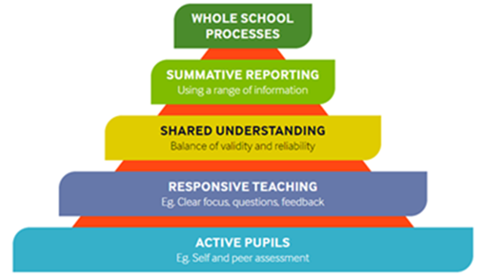
Teacher Assessment in Primary Science (TAPS)
The TAPS pyramid tool provides schools with a supportive structure to evaluate and develop their assessment processes. The rich classroom assessment information produced by ‘active pupils’ and ‘responsive teachers’ can be used formatively to inform next steps or as a summative approach to report to different audiences.
Assessment information flows up the pyramid, from the classroom ‘pupil’ and ‘teacher’ layers, through the ‘shared understanding’ layer where judgements are collated and moderated, to the ‘summative and whole school reporting’ layers. Within each layer are guidance boxes containing suggested practices and examples from across the UK, providing a bank of ideas for the development of assessment in primary science.
The Teacher Assessment in Primary Science (TAPS) project is based at Bath Spa University and funded by the Primary Science Teaching Trust. TAPS has been working in collaboration with teachers across the UK since 2013 to develop support for valid, reliable and manageable assessment, which will have a positive impact on children’s learning. Dr. Sarah Earle who leads TAPS has given permission for it to be included within the WL Progression Pathway.
TAPS Pyramid Tool
Teacher Assessment
WHY USE FOCUSED ASSESSMENT?
A focused assessment increases the validity of teacher judgments. Assessment indicators provide suggestions about what the children might do or say to demonstrate their understanding or knowledge in the context of real classroom activities. This clear focus on an element of science reduces the possible impact of preconceptions about individual children or their skills in other areas, such as writing. Over time, the full range of children’s science enquiry skills and understanding of science can be considered in depth.
Taking one focus at a time means that assessing science, including practical work, becomes more manageable with a whole class. Many teachers find that annotating plans or just noting those who have 'not yet met the objective' is sufficient for record-keeping.
They have been developed and trialled by schools so teachers can feel secure that their judgements are consistent with those of other teachers. In other words, they are reliable.
Specific areas for children’s development can be identified and subsequent teaching can take this into account; the assessment is formative. These focused assessments can also contribute to an ongoing summative record of children's attainment in scientific enquiry instead of relying on end of term testing.
WHEN TO USE THE FOCUSED ASSESSMENTS
Ideally, focused assessment should occur about two thirds of the way through a topic - far enough that the children have had the opportunity to develop their understanding and skills, but allowing sufficient time to act on the assessment information.
HOW TO USE THE FOCUSED ASSESSMENTS
Using this approach to assessment will allow teachers to focus on learning across the full range of working scientifically elements; plan, do, review. This helps to ensure that all aspects are considered - not just fair testing! There is an overview grid to support whole school planning.

Slide 23
STEM Challenge Progression
Early Level | Year 1, 2, 3 | Learning engineering through play which may include construction challenges with blocks, Lego, junk modelling, investigating materials, toy marble runs, ramps, parachutes, floating/ sinking etc. |  |  |  | Evaluate and self- assess skills using SLC Skills Passports
First Level | Year 1 | Perfect pillars and bridge | First Level: Writing task on teamwork Self-assess skills using SLC Skills Passports | Mars landers | Lifting weights- simple pulleys | Evaluate and self- assess skills using SLC Skills Passports
 | Year 2 | Rafts |  | Towers and supporting a weight | Teepees
 | Year 3 | Shipwreck challenge- foil boats |  | Stationery holders | Getting down safely! Slide and parachute
Second Level | Year 1 | Vertical marble run | Second Level: Writing task on skills Self-assess skills using SLC Skills Passports | Mars landers with parachute | Winding mechanisms- drawbridge and well | Evaluate and self- assess skills using SLC Skills Passports
 | Year 2 | Balloon powered rafts |  | Chain reaction machine | Marble mazes
 | Year 3 | Viewing platforms |  | Zip wires | Aqueducts
STEM Challenge Progression resource link which includes additional STEM challenges that can be used to supplement the above and Winter STEM challenges
This progressive planner has been supported by STEM challenges developed by SSERC.
All materials remain the intellectual property of SSERC and are used with permission.
STEM Challenge Progression

