Slide 1
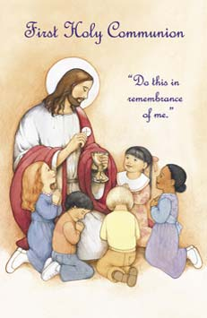
The Sacrament of the Eucharist
Notes:
Good evening and thank you for coming along tonight. Please make sure you have this important date in your diary. Please note that it is a Sunday this year.

Slide 2
The Support Triangle
Home
School
Parish
Notes:
This whole journey is of course a 3-way process- the support triangle including the home the school & the church.
Our first Communion day is one of the greatest memories of childhood and you as parents and carers have an irreplaceable role In guiding your child to fully appreciate its importance. By helping to prepare your child for their First Holy Communion you will be fulfilling your role as the first and most important educators in the ways of faith.

Slide 3
Religious Education
This is our Faith
(RE Syllabus/Core Teaching)
First Holy Communion
Family Workbook
Diocesan Website
www.rcdom.org.uk/first- communion-preparation
Notes:
The main resources we use in preparing the pupils for First Holy Communion are:
This is Our Faith
The core teaching for RE in catholic schools comes from
This Is Our Faith, which helps parents, teachers and clergy : develop the children’s knowledge and understanding of their Catholic faith and other world religions.
The First Holy Communion Family Workbook:
You will become very familiar with this as it goes back and forward between home and school . It provides one way in which you can support your child on their journey. The main theme introduced on the Monday & continued throughout the week. It will be sent home on the Wednesday and returned for the following Monday . Means you to work on it over the weekend if any of the activities are church based. The format of each lesson in the workbook is similar: There is background information for parents, class discussions and activities which are then followed by a home activity. .ends with a family prayer and reflection time where you are asked to you are asked to light a candle. You could use their baptismal candle or another one, just to be still and calm. This prayer and reflection time is for you to talk about what they have been learning is really the most important part. Not worried about all the at home activities so long as you do this part- signature.
The Diocesan Website :
Which provides some extra resources and suggests websites to complement the family workbooks.

Slide 4
Core Learning
Community of Faith
The Sacraments
Journey of Faith
The Last Supper
Holy Communion
The Liturgy of the Word
The Liturgy of the Eucharist
After First Communion
Notes:
The core learning covers the following themes and I’d just like to give you a wee whirwind tour of each theme

Slide 5
Community of Faith
OLOL School Community
Home Communities
Church Community – Community of Faith
At Home: Visit your local parish, draw pictures, take photos
Notes:
We begin by talking about what a community is , what communities we belong to and how it feels to belong to a community. We talk about being valued members of our school community, what other community groups we belong to like sports clubs, cubs, brownies, art & drama clubs and how that makes us feel.
This then leads on to talking about being part of our church community . We learn that the church is a very sacred and holy place but it is the people who go to Mass that make the church special. We call this our community of Faith. In the home session you are asked to visit the church, take photos, draw pictures and ask the priest questions.

Slide 6
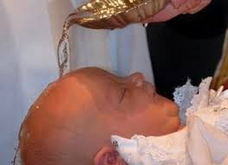
The Sacraments
Journey of Sacraments
The 7 Sacraments
Symbols of Baptism
At Home: Discuss Sacraments already received
Notes:
In this session the children learn about the 7 sacraments (Baptism, Reconcilliation, Eucharist, Confirmation, Marriage, Holy Orders and Annointing of the Sick)
We concentrate especially on the sacraments of initiation (Baptism, Eucharist & Confirmation) in particular Baptism and how when you chose to have your child baptised this was the start of their journey of faith. We talk about how they were welcomed when they were baptised and how they are now continuing to build upon their faith as they prepare for First Holy Communion.
At home you are asked to talk about their baptism with them , about the symbols of Baptism (oil, water, candle and white garmet. You should show photos of who was there and so on.
We also ask you to talk to your child about your experience of receiving the sacraments if appropriate.

Slide 7
Journey of Faith
Bible Stories/Explores the Old and New Testament
Spiritual Nourishment
At Home: Retell the story of the Loaves and Fishes
Notes:
The focus for this session is listening to bible stories reminding them that by listening to these we hear what God is saying to us and what God is asking us to do. We look especially on passages that tell us how God nourished people on their faith journeys (loaves & Fishes) and we talk about how through listening to His word God nourishes us spiritually and how we need spiritual nourishment as well as physical nourishment (love, shelter, food, water and education.)

Slide 8
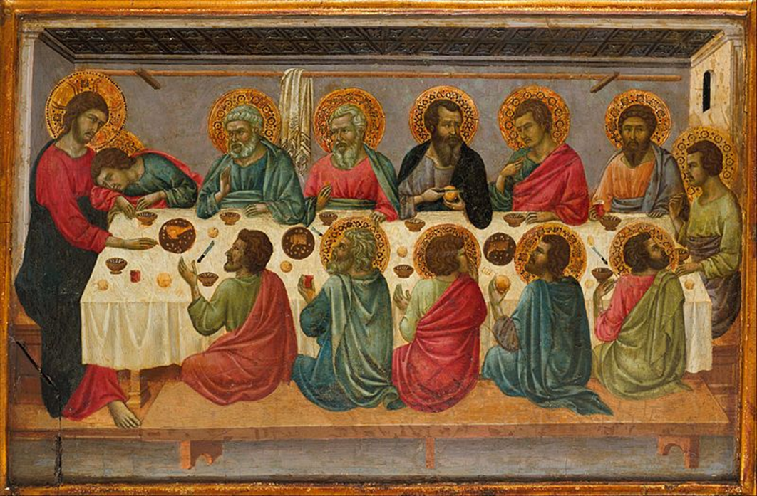
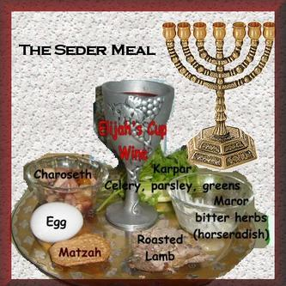
The Last Supper Holy Communion
First Passover/Jesus’ Life/Events of Holy Week
Special occasions
We share a special meal at Mass
Sacrifices we have made.
At Home: Meaning of sacrifice/Last Supper/ : Altar, Objects in church eg lectern, tabernacle
Notes:
We continue to develop the idea of spiritual nourishment through the next couple of sessions - the story of the The Last Supper. Here we have a strong focus on the Consecration in the Mass and talk about how Jesus sacrificed himself on the cross We talk about the meaning of sacrifice and sacrifices we make
The children will also learn about Jesus childhood and how he celebrated the Passover each year and we talk about special occasions in our own lives and how they are often/always celebrated with special meals with family and friends, relating this throughout to the Last Supper and Holy Communion. We also discuss the significance of their Godparents ask them to invite them to come to celebrate Mass with them.
At this point we also ask the children to become ‘Church Detectives’ when they are at Mass as they become familiar with the sacred parts of the church- lectern/tabernacle/altar/sanctuary lamp etc.

Slide 9
The Liturgy of the Word
Readings, Gospel, Sermon, Prayers of the Faithful
Old Testament/ New Testament
Share stories about people they know who try to live like Jesus.
Notes:
Our focus in week 6 is The Liturgy of the Word , the first part of the mass including the readings the sermon and the the prayers of the faithful. We encourage the children to listen to the Gospel stories from the old testament & new testament and act upon it in their daily lives. We tell the story of the Road to Emmaus
We also share stories about people we know who live good lives and try to live like Jesus.(grandparents/parents/people on the news etc.

Slide 10
The Liturgy of the Eucharist
Central part of the Mass
Offertory
Consecration
Receiving Holy Communion
Notes:
Finally then we come to the final week before the sacrament.and the focus is on the Liturgy of the Eucharist. Which is the central part of the Mass this includes the Offertory and receiving Holy Communion. We think about how Jesus wants us to be his disciples and asks us to repeat what he did and said. We discuss how we need to practise things to get better at them (swimming/riding a bike etc) and how if we don’t do that we forget.. It’s the same with our faith. The more we practise the more it becomes part of us.
We also look at the preparations for Mass getting ready to receive Jesus and compare this to welcoming a visitor to your house and all the preparations we would make for them coming. We compare this to preparing ourselves to receive Jesus in Holy Communion.

Slide 11
After First Communion
Time to reflect and celebrate.
The journey of Faith never comes to an end
At Home: Talk about receiving the Sacrament of the Eucharist
Notes:
Remember after this is not the end but indeed the beginning of the next part of their journey.

