Slide 1
Our Lady of Lourdes Sacrament of Reconciliation Information Evening

Slide 2
Preparation for First Reconciliation
Home
School
Church
All working together in Partnership
“Let us not forget this word: God never tires of forgiving, but at times we get tired of asking for forgiveness. Let us never tire! He is the loving Father who always pardons, who has that heart of mercy for us all.”
Pope Francis
First Reconciliation, as the name suggests, is the first in a lifetime of celebrating this sacrament.
Notes:
Key messages
-First in a lifetime of celebrating this sacrament
-confession
-All of us to give same message –God will always forgive when we ask
Pope Francis

Slide 3
First Reconciliation Family Workbook
This will be taken home on a Wednesday and returned to class on a Monday.
Each session contains:
Information for Parents/Godparents
Putting our Faith into Action
At school activities
At home activities
Prayer time at Home
www.rcdomparents.org.uk
Notes:
In school programme of work
This is our faith
Diocesan material
Faith in action as well as reading/exploring themes in scripture

Slide 4
Core Learning
4 What was lost is found.
3. Jesus the Healer
5. Come down Zacchaeus
7. The Rite of Reconciliation
2. Chosen in Baptism
6. Mending Relationships
1. Made in God’s Image
Notes:
St Paul – we are God’s special work of art. Dulled and smudged by our sins but God calls us back and restores us.
Special name, parents and godparents. P2 . Ist sacrament
Ministry of Jesus. Healing bible stories. Hands to do good. Show love. Be like Jesus. A hug can mean more than a 1000 words
Teacher – Parables God is so happy to find us.
Recognising our wrong doings, Desire to change.
Saying sorry. Making amends. Examining our conscience. Resolution and positive change.
Talking to an adult about their first reconciliation.
Prayer after the sacrament
Throughout learning the Act of Sorrow and hymns.

Slide 5
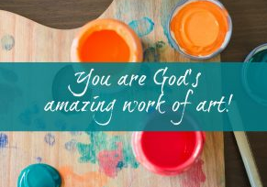
Session 1
Made in God’s Image
St Paul reassures us that we are God’s special work of art. The image of God in us can be dulled and smudged by our sins but God always calls us back and restores us.
At home:
Discuss why your child is so special and unique
What special talents do they have?
Talk about special memories/events you have shared as a family
Scripture Reading - Ephesians 2: 10
Family Prayer Time
Notes:
St Paul – we are God’s special work of art. Dulled and smudged by our sins but God calls us back and restores us.
Special name, parents and godparents. P2 . Ist sacrament
Ministry of Jesus. Healing bible stories. Hands to do good. Show love. Be like Jesus. A hug can mean more than a 1000 words
Teacher – Parables God is so happy to find us.
Recognising our wrong doings, Desire to change.
Saying sorry. Making amends. Examining our conscience. Resolution and positive change.
Talking to an adult about their first reconciliation.
Prayer after the sacrament
Throughout learning the Act of Sorrow and hymns.

Slide 6
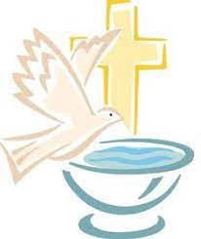
Session 2
Chosen in Baptism
We reflect on the first of the seven Sacraments within our Faith. The Sacrament that the children have already experienced – Baptism.
At home:
Share memories of this special day
Look at photographs/special keepsakes (Baptismal candle etc)
Discuss why they were given their special name
Who were the Godparents?
Scripture Reading – Matthew 3: 13-17 The Baptism of Our Lord
Family Prayer Time
Notes:
St Paul – we are God’s special work of art. Dulled and smudged by our sins but God calls us back and restores us.
Special name, parents and godparents. P2 . Ist sacrament
Ministry of Jesus. Healing bible stories. Hands to do good. Show love. Be like Jesus. A hug can mean more than a 1000 words
Teacher – Parables God is so happy to find us.
Recognising our wrong doings, Desire to change.
Saying sorry. Making amends. Examining our conscience. Resolution and positive change.
Talking to an adult about their first reconciliation.
Prayer after the sacrament
Throughout learning the Act of Sorrow and hymns.

Slide 7
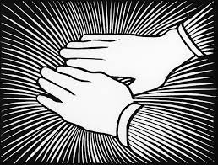
Session 3
Jesus the Healer
We explore the ministry of Jesus and how he healed many people. At the time Jesus lived, people who were ill were often kept apart and isolated. By touching them and healing them, Jesus was telling them that God loved them too. We can show our love for others by being like Jesus and using our hands to do good and show kindness. A hug or gentle touch can mean more than a 1000 words.
At home:
Discuss how our hands can be used to show love and help others
Use hands to bless ourselves with the Sign of the Cross
Scripture Reading
John 9: 1-7 Healing of the man born blind
Matthew 8: 14-15 Healing of Peter’s Mother-in-law
Family Prayer Time
Notes:
St Paul – we are God’s special work of art. Dulled and smudged by our sins but God calls us back and restores us.
Special name, parents and godparents. P2 . Ist sacrament
Ministry of Jesus. Healing bible stories. Hands to do good. Show love. Be like Jesus. A hug can mean more than a 1000 words
Teacher – Parables God is so happy to find us.
Recognising our wrong doings, Desire to change.
Saying sorry. Making amends. Examining our conscience. Resolution and positive change.
Talking to an adult about their first reconciliation.
Prayer after the sacrament
Throughout learning the Act of Sorrow and hymns.

Slide 8
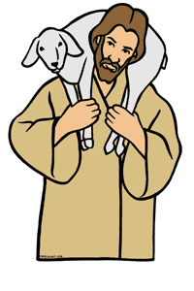
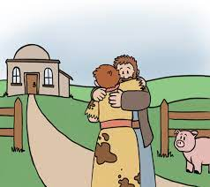
Session 4
What was Lost is Found
Jesus was an excellent teacher and he often used parables as a teaching tool. The parables of The Lost Sheep and The Lost Coin demonstrate how God, like those in the stories, is overjoyed when he finds us after we have wandered off on our own selfish path and we come back to him.
At home:
Read The Lost Sheep with your child
Discuss how they felt and the important messages of forgiveness and reconciliation
When you have lost something/someone, how did it make you feel? How did you feel when they were found?
Scripture Reading
Luke 15: 1-7 The Lost Sheep
Luke 15: 8-10 The Lost Coin
Family Prayer Time (Including Act of Sorrow)
Notes:
St Paul – we are God’s special work of art. Dulled and smudged by our sins but God calls us back and restores us.
Special name, parents and godparents. P2 . Ist sacrament
Ministry of Jesus. Healing bible stories. Hands to do good. Show love. Be like Jesus. A hug can mean more than a 1000 words
Teacher – Parables God is so happy to find us.
Recognising our wrong doings, Desire to change.
Saying sorry. Making amends. Examining our conscience. Resolution and positive change.
Talking to an adult about their first reconciliation.
Prayer after the sacrament
Throughout learning the Act of Sorrow and hymns.

Slide 9
Act of Sorrow
Oh my God, thank you for loving me,
I am sorry for all of my sins, for not loving others and for not loving you, help me to live like Jesus and not sin again.
Amen.
Notes:
St Paul – we are God’s special work of art. Dulled and smudged by our sins but God calls us back and restores us.
Special name, parents and godparents. P2 . Ist sacrament
Ministry of Jesus. Healing bible stories. Hands to do good. Show love. Be like Jesus. A hug can mean more than a 1000 words
Teacher – Parables God is so happy to find us.
Recognising our wrong doings, Desire to change.
Saying sorry. Making amends. Examining our conscience. Resolution and positive change.
Talking to an adult about their first reconciliation.
Prayer after the sacrament
Throughout learning the Act of Sorrow and hymns.

Slide 10
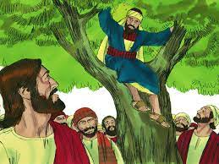
Session 5
Come down Zacchaeus
In this session, we focus on recognising our wrong doings, and having the desire to change and make amends. We reflect on how our choices and behaviour affects those around us and how God is always glad when we want to change for the better.
At home:
Read the story of Zacchaeus
Discuss ways for Zacchaeus to make amends and how he can change his ways
How did Jesus treat him and help him to change?
Scripture Reading:
Luke 19: 1-10 Zacchaeus
Family Prayer Time (Including Act of Sorrow)
Notes:
St Paul – we are God’s special work of art. Dulled and smudged by our sins but God calls us back and restores us.
Special name, parents and godparents. P2 . Ist sacrament
Ministry of Jesus. Healing bible stories. Hands to do good. Show love. Be like Jesus. A hug can mean more than a 1000 words
Teacher – Parables God is so happy to find us.
Recognising our wrong doings, Desire to change.
Saying sorry. Making amends. Examining our conscience. Resolution and positive change.
Talking to an adult about their first reconciliation.
Prayer after the sacrament
Throughout learning the Act of Sorrow and hymns.

Slide 11
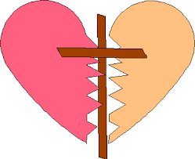
Session 6
Mending Relationships
We explore what it means to turn away from God (sin) and how we can mend our relationship with God and also with other people who we have hurt. We must examine our conscience, say sorry, make amends and then try to make better choices.
At home:
Read and discuss the story of The Loving Father and the Two Sons
Discuss times when you (child and adult) have done something wrong, how this made everyone feel and how you resolved the situation. (Remind your child that, no matter what, God and you will always love and forgive them)
Scripture Reading:
Luke 15: 11-32 The Loving Father and the Two Sons
Family Prayer Time (Including Act of Sorrow)
Notes:
St Paul – we are God’s special work of art. Dulled and smudged by our sins but God calls us back and restores us.
Special name, parents and godparents. P2 . Ist sacrament
Ministry of Jesus. Healing bible stories. Hands to do good. Show love. Be like Jesus. A hug can mean more than a 1000 words
Teacher – Parables God is so happy to find us.
Recognising our wrong doings, Desire to change.
Saying sorry. Making amends. Examining our conscience. Resolution and positive change.
Talking to an adult about their first reconciliation.
Prayer after the sacrament
Throughout learning the Act of Sorrow and hymns.

Slide 12
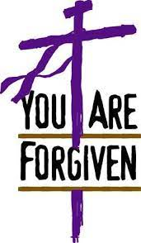
Session 7
The Rite of Reconciliation
Forgiveness and Penance brings us closer together as part of God’s loving family. This sacrament is about God’s love and mercy and not solely about sin. When we are truly sorry, God will always forgive. This demonstrates His eternal love for us.
At home:
Your child will interview someone special to them about when they received the Sacrament of Reconciliation for the first time
Continue to practise The Act of Sorrow
Discuss the celebration of the Sacrament and what they will say to the priest on the evening:
“Bless me Father for I have sinned. This is my First Reconciliation. I did not show love when…”
Your child will then be asked to recite The Act of Sorrow and will receive a blessing.
Family Prayer Time after having received the Sacrament
Prayer after Forgiveness
Notes:
St Paul – we are God’s special work of art. Dulled and smudged by our sins but God calls us back and restores us.
Special name, parents and godparents. P2 . Ist sacrament
Ministry of Jesus. Healing bible stories. Hands to do good. Show love. Be like Jesus. A hug can mean more than a 1000 words
Teacher – Parables God is so happy to find us.
Recognising our wrong doings, Desire to change.
Saying sorry. Making amends. Examining our conscience. Resolution and positive change.
Talking to an adult about their first reconciliation.
Prayer after the sacrament
Throughout learning the Act of Sorrow and hymns.

