Slide 1
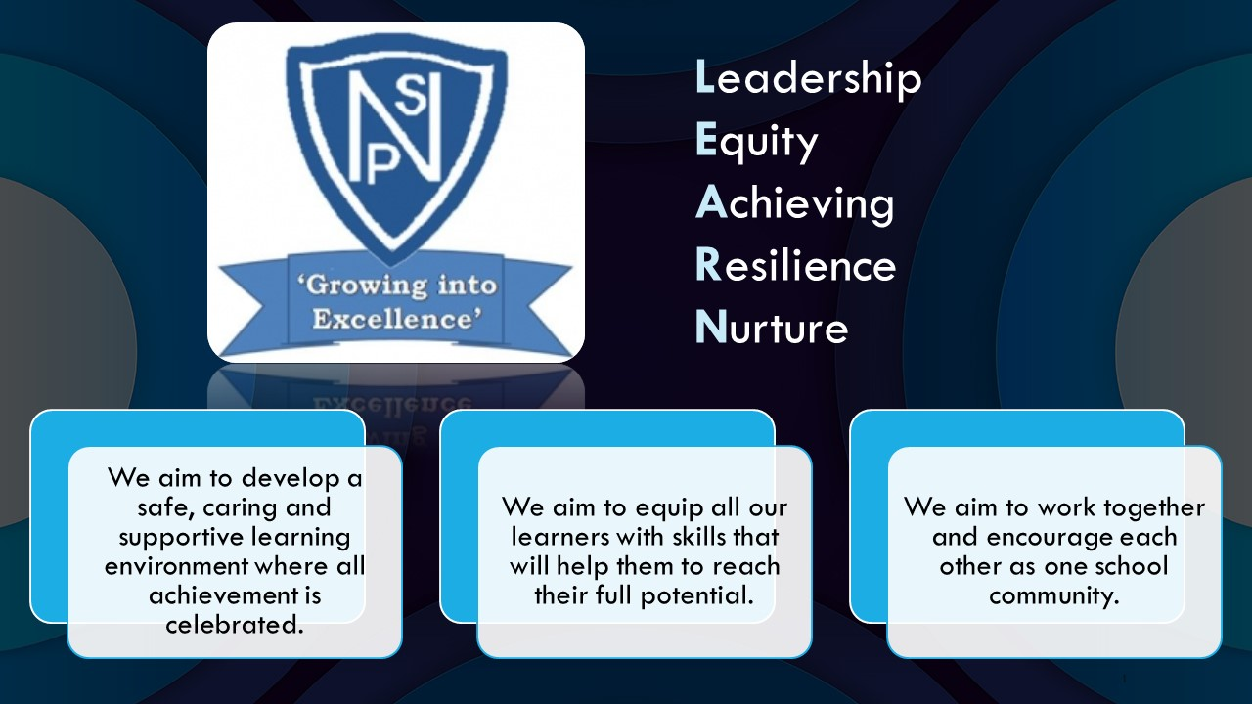




Termly Newsletter Primary 2 Room 2 – Mrs Murray/Mrs Smith
Literacy
Phonics
This term for Literacy we will continue with the Active Literacy phonics programme. We will begin by consolidating the previous phonemes and common words.
Each week the children will be introduced to a new phoneme and 4 common words. Every 2/3 weeks there will be a consolidation week. The children will complete active spelling tasks. They will develop their skills in using the words in sentences and revising the words by writing them in different ways.
Reading
The children will continue to have a weekly home reader as well as one or two differentiated group books per week. The children will work on this text for 2 days to aid their comprehension and read to write skills. The children will be learning strategies to work out tricky words and to help them develop a deeper understanding of what they are reading.
Writing
We will begin with a focus on our describing bubbles as revision for 4 weeks. We will then focus on developing our personal writing skills. The children will be learning and revising how to use a capital letter and full stops, connectives to join sentences and will be adding some descriptive words to extend their writing.
Numeracy
This term we will be learning:
Squares
Addition and subtraction to 20
Ordering and recognising numbers to 100
Counting in 2s, 5s and 10s
Number patterns
Odd and even numbers
Circles
Numbers to 10 – before and after
Missing numbers to 20
Using materials to make and find numbers to 20
Mrs Smith will also cover for both groups-
Language of measurement for length and area
Recognising 2D shapes
We will also be further developing our mental maths skills through completing daily challenges and a variety of mental maths games.
Health And Wellbeing We will be looking at our emotions and using our worry monster to help us to discuss our feelings. We will work on strategies to help us manage our emotions. We will also be exploring friendships and successful group work. The children will also be exploring SHANARRI and looking at their rights linked to our class charter.
PE We will be developing our balance and movement skills with some team games to develop our turn taking.
PE days are Wednesday and Friday.
Technologies
We will be developing our skills in logging on to the system. We will be working on locating all the letters of the alphabet on the keyboard.
Social Science
We will be exploring Sustainability and how our actions can impact the world we live in.
Important Information
Please continue to sign your child’s Ready Steady Learn over the weekend and return on a Monday. Please continue to contact me via the school office, email or Ready Steady Learn book if you have any concerns or worries.
Thank you for your continued support.
Please note homework is to be handed in on a Thursday. It may also be handed in throughout the week as and when it is completed.
Thank you for your continued support.
Mrs Murray and Mrs Smith

