Slide 1
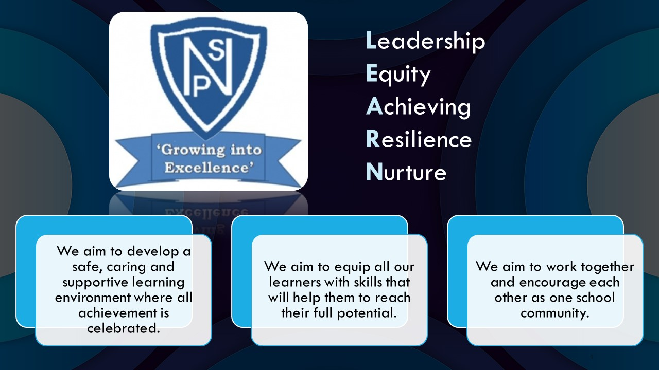




Termly Newsletter Primary 6 Room 7 – Mr Kennedy
Literacy
Reading – We will be reading the novel ‘There’s a Boy in the Girls’ Bathroom’ by Louis Sachar as a whole class. Activities will be differentiated for each group to meet the needs of all children. Children will be asked to read silently, in pairs and aloud. We will use North Lanarkshire’s Active Literacy approach which focusses on 6 main strategies:
Prior Knowledge – making connections between what has been read and our everyday lives.
Metalinguistics – learning definitions and how to use new and unknown words from the text.
Visualisations – displaying an understanding of what has been read through mind-maps, timelines and story plans.
Inference – reading ‘between the lines’ and finding evidence.
Main themes – discussing the main themes which arise in a text.
Summarising – summarising what has been read in our own words.
Writing - A taught writing lesson will be given weekly and will include a variety of genres. We will be focusing on quality writing, looking at short burst writing and description bubbles. We will use our Victorians topic as a stimulus. The children will continue to develop their use of VCOP skills within written work. This year we will be focusing on our new Writing Programme of work linked to Talk 4 Writing.
Spelling - Spelling words will be given out on Monday and practiced daily using a variety of active approaches. The children will be developing their grammar and handwriting on a weekly basis.
Numeracy
This term, we will:
Comparing and ordering numbers to 1 decimal place.
Rounding numbers to nearest 10, 100 and 1000.
Add and subtract 10, 100 and 1000 to numbers with 3 and 4 digits.
Explore properties and identify different 2D and 3D shapes.
Multiply by 10, 100 and 1000.
Explore a variety of mental and written multiplication strategies.
Divide numbers, including remainders to 2 decimal places.
Explore sequences, square and prime numbers and negative numbers.
Health and Wellbeing
Our focus for term 1 will be on exploring topics and activities relating to our Mental, Emotional, Social and Physical Wellbeing. We will be developing our skills in identifying our strengths and discussing strategies to help manage and deal with friendships/conflict. We will also look at how to respond in emergency situations and how to safely travel.
PE – Ball skills
RME- Miss Byworth
Social studies- The Victorians
Expressive arts- Drama and art tasks will be linked to Social Studies
Technology – digital literacy
ICT – We will be exploring computer processes and word processing. We will also incorporate our ICT skills when researching our class topic.
Important Information
PE days will be Tuesday and Wednesday.
Homework will be issued on a Monday and collected on a Friday.
Please discuss your child’s learning targets in their RSL and sign and return on a Monday.
Please continue to contact me via the school office, email or Ready Steady Learn book if you have any concerns or worries.
Mr Kennedy

