Slide 1
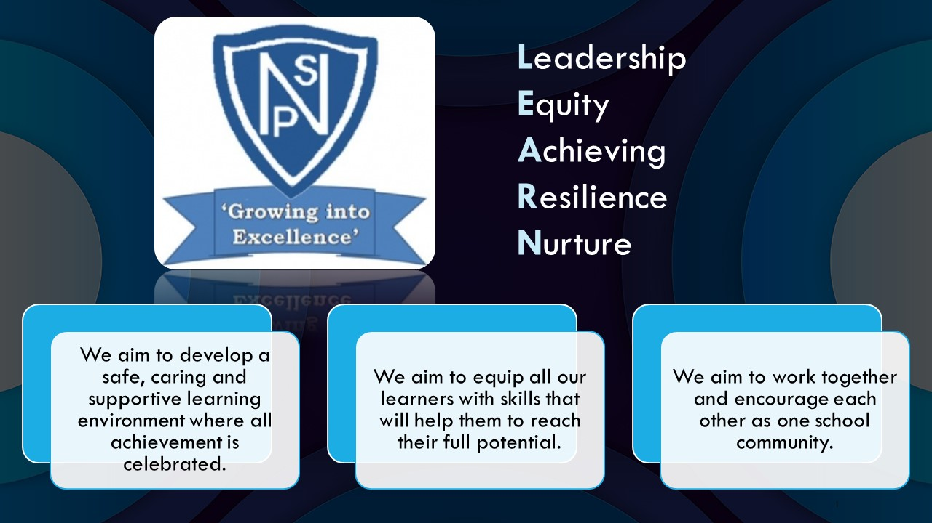




Termly Newsletter Primary 5 Room 9 – Mrs Jones
Literacy
Reading
We will be reading the novel ‘Voices in the Park' as a whole class looking at friendship, inclusion and staying safe. The pupils will continue reading and completing tasks at their individual level to build their knowledge and understanding of different texts.
This term we will focus on books with a moral story at their core as we focus on metalinguistics and comprehension skills. Room 9 will continue to build on their ability to
question what we have read to ensure we have understood while explaining our thoughts and ideas in full sentences.
Writing
A taught writing lesson will mainly focus on imaginative and persuasive genres. We will use the journey story of ‘Coral Ocean'’ for our writing this term, looking at characters and instructions. Children will continue to develop their use of VCOP skills within written work and develop their use of vocabulary to add further depth and detail to their writing.
Spelling
Spelling words will be given out on Monday and practiced using a variety of active approaches. The children will be developing their grammar and handwriting on a weekly basis.
Numeracy
We will revise our times tables and mental recall using our flashcards.
Circles
Place value up to 5 digits, estimating and rounding within 10000
Add and subtract 10, 100 and 1000 to whole numbers up to 1000
Properties of 2D and 3D shapes and shapes in real-life contexts
Mental strategies for multiplication and division
Multiplying numbers to 1000 by 2, 10 and 100
Squares
Order, compare and partition numbers within 10000
Add and subtract numbers to 1000 including doubles and near doubles
Identify 2D & 3D shapes and their properties including right angles
Number patterns-counting forwards and back in 2s, 5s and 10s within 1000
Length – making estimations and using appropriate devices/notation to make accurate length measurement.
Number patterns-counting forwards and back in 2s, 5s and 10s within 1000
Health and Wellbeing - During Term 1 will be exploring topics and activities relating to our Mental, Emotional, Social and Physical Wellbeing by investigating outdoor spaces through our sustainability topic ‘John Muir’. We will be developing our mindfulness skills and discussing strategies to help manage and deal with stress and anxiety. We will also be focusing on acknowledging and celebrating our achievements, linking to the UNCRC.
PE – P.E days will be on Mondays and Thursdays. Please remind your child to bring their PE kit - they should wear shorts underneath their uniform if possible. On Mondays, PE will be taught by Mr Rae with a focus on ball skills. On Thursdays, with Miss Byworth, we will be developing our movement skills by investigating different ways in which to use equipment. We will also be participating in games linking to our focus on fairness (turn-taking), kindness (supporting others) and responsibility (team player/leadership).
Social Studies – We will be exploring John Muir as we work towards earning our John Muir Award. Children should dress for outdoors on Wednesdays when we will be working in the outdoor garden, come rain or shine.
Science – We will be exploring different forms of flora and fauna while looking at energy conservation and waste.
RME – We will be exploring a range of Bible stories.
DRAMA – We will be developing our skills in role play by acting out scenarios linked to topic and HWB.
ICT – We will be exploring internet safety, computer networks and keeping information secure.
Important Information
PE days are Monday and Thursday.
Please continue to sign your child’s Ready Steady Learn over the weekend and return on a Monday.
Our Learning Showcase will be on Wednesday 30th April at 9.30am. We look forward to welcoming our parents and carers as we share what we have been learning throughout the year.
Thank you for your continued support.
Mrs Jones

