Slide 1
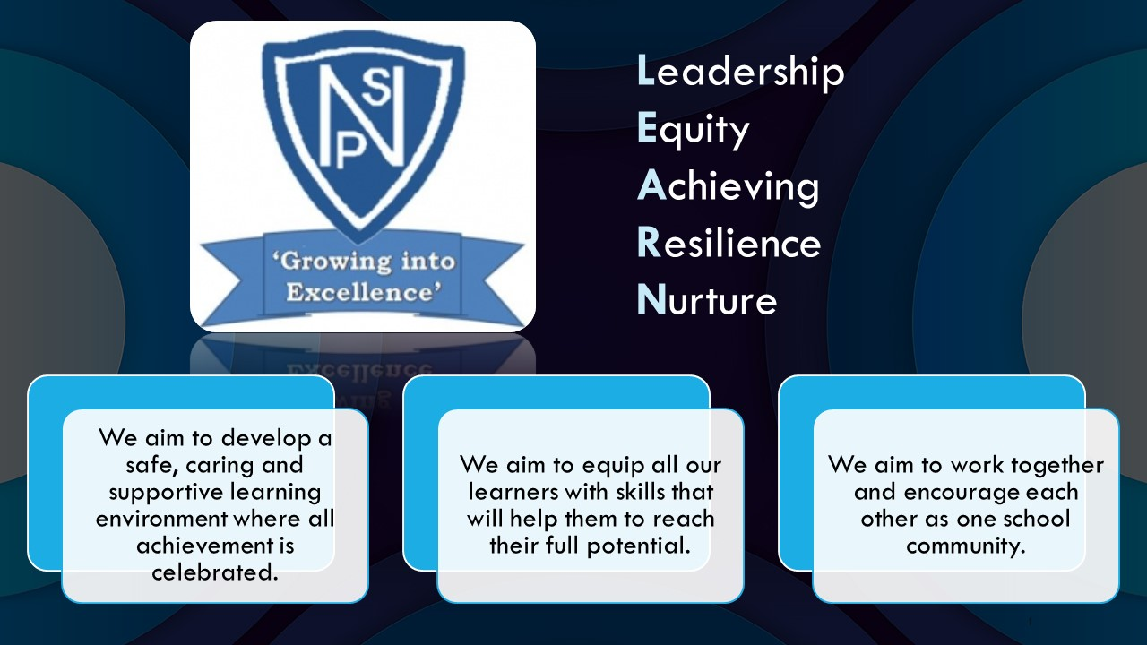




Termly Newsletter Primary 7 Room 8 – Mr Rae
Literacy
Reading
We will be reading the novel ‘Wonder’ by R.J. Palacio as a whole class. Activities will be differentiated in order to meet the needs of all children. Children will be provided with the opportunity to read silently, in pairs and out loud to the whole class. We will use North Lanarkshire’s Active Literacy approach with a focus on summarising and comprehension this term.
Writing
This term we will be focusing on quality writing, looking at short burst writing and describing bubbles. We will use the novel Wonder and our Health and Wellbeing topic as a stimulus. The children will continue to develop their use of VCOP skills within their written work.
Spelling, Grammar and Handwriting
Spelling words will be given out on Monday and practiced daily using a variety of active approaches. There will be weekly grammar lessons linked to what we are learning about in Writing. The children will be practising their handwriting on a weekly basis.
Numeracy
Whole class
Exploring 2D and 3D shapes.
Investigating number sequences and patterns.
Revising multiples & factors and square & prime numbers.
Rounding whole numbers and decimals.
Cuboids
Reading, writing and ordering numbers with up to 8 digits and 3 decimal places.
Cylinders
Reading, writing and ordering numbers with up to 7 digits and 2 decimal places.
Other Curricular Areas
Health & Wellbeing
Our focus this term will be exploring our Mental, Emotional, Social and Physical Wellbeing. We will be developing our skills in identifying our strengths and discussing strategies to help manage and deal with friendships and conflict. We will also be focusing on acknowledging and celebrating our achievements.
We will be participating in a number of lessons on kindness and the way we treat others linked to our class novel, Wonder.
PE
We will take part in Sports Leadership training with Chris from Active Schools and have the opportunity to help run lunchtime clubs for some of the younger children.
We will also be developing our skills in ball games such as dodgeball, rounders and football.
Drama
We will be developing our skills in mime and creating and acting out scenarios in small groups.
Social Studies
Our topic this term is Japan. We will be investigating the language, food, culture and customs of Japanese people.
Important Information
Ready Steady Learn books will be sent home on Friday and should be signed and returned on Monday.
Homework will continue to be issued on Mondays and should be returned to school on Friday.
Please continue to contact me via the school office, email or Ready Steady Learn book if you have any concerns or worries.
Thank you for your continued support.
Mr S. Rae

