Slide 1
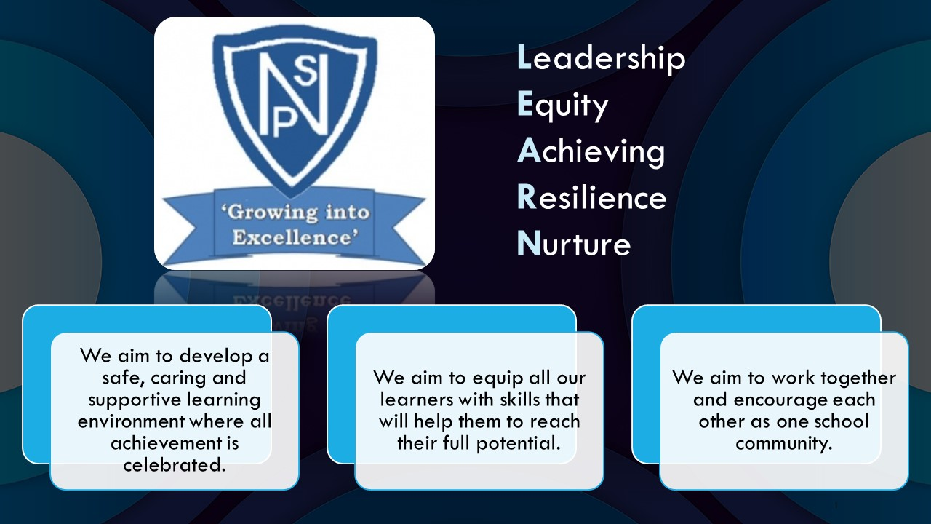




Termly Newsletter Primary 5/6 Room 6 – Mrs Forsyth
Literacy
Reading – We will be reading the novel ‘The BFG’ by Roald Dahl as a whole class. Activities will be differentiated for each group in order to meet the needs of all children. Children will be provided with the opportunity to read silently, in pairs and part of the whole class. We will use North Lanarkshire’s Active Literacy approach to further develop our understanding of different reading skills such as summarising, predicting and visualising.
Writing and Spelling
A taught writing lesson will be given weekly and will include a variety of genres. We will be focusing on quality writing, looking at short burst writing and description bubbles. We will use the novel Wonder and Health and Wellbeing topics as a stimulus. The children will continue to develop their use of VCOP skills within written work. This year we will be focusing on our new Writing Programme of work linked to Talk 4 Writing
Spelling words will be given out on Monday and practiced daily using a variety of active approaches. The children will be developing their grammar and handwriting on a weekly basis.
Numeracy
This term, we will:
Whole Class
revise our times tables and mental arithmetic
continue to develop knowledge of the four functions- addition, subtraction, multiplication and division
Pyramids
place value and sequencing
adding and subtracting 10,100,1000 to whole numbers with 3 and 4 digits to 2d.p
properties of a triangle
multiplying and dividing by 10,100,1000
mental strategies for multiplying and dividing
number patterns including square numbers and prime numbers
Cubes
Round 3 and 4 digit numbers to nearest 10, 100 and 1000
Identify and explore place value to 5 digits
Add and subtract 10, 100 and 100 to whole numbers and decimals to 1 decimal place
Multiply and divide 2 and 3 digits by 10, 100 and 1000
Identify negative numbers in real life
Explore multiples and factors
Cylinders
read, write and sequence numbers within 1000
recognise all 2D and 3D shapes
count forward and back in 2s, 5s, and 10s to 1000
add and subtract multiples of 10 to and from a 2 digit number
measure the length of something using cm and half cm
Health and Wellbeing
Our focus for term 1 will be on exploring topics and activities relating to our Mental, Emotional, Social and Physical Wellbeing. We will be developing our skills in identifying our strengths and discussing strategies to help manage and deal with friendships and conflict. We will also be focusing on nurture and its impact in our lives.
PE – Ball skills
RME- Miss Byworth
Social studies- Ancient Egypt
Expressive arts-linked to Social Studies
Technology – digital literacy
Drama – We will be developing our skills in role play by acting out scenarios linked to topic and HWB.
ICT – We will be exploring computer processes and word processing
Important Information
PE days will be Tuesday and Thursday for the first 4 weeks of term then it will change to a Wednesday and Thursday .
Homework will be issued on a Monday and collected on a Friday.
Please discuss your child’s learning targets in their RSL and sign and return on a Monday.
Please continue to contact me via the school office, email or Ready Steady Learn book if you have any concerns or worries.
Mrs Forsyth

