Slide 1
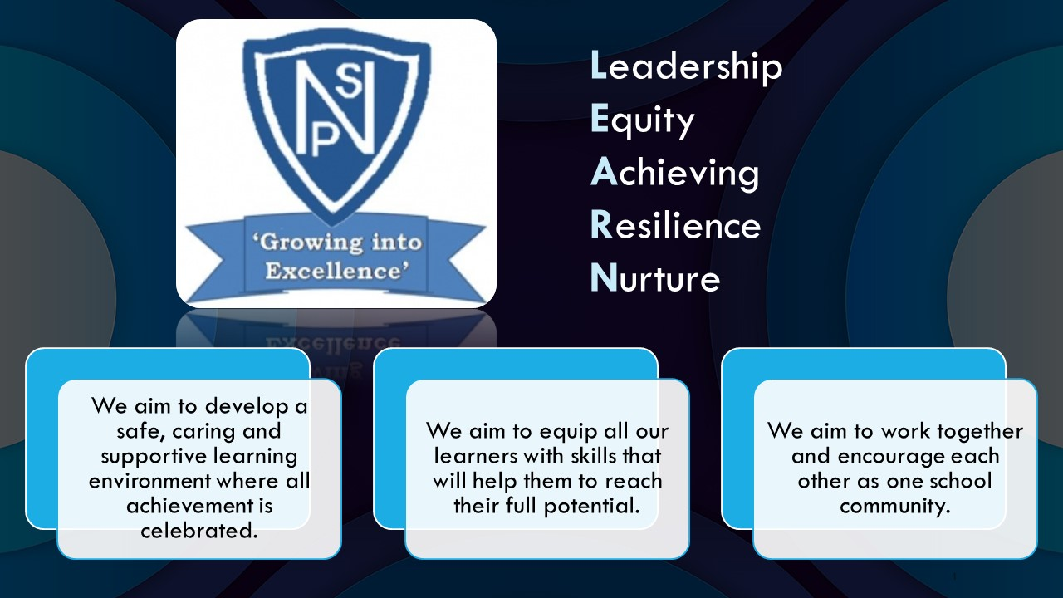




Termly Newsletter Primary 4 Room 5 – Mrs Paton
Literacy
Reading – This term we will be continuing to develop our ability to read fluently and add expression when reading aloud. We will be using the North Lanarkshire Active Literacy programme to further develop our understanding of different reading skills such as summarising, predicting and visualising. We will be using a range of books e.g. group novels, independent home readers and our class novel to work on these skills and to help us improve our comprehension skills.
Writing and Spelling
A taught writing lesson will be given weekly and will include a variety of genres. We will be focusing on quality writing, looking at short burst writing and description bubbles. We will use the novel Tilly and the Badgers as a stimulus. The children will continue to develop their use of VCOP skills within written work. This year we will be focusing on our new Writing Programme of work linked to Talk 4 Writing
Spelling words will be given out on Monday and practiced daily using a variety of active approaches. The children will be developing their grammar and handwriting on a weekly basis.
Numeracy
This term, we will:
Continue to develop knowledge of the four functions- addition, subtraction, multiplication and division
Using our knowledge of place value to count, read, write, order and partition numbers with 4 and 5 digits.
Recalling number bonds quickly and accurately and using multiples of 10 and 100 to create new facts.
Rounding numbers to the nearest 10 and 100.
Continuing to learn our times tables and use them to solve multiplication and division problems.
Exploring 2D shapes and learning about their different features and how to describe them.
Measuring and estimating different lengths
Calculating areas of different shapes
We will also be further developing our mental maths skills through completing daily challenges and a variety of mental maths games.
Health and Wellbeing
In our Health and Wellbeing sessions we will be learning about our rights and responsibilities. We will be exploring the rights that we are all entitled to and the responsibilities that go with them.
In our PE sessions we will be learning how to work as part of a team through playing a range of team games. We will develop a range of different ball skills such as throwing, catching, dribbling, passing and shooting.
In our weekly fitness block, we will be working on our fitness and stamina by playing games and taking part in circuits and the bleep test.
PE – Ball skills
RME- Miss Byworth
Social studies- Extreme Earth
Expressive arts-linked to Social Studies
Technology – digital literacy
Drama – We will be developing our skills in role play by acting out scenarios linked to topic and HWB.
ICT – We will be exploring computer processes and word processing
Important Information
PE days will be Monday and Tuesday.
Homework will be issued on a Monday and collected on a Friday.
Please discuss your child’s learning targets in their RSL and sign and return on a Monday.
Please continue to contact me via the school office, email or Ready Steady Learn book if you have any concerns or worries.
Mrs Paton

