Slide 1
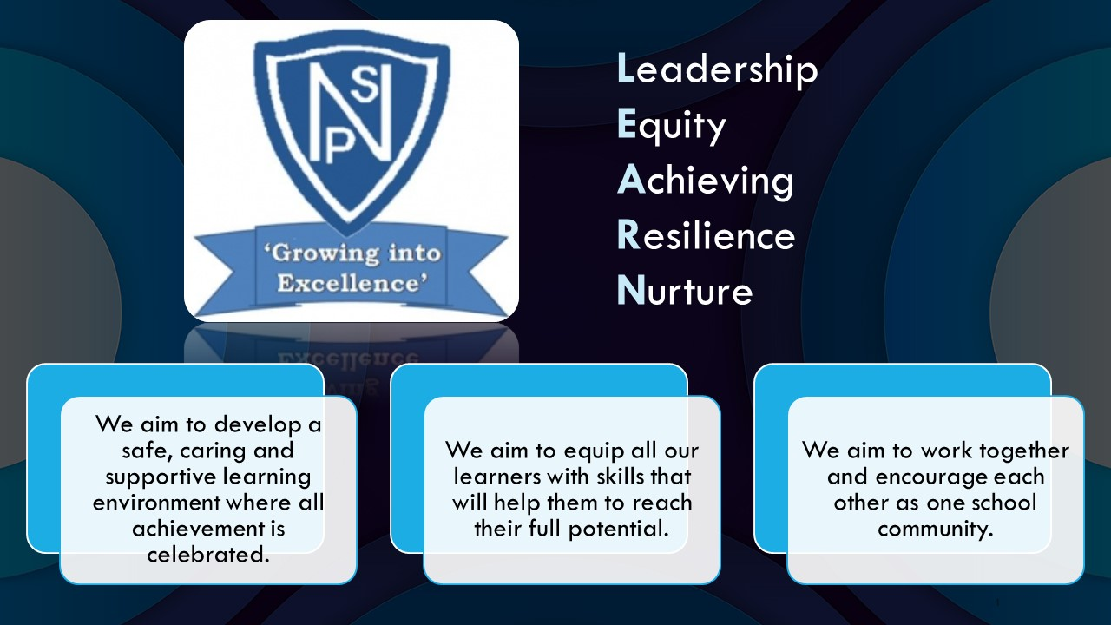




Termly Newsletter Primary 3 Room 4 – Miss Paterson & Mrs Smith
Literacy
Reading
We will be reading the novel ‘The Owl who was Afraid of the Dark’ by Jill Tomlinson. We will use Active Literacy to further develop our understanding of different reading skills such as summarising, predicting and questioning. Children will be provided with the opportunity to read silently, in pairs and part of the whole class. Children will also be reading their banded book alongside this.
Writing and Spelling
Mrs Smith will deliver a taught writing lesson weekly. We will make use of short burst writing and description bubbles. We will use ‘The Owl who was Afraid of the Dark’ as a stimulus for writing. The children will continue to develop their use of VCOP skills within written work.
Spelling words including phoneme and common words will be given out on Monday and practised daily using a variety of active approaches. The children will be developing their grammar and handwriting on a weekly basis.
Numeracy
This term, we will:
Recap our core numeracy skills including number formation, counting, adding and subtraction. We will use lots of oral activities and active maths games to build fluency.
We will also develop our number skills looking at:
addition of single and two digit doubles and near doubles,
addition of multiples of 10 to two digit numbers,
subtraction of single digit numbers from two digit numbers and subtracting multiples of 10,
number processes- counting to and from 1000, ordering values and three digit numbers,
length- selecting appropriate method of measurement, estimating and measuring in metres and centimetres,
area- counting squares to measure area and drawing shapes of a certain area.
In beyond number we will explore:
patterns- sequences, counting forwards and back,
2D shapes- recognising properties of shapes, introducing pentagons, hexagons and octagons, creating patterns and tiling,
expressions and equations- missing numbers, function machines, more than, less than and problem solving.
Health and Wellbeing
Our focus for term 1 will be on exploring topics and activities relating to our Mental, Emotional, Social and Physical Wellbeing. We will be developing our skills identifying positives in challenging times, recognising our emotions and building positive relationships with others.
PE – Fitness and ball skills
RME/Rights - Mrs Smith
Social studies - Sustainability
Expressive arts - linked to Social Studies with Mrs Smith
Technology/ICT – digital literacy exploring word processing.
Important Information
PE days will be Monday and Thursday. Literacy and numeracy homework will be issued on a Monday and collected on a Friday. Children should also be reading their banded book and practising their numeracy flashcards at home.
Please discuss your child’s learning targets in their RSL and sign and return on a Monday.
Please continue to contact me via the school office, email or Ready Steady Learn book if you have any concerns or worries.
Miss Paterson

