Slide 1
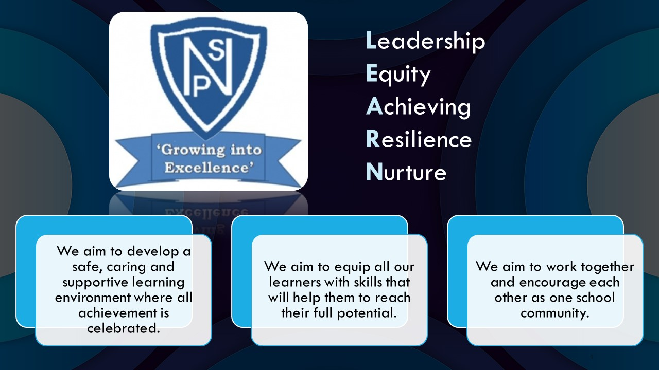




Termly Newsletter Primary 2/3 Room 3 – Mrs Johnston
Literacy
This term for Literacy we will continue with the Active Literacy phonics programme. We will begin by consolidating the previous phonemes and common words for stage 1 (P2) and stage 2 (P3).
Each week the children will be introduced to a new phoneme and 4 common words. Every few weeks there will be a consolidation week. The children will complete daily active spelling tasks. They will develop their skills in using the words in sentences and revising the words by writing them in different ways.
Reading - the children will continue to have their weekly home readers as well as one or two differentiated group reading books per week. The children will work on this text for 2 days to aid their comprehension and read to write skills. The children will be learning strategies to work out tricky words and to help them develop a deeper understanding of what they are reading. P2 children will be continuing to build up their sight vocabulary and P3 children will be continuing to develop their fluency when reading aloud.
Writing – We will begin by participating in Short Burst Writing sessions developing our skills in forming simple sentences at our own level. We will then begin our first Talk for Writing unit developing our skills in developing characters and setting.
Numeracy
We will be developing our counting and core Numeracy skills through a variety of mental maths games and challenges. We will also participate in daily CLIC sessions to help with mental recall.
P2-
Numbers to 100 - recognising, writing and ordering.
Addition and subtraction facts to 10 and 20.
Recognise and name 2D shapes.
Recognise and continue patterns.
Exploring length and area.
P3 –
Exploring numbers beyond 100 – counting in 2s, 5s and 10s.
Addition and subtraction facts with 2-digit numbers.
Recognising and describing the properties of a range of 2D shapes.
Calculating 10 more and 10 less with 3-digit numbers.
Other Curricular Areas
Health And Wellbeing – We will begin by exploring SHANARRI and looking at rights linked to our class charter. P2 will be exploring different feelings and emotions and P3 will be learning how to recognise and manage their feelings and emotions.
PE – We will be participating in a range of ball skills activities to help develop our dribbling, passing, throwing and catching skills. With Miss Byworth we will be participating in a gymnastics unit developing our balance and co-ordination skills.
Social Studies – We will begin by exploring Sustainability through a topic about climate and weather. We will then explore different inventions from over the years and place them on a simple timeline.
ICT – P2 will be developing their skills in logging on to the system. P3 will be developing their typing and spelling skills using different games to support their learning.
ART – We will be developing our line drawing skills linked to our topic and shape work. We will explore different lines and begin to look at shading.
Homework – 1 or 2 reading books per week, maths flashcards, a numeracy task, common words activity and phoneme task in the homework booklet. This will be handed out on a Monday and should be returned on the Friday completed with a signature. Please ensure the homework pack is in your child’s bag every day to allow us to hear reading and flashcards.
Important Information
Please make sure you have your child’s name on their clothing. This is a great help.
PE days – will be Tuesday afternoon and Wednesday morning.
Bringing things to school – please remember to not send any toys or items to school. We don’t want them to get lost or damaged.
Please continue to sign your child’s Ready Steady Learn Book. This is sent home on a Friday and should be returned on a Monday with a signature.
Thank you for your continued support.
Mrs Johnston

