Slide 1
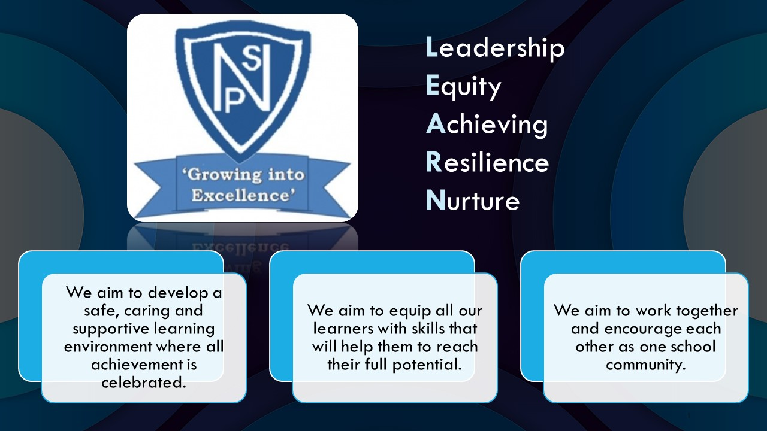




Termly Newsletter Primary 1 Room 1 – Mrs McCafferty
Literacy
Phonics –The learners will begin P1 by participating in the SLC FLIPP training Programme. This focuses on Phonological Awareness - building their knowledge of words and sounds through rhyme, listening, repetition, patterns in words, alliteration, syllables and taking part in word awareness games.
Reading – The children will soon be bringing home a reading book. To begin their books will have no words. The purpose of these is to build upon early book concepts and reading aloud skills. The learners have the opportunity to select a book of their choice each week from our independent reading library, look out for this in our homework pack along with a reading marker to ask questions about what they have read.
Writing – We will firstly be taking part in lots of pre-writing activities such as ‘Disco Dough’ to help get us ready to write. Try to ensure your child has the correct pencil grip before completing written homework tasks. We will be using the programme Foundation of Writing to develop our storytelling skills through our drawings and begin to attempt to trace over and under some letters.
Numeracy
Exploring Number
The learners will be exploring patterns. They will then begin learning about numbers to 10. With a focus on counting ,correctly forming numbers to 10, recognise, ordering and counting forwards and backwards from 10.
The learners will explore different tools used in Numeracy such as dot patterns and array frames.
Beyond Number
The learners will investigate 2D shapes and 3D objects. Leaners will be able to sort and describe them.
Other Curricular Areas
Physical Education – A polo shirt should be worn for gym days with leggings or joggers. Please provide indoor gym shoes. Getting ready can be challenging for young children please where possible promote independence, this will give your child a sense of achievement and it makes getting ready a lot easier in class. Please ensure every item of clothing has your child’s name on it.
In Physical Education, P1 will be trying out new team games and developing the skills associated with them including; turn taking , how to be a good team player , sharing , helping one another etc. They will also be learning to use equipment safely and having some fun exploring the different resources we have available. The children will develop throwing and catching skills, gross motor skills, coordination and spatial awareness during these lessons.
During our Health and Wellbeing lessons this term the learners will be exploring their mental, social and emotional wellbeing, through the theme ‘All about Me’. P1 will be learning to name their emotions, explore how they are feeling and learn how to regulate their emotions though various strategies. They will also be looking at friendship through different stories and discussing how to be a good friend.
.
Important Information
PE days are Monday and Tuesday.
Please continue to sign your child’s Ready Steady Learn over the weekend and return on a Monday.
Please ensure all items has your childs name on it.
Thank you for your continued support.
Mrs McCafferty

