Slide 1
Murray Primary School Changes to OUR school to make it a safe environment for our pupils & Staff

Slide 2
We have been working hard to make sure our school is safe for our pupils & STAFF to return. There are a few changes to how our school looks, let’s have a look at them.

Slide 3
We have a one way system for walking around the school.

Slide 4
The one way system is well signposted with posters on the wall and tape on the floor.

Slide 5
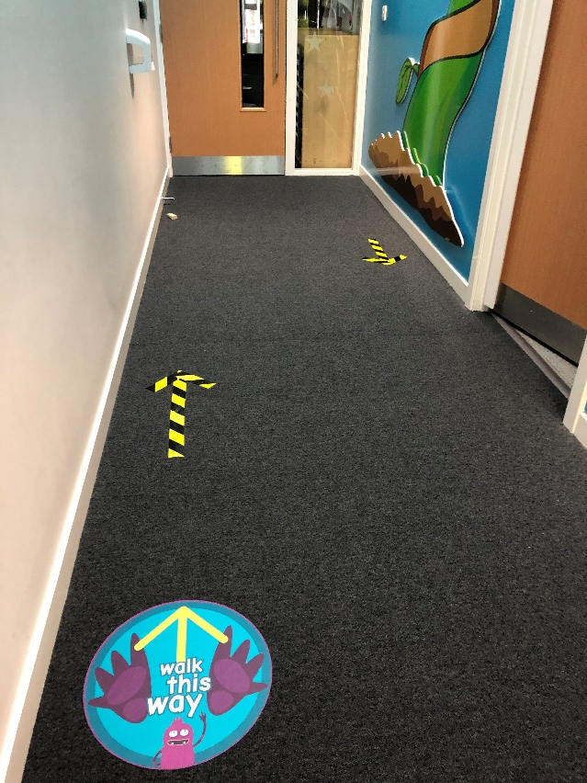
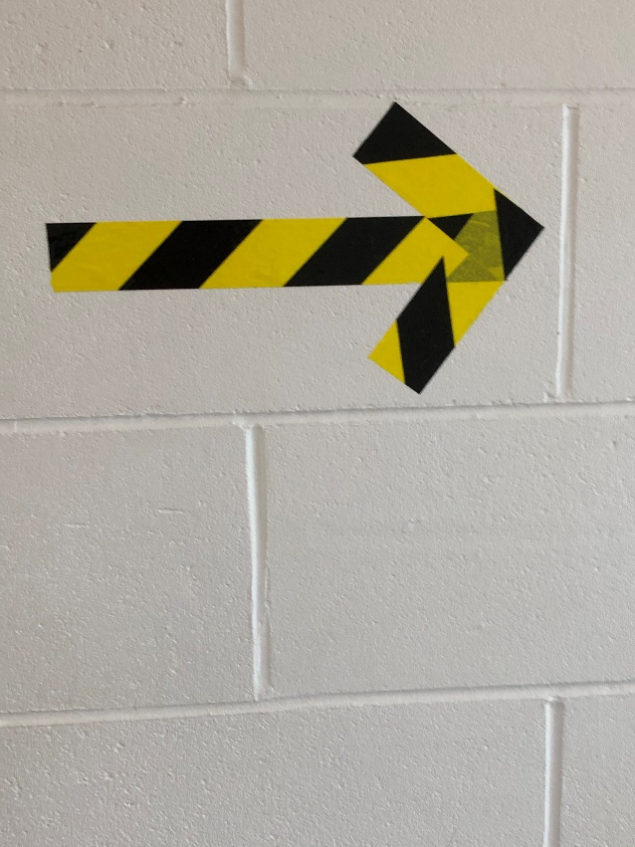
One-way system

Slide 6
We will be socially distancing in the corridors

Slide 7
We have lots of hand sanitiser stations throughout the school, for pupils to use.

Slide 8
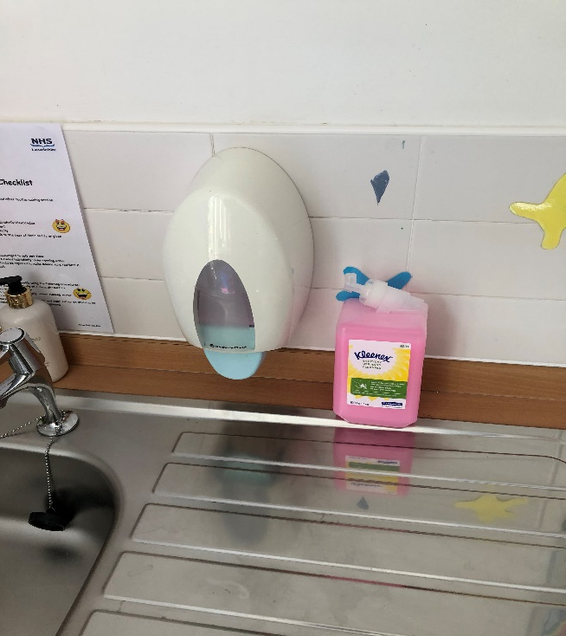
We have tissues and hand washing facilities in every class

Slide 9
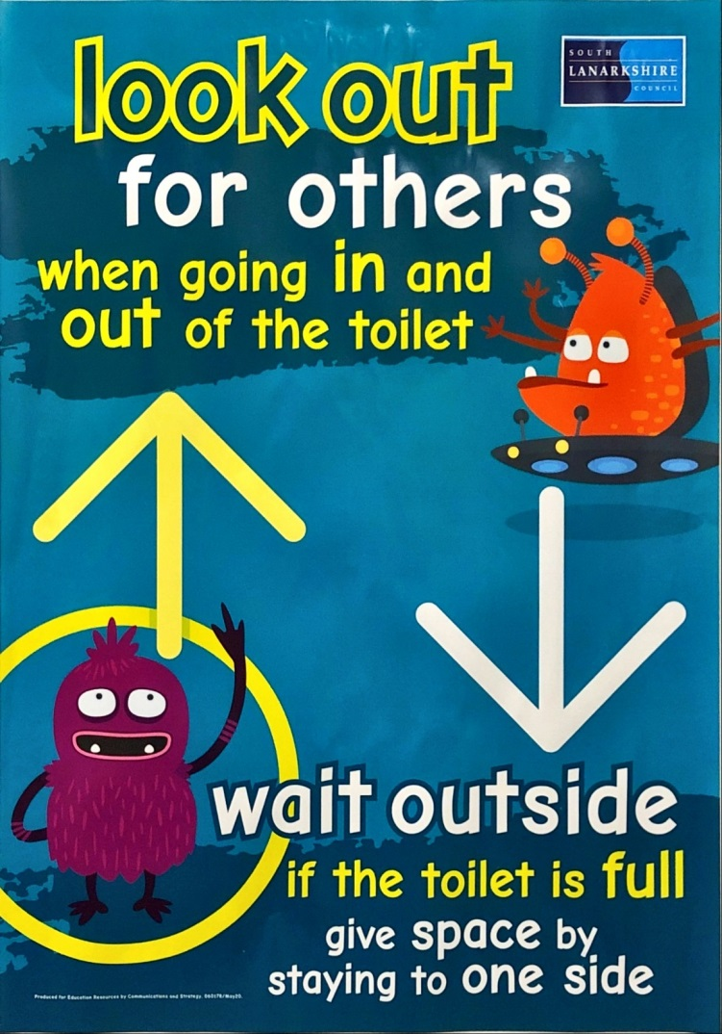

Slide 10
We have reminder posters all around the school and nursery

Slide 11
Our teachers will be speaking to the pupils about all of the changes when they return and we will be here to help them if they are unsure about anything.

Slide 12
We can’t wait to see all of our pupils again!

