Slide 1
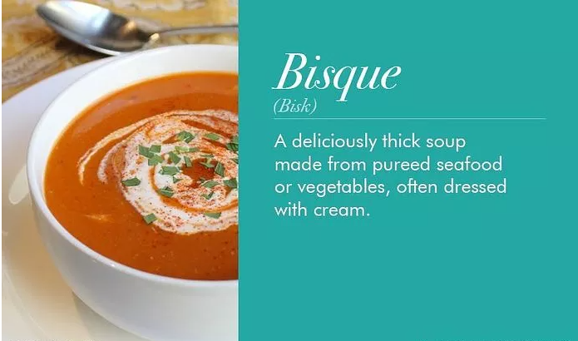
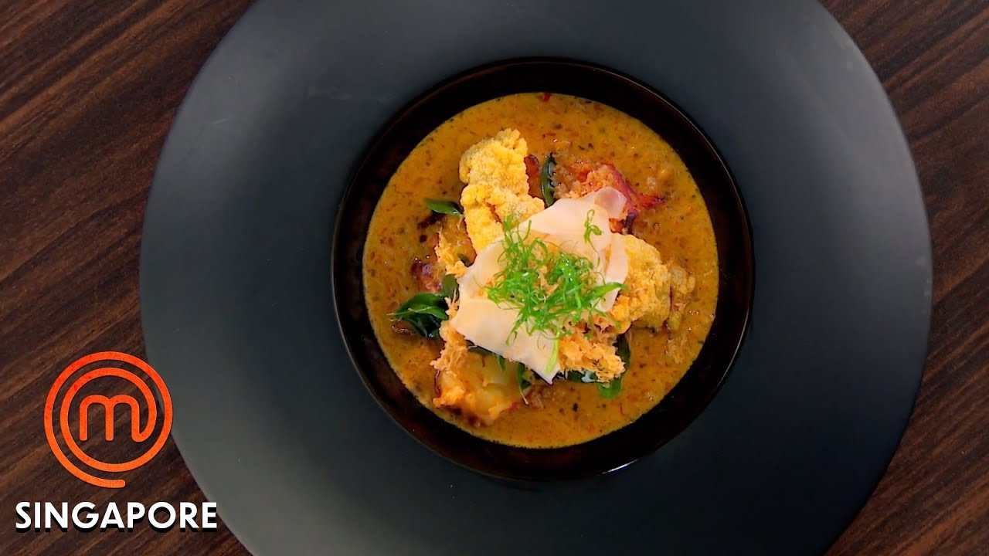
Lobster Bisque

Slide 2
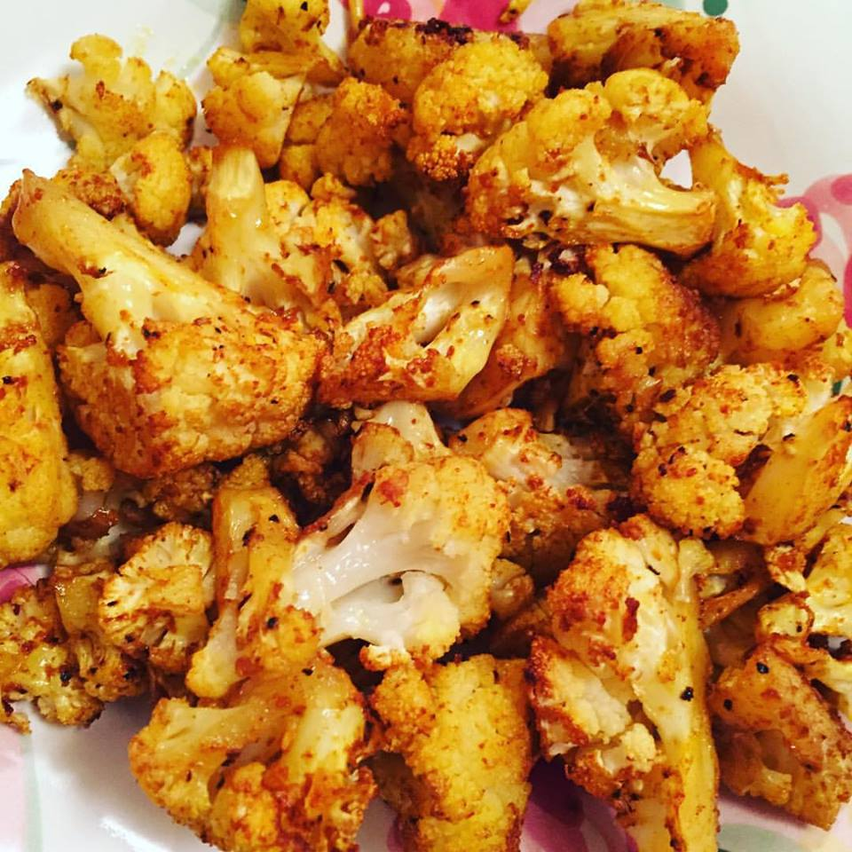
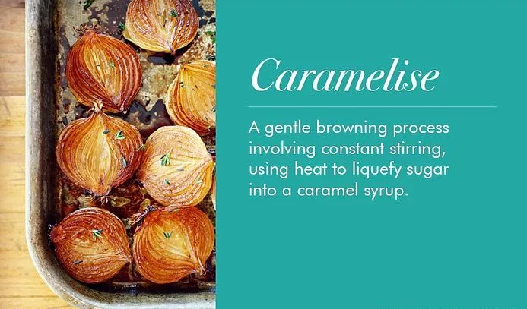
Caramelisation

Slide 3
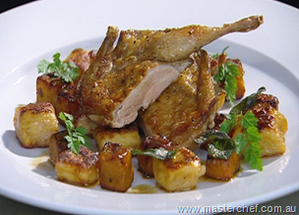

Slide 4
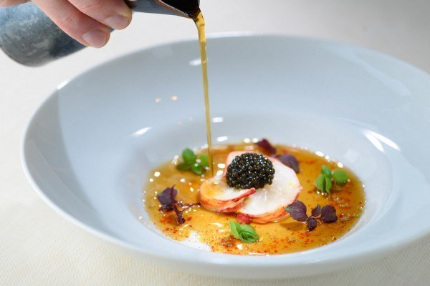
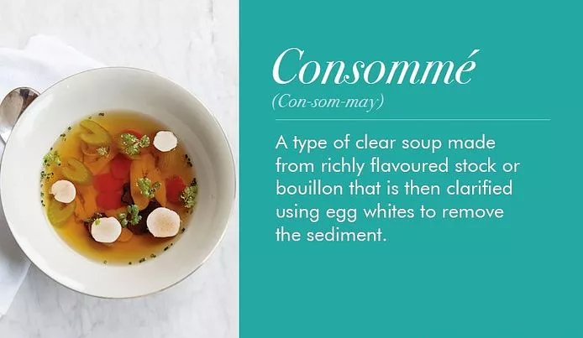
Consomme

Slide 5
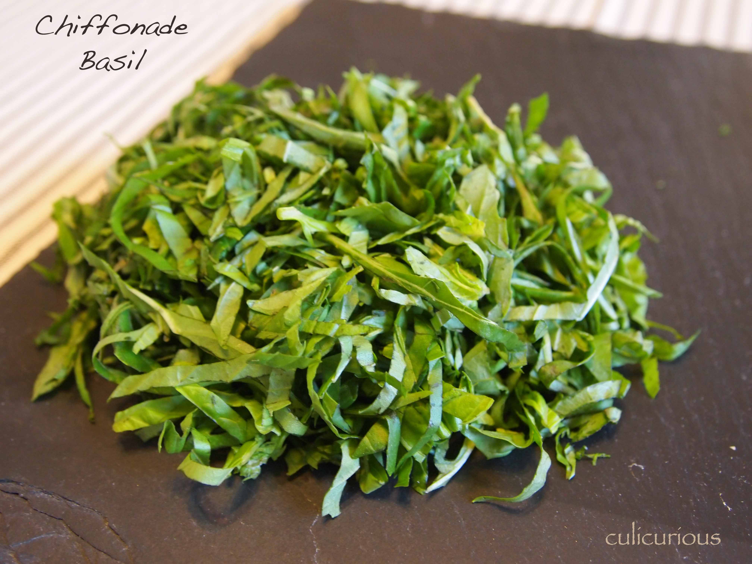

Slide 6
Deconstructed Marmite on toast

Slide 7
This is a technique used by chefs

Slide 8
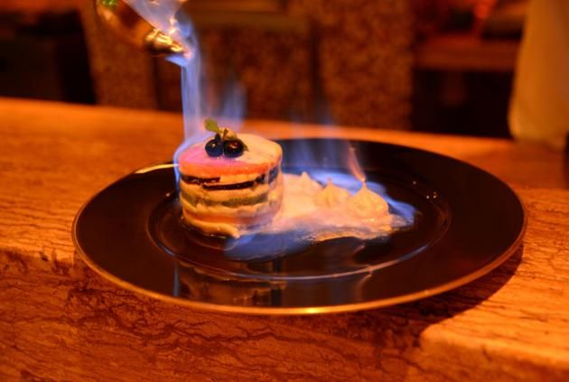

Slide 9
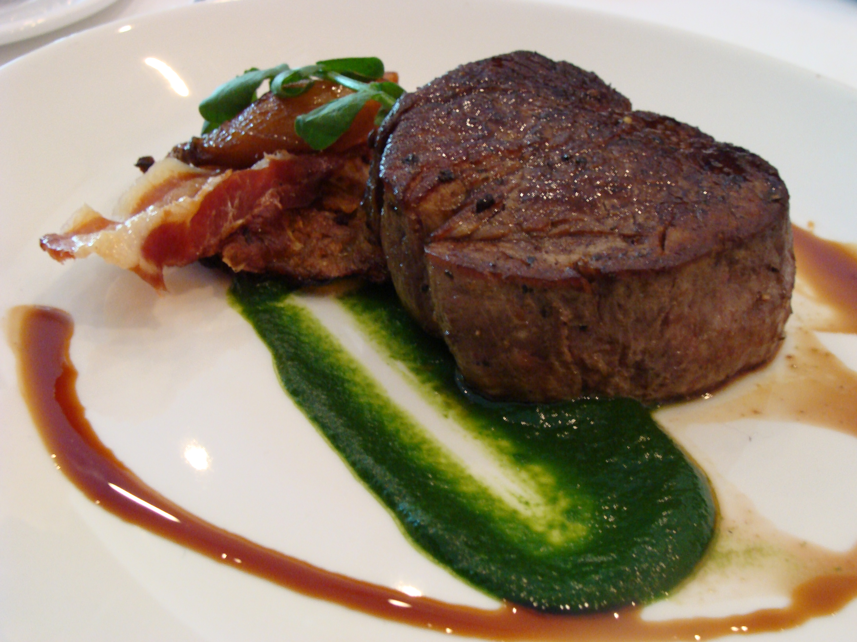
Red wine jus

Slide 10
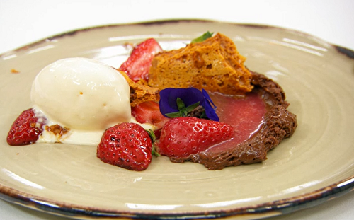
Macerated strawberries with chocolate mousse, ice cream and honeycomb

Slide 11
A roux is a base for a sauce. For example, you can make a roux with butter, flour and milk. Add cheese to make sauce for your mac and cheese!

Slide 12
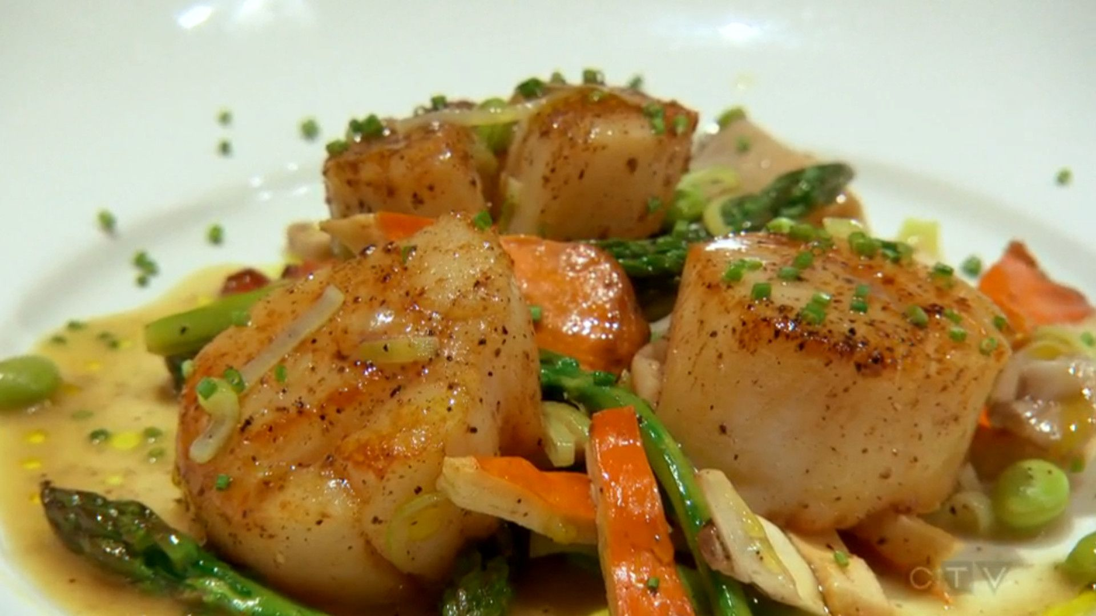
Seared scallops with asparagus, edamame and mushrooms

Slide 13
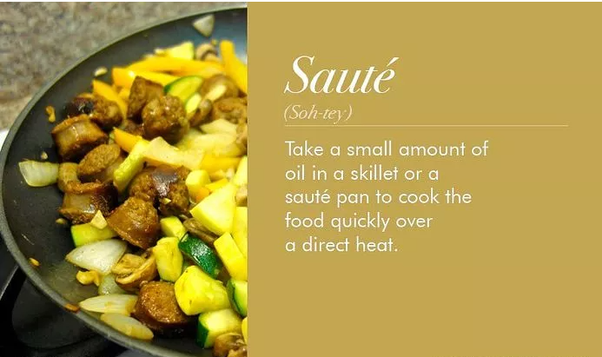
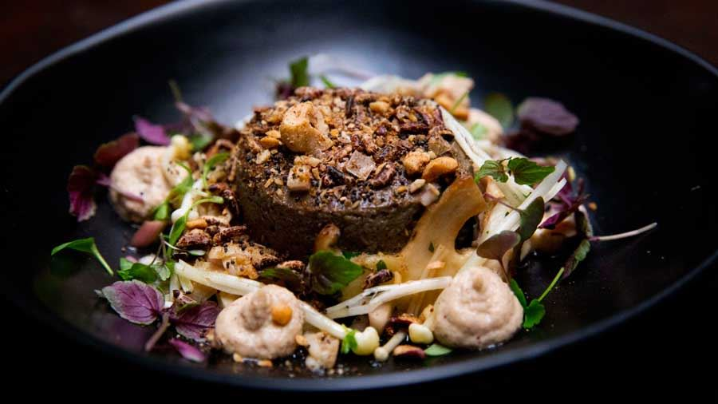
Mushroom custard with hazelnut granola and sautéed mushrooms

Slide 14
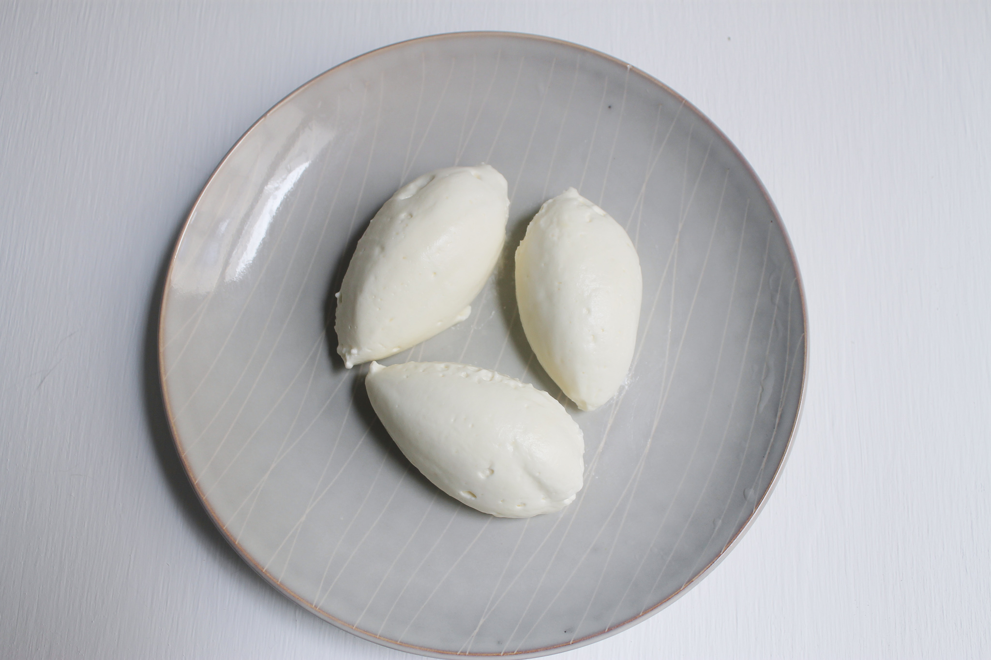
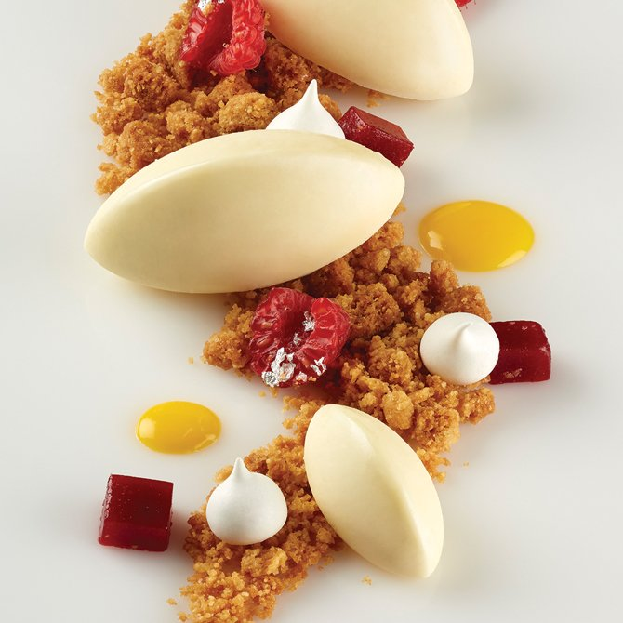
A quenelle is also a way of presenting food

Slide 15
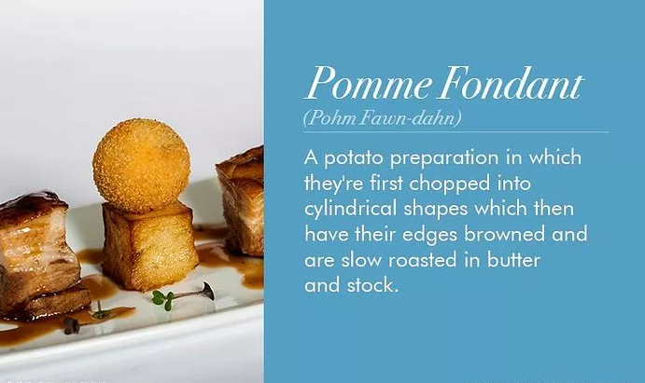
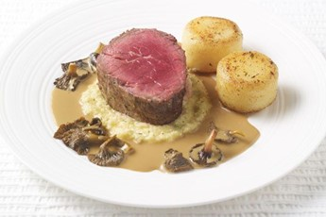
Fillet of beef with celeriac puree, mushroom jus and fondant potato

Slide 16
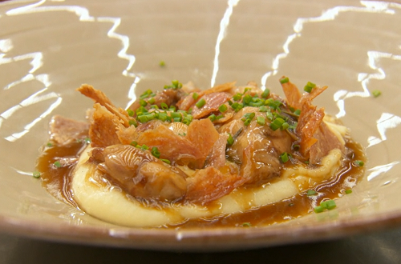
Glazed chicken with pomme puree and chicken jus

Slide 17
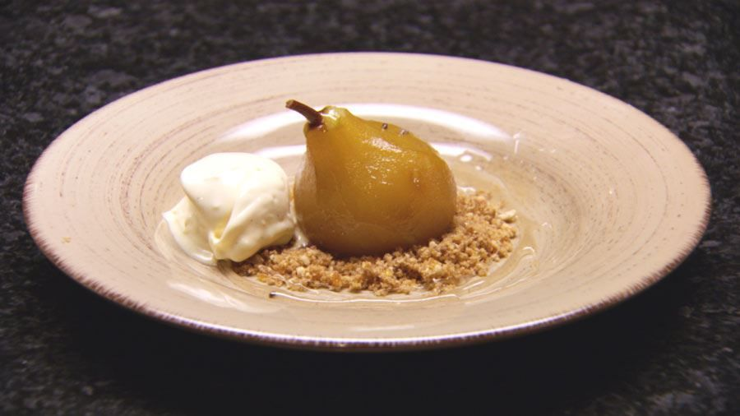
Poached pear with ice cream and a hazelnut crumb

