Slide 1
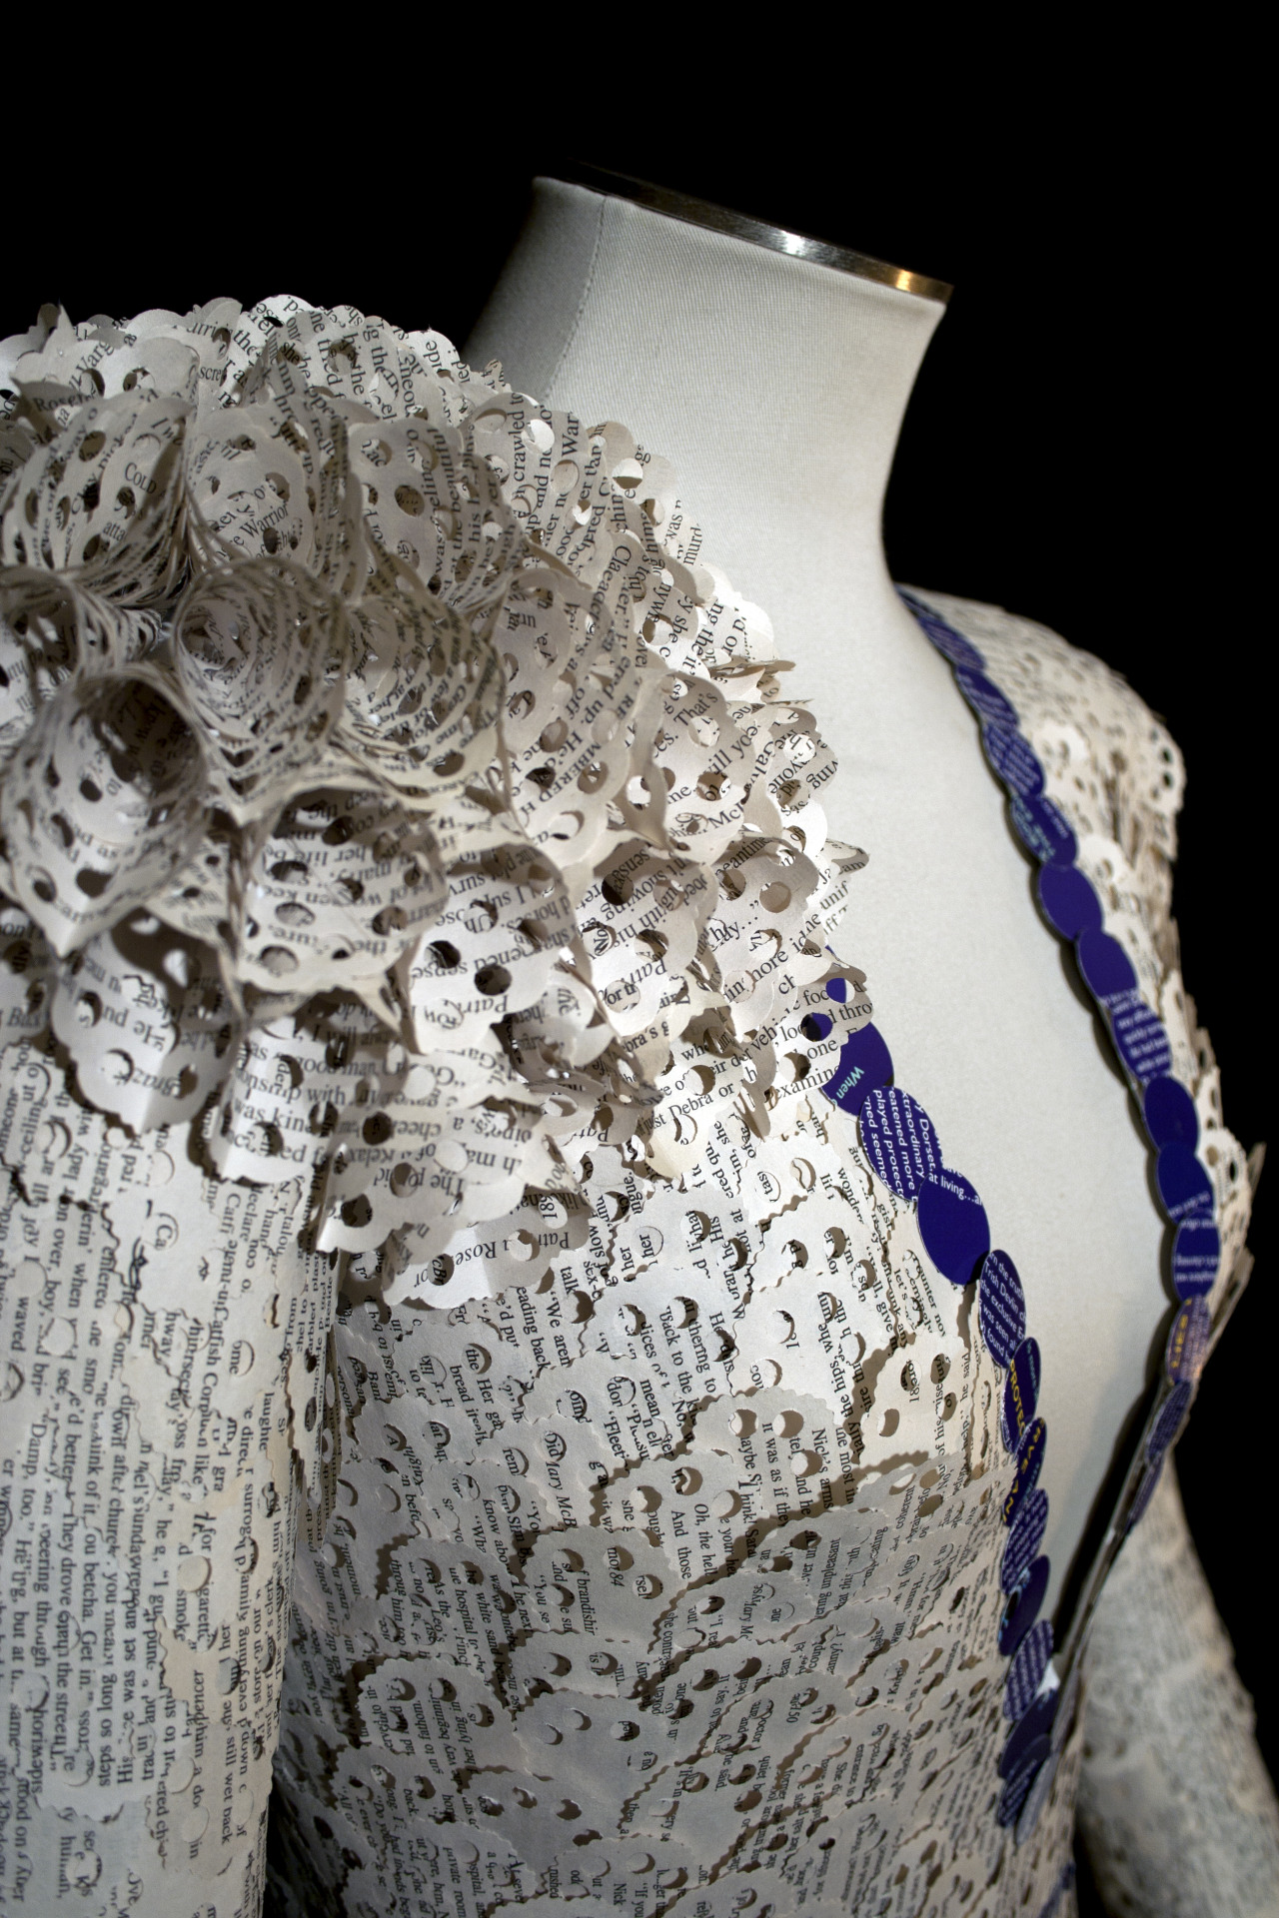
Carrie Ann Schumacher

Slide 2
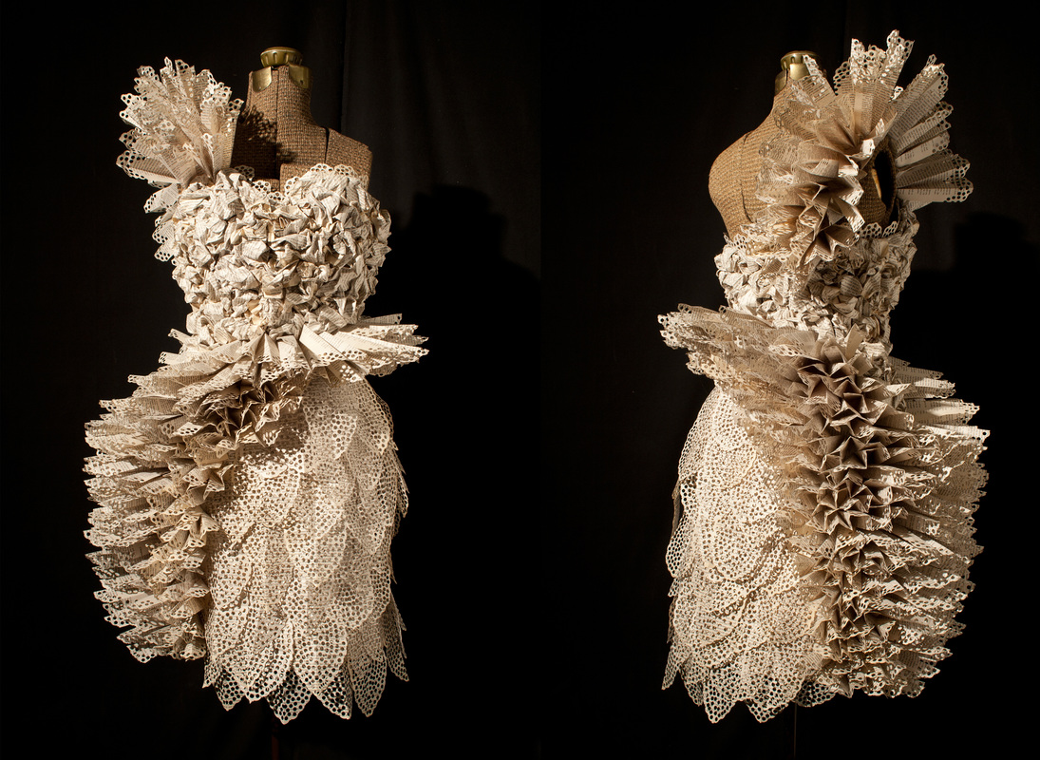
Notes:
Carrie Ann Schumacher is an artist who makes dresses out of old book pages and magazines. She could be described as a 3D Recycling Artist.
How would you describe these dresses?
When you do your research, I would like you to find out what sort of books she uses.

Slide 3
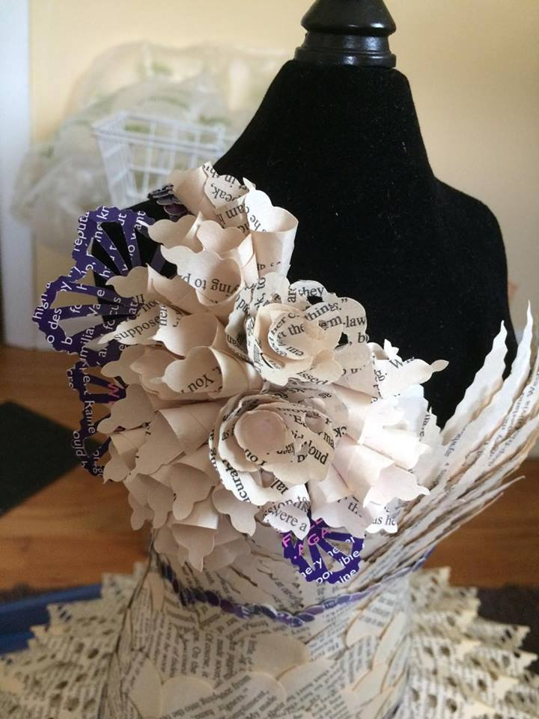
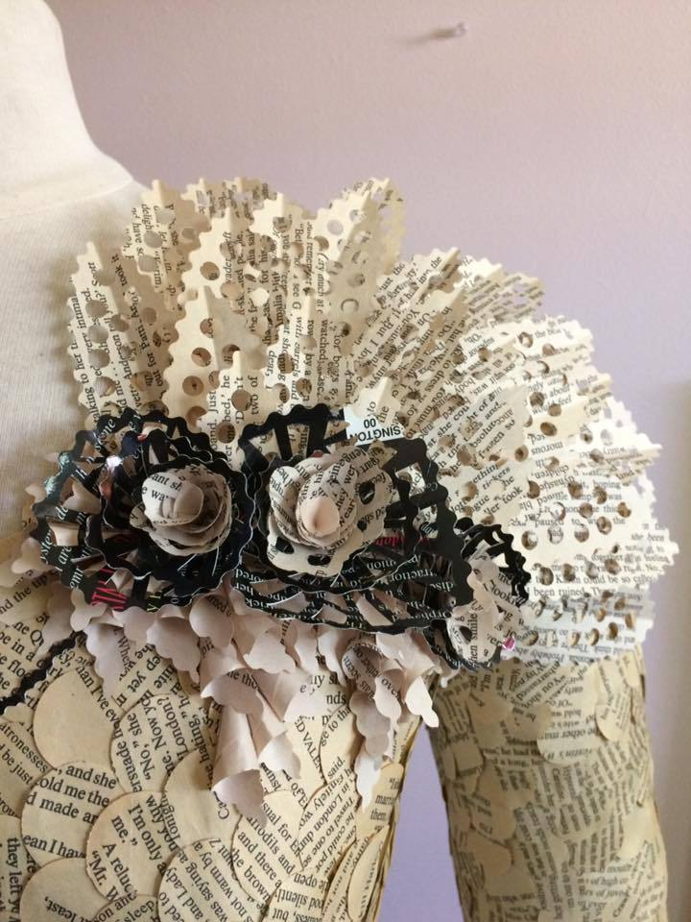
Notes:
As you look at her work write down key words to describe her work. Think about it's appearance, texture and what it makes you think of.
What words do you think of when you look at these two images?
(ruffled, layered, lacy)

Slide 4
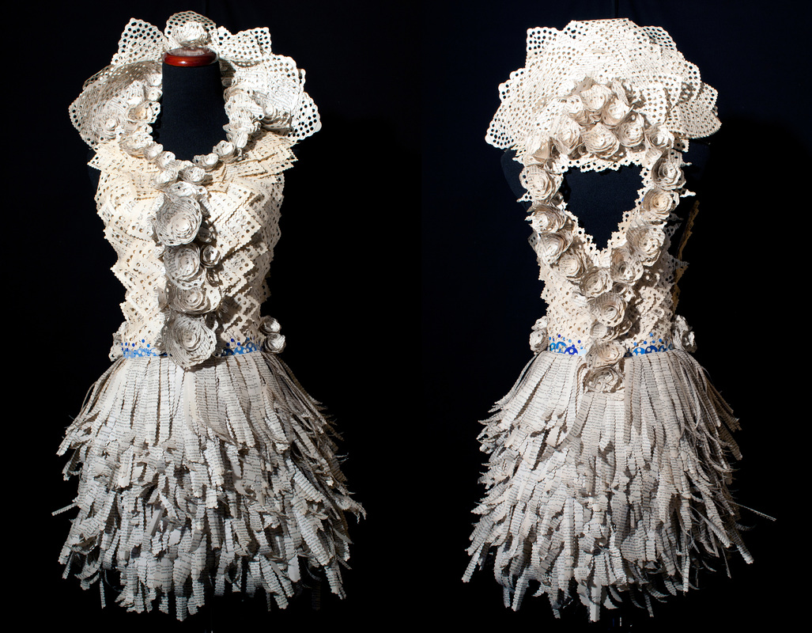
Notes:
What different shapes can you see here?

Slide 5
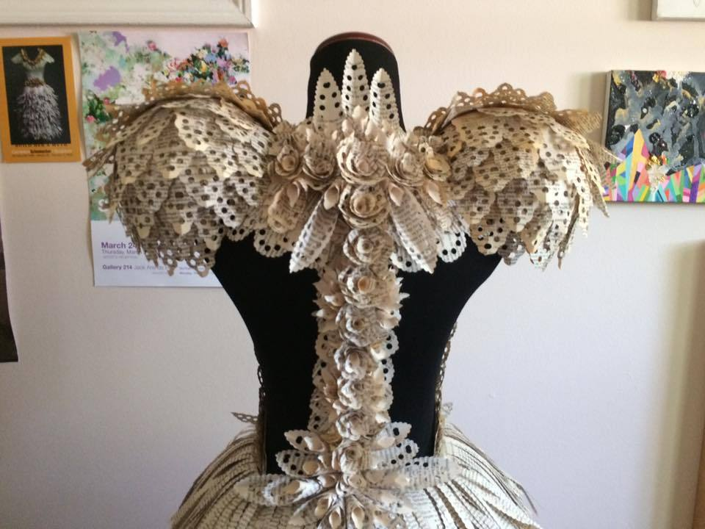
Notes:
Wow! Look at the amazingly detailed shoulders on this one!

Slide 6
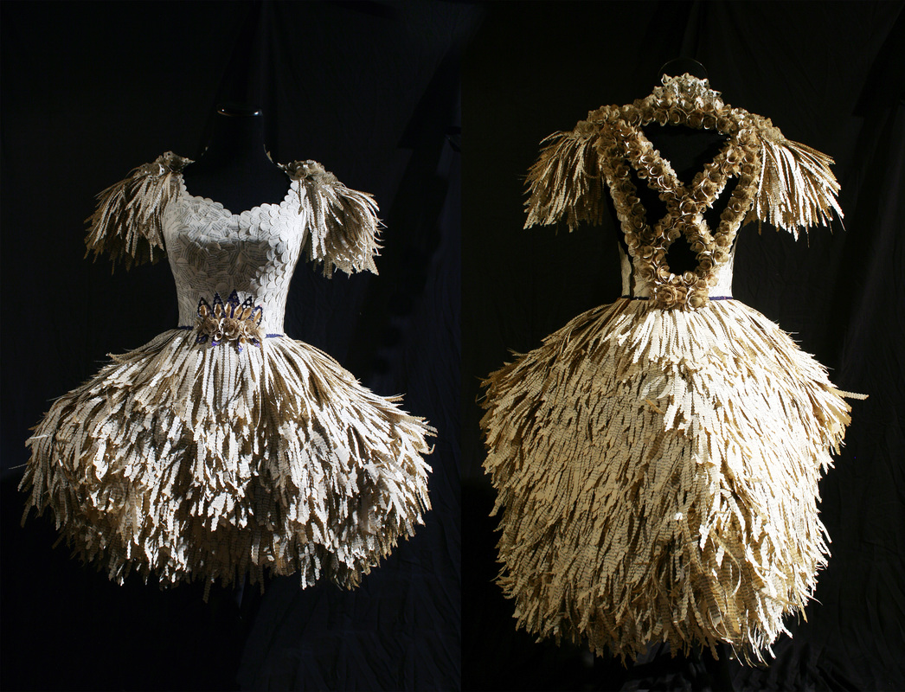
Notes:
How would you describe the technique used on the front of the costume?
(Circles are used like scales)

Slide 7
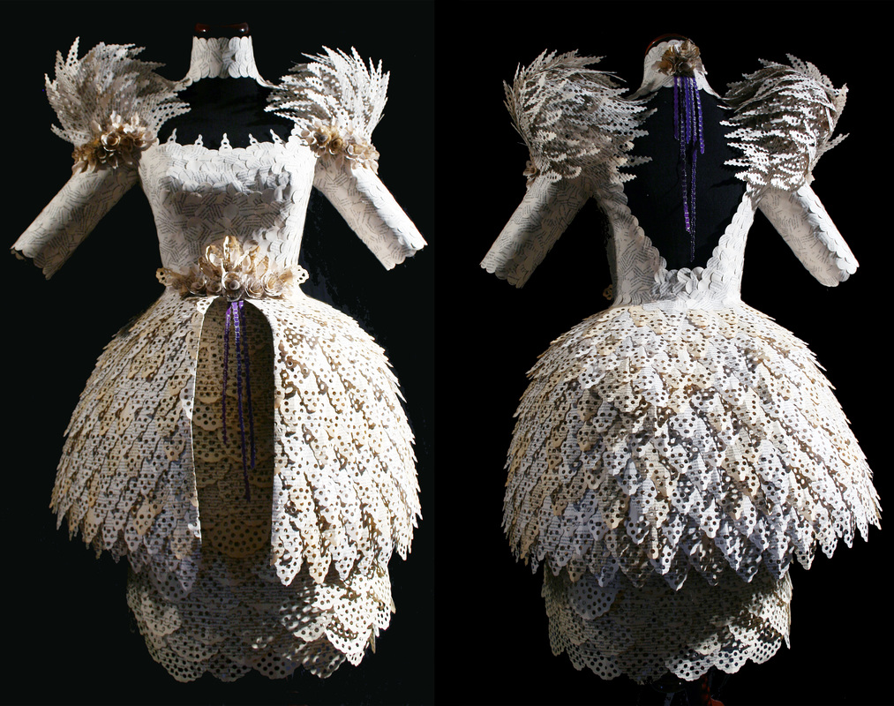
Notes:
Who do you think wears these dresses?
(Trick question! No one!)
Click to next slide.

Slide 8
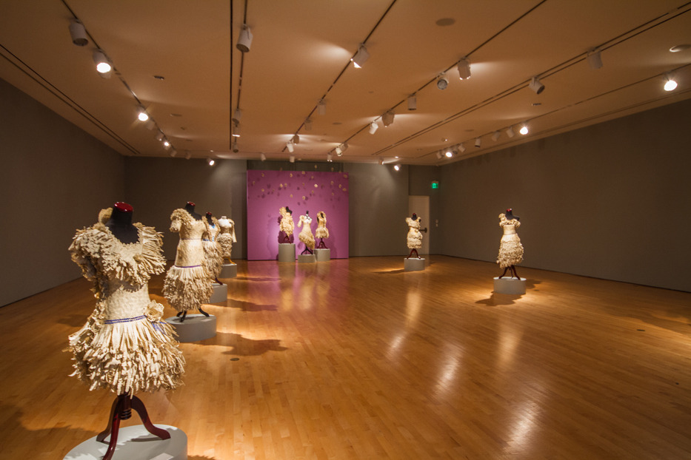
Notes:
The dresses aren’t made to wear, they are made as sculptures. They are ‘Art’
Here they are being exhibited in America.

Slide 9
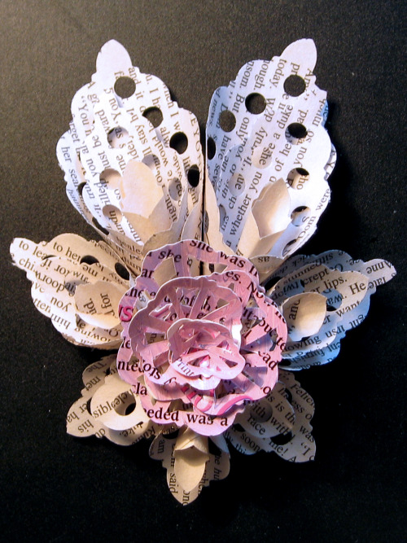
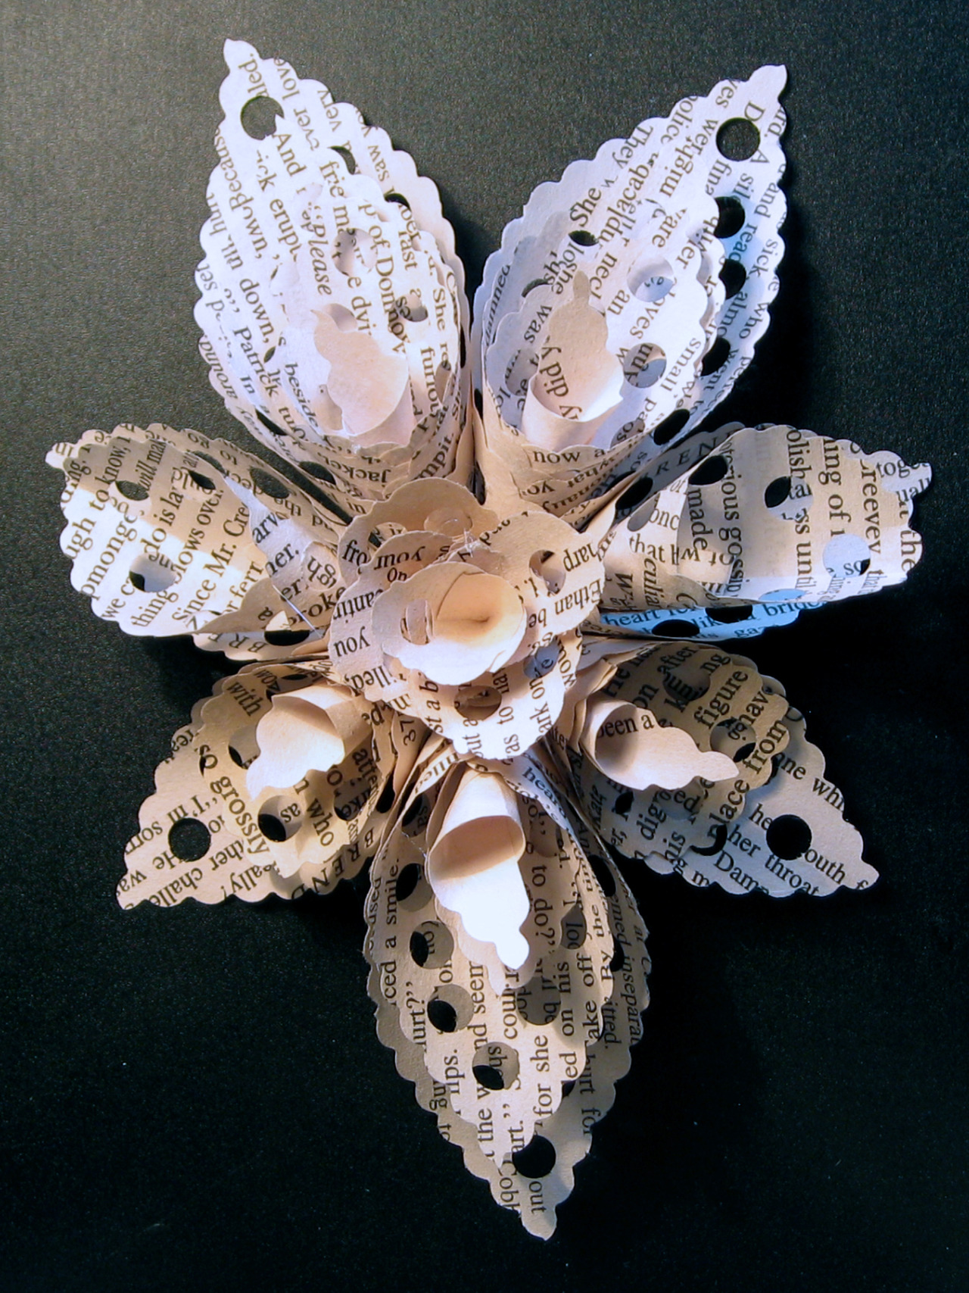
Notes:
During this project you are going to be making a costume inspired by her work. (Show good example from Schumacher project resources)
(We don’t have the space or time to make one a big as Schumachers!)
As you can see they include different ways of sculpting paper, and each costume is made of old books and includes one splash of colour.
Schumacher made these mini paper sculptures to purchase just as they are, but you can see how you could craft things like this to stick on your work.

Slide 10
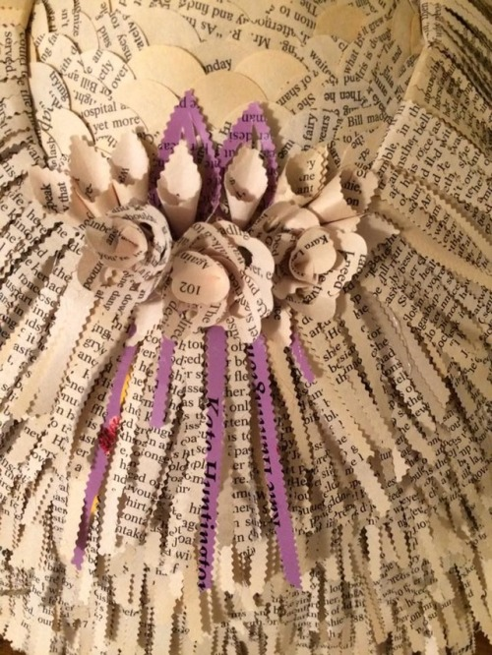
Research Schumacher in your sketchbook creating a research page.
Experiment with recreating Schumacher's paper forms.
Find your own shapes in nature to influence your work and make it personal and unique.
Create a card and paper costume inspired by her work and your personal research.
Notes:
(Read from the slide what they are going to do in this project)

