Slide 1
Design Critical Analysis

Slide 2
What is Graphic Design?
Graphic Design is a way of visually communicating an idea through using typography, photography and illustration.
It’s Art with a purpose.

Slide 3
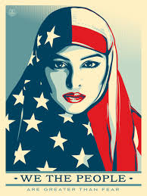
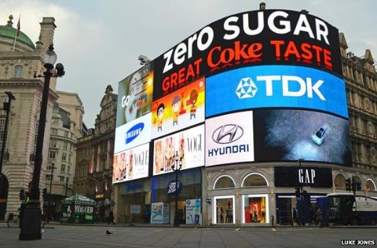
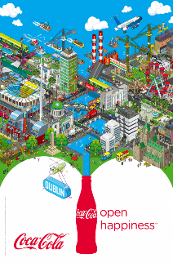
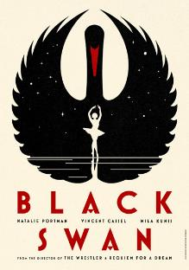
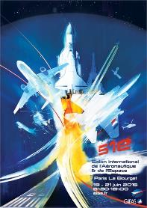
Examples of Graphic Design

Slide 4
Main Types of Graphic Design
Poster/Book – promotes a product/service
Advertising – informs people about products or services
Logo (Branding) – a shape, emblem or symbol used to recognise a business
Packaging – protecting product while encouraging people to buy it

Slide 5
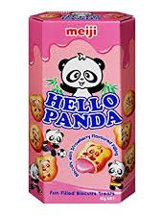
Advertising Logo Packaging (poster) (branding)

Slide 6
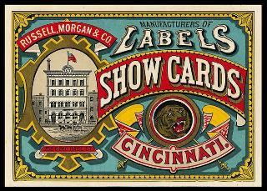
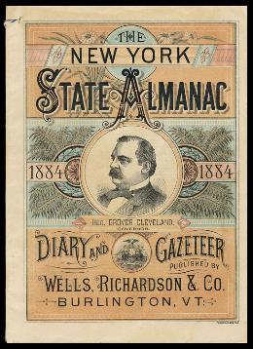
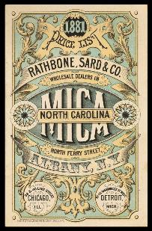
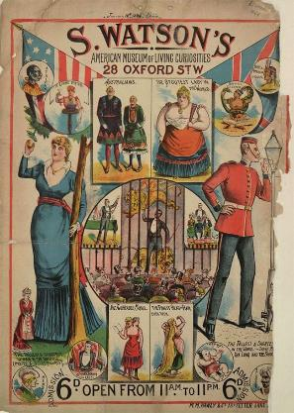
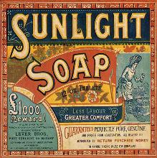
Timeline of Graphic Design
Victorian 1837-1901
Key Features:
Decorative outer borders
Elaborate typography
Symmetry
“Busy” imagery
Very few straight lines or edges
Social/Cultural Factors: Very religious time, lithography,
colour printing (chromolithography), industrial revolution,
expansion of British influence due to political power,
advertising became popular

Slide 7
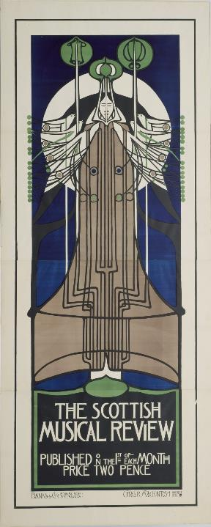
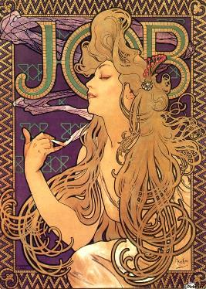
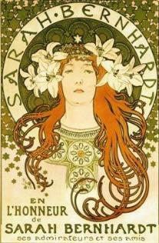
Timeline of Graphic Design
Art Nouveau 1890-1920
Key Features:
Intricate hand drawn style
Linear based designs
Use of natural forms/imagery
Featured mostly women
Social/Cultural Factors: Industrial revolution – mass printing,
young wanting to be different from old Victorian style,
social aim of making art for everyone,
trying to reconnect with natural world

Slide 8
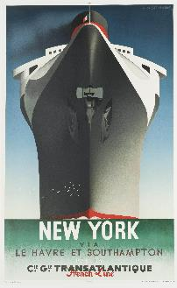
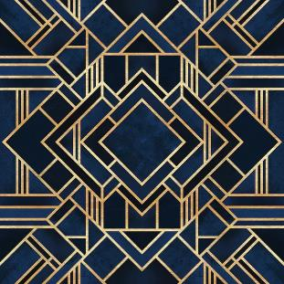
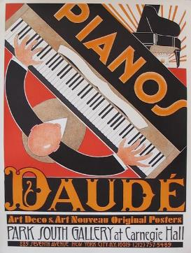
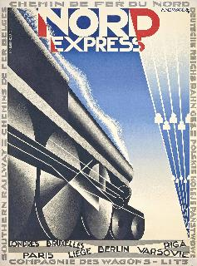
Timeline of Graphic Design
Art Deco 1920-1940
Key Features:
Bold geometric shapes
Clear lines
Simple
High contrast in colours
Looks flat
Social/Cultural Factors: Cubism, modern technology (cars), luxury,
reaction to WWI austerity, archaeological Egyptian discoveries
(Tutankhamun, 1922), African textiles, jazz,
development of electricity, travel

Slide 9
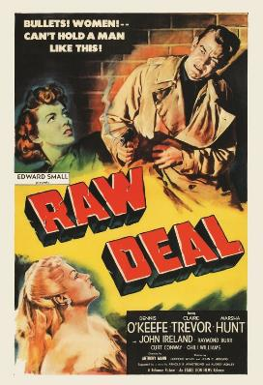
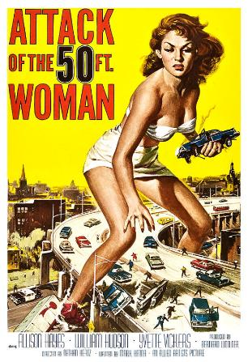
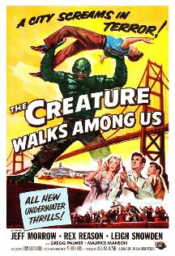
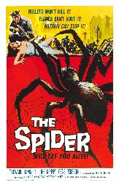
Timeline of Graphic Design
Kitsch 1950s
Key Features:
Contrasting imagery and fonts
Bold, vibrant colours
People in dramatic poses
Dramatic typography
Social/Cultural Factors: Film, Cinema, Hollywood, comic books,
Space race, cold war – nuclear arms race, classic rock,
future, car industry, franchises, photography

Slide 10
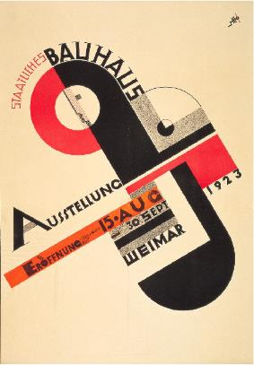
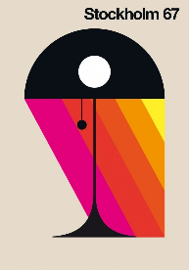
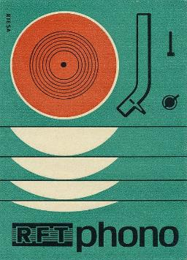
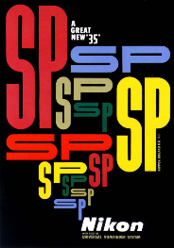
Timeline of Graphic Design
Modernism 1940s-1960s
Key Features:
Strict structured grid system for layout
Simple colour schemes
Functional simple typography
Clear images
Social/Cultural Factors: Film, wish to streamline design, design to be
functional, post war, developments in film/photography, rejection of
intricate design, mass consumerism

Slide 11
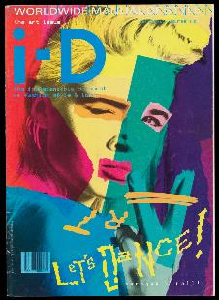
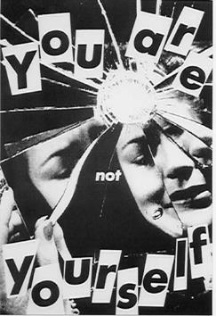
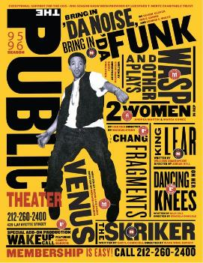
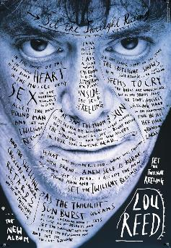
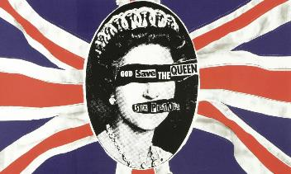
Timeline of Graphic Design
Post Modern 1970-1990s
Key Features:
Collage
Overlapping images/text
Impulsive/playful
Design tends to be tilted on edges
Experimental photography
Social/Cultural Factors: Photography, anti-patriotic, computers,
Photoshop, pop culture, internet, punk, youth culture, MTV,
commercial mass culture

Slide 12
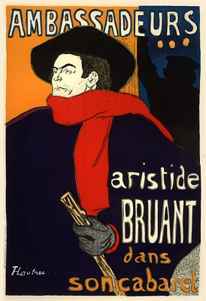
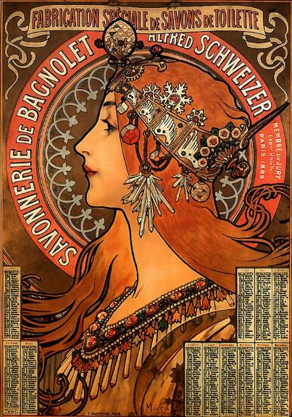
History of Graphic Designers Henri de Toulouse-Lautrec Alfonse Mucha

Slide 13
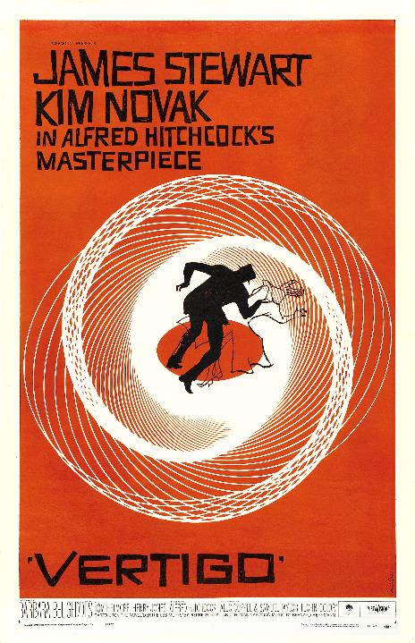
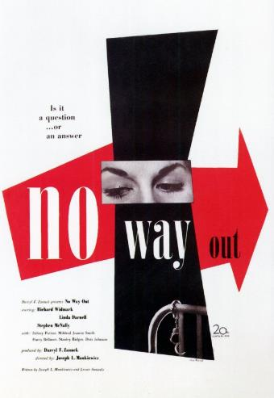
Modern Graphic Designers
Saul Bass
Paul Rand

Slide 14
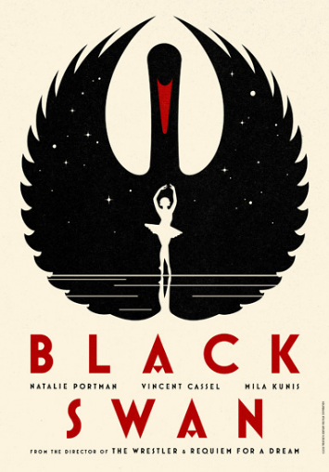
Contemporary Graphic Designers
La Boca and Shepard Fairey

Slide 15
Style
Does it look simple, detailed, extravagant, intricate, bold?
Can you tell what time it is from? Does it look like it was from the 60s? How can you tell?
Do you recognise the design movement it comes from?
eBoy – Coca Cola Dublin
The poster is incredibly detailed and looks like it is from a comic book because of the simple colours and shading.
It looks like it is a game for a phone/tablet because of all the buildings, cars and people living in the mini city.
I think it comes from pixel art movement because of the shape of all the objects/people and the simple shading.

Slide 16
Inspiration
Where has the designer got the inspiration from? How can you tell?
eBoy has got his inspiration from the city of Dublin, you can tell because it has some iconic parts of Dublin city. eBoy has also been inspired by computers/pixel art and making simple images. Coca Cola Dunlin looks like it has been inspired by puzzles.

Slide 17
Target Market
Who has this poster been designed for? What age group would be interested in this? Is it designed for male/female? What would be their job, lifestyle, personality?
This poster looks like it has been designed for younger people, probably around the age range of 13-25. It looks like it designed for both male and females, probably students who are fun and like to travel because it is based on a city and looks like a cartoon.

Slide 18
Function
What is the poster for? Does it make sense/can you tell what it is advertising?
The poster is for Coca Cola and to promote Dublin, I can tell this because of the clear Dublin sign being held up by a pixelated helicopter and because of the Coca Cola logo and the bottle design. It is also to make Dublin look like a fun place which it does because there is so much detail in the design.

Slide 19
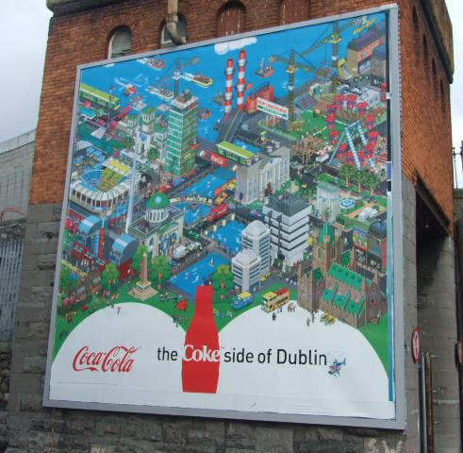
Materials/ Techniques
What materials have been used? How has it been made? What is the scale? Have any special technologies been used to produce the design?
eBoy has used digital art techniques to make his poster. He has created this work on either Photoshop/Illustrator, this is clear because of the style of the images he has made, it looks pixelated. The scale is very large and fits the side of a building, meaning it can be seen from a distance making the poster very effective.

Slide 20
Social/ Cultural Influences
Style – Pixel art
Technological Advances – Larger monitor displays, graphic tablets, Photoshop/Illustrator,
Cultural Influences – 8 bit computers
Electronic music – Mutya Buena – Song 4 Mutya (Out of Control)
Where’s Wally
Lego
Pop Culture
Nintendo
Other Artists? Jonathan Ball, Waanella, Rod Hunt

Slide 21
Colour/Shape/ Pattern
Identify where in the image these are used, describe in detail and use descriptive words
Colour
Exotic, bold, neon, clashing, contrasting, dull, sombre, neutral, monochromatic
The colours eboy has used are quite simple but bold and eye-catching to make the poster look fun and interesting.
Shape
Simple, symmetrical, flat, angular, organic, sculptural, 3D/2D
The shape eboy has in the details of the poster look 3D and very angled to make the poster look like it is a model of a city.
Pattern
Detailed, repeated, floral, multi-coloured, large scale, graphic
Eboy has used pattern to create the buildings but there is not a lot of pattern that makes each part of the poster interesting because there is not one area to focus on apart from the Coca Cola logo and bottle

Slide 22
Typography/Layout (composition)
Is the text easy to read? Does it look formal (important) or informal (fun)? Does it take up a lot of space? Is it neatly arranged or is it scattered? Where does your eye go first? What do you think the artist wants you to look at?
In Eboy’s Coca Cola Dublin the text is vey easy to read, although there are smaller signs which can be difficult to spot. The Coca Cola logo is very clear to see and the slogan “open happiness” is very neatly arranged. The composition is split between the city and the advert for Coca Cola which leads the viewer into the bottle

