Slide 1
Expressive Critical Work
Nat 5

Slide 2
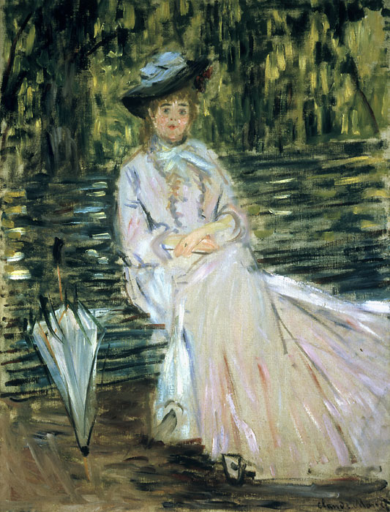
Art Movements: Impressionism
1870s to 1900
The impressionists were revolutionary in their choice of subject matter; they focussed on the effects of light and visible brushstrokes to portray life in Paris.
Artists: Edouard Manet, Claude Monet, Edgar
Degas, Pierre-Auguste and Renoir
Claude Monet,
Woman Seated on a Bench
1874
Oil on Canvas

Slide 3
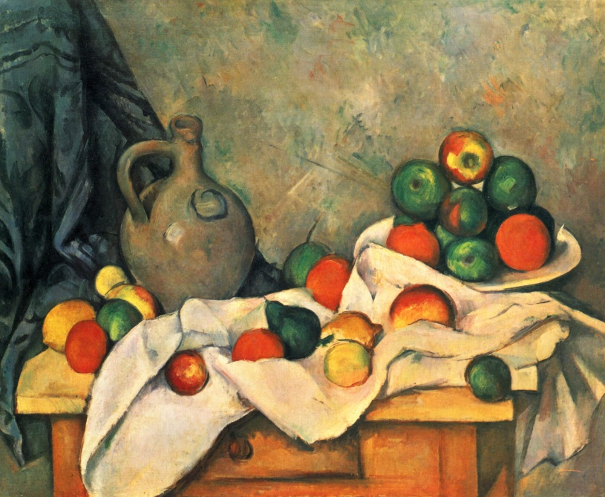
Art Movements: Post Impressionism
1880-1905
Post Impressionism was born from Impressionism, they rejected the naturalistic depiction of light and colour and emphasis was placed on abstract qualities or symbolic content. A prominent technique used to represent these movements was Pointillism.
Artists: Paul Cezanne, Vincent Van Gogh
Paul Cezanne, Curtain Jug and Fruit, 1894, Oil on Canvas

Slide 4
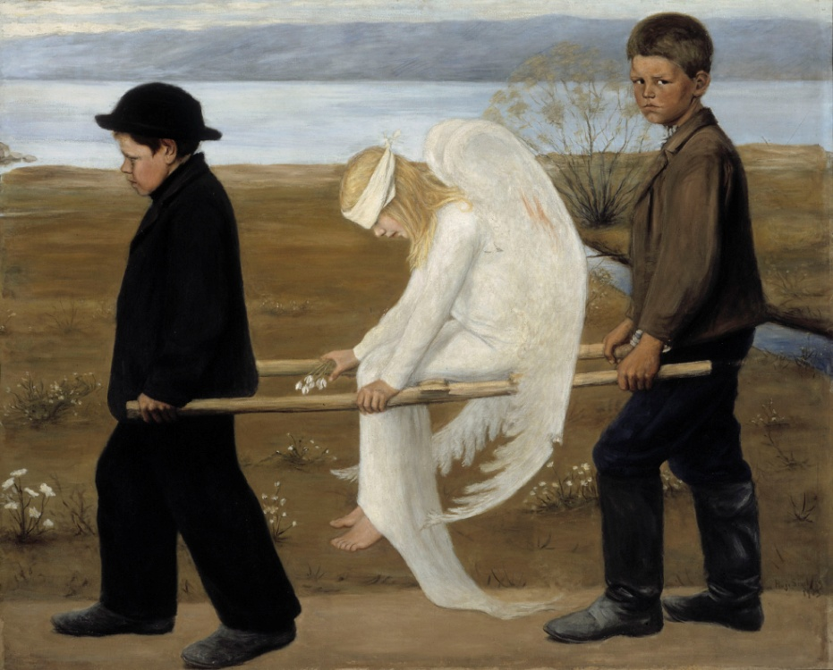
Art Movements Symbolism
1885-1910
Symbolism sought to re-establish the importance of the imagination and created work which evoked moods and feelings. As opposed to Impressionism which tended to ignore the imagination and concentrate of what the artist saw.
Artists: Gustav Moreau, George Frederic Watts, Pierre Puvis de Chavannes, Hugo Simberg
Hugo Simberg, The Wounded Angel, 1903, Oil on canvas

Slide 5
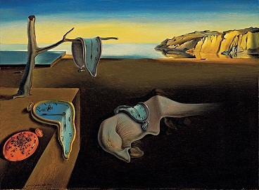
Art Movements: Surrealism
1920s-1940s
Surrealism is characterised by using the subconscious as a source of creativity to liberate pictorial subjects and ideas.
Artists painted unnerving, illogical scenes with photographic precision, created strange creatures from everyday objects and developed painting techniques that allowed the unconscious to express itself.
Artists: Salvador Dali, Joan Miro, Rene Magritte, Max Ernst
Salvador Dali, Persistence of Memory, 1931, Oil on canvas

Slide 6
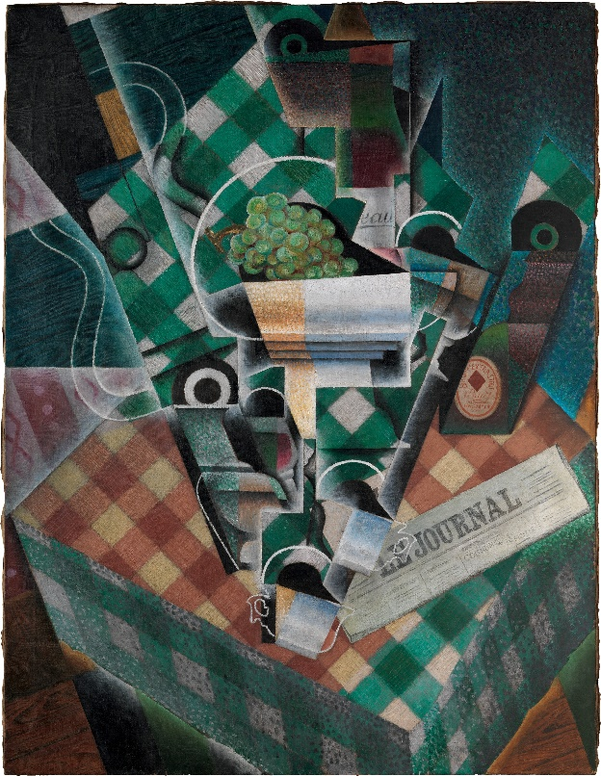
Art Movements: Cubism
1907-1912
The Cubist art movement began in Paris around 1907. Led by Pablo Picasso and Georges Braque, the Cubists broke from centuries of tradition in their painting by rejecting the single viewpoint. Instead they used an analytical system in which three-dimensional subjects were fragmented and redefined from several different points of view simultaneously.
The movement was conceived as ‘a new way of representing the world’, and combined outside influences, such as African art, as well as new theories on the nature of reality, such as Einstein’s Theory of Relativity.
Artists: Pablo Picasso, Georges Braque, Juan Gris, Fernard Leger
Juan Gris, Still Life with Checked Table Cloth, 1915, Oil on Canvas

Slide 7
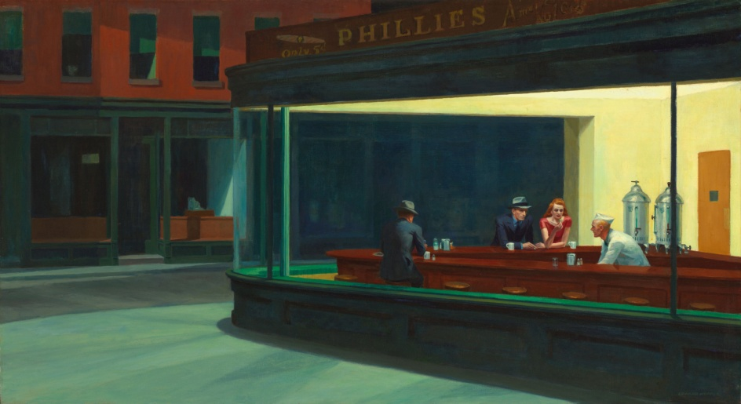
Art Movements: Realism & Figurative
1930s-1940s
A number of artists defied the idea of Abstraction in favour of working in a more conventional style retaining the essence of everyday life.
Artists: Georgia O’Keeffe, Grant Wood, Edward Hopper, LS Lowry
Edward Hopper, Nighthawks, 1942, Oil on Canvas

Slide 8
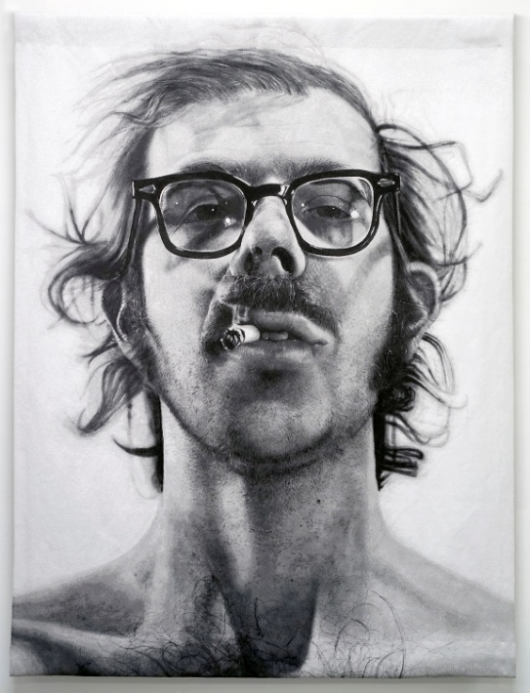
Art Movements: Superrealism/Hyperrealism
1965-1975
Superrealism, or hyperrealism, is a genre of painting based on using cameras and photographs to gather visual information and then from this creating a painting that appears to be photographic.
Artists: Chuck Close, Malcom Morley, John DeAndrea, Roberto Bernardi, Ralph Goings
Chuck Close, Big Self Portrait, 1967, Acrylic on Canvas

Slide 9
Example Prelim Questions
1. Artists communicate and express their ideas about their subject in a variety of ways. Identify two works by different artists that you have studied. These should be based on similar subject matter and/or the same theme. With reference to these works in your answer, compare each artist’s use of:
• Which of the two works do you find most appealing? Give two reasons. (10 marks)

Slide 10
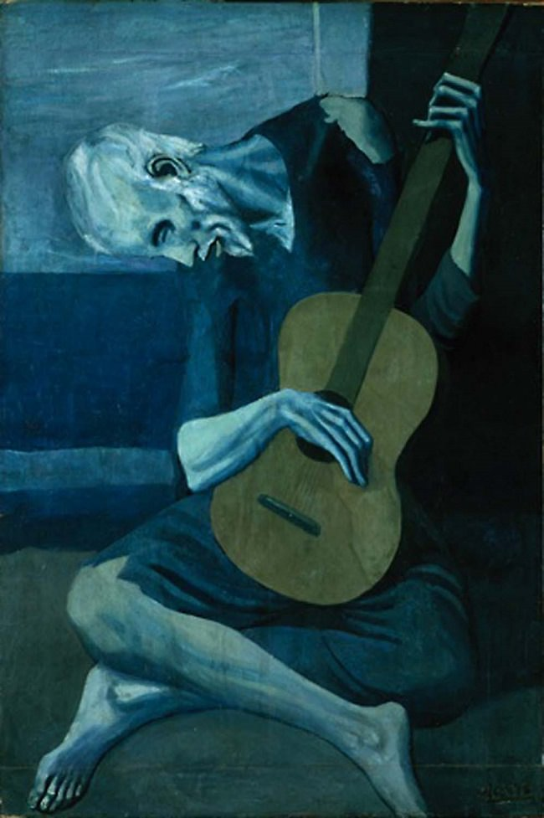
Colour
Range of colours, is there a colour scheme in the painting? Hot/cool tertiary/complementary/primary/secondary…
Why do you think the artist chose the colour scheme in this painting?
Do the colours suggest a time of day/month/season?
Is colour used to suggest a mood within the painting?
Pablo Picasso, The Old Guitarist, 1904, Oil on Canvas

Slide 11
Media Handling aka what material has the artist used
Discuss how the media has been applied, your answer will vary depending on what material the artist has used, for example watercolour paint can’t be painted thickly but oil paint can, the thicker the paint the more texture it will leave on the canvas.
Has the artist used the media to make the painting look realistic/unrealistic? Exaggerated/distorted.
Don’t discuss how the media has been applied without discussing what effect this has on the painting!

Slide 12
Brushstrokes (finely pointed, tightly controlled or loose, sweeping), Brushmark textures or fine layers of watercolour wash?
Finely pointed would take longer, giving more detail. Loose/sweeping would give a quick, rough impression.

Slide 13
Mood and Atmosphere
Think of different emotions we have: happy, sad, depressed, anxious, melancholic, ecstatic, frightened…
When you look at a painting think about what emotions you think the artist intended for us to feel when looking at it?
Atmosphere is similar to mood but more specific to a situation. For example when you go to the cinema will the atmosphere be the same as a football game? Or when you start school on a Monday morning or leave on a Friday afternoon.

Slide 14
Gustave Courbet’s Desperate Man
Does this man look delighted that he’s passed his NAT 5 prelim or has everything he ever learned about Art disappeared right before his prelim?
How has he created a mood/atmosphere?
Intense lighting, dramatic pose, eyes are focal point, central (staring), limited colour but high range of tone.
Gustave Courbet, Desperate Man, 1845, Oil paint

Slide 15
Pose
You would be expected to describe the pose eg. Sitting, standing, relaxed, serious, side on view…
BUT…
You should discuss what effect this has!
Close viewpoint: intimidating, grabs our attention
Face looking at the viewer: looking for attention/reaction
Face/body looking away: deep in thought, distracted
Body language (tells us the story): arms outstretched chest puffed out (intimidating), arms crossed head down (shy/introverted).

Slide 16
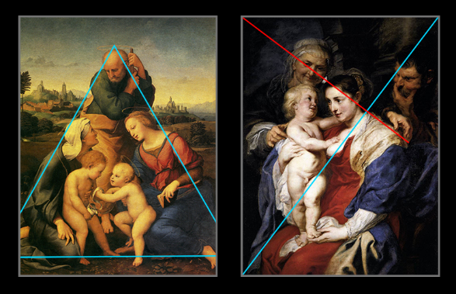
Composition
Focal point: where is your eye drawn to and why?
Background: gives a setting, introduces us to characters or suggests a situation.
Can you see everything? Are some parts purposefully hidden?

Slide 17
Composition lines
Your eye automatically stops when it sees a straight line, either vertical or horizontal. Angles will lead your eye around the painting, sometimes in one particular direction for emphais.

Slide 18
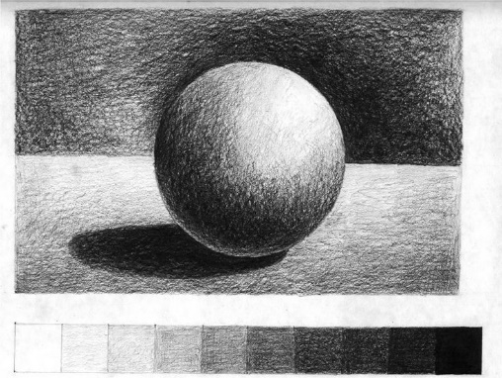
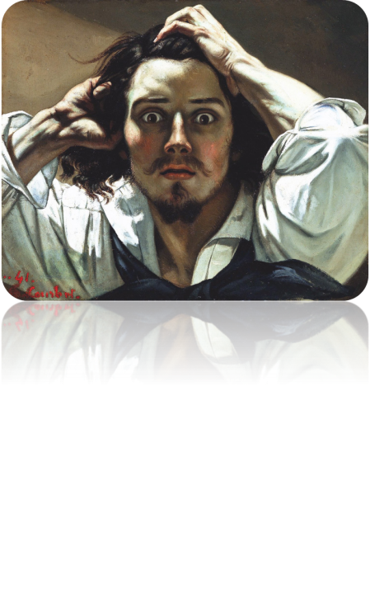
Tone (source of light)
Is there natural daylight or artificial light? (electric/torch etc.)
Which direction does the light source come from?
Does the light cast shadows? Do you think that the shadows are there to show 3D form or atmosphere?

