Slide 1
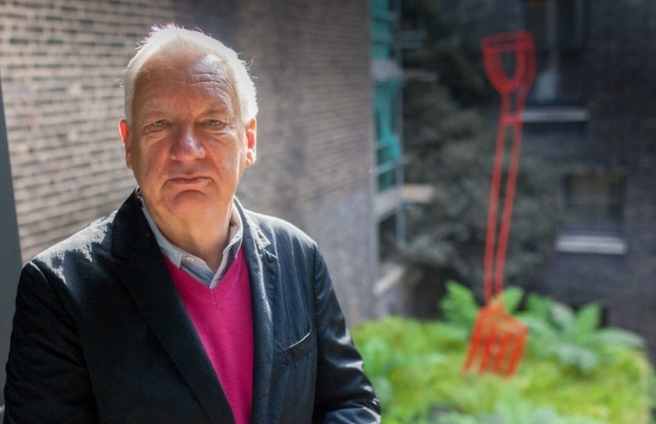
MICHAEL CRAIG MARTIN
Michael Craig-Martin is one of the most prominent artists of his generation: of this, there is no doubt. You’d recognise his stuff immediately - large, graphic paintings of everyday objects such as laptops and light bulbs, floating surreally against vivid slabs of blank colour.
The objects are evoked using minimal means: just a few precise outlines, creating an elegant effect, like an architect’s drawing. At the same time, Craig-Martin saturates his images with surprising combinations of neon colours. The clash between the restraint of the drawing and the fierce, riotous hues animates each composition.
Craig-Martin was born in Dublin in 1941 and studied at Yale before moving to Britain in 1966

Slide 2
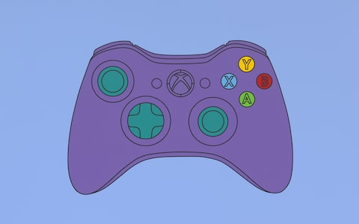
How do you think Michael Craig Martin Created this piece of work?
How do you think we could recreate it?

Slide 3
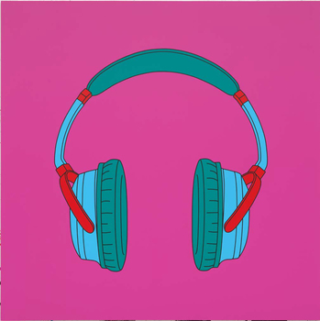
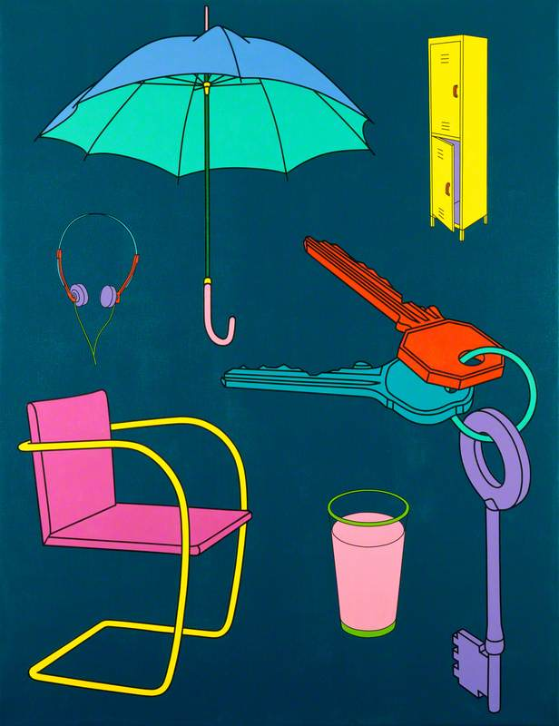
Look at these paintings......
Untitled
1998
What Visual Elements do you think MCM Focuses on the most?
Line
Tone
Form
Shape
Texture
Colour
Pattern?

Slide 4
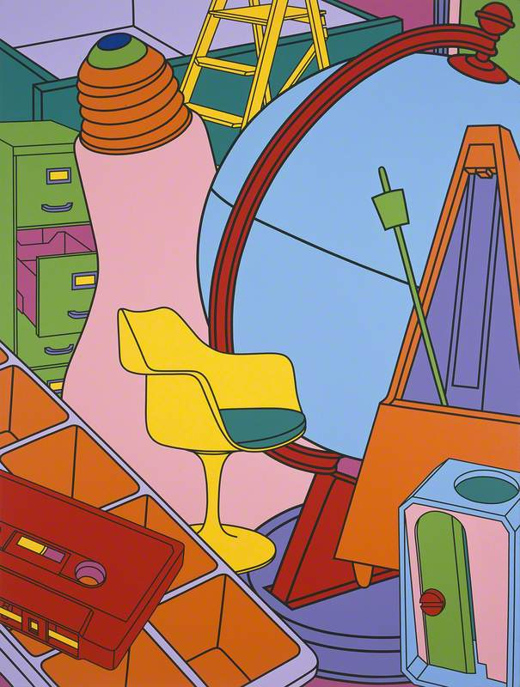
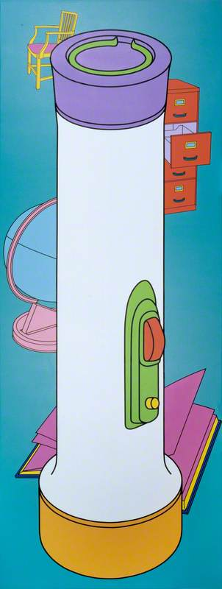
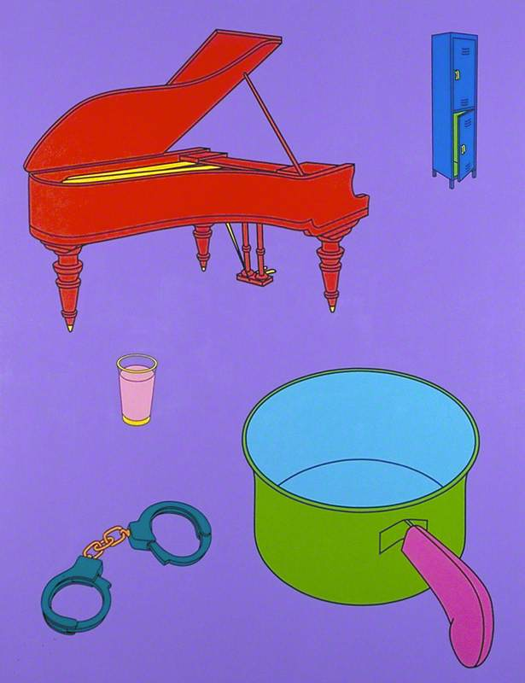
The correct answers are: Line Colour Shape Form
Inhale Yellow
2001
Housework 1997
Lighthouse
1999

Slide 5
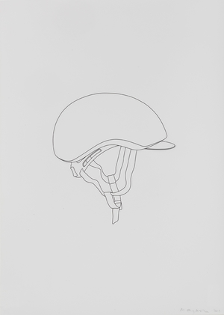
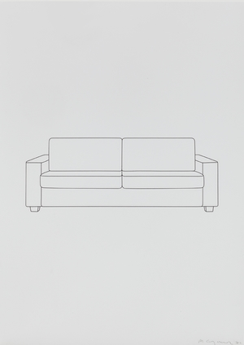
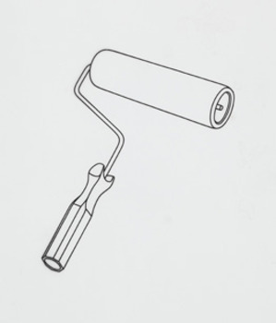
AIM: OBSERVATIONAL LINE DRAWING
The drawing of something which you can physically see in front of you.
WALT
observe
WILF
A full page drawing of your everyday object
drawing one bit at a time focussing on outlines.
NO SMUDGING
WE ARE GOING TO OBSERVE AND DRAW MULTIPLE LINE DRAWINGS IN THE STYLE OF MICHAEL CRAIG MARTIN.
WE MUST DO AT LEAST 3 OBJECTS.

Slide 6
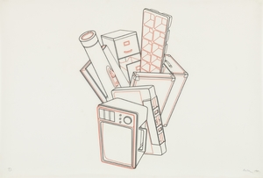
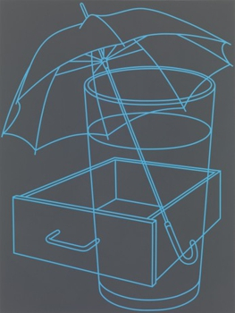
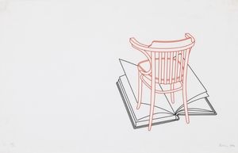
AIM: Layering
We are now going to layer our drawings by tracing them over each other.
You may cross your lines over so that your items can all look like one shape
You can stop your lines when it meets another, to make your items look separate.
We need to produce at least 3 Layer drawings.

Slide 7
AIM: PAINTING
We are now going to use paint to fill in the bold and bright colours of our everyday objects, taking inspiration from Michael Craig Martin’s Paintings.

Slide 8
PAINTING
We are Going to paint our layered drawings with bold colours in the style of MICHAEL CRAIG MARTIN.
But first we have to practise.

Slide 9
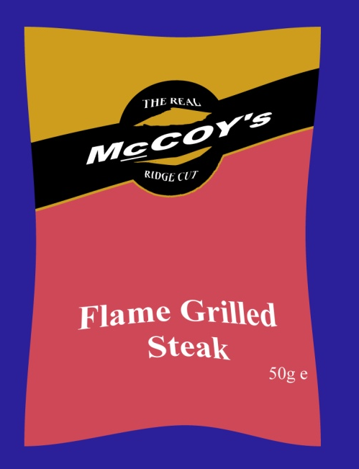
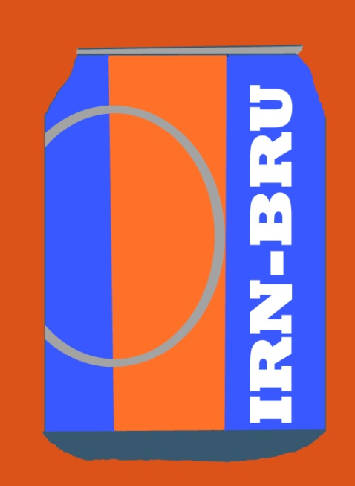
AIM: ICT Colour Fill
All your bold black outline drawings have been emailed to you
Please download these pictures
Please open these pictures using the program “SERIF PHOTO PLUS”
PAST PUPIL EXAMPLES

Slide 10
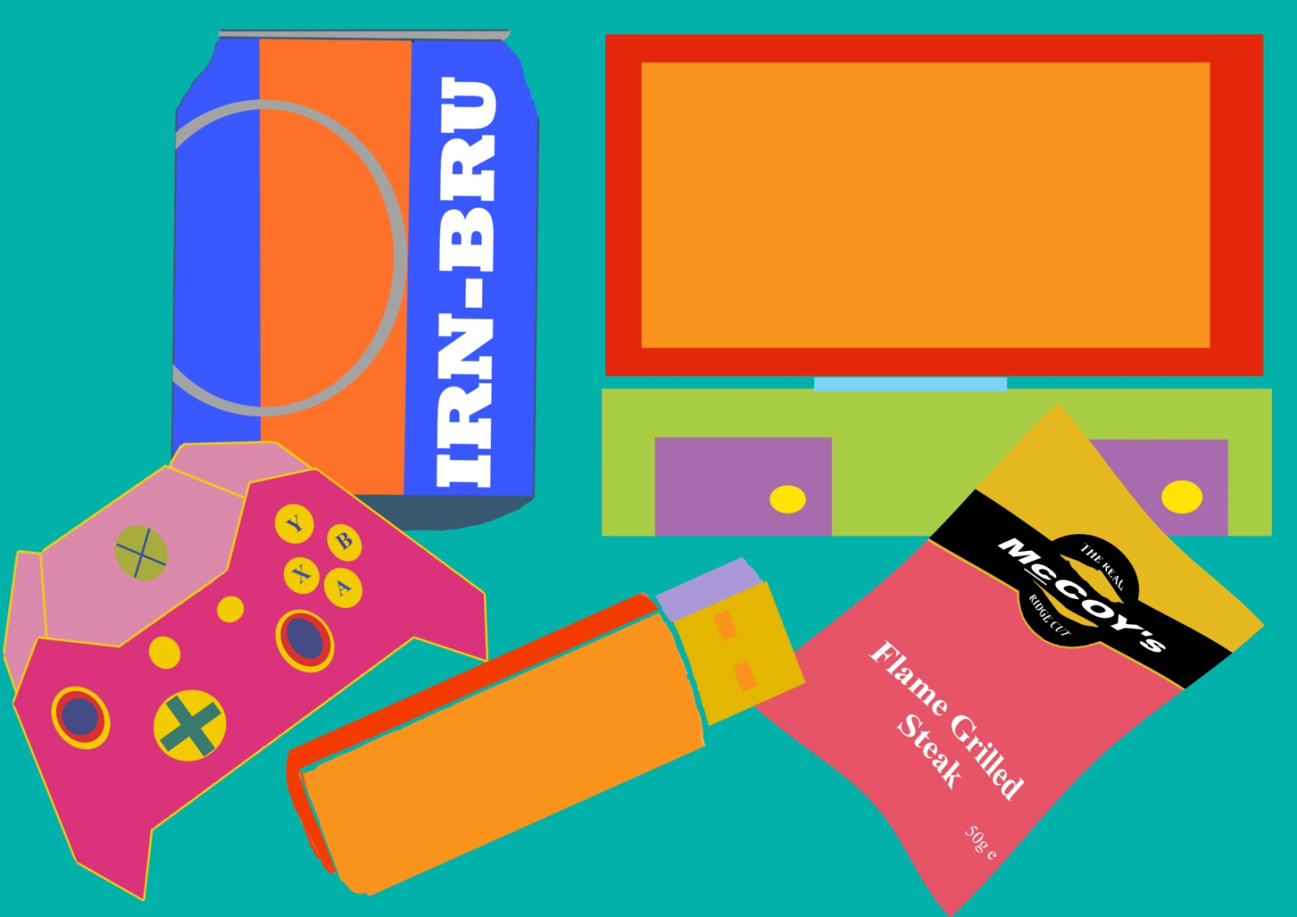
FINAL OUTCOME 2:
We will now put all our ICT painted images into one final Michael Craig Martin inspired DIGITAL PAITING.

Slide 11
AIM: SCULPTURE
LOOK at these MCM Sculptures.
Look at the 3 different types of media on your table....
What Media do you think he has used to create them?
Using our previous line drawings of our still life objects as templates, we are going to create our on MCM sculptures to go in our garden!
This will also benefit our outdoor learning ☺

Slide 12
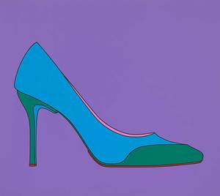
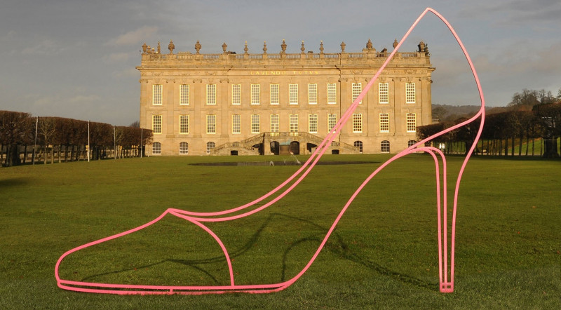
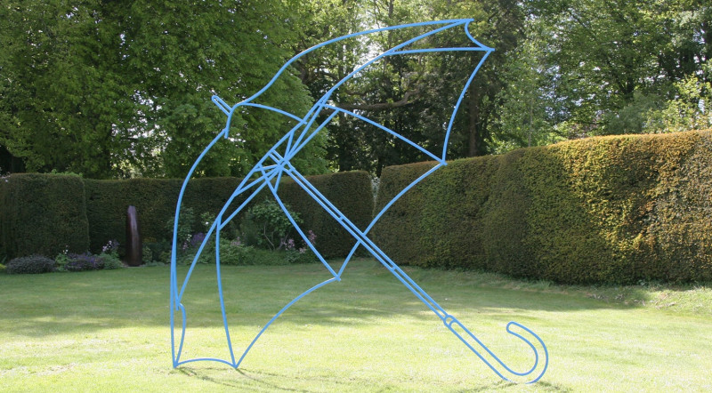
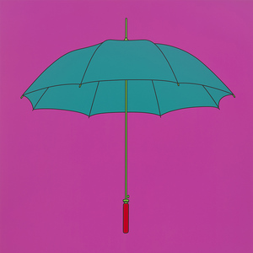
FINAL OUTCOME 3: We Will photograph our completed sculpture in the situation it was intended for.

Slide 13
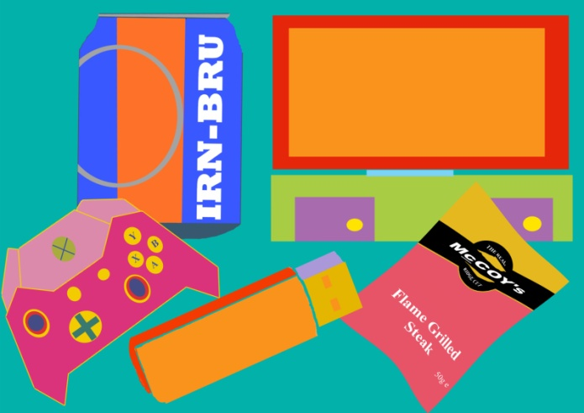
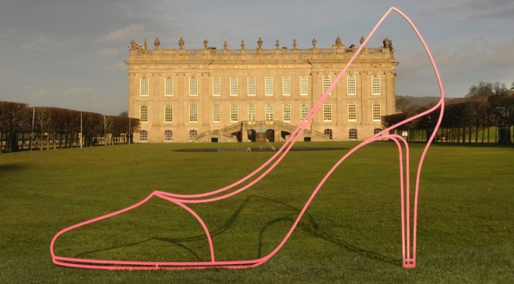
OUR 3 Final Outcomes Will BE:
1
Our Layered Painting
Our Layered Computer Painting
Our Sculpture and Photograph.
2
3

