Slide 1
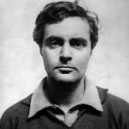
Amedeo Modigliani
Amedeo Clemente Modigliani was an Italian Jewish painter and sculptor who moved to France in 1906. He is known for portraits and nudes in a modern style characterized by elongation of faces and figures. His paintings were not received well during his lifetime, but later found acceptance.
He was influenced by artist such as; Pablo Picasso, Paul Cezanne, Henri de Toulouse and Native Art. His favourite subject matter was the human form.
BORN: 12 July 1884
DIED: 24 January 1920
PEROIDS: Expressionism, Modern Art, School of Paris, Fauvism.

Slide 2
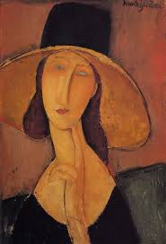
Portrait of Jeanne Hebuterne in a large hat
This portrait shows the artist’s partner, Jeanne Hebuterne. Hebuterne was an artist herself but committed suicide the day after Modigliani died of tuberculosis.
In the painting she is wearing a wide brim hat and she has a pensive expression (engaged in, involving, or reflecting deep or serious thought). With two finger resting on her chin. Her eyes are a simple oval shape and dose not have detail making them not look lifelike. As well as the shoulders slopping and the neck elongated. The dress and top of the hat are black and uses creamier tones for the face which Modigliani used to help make the figure stand out from the earthy brown tones used for the background creating a contrast between the two.
Created: 1989
Period: Expressionism
Media: Oil
Size: 37.5 x 54 cm

Slide 3
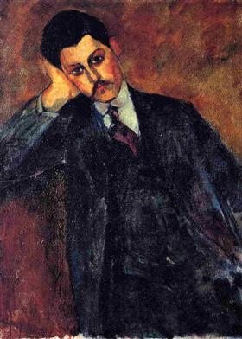
The painting is of man who is resting on his right hand and wearing a dark suit and maroon tie. Modigliani uses rich colour to give the painting more meaning and more attractive.
This painting was inspired by an African carving, used the technique and had the mans head bending. Modigliani uses both warm and dark colours to make the painting look professional lets us see a theme, that even if you were wealthy and educated you could be affected by hard times.
The uses of black for suit as it was a sign of wealth in those times. A brown background was used to make the painting more attractive. Modigliani tries to show us that the man comes from a wealthy and educated background. However the compassion of the man would suggest that he id depressed as he is leaning to the one side with his head resting on his hand, deep in thought.
The Portrait of Jean
Alexandre
Created: 1909
Media: Oil
Size: 65 x 81 cm

Slide 4
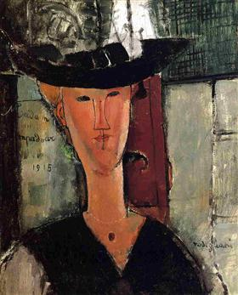
This is one of Modigliani’s famous paintings of a women called, Beatrice Hastings. She had a love affair with the artist for over two years and became the subject for many of his paintings. Once again his style of turning the face into a mask is seen and the elongation of the face and body. Exaggerating the form simple lines. Using a traditional image to make a non traditional style of painting. There is also a hint of the renaissance which was a huge influence, as the large hat symbolises a halo around the women’s face.
Madame Pompadour
Created: 1914
Media : Oil
Size: 61 cm x 52 cm

Slide 5
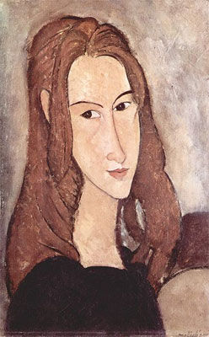
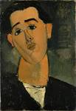
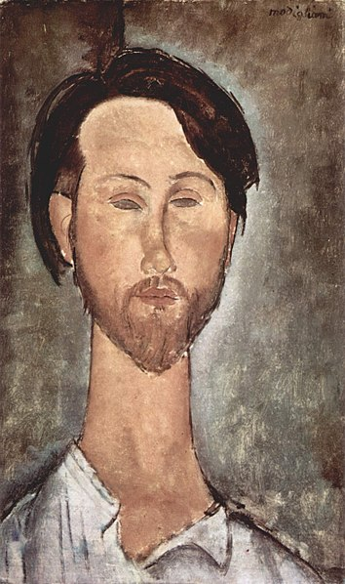
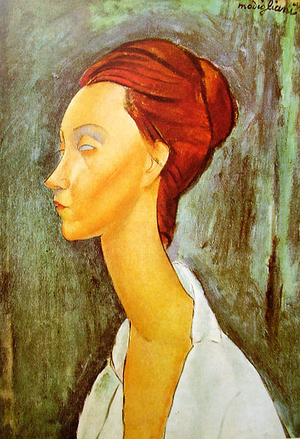
We are going to draw a Self Portrait in the style of Modigliani.
What do you notice about Modigliani’s paintings?
Think about:
Colour
Physical proportions
Physical features

Slide 6
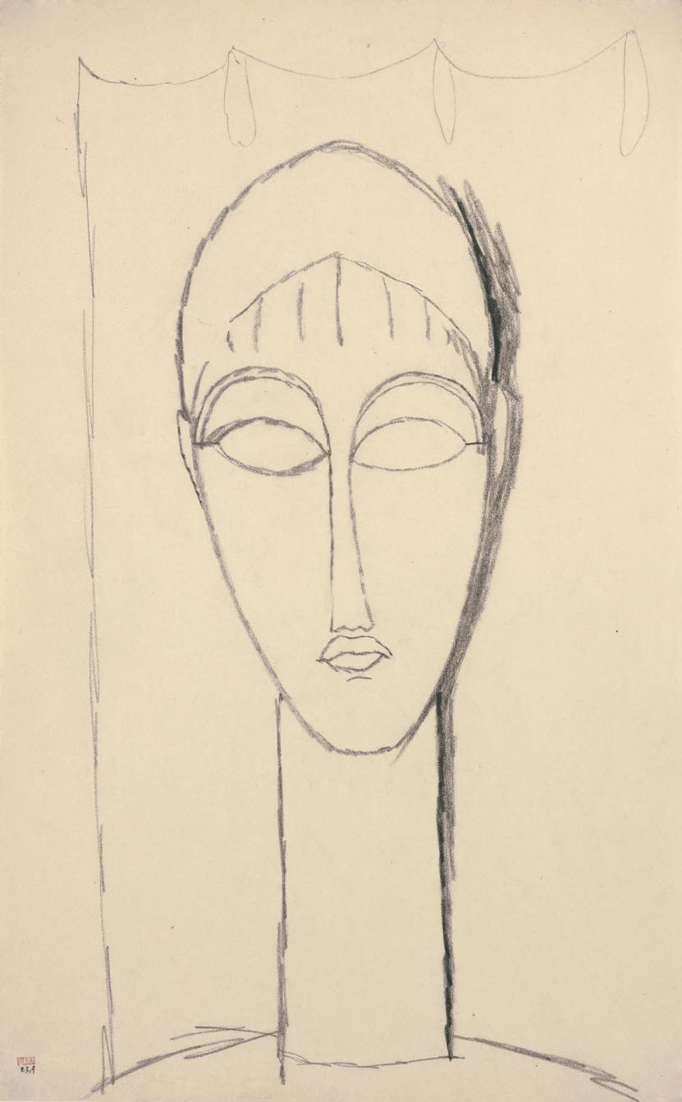
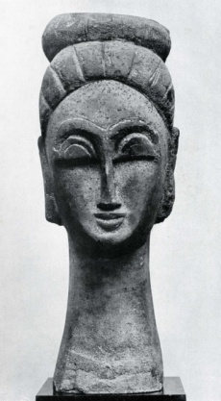
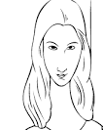
Aim: Line Drawing
Let us start with a line drawing of our own Face.
Remember you are drawing in the style of Modigliani.
Use your Mirror/ Photograph to help you
Amedeo Modigliani
1884 - 1920
Female Head c. 1911
Black crayon; stamped with the Paul Alexandre collection mark.
16 ¾ x 10 3/8 inches 42.7 x 26.4 cms.

Slide 7
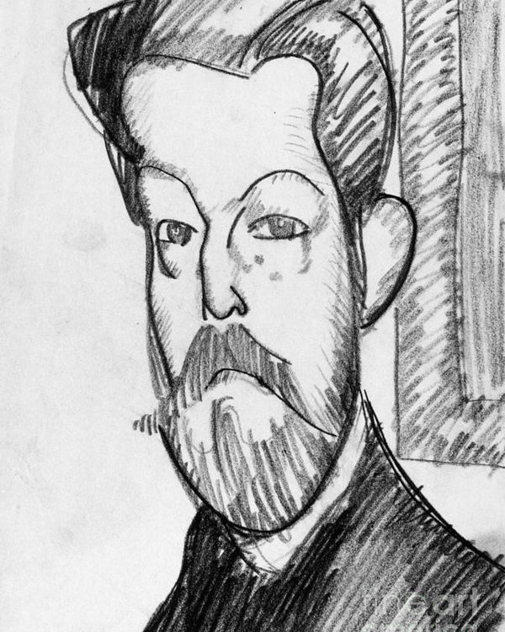
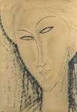
AIM: Tone
We Are Now Going to add tone into our Modigliani Drawings.

Slide 8
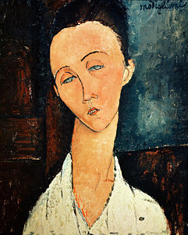
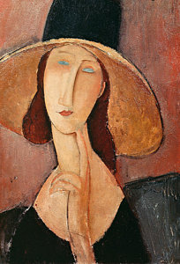
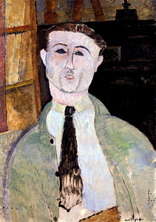
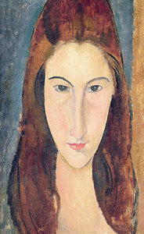
AIM: Paint
We Are Now Going to add paint onto our enlarged Modigliani Drawings.
Starting with our Skin Tone.
First we will need to practice mixing paint so we can COLOUR MATCH

Slide 9
AIM: Texture
We Are Now Going to add texture into the background of our Modigliani Paintings.
First we will need to practice making suitable textures in the style of Modigliani

Slide 10
LETS EVALUATE! USE THE FOLLOWING TO HELP YOU START YOUR SENTENCES:
WHAT WENT WELL?
MY LINE DRAWING WENT WELL BECAUSE.......
ADDING TONE TO MY DRAWING WENT WELL BECAUSE.......
MY PAINTING WAS SUCCESSFUL BECAUSE.....
WHAT I LIKED ABOUT ADDING TEXTURE WAS.......
EVEN BETTER IF?
WHAT I FOUND DIFFICULT ABOUT MY LINE DRAWING WAS........
ADDING TONE TO MY DRAWING WAS DIFFICULT BECAUSE.......
I FOUND PAINTING HARD BECAUSE.......
TEXTURE WAS DIFFICULT BECAUSE......

