Slide 1
National 4 Expressive Drawing Unit
Natural World - Fruit

Slide 2
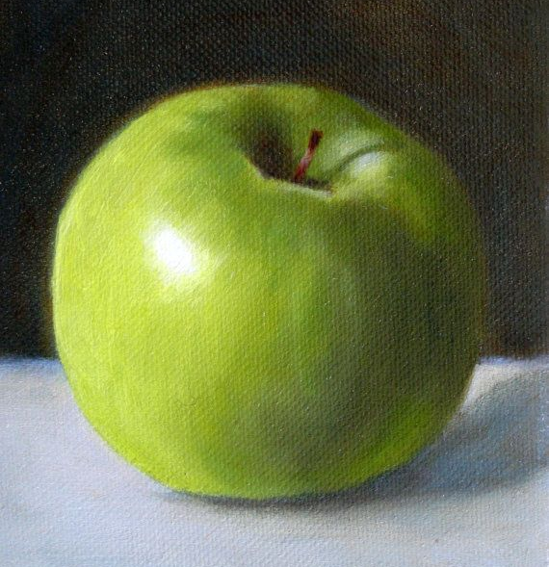
Investigation Drawings
The following 3 objects are close ups of different kinds of fruit. As part of your unit you have to draw these objects in as much detail as you can.
Drawing 1 - Tone
Look carefully at the apple on the left. It is basically a sphere shape,
The thing that makes it look rounded is the shading.
In pencil draw this apple as neatly as you can shading the areas of tone to create a realistic apple.

Slide 3
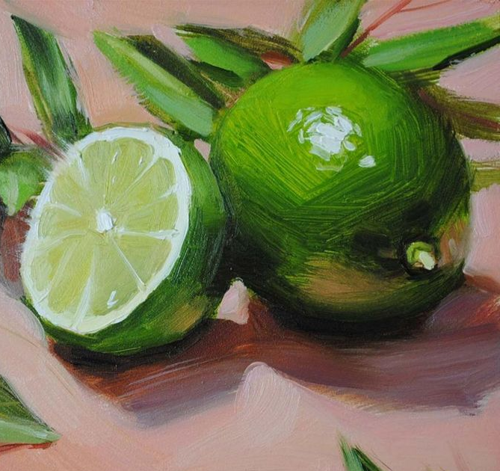
Investigation Drawings
Drawing 2 - colour
Look carefully at the limes on the left. There is a full oval shape and a cut section which contains a shape called an ellipse.
The thing that makes these shapes look rounded is again the shading, except this time the artist has used colour shading.
In oil pastel draw these limes as neatly as you can trying to match the colours through blending the pastels together.

Slide 4
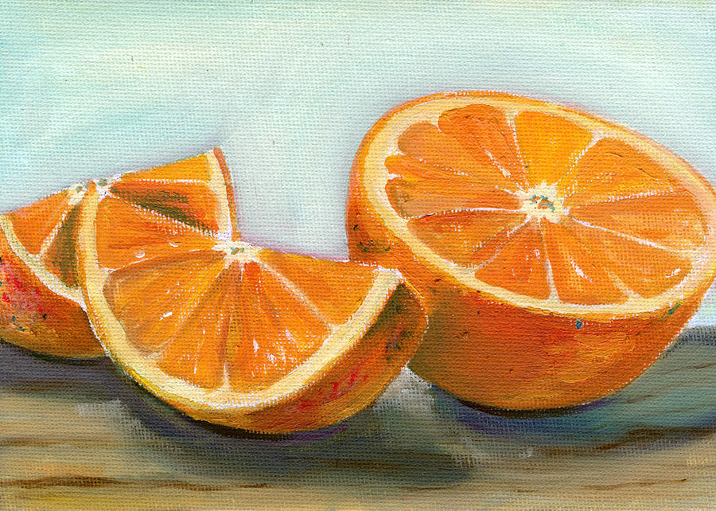
Investigation Drawings
Using the techniques you learned from Drawings 1 and 2 using coloured pencil now try to draw this orange. Look at how the ovals are now broken down into quarters. The orange also has shadows underneath to make the look 3D
HINT: SHADOWS ARE NOT BLACK

Slide 5
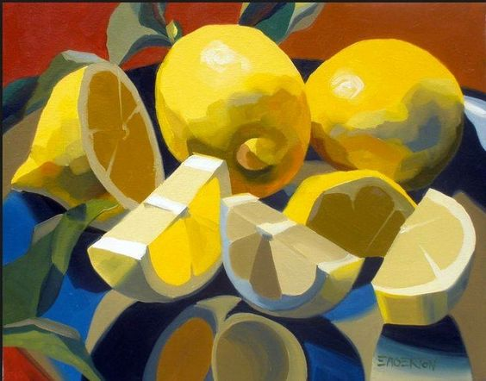
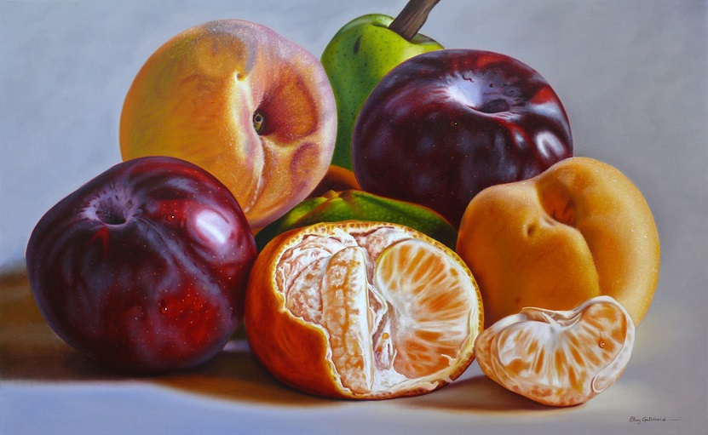
Development Drawings
In the next steps for this unit you will now be asked to draw groups of similar objects.
2 of these will be pencil sketches, where you will focus on improving your measurement, tone and shape drawing using pencil.
The final 2 drawings will focus on your use of different art materials, for these you will be drawing from real photos.
1 of the pictures should be a painting
The second can be in an art material of your own choice.

Slide 6
Pencil Drawing 1

Slide 7
Pencil Drawing 2

Slide 8
Folio Drawing 1 - Painting

Slide 9
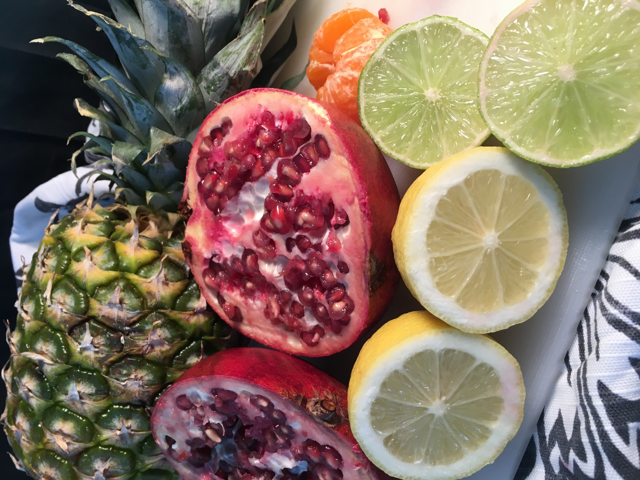
Folio Drawing 1 – You Choose the art material you want to use

Slide 10
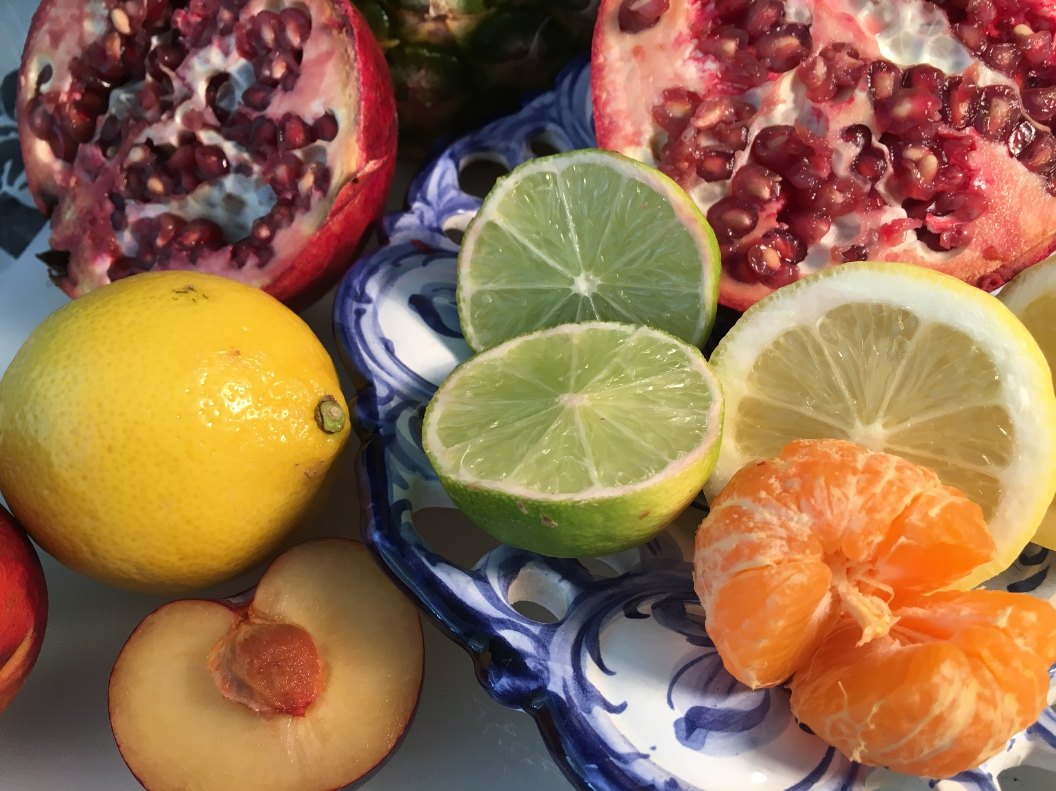
Final Piece
The final drawing for this unit should be on A3 paper and needs to be your best work! You should pick your best Art Material and create a piece of Art which shows off all of your abilities

Slide 11
National 4/5 Art and Design — expressive portfolio Evaluation
Candidate name: |  | Candidate number:
Centre number:
Instructions to candidates You should reflect on and critically evaluate the creative process you followed when working through your expressive portfolio. In your evaluation give justified personal opinions on: the decisions you made when working through your portfolio the success of the visual qualities of your portfolio, referring to your theme/stimulus

