Slide 1
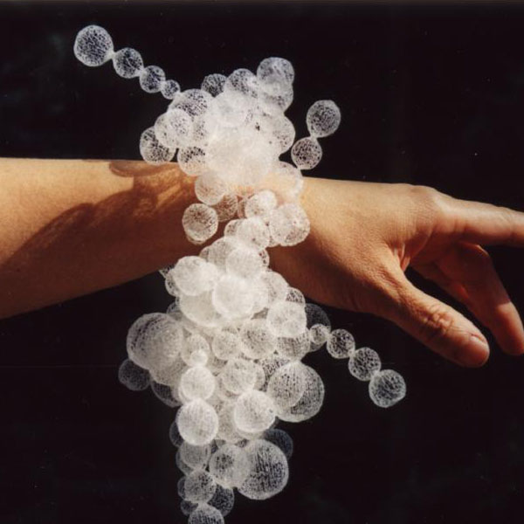
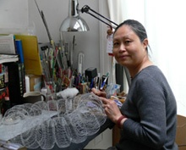
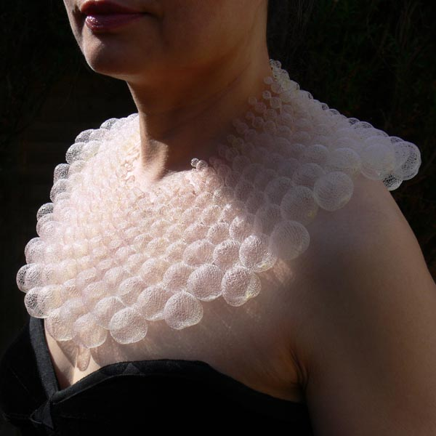
Senior Phase JEWELLERY ART & DESIGN STUDIES Nora Fok (1952 – Present) Contemporary Jewellery designer
norafok.com
themaking.org.uk
norafok.com
Disc Florets
Bubble Bath
Nora Fok Talks:
https://www.youtube.com/watch?v=UKGpsY8dNdQ

Slide 2
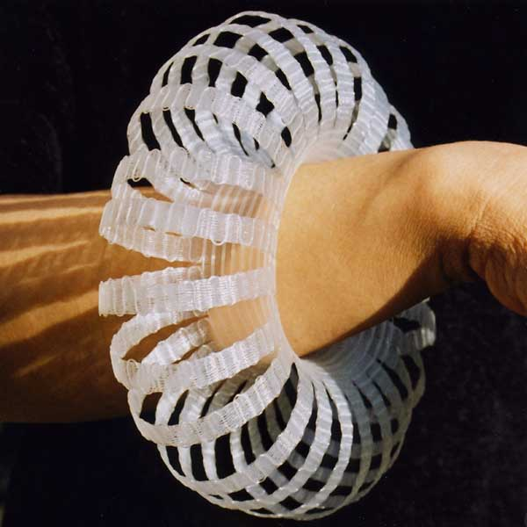
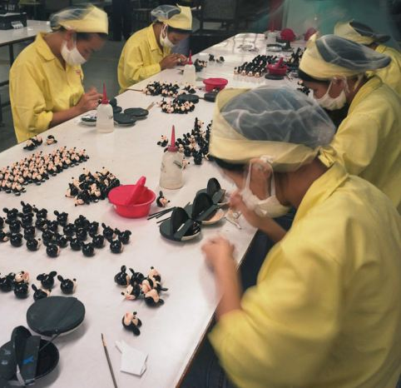
Nora Fok (1952 – Present)
BIOGRAPHY (with social and cultural aspects):
Fok is a highly talented and creative contemporary jewellery designer who expresses her ideas in a distinctive way.
She has a unique ability to translate ideas into delightfully delicate pieces which one instantly associates with her.
Exposure to different Cultures:
Fok was born in Hong Kong in 1952.
She left school at the age of 12 to work in a toy factory.
This gave her a very structured and disciplined up bringing which under pins her work today.
norafok.com
Woven Torus
norafok.com

Slide 3
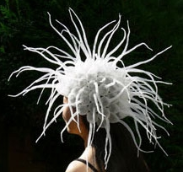
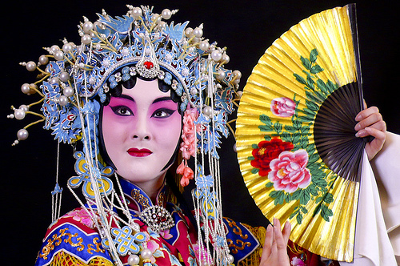
Nora Fok (1952 – Present)
BIOGRAPHY (social and cultural aspects):
Exposure to different Cultures:
When Fok was a child she visited Chinese operas.
She loved the ‘bling’ of the traditional costumes – they were colourful, glittering and fantastic.
Her earlier work related to these costumes, but instead of using gold and precious materials she redesigned them in nylon.
Fok was also influenced by the elaborate forms of the costumes and to begin with used shapes like the headpieces with dangling tassels as a reference.
‘Walking
Onions’ (right)
norafok.com

Slide 4
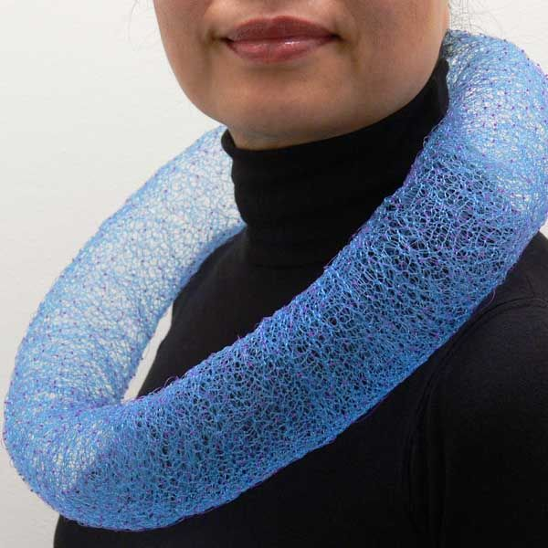
Nora Fok (1952 – Present)
Developments in Other Fields:
Fok first trained as a graphic designer in Hong Kong, doing several courses at the polytechnic in design and in advertising during the 1970s but she always knew this area of design was never for her.
Developments in Other Fields:
In 1978 she moved to England to complete a wood, metal, ceramics and plastics course at Brighton Polytechnic. This course encouraged her to explore materials in a new way. This course was the beginning of Fok’s journey into jewellery
Title: Constellations (1996)
Materials: knitted knotted dyed nylon diameter: 34cm

Slide 5
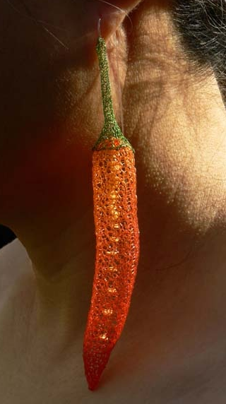
Nora Fok (1952 – Present)
Influence of other artists/ art movements:
Fok’s teachers at the Brighton Polytechnic (Caroline Broadhead and Susannah Heron) played an important role in helping her develop her own style of jewellery.
One tutor, was a keen angler, who brought in some nylon fishing line. Fok spent a lot of time playing around with the fishing lines and experimented with knitting and knotting it.
Red hot chillies earrings

Slide 6
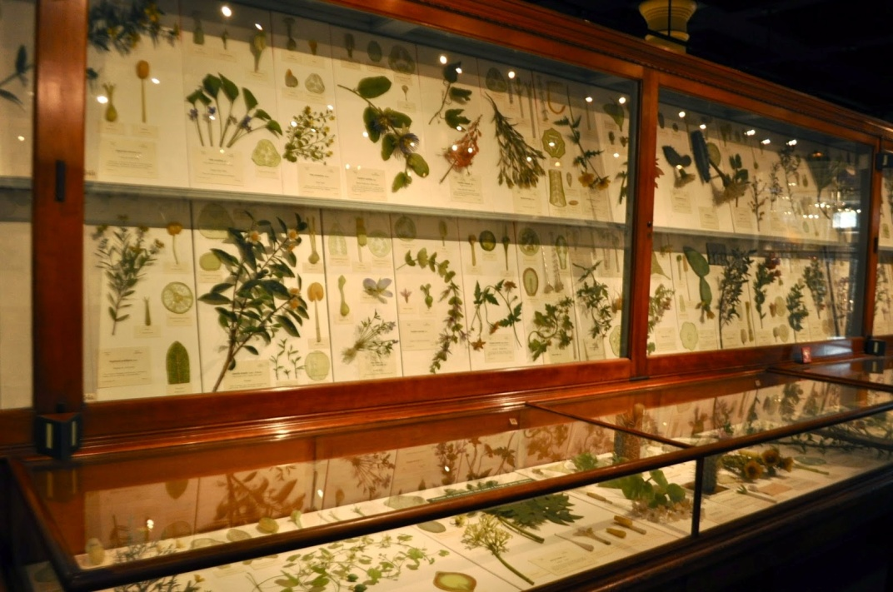
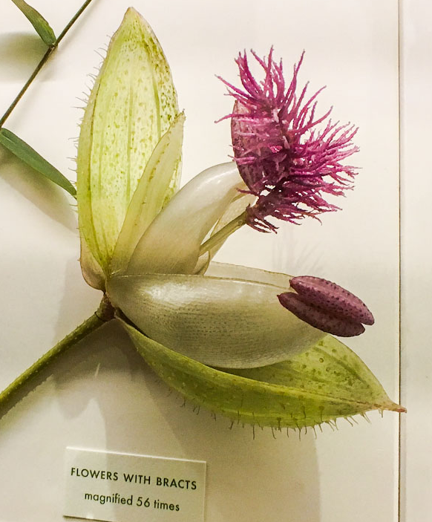
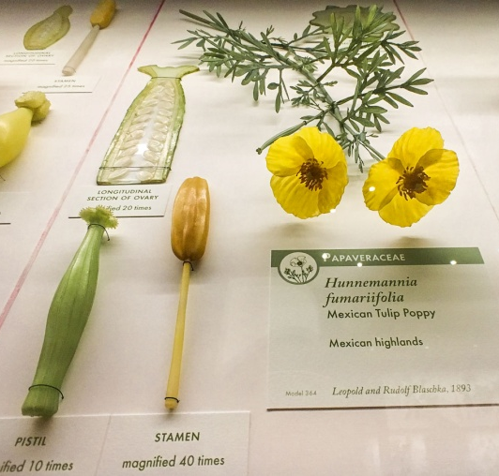
Nora Fok (1952 Present)
Influence of other artists/ art movements:
In 2004 Fok had the opportunity to visit the Glass Flowers exhibition at The Harvard Museum of Natural History.
The exhibition marked a turning point in her creative work as she started to study plants intensively.
She would dissect them and look at their geometry and underlying mathematical order and surface pattern.

Slide 7
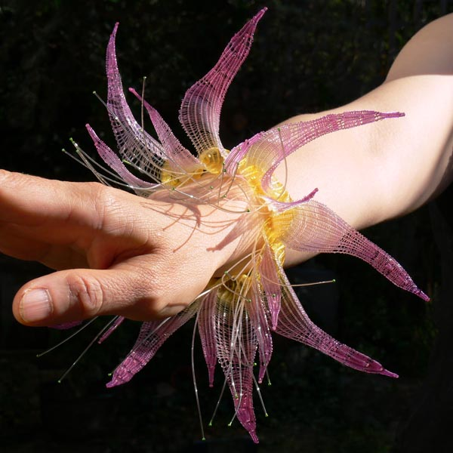
Nora Fok (1952 – Present)
New and Emerging Technology:
The new jewellery movement at this time focused on designers’ using different non-traditional materials, which Fok was really enthusiastic about.
New and Emerging Technology:
Lots of new, interesting materials were being used and Fok experimented with different materials like resin, fibre glass and acrylic. She spent a lot of time playing around with the fishing lines and experimented with knitting and knotting it. Fok also learnt to use dye to colour it.
Title: Aqualegia (2004) Function: wrist piece Production techniques woven, dyed
Materials: nylon
Size: diameter:19cm/7.5”

Slide 8
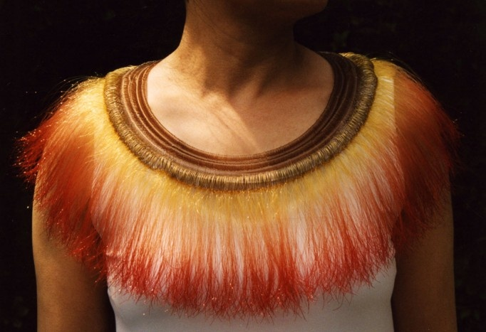
Nora Fok (1952 – Present)
New and Emerging Technology:
Fok felt that there was something new and special for her to discover with the use of nylon, as it was only invented in 1935 so it was new and exciting. The challenge was to learn new processes and develop creative ways to use the material.
New and Emerging Technology:
Fok knew the nylon had lots of potential and wanted to carry on working with it, especially as it was easy to manipulate. She loved its tactile qualities and the way that it is warm when you wear it against the skin. It also responds well to dying.
"Ring of Fire" 2003 Woven, knotted, dyed, pigmented nylon

Slide 9
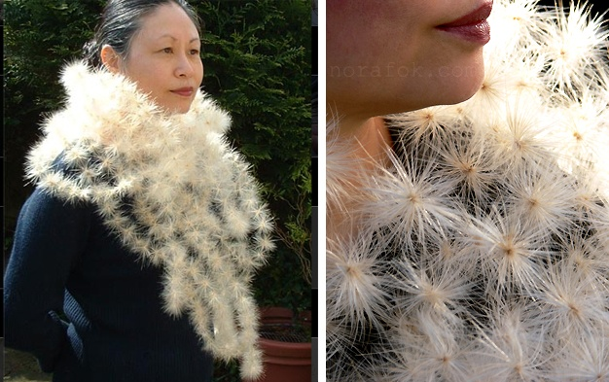
Nora Fok (1952 – Present)
Living Conditions:
Fok married artist and lecturer Frank Hills in 1984. She chose to work with nylon thread for practical reasons. It was not until the birth of her first child that she decided to work exclusively with nylon monofilament, as it is easy to work with and used simple techniques.
Living Conditions:
As a mother Fok would frequently travel to the market and buy vegetables. While preparing these at home she began to discover their natural beauty and source of inspiration.
Living Conditions:
When she returned to Hong Kong she didn’t have a studio or very much space so couldn’t work with aluminium or anything that needed a lot of equipment, but she could continue working in nylon at home.
Title: Million Dollar Collar (2006)
Materials: threaded artichoke seed parachutes and clear nylon.
Size: 65ft diameter.

Slide 10
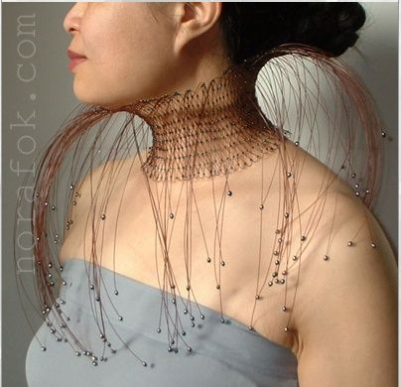
Nora Fok (1952 – Present)
FUNCTION: (What is the purpose of Fok’s designs?)
Fok’s work explores all areas around the body. She has designed small accessory pieces like rings and earrings to her more recognised larger scaled neck and head pieces.
Fok’s designs are for display purposes and are not meant to be worn as and everyday design. She eventually hopes to produce whole body jewellery/ sculptures.
JEWELLERY CATAGORIES:
Fashion or Costume Jewellery is designed around specific trends and is made from faux gemstones, and from non-precious materials. Pieces incorporate plastic, leather, wood, mother of pearl, and feathers.
Vintage Jewellery refers to styles from past decades: antique, estate (resold) or retro.
Studio Jewellery is created with a variety of materials. not just precious metals and gems it also includes the use of synthetic materials such as polypropylene, nylon, and acrylic to create dramatic effects.
Fine Jewellery usually has a much higher value then Fashion and Studio because of the application of precious metals like Gold and Platinum wth gemstones of Diamond, Emerald, Ruby, Sapphire and Genuine Pearls.
'Fountain' 2004

Slide 11
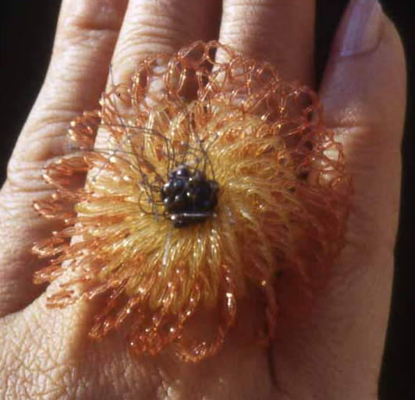
Nora Fok (1952 – Present)
INFLUENCES/ INSPIRATIONS:
(where does Fok get her ideas from?)
In her early work Fok used a combination of her many childhood and traditional memories as inspirations. She also takes inspiration from looking at dressmaking and theatre costumes with their use of beading and sequins.
After moving to England she became interested in the botanical world of nature. Looking under microscopic cells of plant life to get inspiration.
She always enjoyed making organic forms because the nature of the nylon thread made these shapes fairly easy to produce. Fok has spent a lot more time studying the natural world and found lots of things here that she had never seen before. Her Nylon Botanicus Collection was the result of some of my studies.
Title: Windflower ring – The Nylon Botanicus Collection (2005) Production/ Materials: woven dyed nylon with beads Size: diameter:5cm/2 inches One of Fok’s favourite flowers-I made this one especially hoping one day I would found one in golden orange in my local garden centre.

Slide 12
Nora Fok (1952 – Present)
PRODUCTION TECHNIQUES: (what processes has she used to make her deigns?)
Fok is a very traditional craftsman using basic weaving, knitting, pleating, knotting and tying methods with the nylon to achieve her forms. She uses no mechanical equipment, all her work is carried out by hand processes, with only basic tools.
She hand dyes and hand crafts all her work. Working with nylon monofilament she creates forms that have a delicate and flimsy appearance but are in fact extremely strong and secure and have a crush free character.
Fok initially completes lots of studies of a particular flower that interests her, and may then scan the flower so I can enlarge it on the computer. Sometimes she will leave it for a while before returning to it and trying to construct a piece around its form.
Fok quite often makes several test pieces first, working out the colours and sizes as well as the structures. There are always a lot of different possibilities, but she will use her judgement to work out where she wants to go with the peice, making decisions as she goes along. The majority of Fok’s pieces are one-offs so the whole making process is very experimental and time consuming.

Slide 13
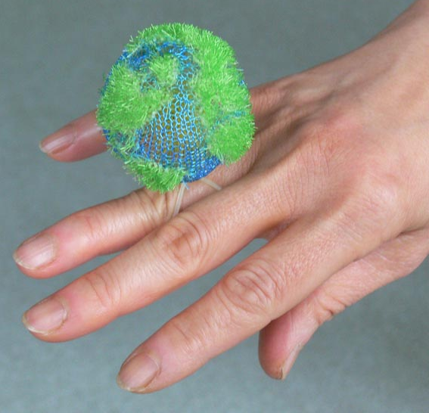
Nora Fok (1952 – Present)
MATERIALS:
(what does Fok use to make her designs?)
Fok works mainly with nylon monofilament.
She has chosen to work with this material because it is a cheap and simple material and she can experiment with it at home.
COST: (Are Fok’s designs expensive?)
Although Fok uses inexpensive materials her jewellery is extremely sought after and valuable due to her unusual working methods whereby she takes simple ideas and materials and creates unique intricate pieces of body adornment.
DURABILITY:
Working with nylon monofilament she creates forms that have a delicate and flimsy appearance but are in fact extremely strong and secure and have a crush free character.
Home ring (2004) knitted knotted dyed pigmented nylon height:6.5cm/ 2.5 inches “This is the only planet I know in the universe can sustain human life and am living on it”.

Slide 14
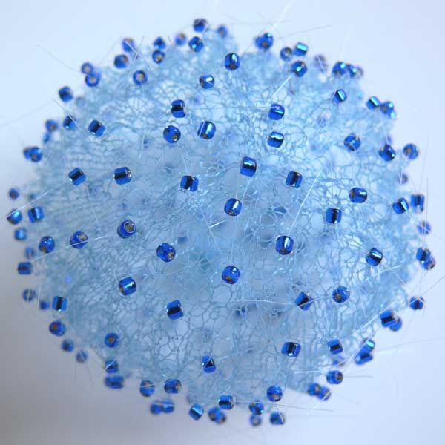
Nora Fok (1952 – Present)
Achievements/ Legacy:
Nora Fok’s major break through came in 1997 when ‘Galaxies’, Fok’s first solo exhibition was shown at the Hove Museum and Art Gallery (south east coast of England) . At this time Tim Wilcox also reviewed her jewellery in Crafts magazine (20.01.11 and 09.07.14).
Her work has progressed to become widely recognized internationally by inclusion in exhibitions, collections, and gallery shops.
In 2002 Fok was commissioned by the Weaving Stories at the City Art Centre in Edinburgh, Fok was asked to make whatever she liked as long as it was woven. This was really beneficial for Fok as she spent the majority of her time learning how to weave properly and afterwards she could incorporate these techniques in her own jewellery using different weaving techniques.
Her success has continued to develop over the decades and in 2010 she was one of 29 makers to be awarded the Jerwood prize for contemporary makers.
Nora Fok has now established herself as a pioneering maker, transforming organic forms into wearable, ethereal (extremely light or delicate) sculpture. Her delicate, intricate forms are woven from an ordinary material, nylon microfilament.
The processes Nora uses – knitting, weaving, crocheting and knotting – transform the linear nylon into simple and complex structures inspired by her fascination with the natural world and the mathematical models that underpin it.
Title: Blue pollen earring (2008)
Process/ Materials: knitted dyed nylon Size: D:7cm/2.75inches, height:7.5cm/3 inches

Slide 15
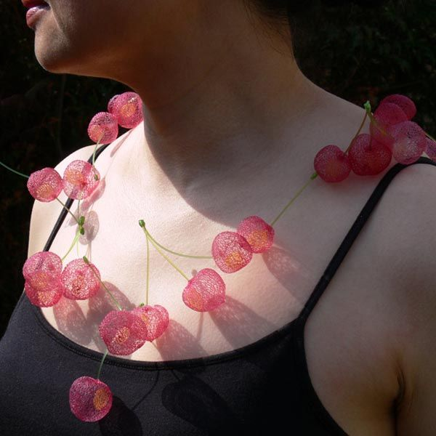
Nora Fok (1952 – Present)
The Future:
Ideally Fok would like to do much larger scale work and would like to make more sculptural objects rather than practical, wearable, saleable forms.
Fok is happy to think outside the box and has many unique and whacky ideas - like building a cocoon form around the body.
Title: Armadillo ( 2007)
Material: nylon
Nora Fok's intricate three dimensional jewels show her ability to capture the fragility and transient beauty of nature.
Title: Sweet Cherry
Date: 2007-08
Material: nylon
Process: Knitted, tied and dyed
Size: Diameter: 30cm

