Slide 1
Iris van Herpen: Transforming Fashion
November 7, 2015- May 15, 2015

Slide 2
Iris van Herpen
Chemical Crows, Dress, Collar, 2007‑2008
Iris van Herpen
Chemical Crows, Dress, Collar, 2007‑2008
Iris van Herpen
Chemical Crows, Dress, Collar, 2007‑2008
Ribs of children's umbrellas and cow leather
Ribs of children's umbrellas and cow leather
Ribs of children's umbrellas and cow leather
Iris van Herpen
Chemical Crows, Dress, Collar, 2007-2008
Ribs of children's umbrellas and cow leather
Groninger Museum, 2012.0193.a-b

Slide 3
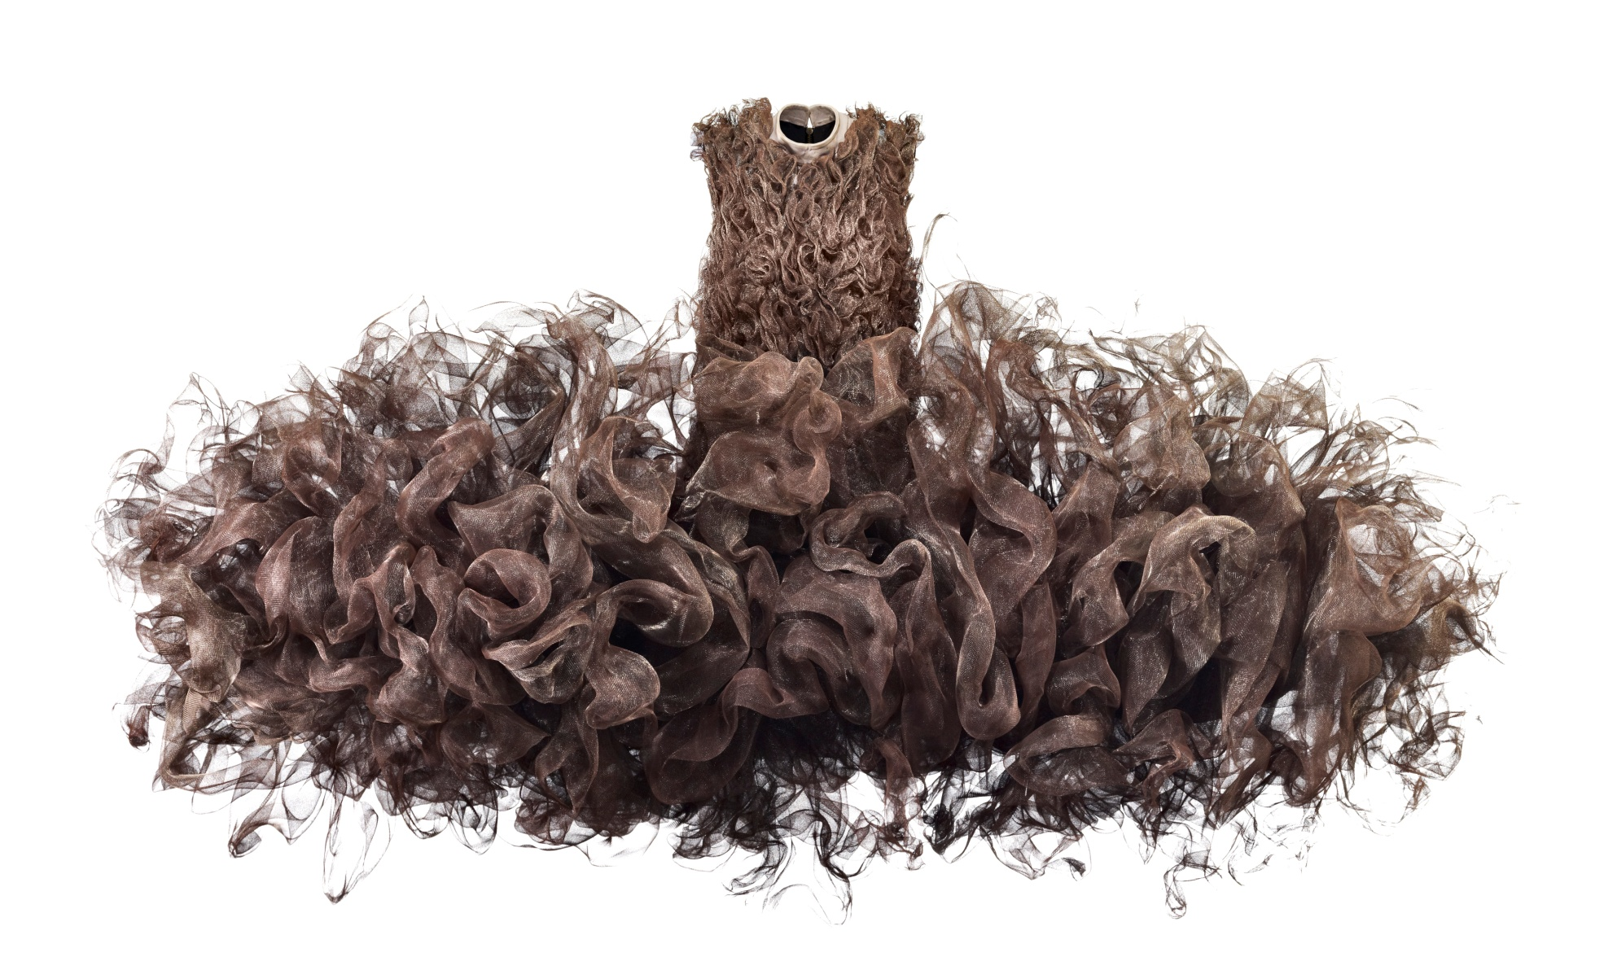
Iris van Herpen
Refinery Smoke, Dress, 2008
Untreated woven metal gauze, cow leather, and cotton
Groninger Museum, 2012.0196

Slide 4
Iris van Herpen
Mummification, Dress, 2009
Goat suede, metal eyelets, cow-leather
laces, busks, and cotton
Groninger Museum, 2012.0224

Slide 5
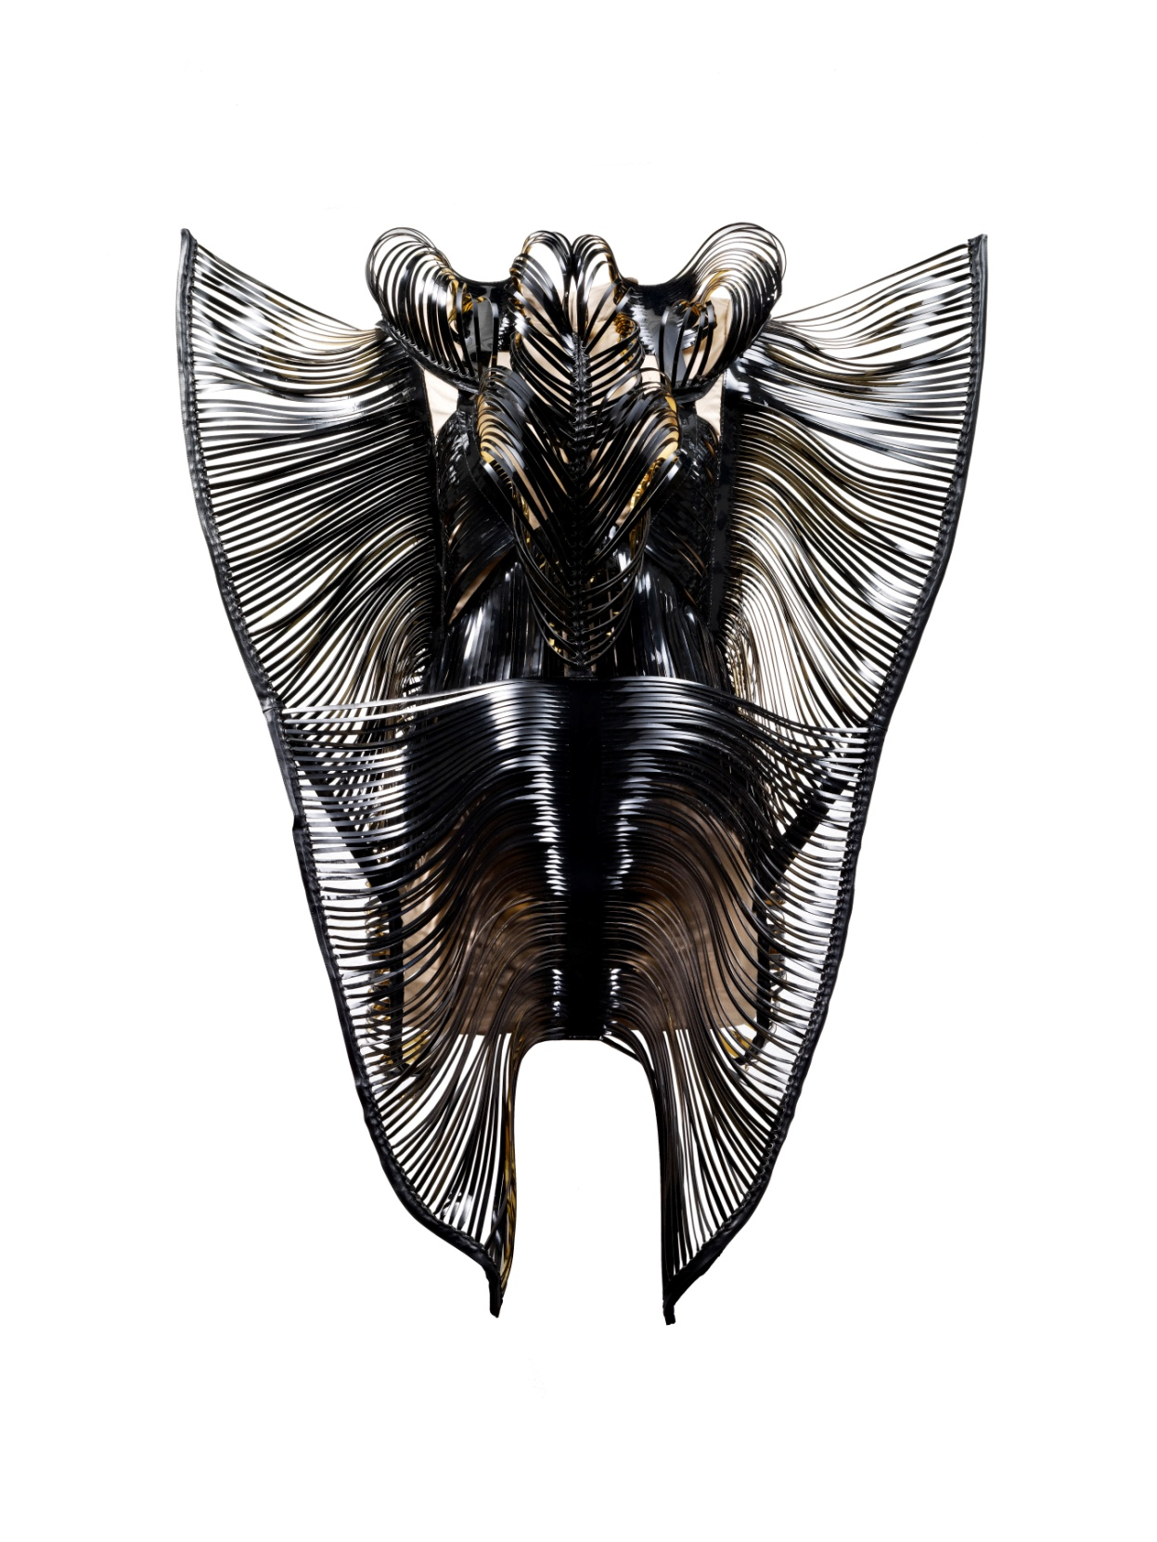
Iris van Herpen
Synesthesia, Dress, 2010
Lacquer leather, cow leather, gold foil, metal eyelets, busks, and cotton
Groninger Museum, 2012.0202.a-b

Slide 6
Iris van Herpen
Escapism, Dress, 2011
Transparent acrylic sheets, cotton, and tulle
Groninger Museum, 2014.0051

Slide 7
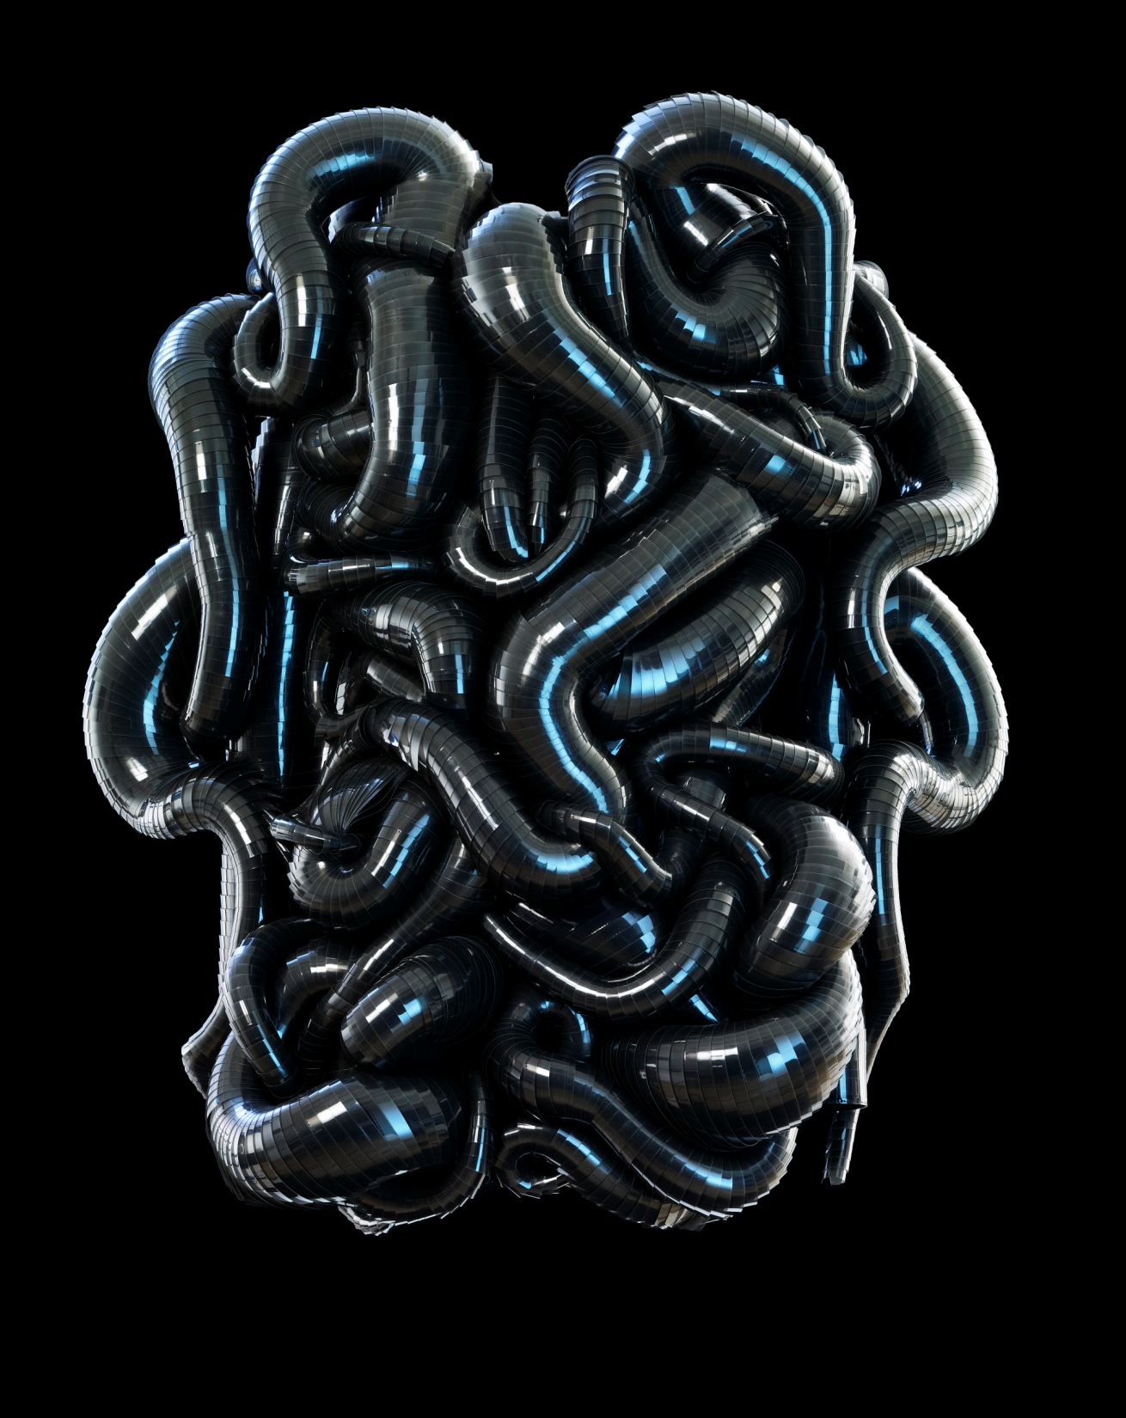
Iris van Herpen
Capriole, Dress, 2011
Transparent acrylic sheets, tulle, and cotton
Groninger Museum, 2012.0227

Slide 8
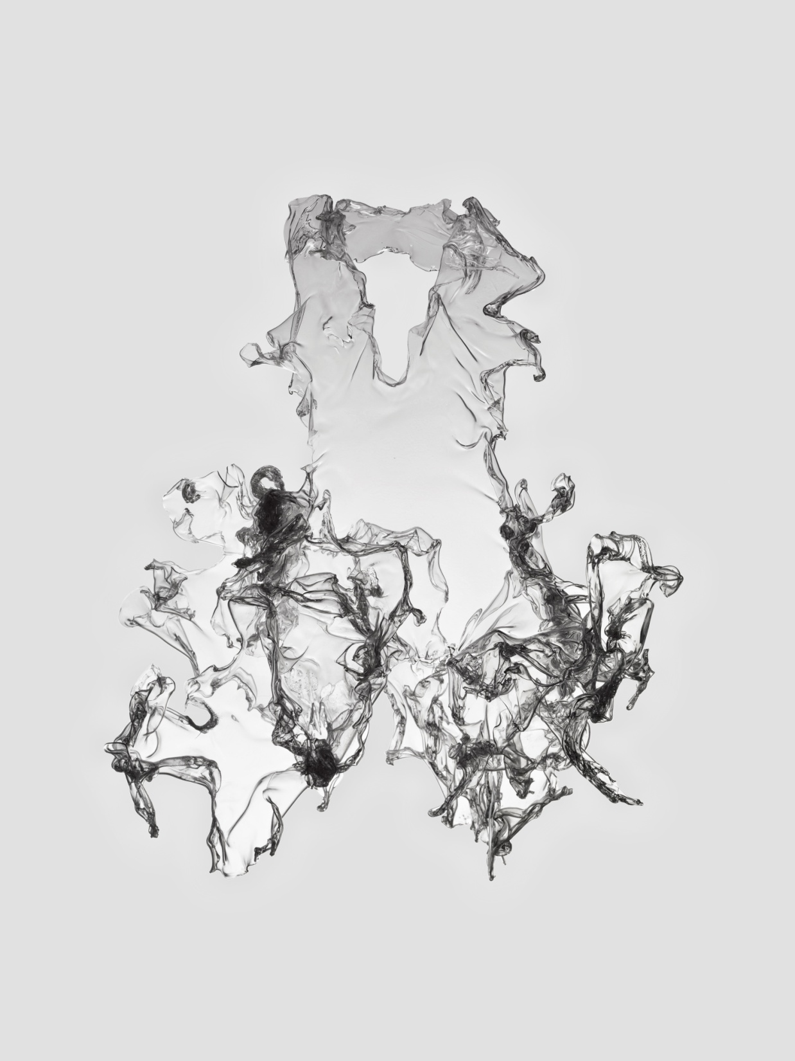
Iris van Herpen
Crystallization, Dress, Collar, 2010
Transparent polyethylene terephthalate, ECCO leather with oil treatment, goat leather, silver chains, and viscose
Groninger Museum, 2012.0206.a-b

Slide 9
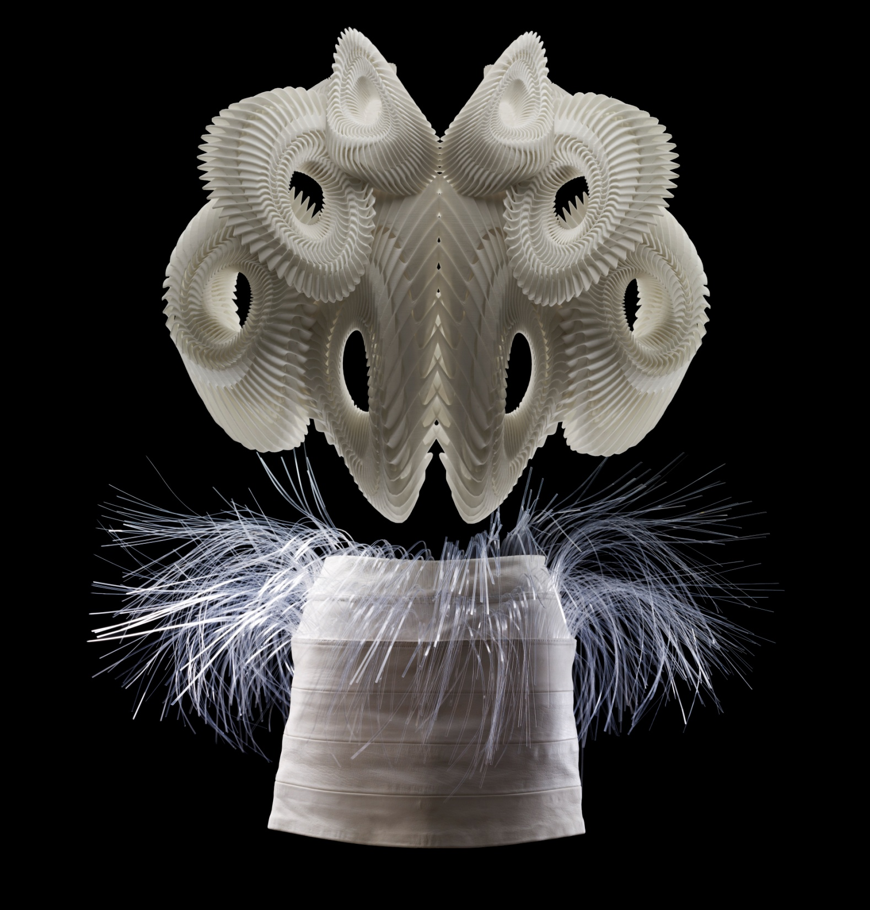
Iris van Herpen
Crystallization, Skirt, Top, 2010
3-D printed polyamide, goat leather, and transparent lasered acrylic sheets
Groninger Museum, 2012.0207.a-b

Slide 10
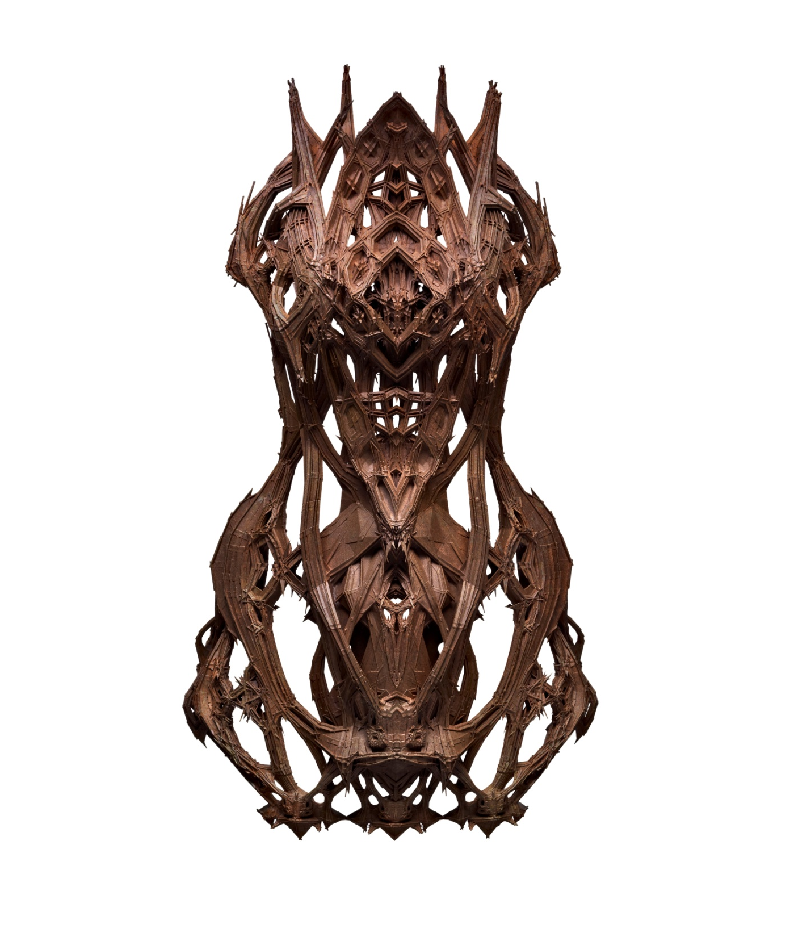
Iris van Herpen
Micro, Dress, 2012
3-D printed polyamide with art-copper treatment
Groninger Museum, 2015.0202

Slide 11
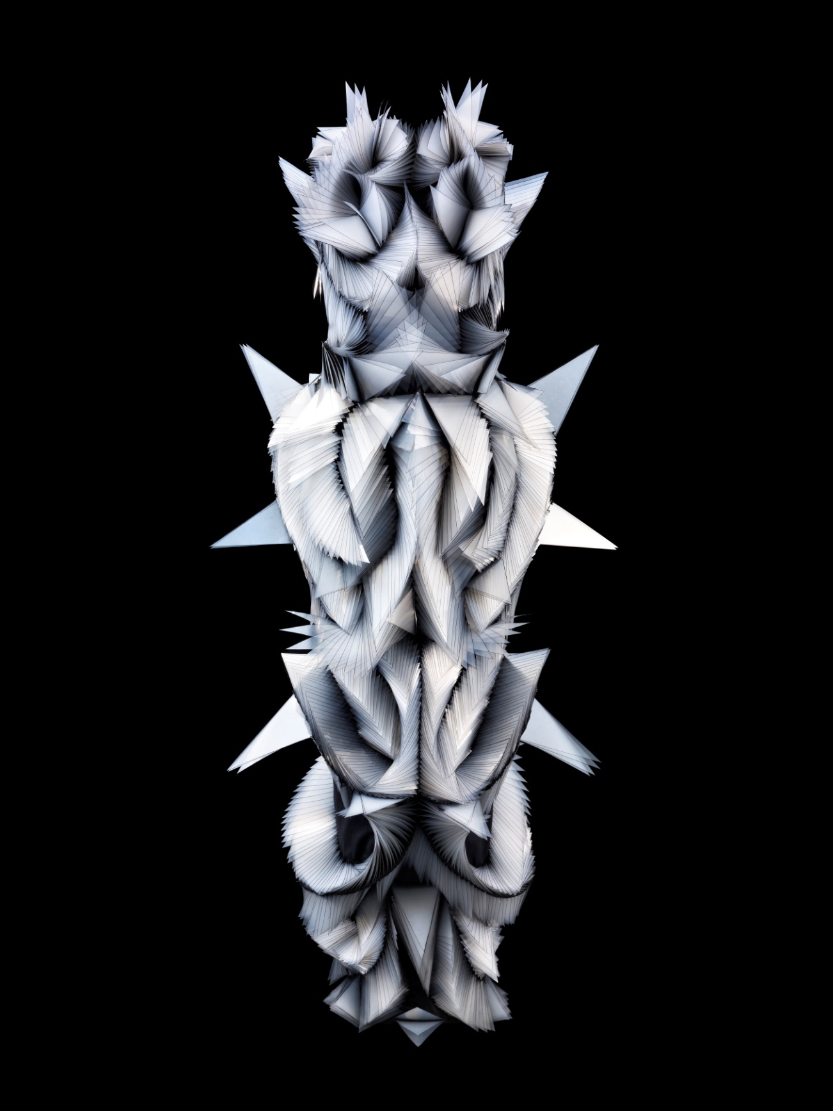
Iris van Herpen
Capriole, Dress, 2011
Transparent acrylic sheets, cotton, and tulle
Groninger Museum, 2014.0050

Slide 12
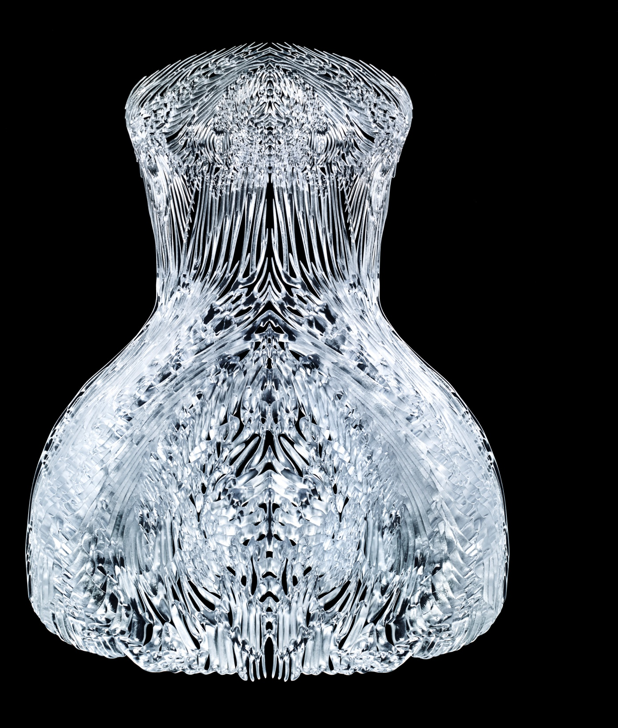
Iris van Herpen
Magnetic Motion, 2014
3-D printed transparent Photopolymer, SLA (stereolithography) resin

Slide 13
Iris van Herpen (Dutch, b. 1984)
Hybrid Holism, July 2012
3-D printed UV-curable polymer

Slide 14
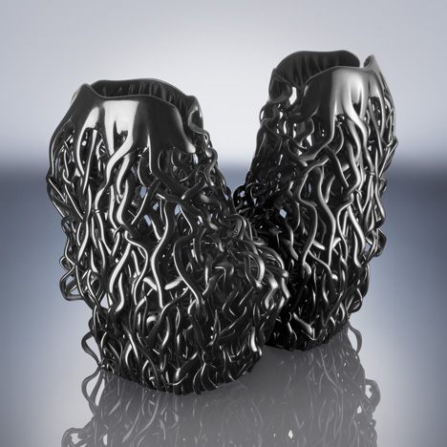
Iris van Herpen
Wilderness Embodied, Shoes
Rigid opague photopolymer

Slide 15
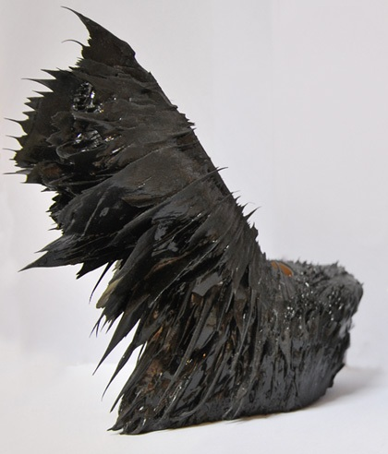
Iris van Herpen
Magnetic Motion, Shoes
Iron filings and polyurethane resin

