Slide 1
Expressive Drawing Unit
Still Life
Theme: Time Out

Slide 2
Ralph Goings
https://docs.google.com/presentation/d/e/2PACX-1vR54G4c3jCjif28LkYMLgsb2vbYDH9PHxrtm1_7OFUdnI-mzRfBB9VnE1nP-yWfOFuezKJVTiv4qj6h/pub?start=false&loop=false&delayms=60000&slide=id.g89986e3284_0_14

Slide 3
LI:
I am learning how to draw various objects.
SC:
I can identify basic shapes within an object
I can use and apply knowledge to basic shapes to create form
I can use different drawing techniques to create form

Slide 4
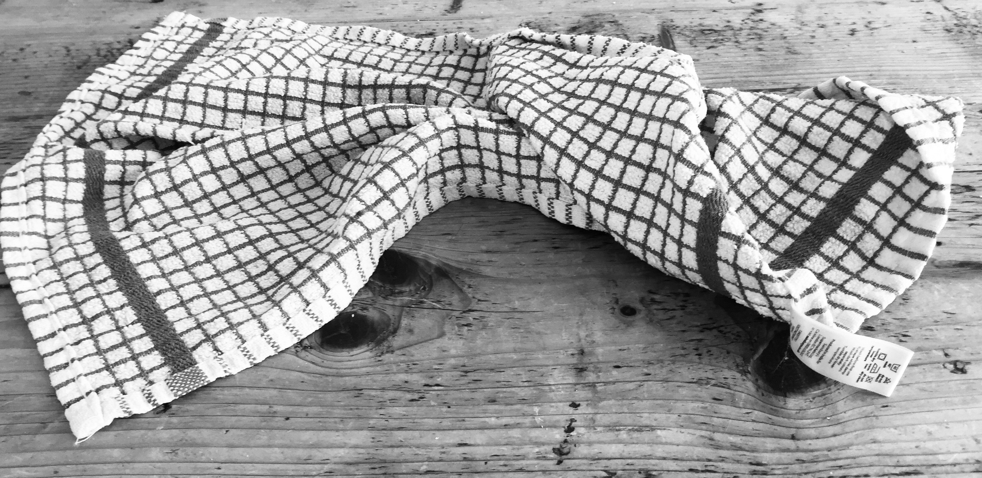
Investigation: Line Drawing

Slide 5
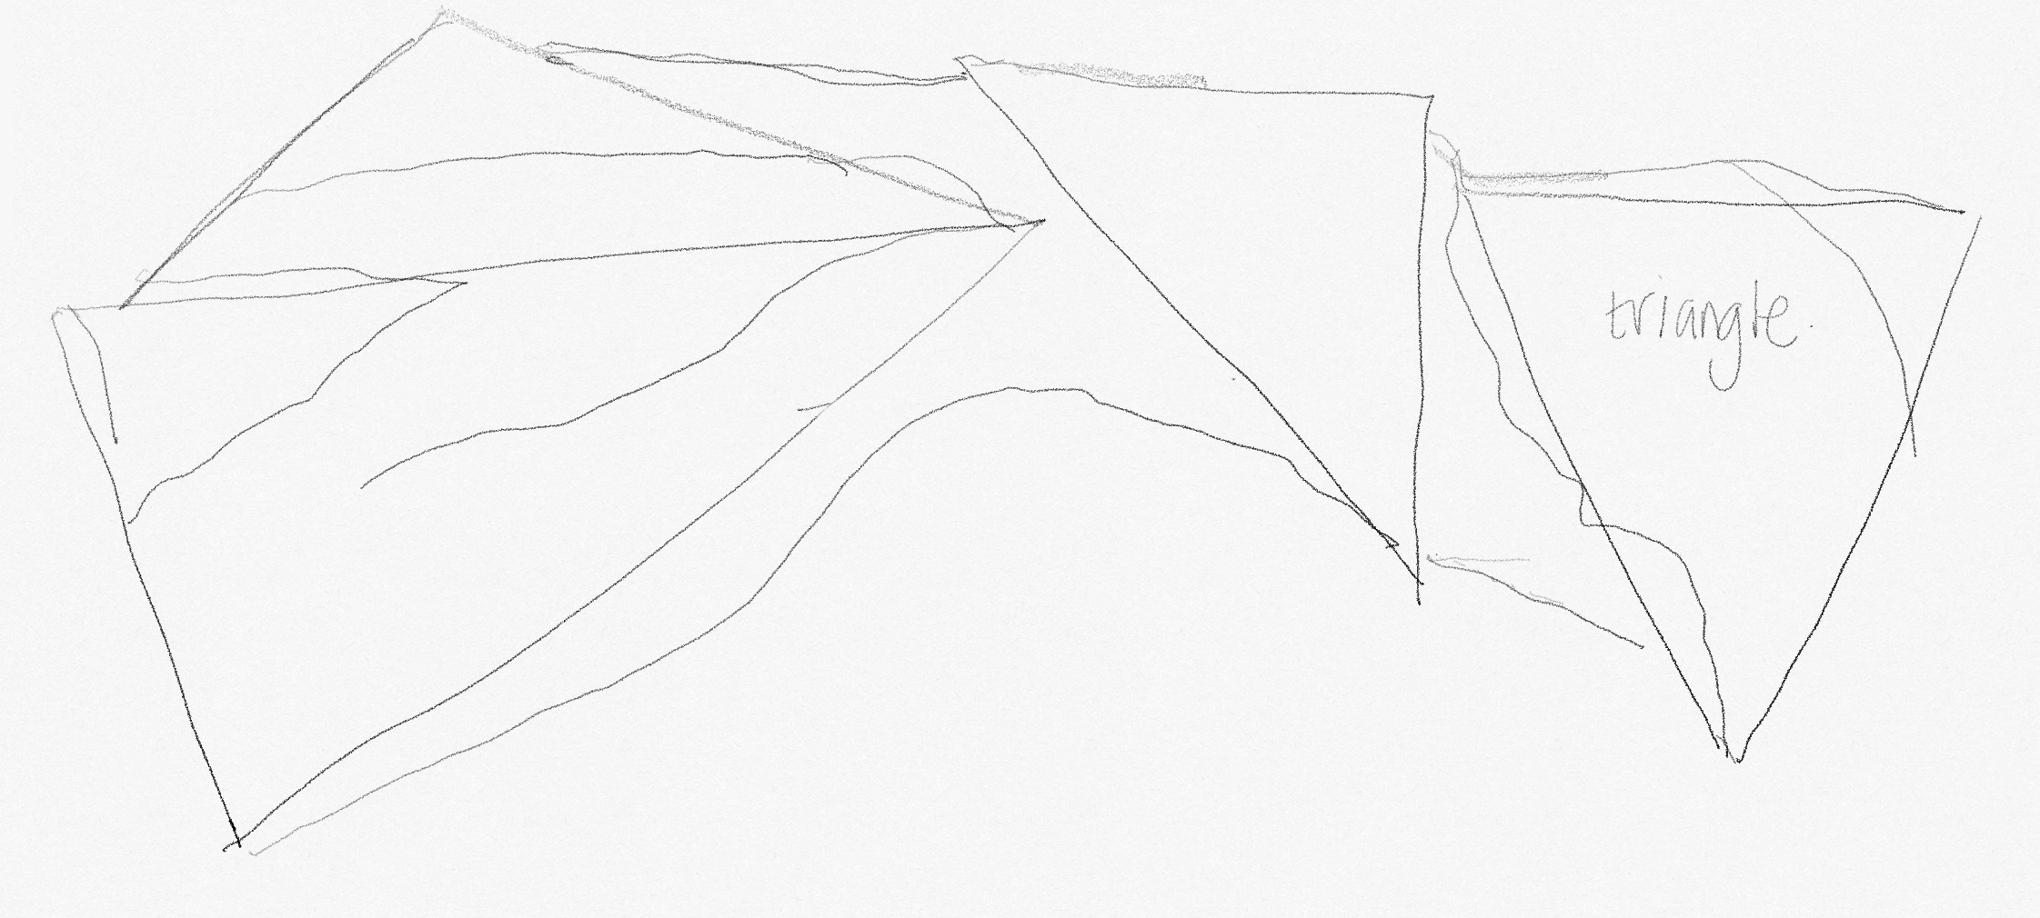
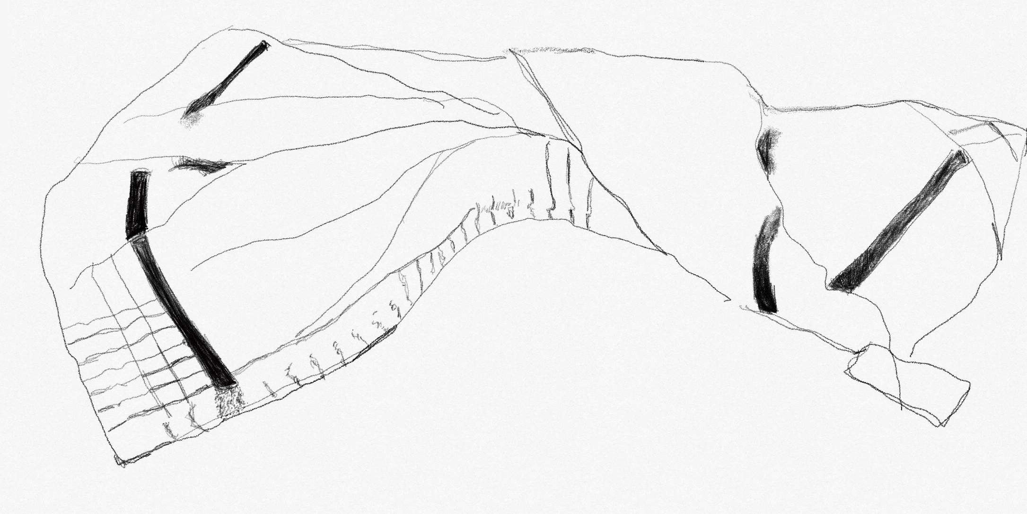
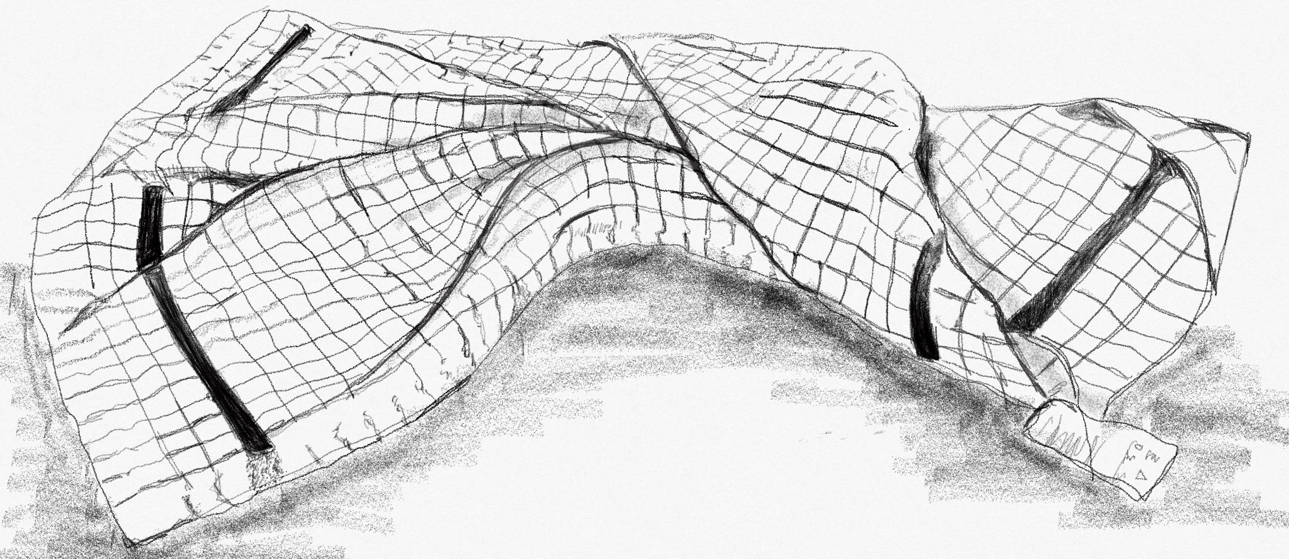
Investigation: Line Drawing
LI: I am learning how to draw various objects.
SC: I can identify basic shapes within an object . I can use and apply knowledge to basic shapes to create form. I can use different drawing techniques to create form

Slide 6
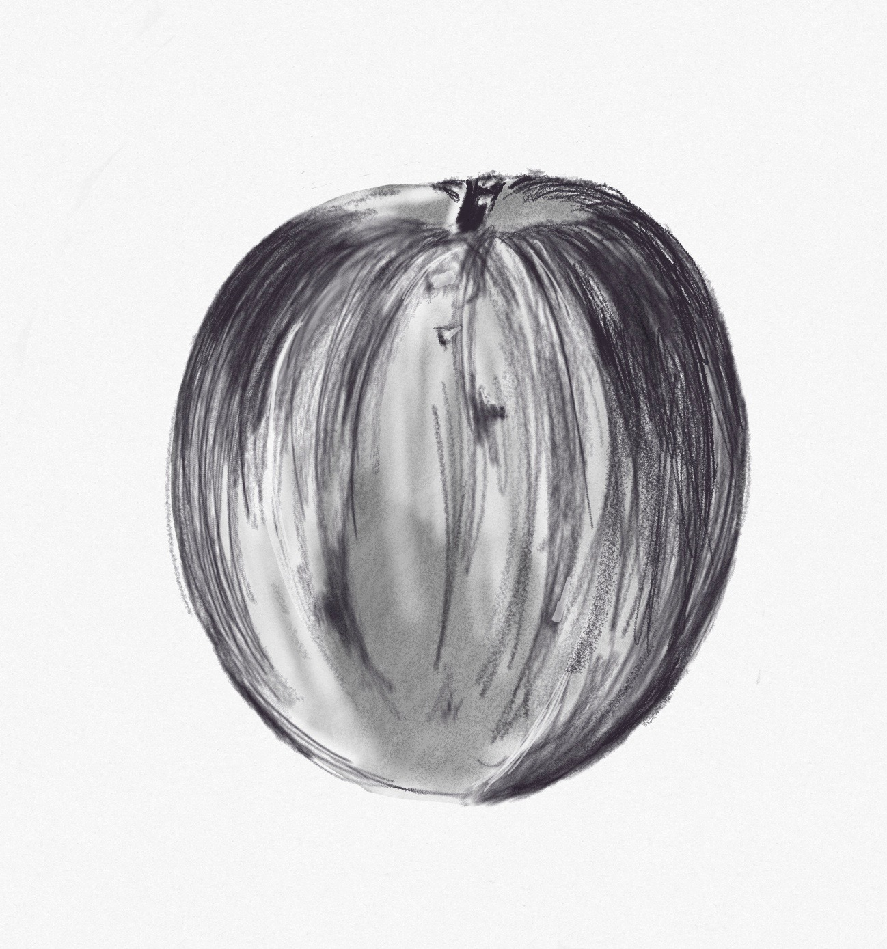
Investigation: Eraser and Pencil
The following 3 objects are close ups. As part of your unit you have to draw these objects in as much detail as you can.
Buzz words
Visual elements
Basic shapes
Apple Drawing – Eraser and Pencil
Look carefully at the object on the left.
Break down into a basic shape.
What makes the apple look rounded?
Using pencil and an eraser draw the apple as neatly as you can
The next slide will help you prepare your paper
Notes:
Change the thread ….fabric

Slide 7
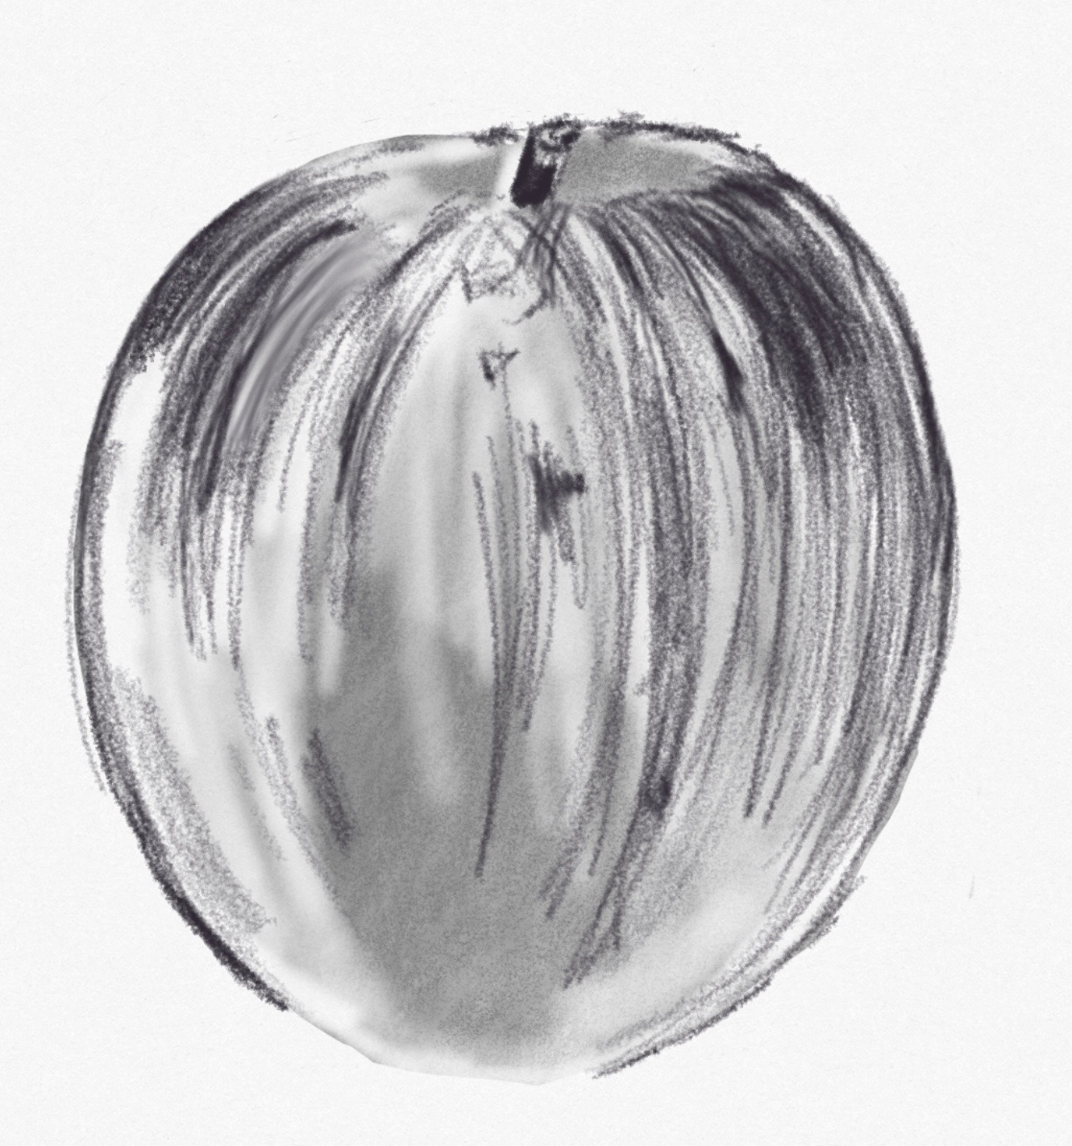
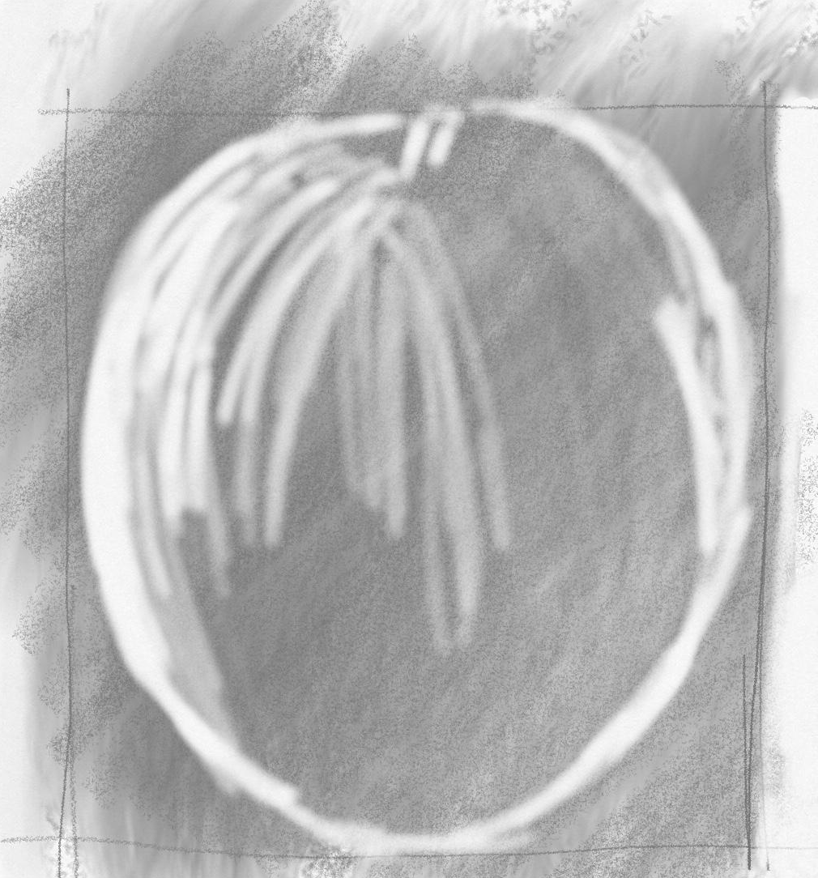
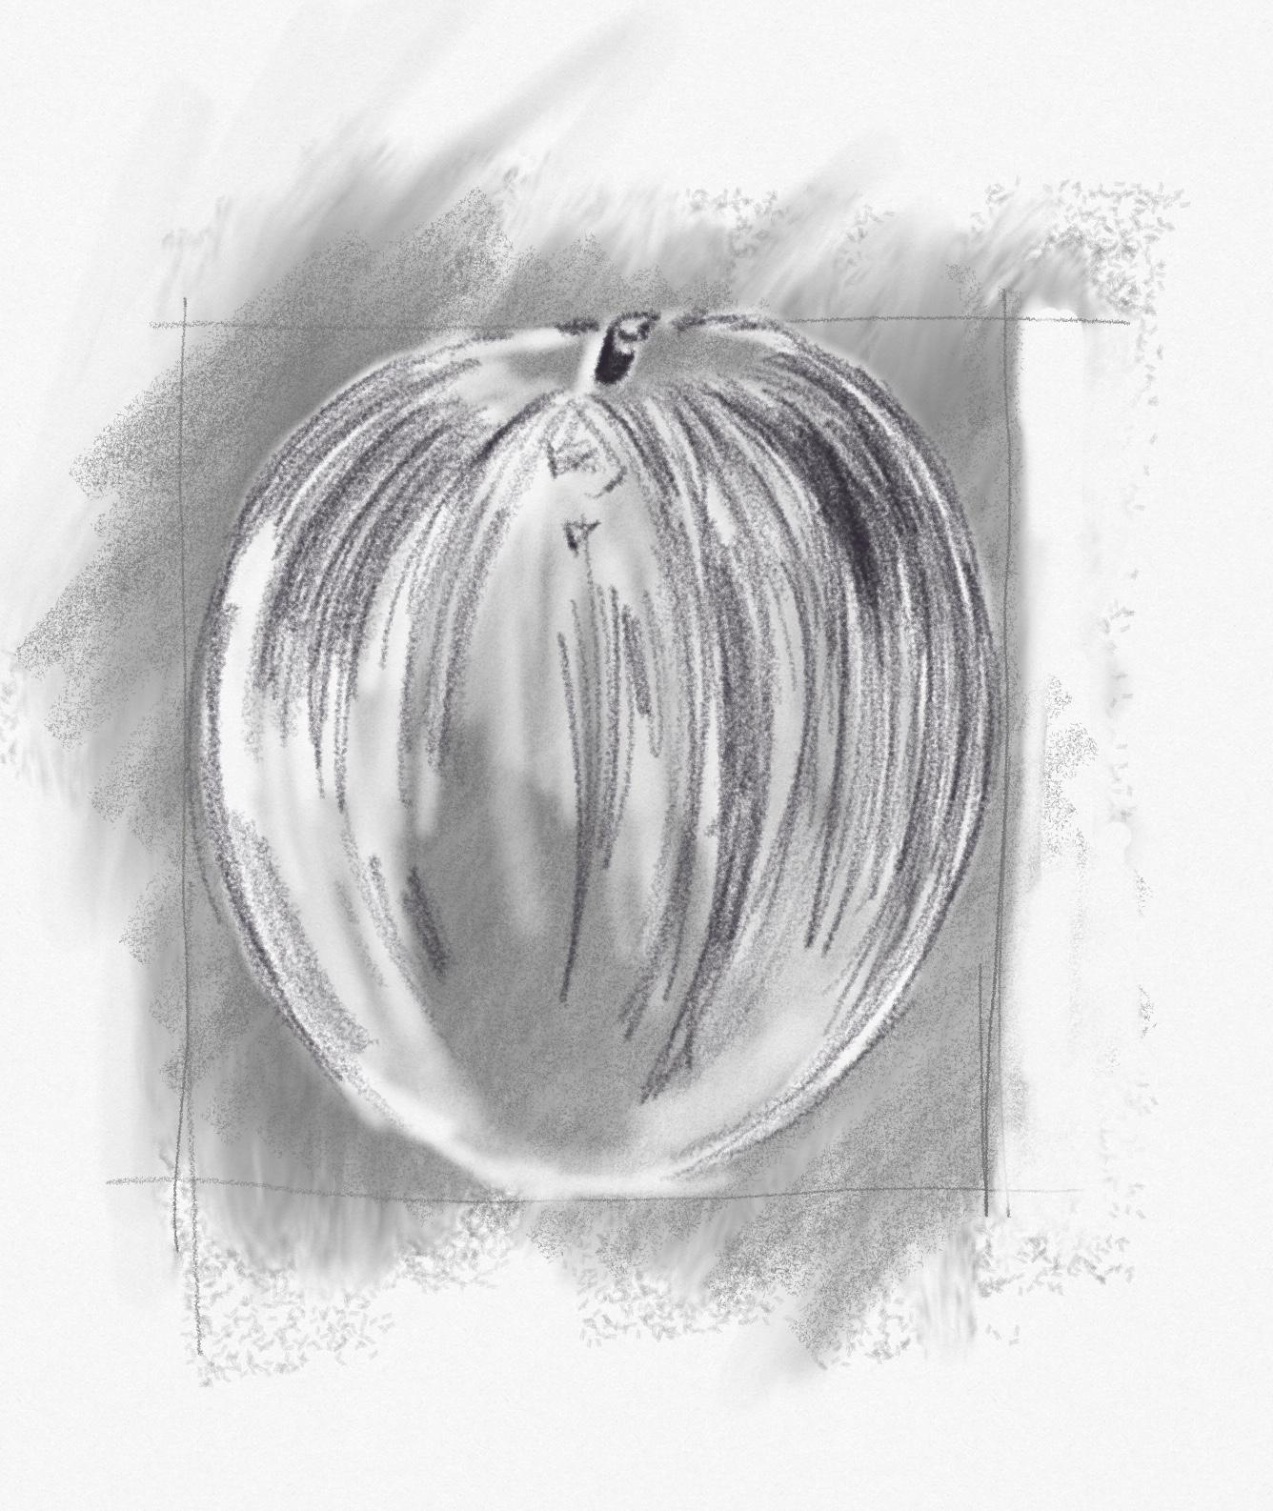
Step 1: 3 layers of rubbing side of pencil on paper
Step 2 : 3 more layers of rubbing side of pencil on paper
Step 3 : 3 more layers of rubbing side of pencil on paper
Drawing Skills
LI: I am learning how to create form using tone
Step 4: draw using the eraser
Step 4: draw using the eraser and pencil
SC: I can apply tone in a controlled and sensitive manner

Slide 8
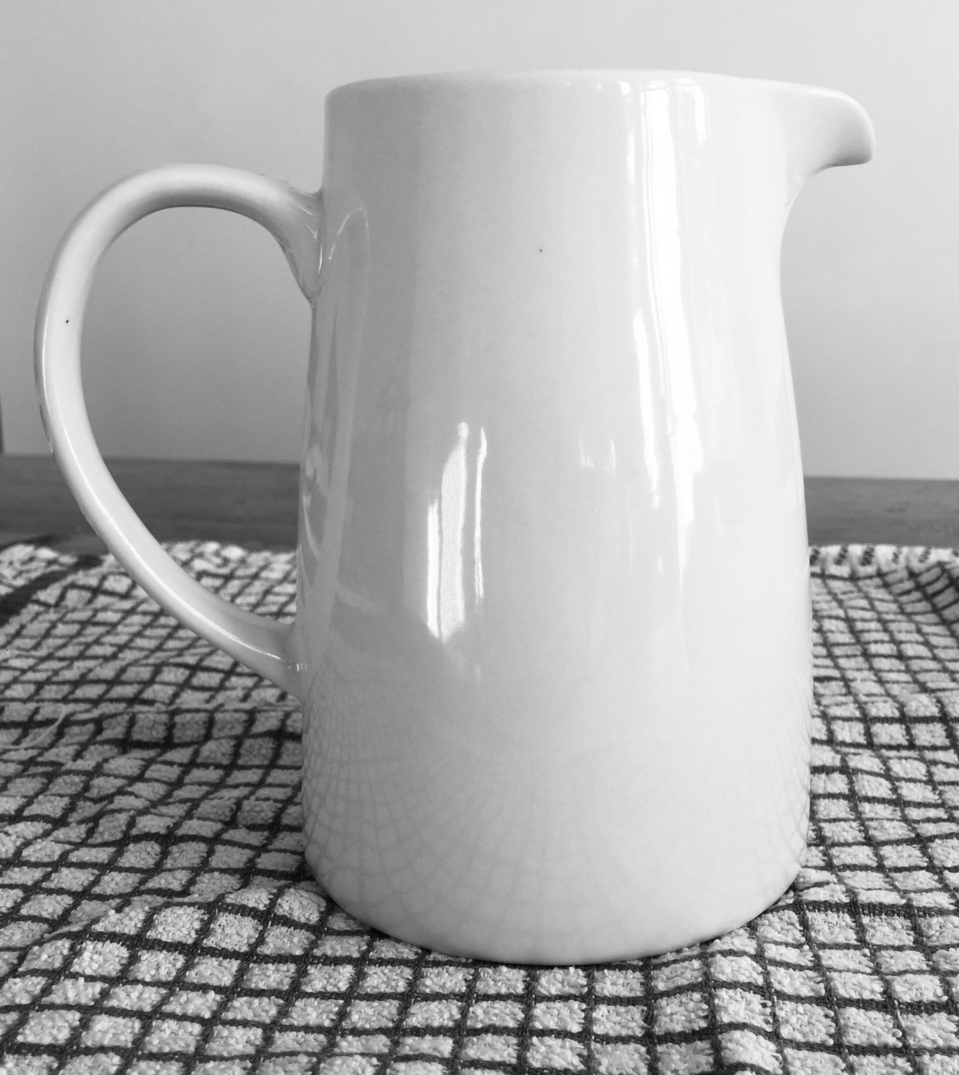
Investigation: Tone
Drawing
Look carefully at the this image.
There are a curves on this object, which contains a shape called an ellipse.
The thing that makes these shapes look rounded is how the light reflects off the object..
Using pencil draw the object as neatly as you can.
An ellipse a geometric is a geometric shape that results from viewing a circular shape in perspective, or from a different vantage point.

Slide 9
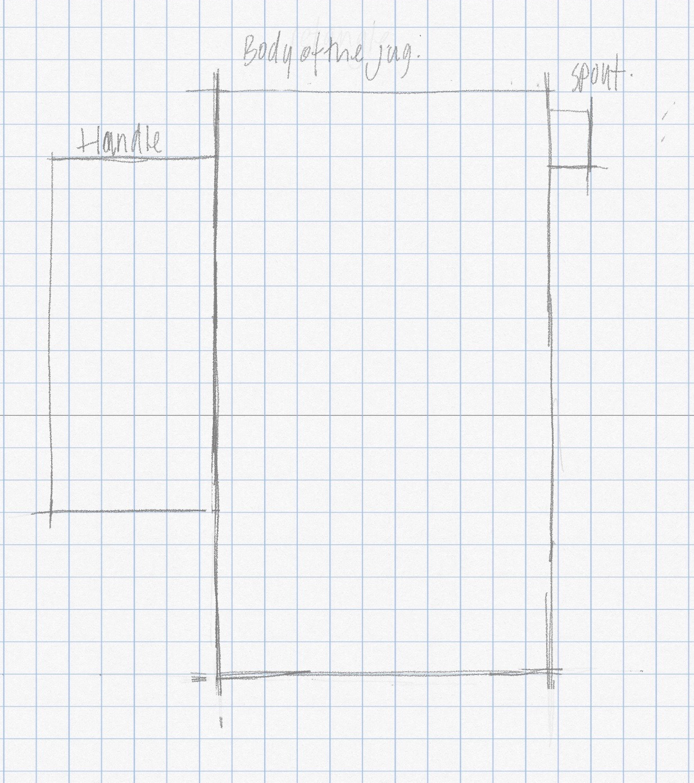
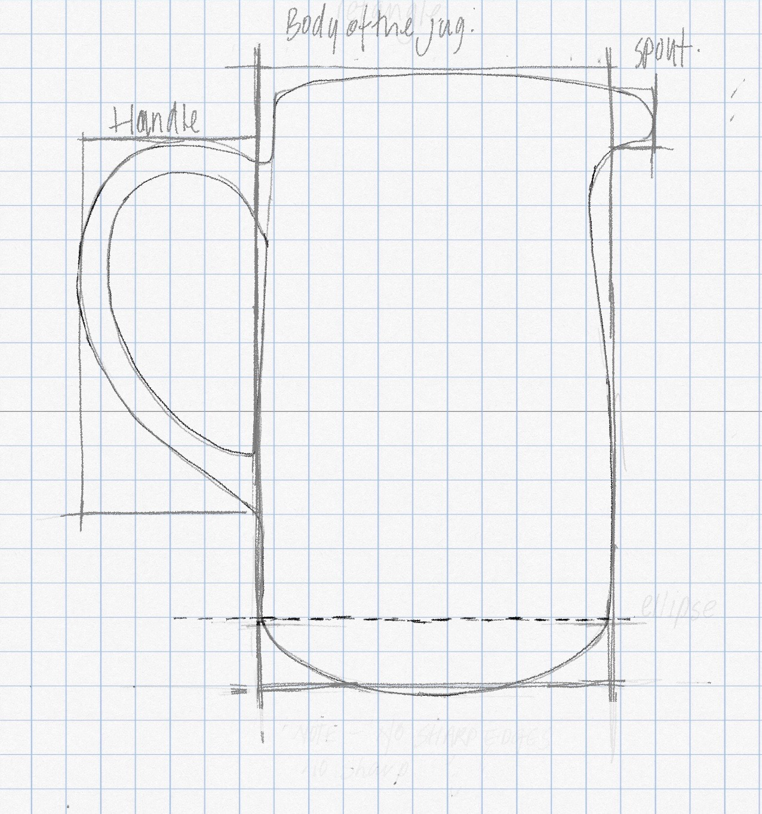
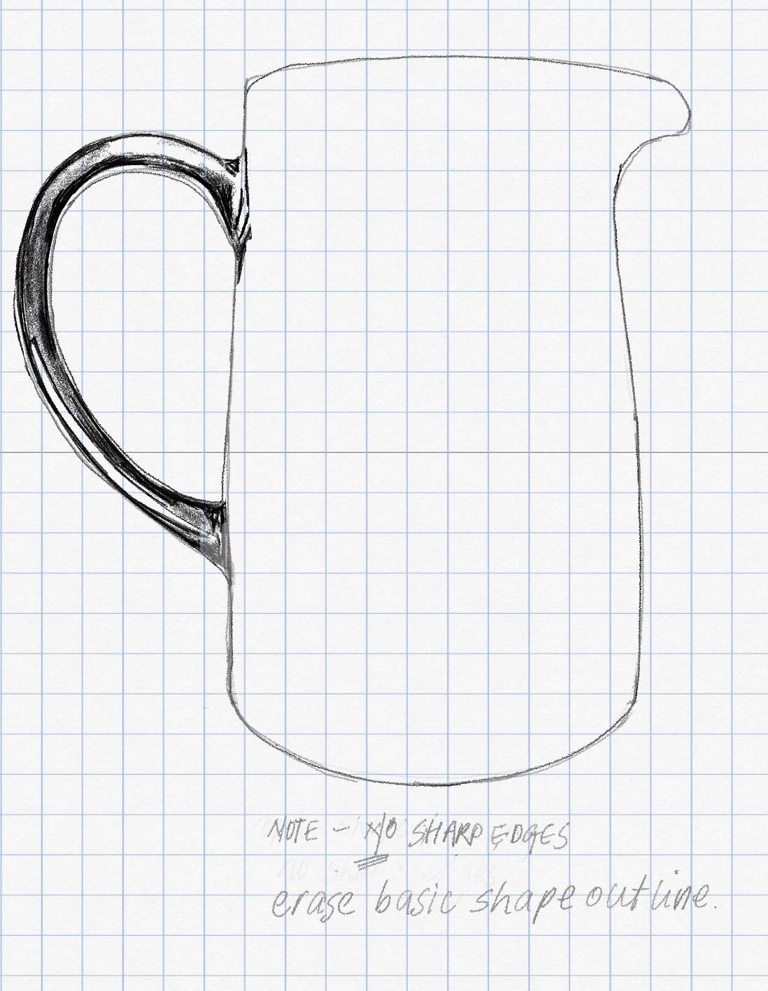
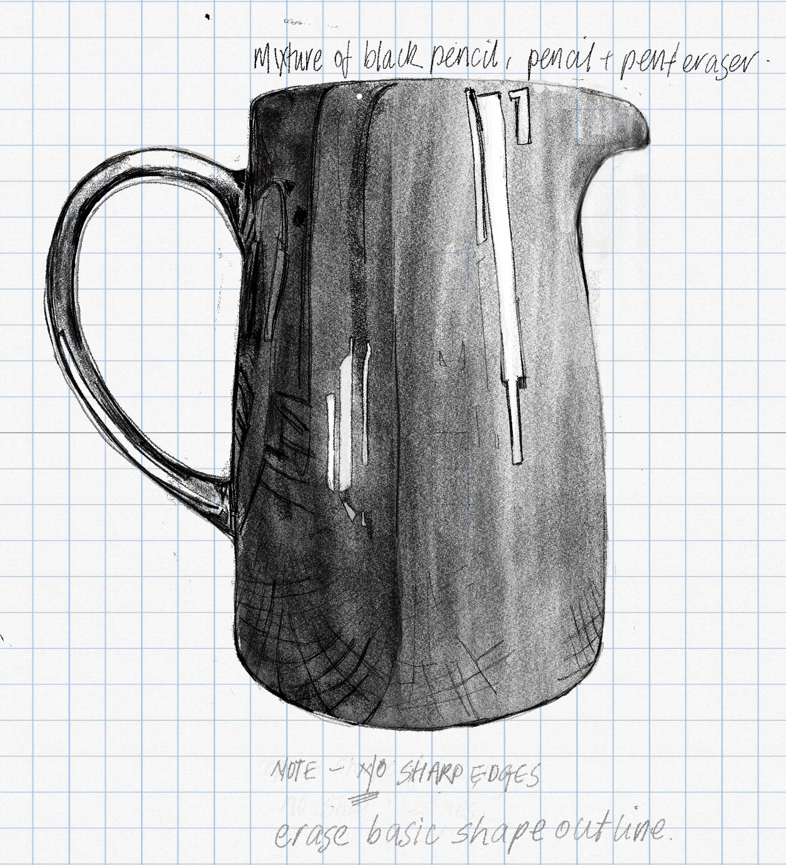
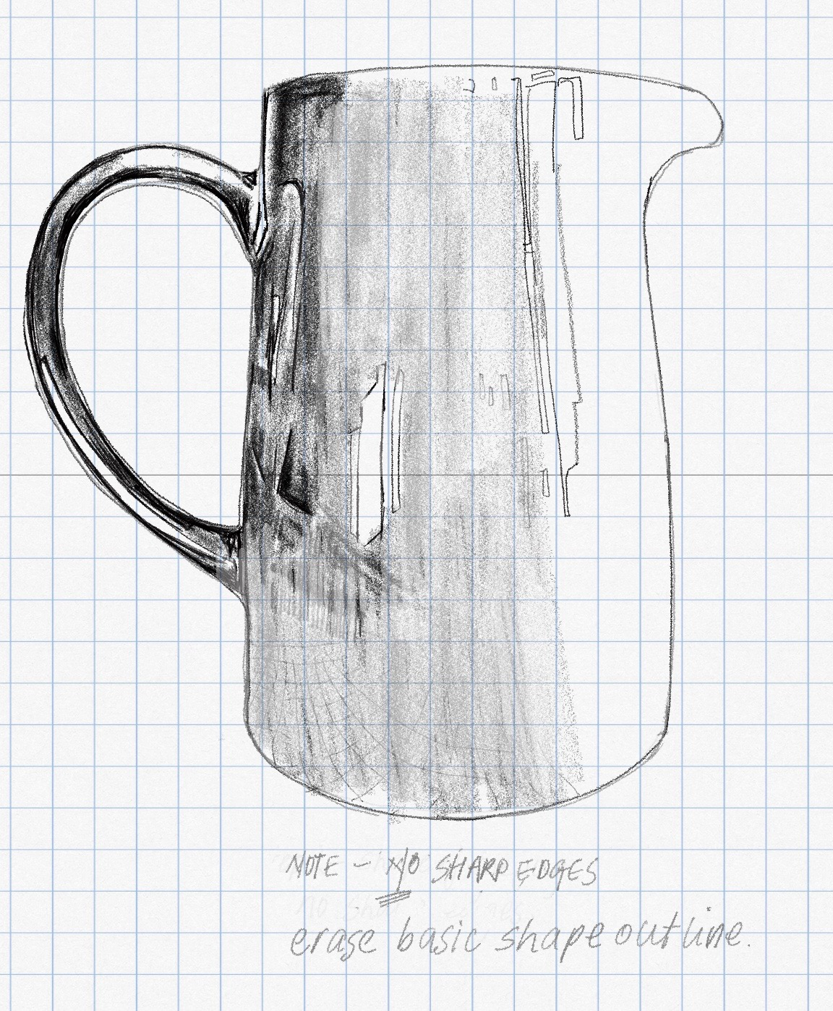
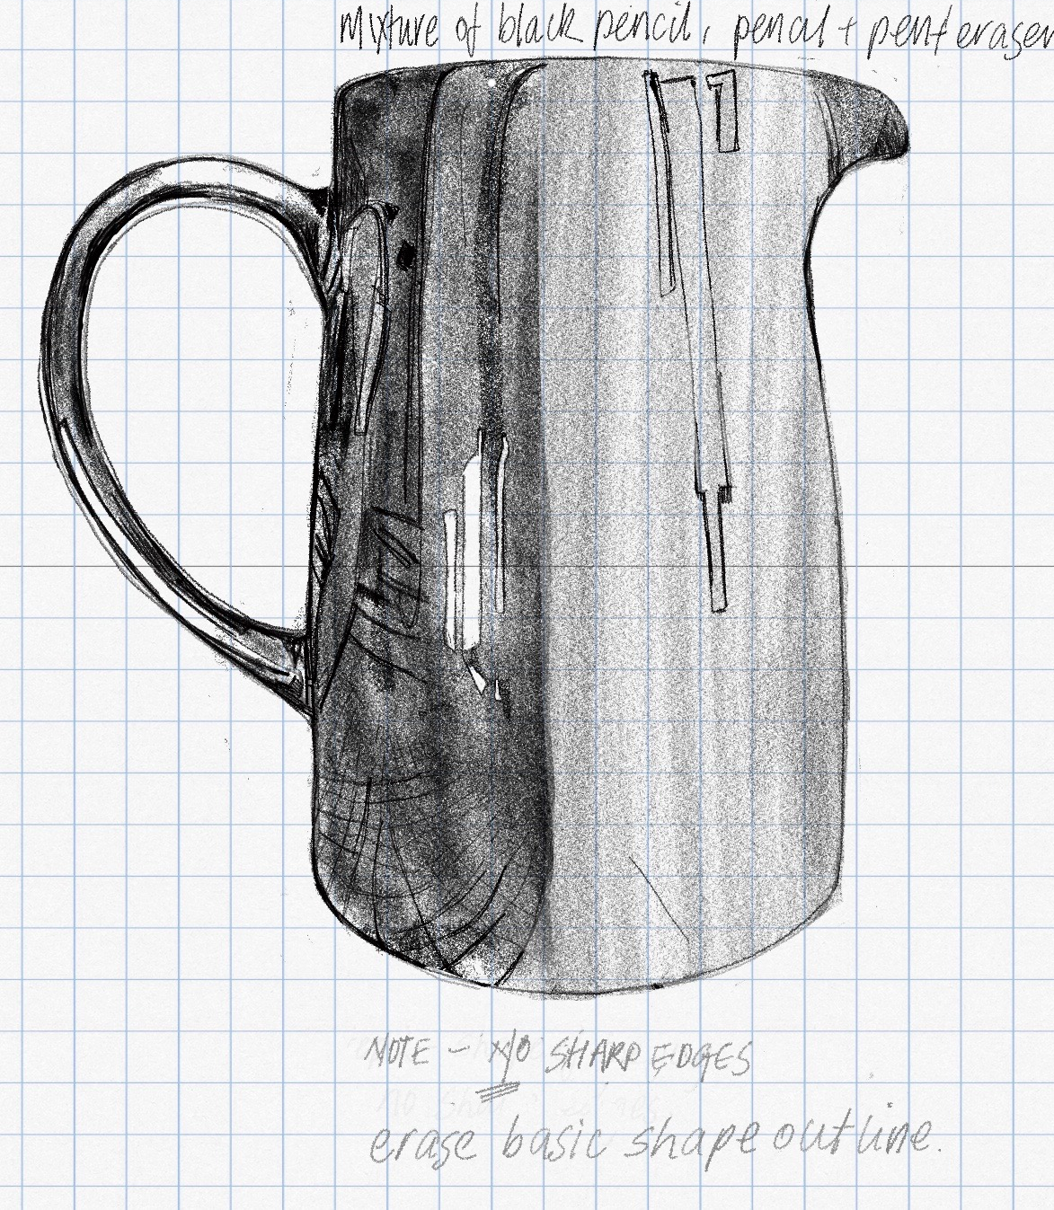

Slide 10
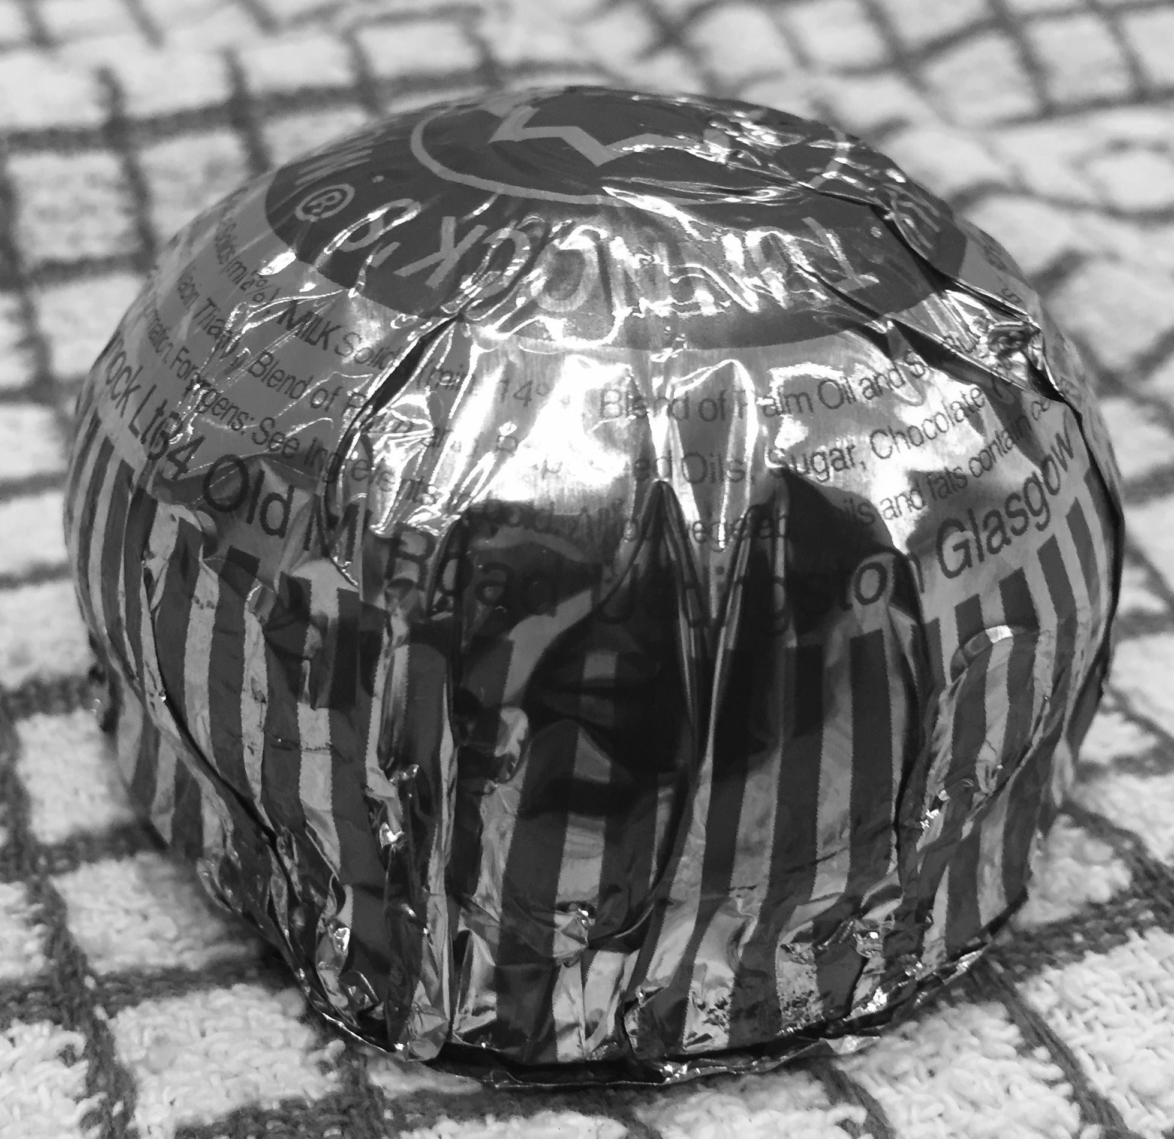
Investigation: Line Drawing
LI:
I am learning how to draw various objects.
SC:
I can identify basic
shapes within an object
I can use and apply
knowledge to basic
shapes to create form
I can use different
drawing techniques to
create form

Slide 11
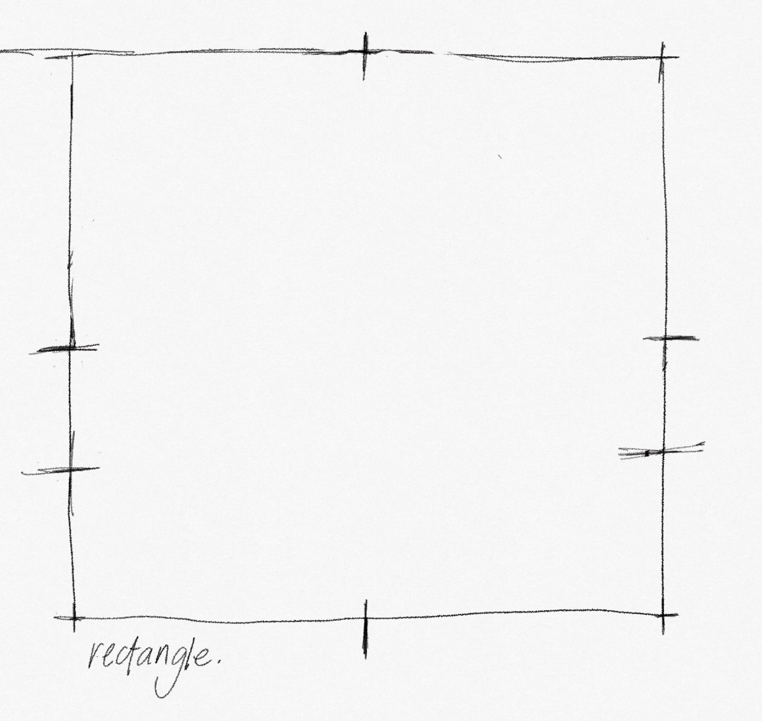
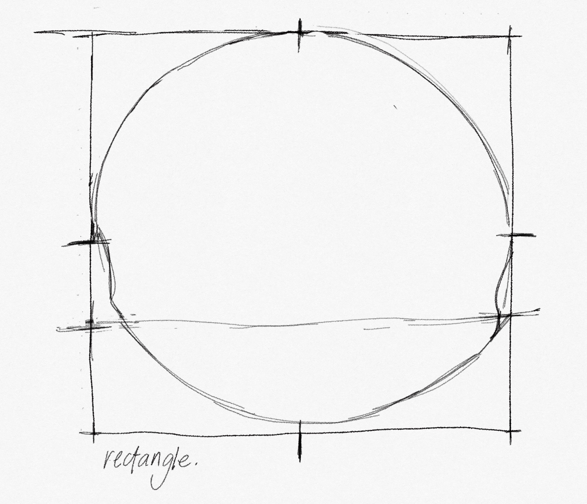
LI: I am learning how to draw various objects.
SC: I can identify basic shapes within an object . I can use and apply knowledge to basic shapes to create form. I can use different drawing techniques to create form

Slide 12
Investigation
LI: I am learning how to draw various objects.
SC: I can identify basic shapes within an object . I can use and apply knowledge to basic shapes to create form. I can use different drawing techniques to create form

Slide 13
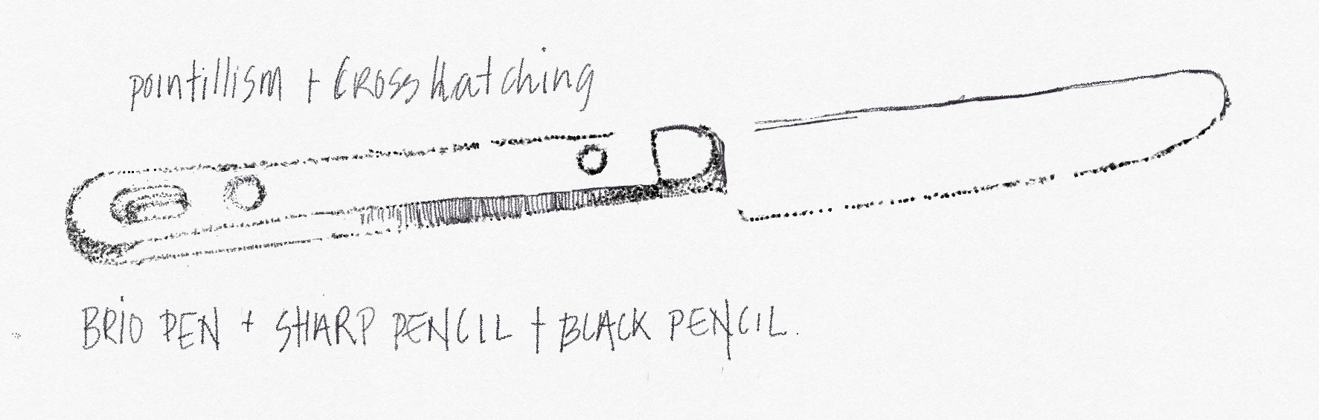
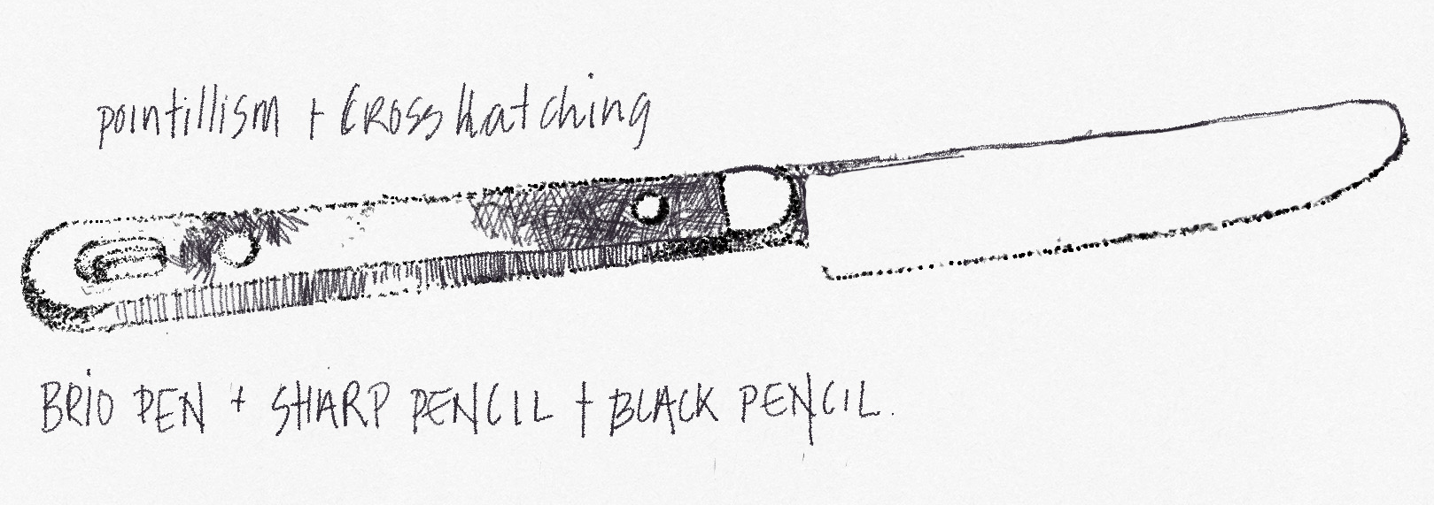
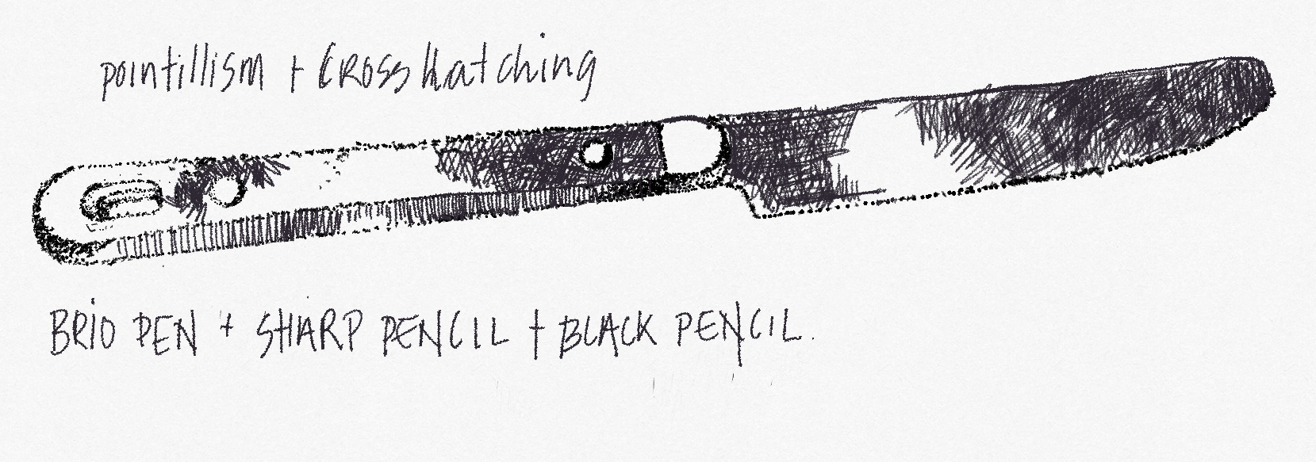
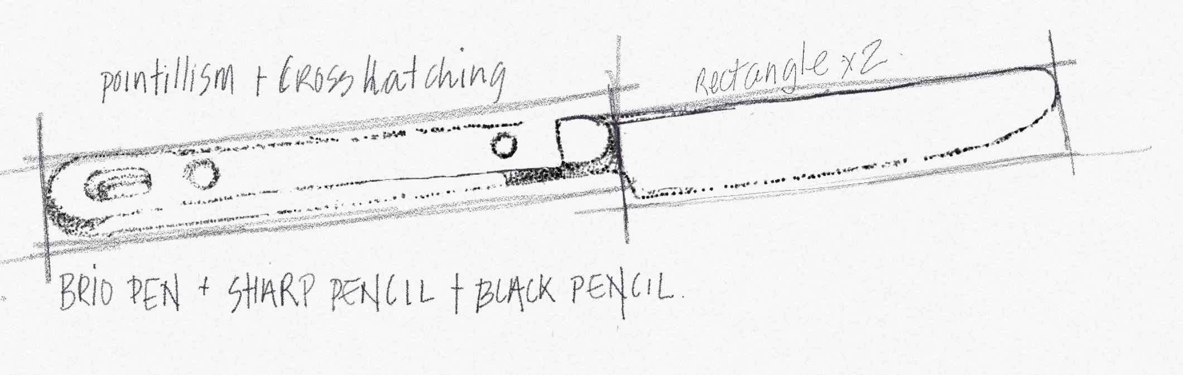
Investigation: Cross Hatching

Slide 14
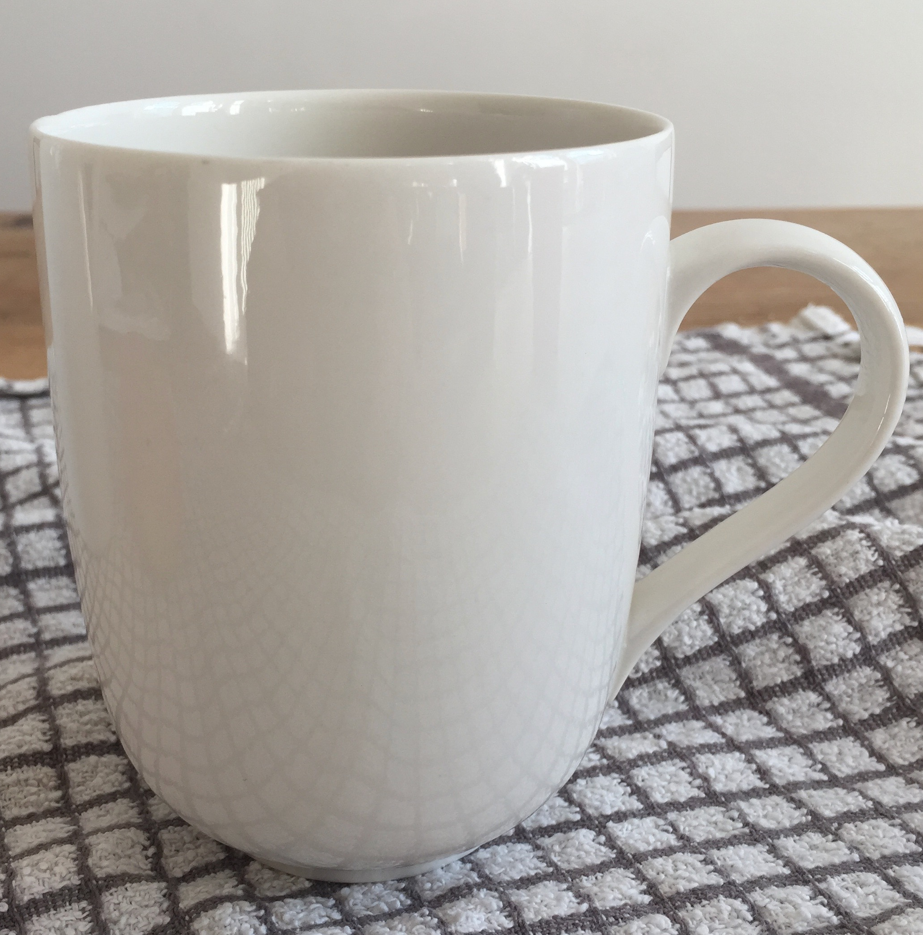
Investigation
Drawing
Look carefully at the this image.
There are a curves on this object, which contains a shape called an ellipse.
The thing that makes these shapes look rounded is how the light reflects off the object..
Using pencil draw the object as neatly as you can.

Slide 15
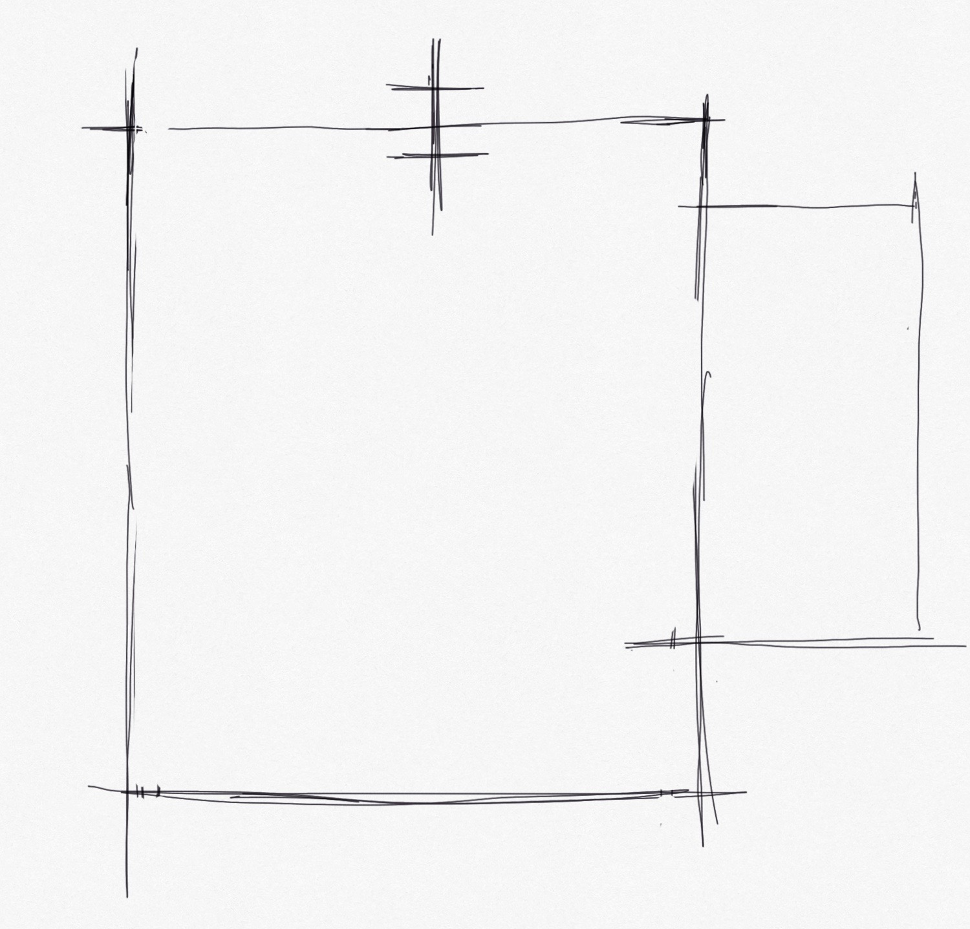
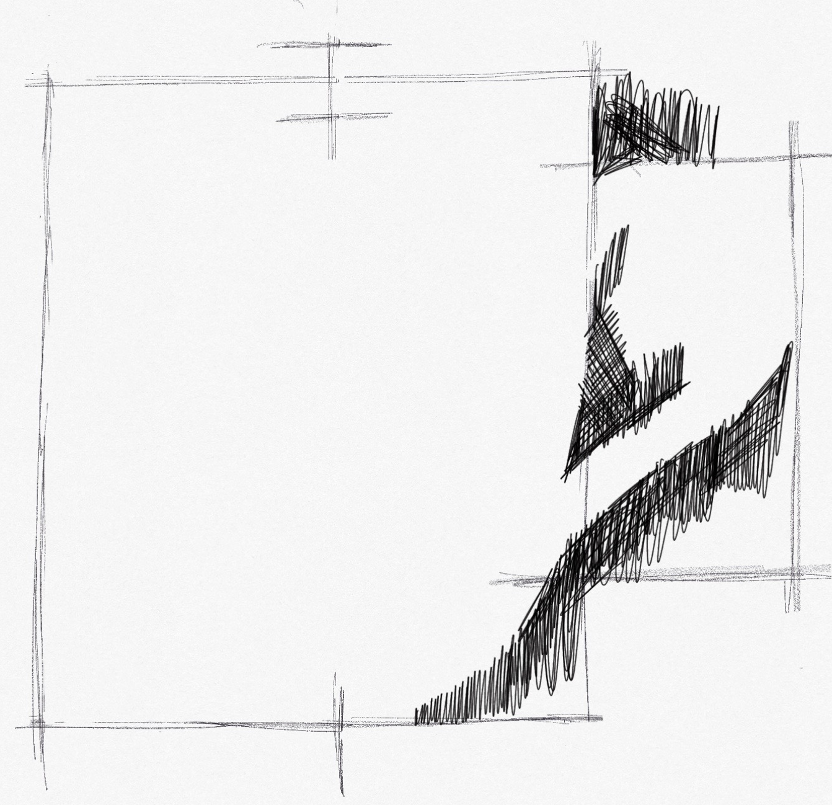
Investigation
LI: I am learning how to draw various objects.
SC: I can identify basic shapes within an object . I can use and apply knowledge to basic shapes to create form. I can use different drawing techniques to create form

Slide 16
Development Compositions.
In the next steps for this unit you will now be asked to draw groups of similar objects and complete two compositions.
1 of these using a drawing technique of your choice where you focus will be improving your scale, tone and shape.
1 of the compositions should in pencil where you will focus on improving applying line to create form.

Slide 17
Development Compositions.
Complete the worksheet
LI: Independently, I am going to combine newly learnt techniques to complete two compositions.
SC: I have attempted composition applying line to create form.
SC:I have applied tone, depicted scale in my composition using various techniques
HINT: SHADOWS ARE NOT BLACK

Slide 18
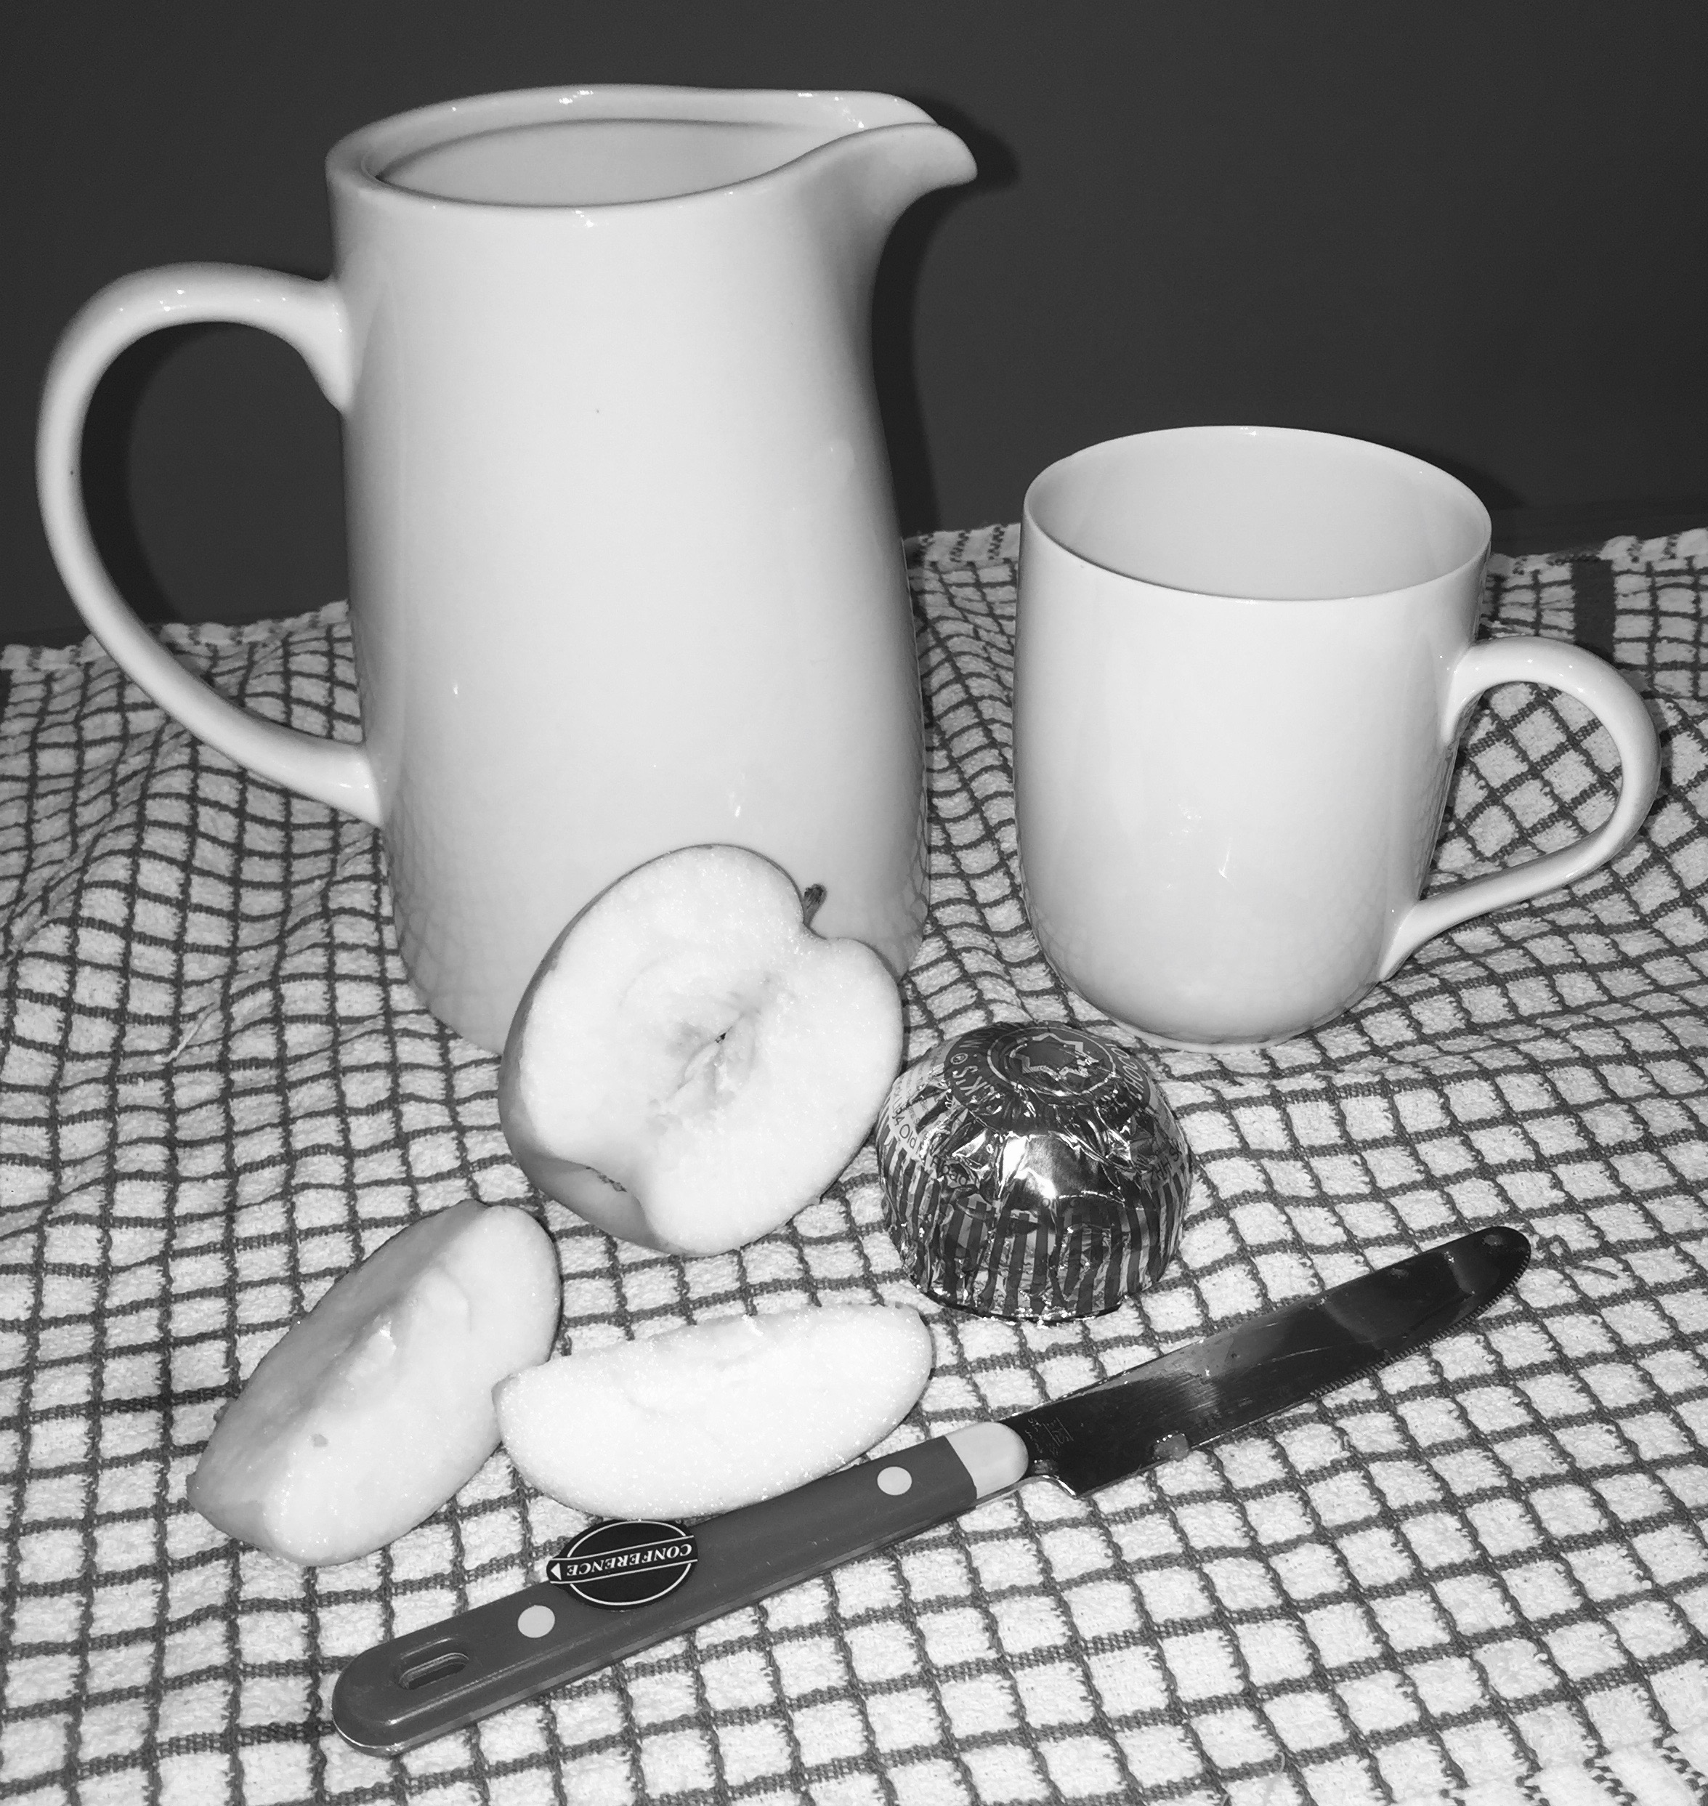
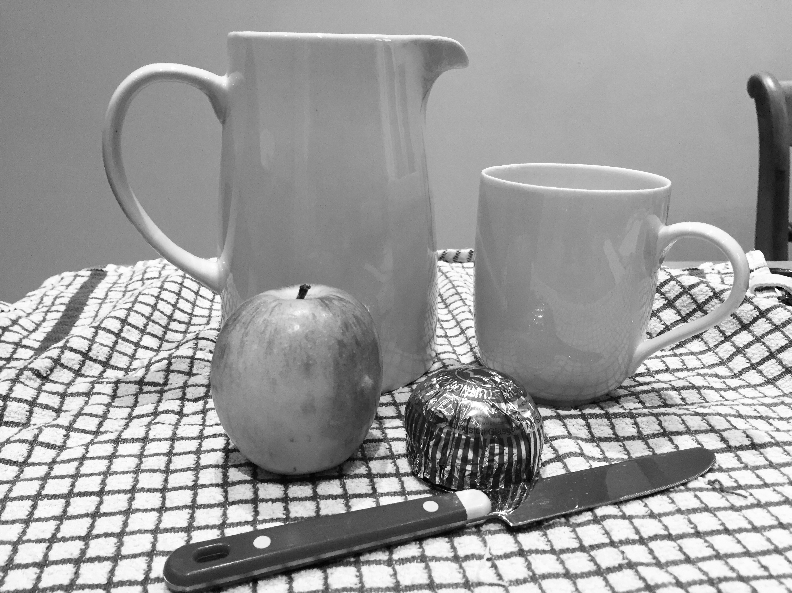
Development Compositions.

Slide 19
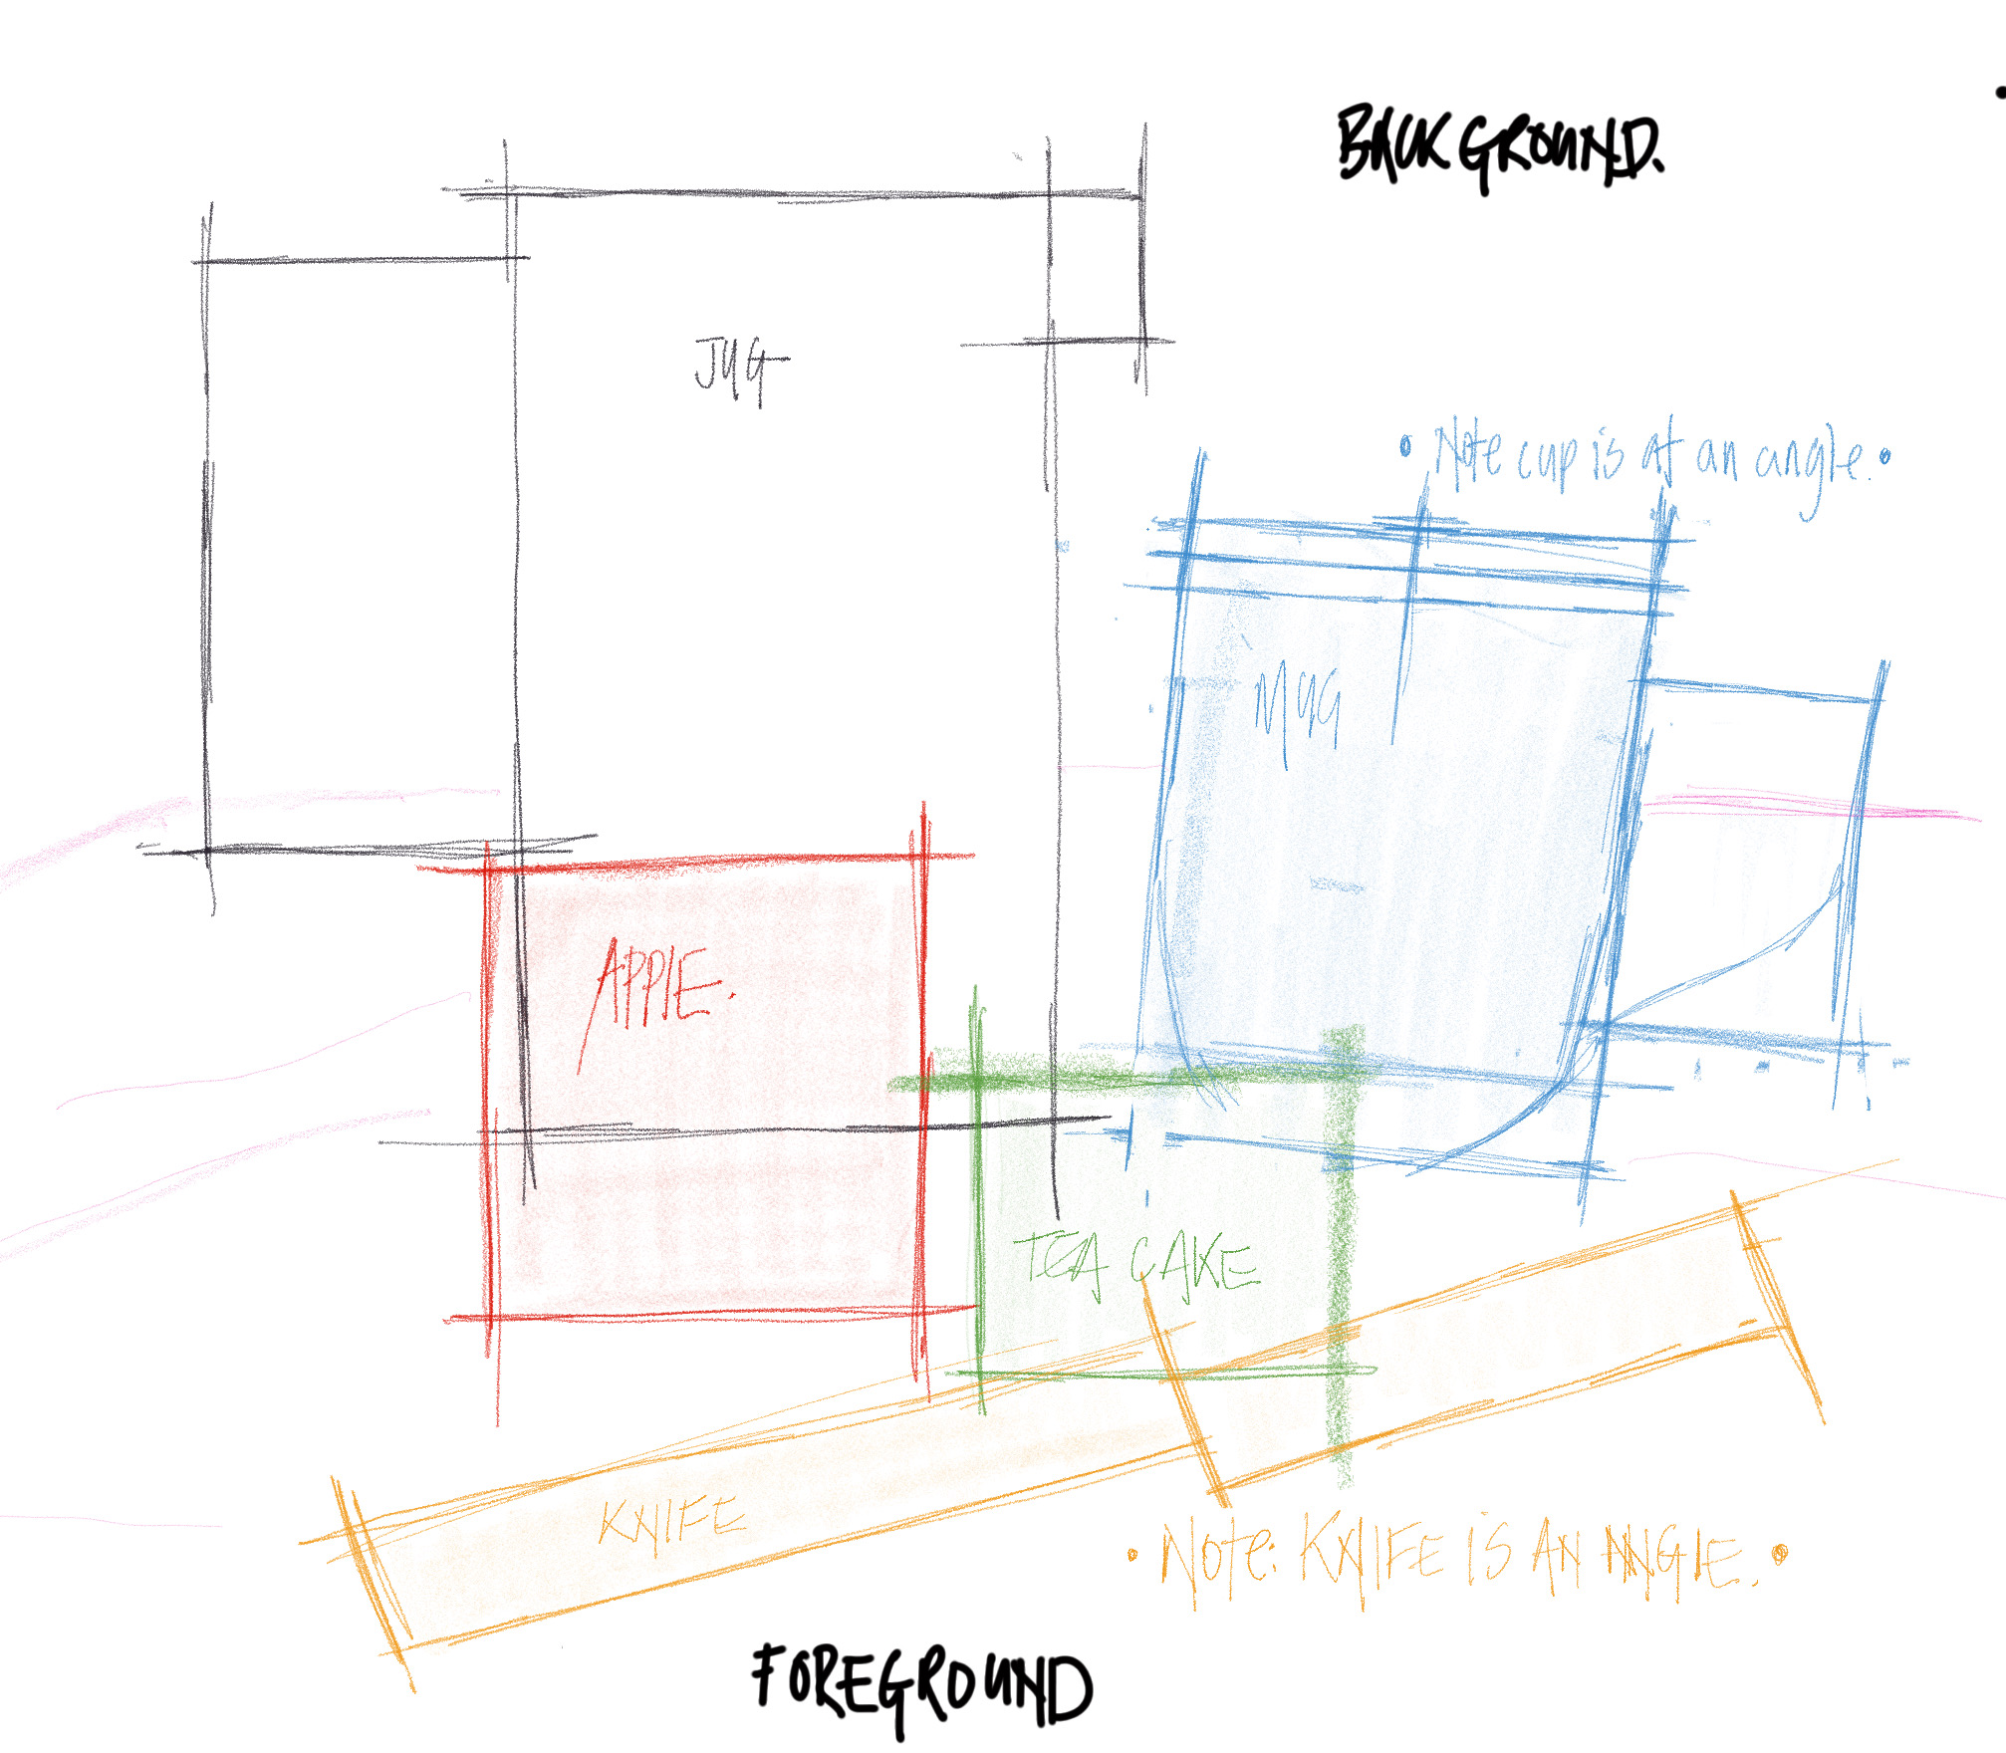
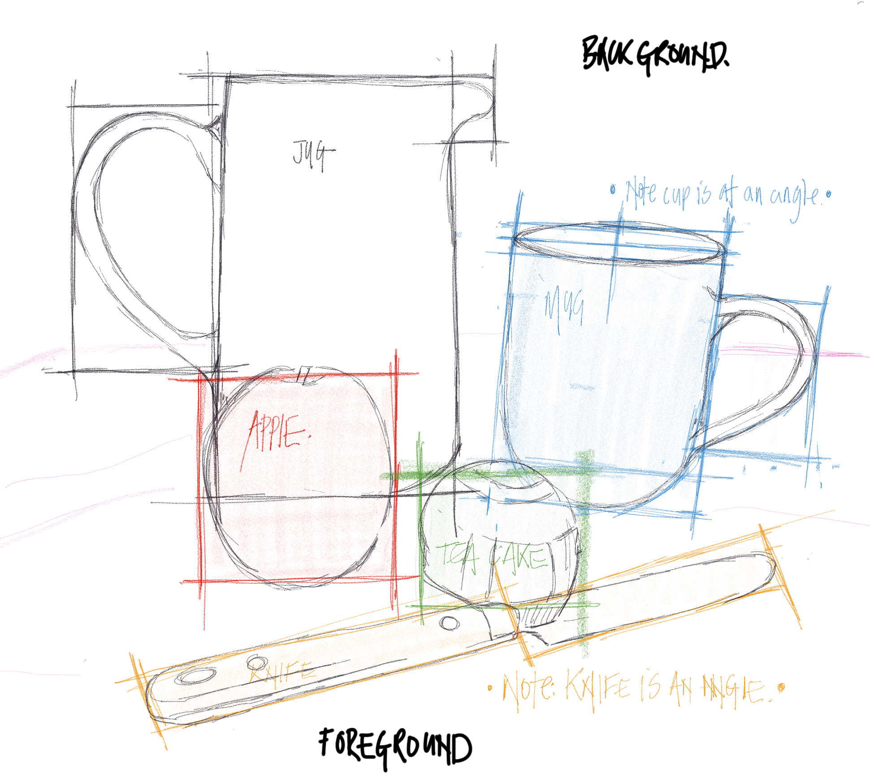
Critical Lesson on Ralph Goings
Development: Composition

Slide 20
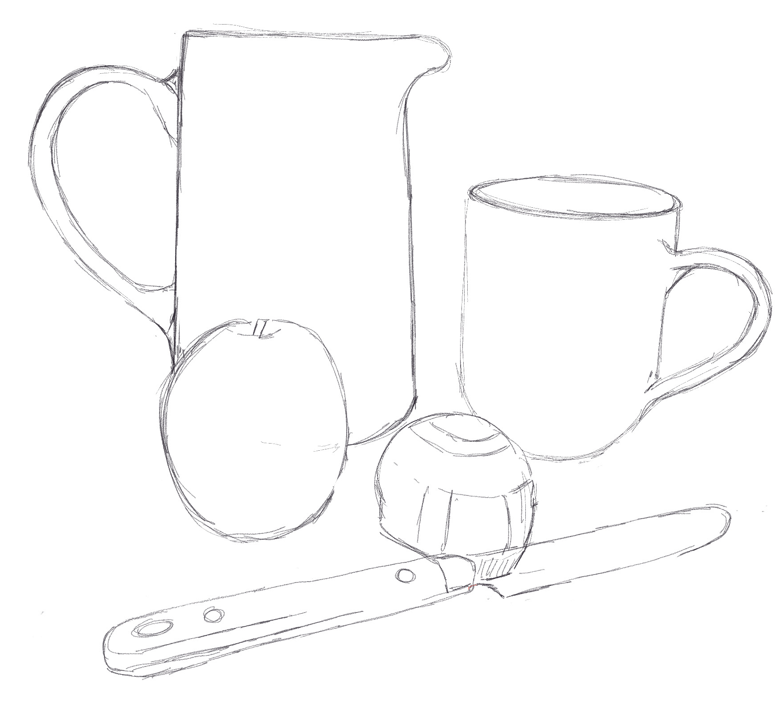
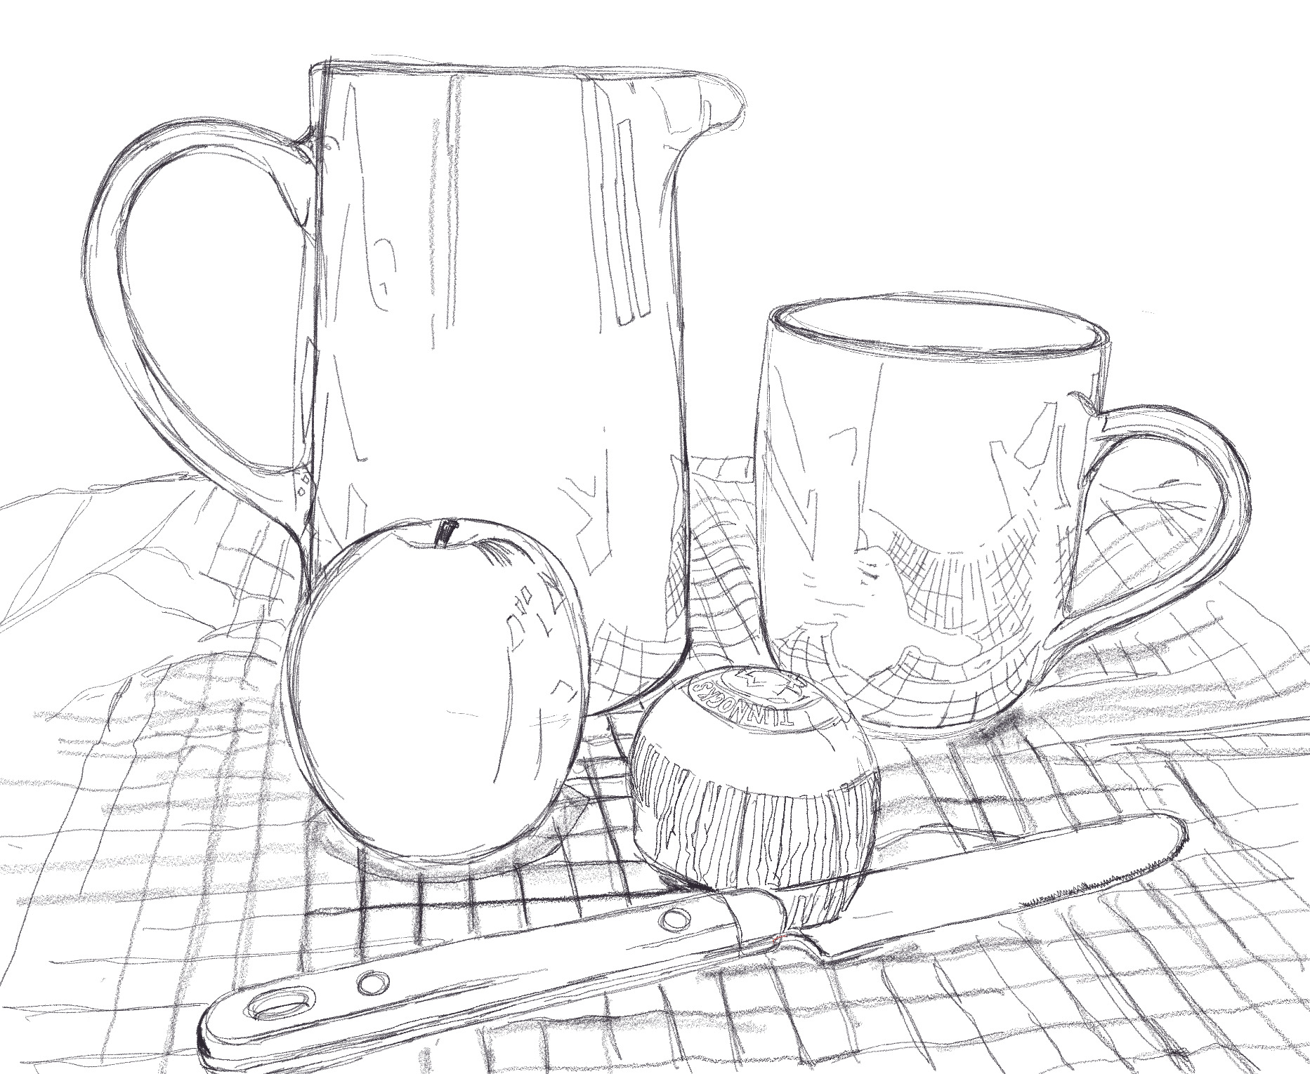
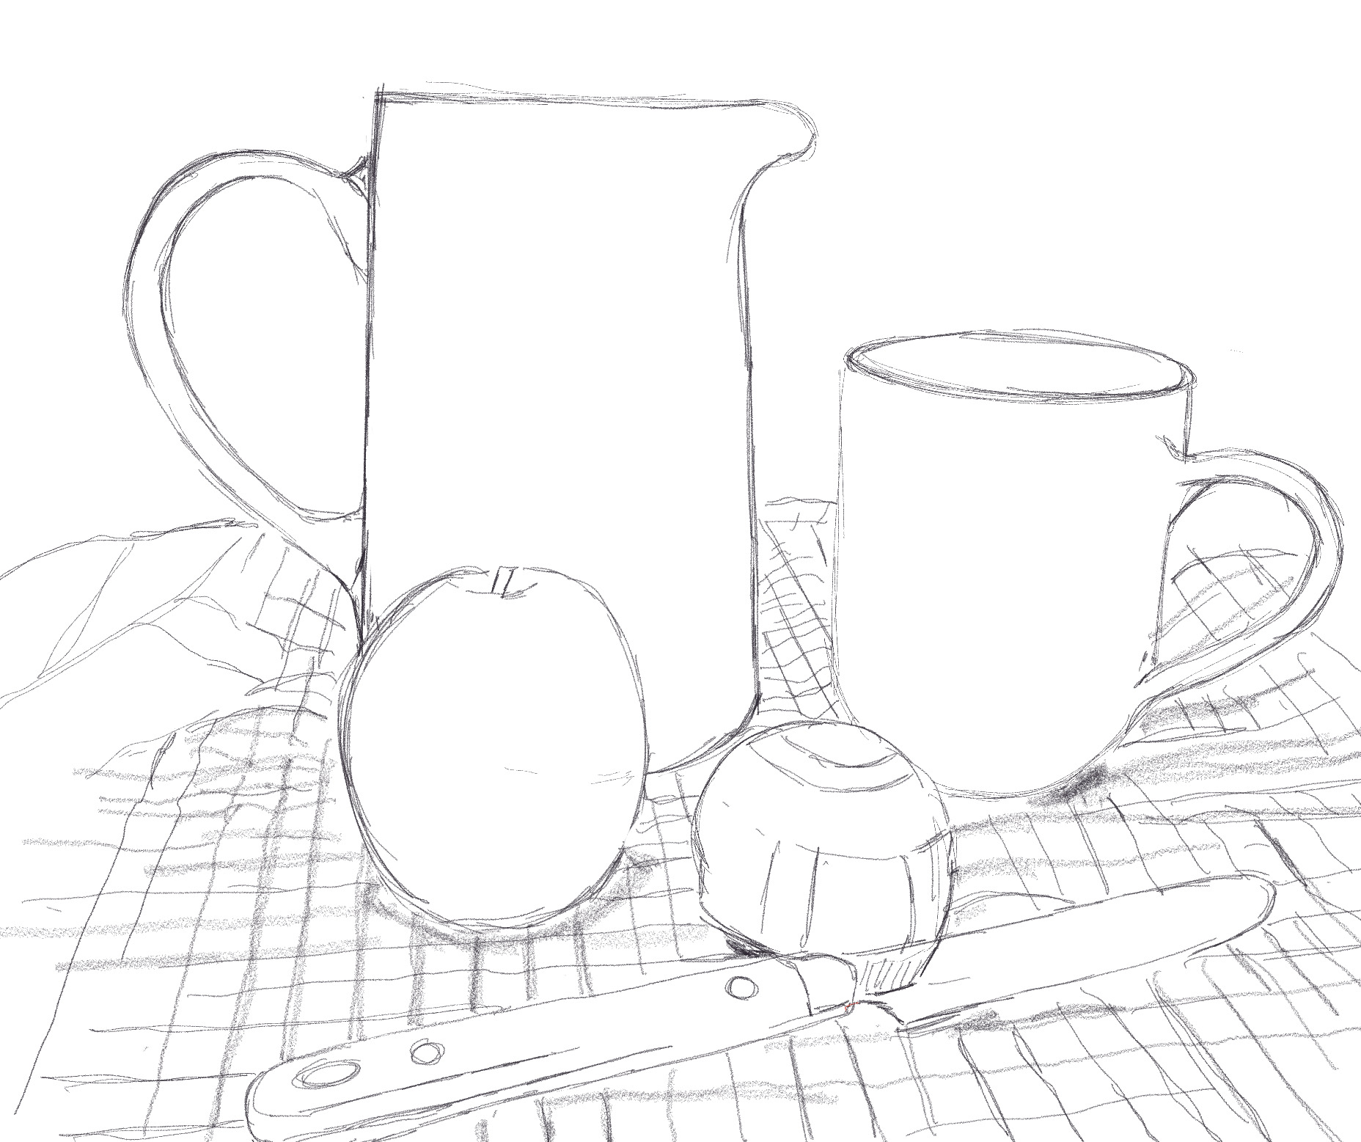
Development: Compositions.
SC: I have attempted composition applying line to create form.

