Slide 1

SLC
Attachment
Strategy

Slide 2
How does SLC Attachment Strategy link with National priorities?
Attachment theory supports the understanding of early childhood trauma, the impact of loss and underpins Adverse Childhood Experiences (ACE).
The Attachment Strategy is in line with ‘Getting It Right For Every Child’ (GIRFEC) and directly links to the 6 Principles of Nurture.
With HWB being the responsibility of all, pupil wellbeing and meeting their needs is outlined in GTCS Standards and HGIOUS framework.
The strategy directly links to the Scottish Government (2013) ‘Scotland, the best place to grow up’.

Slide 3

Attachment Strategy Aim (SLC)
Attachment theory and practice is important for everyone working within Education Resources, whatever their role and remit, so that we all realise the difference we can make to our young people.
Discouraging labelling or diagnosing conditions when people present with distressed behaviours and instead think about what their behaviour is communicating.
Making recommendations for awareness-raising and training on the implementation of attachment-informed practice.
Build understanding in the workforce and highlight the need for adults to support each other in this drive to improve outcomes for all.

Slide 4

Attachment at Kirklandpark Primary
School Improvement Plan
Priorities 2024/2025:
Further staff training to embed and refocus attachment strategies and nurture principles across all stages.
Attachment Ambassadors / Leads from upper stages to be established and to support learners across all stages KP.
Customised Nurture Principles and Attachment Strategy Pledges to be displayed across school to support consistency in language and pedagogy.
Regular whole class/group visits to Nurture Neuk.
Work towards SLC Attachment Accreditation.
Further Staff training in Emotion Coaching.
Identification of children to be part of Targeted Intervention Group and focused intervention to be delivered.
Participation in Psychological Services Pilot Project, ‘Magic Minds.’
Parental workshop & information booklet to promote understanding of nurture and attachment.
Relationship policy to be updated.

Slide 5
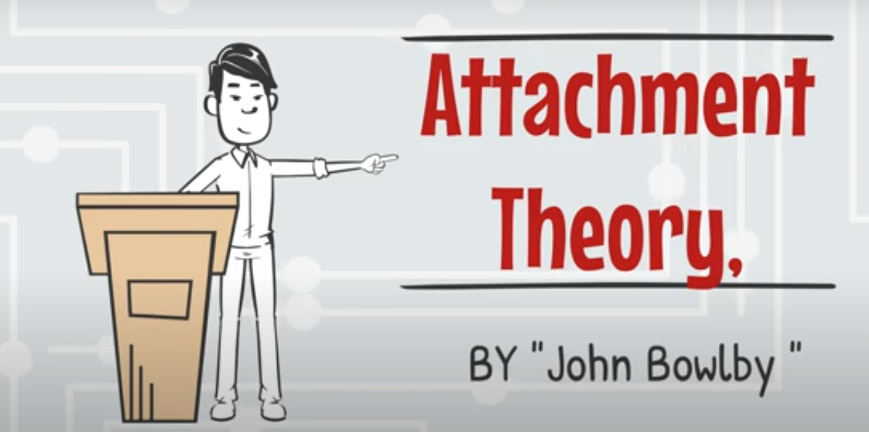
Notes:
https://youtu.be/K9PQPf5xlRU

Slide 6
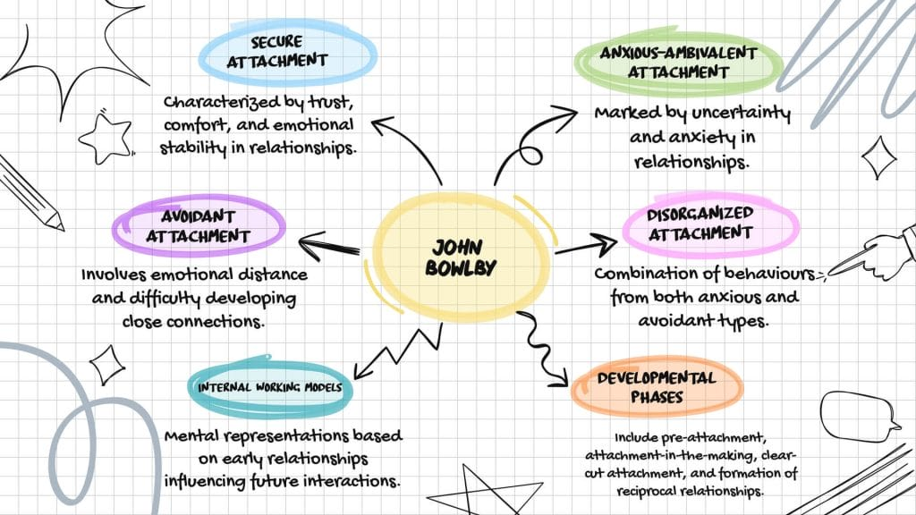

Slide 7

Other Contributing Factors
Children who have experienced neglect or abuse.
Parents who have issues around substance misuse.
Pupils who are seeking asylum or are refugees.
Children who have experienced a significant loss (parent/grandparent).
Experience of a lengthy stay in hospital during early childhood (parent or child).
A parent who works away regularly (army/offshore)
A parent who has been or is currently in prison.
Frequent changes in early life (regular house/school moves).
Pupils who have divorced parents.
Children raised by single parents.
Children who live in violent households.
Premature babies or babies from difficult/traumatic births.
Pupils who are adopted / fostered/ looked after.
Parents with mental health issues (depression, post partum, bipolar).

Slide 8
What does this mean for schools?
Not able to show empathy to others.
Lack of flexibility and very rigid in routine.
Poor eye contact when listening or speaking.
Abnormal eating and elimination patterns (e.g., wetting, soiling, hoarding food)
Fear of abandonment/ trust issues.
Tendency to overanalyze behavior.
Difficulty forming relationships.
Maintaining a positive sense of self.
Difficulty regulating emotions.
Overwhelmed in social situations.
Lack of seeking comfort adult/ physical affection.
Overly dependent on adults/ inappropriate clinginess.
Anti-social behaviors
(e.g., lying, stealing, manipulating, destructiveness, cruelty, aggression)

Slide 9

Benefits of Attachment Informed Practice
Closer friendships and better social skills.
Happier, healthier and trusting relationships with caregivers.
Greater sense of self and higher self esteem.
Greater empathy towards others.
Ability to make healthier choices in the face of setbacks and challenges.
Improved emotional regulation.
Increased academic success.
Ability to verbalise their feelings.
Increased sense of security.
Improved mental health.
Improved family connections.

Slide 10

How are staff already supporting the social and emotional needs of our pupils at Kirklandpark?

Slide 11
What Kirklandpark staff came up with during their discussion time.
Quiet time
Morning Greetings
Soft Start/Responsibilities
Preparing children for change
Brain breaks
Mindfulness Activities
Library areas/Cozy Corners
Supporting during transitional times e.g. daily, termly, yearly
Enhanced transition where needed
Now/Then/.Next boards
Self Soothe box
Growth Mindset
Visual timetables
Fidget toys
Children’s Mental Health Week Activities
Wobble Cushions
Play Pedagogy
Check-ins with an adult
Desk Pets
School Rules and Boundaries
Calm and Consistent ethos
Morning Routines
Relaxing music to help with transitions
Watching out for children’s personality changes
Nurture groups
Emotional check-ins
Social Stories
Positive phone calls home
Emotion Works
ASP’s
PASS Assessment
Class Charter
Personal interests recognised

Slide 12
Supports and Interventions recognised being used across Kirklandpark Primary School by SLT.

Slide 13

‘Promoting Positive Relationships and Understanding Distressed Behaviour’ SLC policy.
Nurturing classrooms (visual timetables, wobble cushions, now/next boards etc)
Boxall Profiles for interventions
Nurture groups (targeted interventions)
Morning greetings
Emotion Coaching training for staff
Children’s Mental Health week
Emotion Works HWB programme
APS’s- HWB
Play pedagogy
Children’s Rights (charters)
Teachers incorporate different learning styles (group work, digital, outdoor)
Attachment Learn Online Courses
PASS Assessments
Parental meetings/phone calls/notes home
Do Be Mindful
SHANARRI focus
Daily/weekly check ins with pupils
Playground Pals
Transitions- soft starts, enhanced transitions
Personalised programmes to meet individual needs
Achievements (celebrating success)
Pupil voice opportunities (chit chat, learning conversations, pupil committees)
Parental links (PTA, assemblies, showcases, workshops)

Slide 14
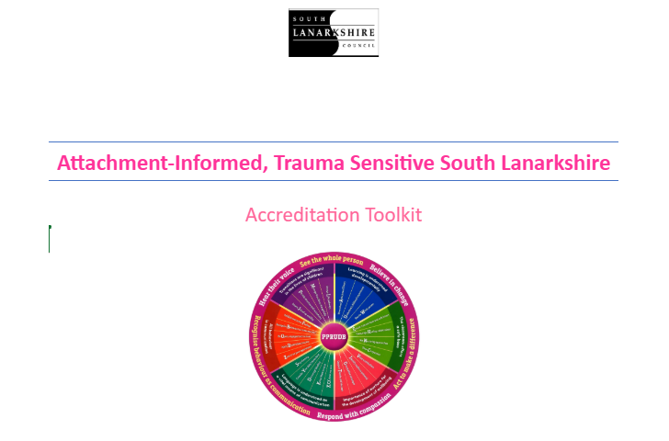

Slide 15
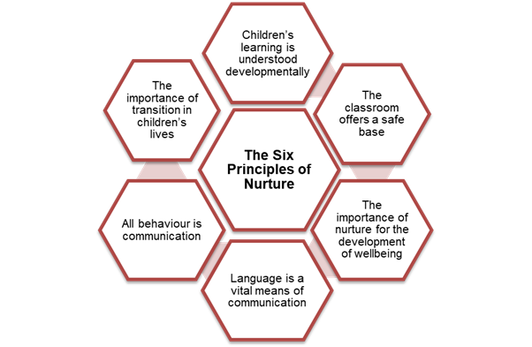

Attachment Pledges
1: Act to Make a Difference
2: Hear Their Voice
3: See the Whole Person
4: Recognise Behaviour as Communication
5: Respond with Compassion
6: Believe in Change

Slide 16

Pledge 1: Act to Make a Difference
Attachment is part of your establishments SIP.
Staff have an awareness of Attachment.
Staff training is provided and continuous opportunities for further development offered.
Network meetings attended and updates provided for staff.
Materials to support the implementation of Attachment-Informed, Trauma Sensitive approaches are available to staff.
(e.g., Attachment Strategy pledge cards and A to Z resources, newsletters, PPRUDB, Nurturing Interventions Toolkit).
School has nominated attachment leads and ambassadors.
Attachment approaches align with other initiatives already in place.
Attachment-Informed, Trauma Sensitive approaches with pupils, families, and staff.
Develop a working party to review current practices and focus on areas for development.

Slide 17

Pledge 2: Hear Our Voice
Parents and carers have opportunities to provide feedback on establishment policy, procedures and practice and share ideas for improvement.
Pupils and families are given a voice to express concerns and there are systems in place to encourage two-way communication
Pupils are asked for their views and given a say in matters affecting them.
Attachment information and updates are shared with parents/carers to support learning at home.
Staff have opportunities to reflect on thoughts, feelings and experiences individually and in groups within a safe space.
There is a clear, confidential, and non-shaming system in place for staff and pupils to access wellbeing support when needed.
Self-care is promoted encouraged across the establishment.

Slide 18

Next Steps
Review our relationships/nurture/attachment policy.
Enhance and support staff wellbeing
Incorporate time at meetings for staff reflection/ drop in sessions.
Building staff capacity- updating staff and provide continuous opportunities for training.
Consistent approach to restorative and trauma sensitive practice.
Continue to inform parents and provide opportunities for parental engagement.
Revisit Emotion Works programme to support self regulation strategies.
De-escalation training.
Continue raising awareness through assemblies and displays around the school.
Revise our nurture spaces/self regulation areas.

Slide 19
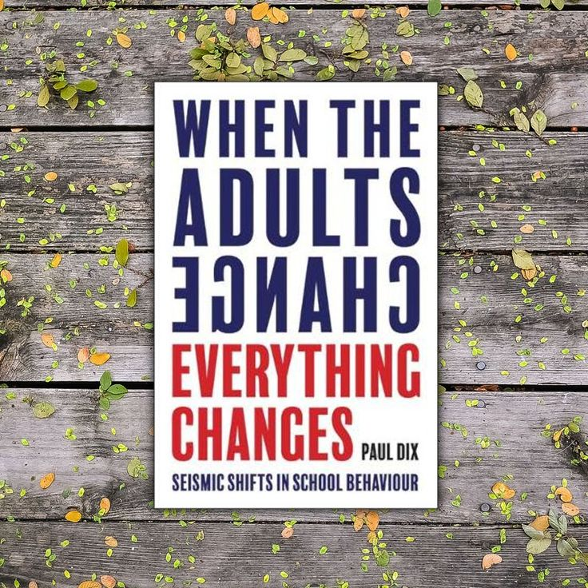
“With the right culture, the strategies that are used become less important. The culture is set by the way that the adults behave and teamwork makes it sustainable”.
Paul Dix

