Slide 1

Jackton ELC September News 2025

Slide 2

Jackton ELC Family Collective
Meeting 22.09.25
Welcome to our Family Collective - a space to collaborate, share ideas and help Jackton ELC grow.
Building Community Links.
Promoting Sustainability.
Seasonal plans i.e. Halloween, Christmas.
Fundraising ideas:
Compile a nursery cookbook with recipes from children/families and staff.
Our next meeting will be held on Tuesday 18th November. We hope to see you there!

Slide 3

Magic Moments
When you enter the nursery, you’ll see a special tree we’ve created. This tree is all about celebrating your child’s achievements, whether they happen at nursery or at home. If your child accomplishes something exciting, feel free to add it to a leaf and hang it on the tree. We’d love to celebrate their successes together!

Slide 4

Nursery Photographs
The photographer will visit Jackton ELC on Monday 27th October. There is a sign-up sheet on the door of each playroom for you to register your interest. There will also be the opportunity for sibling photographs if you have children who attend Jackton Primary School.

Slide 5

Pre-School Visual Screening
Pre school vision screening will take place on Thursday 13th November. If your child does not attend on this day, you are welcome to drop in. Please speak to a member of the management team if you wish to arrange this. You can scan the QR code below for further information. If you have not done so, please remember to return your consent form.

Slide 6

Nursery closure
Please note the Nursery will be closed on Monday 10th November. This is an in-service day.

Slide 7
Staff Training
Over the last month members of our staff team have continued to engage in various opportunities for Continual Professional Development.
These have included –
Musical Markers Training
Digital Training
Literacy Beyond The Sparkle
Alice Sharp - Treasure Troves, Curious Collections, Visual Impacts and Materials.

Slide 8

Halloween Fun
The 3-5 Children will have a fancy dress Halloween disco on Wednesday 29th October at 4pm .
The 2-3 Children will have a party within their playroom on Wednesday 29th October from 10am – 11am and Friday 31st October from 2pm – 3pm
If this not your child's allocated session they are welcome to join in with the fun.
More information will follow please look out for posters within the nursery and on learning journals.

Slide 9
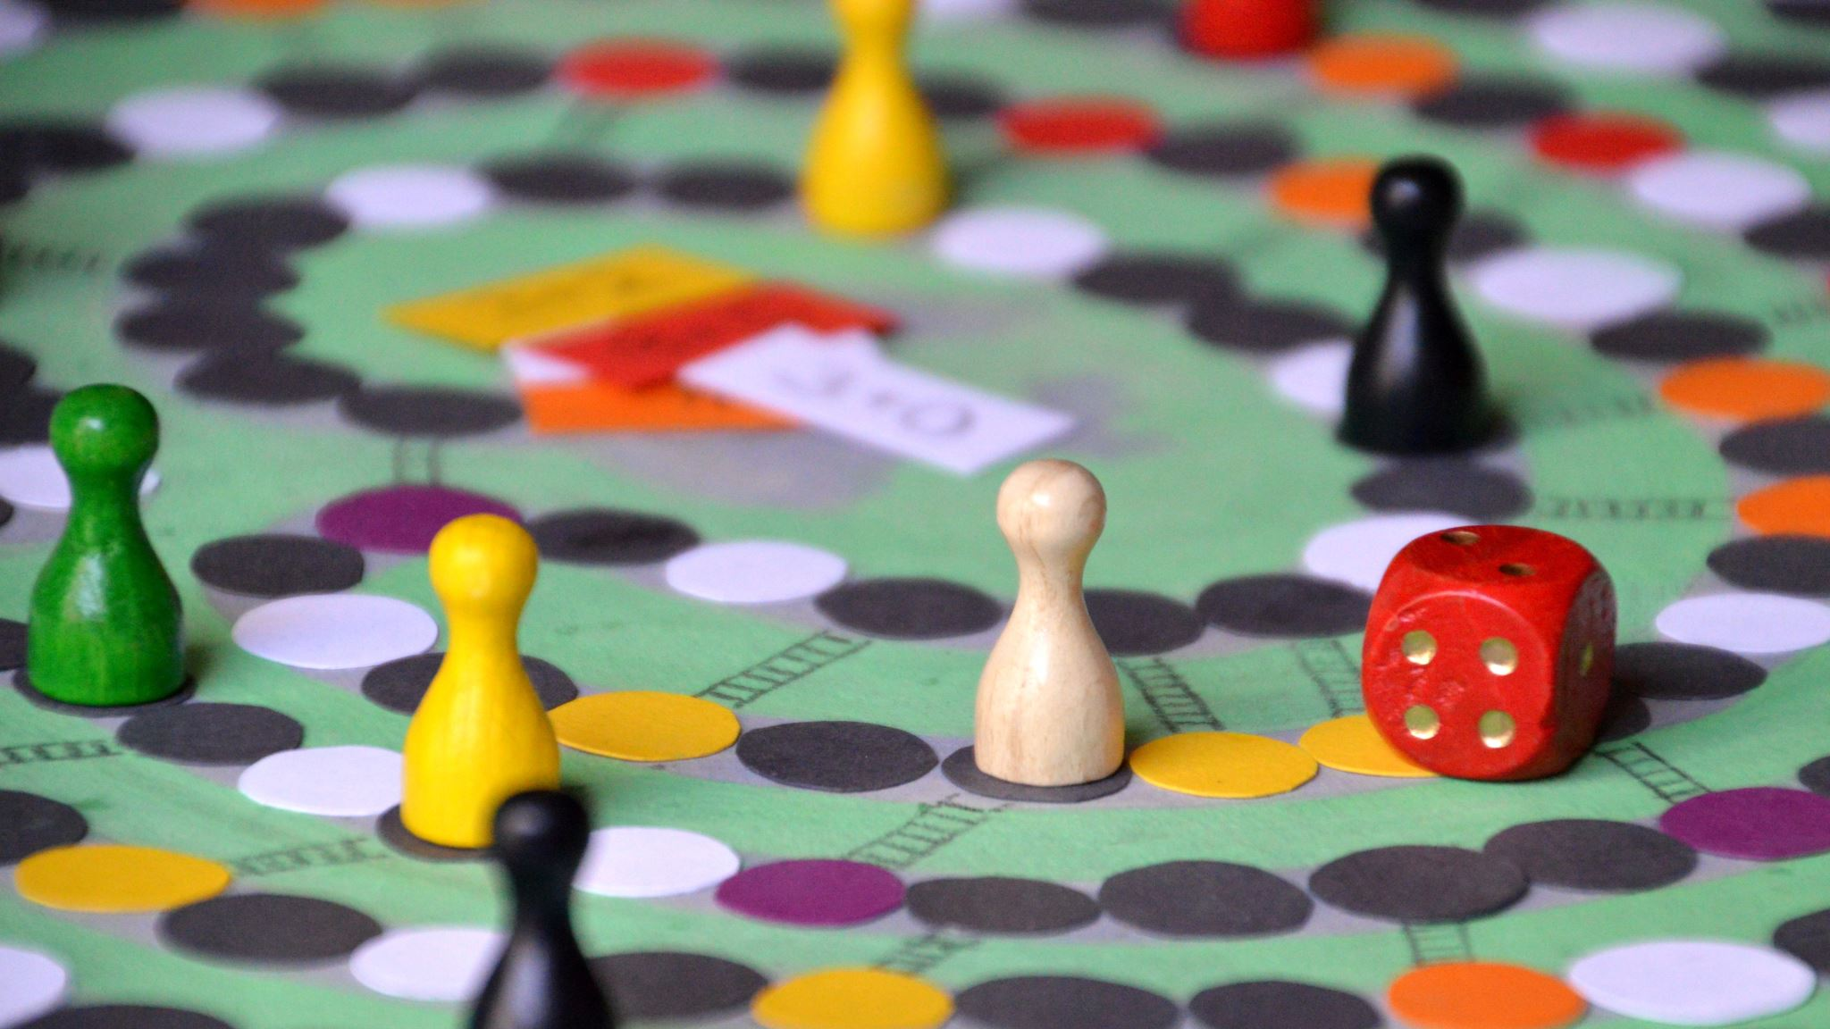
Stay and Play Sessions
Our next stay and play session will be held on Wednesday 5th November from 2-3pm. All family members are welcome to attend.
This will also be our themed lunch days – Menus for this will be displayed in the corridor closer to the time.

Slide 10
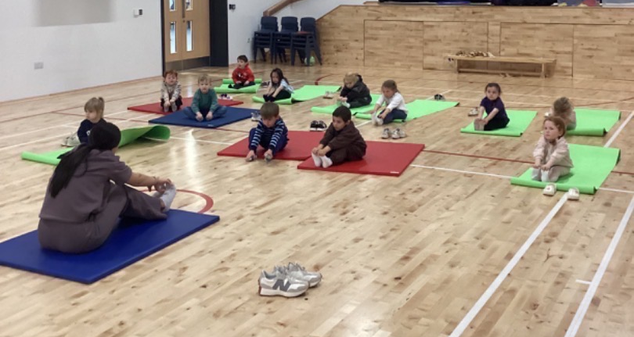
Yoga Sessions @ Jackton ELC
We’ve just started our very first weekly yoga sessions in the gym hall at the school and what a fantastic time we had! ⭐️The children were full of smiles as they tried out different poses, stretched like tall trees, balanced like flamingos, and even breathed like sleepy lions. 🦁🌳 Yoga is a lovely way for the children to move their bodies, build strength and balance, and find calm moments, all while having lots of fun! It's also great for helping them learn how to focus, listen, and relax (even if just for a moment!). We’ll be enjoying these sessions every week, building up our yoga adventures together!🧘‍♀️
If you'd like to give it a go at home, here are a few fun ideas:
Cosmic Kids Yoga on YouTube – brilliant, story-based yoga adventures (perfect before bedtime!).
Try a “pose of the day” – ask your child to show you their favourite from class!
Create a calm-down space with a mat or blanket, soft music, and some slow stretches together.
We’re so proud of how beautifully the children joined in – we can't wait for next week’s session! 🌟

Slide 11
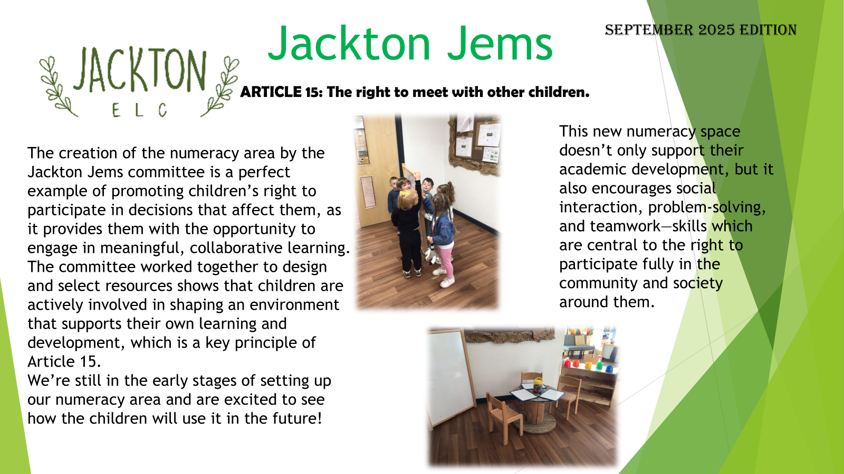

Slide 12
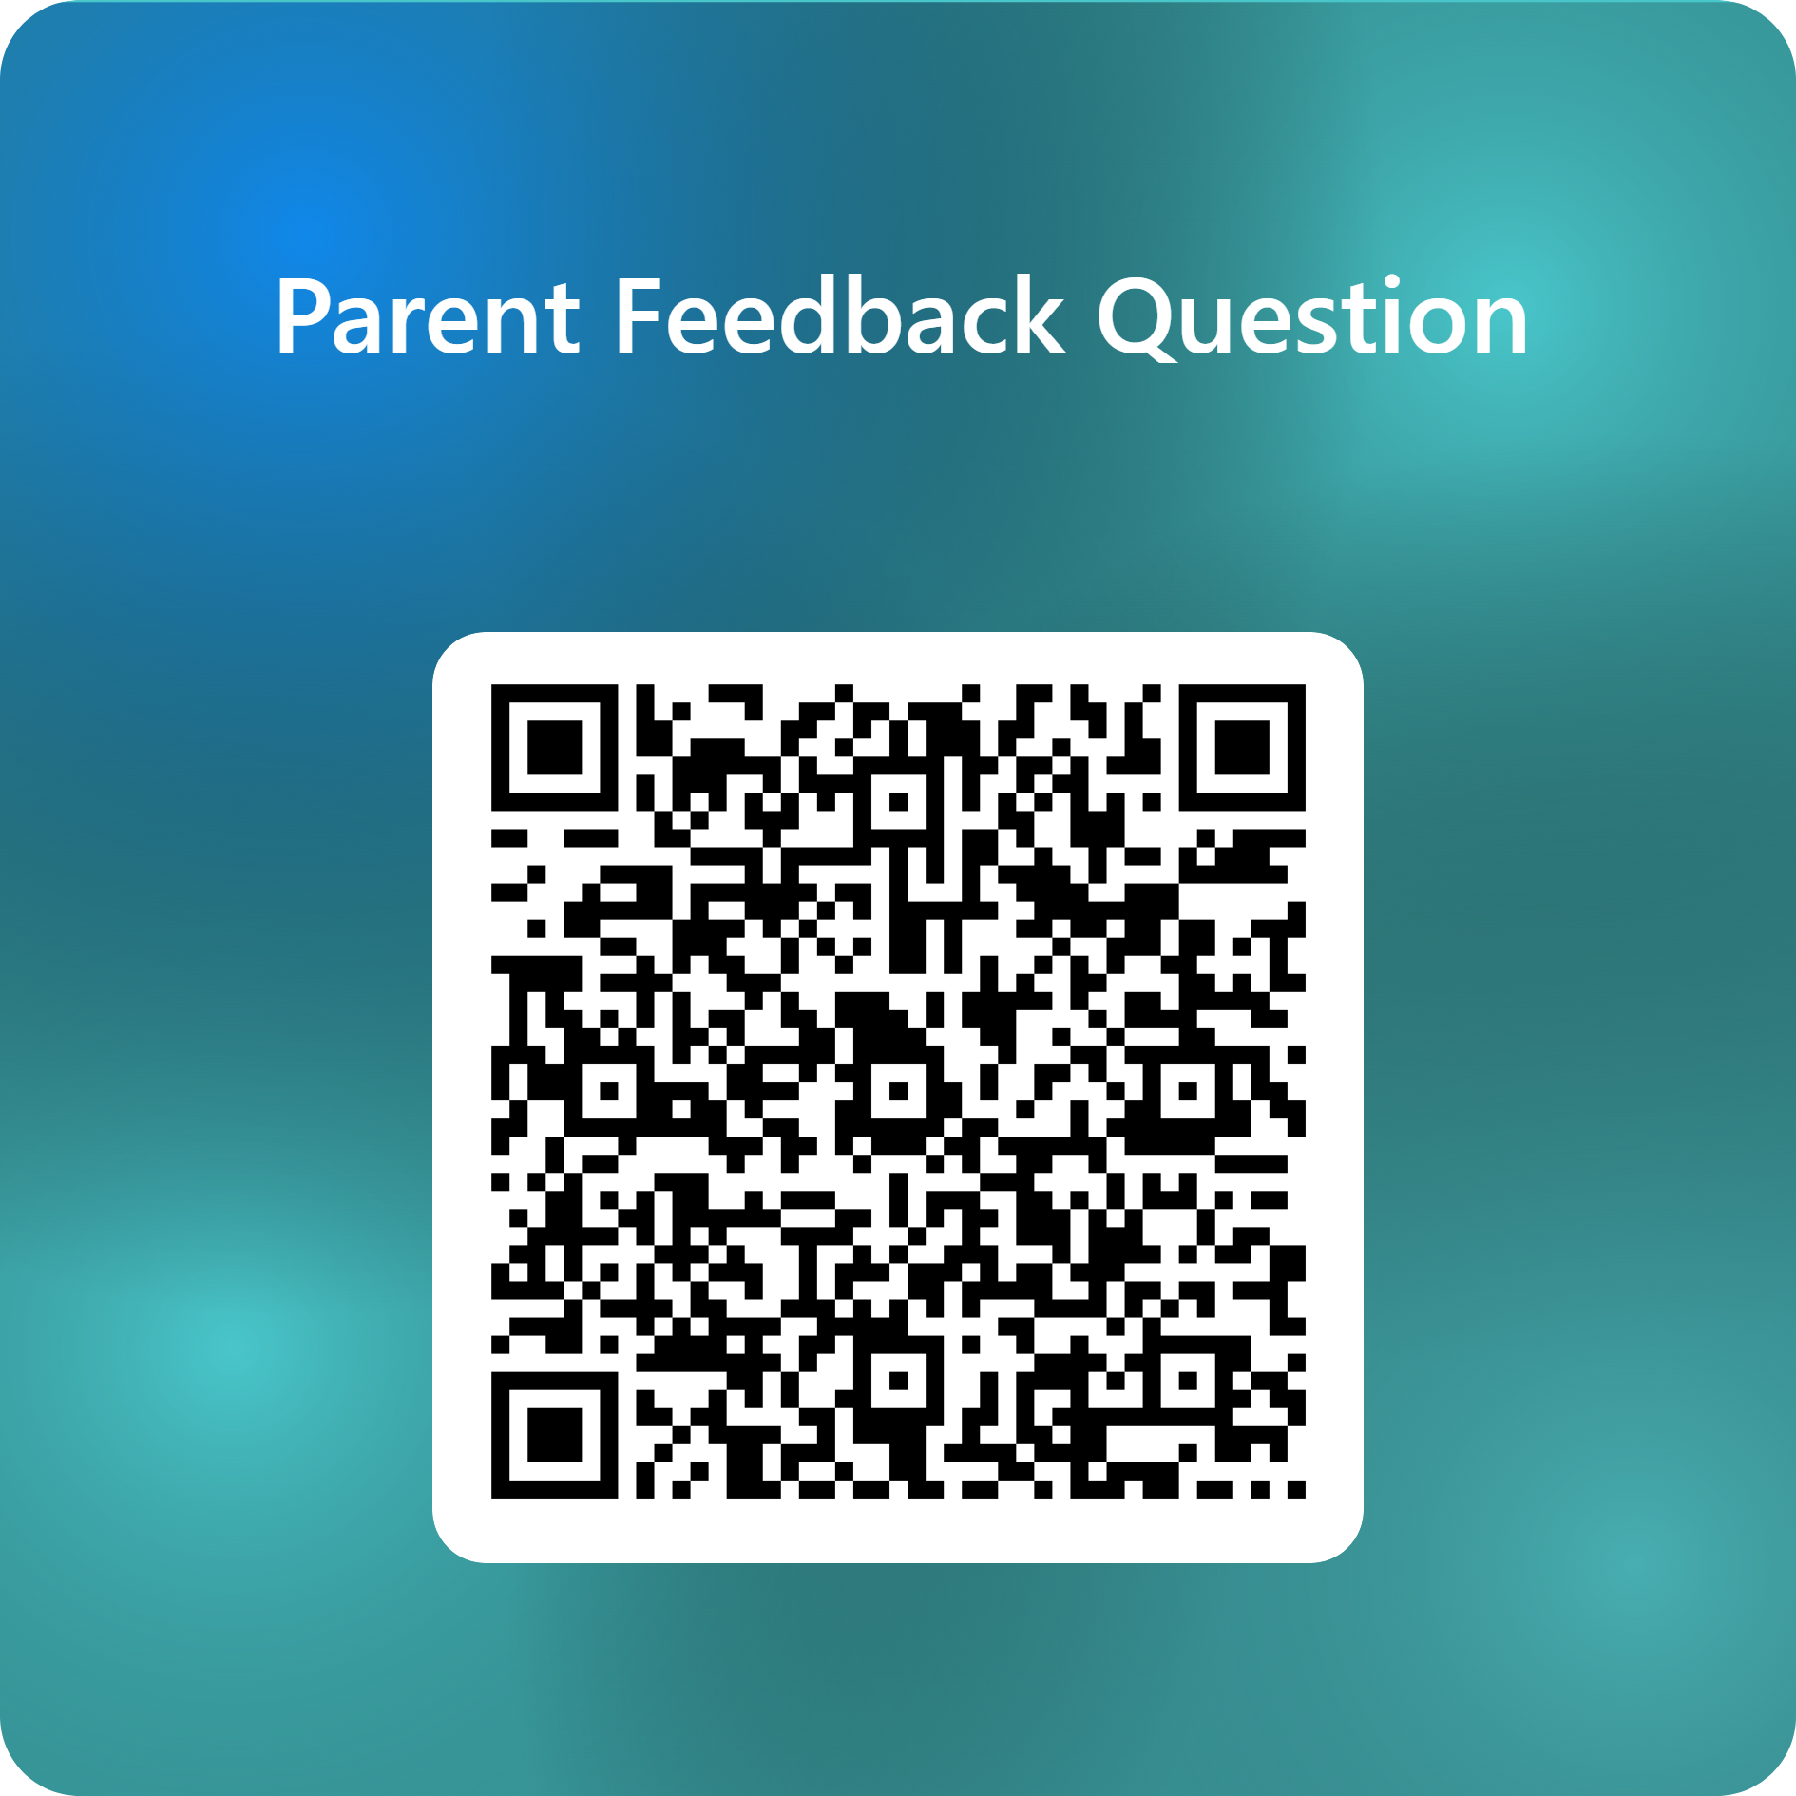
Parent Feedback Question.
Do you feel that your child is confident within their learning environment and that staff have a positive influence on their learning journey at nursery?
Please take the time to submit your response to this question by scanning the QR code opposite.

