Slide 1









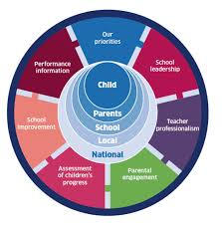




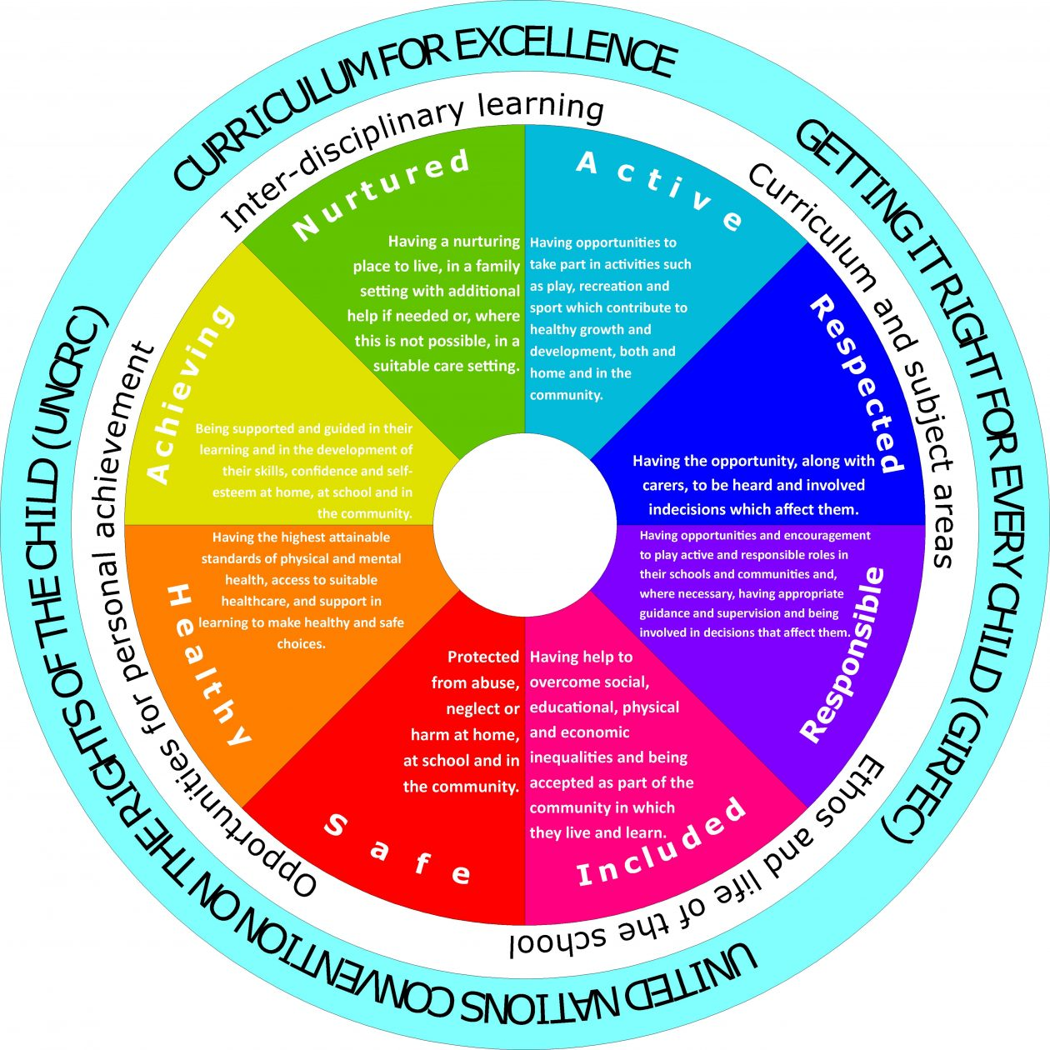


Summary of School Improvement Priorities for Heathery Knowe Primary School 2025-2026
HGIOS Quality indicators
2.2 curriculum
3.2 Raising Attainment
1.3 Leadership of Change
1.1 Self-Evaluation for School
Improvement
Ensuring wellbeing equality and inclusion
2.3 Learning, teaching and assessing
2.4 Personalised support
2.5 family learning
Develop School Vision, Values and Curriculum Rationale to further develop learner engagement, attainment, and achievement through considered curriculum design and enquiry based learning | To raise attainment in Writing through considered curriculum mapping and a consistent approach to the use of Learning Intentions & Success Criteria with a particular focus on teaching writing in an interdisciplinary manner through engaging IDL themes and the IOW programme. | To improve attainment through maximizing pupil attendance and Parental engagement. | To develop robustness of teacher professional judgment through professional learning and ensuiry with build your pedagogy – further developing assessment practices and quality of evidence for judgement
Drivers for School Improvement
A clear curriculum rationale, outlining a shared vision and values that is shared and understood by learners, teachers and the Heathery Knowe community Enquiry themes encompassing learning for sustainability and the United Nations Convention for the Rights of the Child
Improve attainment through targeted intervention of writing
Develop practitioner pedagogy through professional learning in Improving our Writing
Improve attendance of learners in all year groups
To improve punctualtiy in all year groups
Improve parental engagement in all areas of school life, particularly learning related to improve learning outcomes.
To ensure attainment data is professionally judged on robust evidence
To develop practitioner confidence through professional learning, enquiry within the context of Build Your pedagogy programme.
‘Be Safe, Be Kind, Be Ready to Learn’

