Slide 1
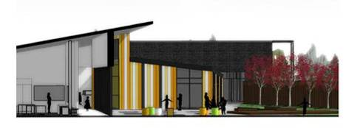
East Milton Primary School
Curriculum Rationale and Design
Growing Together Learning Together
Refreshed 2024

Slide 2
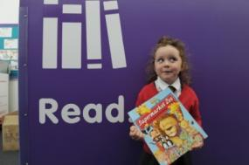
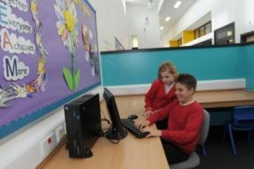
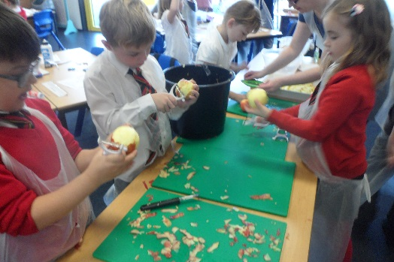
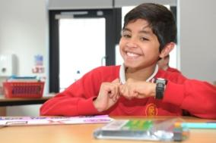
East Milton Primary School
Curriculum Rationale and Design
Scotland’s curriculum places learners at the heart of education. At its centre the 4 Capacities reflect and recognise the lifelong nature of education and learning. They:
recognise the need for all children and young people to know themselves as individuals and to develop their relationships with others, in families and in communities
recognise the knowledge, skills and attributes that children and young people need to acquire to thrive in our interconnected, digital and rapidly changing world
enable children and young people to be democratic citizens
Our Curriculum Rationale takes account of:
Our school community’s vision and values
Our attainment data and achievements
The views of our learners, staff and parents/carers
Knowledge and skills for learning, life and work required by 21st Century citizens
The skill sets of our educators
The following drivers are important to us:
Ensuring health and wellbeing, equality and inclusion are at the heart of all we do
Developing the 4 capacities
Ensuring pupils are literate, numerate and digitally literate
Enabling pupils to be independent, resilient and self-reflective
Developing skills for Learning, Life and Work
Ensuring pupils are socially and Sustainable Development Goal aware and active
Working with families and partners
Growing Together Learning Together

Slide 3
East Milton Primary School
Curriculum Rationale and Design
Wellbeing
Friendship
Respect
Kindness
Teamwork
Growing Together Learning Together
Excellence
Achievement
Courage
Underpinned by our Vision and Values

Slide 4
East Milton Primary School
Curriculum Rationale and Design
Effective Contributers
Breadth
Challenge and Enjoyment
Depth
Successful Learners
The Purpose of our Curriculum is to enable young people to become
Our curriculum is designed to ensure
Progression
Relevance
Growing Together Learning Together
Confident Individuals
Responsible Citizens
Coherence
Personalisation and
Choice
Underpinned by our Vision and Values

Slide 5
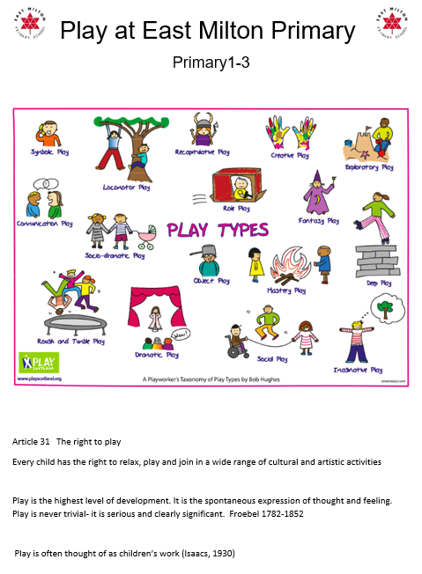
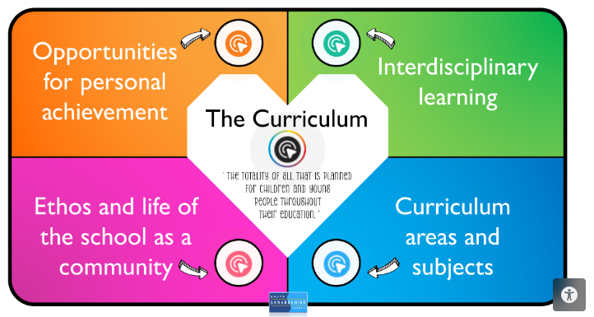
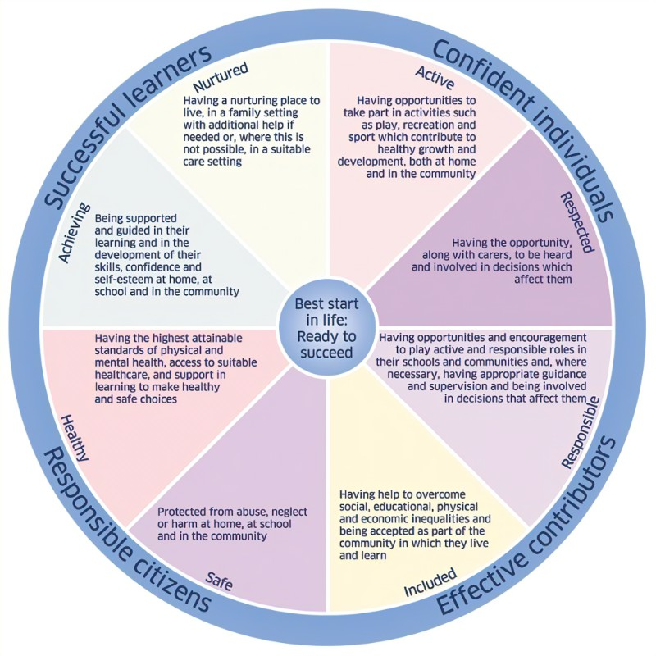
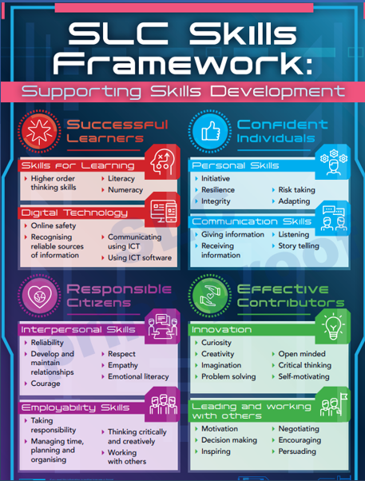
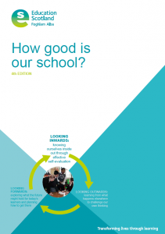
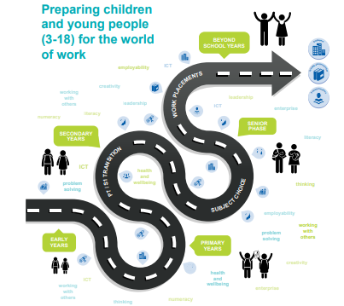
East Milton Primary School
Curriculum Rationale and Design
Taking Account
of
Growing Together Learning Together

Slide 6
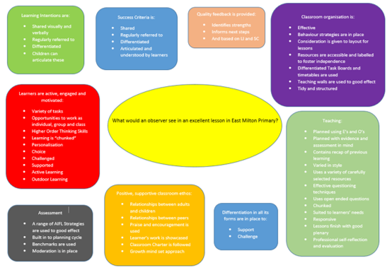
East Milton Primary School
Curriculum Rationale and Design
We aim to
Provide a rich and stimulating curriculum for all Curricular areas including Learning for Sustainability
Embed the 4 capacities of Curriculum for Excellence
Ensure clear progression through the E’s and O’s
Provide opportunities for personalisation and choice
Provide opportunities for personal achievement
Engage learners through quality learning and teaching
Ensure lessons and interventions support and challenge pupils
Utilise ICT to enhance curriculum delivery and learning
Deliver the curriculum in a blend of IDL and subject specific lessons
Responsibility of All
Expressive Arts
Art and design
Dance
Drama
Music
Health and Wellbeing Curriculum
Healthy Schools Programme
Nurture
Partnerships to provide extra curricular activities
Progressive Pathway
Languages 1+2
French
Spanish
Literacy and Numeracy
Rich and stimulating curriculum
Skills based
Progressive Pathway for all 3 areas of literacy.
RME
Quality Learning and teaching
Themed Workshops, Days, Weeks & Assemblies
Sciences
Learning Through Play
Social Studies
Working with partners
Technologies
Outdoor Learning
Learning
for
Sustainability
Growing Together Learning Together

Slide 7
East Milton Primary School
Curriculum Rationale and Design
We make links wherever we can
Growing Together Learning Together

Slide 8
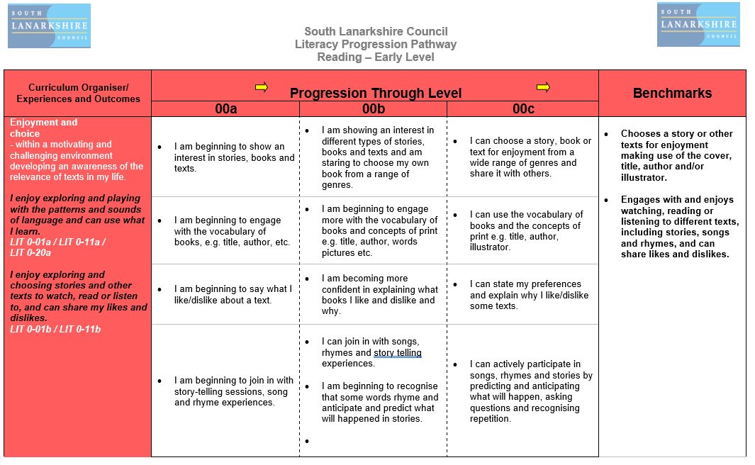
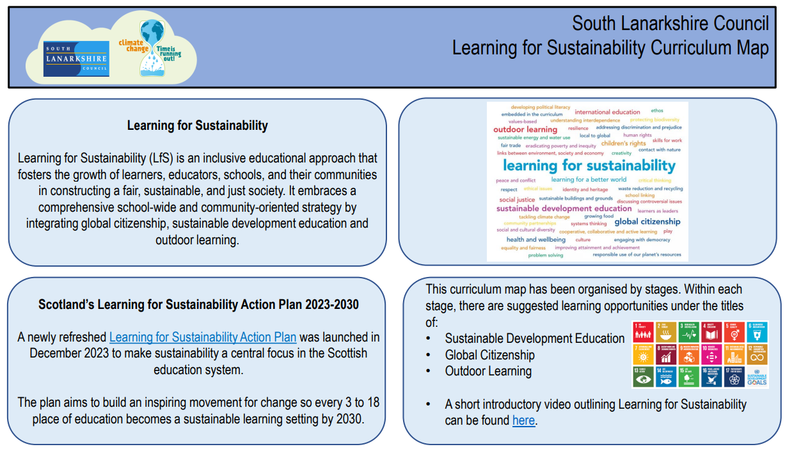
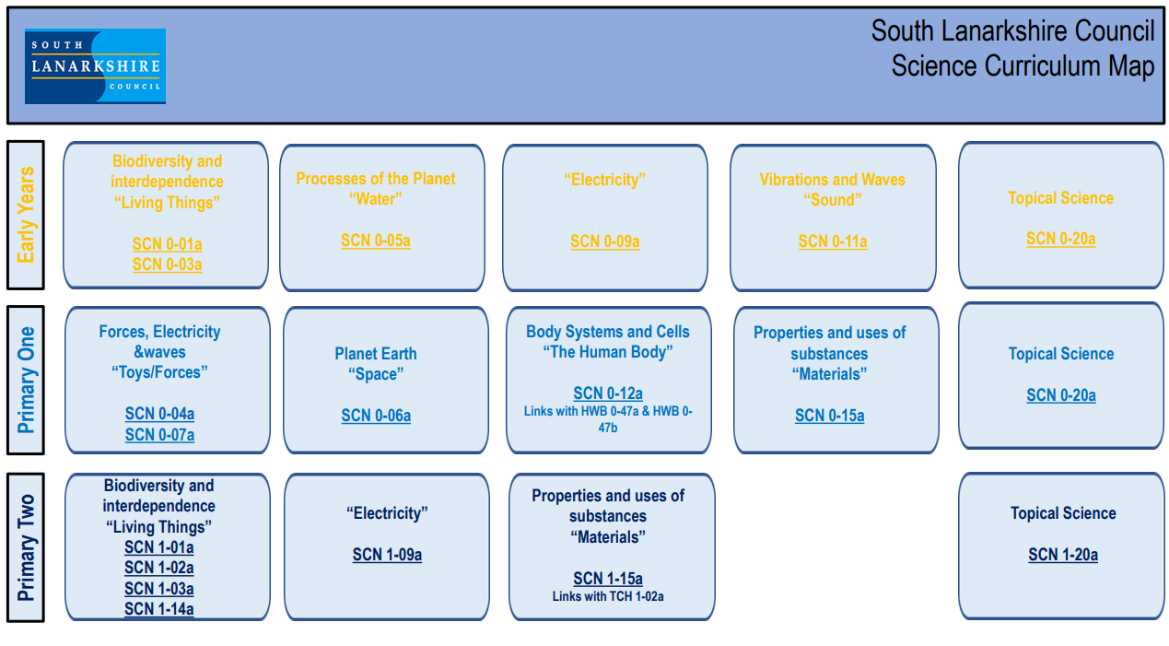
East Milton Primary School
Curriculum Rationale and Design
Curriculum Maps and Progression Pathways
Experiences and Outcomes by Level are bundled together where appropriate, with our curriculum being delivered via a blend of interdisciplinary and subject specific lessons/experiences.
Lessons are designed to be engaging and make links to skills, UNCRC and SDG as appropriate.
Progression Pathways allow staff to track progress through a level.
Growing Together Learning Together

Slide 9
East Milton Primary School
Curriculum Rationale and Design
Opportunities for Personal Achievement
Pupil Leadership Roles
Pupil Council
Young Leaders of Learning
Health and Wellbeing Committee
Eco Committee
Junior Road safety Officers
Tech Team
House Captains
Equalities Group
Paired Reading Buddies
Sports Leaders
Extra Curricular Activities
Choir
Dance Showcase
Football Team
Netball Team
Hockey
Cross Country
Primary Engineers
Coding Club
Homework Club
P7 Residential Experiences
Sharing and Celebrating Achievements
Awards Assembly
Certificates
Celebrating Success within and out with school
X
SLC Awards
Learning Logs
School House System
Growing Together Learning Together

