Slide 2
Concept of Time
Children are introduced to the concept of time through everyday language.
We talk about what happens in the morning, afternoon or evening, at the weekend or during the holidays.
We think about how long films last or how much time it takes to do something or travel somewhere.

Slide 3
Routines
Reinforce your child’s understanding of time by looking at how we measure time.
Talk about days, months and seasons.
Look for time in real life contexts and explain why it is useful to know the time.
Encourage your child to use a timer on a phone or microwave to apply their knowledge.

Slide 4
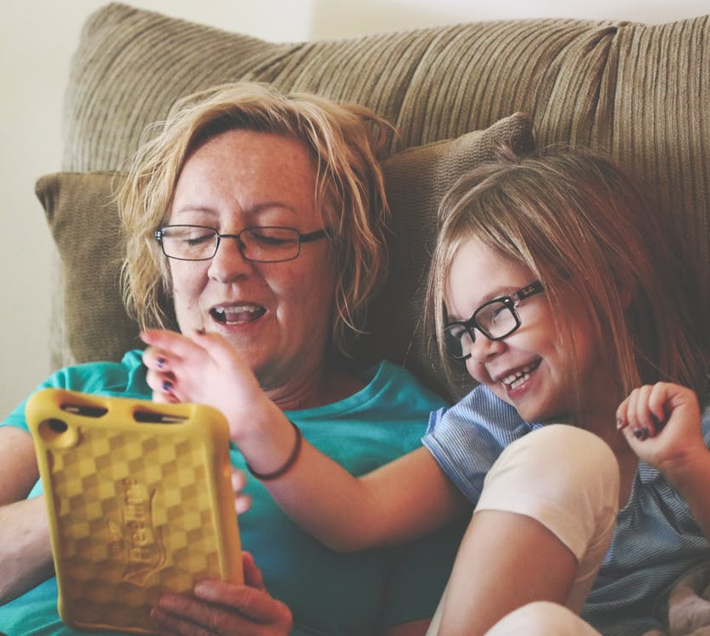
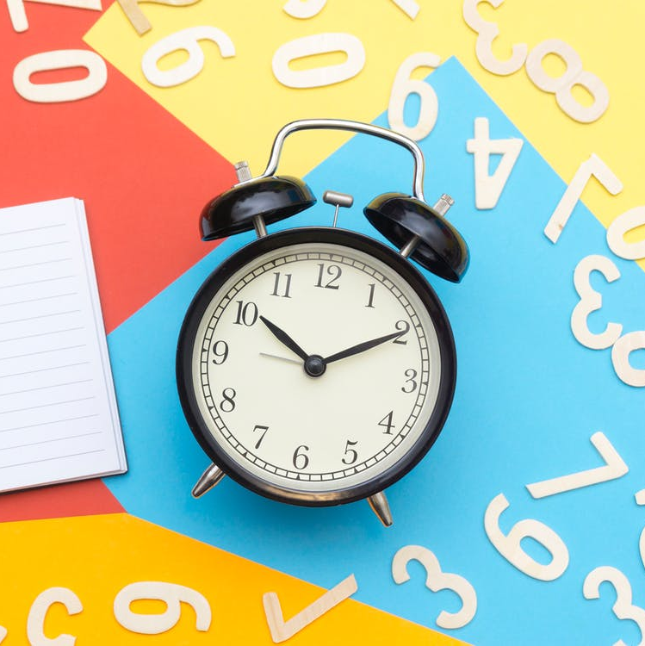
Telling the Time
Children can have difficulty linking a clock face to what they know about number.
A number line with 1-12 can help with time.
1 | 2 | 3 | 4 | 5 | 6 | 7 | 8 | 9 | 10 | 11 | 12
Children can use this number line to answer questions.
Children can then see a clock face as a circular number line.
If it is 5 o’clock, what time will it be in 2 hours?

