Slide 1
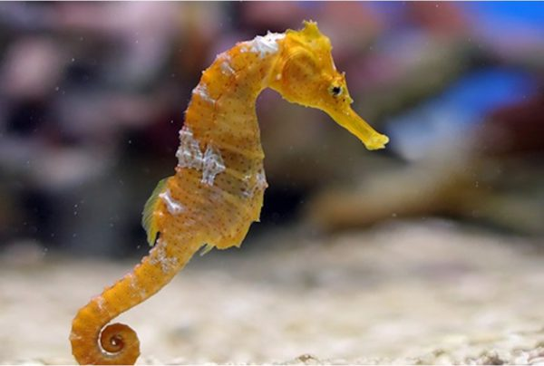
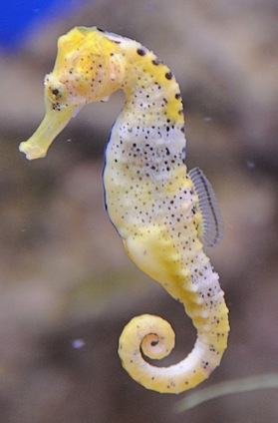
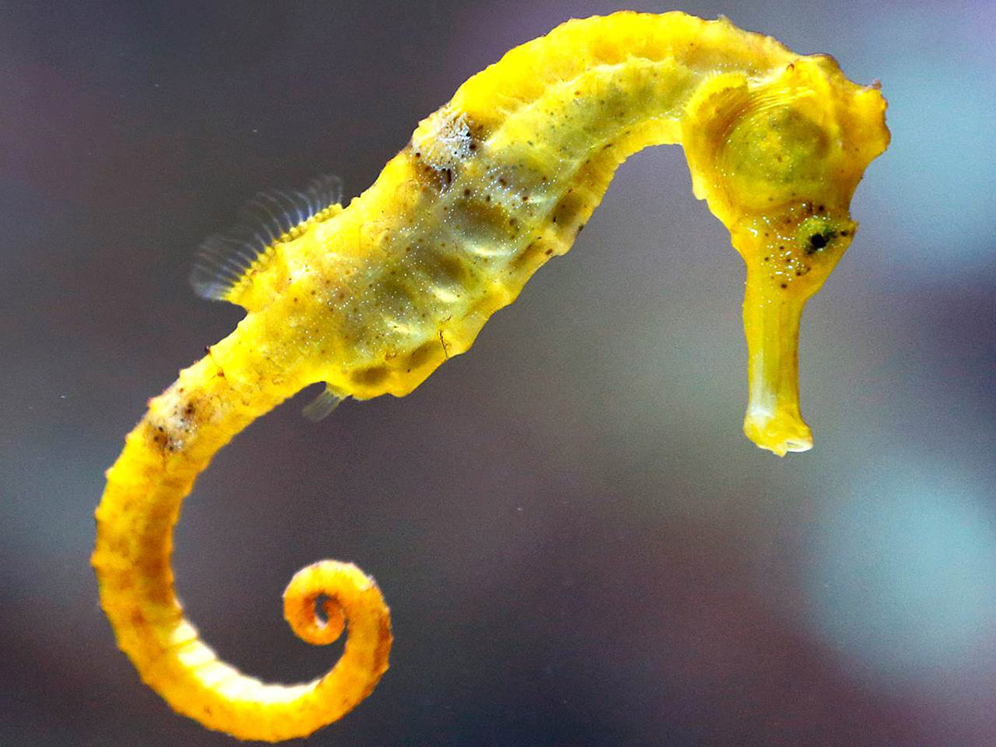
Super Seahorses By Ròs Macdonald
Learn about these amazing creatures!

Slide 2
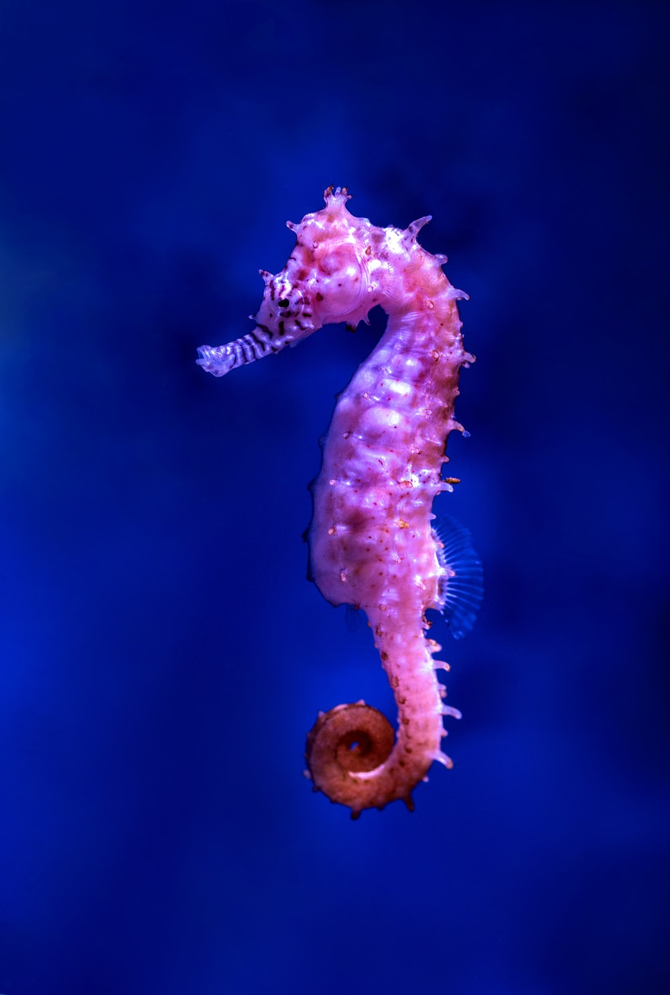
Cool Contents!
Family Facts
Homely Habitats
Awesome Appearances
Mobile Movers
Delightful Diets
Thank You

Slide 3
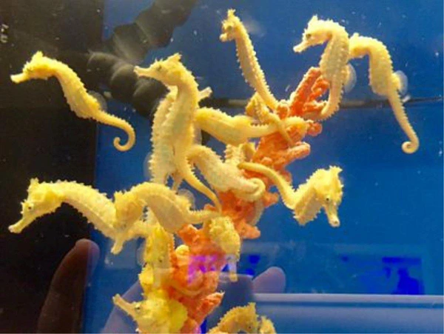
Family Facts!
Seahorses are FISH
Their family is called SYNGATHIDAE
Their genus is HIPPOCAMPUS (hippo = horse and campus = sea monster)
There are 36 species, some of which are VULNERABLE !

Slide 4
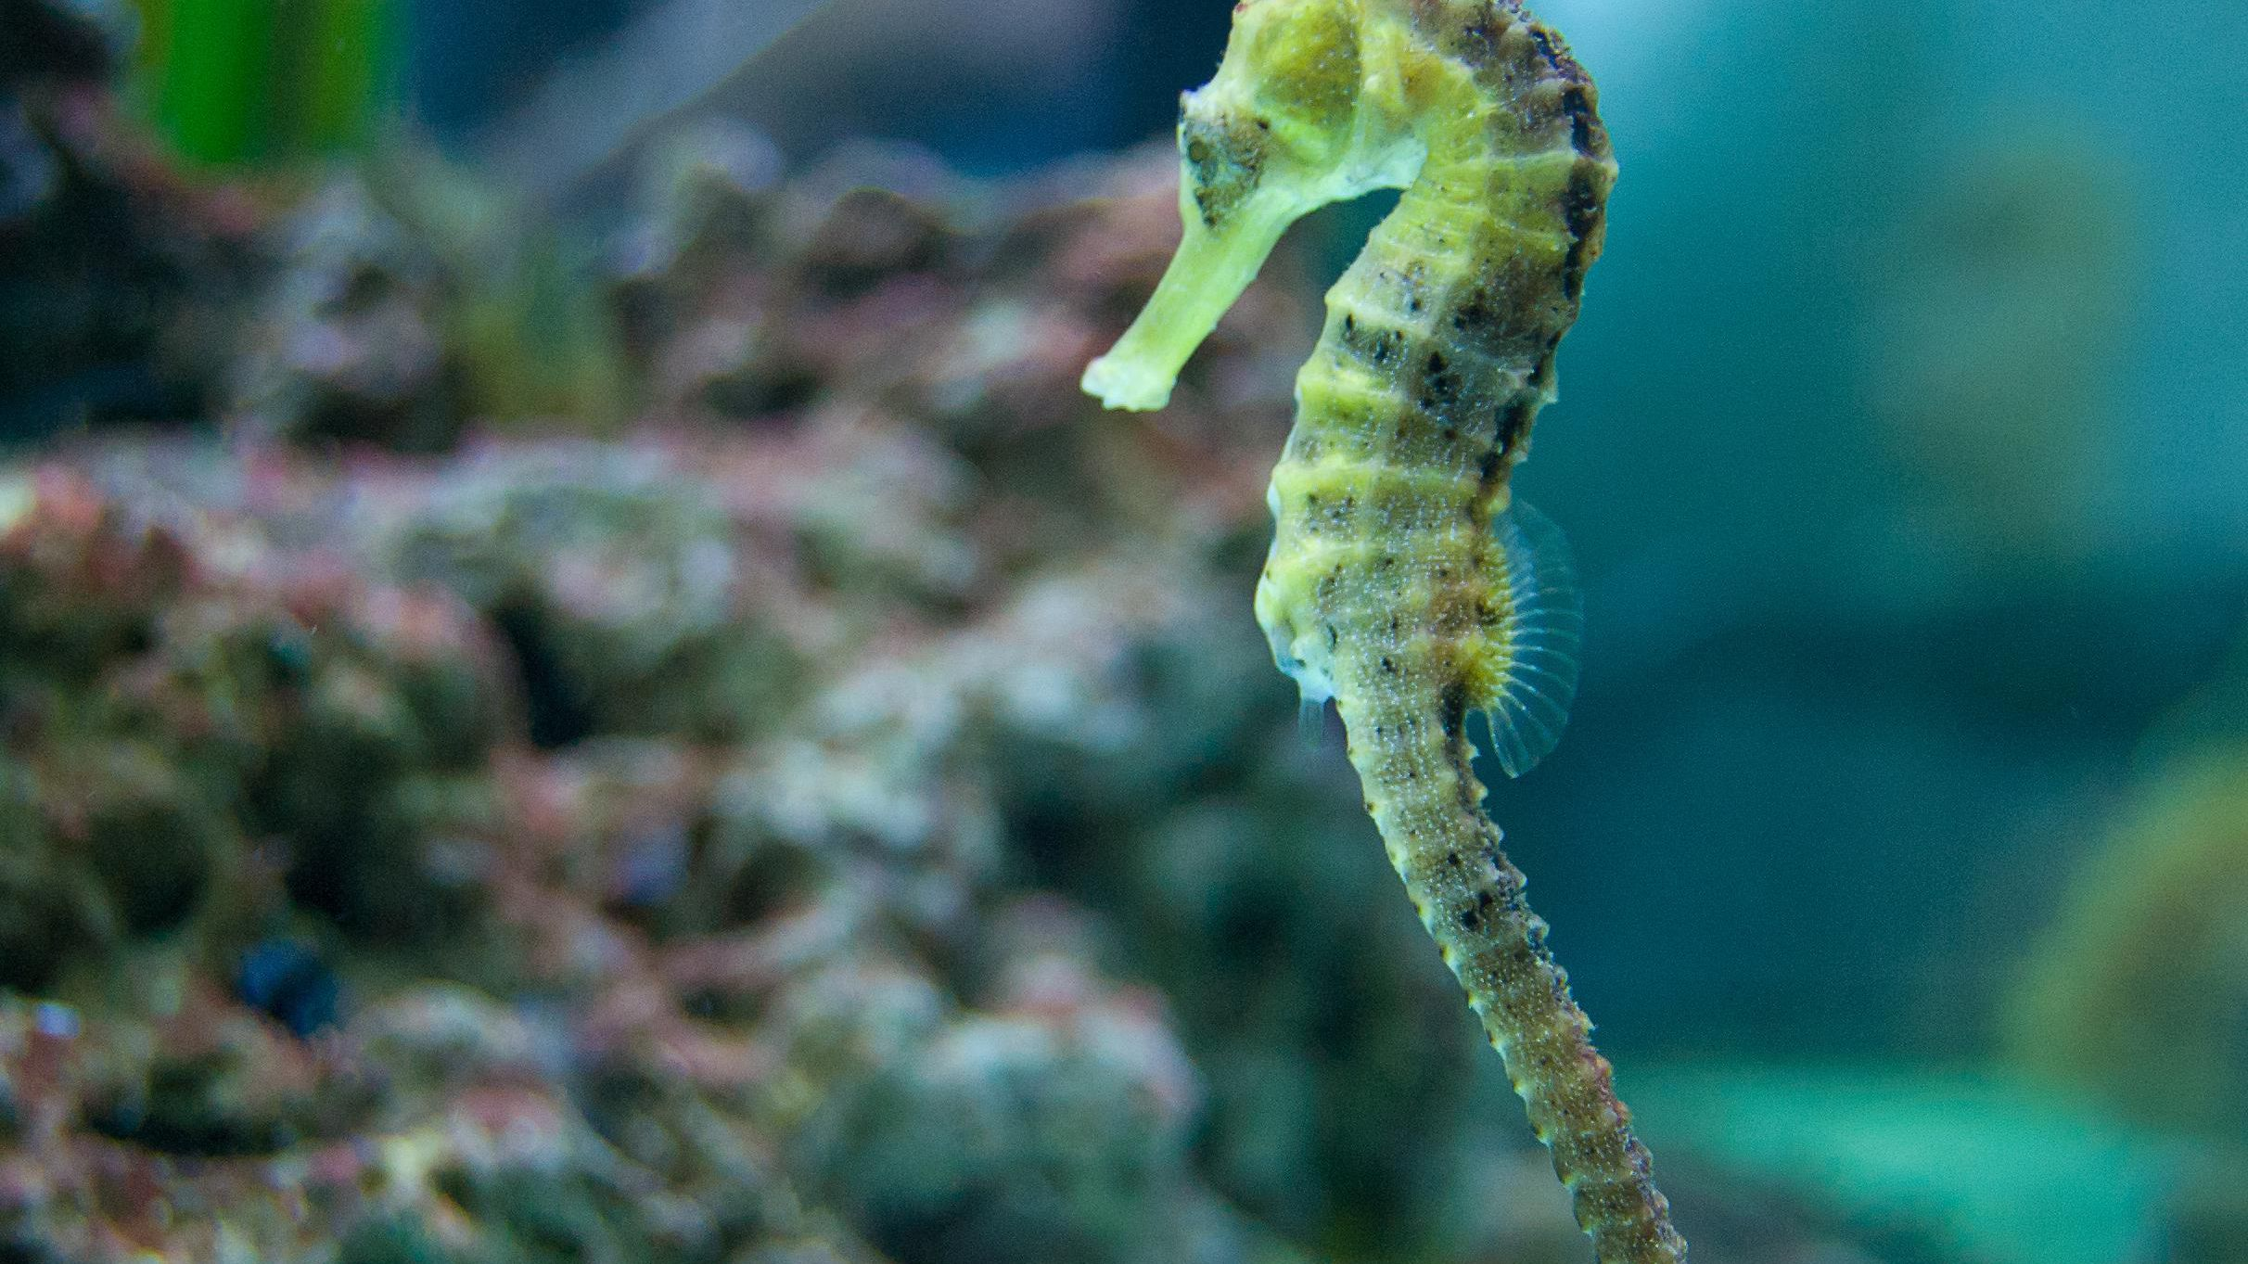
Homely Habitats!
These friendly little guys live in COASTAL AND WARM WATER!
Sea-horses live in the SUNLIGHT ZONE !
Sea horses are probably found in the BVI! (Where my Auntie Catriona lives)
There are only 2 species of seahorse (Spiny & Short-snouted) in the UK!

Slide 5
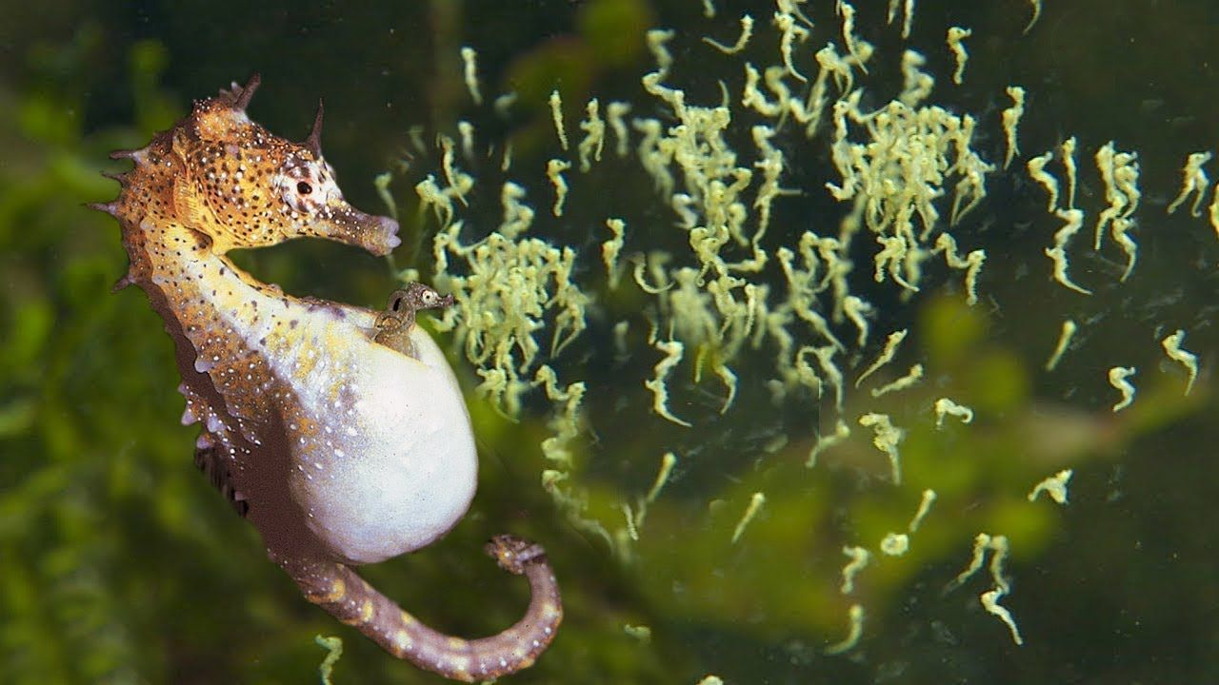
Awesome Appearances!
They have spiny plates covering their ENTIRE BODIES!
They live for about three years in the wild and can grow to 200g
They only move at 150cm per HOUR!
Daddy sea horses carry baby sea horses around in their BROOD POUCHES for 45 days until they hatch!
Their tail is used to anchor them to VEGETATION!

Slide 6
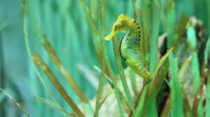
Mobile Movers!
They use their dorsal (back) fin to swim.
To go up or down they alter the amount of water in their swim bladder (a pouch full of water).
They hide in seaweed and plants.

Slide 7
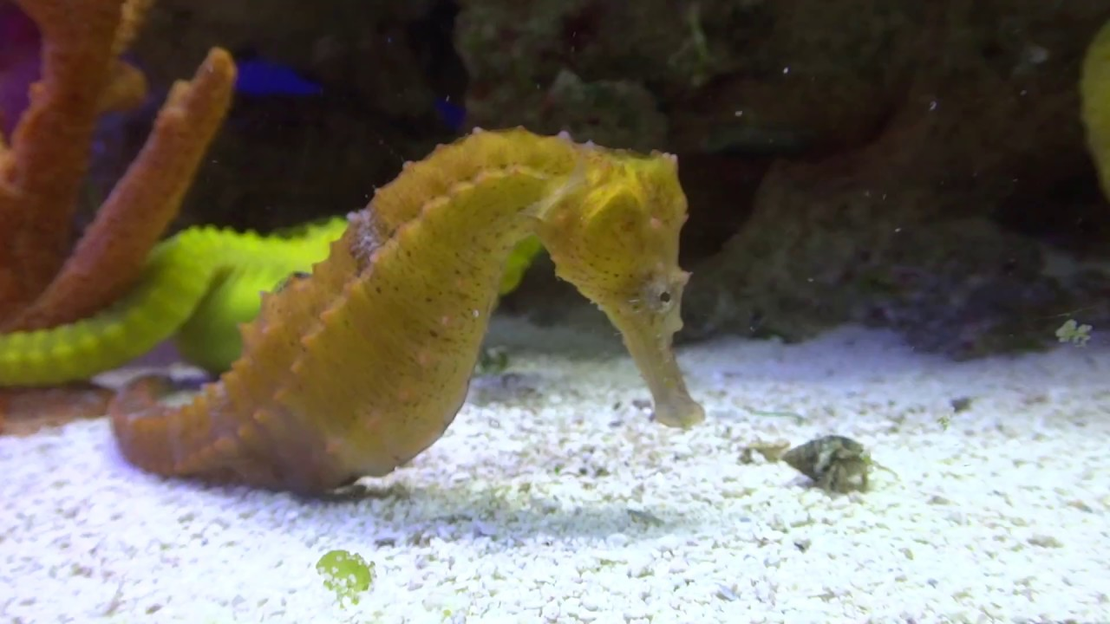
Delightful Diets!
Sea horses are CARNIVORES!
They eat small CRUSTACEANS!
So they don’t become someone else’s dinner, they use camouflage to hide! Their camouflage also helps them to hunt for prey!

Slide 8
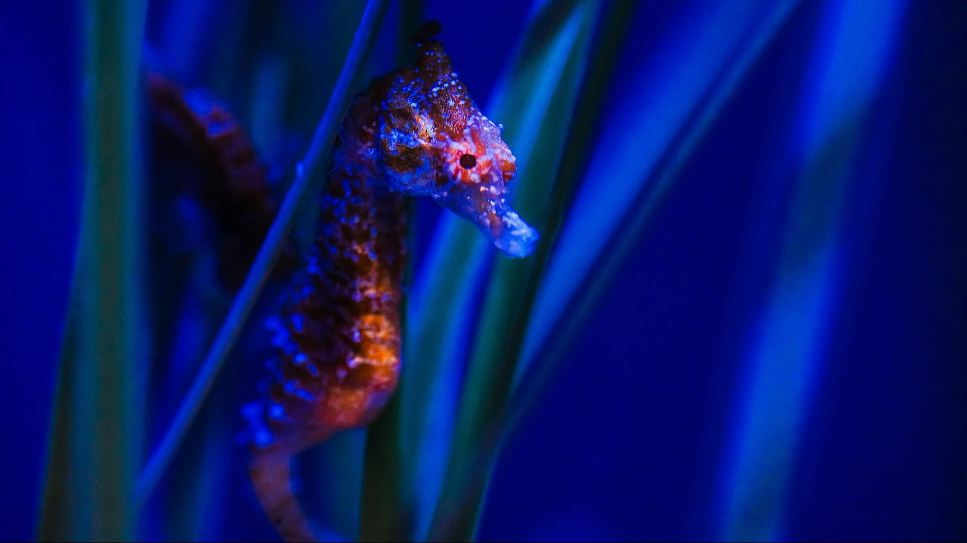
Thank you!
I hope you enjoyed learning about sea horses!
I loved when I found out that sea horses were carnivores!

