Slide 1
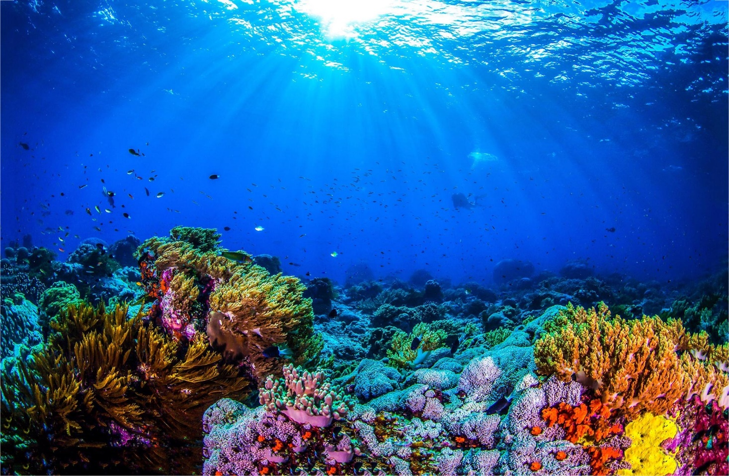
The amazing world of Coral
Jack Haggerty

Slide 2
Contents
What is Coral?
What is Coral made off?
Where is Coral found?
What do Coral eat?
Coral protects and needs protected!!
Where is the largest coral reef?
Summary.

Slide 3
What is Coral?
There is only 1% of Coral on the ocean floor, but it supports 25% of the marine animals in the world!
Believe it or not, Coral is actually an animal and is not a plant!!
Coral is stationary which means it doesn’t move.

Slide 4
What is Coral made off?
Coral is built by thousands of tiny animals called “Polyps”
Polyps are related to Jellyfish.
Hard Coral make reefs with calcium carbonite or limestone
Not all Coral is hard. You get soft coral too

Slide 5
Where is Coral Found?
Coral is found in warm tropical oceans like the Indian Ocean and the Pacific Ocean
Coral reefs are only found in shallow waters.
Coral lives mostly in the “sunlight zone” within oceans

Slide 6
What do Coral eat?
Coral has a venomous tentacle to eat its prey!
Coral eat Zooplankton and even small fish!

Slide 7
Coral protects and needs protected!
Coral provides protection to small fish from predators like sharks!
Coral grows very slowly, only a few centimetres a year.
Pollution is killing the Coral quicker than it can grow!

Slide 8
Where is the largest coral reef?
The largest coral reef is “The Great Barrier reef” found in Australia.
It has 2900 individual reefs covering an area of 133,000 square miles.
That is over 4 times the size of Scotland!

Slide 9
Summary
Coral is so important to the worlds climate and its marine animals
Coral provides protection to small animals and also is a barrier to our beaches.
We need to protect our Coral from pollution and plastic waste more or we will lose it forever.

Slide 10
The End
Jack Haggerty

