Slide 1
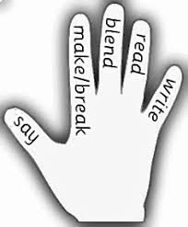
W/c 20/1/20
Pencils & Rubbers (ea)
speak
clean
steal
team
stream
wheat
ask
year
eat
Pens & Crayons (ll)
well
spill
dull
drill
allow
shallow
well
will
fell
call

