Slide 1
Primary School Edition Mr Bissett

Slide 2
1
2
3
4
5
6
7
8
9
10
11
12
13
14
15
16
17
18
19
20

Slide 3
The 10 foods The Very Hungry Caterpillar ate on Saturday
Notes:
The 10 foods the Very Hungry Caterpillar ate on Saturday [As listed in the Eric Carle book.]

Slide 4
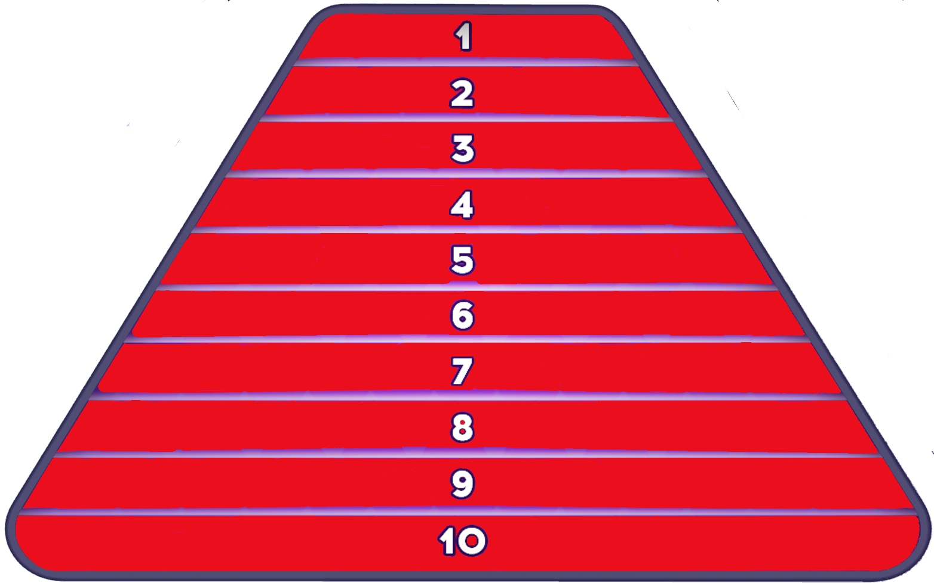
Chocolate Cake
Ice Cream Cone
Pickle
Swiss Cheese
Salami
Lollipop
Cherry Pie
Sausage
Cupcake
Water Melon
Notes:
The 10 foods the Very Hungry Caterpillar ate on Saturday [As listed in the Eric Carle book.]

Slide 5
The last 10 coloured properties alphabetically on a Monopoly board
Notes:
The 10 foods the Very Hungry Caterpillar ate on Saturday [As listed in the Eric Carle book.]

Slide 6
Park Lane
Pentonville Road
Picadilly
Regent Street
Strand
The Angel Islington
Trafalgar Square
Vine Street
Whitechapel Road
Whitehall
Notes:
The 10 foods the Very Hungry Caterpillar ate on Saturday [As listed in the Eric Carle book.]

Slide 7
The 10 ‘animal-bug’ emojis
Notes:
The 10 foods the Very Hungry Caterpillar ate on Saturday [As listed in the Eric Carle book.]

Slide 8
Ant
Butterfly
Caterpillar
Cricket
Honeybee
Ladybird
Mosquito
Scorpion
Snail
Spider
Notes:
The 10 foods the Very Hungry Caterpillar ate on Saturday [As listed in the Eric Carle book.]

Slide 9
The last 10 live-action Marvel and DC Comics films (as of 3rd July 2019)
Notes:
The 10 foods the Very Hungry Caterpillar ate on Saturday [As listed in the Eric Carle book.]

Slide 10
Spider-man: Far From Home
Dark Phoenix
Avengers: Endgame
Shazam
Captain Marvel
Aquaman
Venom
Antman and the Wasp
Deadpool 2
Avengers: Infinity War
Notes:
The 10 foods the Very Hungry Caterpillar ate on Saturday [As listed in the Eric Carle book.]

Slide 11
The 10 bird emojis
Notes:
The 10 foods the Very Hungry Caterpillar ate on Saturday [As listed in the Eric Carle book.]

Slide 12
Turkey
Chicken
Penguin
Dove
Eagle
Duck
Swan
Owl
Peacock
Parrot
Notes:
The 10 foods the Very Hungry Caterpillar ate on Saturday [As listed in the Eric Carle book.]

Slide 13
The UK’s ten most loved vegetables (poll in 2018 by Dolmio Veggie Goodeness)
Notes:
The 10 foods the Very Hungry Caterpillar ate on Saturday [As listed in the Eric Carle book.]

Slide 14
Potato
Carrot
Tomato
Onion
Pea
Broccoli
Pepper
Sweetcorn
Green bean
Cabbage
Notes:
The 10 foods the Very Hungry Caterpillar ate on Saturday [As listed in the Eric Carle book.]

Slide 15
The first 10 children’s novels by David Walliams (shorts stories and picture books excluded)
Notes:
The 10 foods the Very Hungry Caterpillar ate on Saturday [As listed in the Eric Carle book.]

Slide 16
The Boy in the Dress
Mr Stink
Billionaire Boy
Gangsta Granny
Ratburger
Demon Dentist
Awful Auntie
Grandpa’s Great Escape
The Midnight Gang
Bad Dad
Notes:
The 10 foods the Very Hungry Caterpillar ate on Saturday [As listed in the Eric Carle book.]

Slide 17
Top 10 Scottish Premiership football teams of the 2018/19 season
Notes:
The 10 foods the Very Hungry Caterpillar ate on Saturday [As listed in the Eric Carle book.]

Slide 18
Celtic
Rangers
Kilmarnock
Aberdeen
Hibernian
Heart of Midlothian
St Johnstone
Motherwell
Livingstone
Hamilton Academical
Notes:
The 10 foods the Very Hungry Caterpillar ate on Saturday [As listed in the Eric Carle book.]

Slide 19
The 10 best-selling car brands in the UK in 2018
Notes:
The 10 foods the Very Hungry Caterpillar ate on Saturday [As listed in the Eric Carle book.]

Slide 20
Ford
Volkswagen
Vauxhall
Mercedes-Benz
BMW
Audi
Nissan
Toyota
Kia
Hyundai
Notes:
The 10 foods the Very Hungry Caterpillar ate on Saturday [As listed in the Eric Carle book.]

Slide 21
The 10 highest earning football clubs in Europe (2017/18 season)
Notes:
The 10 foods the Very Hungry Caterpillar ate on Saturday [As listed in the Eric Carle book.]

Slide 22
Real Madrid
Barcelona
Manchester United
Bayern Munich
Manchester City
Paris Saint-Germain
Liverpool
Chelsea
Arsenal
Tottenham Hotspur
Notes:
The 10 foods the Very Hungry Caterpillar ate on Saturday [As listed in the Eric Carle book.]

Slide 23
The 10 fruits in Robinson’s Fruit Squash range (March 2019)
Notes:
The 10 foods the Very Hungry Caterpillar ate on Saturday [As listed in the Eric Carle book.]

Slide 24
Apple
Blackcurrant
Cherry
Lemon
Mango
Orange
Passionfruit
Pineapple
Plum
Strawberry
Notes:
The 10 foods the Very Hungry Caterpillar ate on Saturday [As listed in the Eric Carle book.]

Slide 25
The 10 most popular musical instruments for children that children play or would like to play
Notes:
The 10 foods the Very Hungry Caterpillar ate on Saturday [As listed in the Eric Carle book.]

Slide 26
Guitar
Piano - Keyboard
Drums
Bass Guitar
Ukulele
Violin - Viola
Recorder
Saxophone
Flute
Trumpet
Notes:
The 10 foods the Very Hungry Caterpillar ate on Saturday [As listed in the Eric Carle book.]

Slide 27
The 10 overseas countries with the most popular cuisines (2018 study)
Notes:
The 10 foods the Very Hungry Caterpillar ate on Saturday [As listed in the Eric Carle book.]

Slide 28
Italy
China
India
Spain
Mexico
Thailand
Greece
United States
France
Turkey
Notes:
The 10 foods the Very Hungry Caterpillar ate on Saturday [As listed in the Eric Carle book.]

Slide 29
The 10 Pixar animated feature films between ‘Toy Story’ and ‘The Good Dinosaur’ (as released in the UK)
Notes:
The 10 foods the Very Hungry Caterpillar ate on Saturday [As listed in the Eric Carle book.]

Slide 30
A Bug’s Life
Monsters Inc
Finding Nemo
The Incredibles
Cars
Ratatouille
WALL-E
Up
Brave
Inside Out
Notes:
The 10 foods the Very Hungry Caterpillar ate on Saturday [As listed in the Eric Carle book.]

Slide 31
The first 10 words of six or more letters in ‘A Whole New World’ (From the 1992 animated feature film).
Notes:
The 10 foods the Very Hungry Caterpillar ate on Saturday [As listed in the Eric Carle book.]

Slide 32
Shining
Shimmering
Splendid
Princess
Decide
Wonder
Sideways
Carpet
Fantastic
Dreaming
Notes:
The 10 foods the Very Hungry Caterpillar ate on Saturday [As listed in the Eric Carle book.]

Slide 33
The 10 US states containing the letters ‘J’ or ‘K’
Notes:
The 10 foods the Very Hungry Caterpillar ate on Saturday [As listed in the Eric Carle book.]

Slide 34
New Jersey
Alaska
Arkansas
Kansas
Kentucky
Nebraska
New York
North Dakota
Oaklahoma
South Dakota

Slide 35
The 10 words of six or more letters in the titles of the ‘Harry Potter’ books (This refers to the UK releases of the original 7 books in the series by JK Rowling and does not include hyphenated words; words including apostrophes will be accepted; because the word ‘Potter’ is in the question it will not be accepted as an answer)

Slide 36
Azkaban
Chamber
Deathly
Goblet
Hallows
Philosopher’s
Phoenix
Prince
Prisoner
Secret

Slide 37
The 10 most played ball sports by adults in England

Slide 38
Football
Golf
Table Tennis
Goblet
Squash
Bowls
Cricket
Basketball
Netball
Rugby Union

Slide 39
The 10 least-used letters in the English language

Slide 40
Q
J
Z
X
V
K
W
Y
F
B

Slide 41
The 10 Mr Men characters with last names beginning with S or T

Slide 42
Mr Silly
Mr Skinny
Mr Slow
Mr Small
Mr Sneeze
Mr Snow
Mr Strong
Mr Tall
Mr Tickle
Mr Topsy-Turvy

