Slide 1
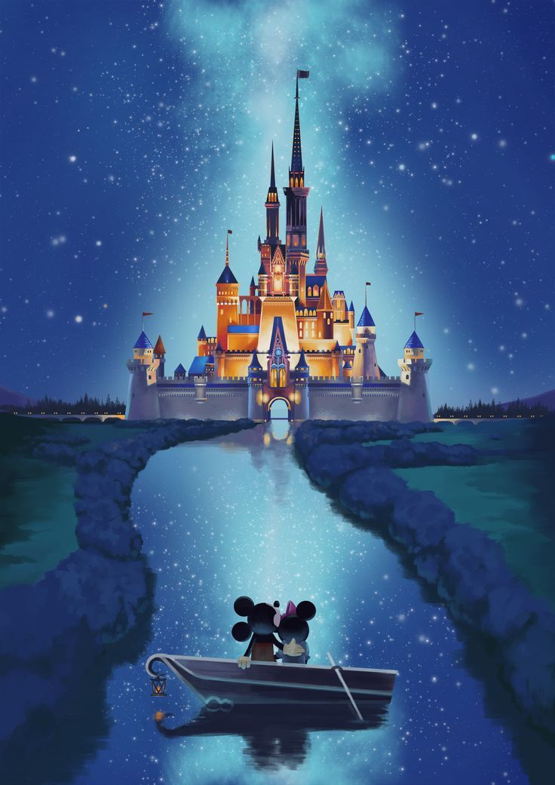
Working out with Disney and Friends

Slide 2
Before completing any workout, you must always remember to warm up Simba!
But why
Rafiki?

Slide 3
A warm up helps to prepare your body for exercising and increases your heart rate.

Slide 4
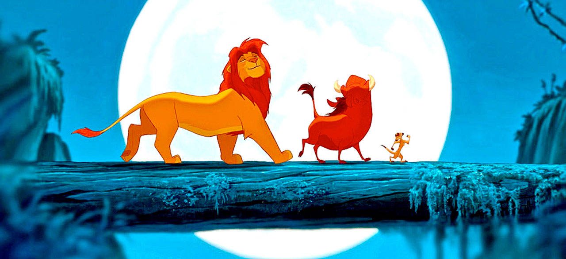
Lets get started!
I know a few friends that can help us!
Hakuna Matata!

Slide 5
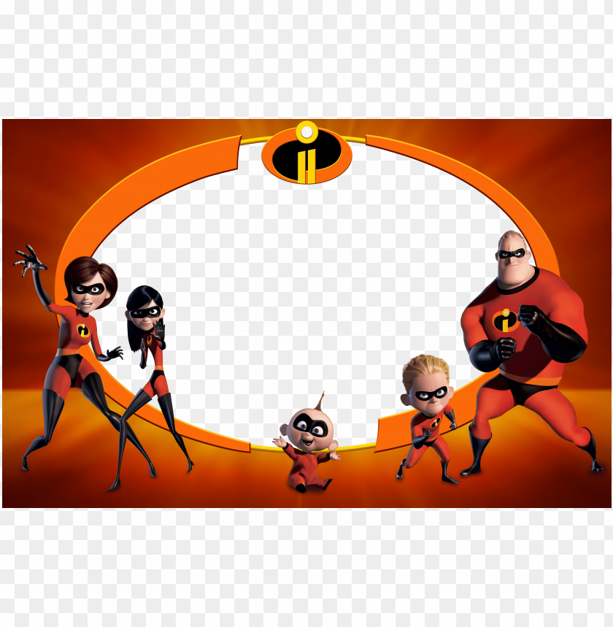
Get your body moving with an incredible warm up!

Slide 6
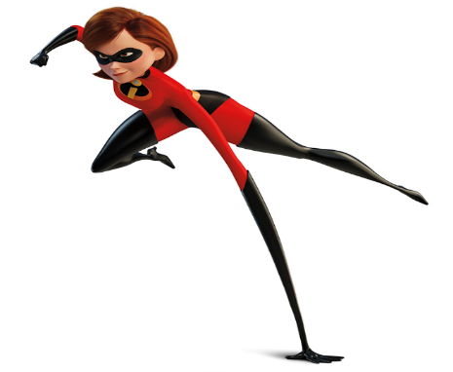
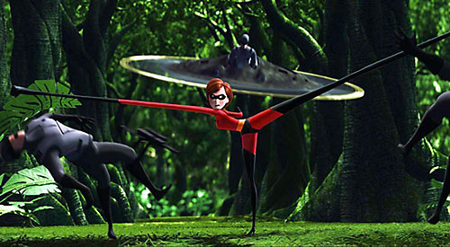
Time to s-t-r-e-t-c-h
5 toe touches
4 quad stretches4
forward lunges
5 forward and
backward arm circles

Slide 7
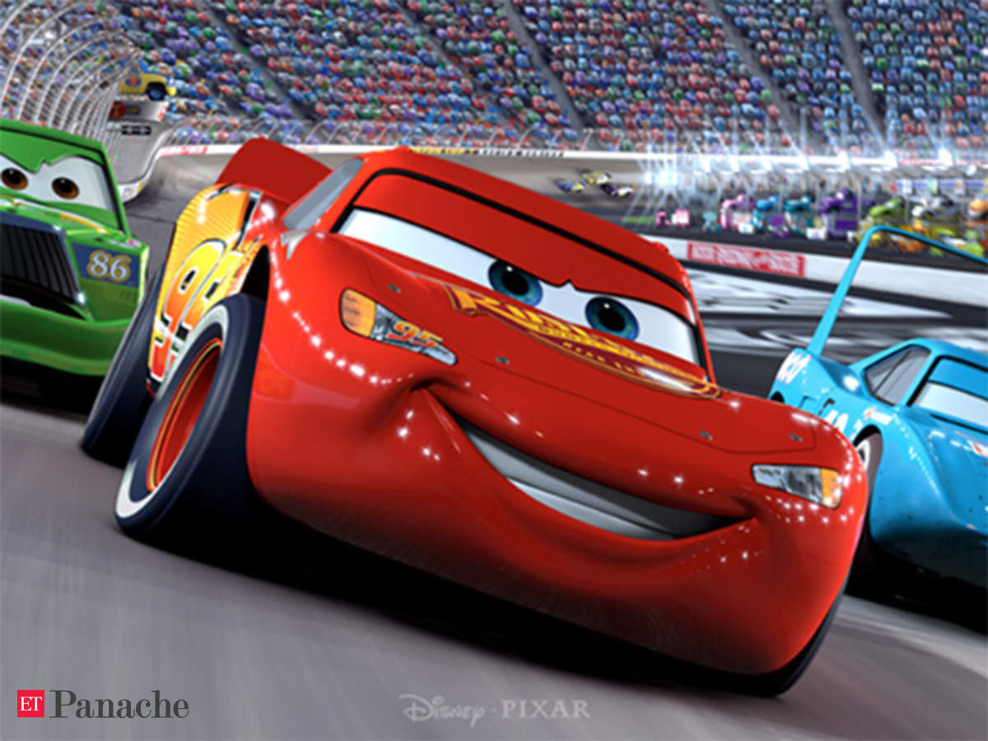

Slide 8
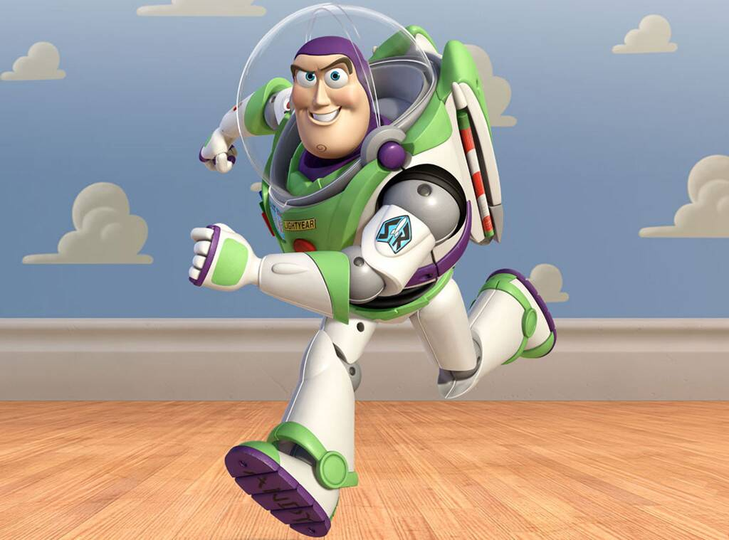
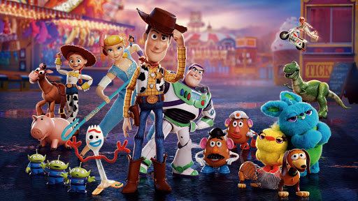
Get your wings ready... 10 jumping jacks 10 superhero jumps

Slide 9
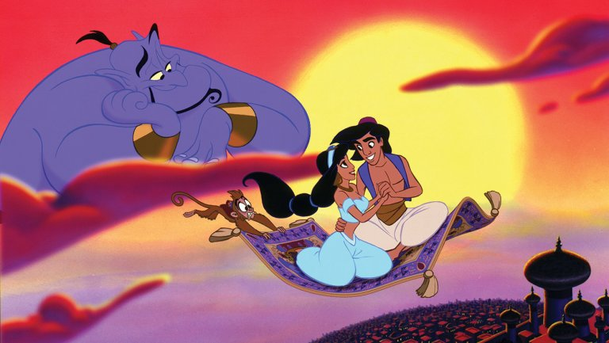
Magic Carpet Plank
Hold on for 30 seconds!

Slide 10
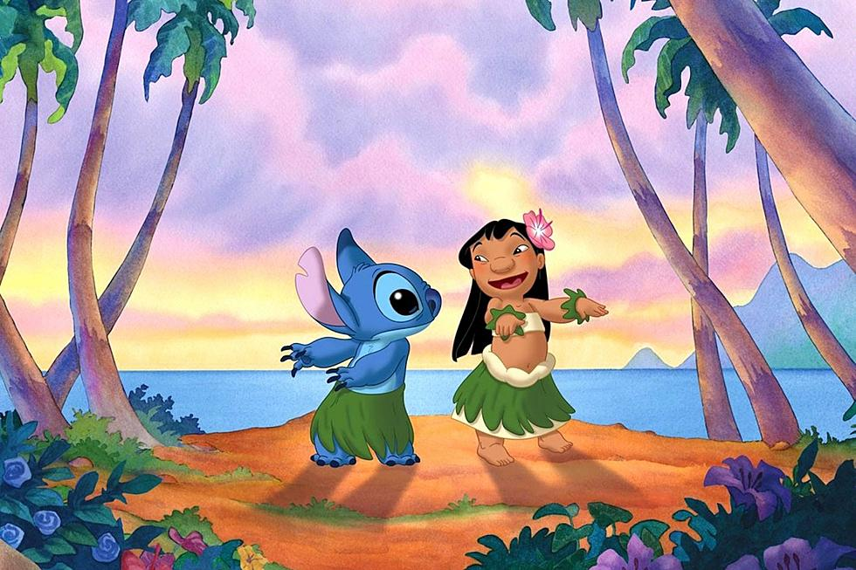
Squat like Stitch
Squat like Stitch
5 Squats and hold
5 squats and hold
Remember your hula hands!

Slide 11
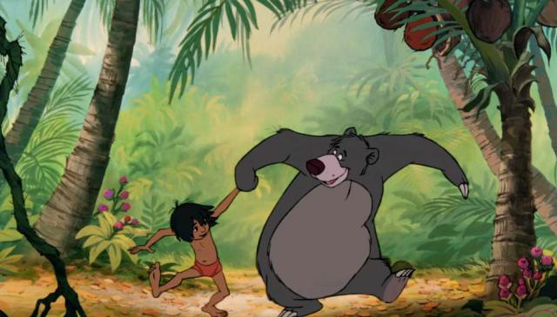
Bear Crawl like Baloo the Bear 30 seconds

Slide 12
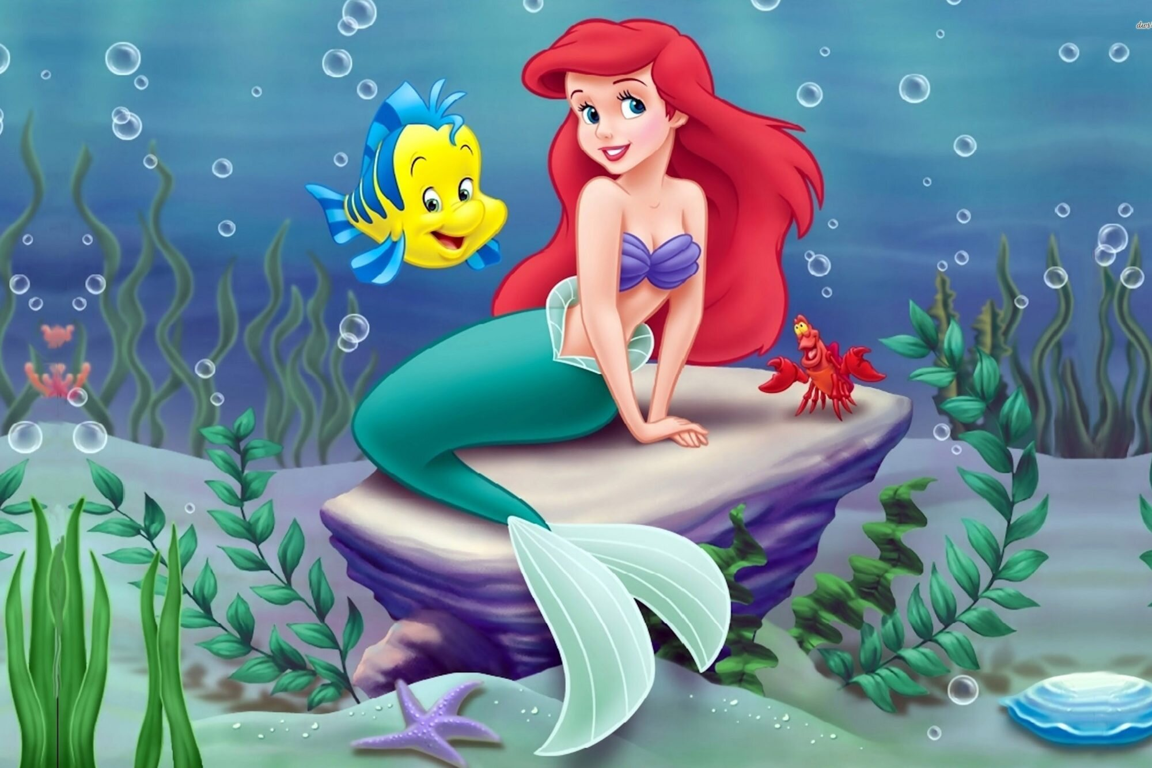
Swim like ariel with 10 side crunches Crab walk like Sebastian (30 seconds)

Slide 13
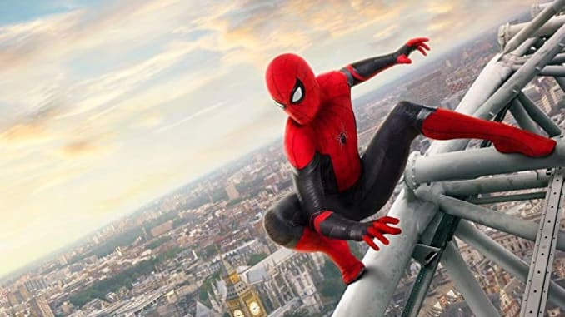
10 Spiderman Squat Jumps 10 Superman Burpees

Slide 14
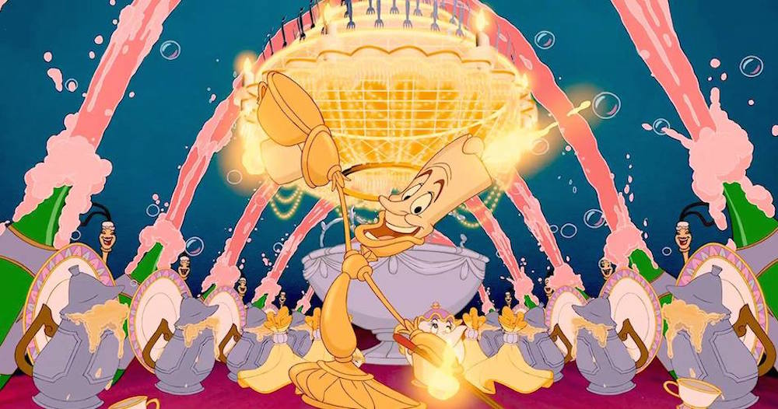
Be our Guest! Find a wall and take a seat against it (30 seconds)

Slide 15
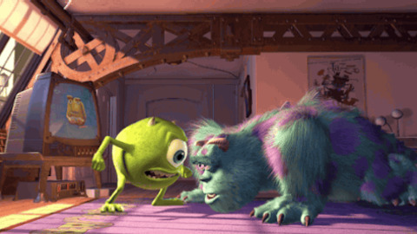
10 Monster Press ups Remember to roar after each one !

Slide 16
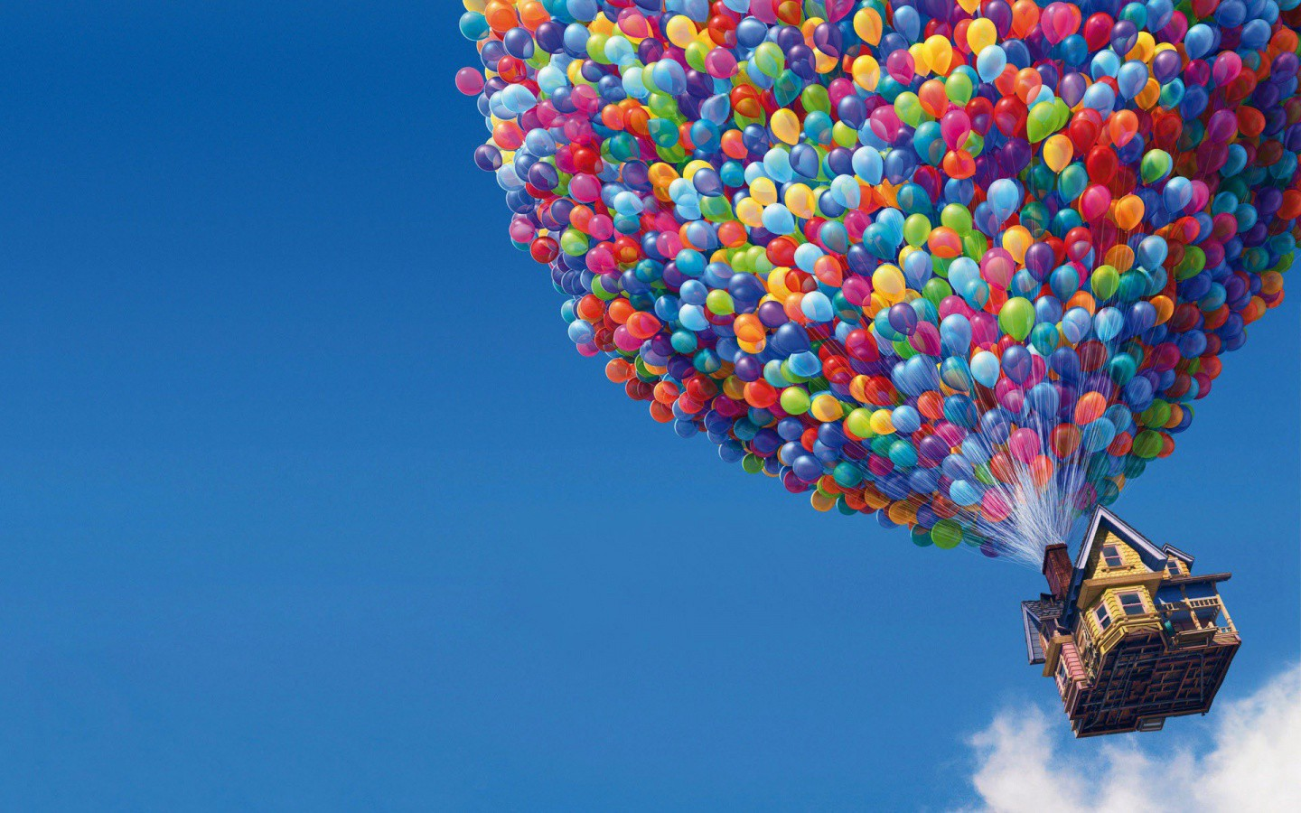
10 sit UPs

Slide 17
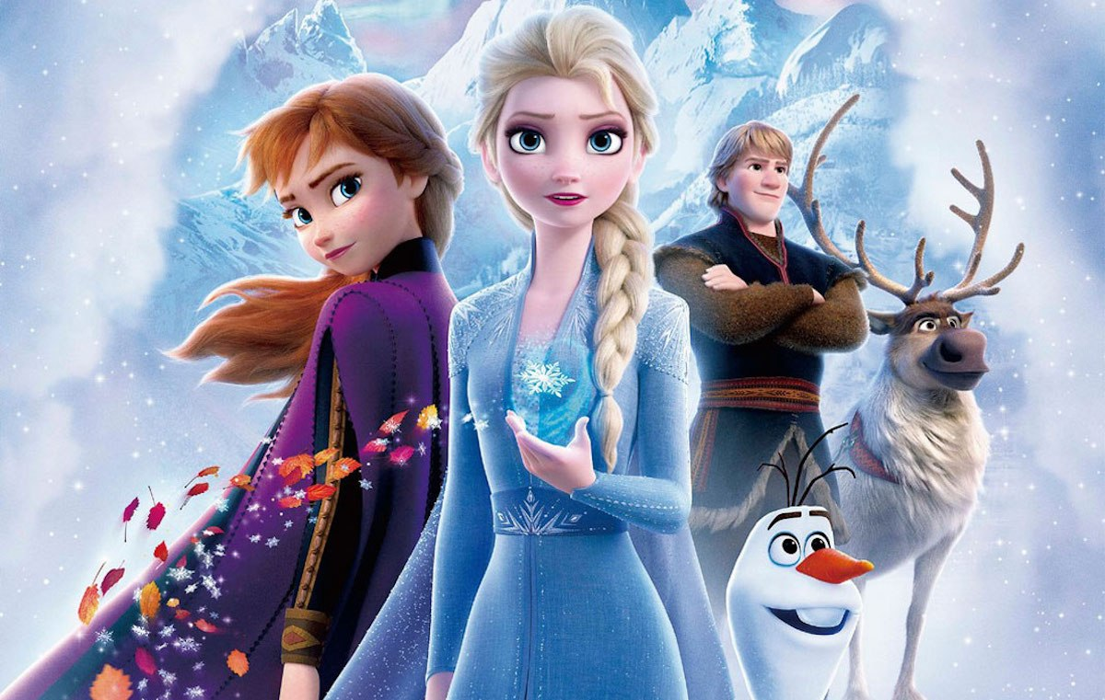
Time to Cool down

Slide 18
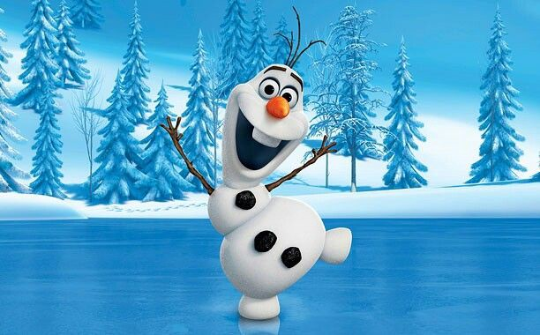
Warm Hug your knees
Toe touches
Bend to the right bend to the left

Slide 19
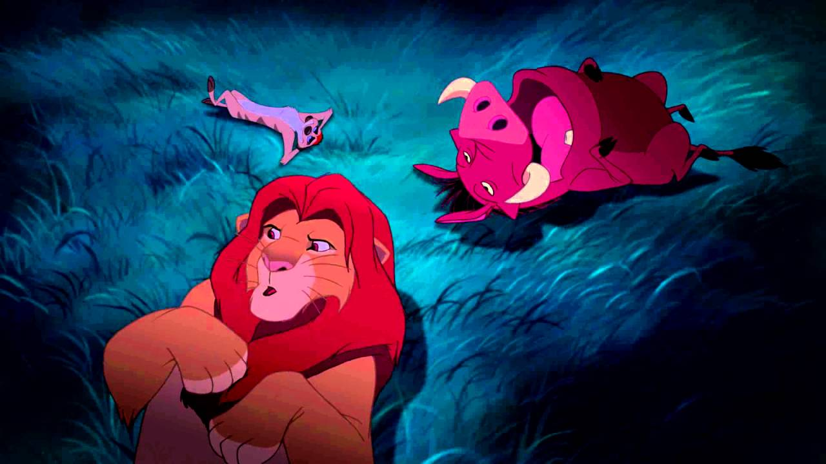
I am exhausted after all of that
Z
Z z

