Slide 1



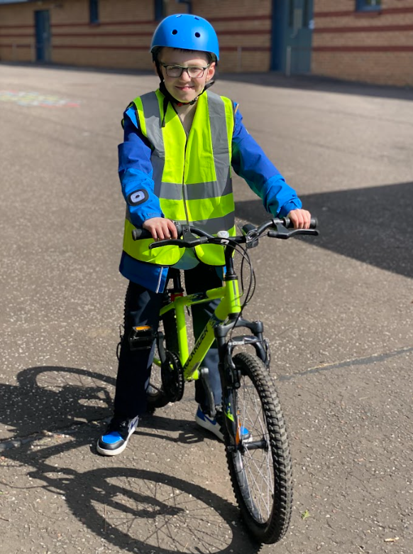
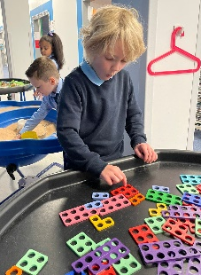

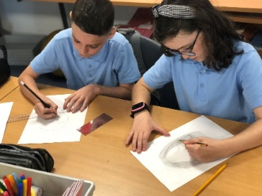

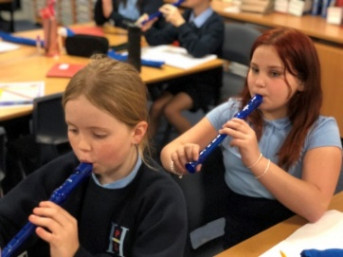
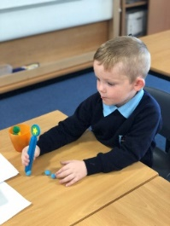





Hallside Primary School:Pre-Enrolment
1881
When We Work Together, Everything Is Within Our REACH January 2026

Slide 2



Introductions
1881
Head Teacher
Depute Head
Principal Teacher

Slide 3
School Values
School Vision
When We Work Together, Everything Is Within Our REACH
1881

Slide 4

School Ethos
Successful Learners
Confident Individuals
Once a Hallsider, Always a Hallsider
Responsible Citizens
H
Effective Contributors
P
S
1881
S

Slide 5






Our Collective
Responsibility or
Our School Rules
1881

Slide 6

P1 Enrolment 2026
1881

Slide 7
P1 Enrolment 2026
1881
Parents/carers of children who are 5 between 1st March 2026 and the end of February 2027 are required to register their child for school during Infant Enrolment Week.
Infant Enrolment commences this week.
Enrolling your child for school – South Lanarkshire Council

Slide 8
1881
P1 2026 What happens next?
Week beginning 12th January We will contact all families to confirm receipt of enrolment documentation and invite families for a one-to-one visit with a member of the Senior Leadership Team.
February-March A member of the staff team will visit your child in their nursery setting.
S

Slide 9
1881
P1 2026 induction days – Save the Dates
Tuesday 9th June 1.30pm-2.45pm (Induction Day 1)
Wednesday 10th June 1.00pm – 2.45pm (Induction Day 2)
(Children and parent/carer should attend both sessions.)
S

Slide 10
1881
P1 2026 ADDITIONAL Transition Events
Wednesday 29th April 1.45pm-2.30pm (Additional transition event – all welcome)
Wednesday 27th May 1.45pm-2.30pm (Additional transition event – all welcome)
S

Slide 11
School Information
Hallside Primary School Handbook Session 25-26
Education Scotland Report
Standards and Quality Report 2024-2025
1881

Slide 12
Communication
1881
Email parent/carer group list
Parents Portal
Google Classroom
X/Twitter
Newsletters, consent forms, updates, information
Teacher to Pupil communication/ homework/ home learning
Emergency Communication
Parental communication should be sent via the school office email address (gw14hallsidepsoffice@glow.sch.uk) so that it can be directed to all the relevant staff. Google classroom is for teacher-pupil communication)

Slide 13
1881
Any questions?

Slide 14
Tour of the School
1881

Slide 15
Hallside Primary School:Pre-Enrolment
1881
When We Work Together, Everything Is Within Our REACH January 2026

