Slide 1



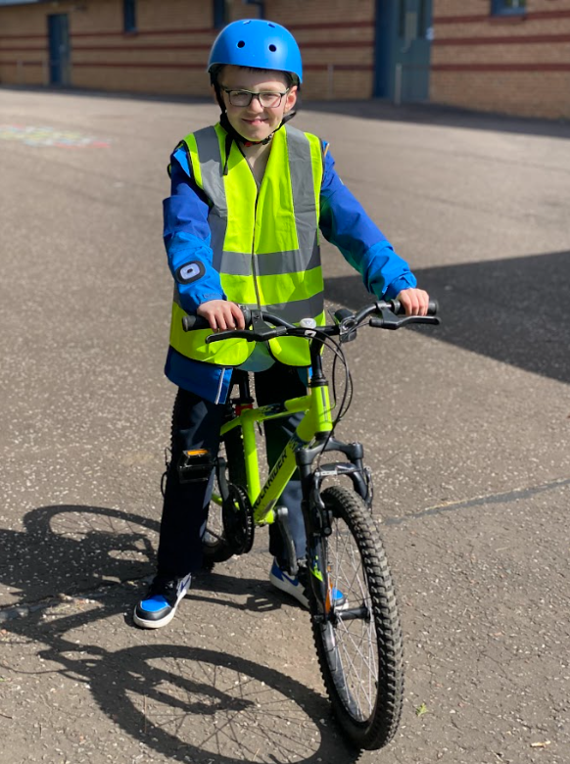
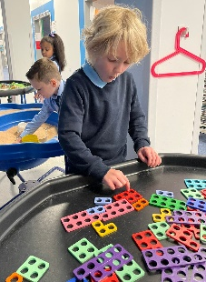
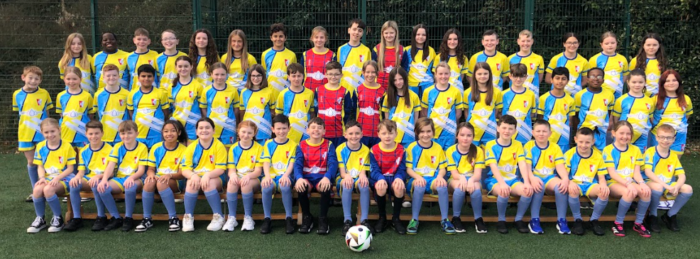
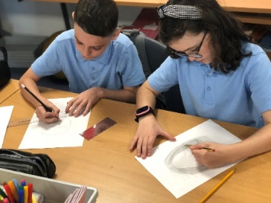
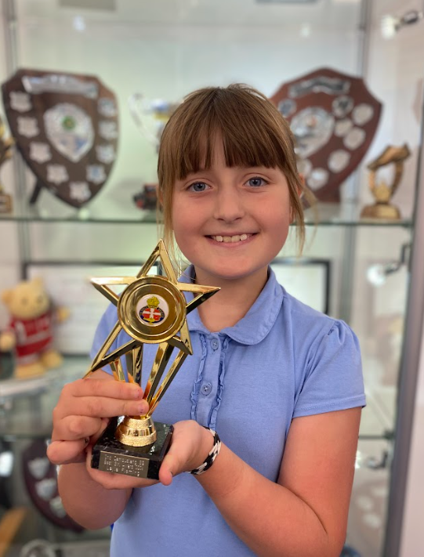
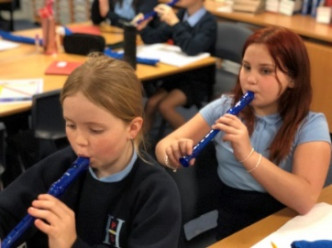
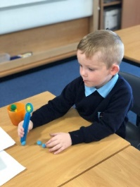




Hallside Primary: P1 Induction
1881
Day 1 10th June 2025

Slide 2


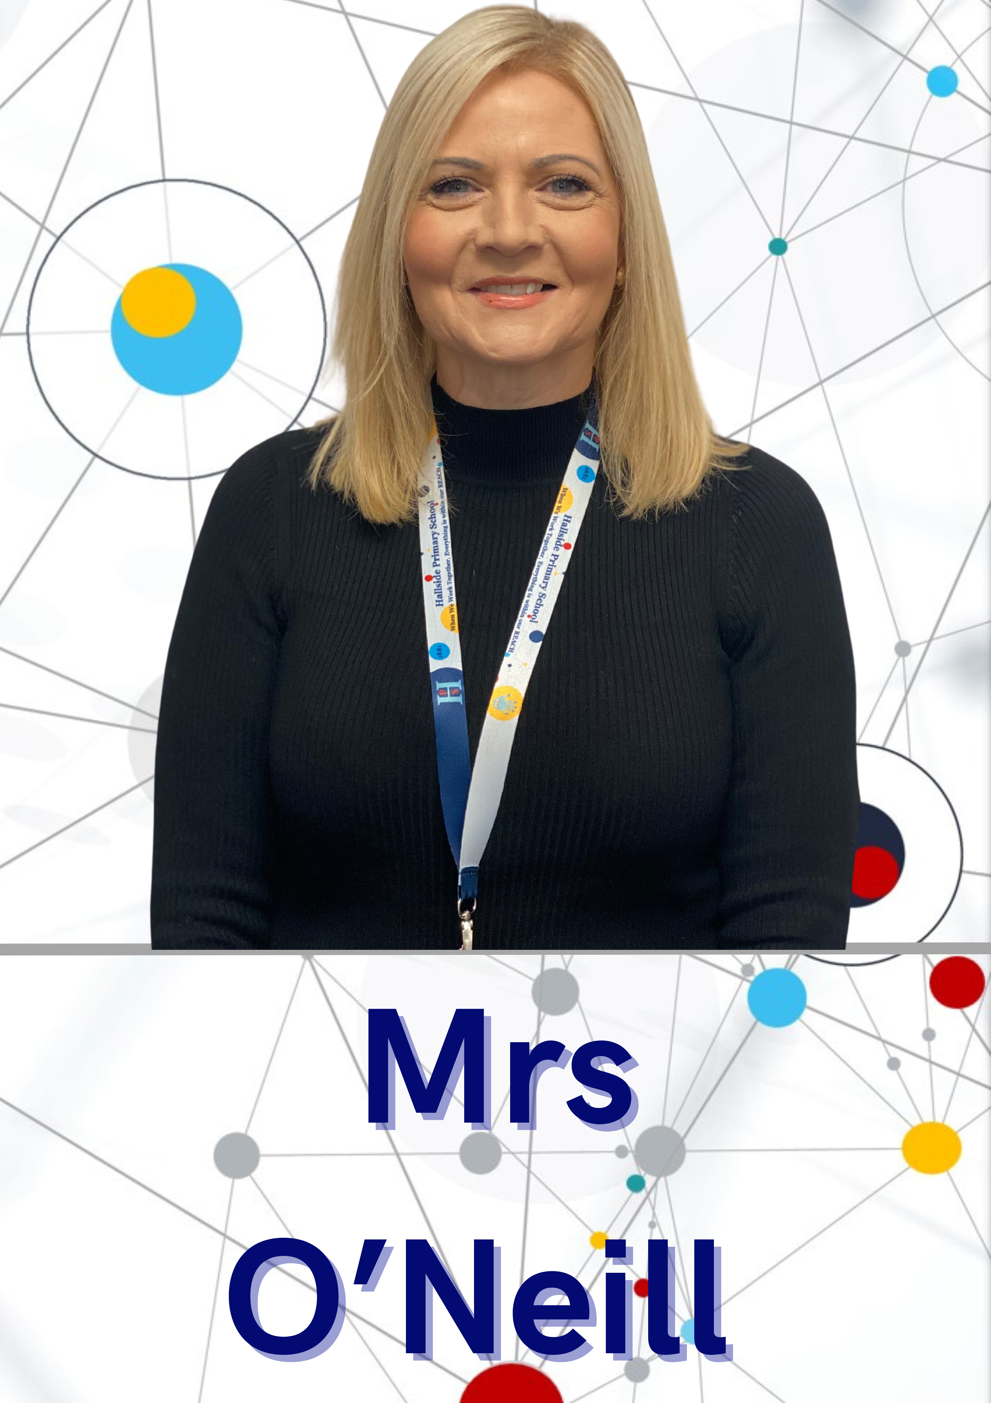
Introductions
1881
Head Teacher
Depute Head
Principal Teacher

Slide 3
Introductions
1881
P1 Team 2025-2026
Mrs Macdonald Class Teacher
Mrs Byrne Class Teacher
Mr Bryans Class Teacher
Groups with teachers.

Slide 4
Induction Day 1
1881
Two Sessions this afternoon.
Session 1
Children visiting classes with class teachers planned activities. Meet buddies. Parents/carers in gym hall to hear from some of our senior pupils and view information stalls. (30 mins)
Session 2
Family Learning session in dining hall for parents/carers and children. (30 mins)

Slide 5
Induction Day 2
1881
Family Lunch: 1 adult and 1 child lunch. Lunch order must be completed today so that catering team can prepare. Thank you.
Red Group 12.30pm
Green Group 12.35pm
Blue Group 12.40pm
Purple Group 12.45pm
1.00pm-1.30pm Children taken to classes by parents/carers after lunch.
1.00pm-1.30pm Parents/carers assemble in gym hall.
1.30pm-2.30pm Presentations from Parent Council and School Staff.

Slide 6
Pupil Presentation
1881

