Slide 1
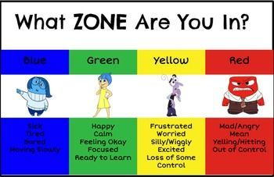
In Primary 3/4 we have been enjoying our Zones topic!
We have been learning about our feelings and emotions and working as part of a team.
We cant wait to show you some pictures of our work!

Slide 2
We enjoyed watching the movie Inside Out! We hope you did too!

Slide 3
We traced the characters from Inside Out on to large pieces of paper.
This was a little tricky at first but we soon got the hang of it!
Here are some pictures…

Slide 4
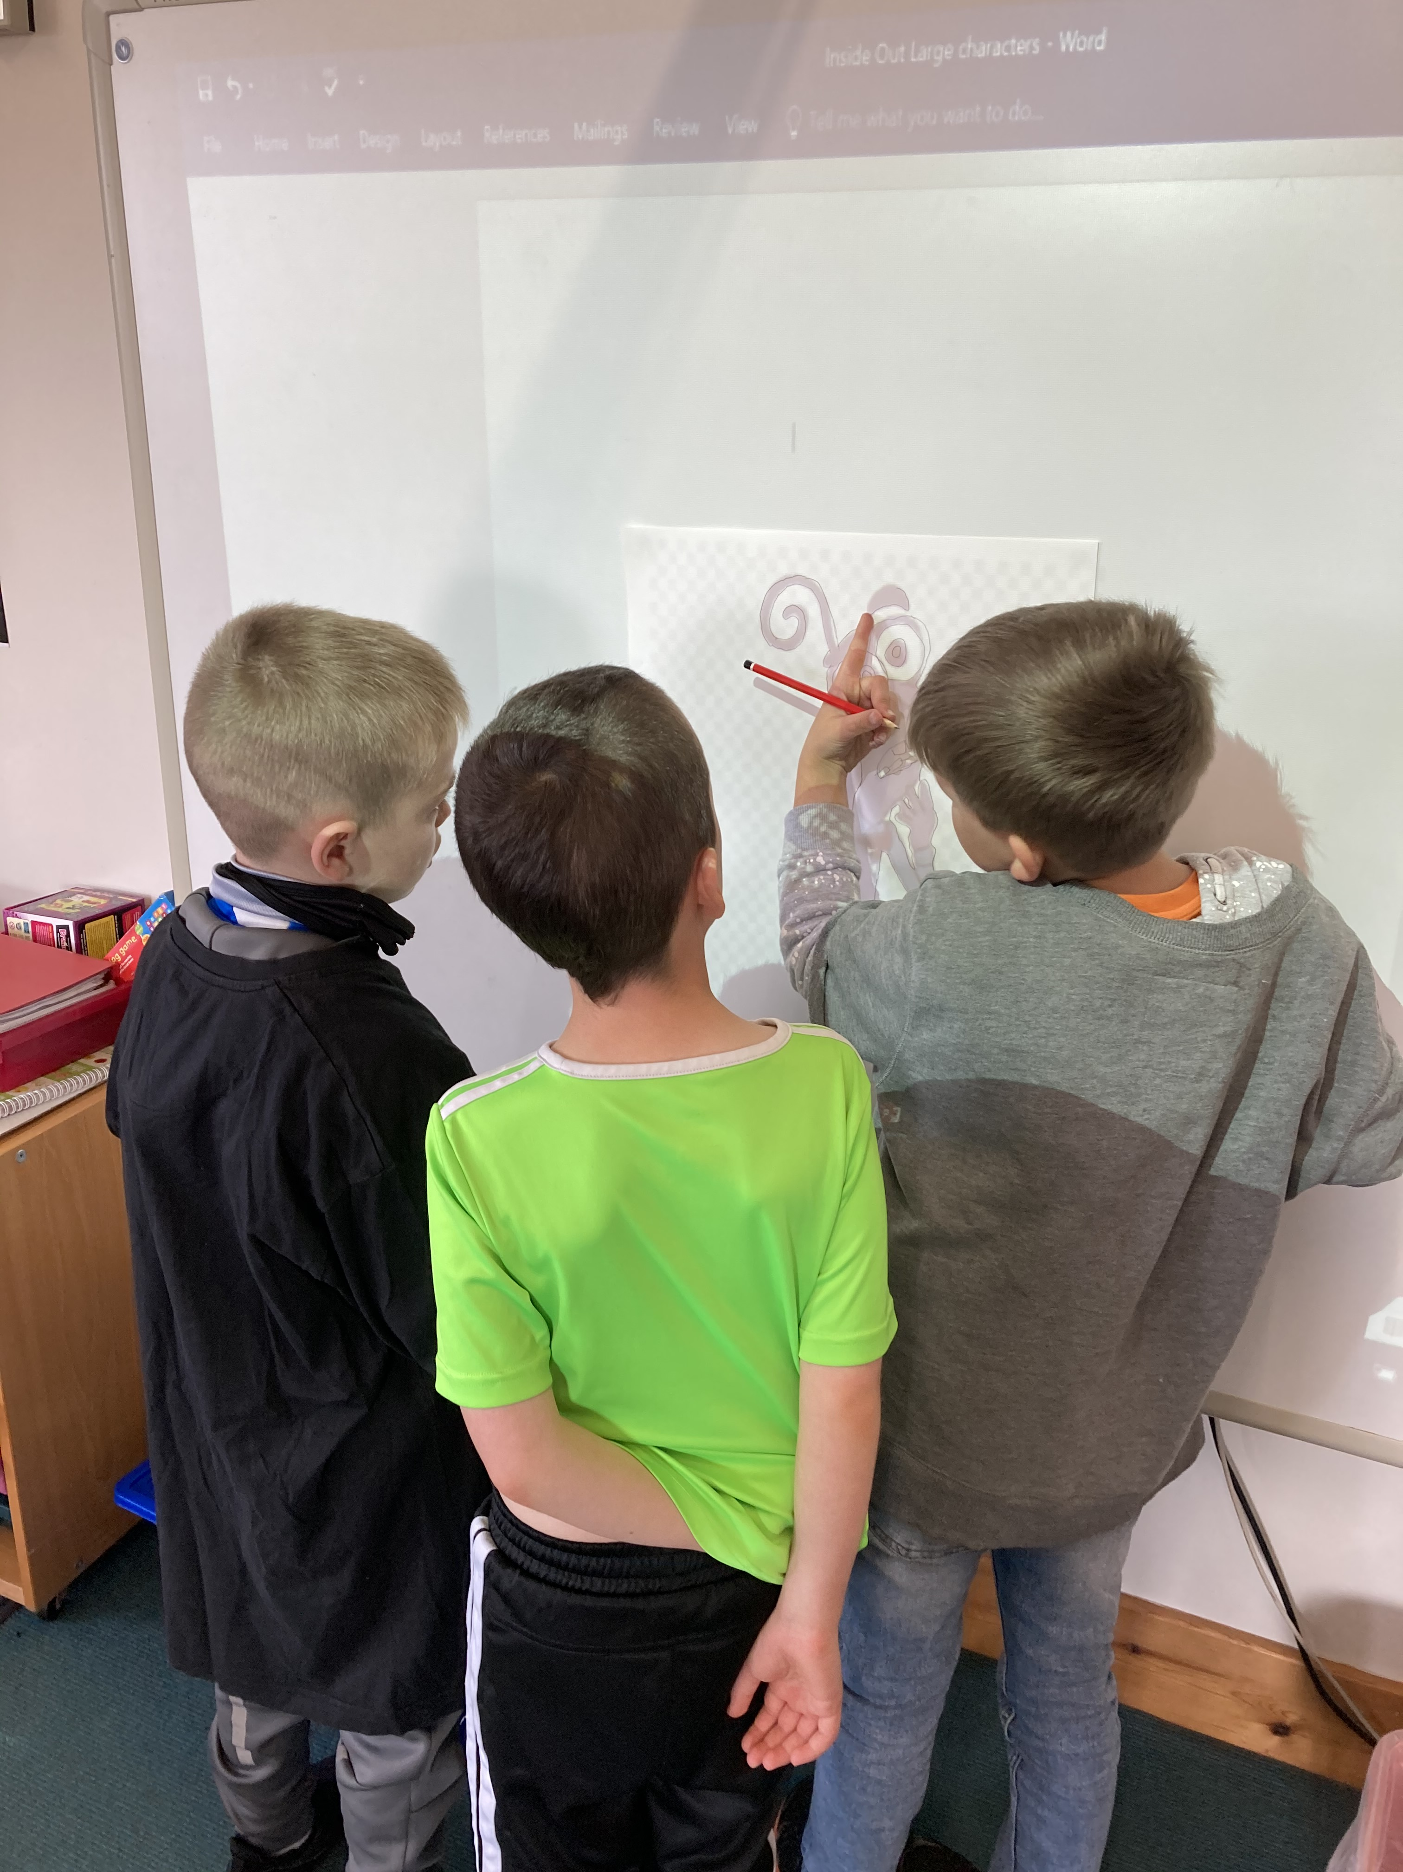

Slide 5
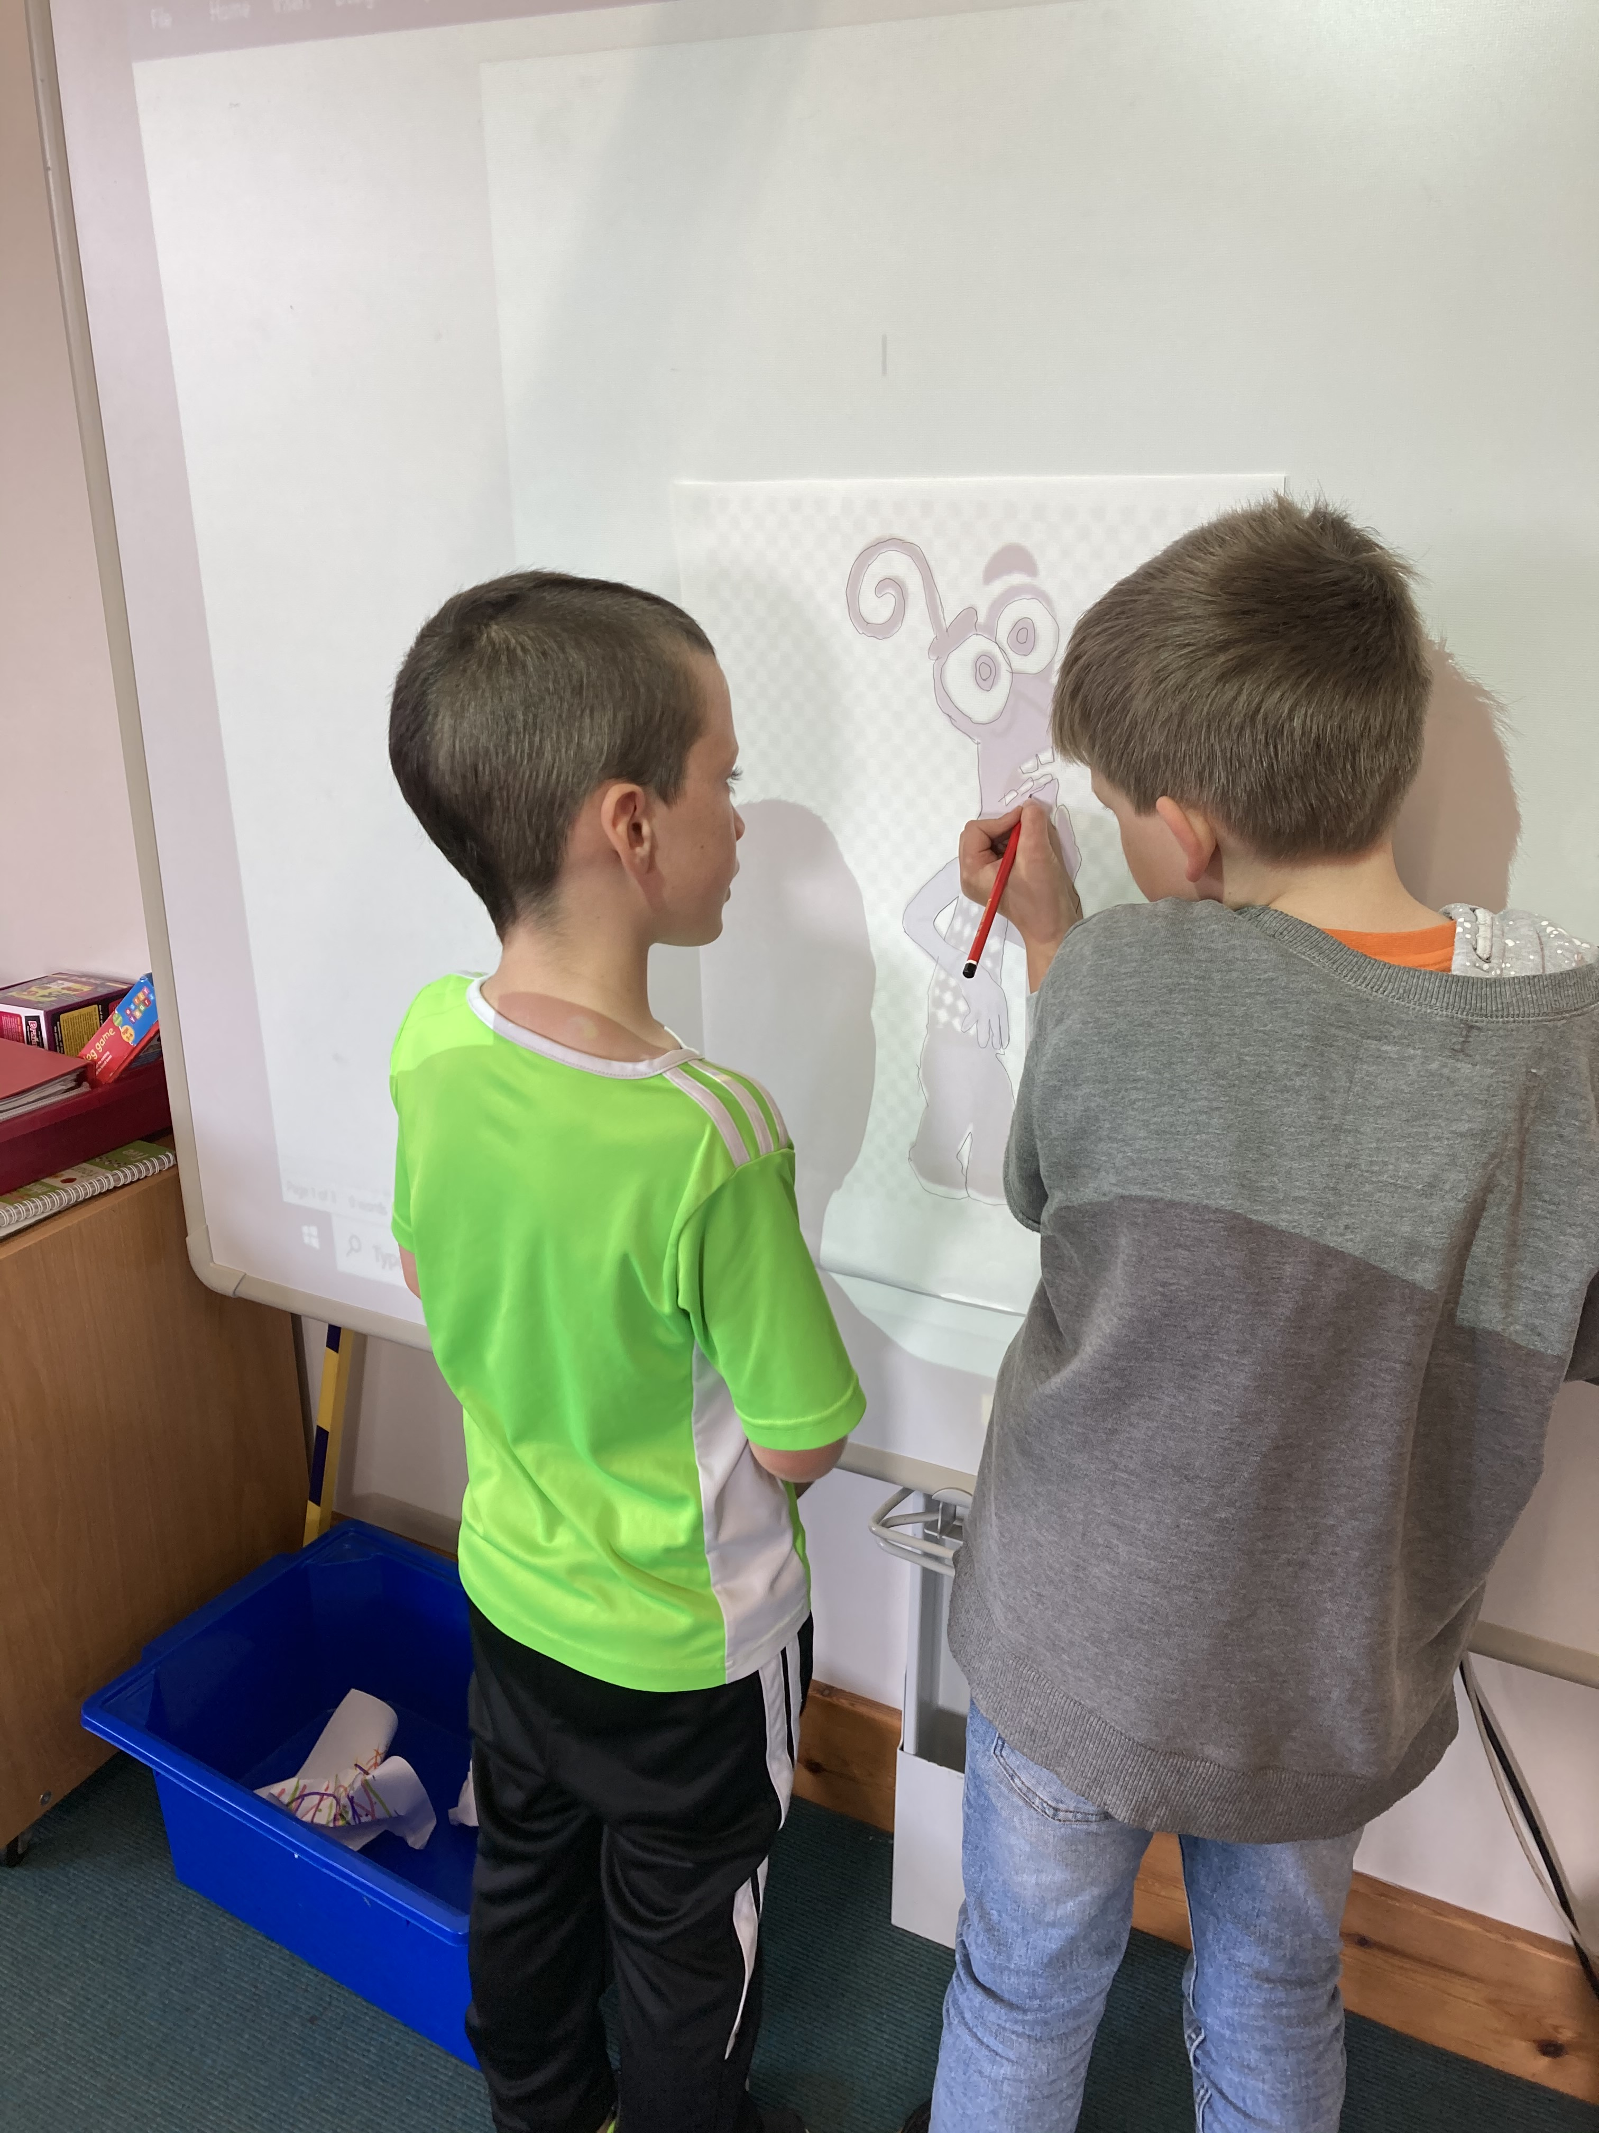

Slide 6
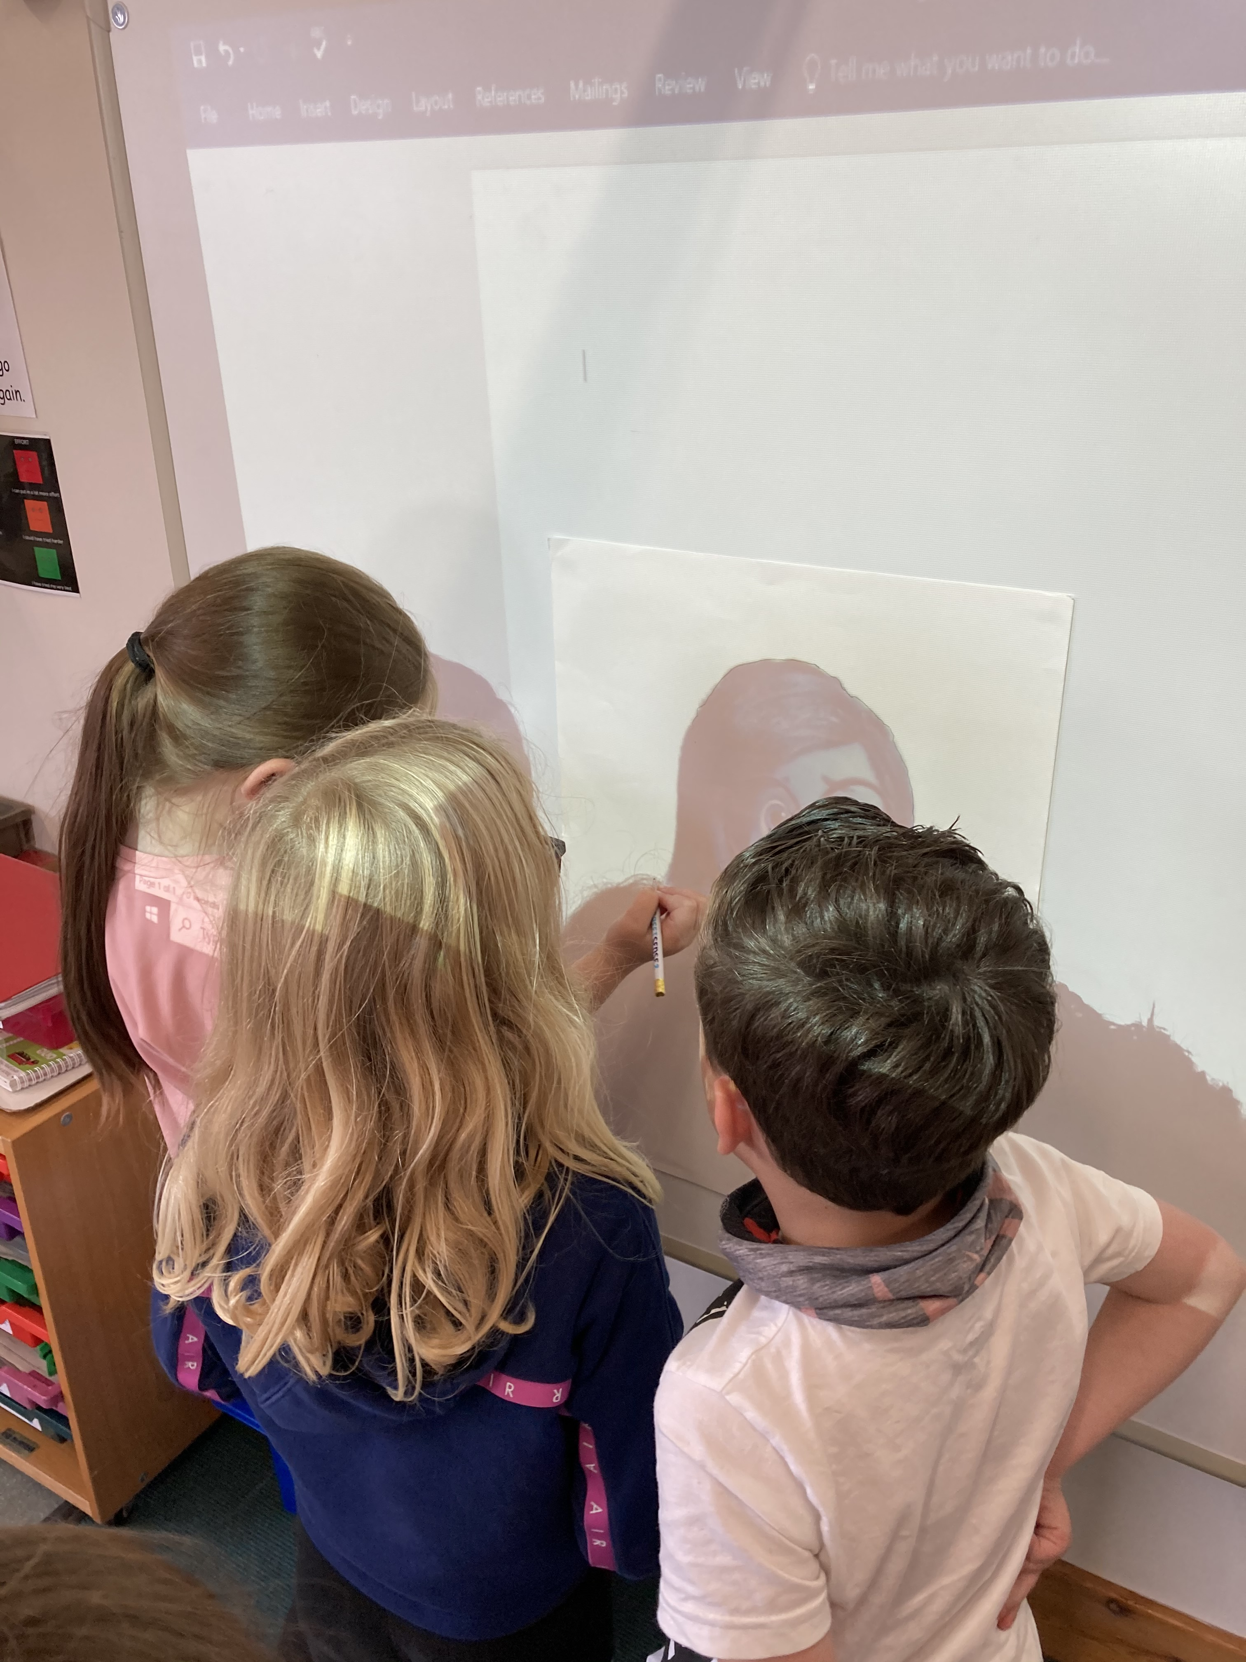

Slide 7
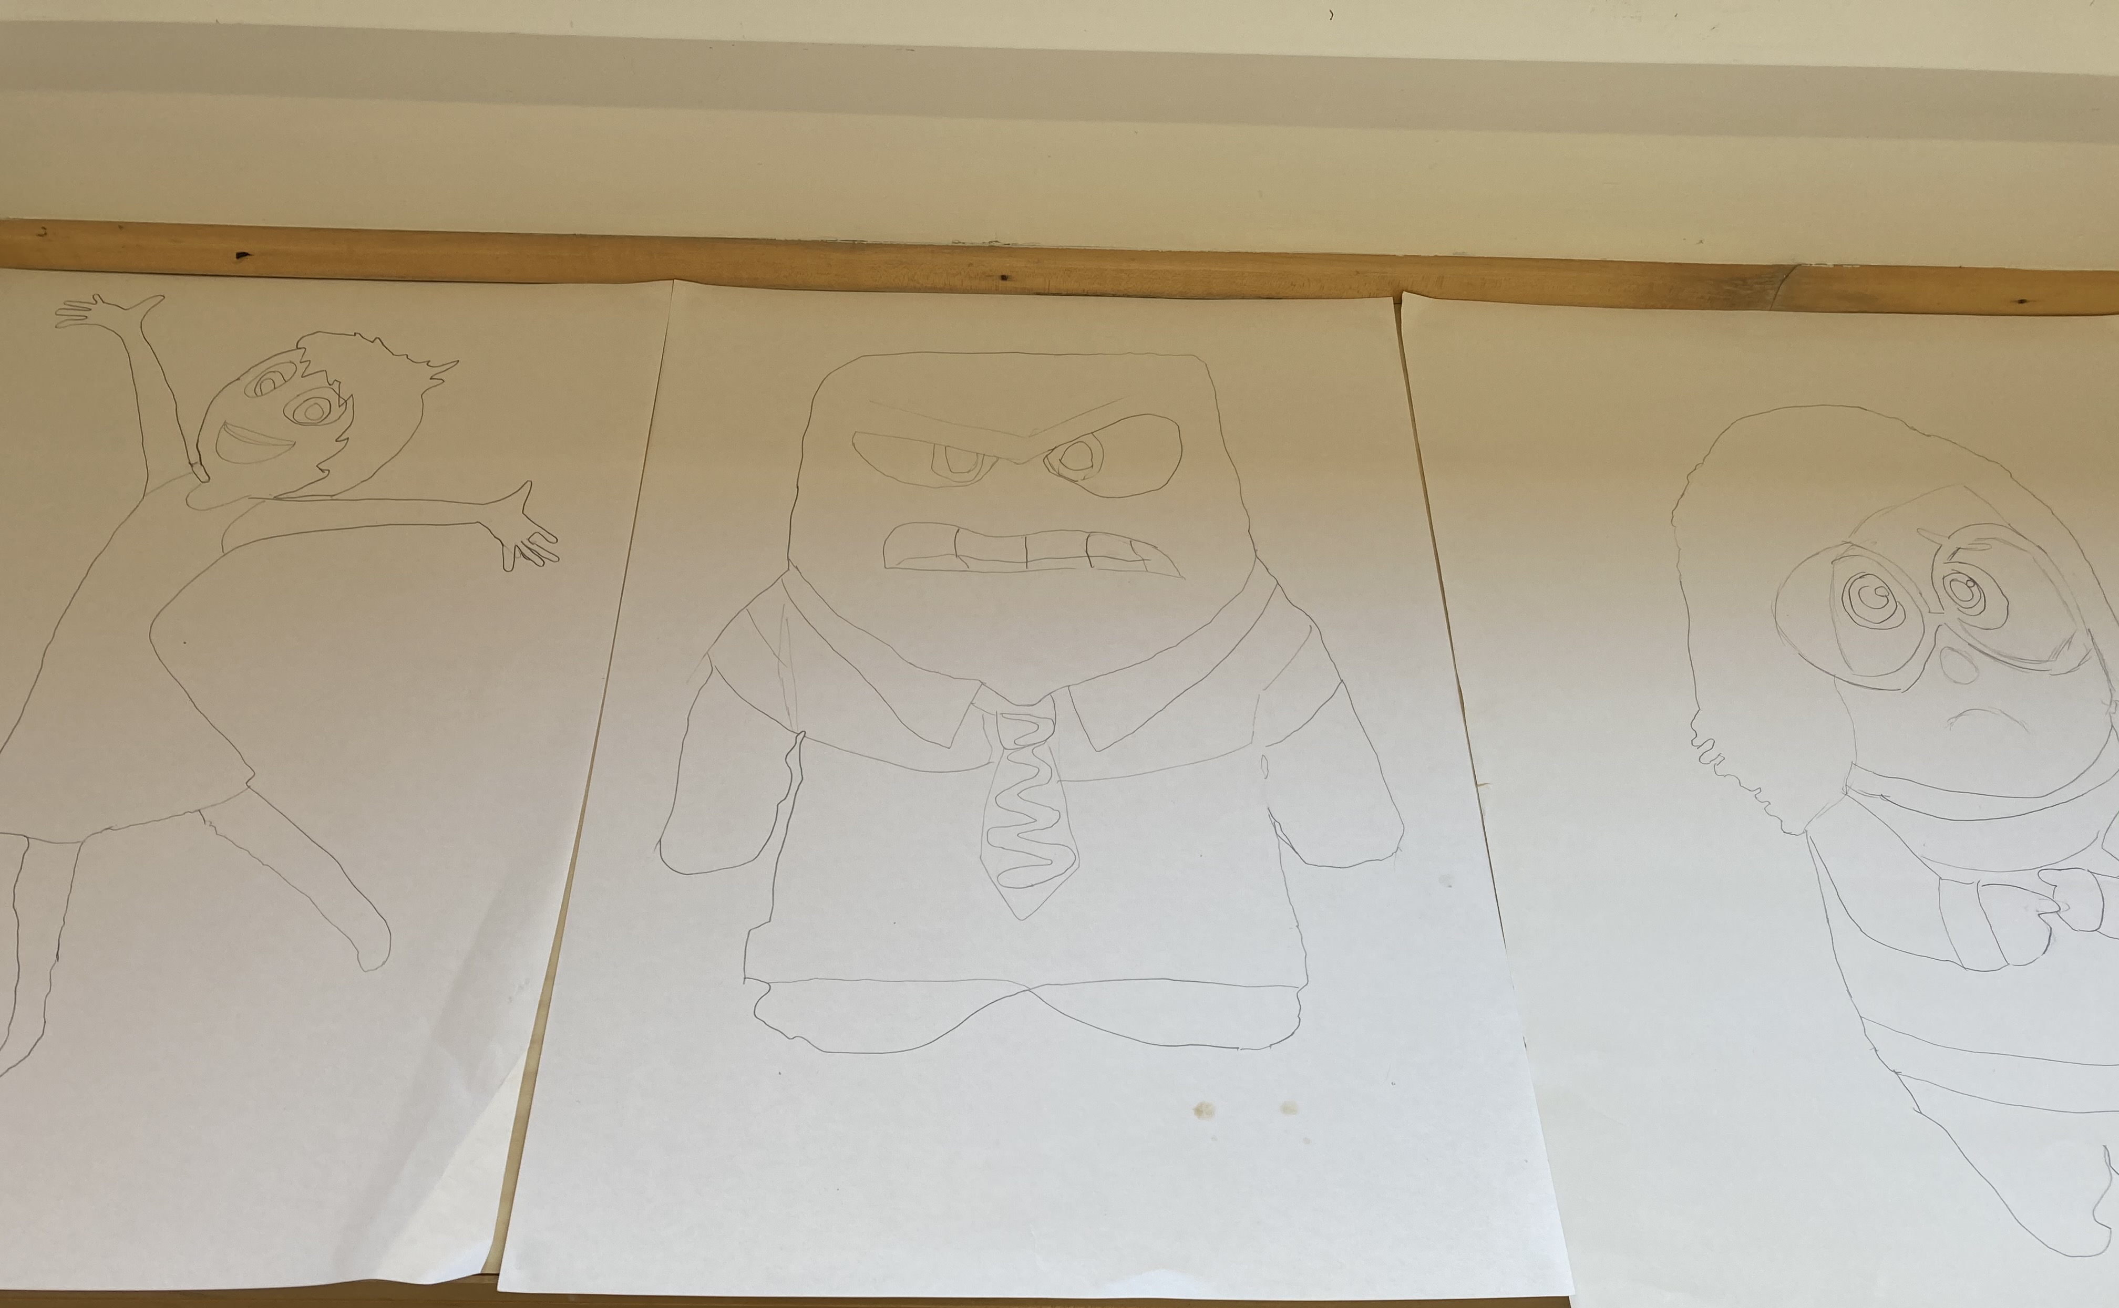

Slide 8
We worked in groups to paint our characters
Here are some pictures…

Slide 9
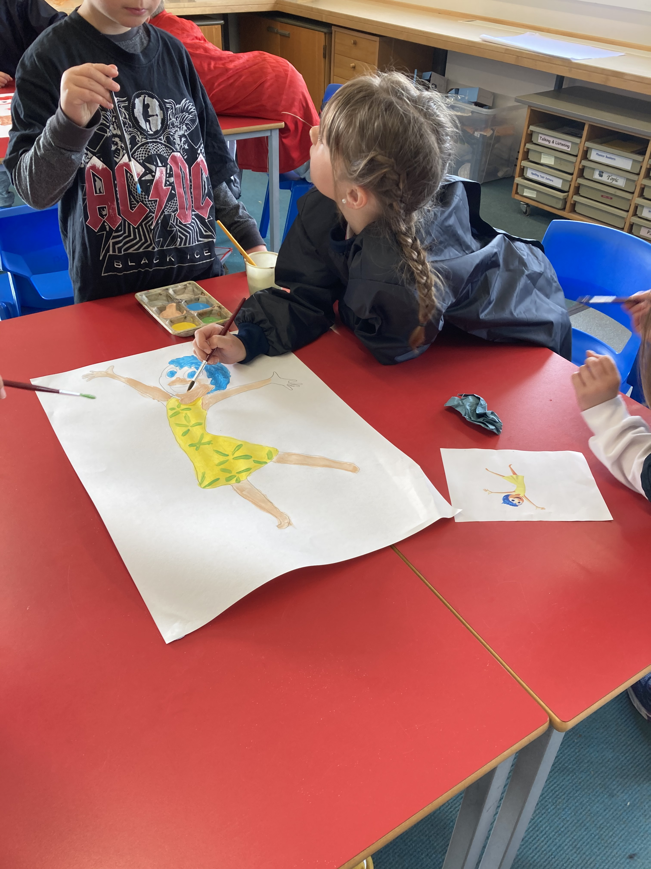

Slide 10
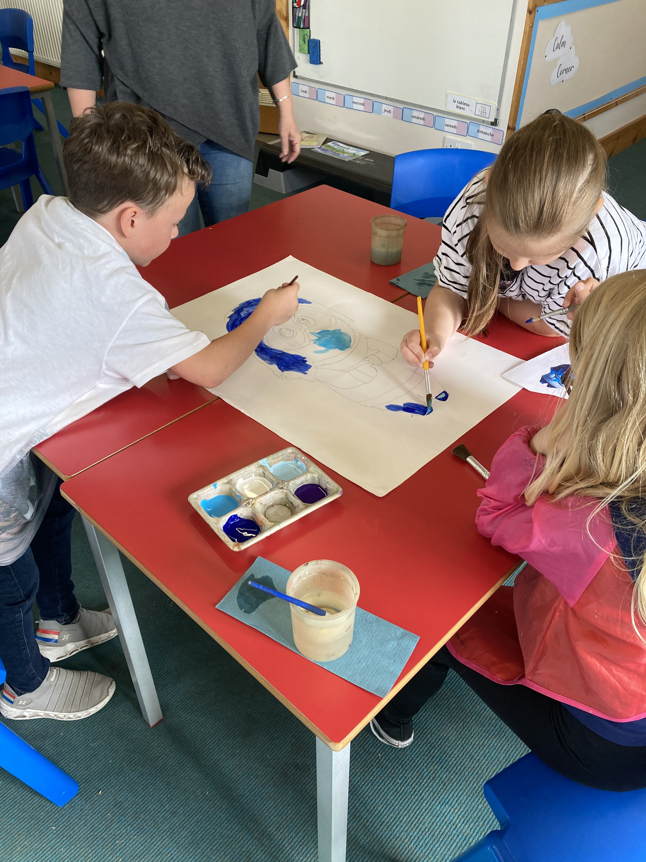

Slide 11
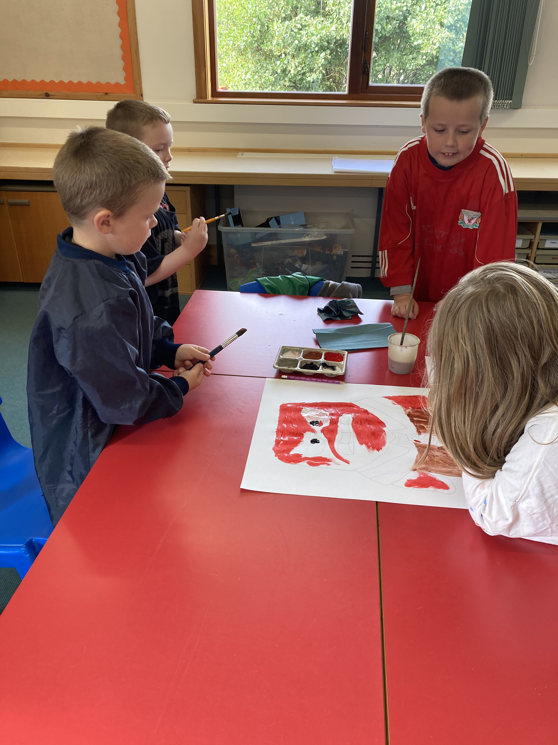

Slide 12
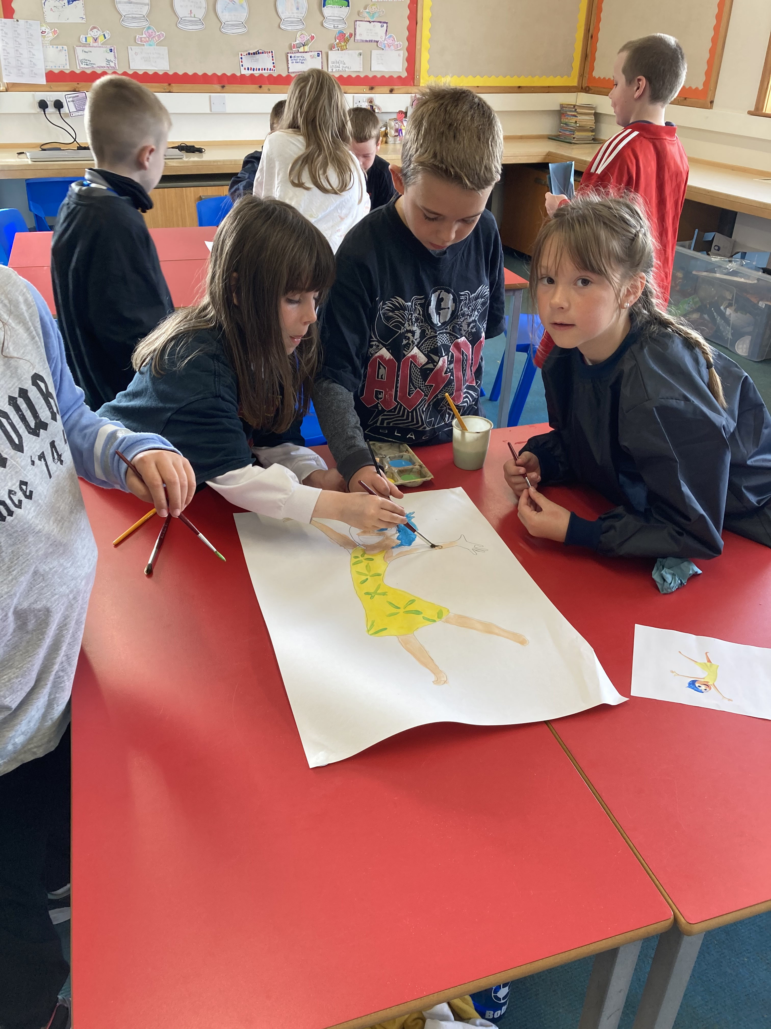

Slide 13
Our finished characters!
Do you know who they are?

Slide 14
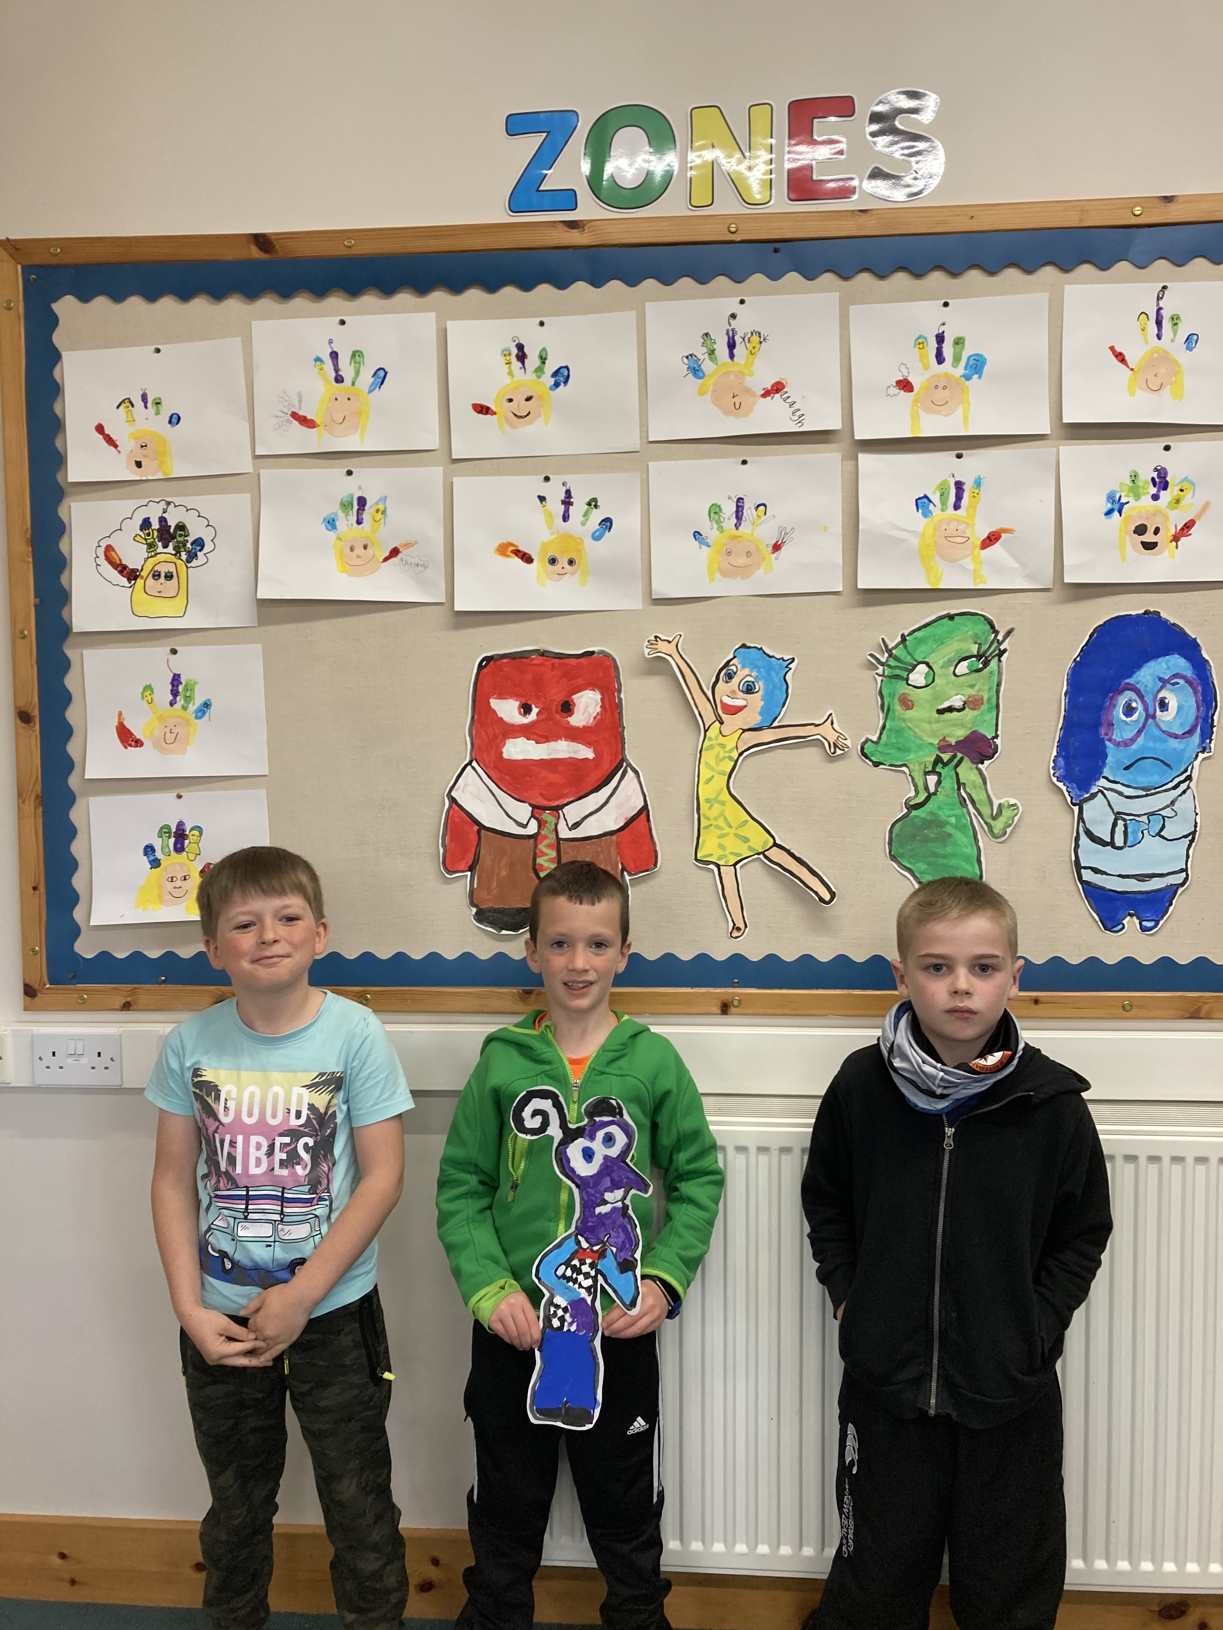

Slide 15
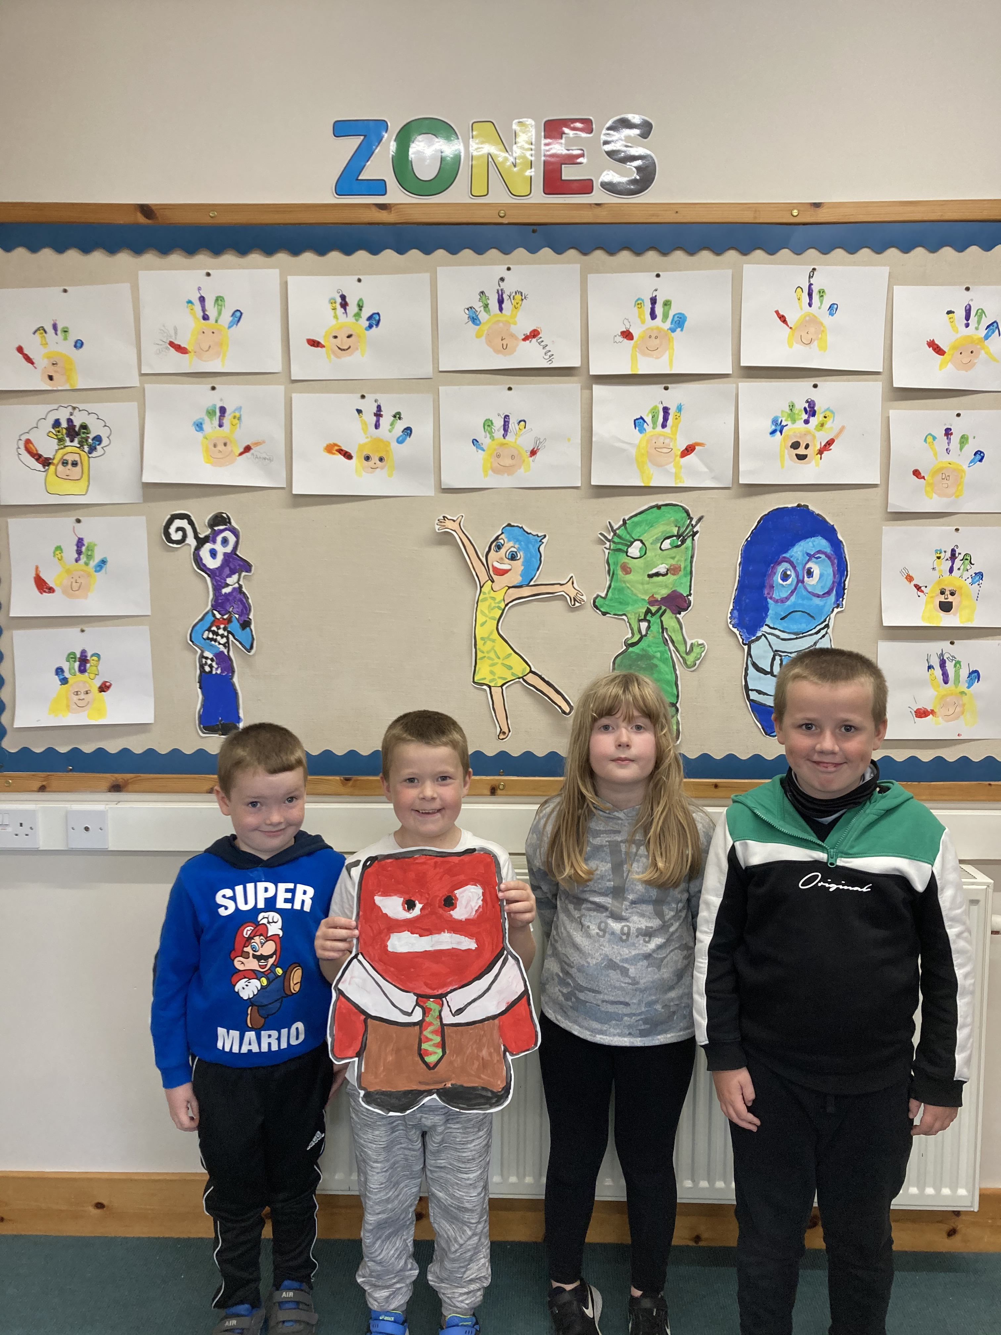

Slide 16
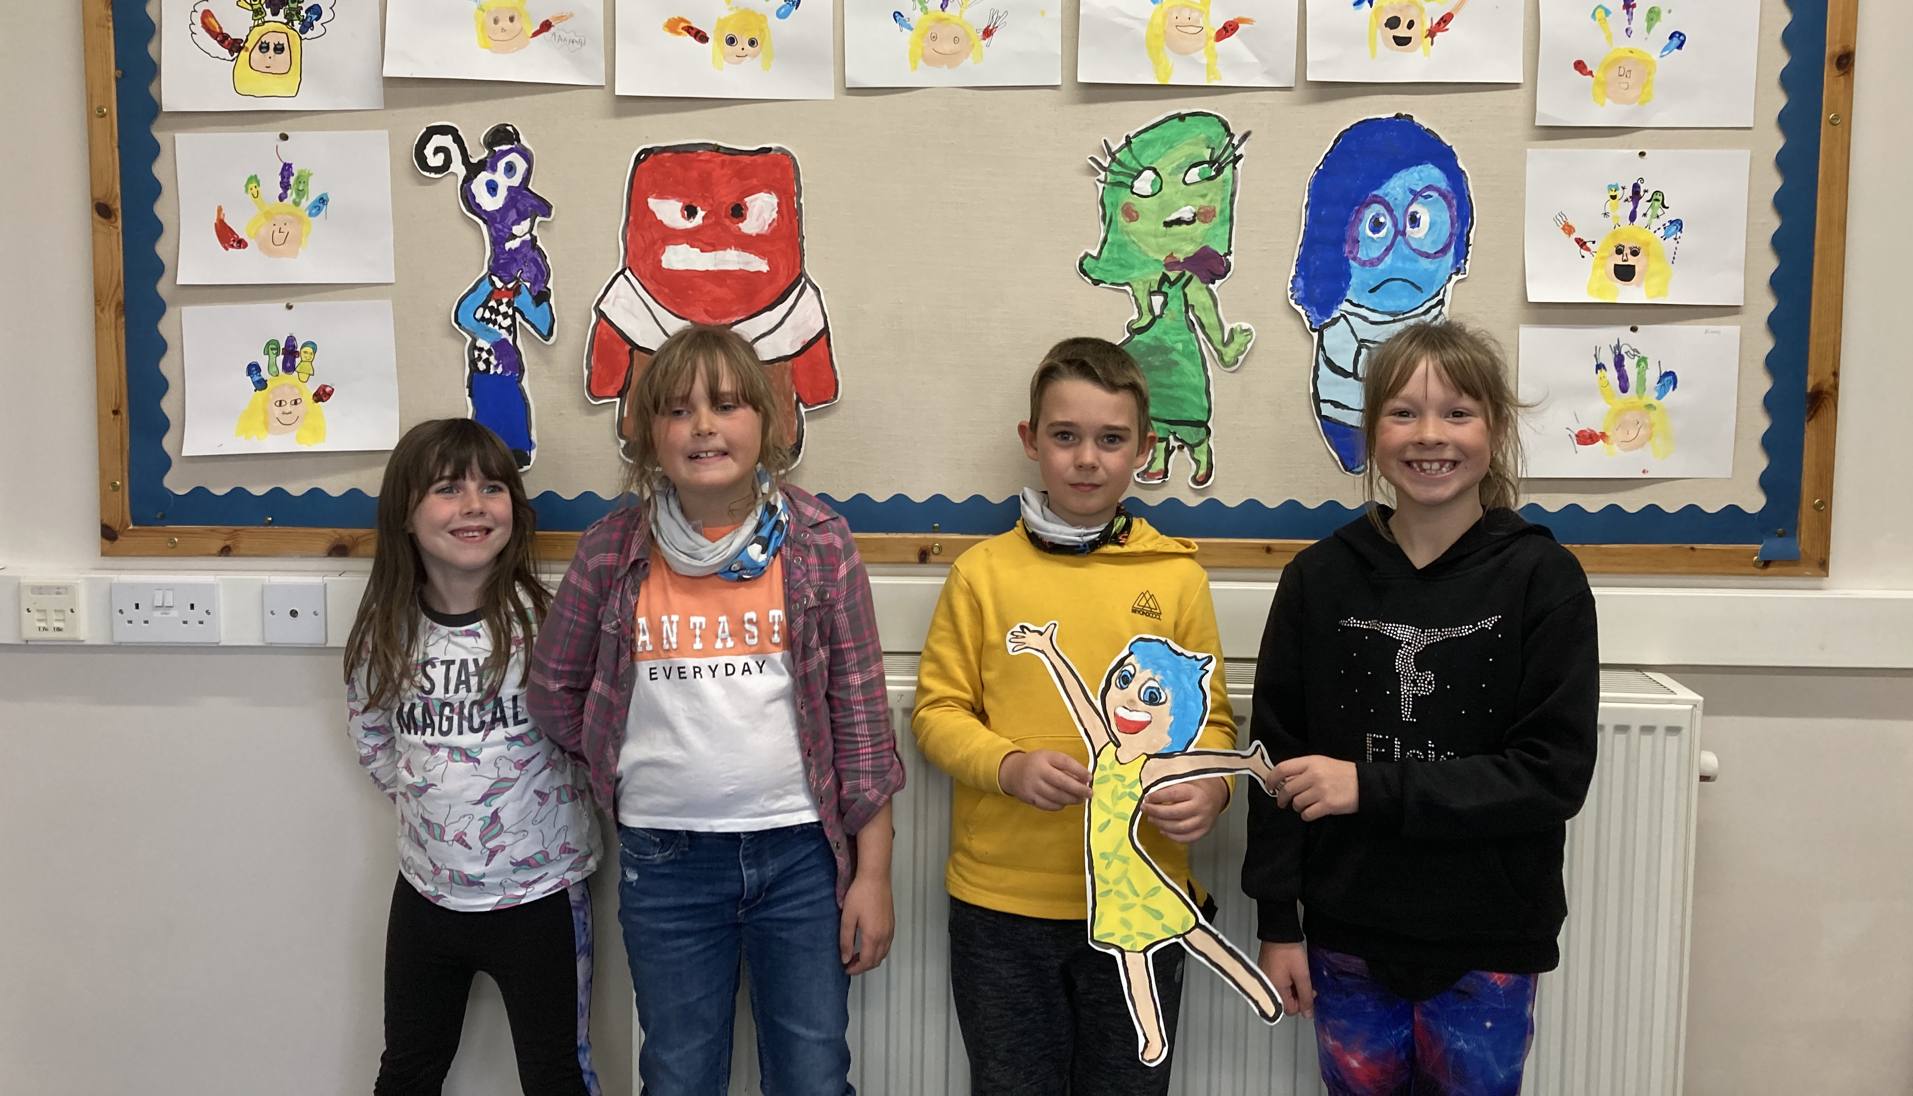

Slide 17
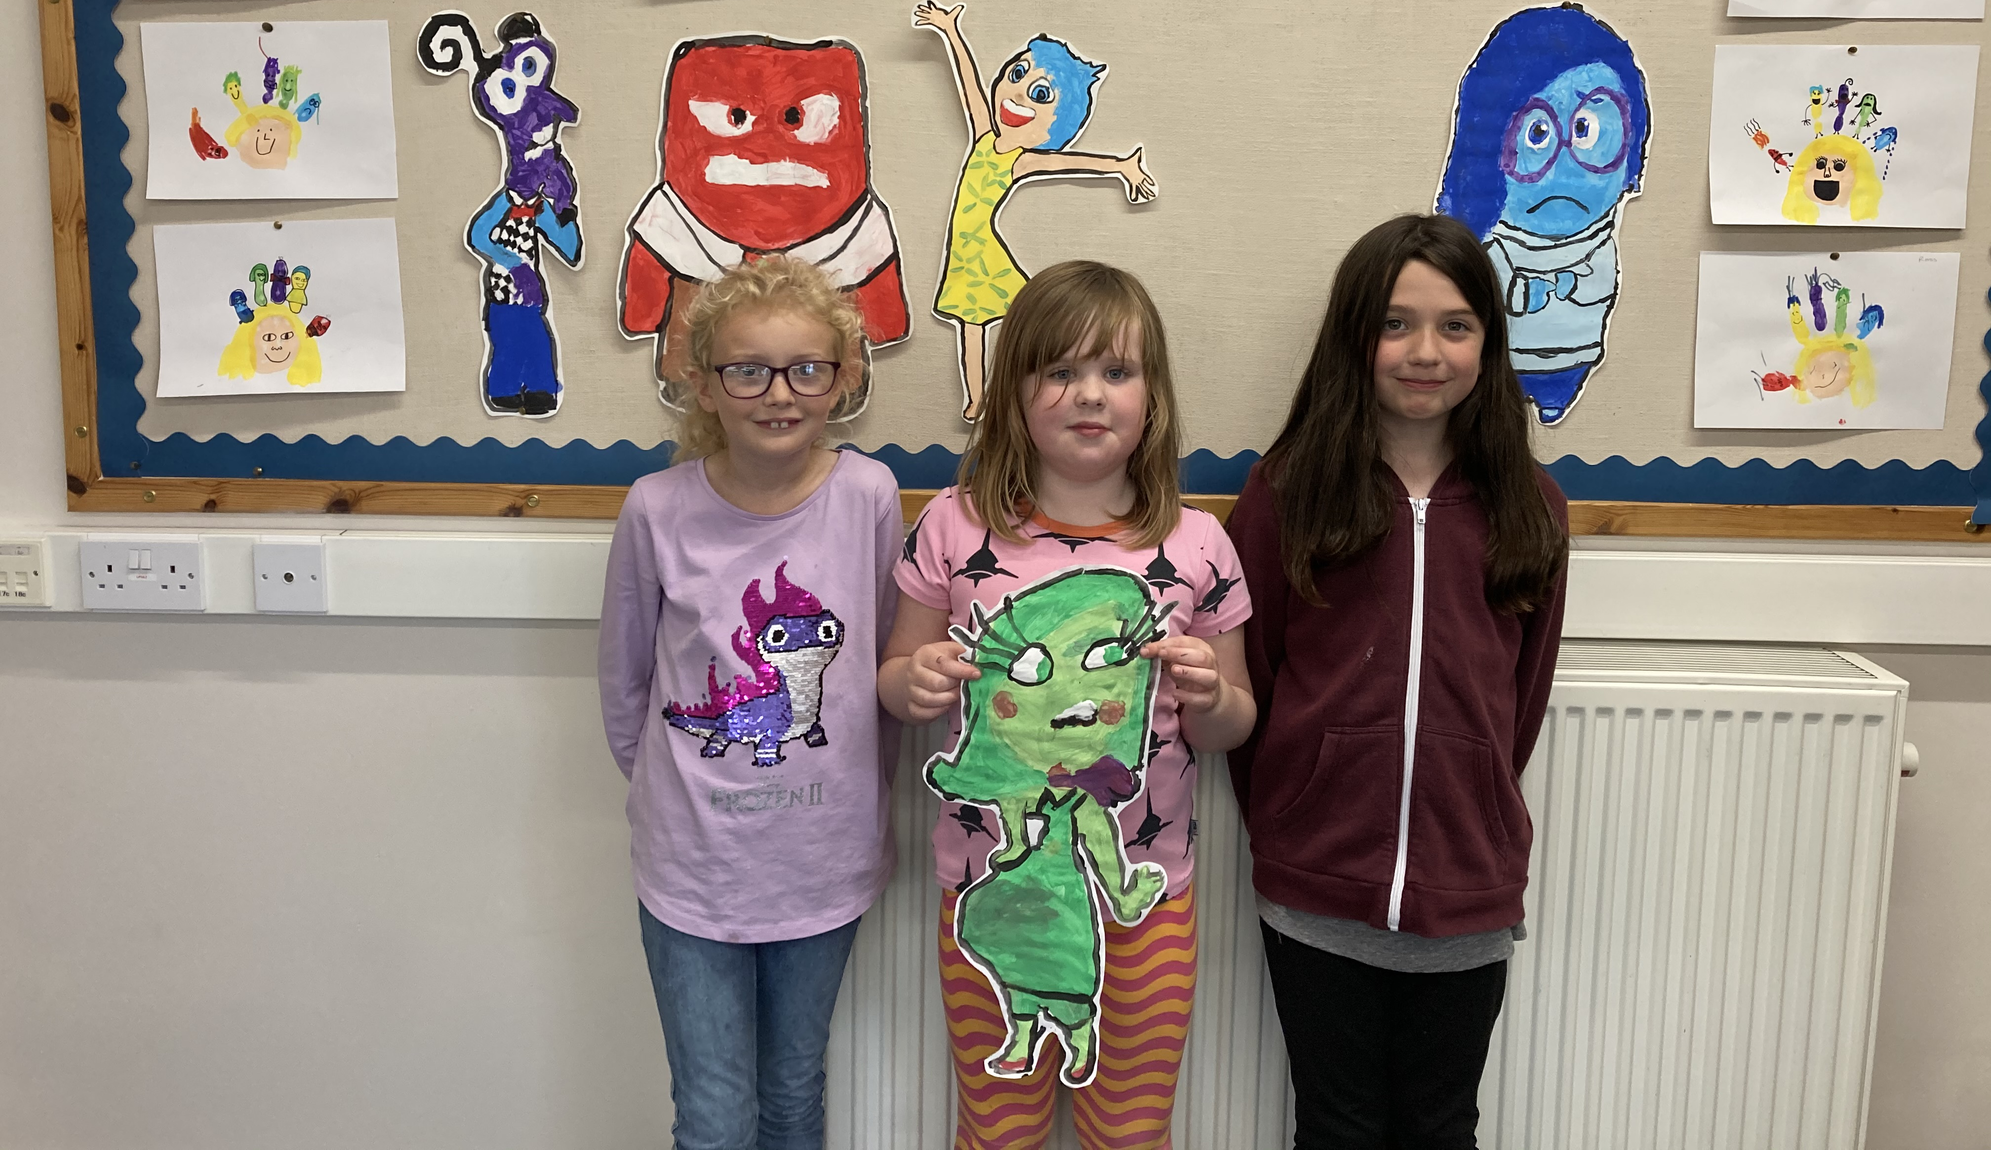

Slide 18
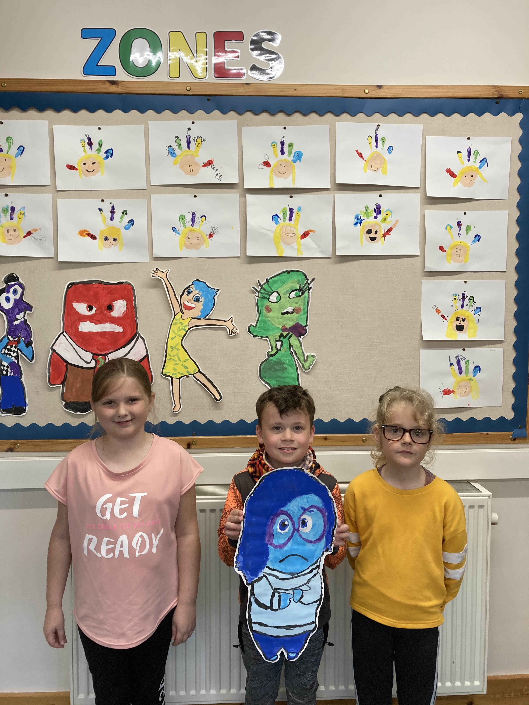

Slide 19
We created artwork of Riley and the characters using our handprints.
This was a little bit messy but really fun!

Slide 20
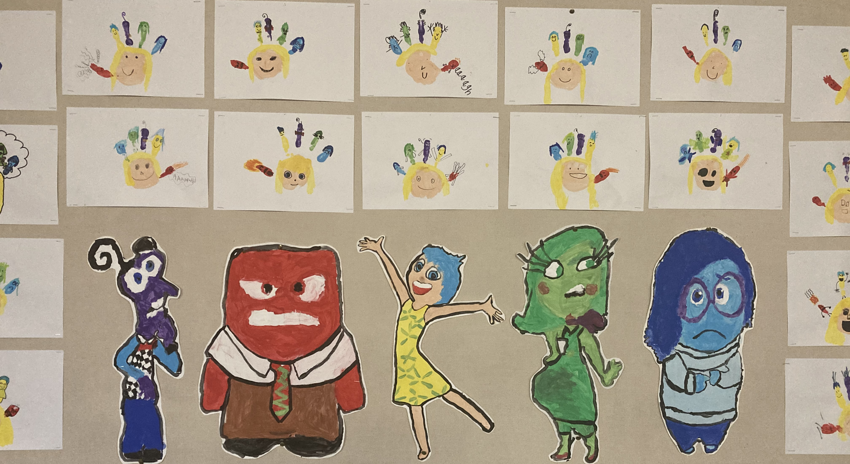

Slide 21
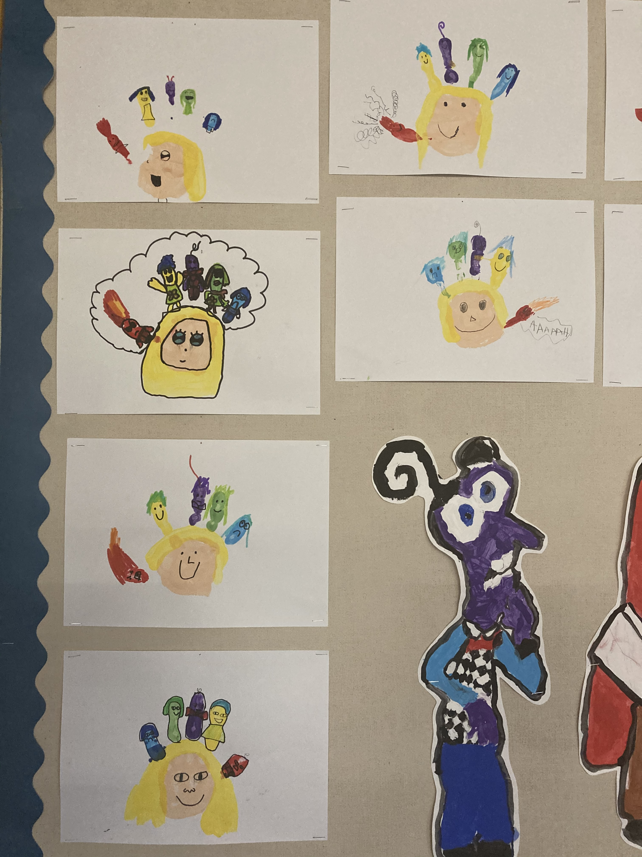

Slide 22
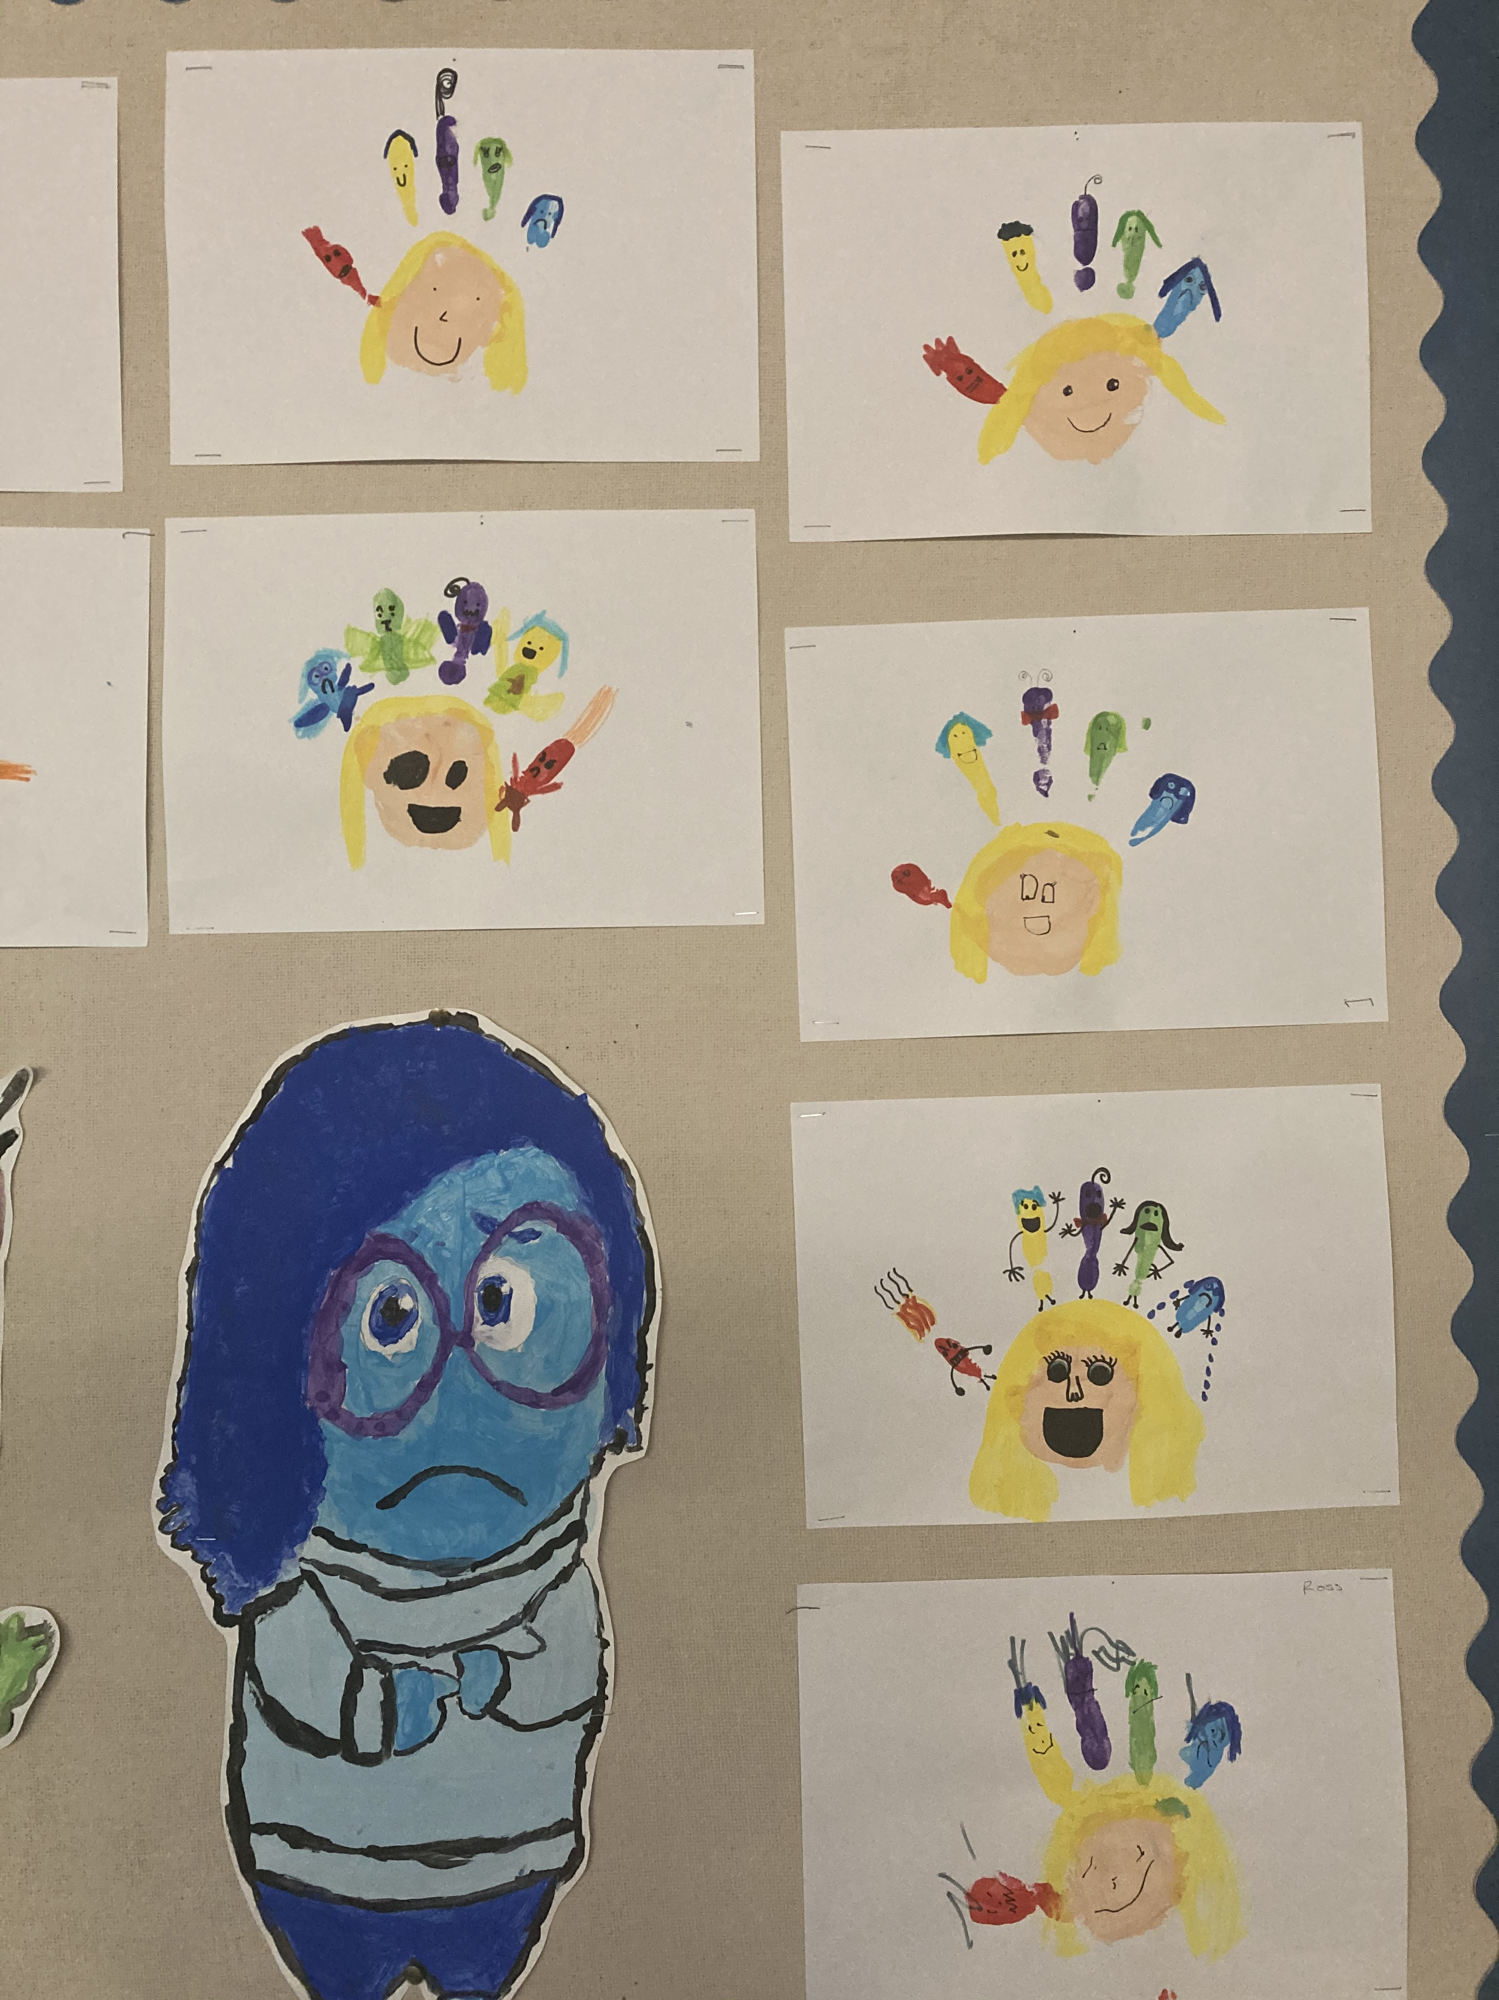

Slide 23
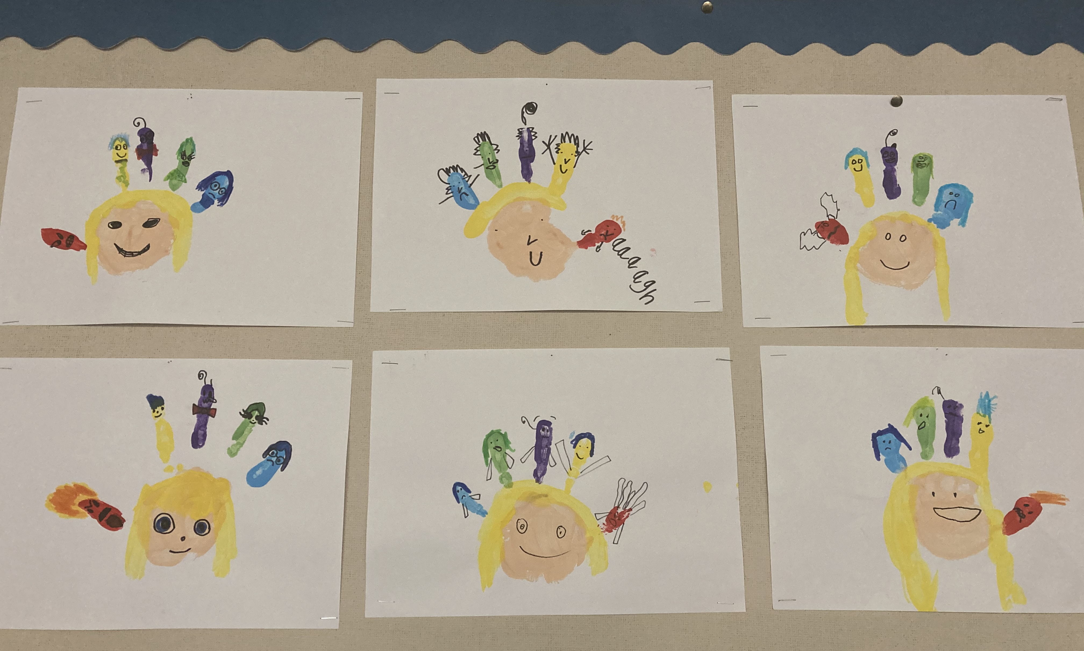

Slide 24
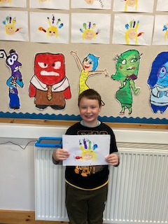

Slide 25
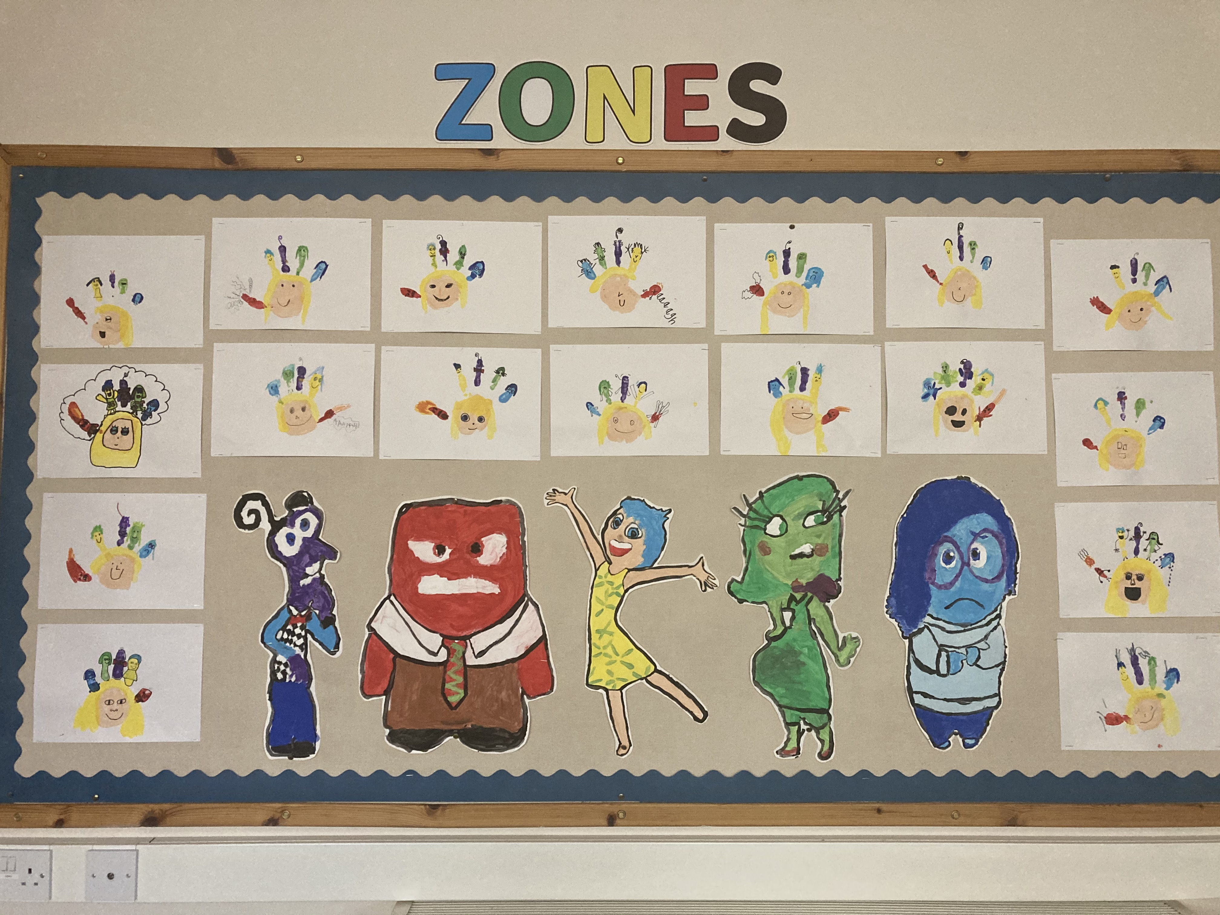

Slide 26
Spot the difference Time!
Can you spot two differences on each character?

