Slide 1
In p6/7 term we did
Around the World

Slide 2
Our learning suggestions
We got to write in speech bubbles to suggest what we want to learn about this term in topic about the world cup and learn about some of them.

Slide 3
Migrant workers in Qatar
Migrant workers is a person who migrates from one country to another with a view to being employed other then on his account.
In the making of the football stadium over 6500 people died but Qatar said only 3 people died in the making of a stadium.
The living conditions of the workers were horrific. It was small dirty spaces with little of anything. They had to salvage what they had, but they had very little. They hated their lives during work. It was unfair.

Slide 4
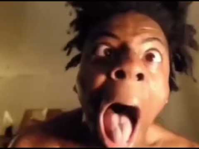
Ishowspeed
the creator of world cup song
Ishowspeed
The creator of world cup song.

Slide 5
The world cup song is the most famous song in our school. We listened to the world cup song in music and our class.

Slide 6
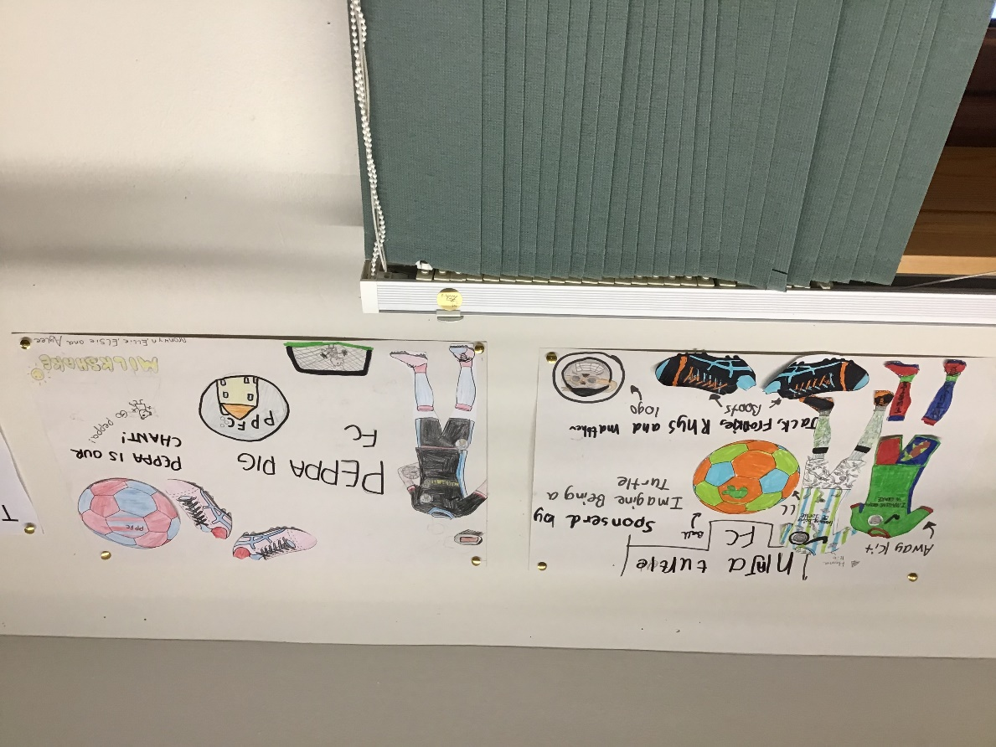
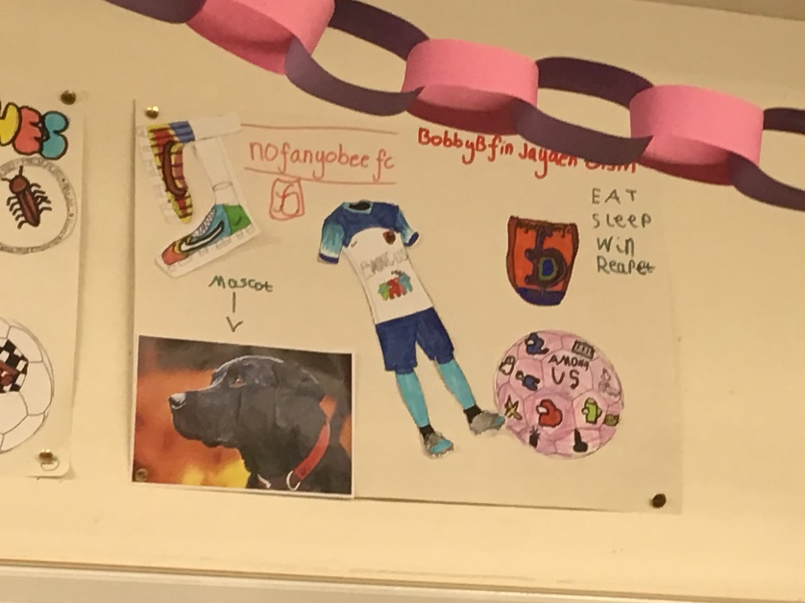
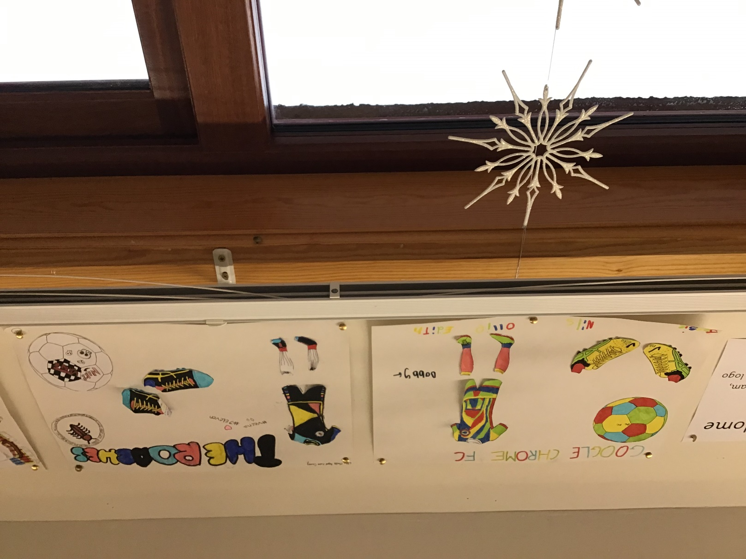
Home teams
We made home teams of four and five for group work.

Slide 7
Sweepstake
About our class sweepstake
Here are the people that got each country Bobby G- Qatar and south Korea Bobby B- Belgium Frankie-Ecuador and Serbia Jayden-Tunisia and Cameroon Fin-Saudi Arabia and Spain Aylee- Canada and USA Jessie-Argentina Martha-Uruguay Abagail-Iran and Mexico Ellie-Morocco Matthew-Portugal Nils-Australia Jack-Denmark and japan Bronwyn-Netherlands Oisín-Croatia Edith- wales and France Sonny-brazil Elsie- Switzerland Keira-England Libby- Ghana Rhys- Poland Ollie- Senegal

Slide 8
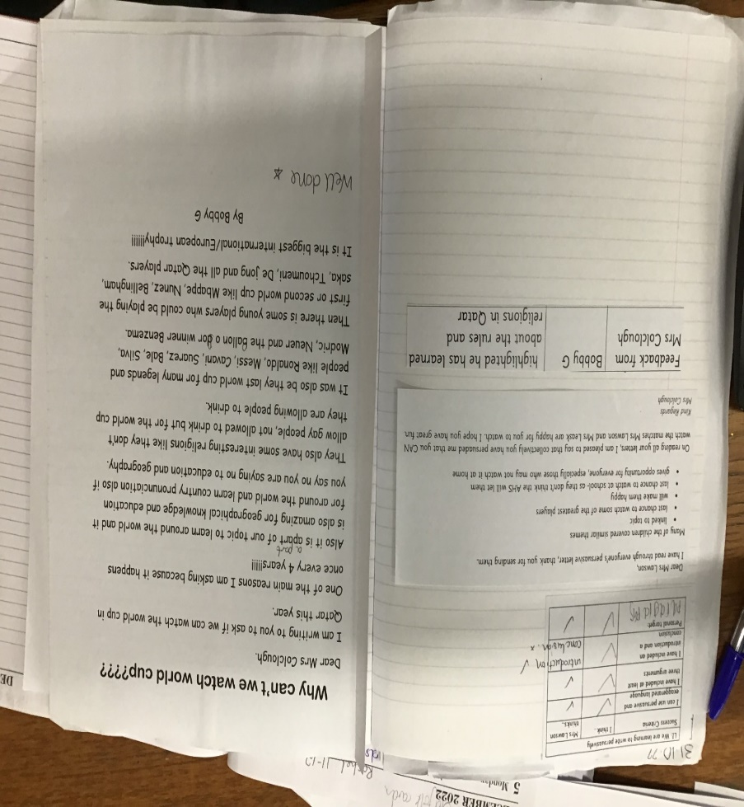
Our persuasive writing
We all had to think of ways to persuade Mrs Colclough to let us watch the world cup. We all did really well and we where able to watch a part of the 1 pm games. Here are some examples of our writing.

Slide 9
What Games we watched
England vs Iran 6-2
Denmark vs Tunisia 0-0
Germany vs Japan 1-2
Qatar vs Senegal 1-3

Slide 10
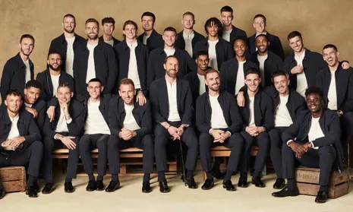
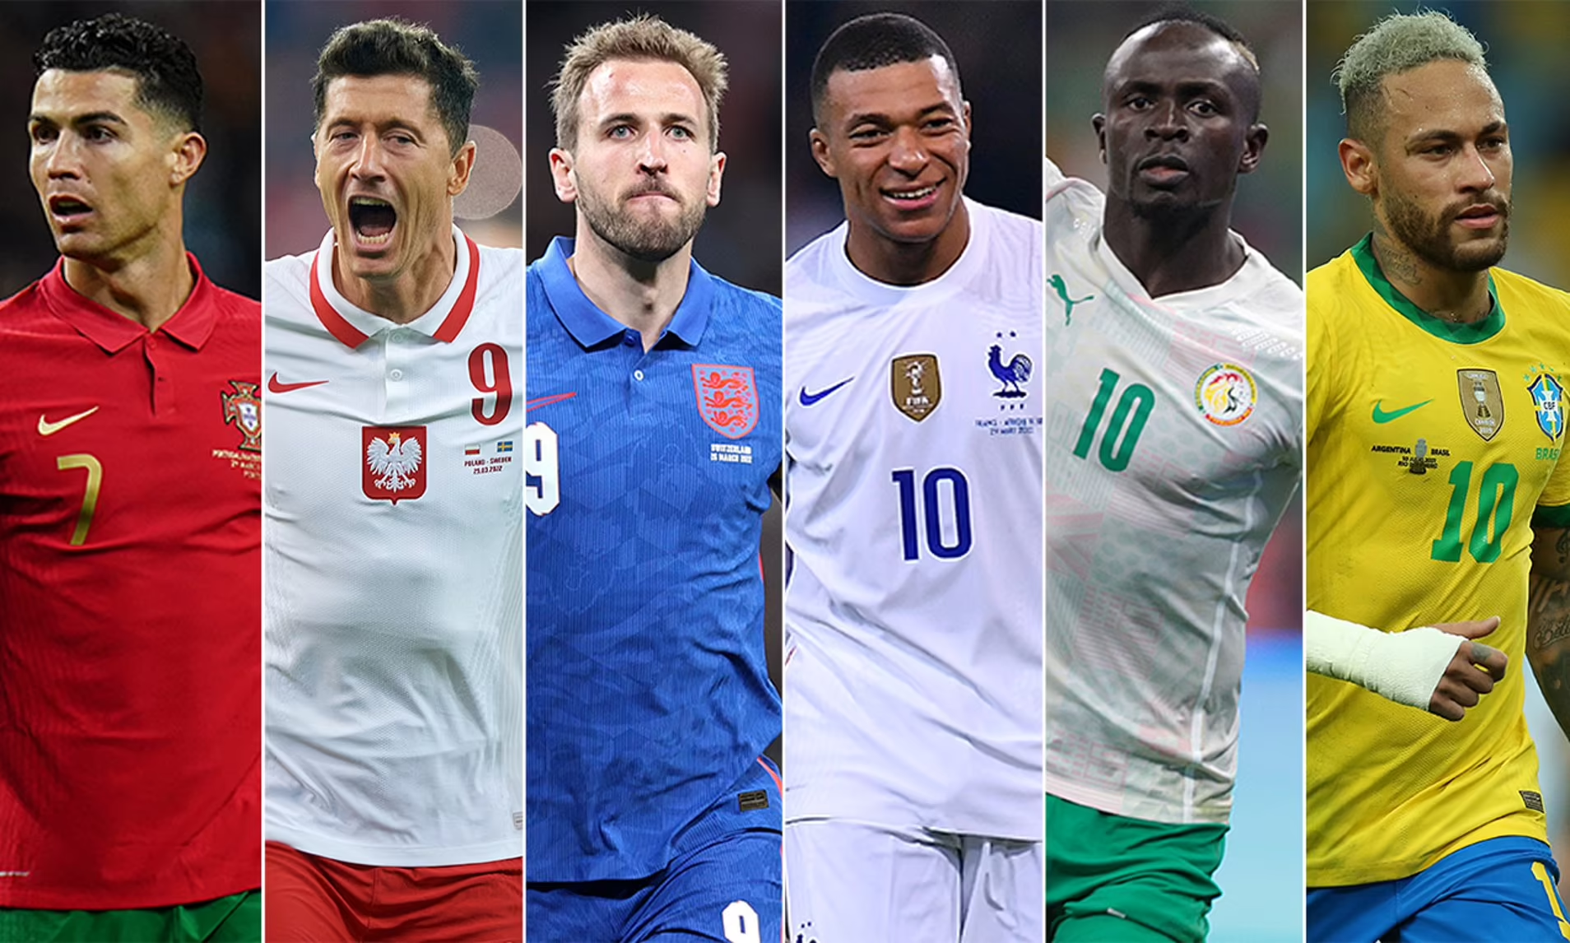
We made presentations for or countries and some people made extra

Slide 11
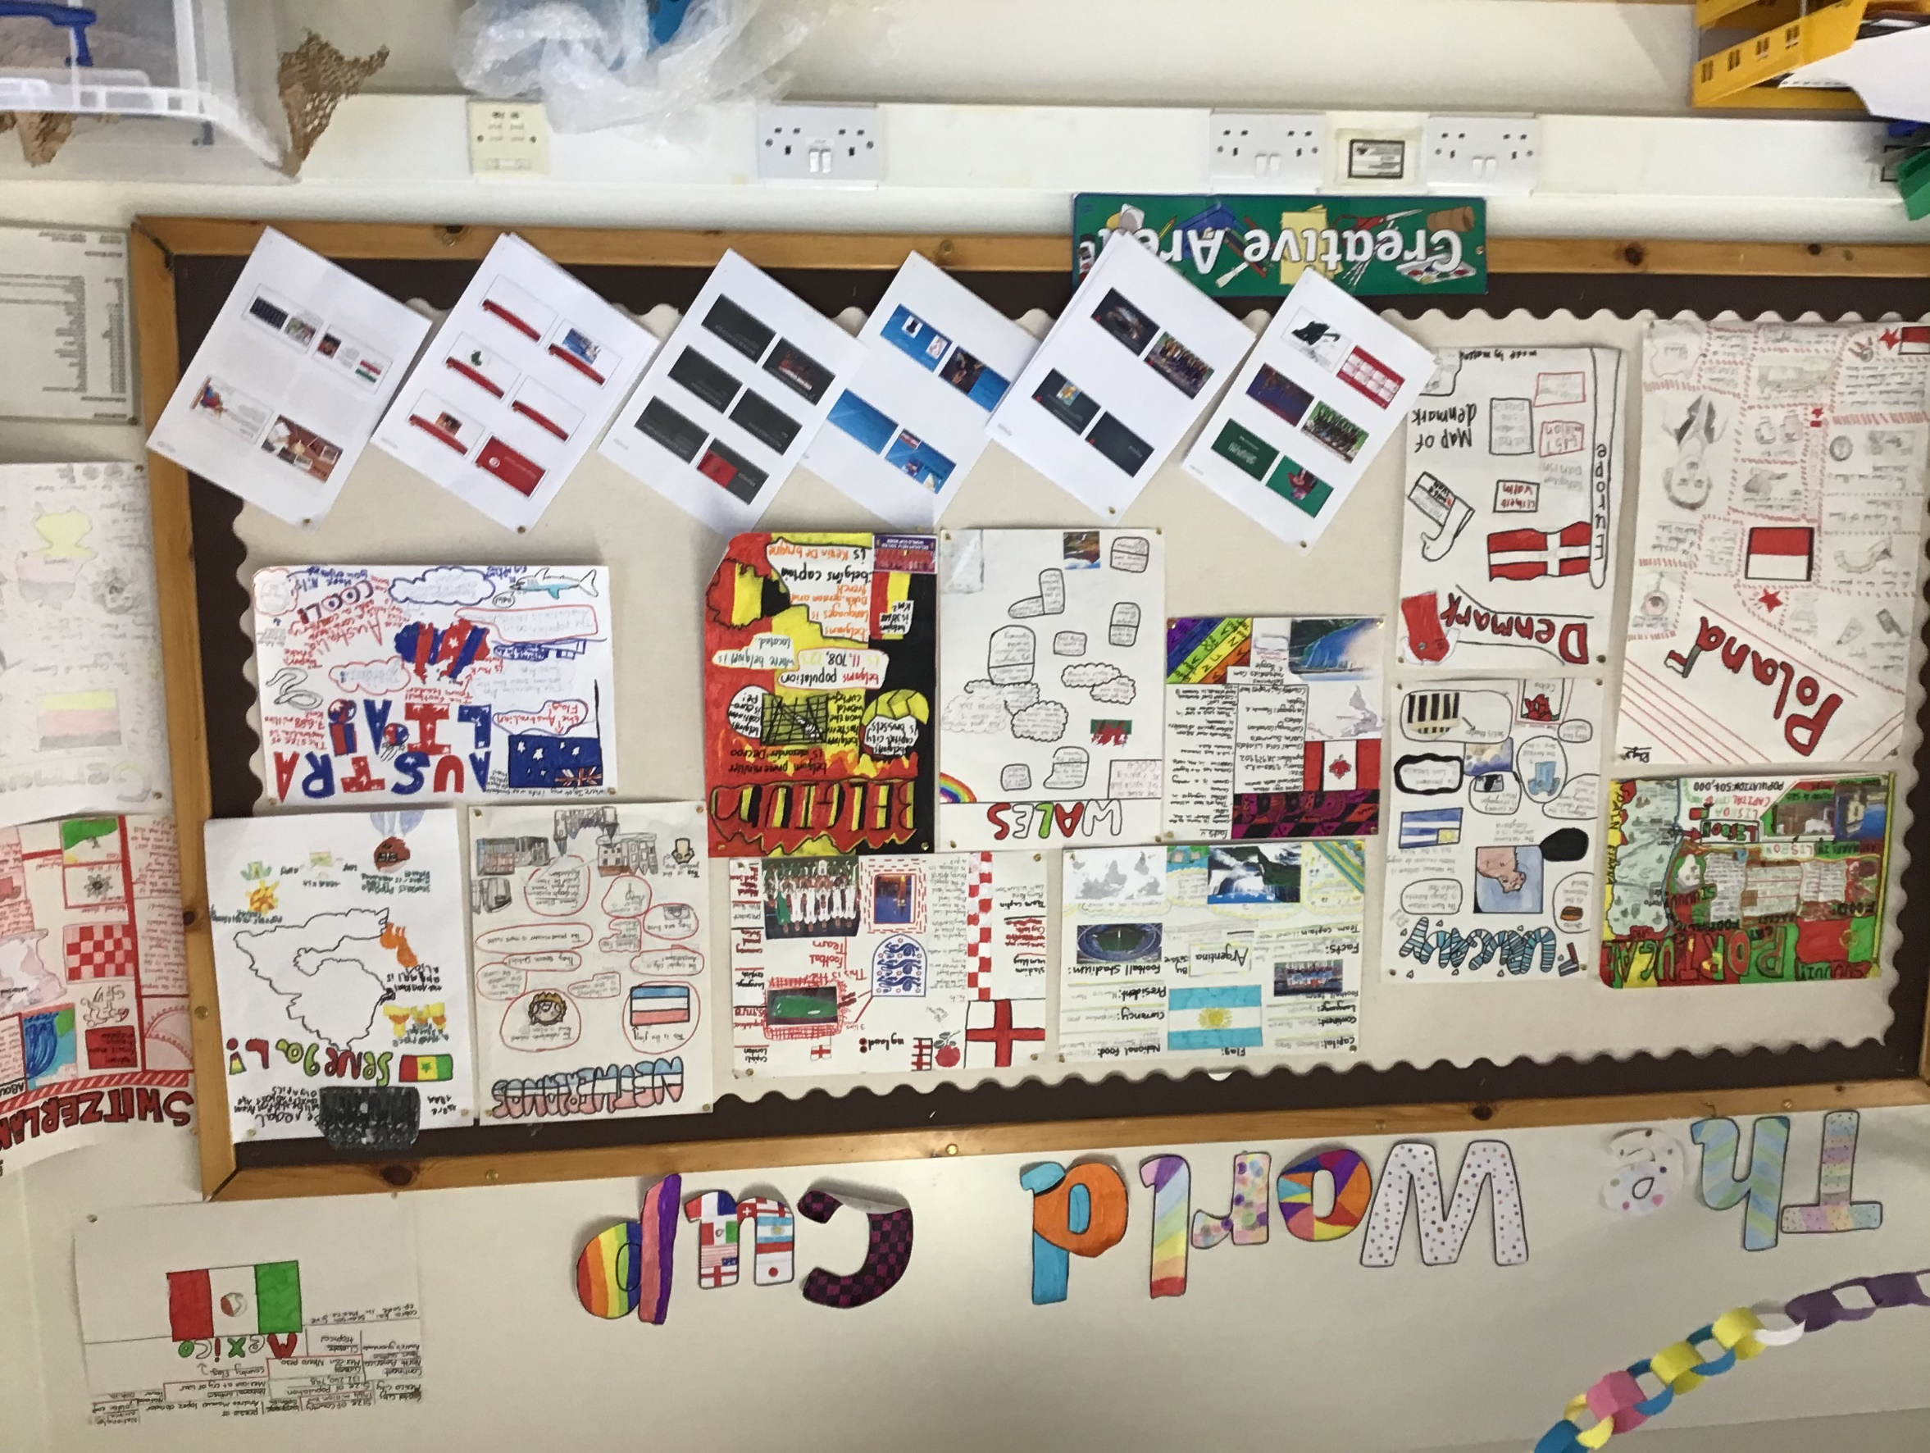

Slide 12
Map showing where countries are!

Slide 13
We got maps and showed were countries were on them
we got maps and showed where countries in the world cup are on the map

Slide 14
World cup timeline

Slide 15
World cup timeline!
We made timelines of what countries held and won the world cup at that time.

Slide 16
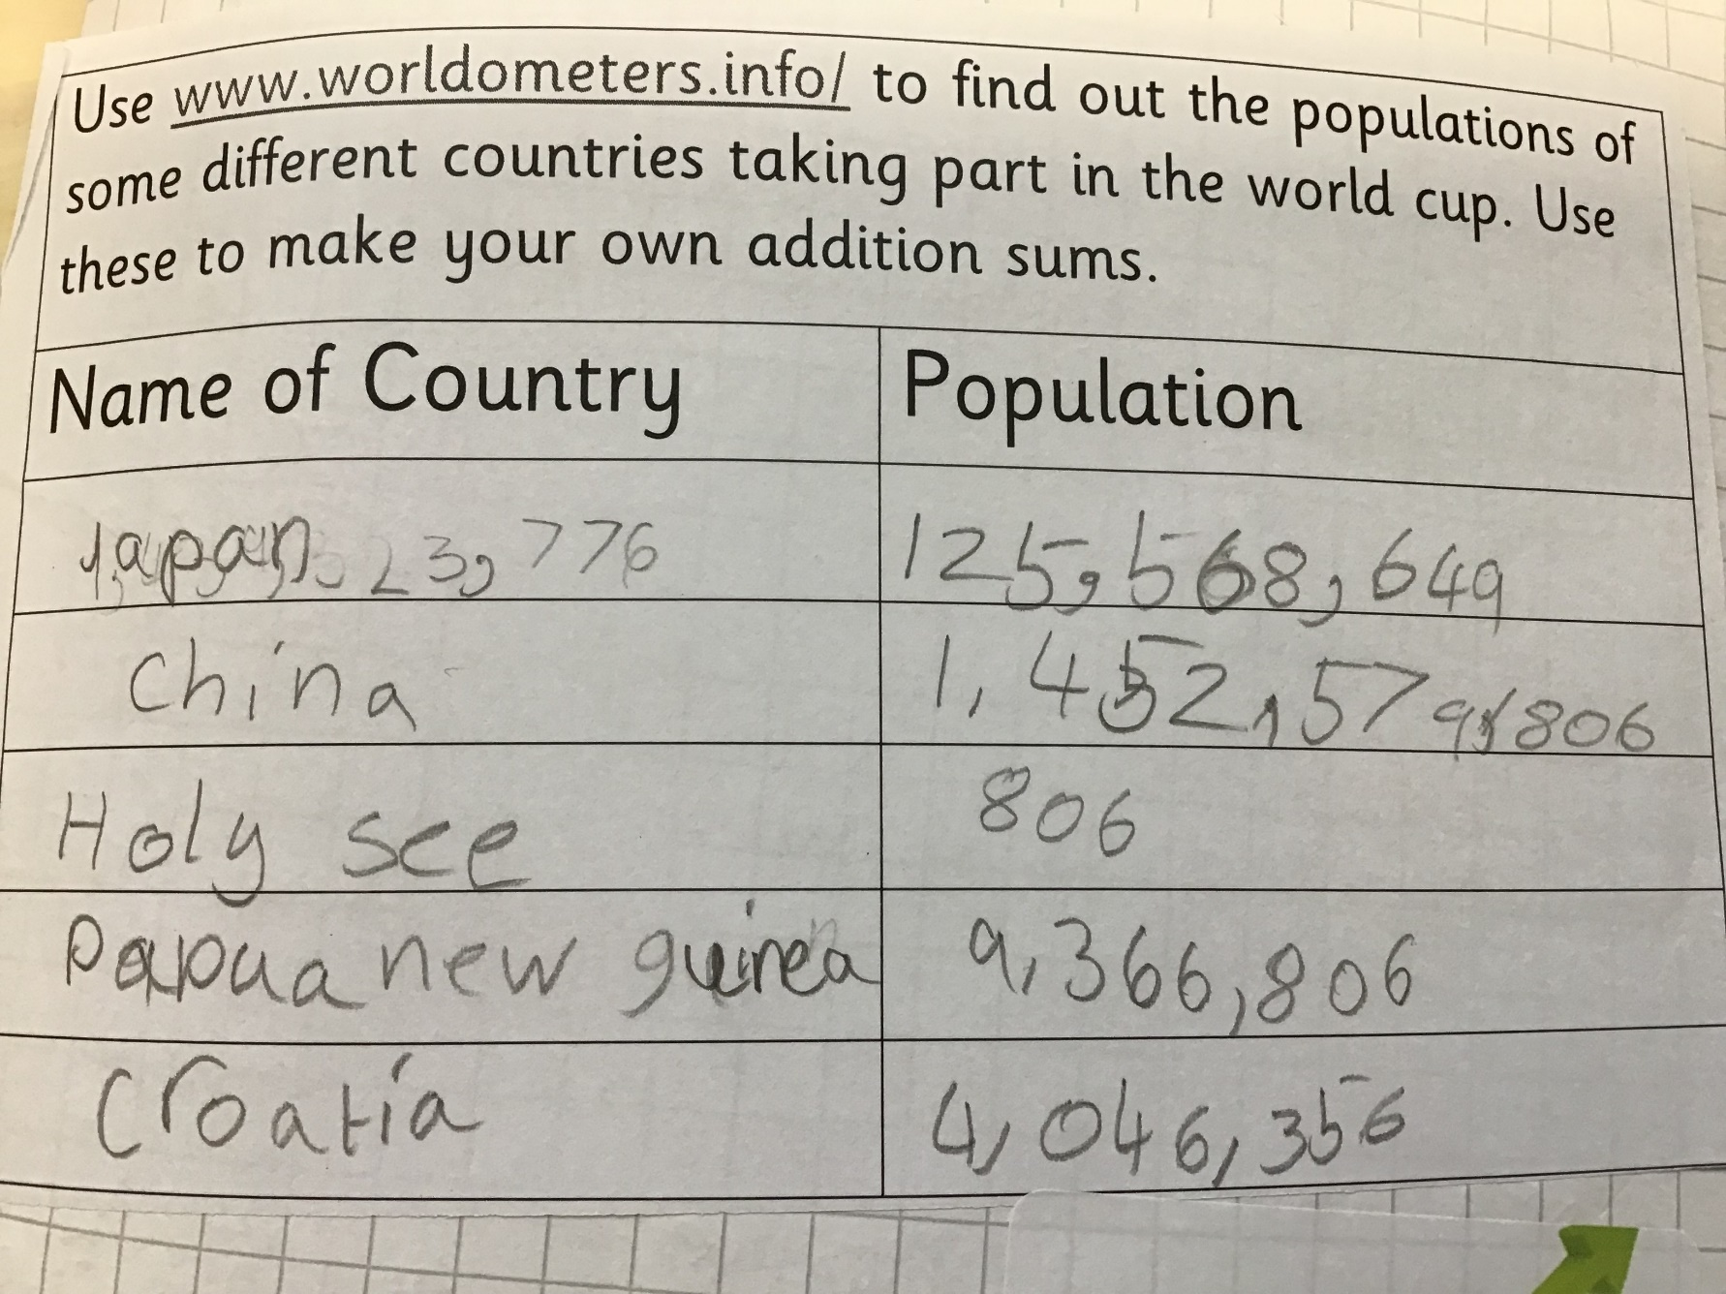
We got the populations of Five countries in the world cup and did addition sums for them.

Slide 17
Here are the sums..

Slide 18
Here are some subtracting sums on stadiums

Slide 19
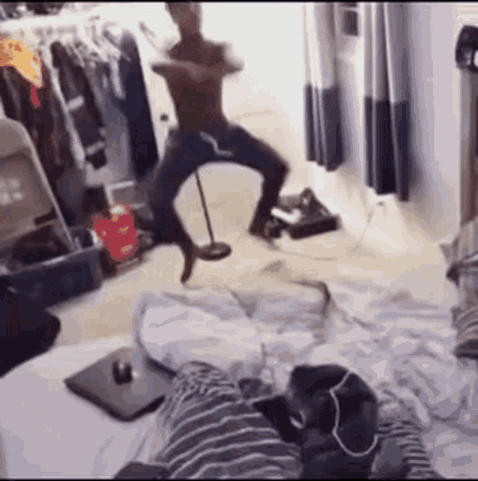
Thanks for watching!

