Slide 1

Our School Values

Slide 2
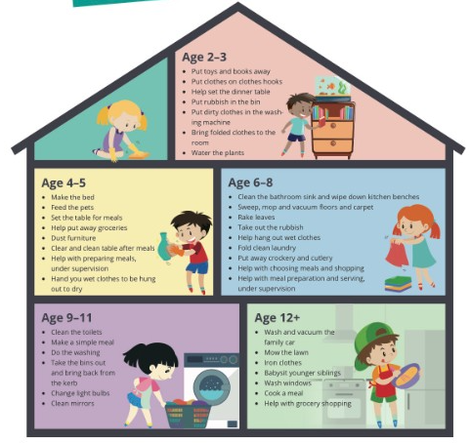
Lets take a look at RESPECT
Property
People
Family
By picking objects up off the floor
By keeping my belongings on my peg
By putting rubbish in the bin and paper in the recycling
By leaving areas tidy after I have used them
By looking after resources so they are kept in good condition
By listening
By smiling
By replying when spoken to
By holding doors open
By waiting for others to pass
Views
By listening to different ideas
By listening to different opinions
By listening to different beliefs

Slide 3


