Slide 1

Tingwall Primary School Term 4 Newsletter 2026
Welcome to our final newsletter of this school year.
It has been such a busy term but also a term filled with fun and great learning opportunities! There have been many highlights, some of which are showcased on the following pages.
The last week has been very bittersweet with lots of ‘lasts’ as we held our Leavers’ Assembly for the P7s leaving us and heading for the Anderson High School, and today we held the Nursery Graduation for those moving on from Nursery to Primary 1. Across the week we have been saying a final farewell to Mrs Paul, who will be leaving us as art teacher, Mr Kirkness who has been successful in securing a new post as PT for Expressive Arts in Brae High School and to Miss Saunders who is leaving after 10 years serving Tingwall School and moving on to pastures new in Scalloway and Lunnasting Primaries. Although we will miss them all very much, we wish them all every success in their new ventures after the summer.
This will also be my last newsletter with you all and I want to take this opportunity to say a huge thank you to you all – parents, families and the wider community, wir fabulous bairns and wir amazing staff. It has been such a privilege to have been your Head Teacher across the last 18 months and I will hold this peerie school and everything it stands for in my heart forever. Thank you all for your support across my tenure, it has been a very special time. Also, thank you so much for the generous and thoughtful gifts you have presented me with, I feel so very lucky and am deeply grateful.
We hope you all enjoy a wonderful summer holiday and have some lovely time together with your families and friends. Let’s hope the sun does finally start to shine!
The team looks forward to welcoming all wir bairns back to school on Wednesday 19th August for the beginning of our next academic year.
With love and best wishes,
Lesley

Slide 2
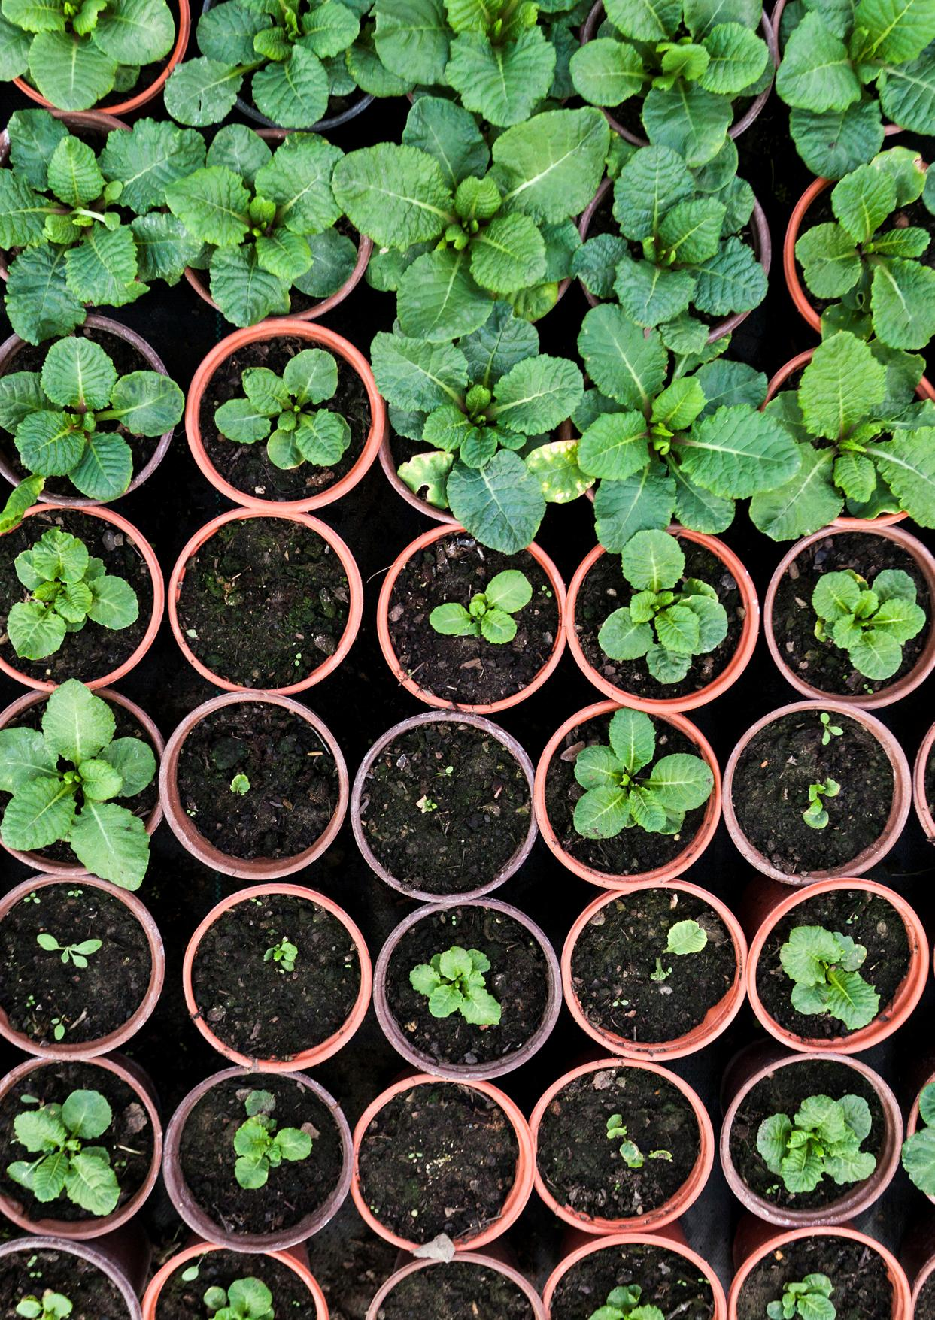
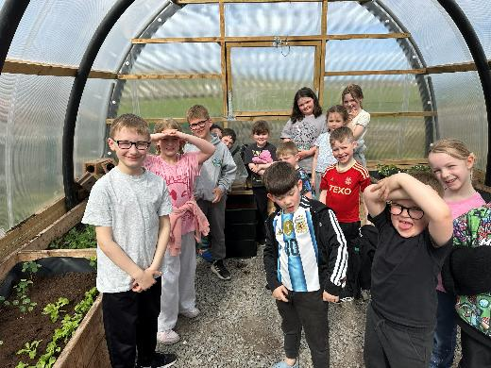
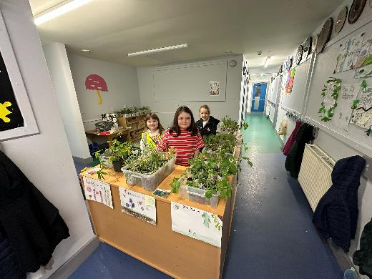
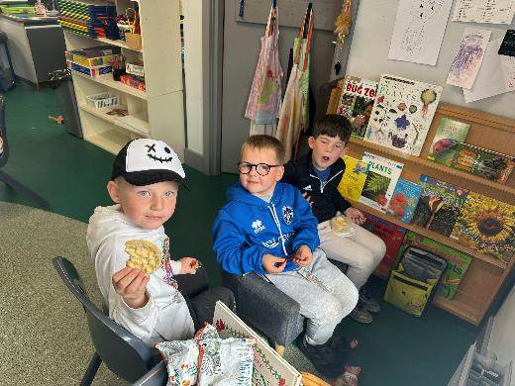
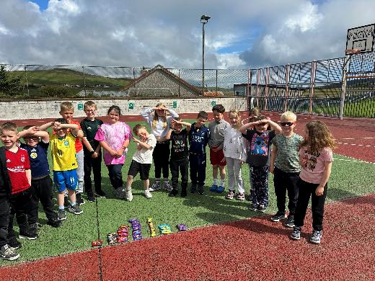
P123 – Term 4
We have been so busy in our learning…what an amazing term we’ve had!
We have been growing plants from seed, starting them in propagators and moving them to the polycrub. We have learned about all the stages of a plant’s growth , from germination to fully grown. We’ve even learned about how a plant disperses its seed for the next generation.
We made ‘Germination Stations’ with bean seeds, which we were able to watch. We were able to see how a seed germinates and produces roots and shoots!
We designed experiments to see what a plant needs to grow and discovered that they won’t grow for long in dark, cold places or without water.
We prepared our plants for our ‘Plant Sale’ and some of us took part in selling them.
We have been doing ‘Food Fridays’ where we have been trying new and different foods. We have been eating some of our food from the polycrub. We have also been developing our food technology skills, like chopping and spreading.
We have been learning about where our food comes from, in lots of different ways, such as:
  We have had parents in to tell us about their jobs in the seafood industry
  We have learned about farms and food producers in Shetland.
  We have investigated food packaging and found out which countries they have come from. We have found these places on a map…some have travelled a long way and have a lot of food miles!
We have been learning about the ‘Eatwell Plate’, which tells us about all the different food groups and what a balanced meal looks like.
We have been looking at some Shetland food and recipes, including seeing a big chunk of ‘Reestit Mutton!’
We have really been developing our writing, and Miss Saunders has been astounded by the stories we have been writing, especially the one about the mysterious keys we found!

Slide 3
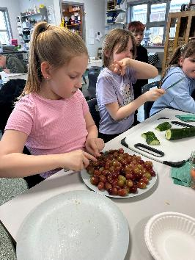
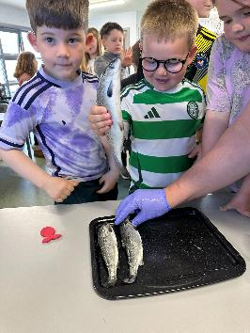
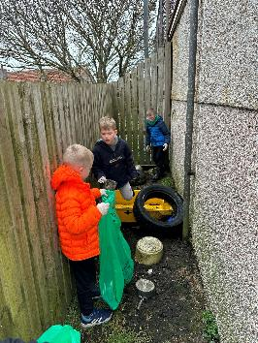
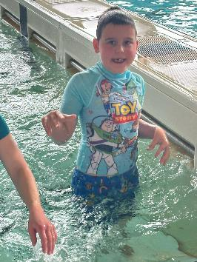
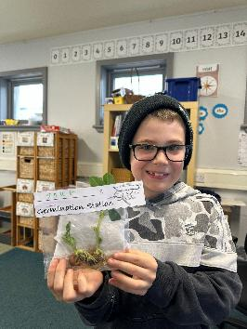
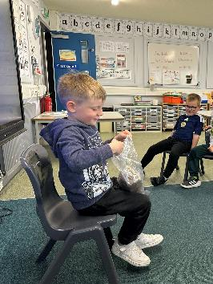
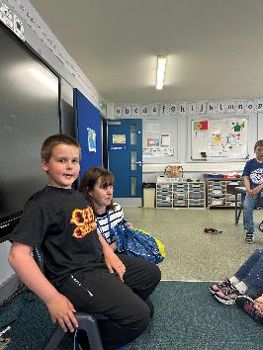
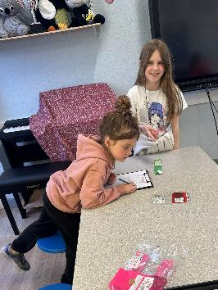
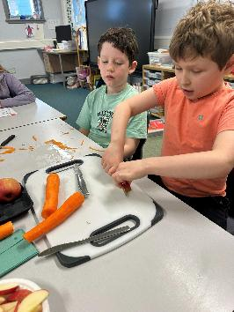
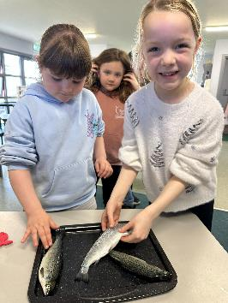
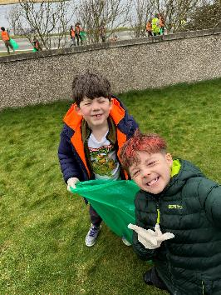
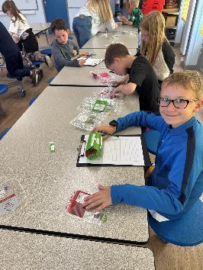
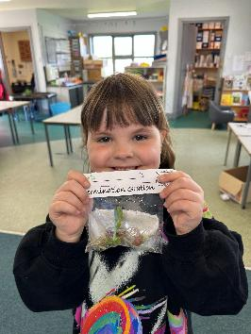
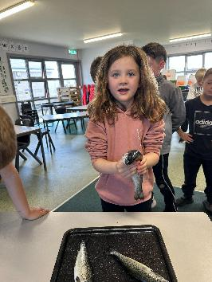
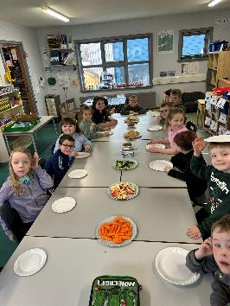
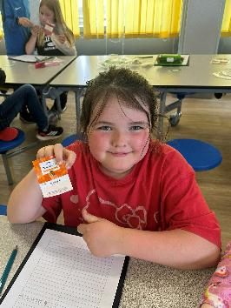
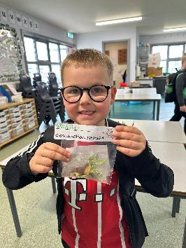
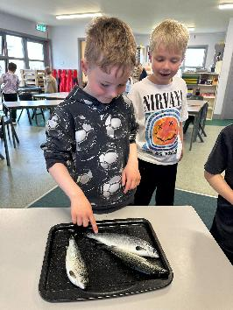
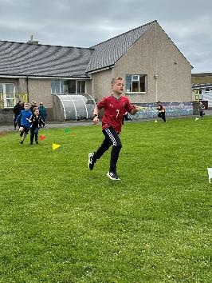
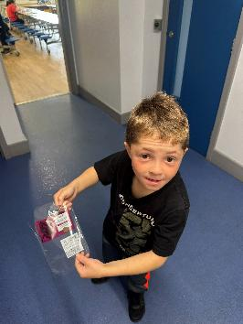

Slide 4
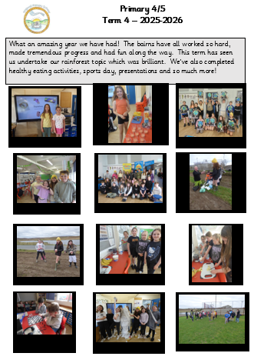

Slide 5
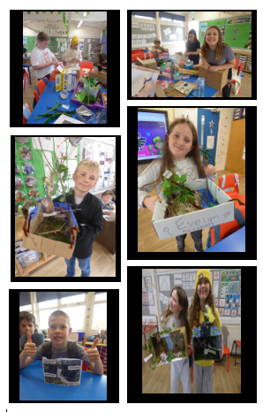

Slide 6
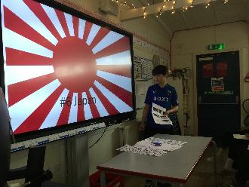
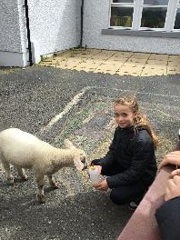
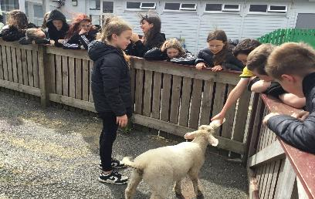
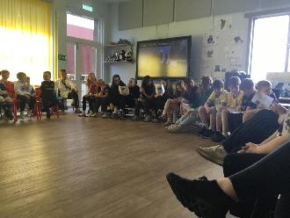
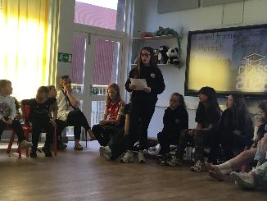
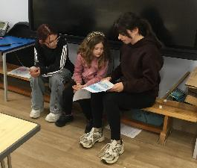
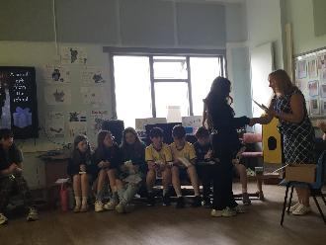
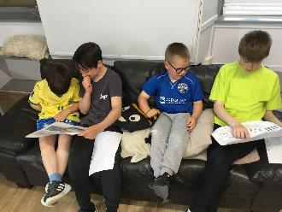
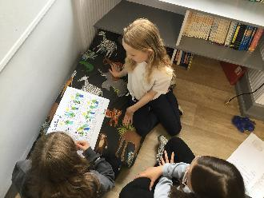
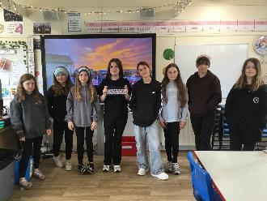
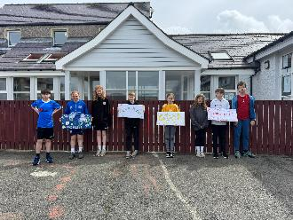
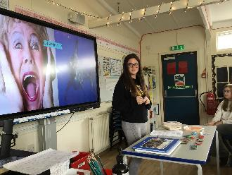
Primary 6/ 7 - Term 4
What a term we have had! It has been an amazing way to finish the year, full of fun and memorable experiences. We had a fantastic Sports Day, where Califf came out on top! The Voar Redd Up was a huge success, with the P7s working incredibly hard to help clean up all the rubbish.
We also held our own political party campaign, where pupils were organised into groups to create school-based manifestos and campaigns. We then held an election and voted at our very own “polling station.” Congratulations to the National Tingwall Party for their winning manifesto and the Shetland Islands Party for their leadership success.
There have been many transition activities for our P7s, as well as brilliant visits from Anderson High School staff to help prepare them for the move. Pupils completed amazing personal projects, presenting on topics of their choice. The bairns did a fantastic job presenting, and we even enjoyed food tastings, quizzes and a lovely visit from Custard Cream the caddy lamb! As part of our learning about relationships and wellbeing, pupils also took home eggs to practise the responsibilities of parenthood and develop an understanding of the role and commitment involved.
The P7s had a brilliant time on their school trip to Voxter, making lifelong memories. We shared comic strips and letters with buddies, which they loved. Finally, we held a wonderful leavers’ assembly, which was a fantastic tribute to our P7s as they finish their time at primary school.

Slide 7
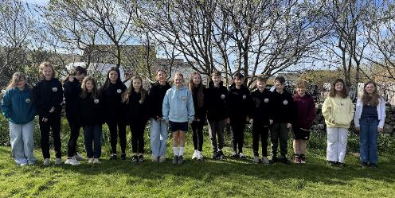
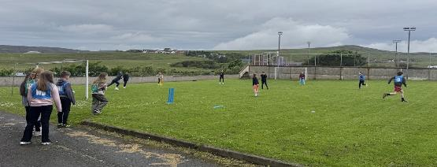
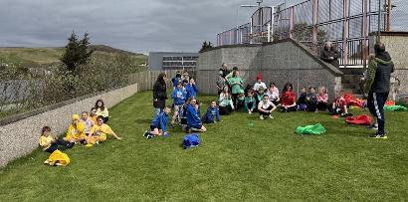
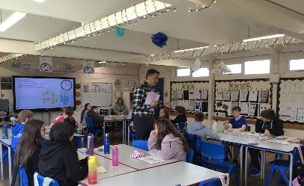
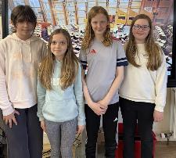
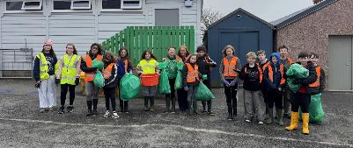
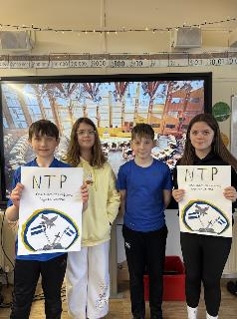
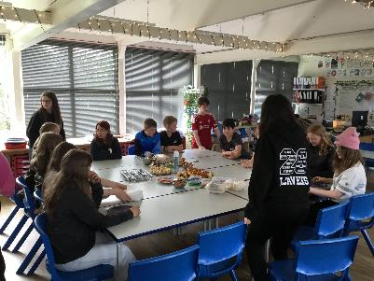
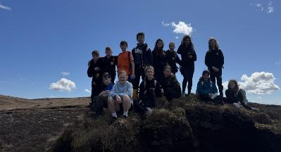
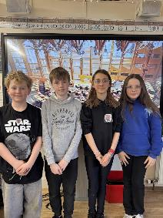
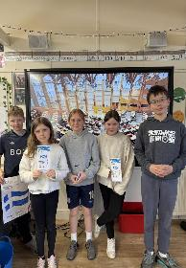







Primary 6/ 7 - Term 4

Slide 8
Dates for your Diary for 2026/2027
Monday 17th August – In-service Day. ELC/School open to staff only.
Tuesday 18th August - In-service Day. ELC/School open to staff only.
Wednesday 19th August - Return to ELC and School
Monday 31st August - Parent Council AGM and meeting at 6.30pm
Friday 9th October – Last day of term 1
Monday 11th – Friday 23rd October – October Holidays
Monday 26th October - In-service Day. ELC/School open to staff only
Tuesday 27th October - In-service Day. ELC/School open to staff only
Wednesday 28th October – Return to ELC and School
Monday 2nd November - Parent Council meeting at 6.30pm
Friday 18th December – Last day of term
Monday 21st December 26 – Tues. 5th January 27 – Christmas Holidays
Tuesday 5th January 2027 – Return to ELC/ School for staff and pupils
Further dates will be communicated once Mr Healy is in post.

