Slide 1


School inspections are changing
Shape What’s Next
Communications toolkit
HM Inspectors of Education | Public Consultation
#Schoolinspectionsarechanging #HMIE

Slide 2


Background
A national public consultation has been launched to gather views on how school inspections are carried out across Scotland.
The consultation, ‘School inspections are changing: Shape what’s next’ invites everyone, from parents and carers to learners and educators, to share their thoughts on how inspections can best support improvement in schools.
We have also developed an age-appropriate and accessible version of the consultation for children and young people.
The consultation is open until 26 November 2025
School inspections are changing: Shape What’s Next

Slide 3
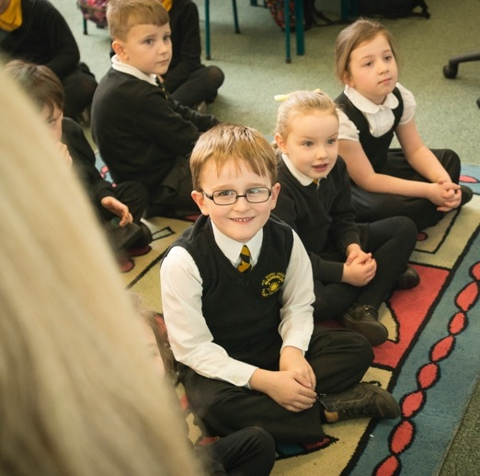

How you can help
We want as many people as possible to hear about this public consultation and help us shape the future of school inspections.
We’re asking our partners to spread the word about the public consultation, and we hope you find this toolkit helpful in communicating this message.
Some ideas to help spread the word include:
Posting a news item on your website sharing details of the consultation
Highlighting the consultation on your social media channels
Updating your website to include details of the consultation
Including details in your e-newsletters or emails
If you have any questions about this campaign, please contact Frances.Douglas@educationscotland.gov.scot.
School inspections are changing: Shape What’s Next

Slide 4
Key messages
These are the key messages that will be communicated as part of the ‘School inspections are changing: Shape what’s next’ campaign. They can be used as
a guide when you are planning any communication to support the campaign.
A national public consultation has been launched to gather views on how school inspections are carried out across Scotland.
The consultation ‘School inspections are changing: Shape what’s next’ is open until 26 November 2025.
An age-appropriate and accessible version of the consultation is available for children and young people.
Running alongside the consultation, HM Inspectors will continue to engage with children, young people and education partners to explore key themes in more depth.
Everyone, including children and young people, can complete the consultation.
Take part in the consultation online before the deadline of 26 November 2025.
The consultation is the second phase of our review of school inspections.
Find out more about the consultation, and our review of school inspections, on our website.
School inspections are changing: Shape What’s Next

Slide 5
Copy
This copy is for you to use across your channels when talking about the campaign.
For example, the copy can be included in newsletters, emails and on your website.
Feel free to edit it to fit with your own tone of voice.
Long copy:
Every child in Scotland has the right to an education that helps them thrive. To make sure inspections play their full part in achieving that, His Majesty’s Chief Inspector of Education has launched a national consultation on the future of school inspections.
The consultation, ‘School inspections are changing: Shape what’s next’, invites everyone, from learners and parents and carers, to educators, to share their views on how inspections can best support improvement in schools and provide public confidence in the quality of education.
The consultation is open until 26 November 2025. Want to share your views? Complete the consultation.
Short copy:
Every child in Scotland has the right to an education that helps them thrive. To make sure inspections play their part in achieving that,
His Majesty’s Chief Inspector of Education has launched a national consultation on the future of school inspections. The consultation, ‘School inspections are changing: Shape what’s next’ is open to everyone.
Want to share your views? Complete the consultation, by 26 November 2025.
School inspections are changing: Shape What’s Next

Slide 6



Social assets
One of the easiest ways to spread the word about the campaign is through your social media channels.
We have created a range of static and animated social assets for channels including Facebook, Instagram and X.
Social static & animated 1080x1080
1350x1080
School inspections are changing: Shape What’s Next

Slide 7
Suggested social media posts
X/TWITTER:
School inspections are changing. A public consultation has been launched by HM Chief Inspector of Education to gather views on the future of school inspections in Scotland.
Take part before 26 November #Schoolinspectionsarechanging #HMIE
FACEBOOK:
School inspections are changing: Shape what’s next
A public consultation has been launched by HM Chief Inspector of Education to hear your views on the future of school inspections in Scotland.
The consultation covers topics including:
✅ Who’s involved in inspections
✅ How often schools are inspected
✅ Use of inspection grades
This is your chance to shape how inspections support improvement in schools. Whether you’re a parent, pupil, educator, or member of the public – help shape what’s next.
📅 Closes: 26 November 2025
#Schoolinspectionsarechanging #HMIE
School inspections are changing: Shape What’s Next

Slide 8
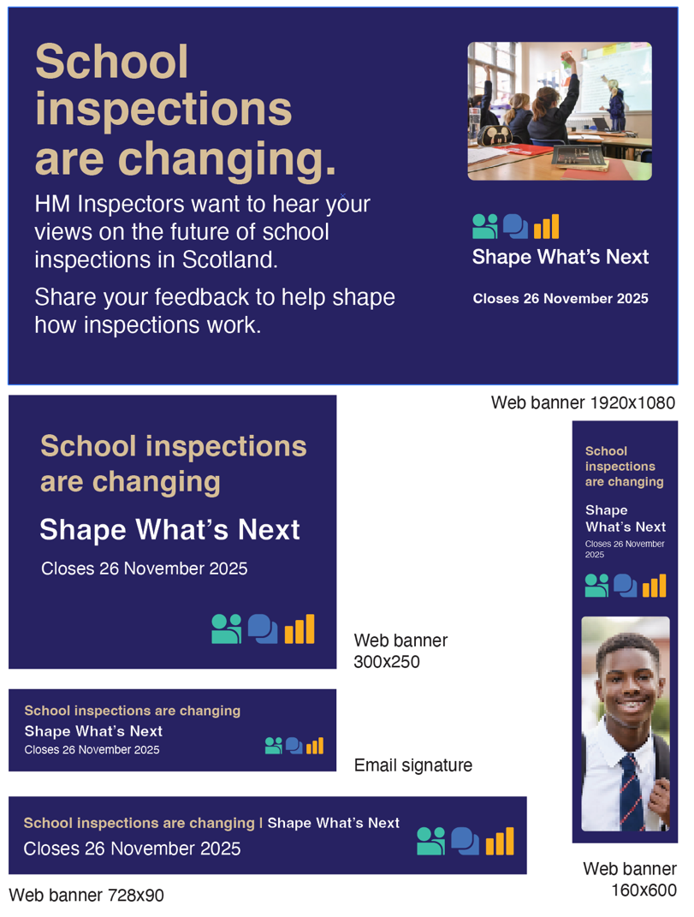
Digital assets
We have developed a range of digital assets for you to place across your channels.
This includes:
Static web page banners to display on your website
An email signature banner to add to your internal and external emails
School inspections are changing: Shape What’s Next

Slide 9





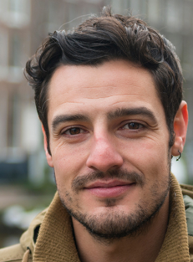



Thank you for your support in promoting this campaign

