Slide 1
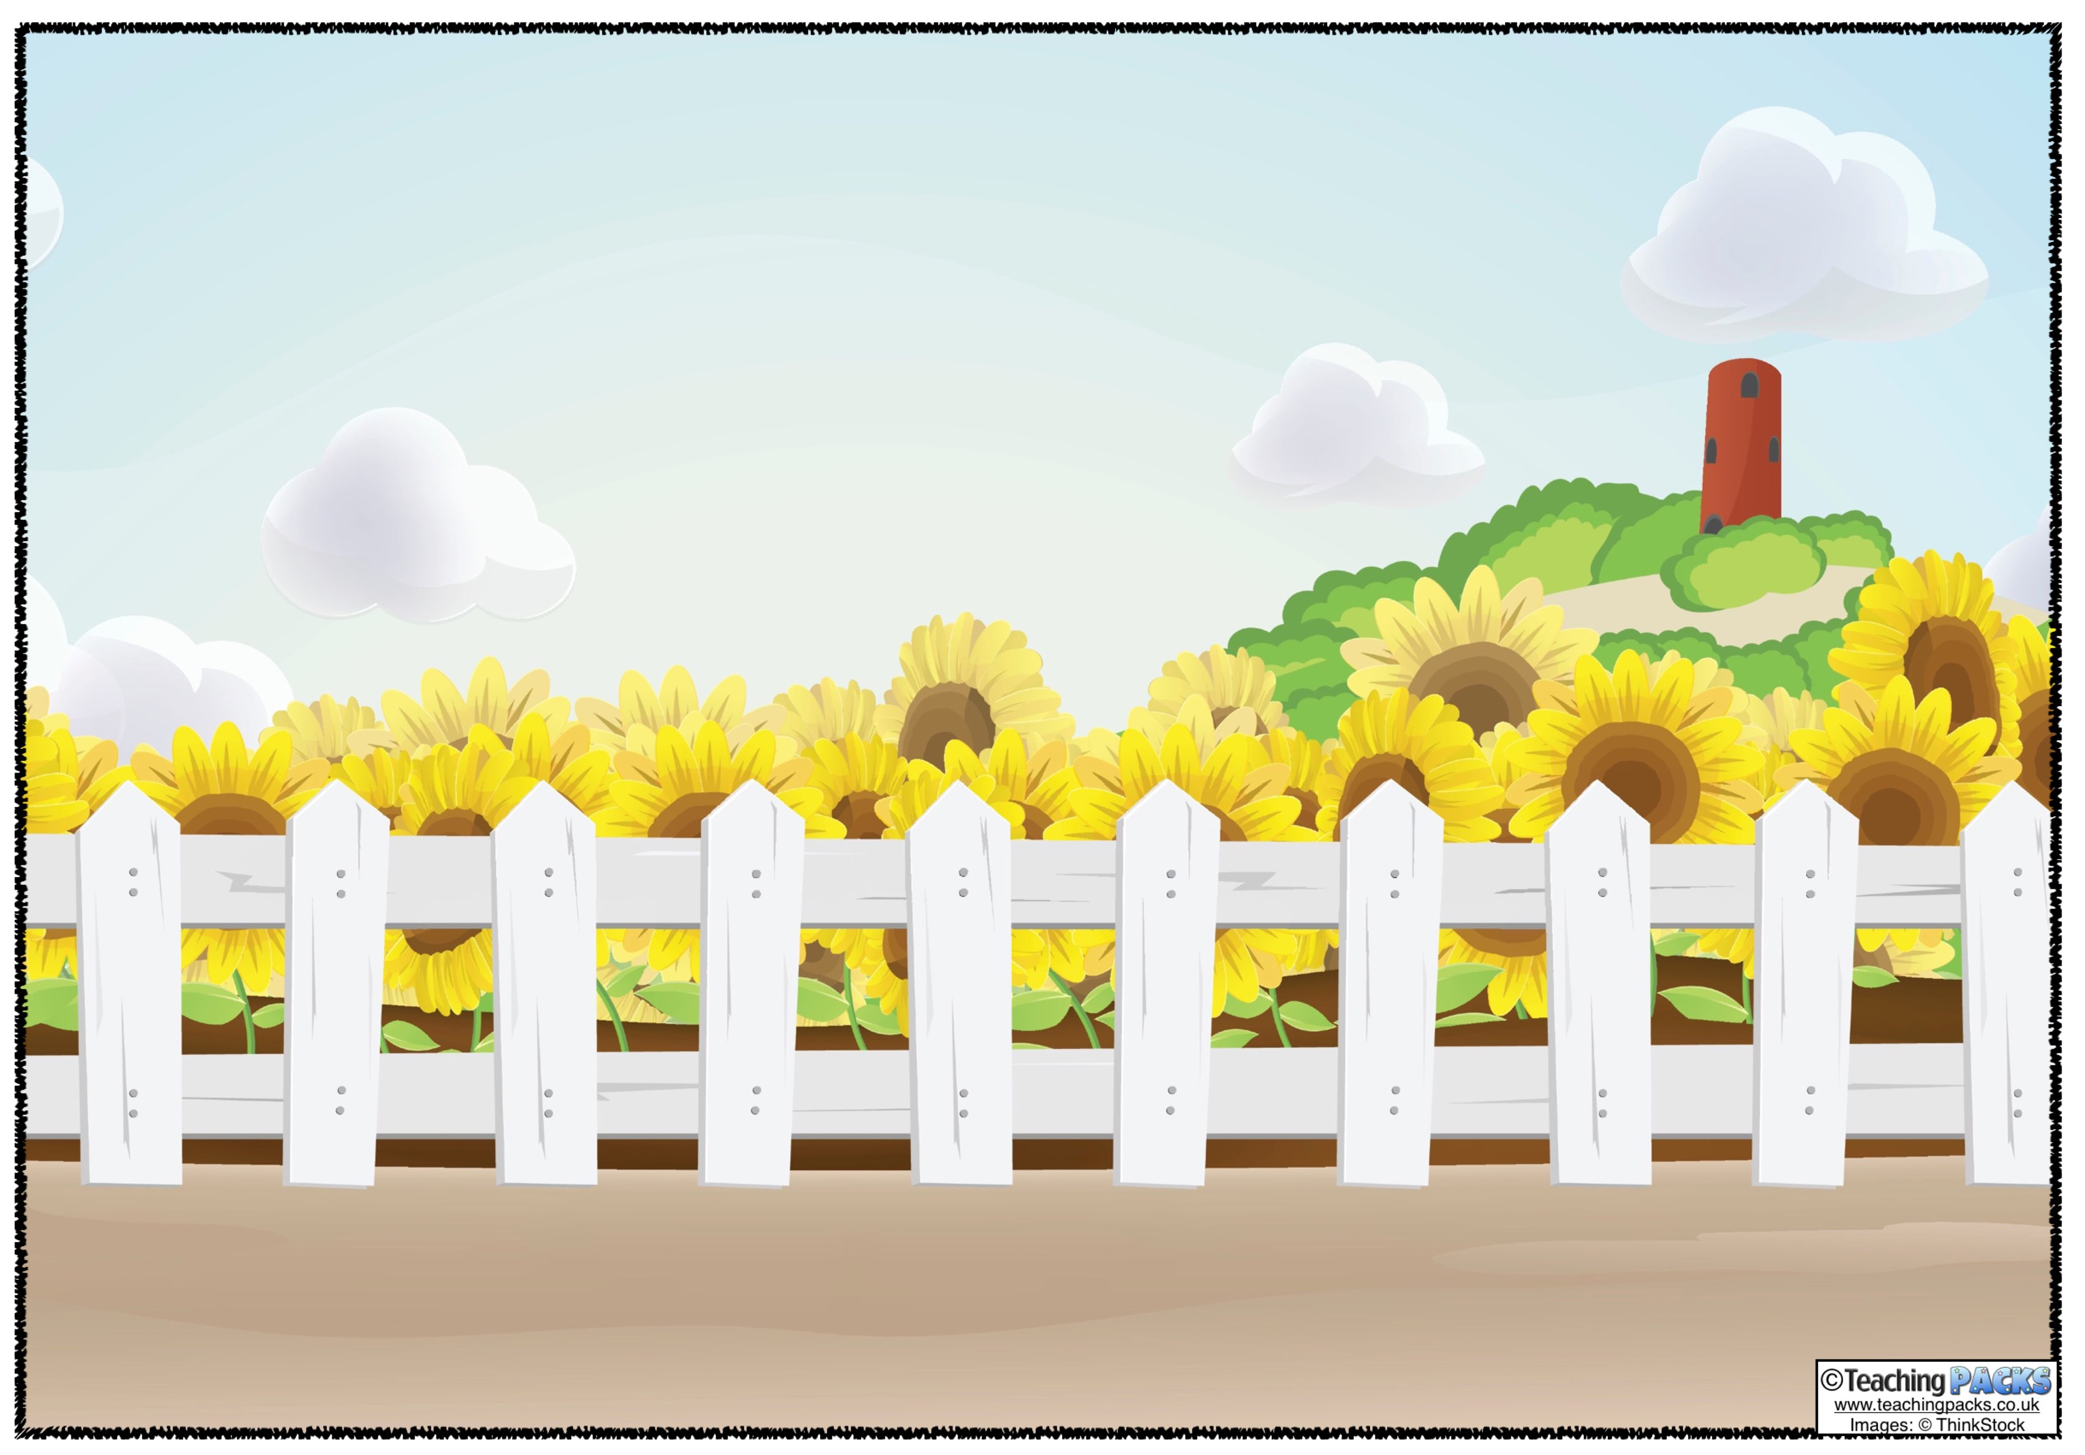
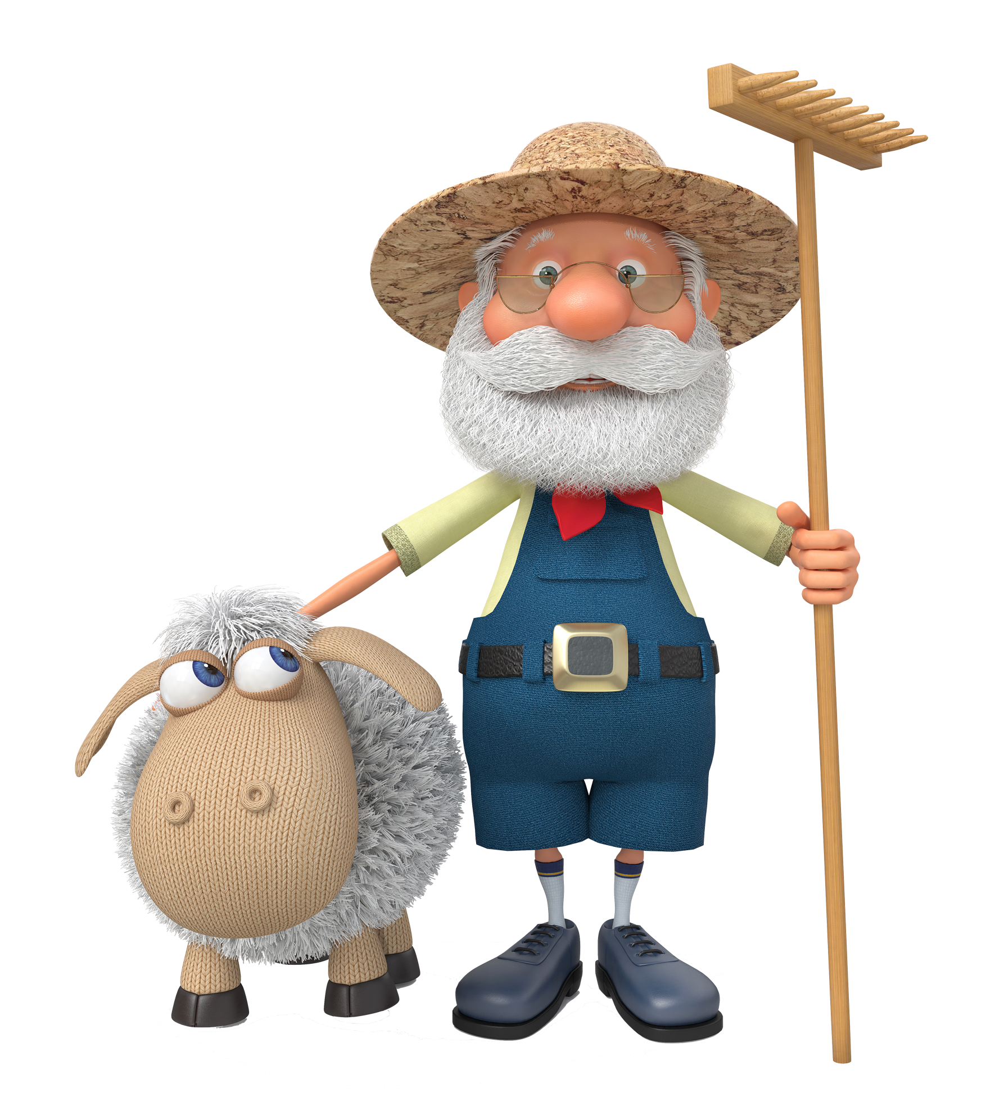
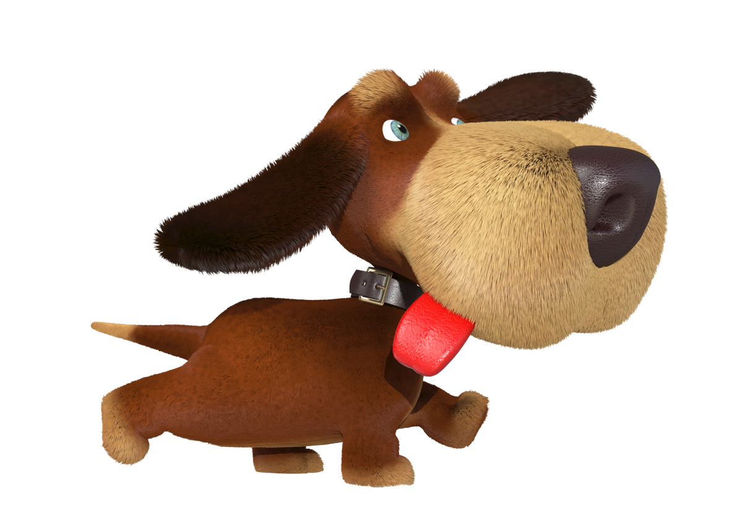
Area is the amount of space inside a shape.
The Area of a shape is also called the surface.

Slide 2
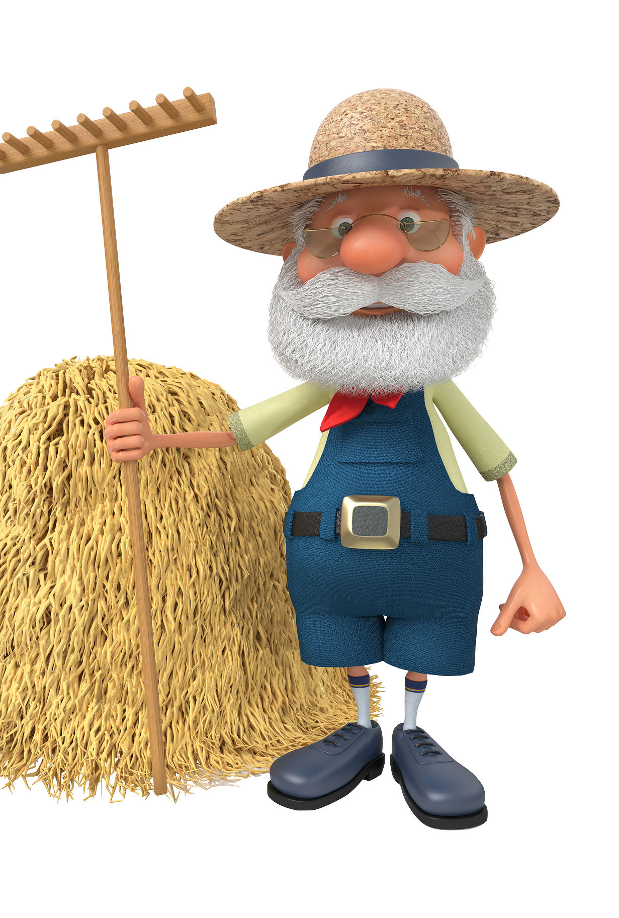
The area of a shape is the amount of space inside it.
My wheat fields all have large areas so that I can grow plenty of crops!

Slide 3
Who needs to know about area?

Slide 4
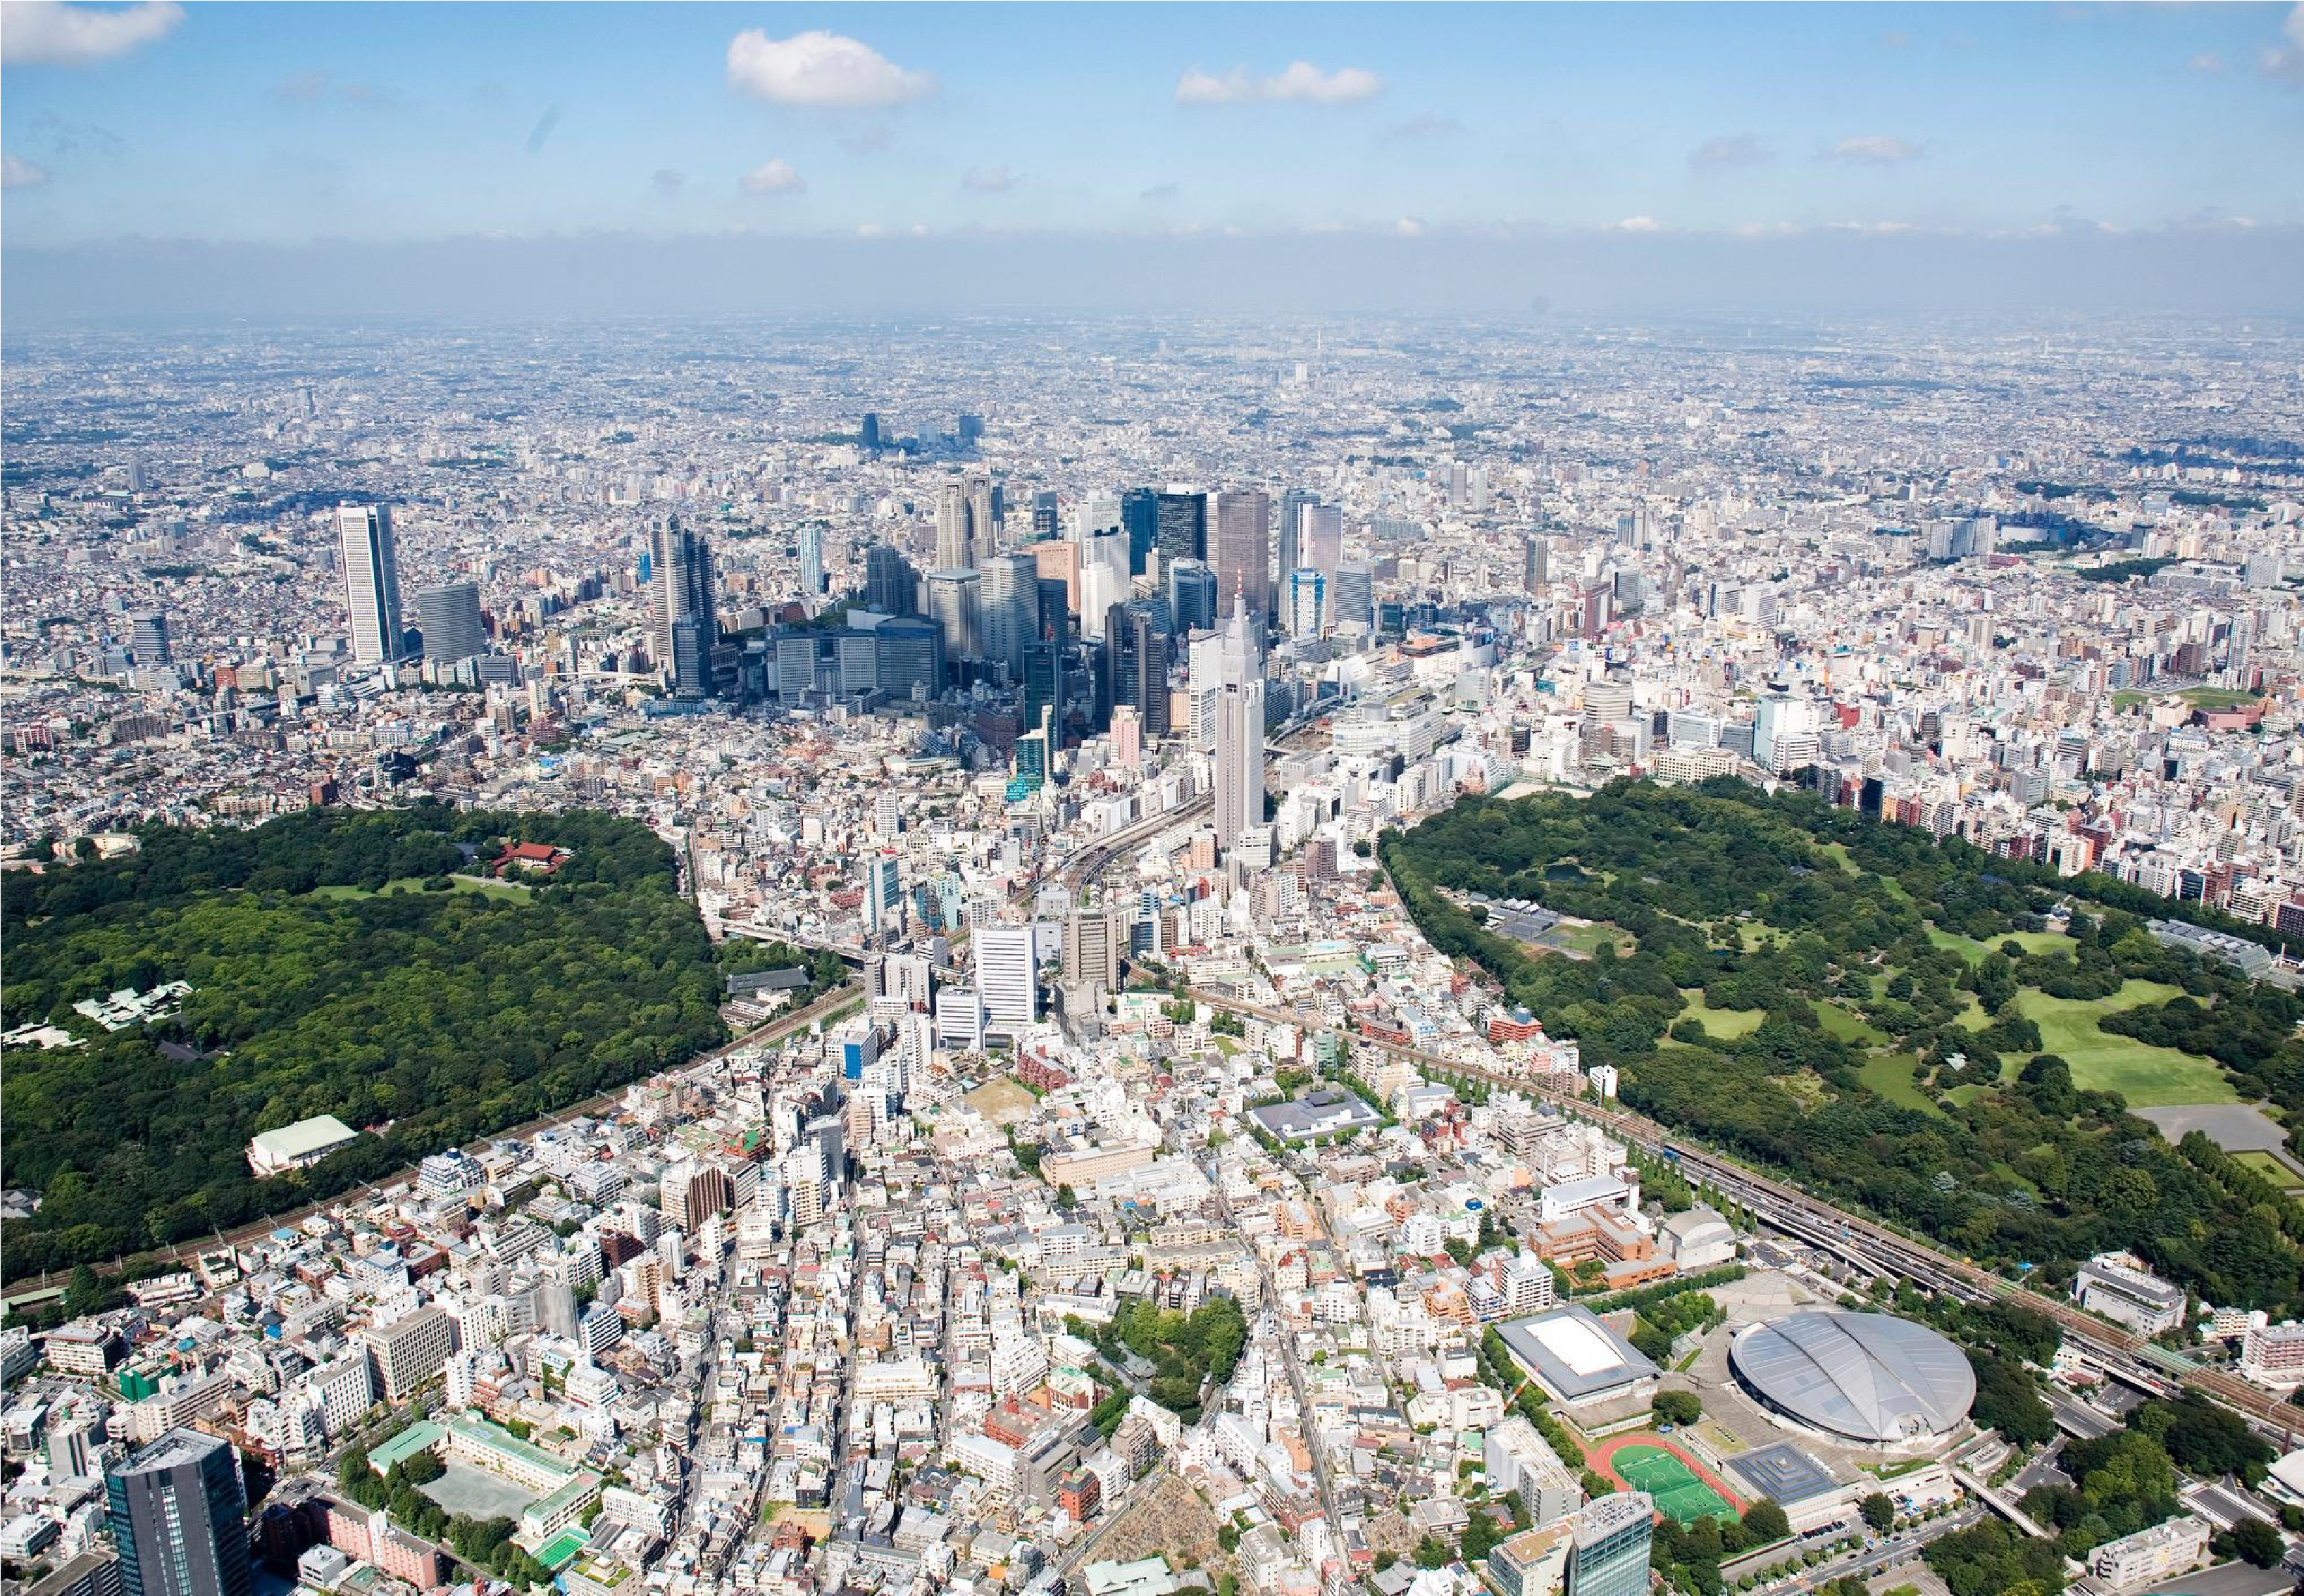
I’m a city planner.
I make sure that new developments can fit
into the space available in the city!
can
fi
t into the space available in the city!

Slide 5
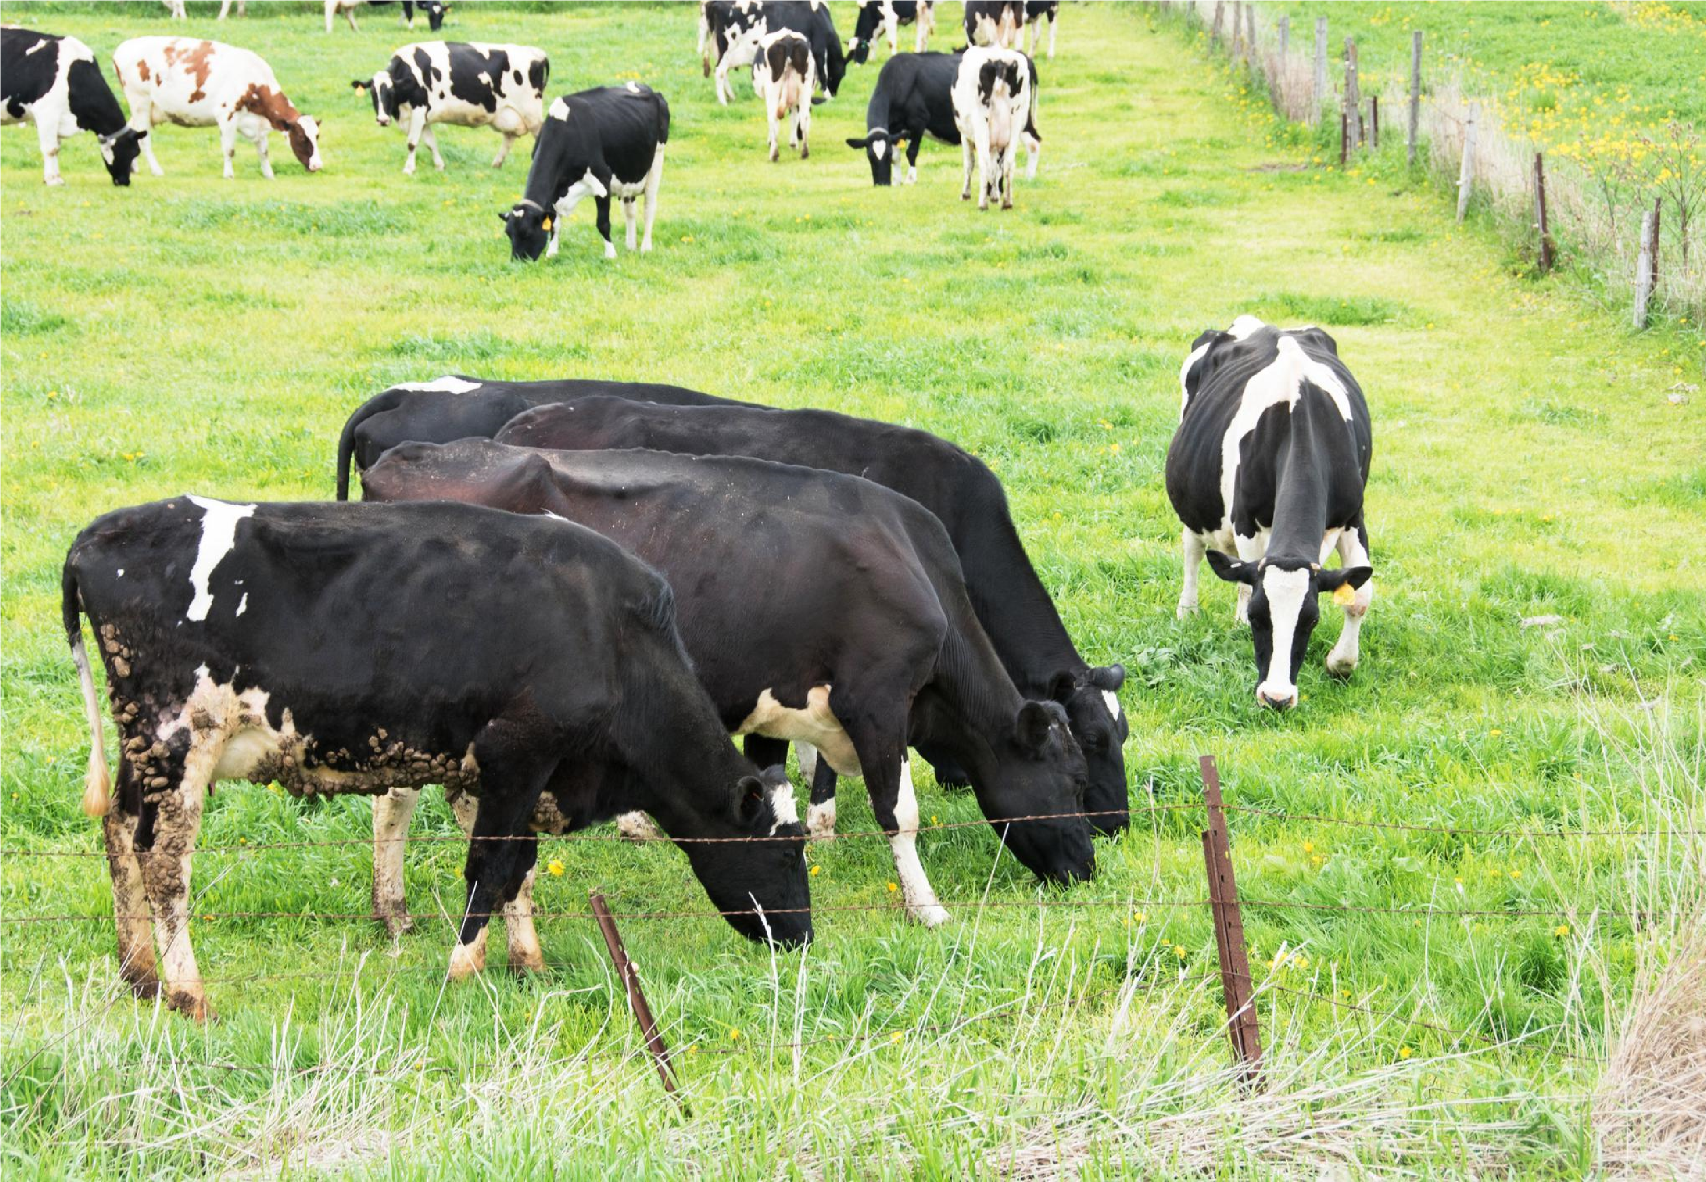
I’m a farmer. I make sure my fields have plenty of area for my cows to graze on.I make sure that my
fi
measure the perimeter fence carefully.
.

Slide 6
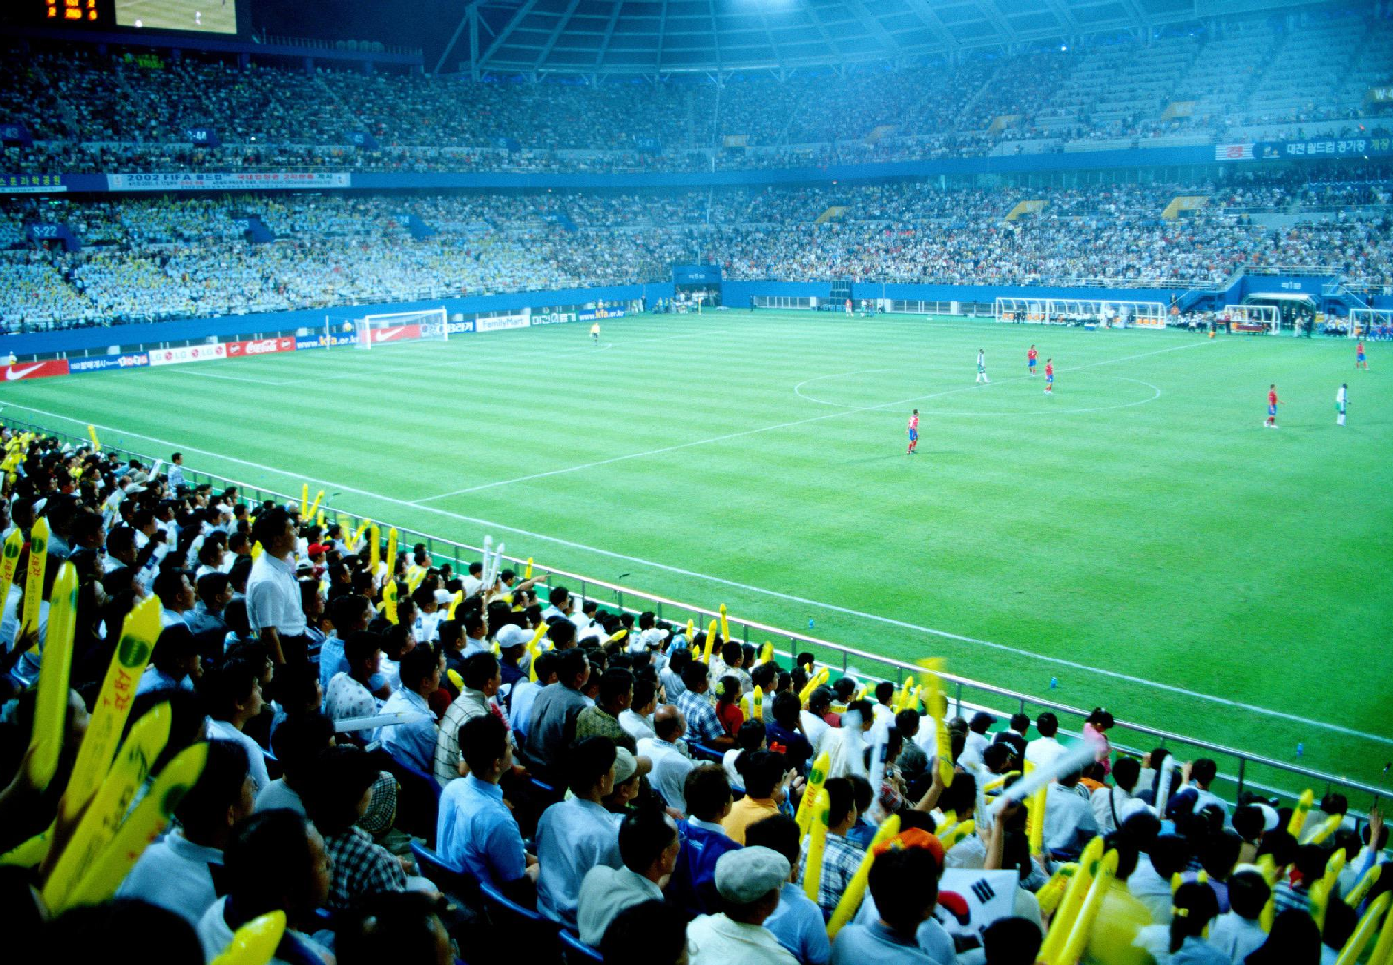
I I design sports stadiums. I have to make sure
that the pitch and seating areas are big enough. s m p

Slide 7
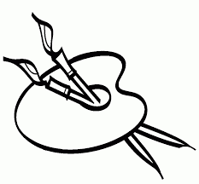
Now it is your turn. Make 2 paint blobs for your artist’s palette. They must have different areas.

Slide 8
The ___ paint blob has the biggest surface area.
The ___ paint blob has the smallest surface area.

Slide 9
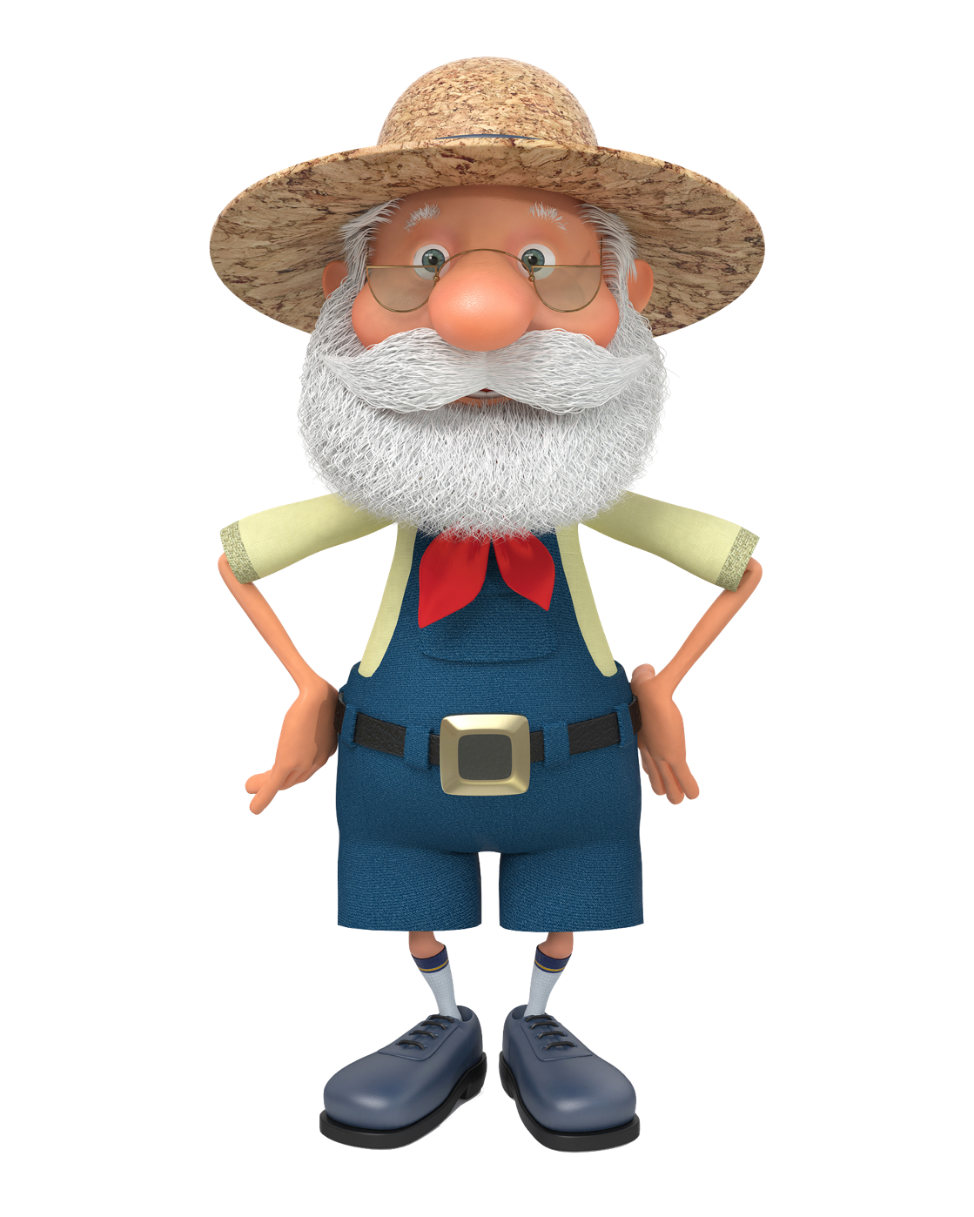
This field is a rectangle.
It is 4 metres long and 3 metres wide.
We can find out the area of a rectangle by multiplying the length by the width.
4m
4 x 3 = 12
3m
So the area of the field is 12 square metres.
These measurements are called the shape’s dimensions.
This means ‘squared’.
We can write this as 12m².

Slide 10
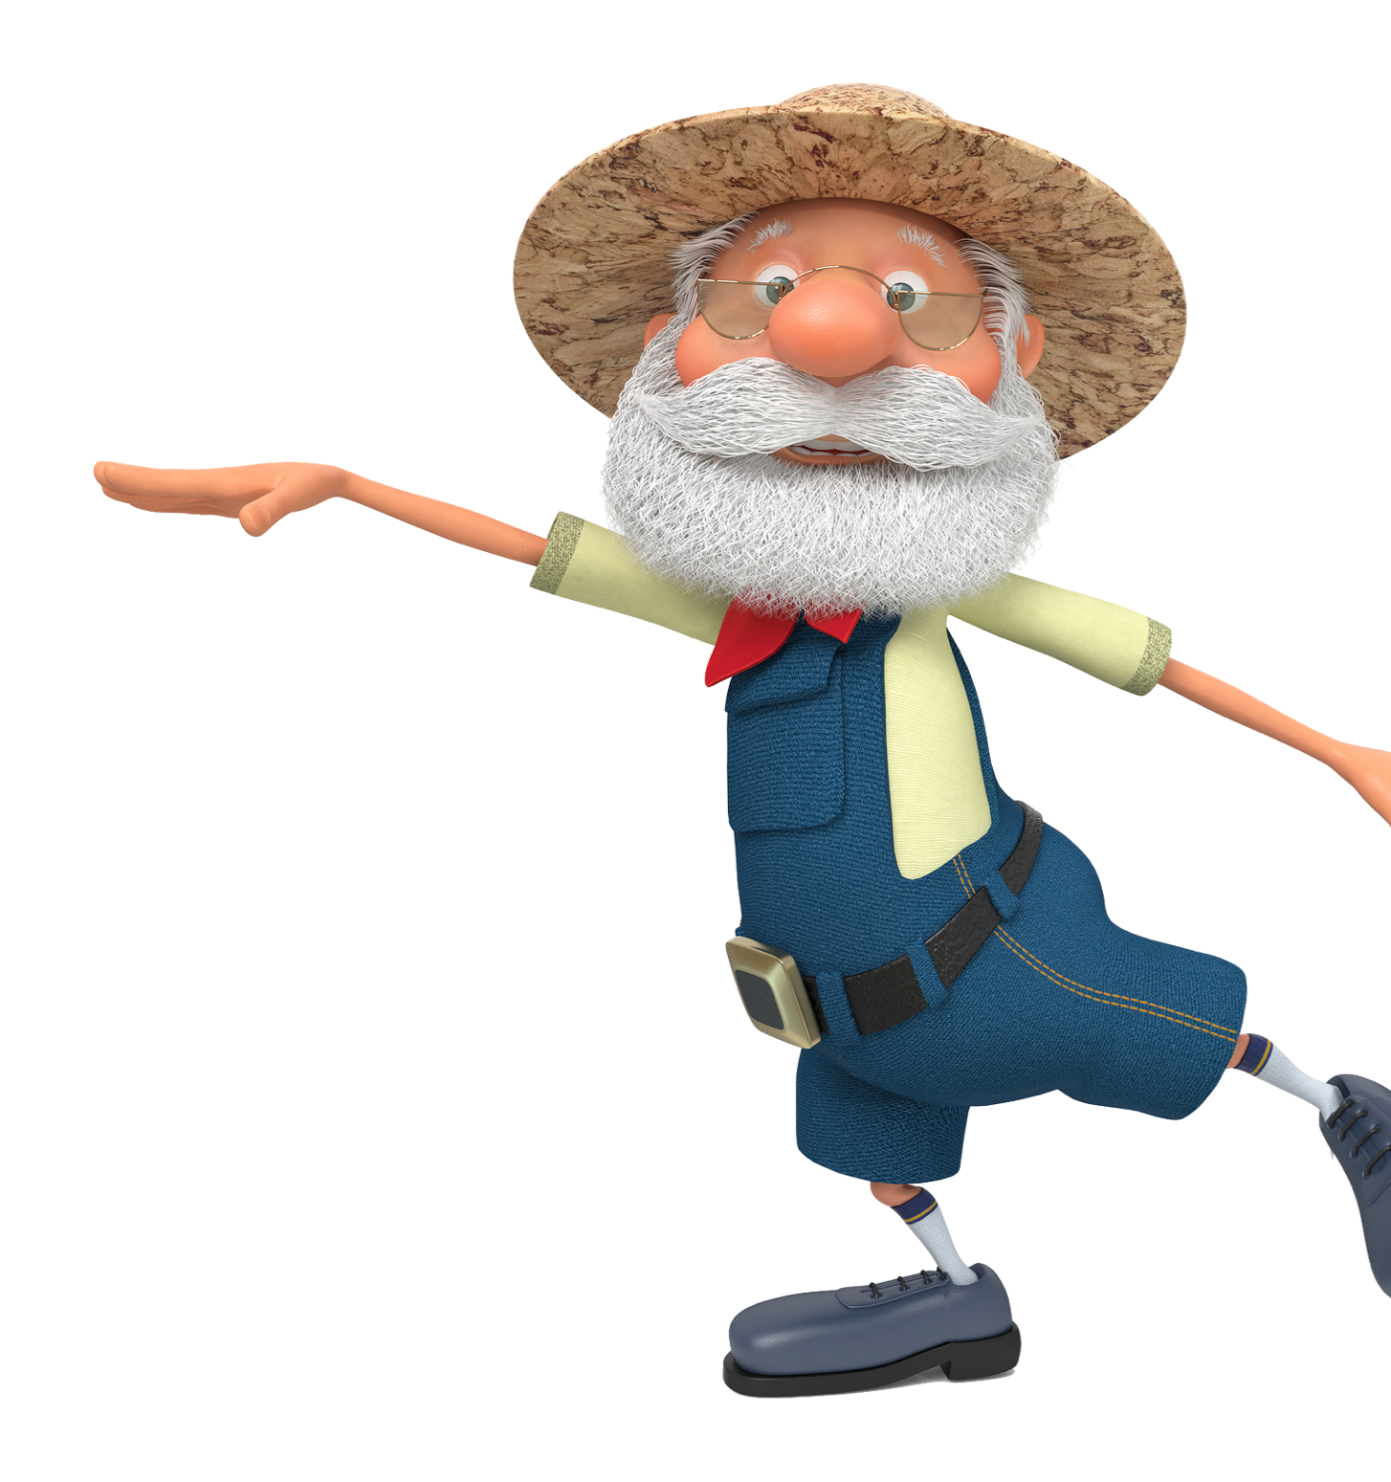
4m
2m
Can you work out the areas of these rectangular fields?
4m
5m
Remember...
A = L x W
Area = Length x Width
9m
... and don’t forget to show the units by writing m² (or cm²) after your answer.
2m

