Slide 1

Leadership P2/3B
Our amazing bodies!

Slide 2
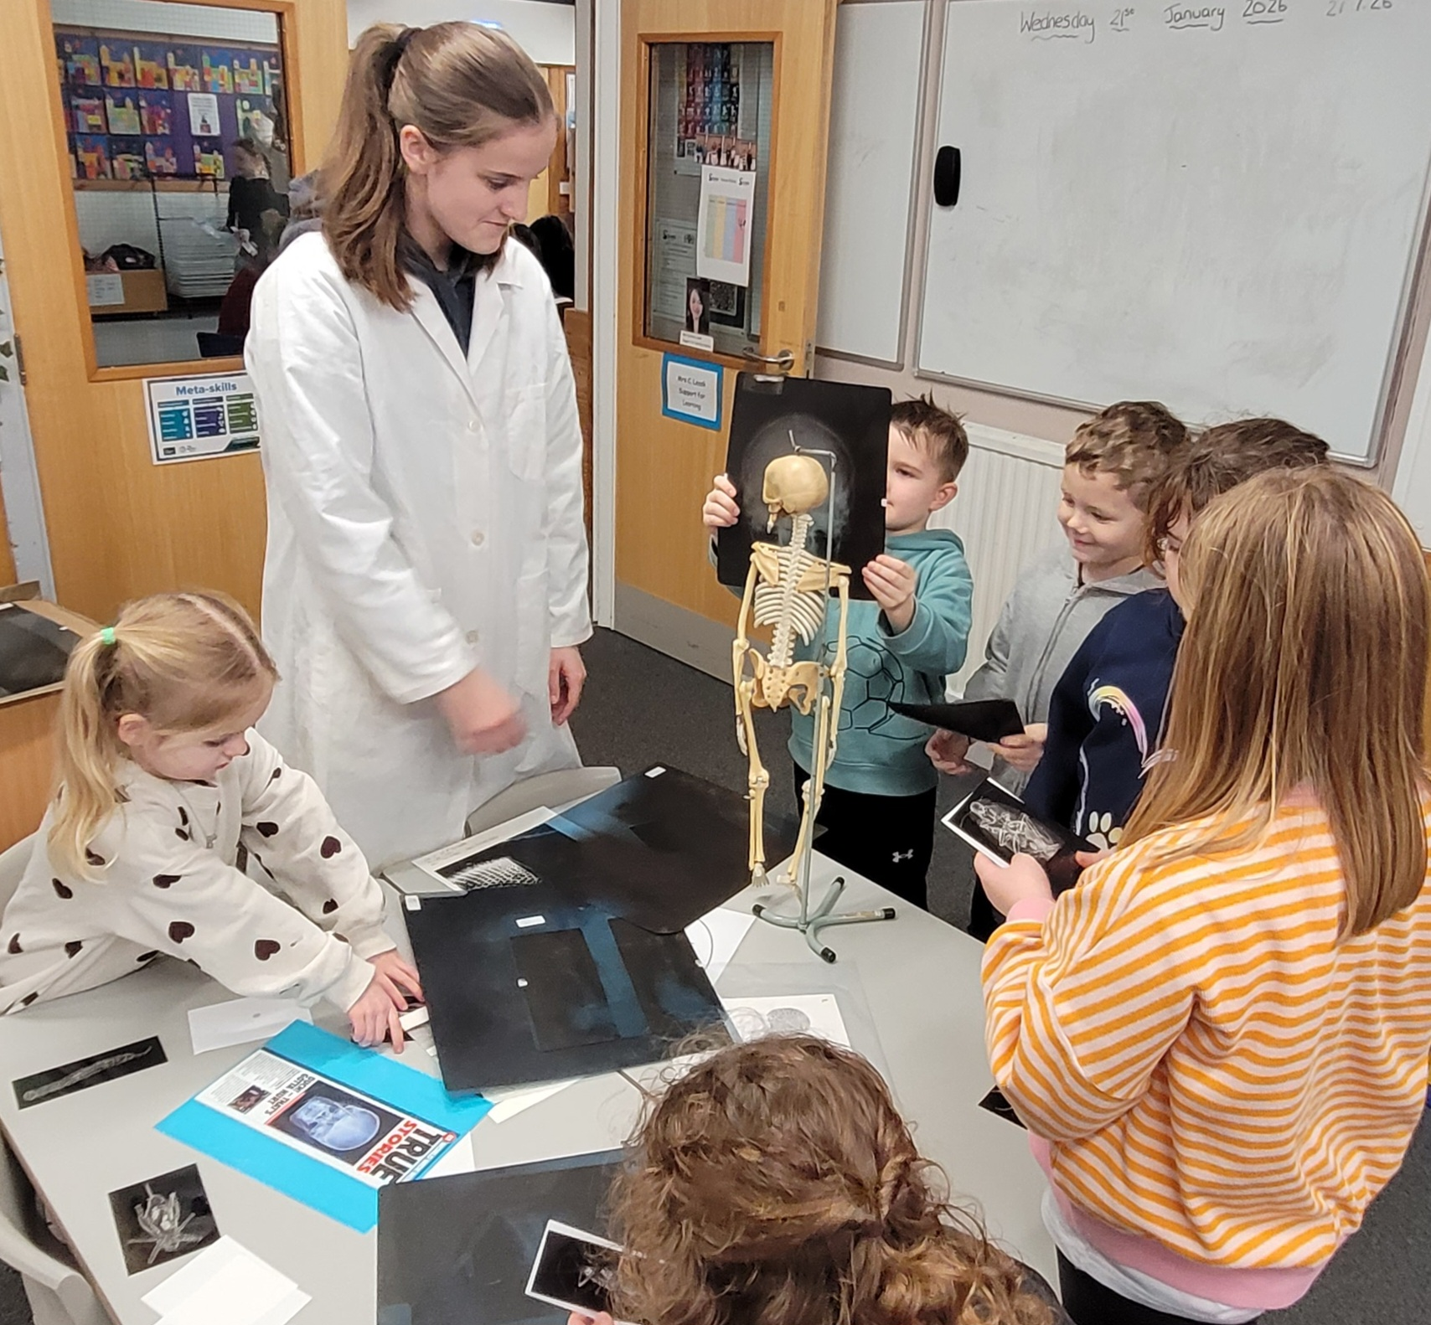
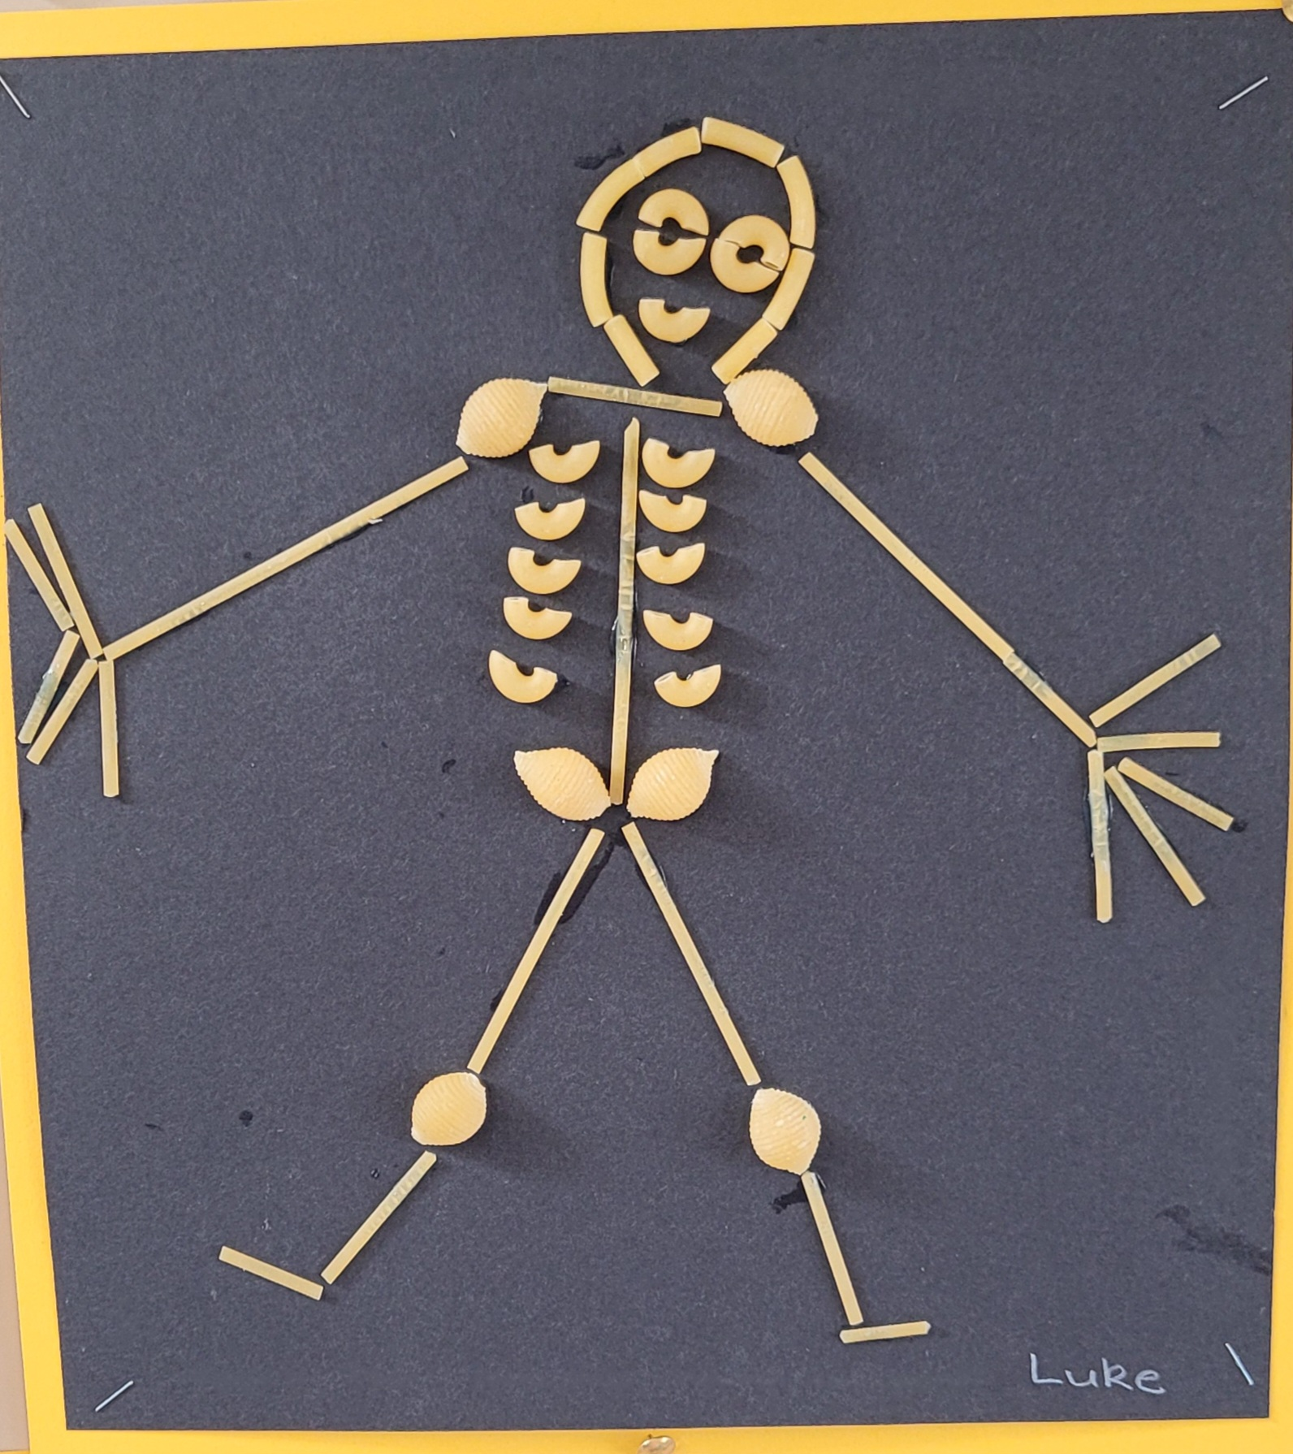

Babies have 300 bones, and adults have 206!
The biggest bone in your body is your thigh bone.
Harley, Kayla Iona

Slide 3

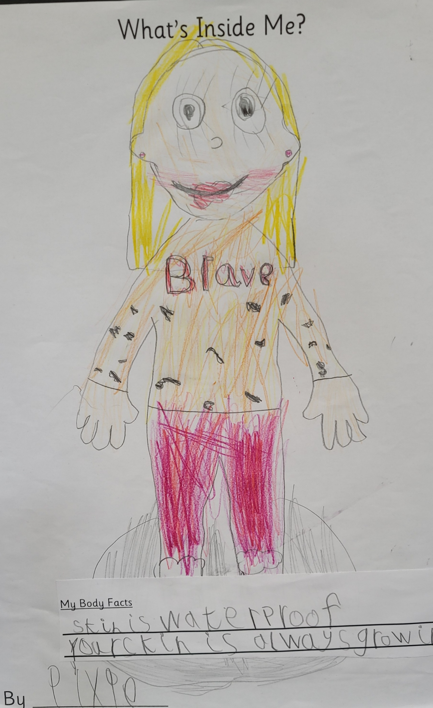
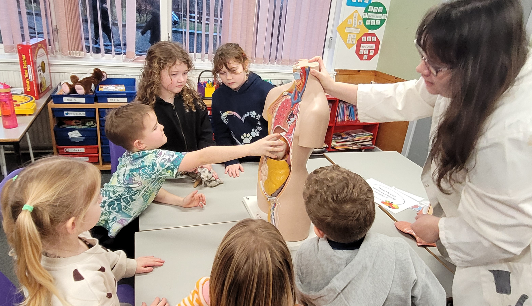
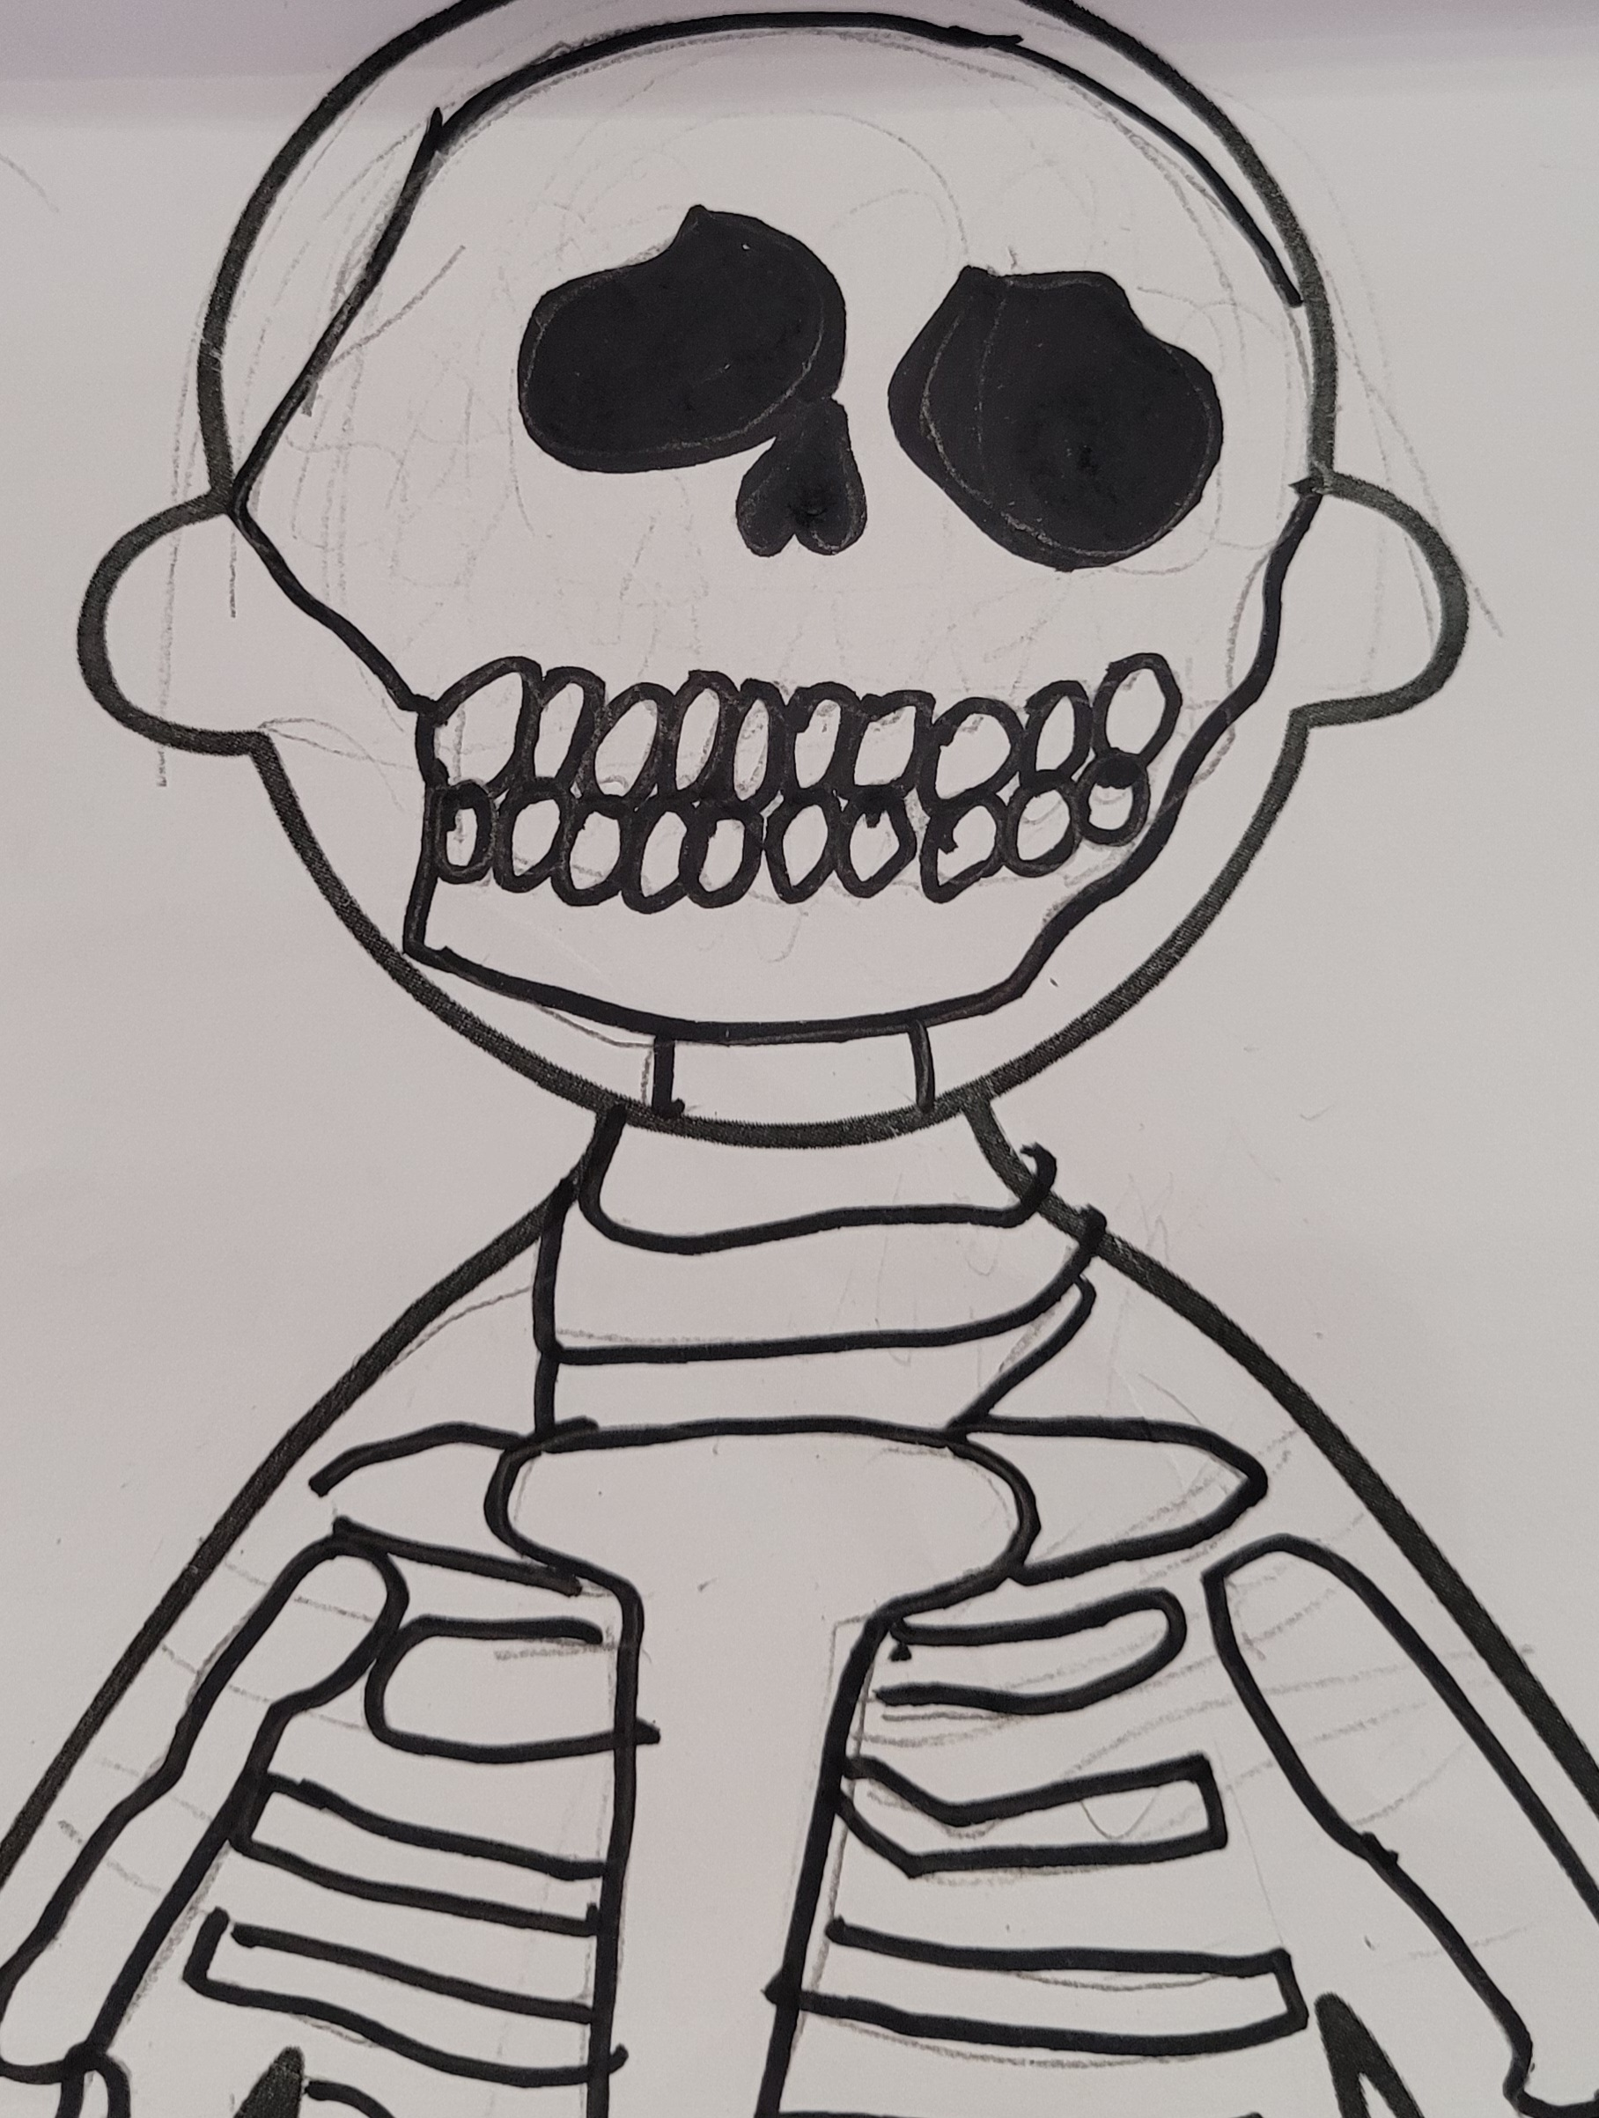
Your skin is the biggest organ in your body! Your skin is waterproof.
Aalia and Pixie
Mirrie Mollie Lauren
Your brain is the big boss of your body, eating foods like fish, eggs and nuts is good for your brain.

Slide 4
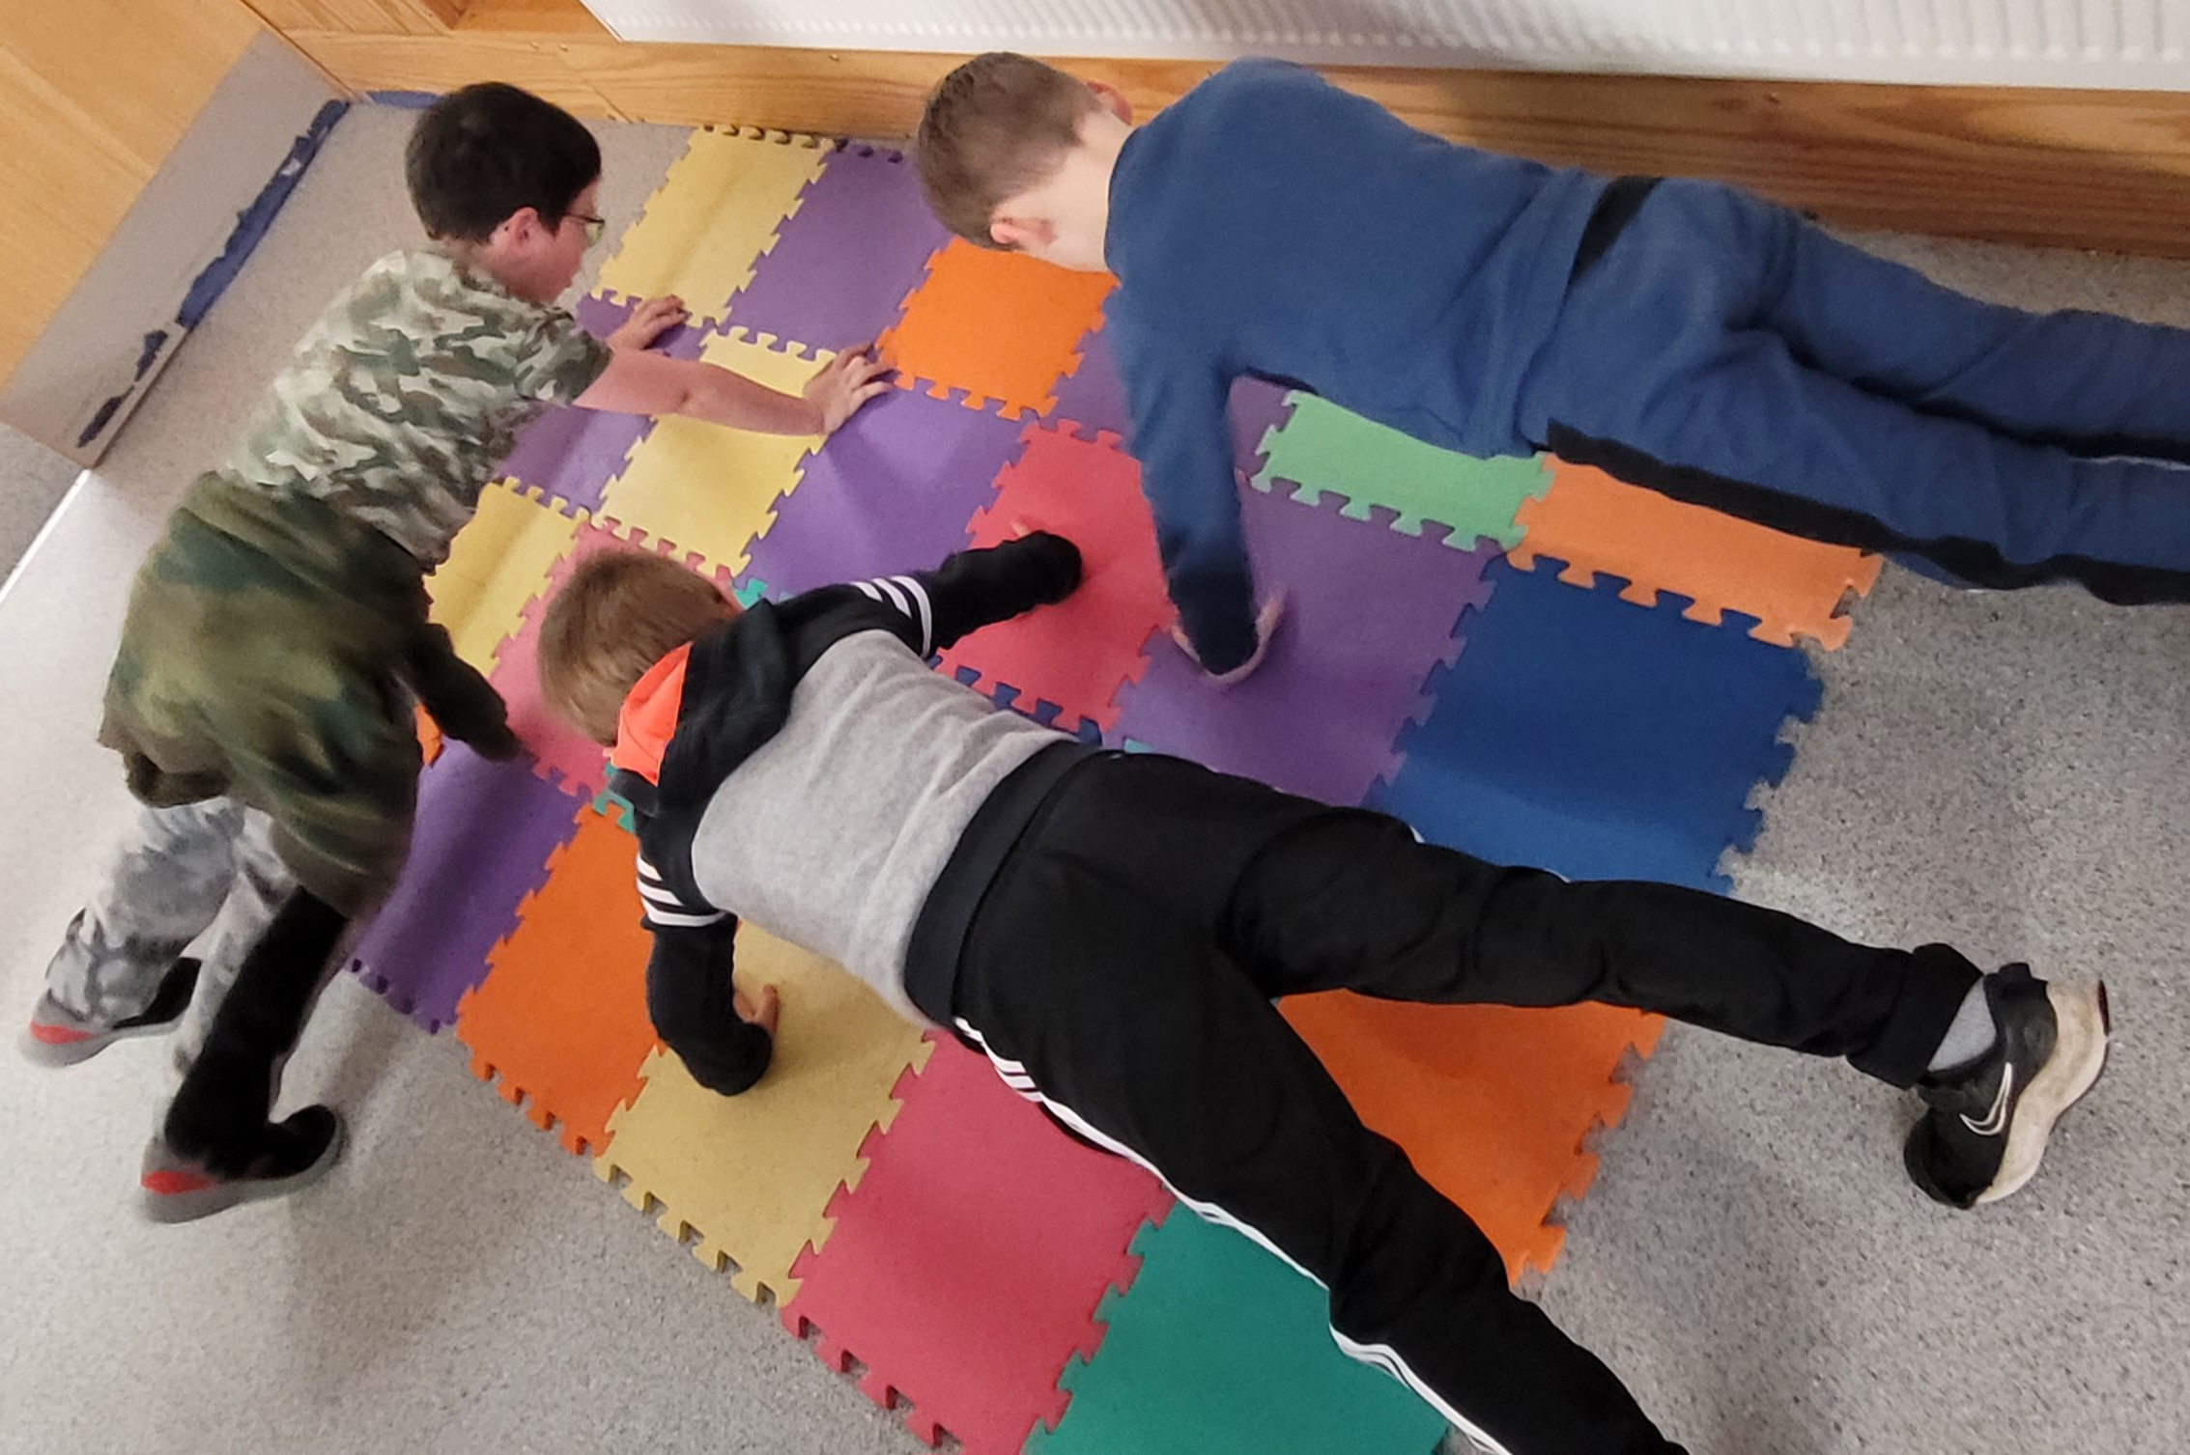
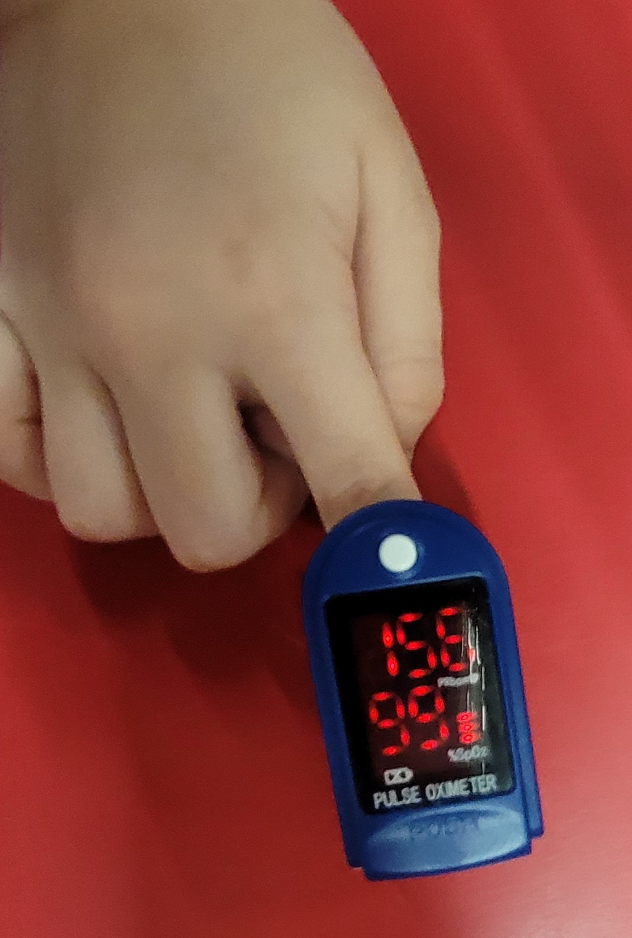
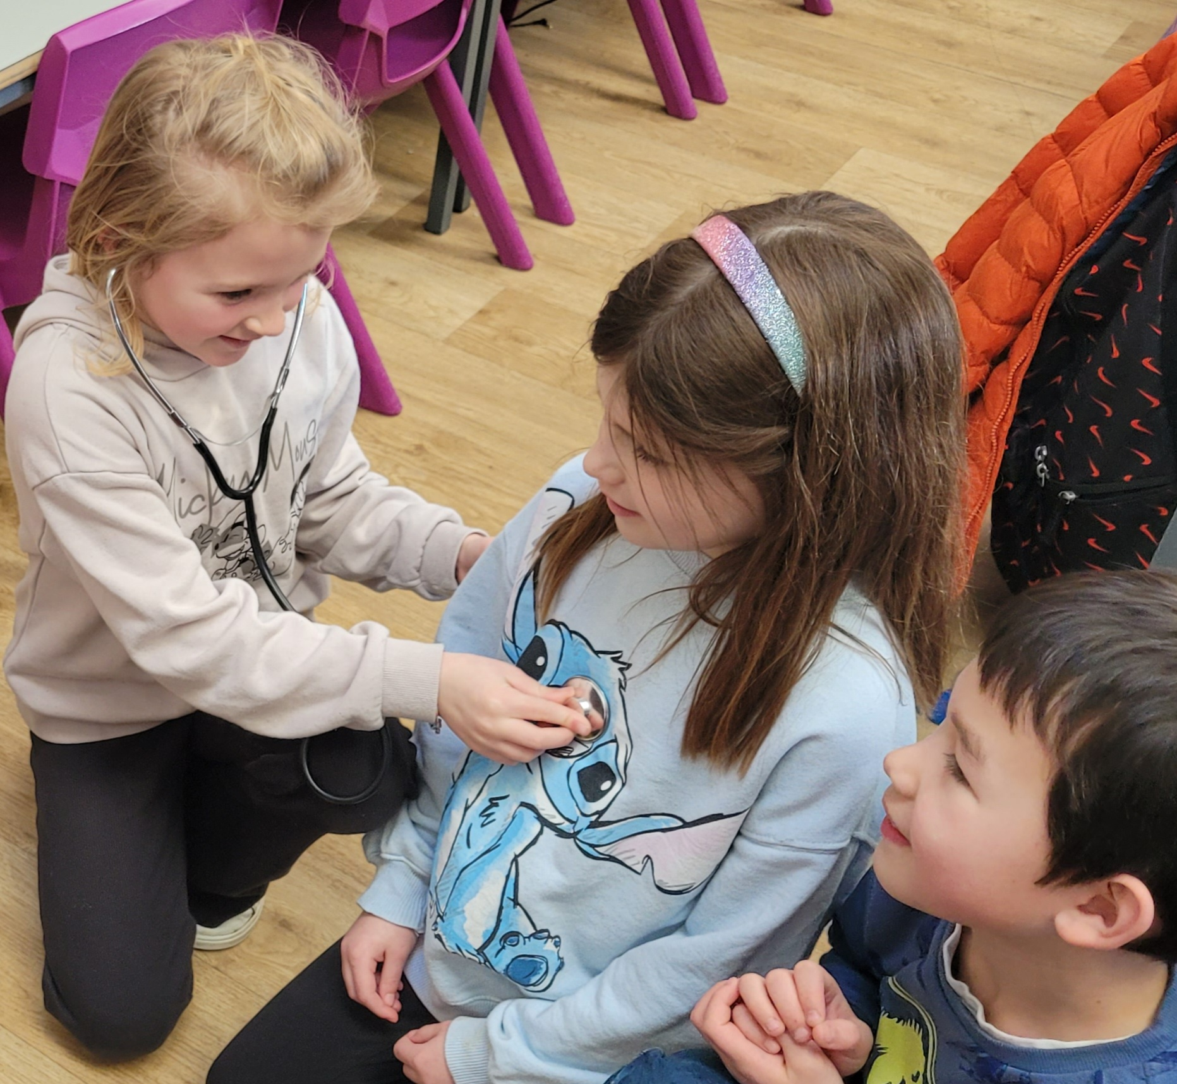
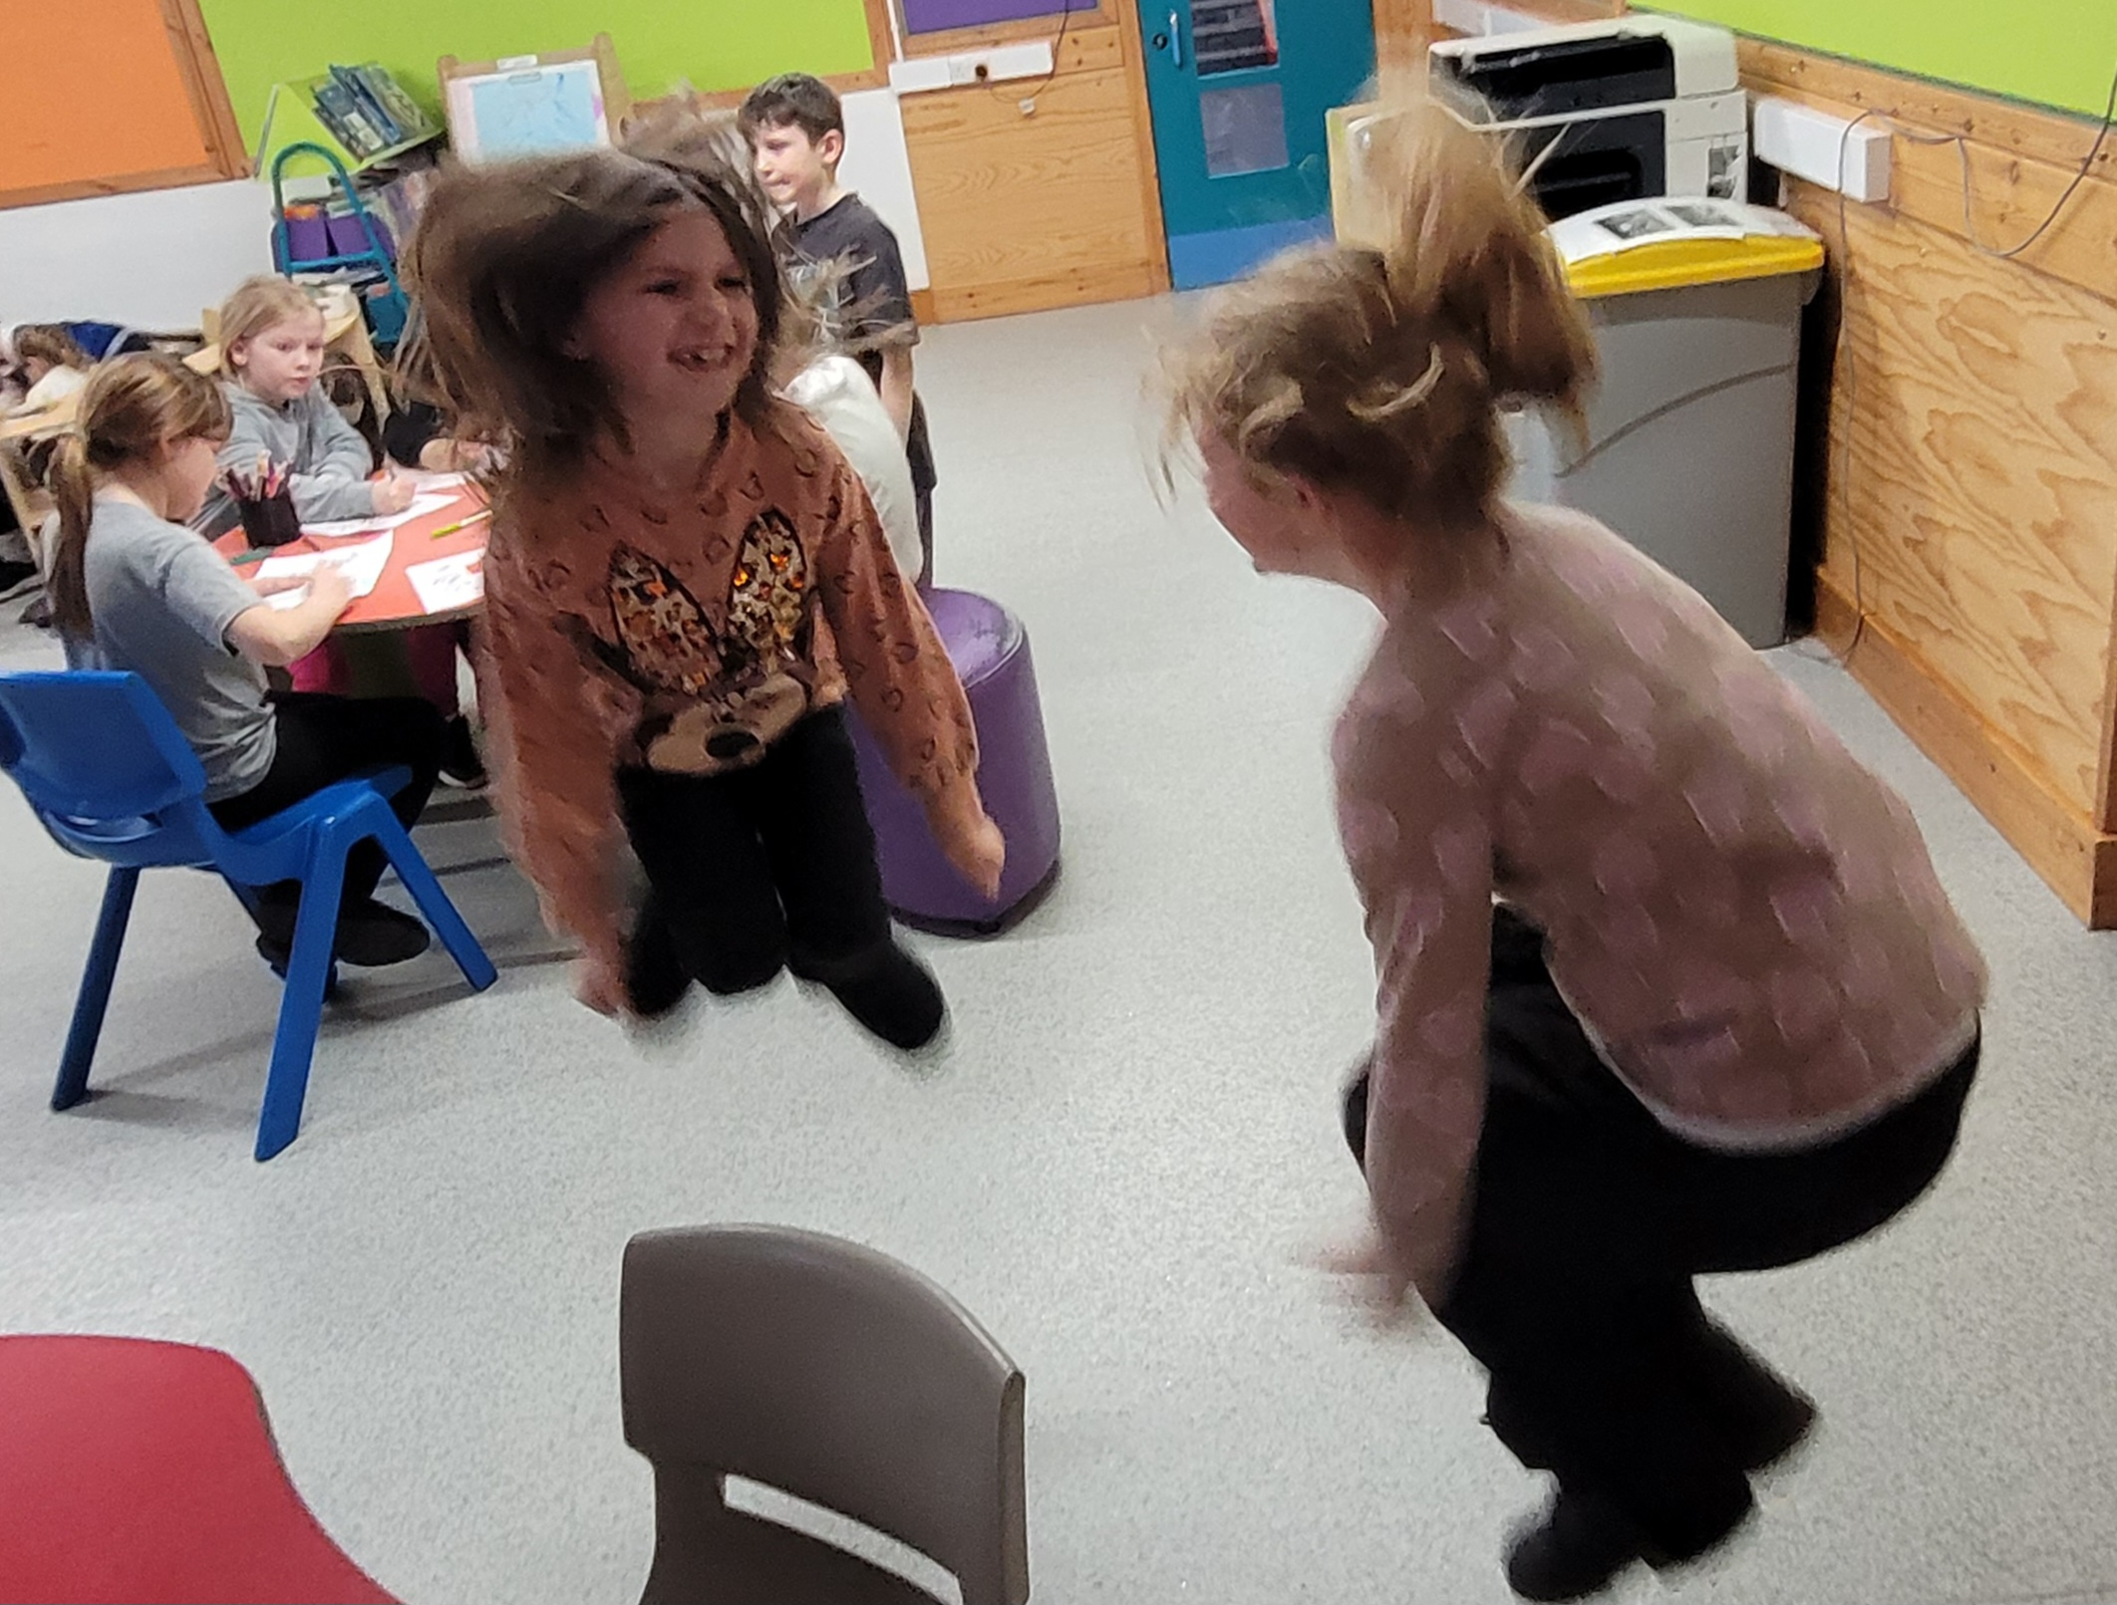
You can keep your heart healthy by moving.
The more you exercise, the faster your heart beats.
Your heart beats 100 000 times a day and pumps your blood around your body.
Luke Luca Shay
JJ Becca Ava

Slide 5
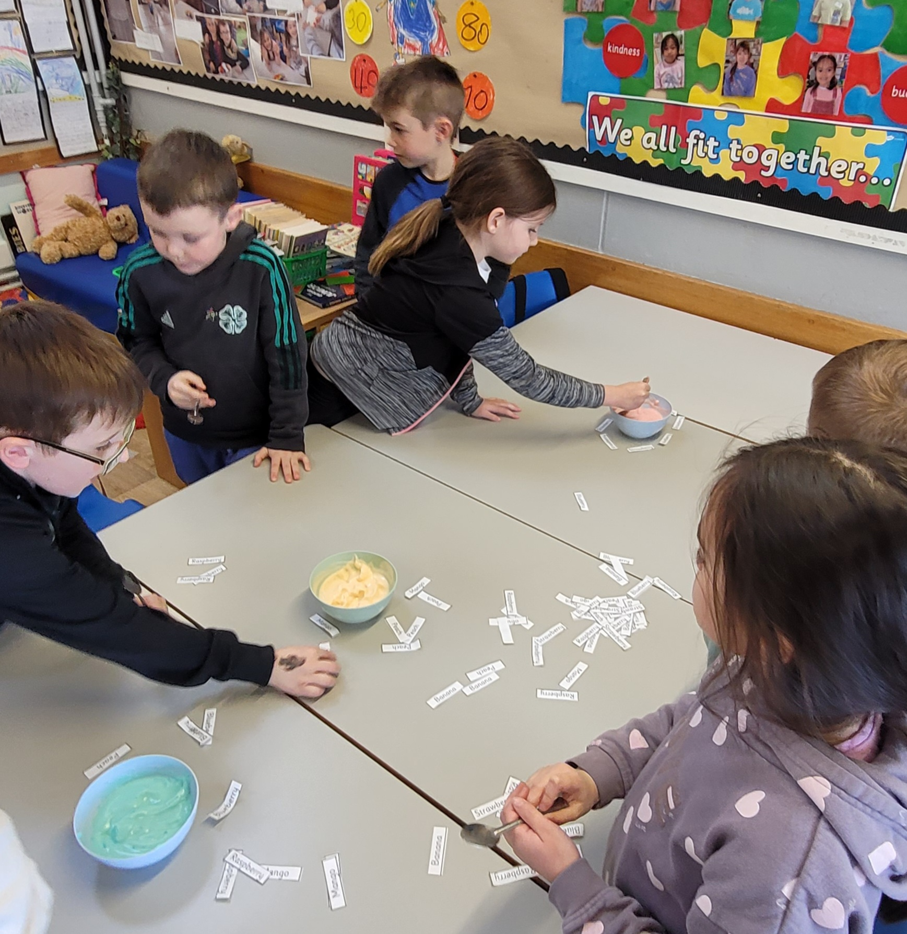
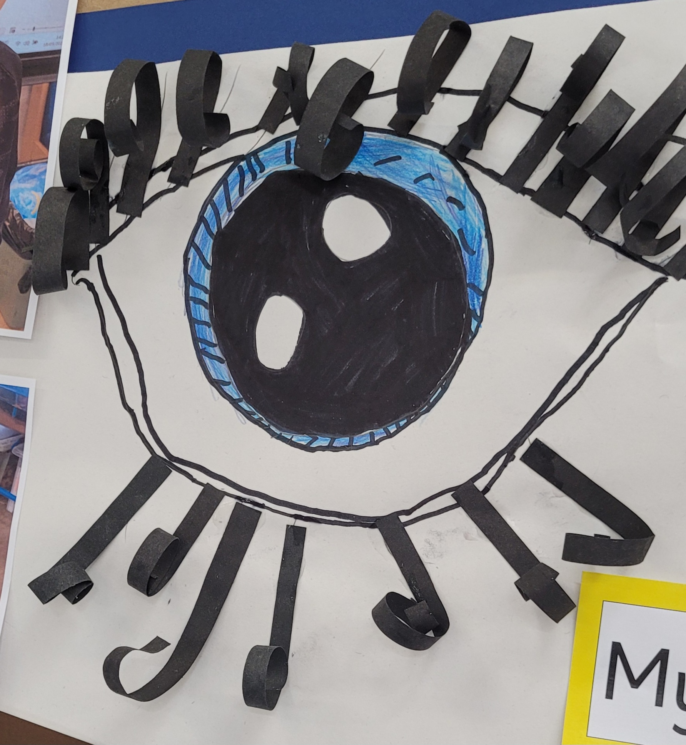
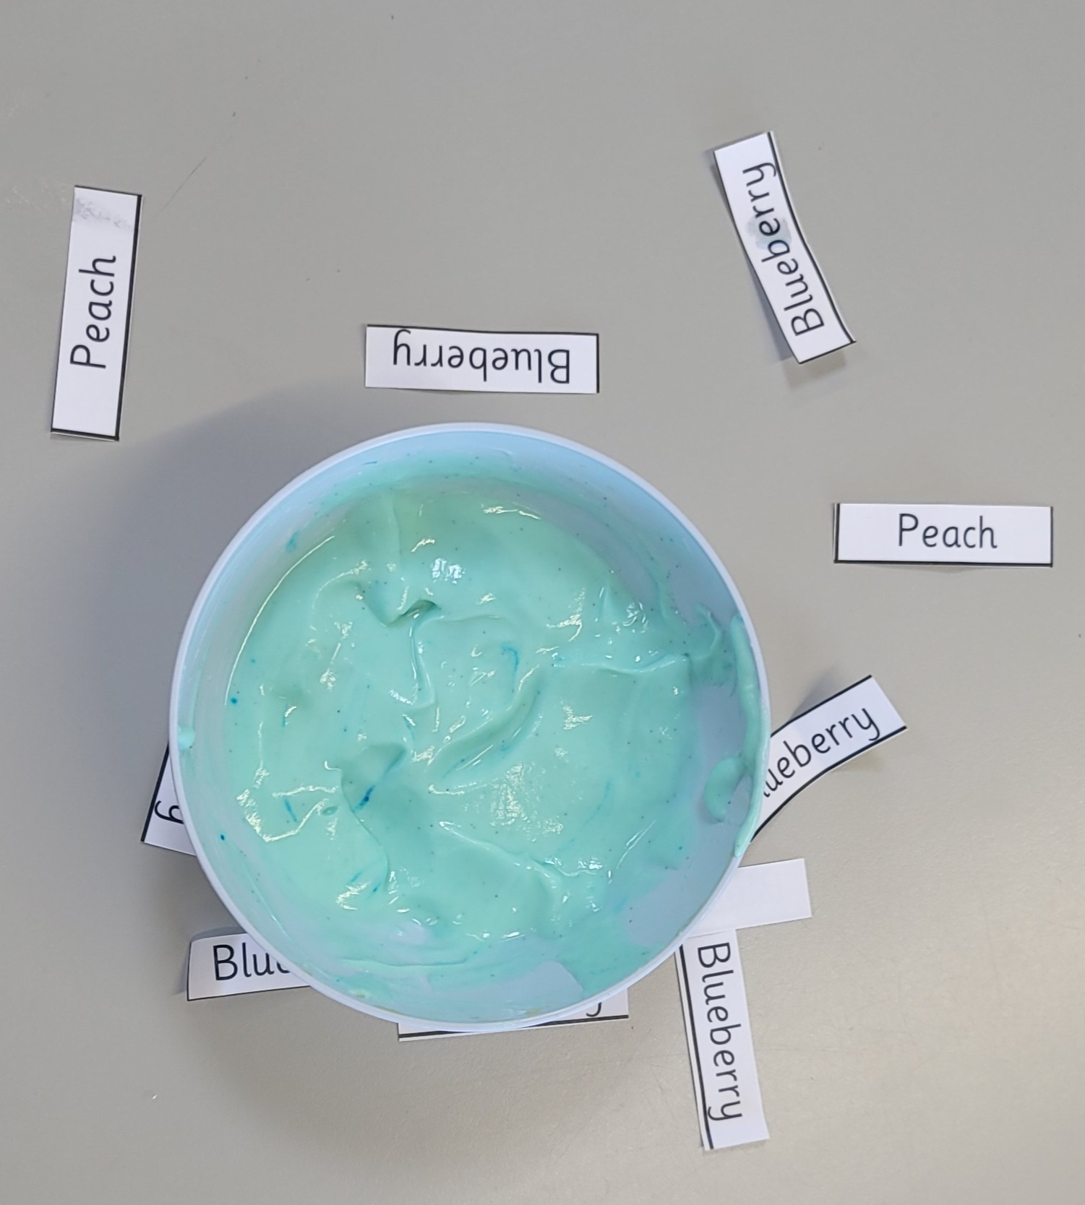
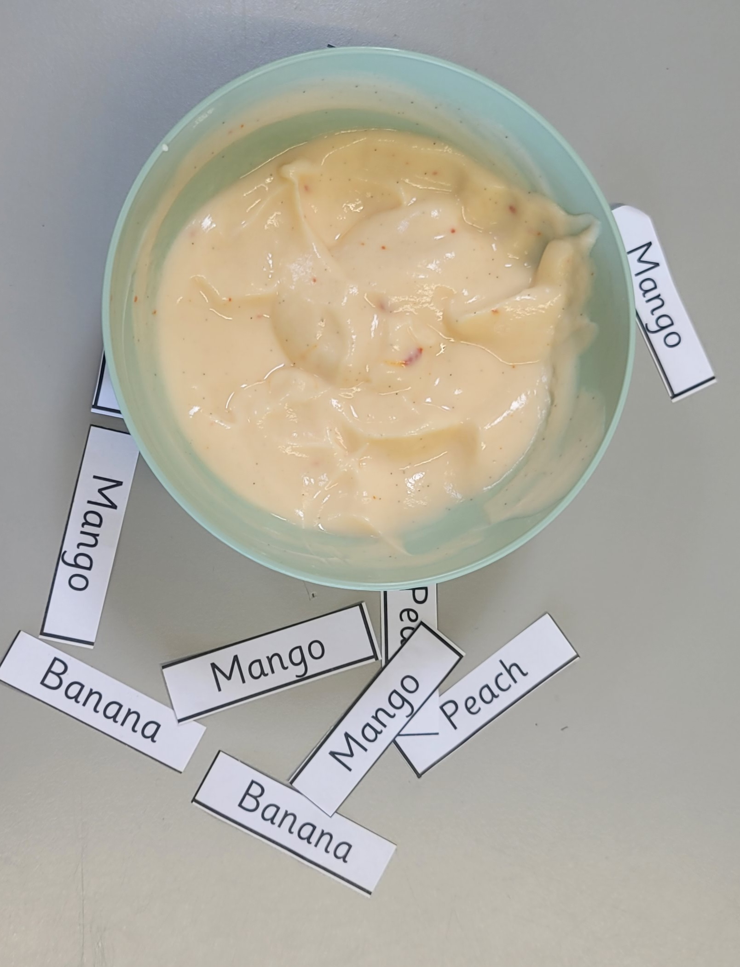
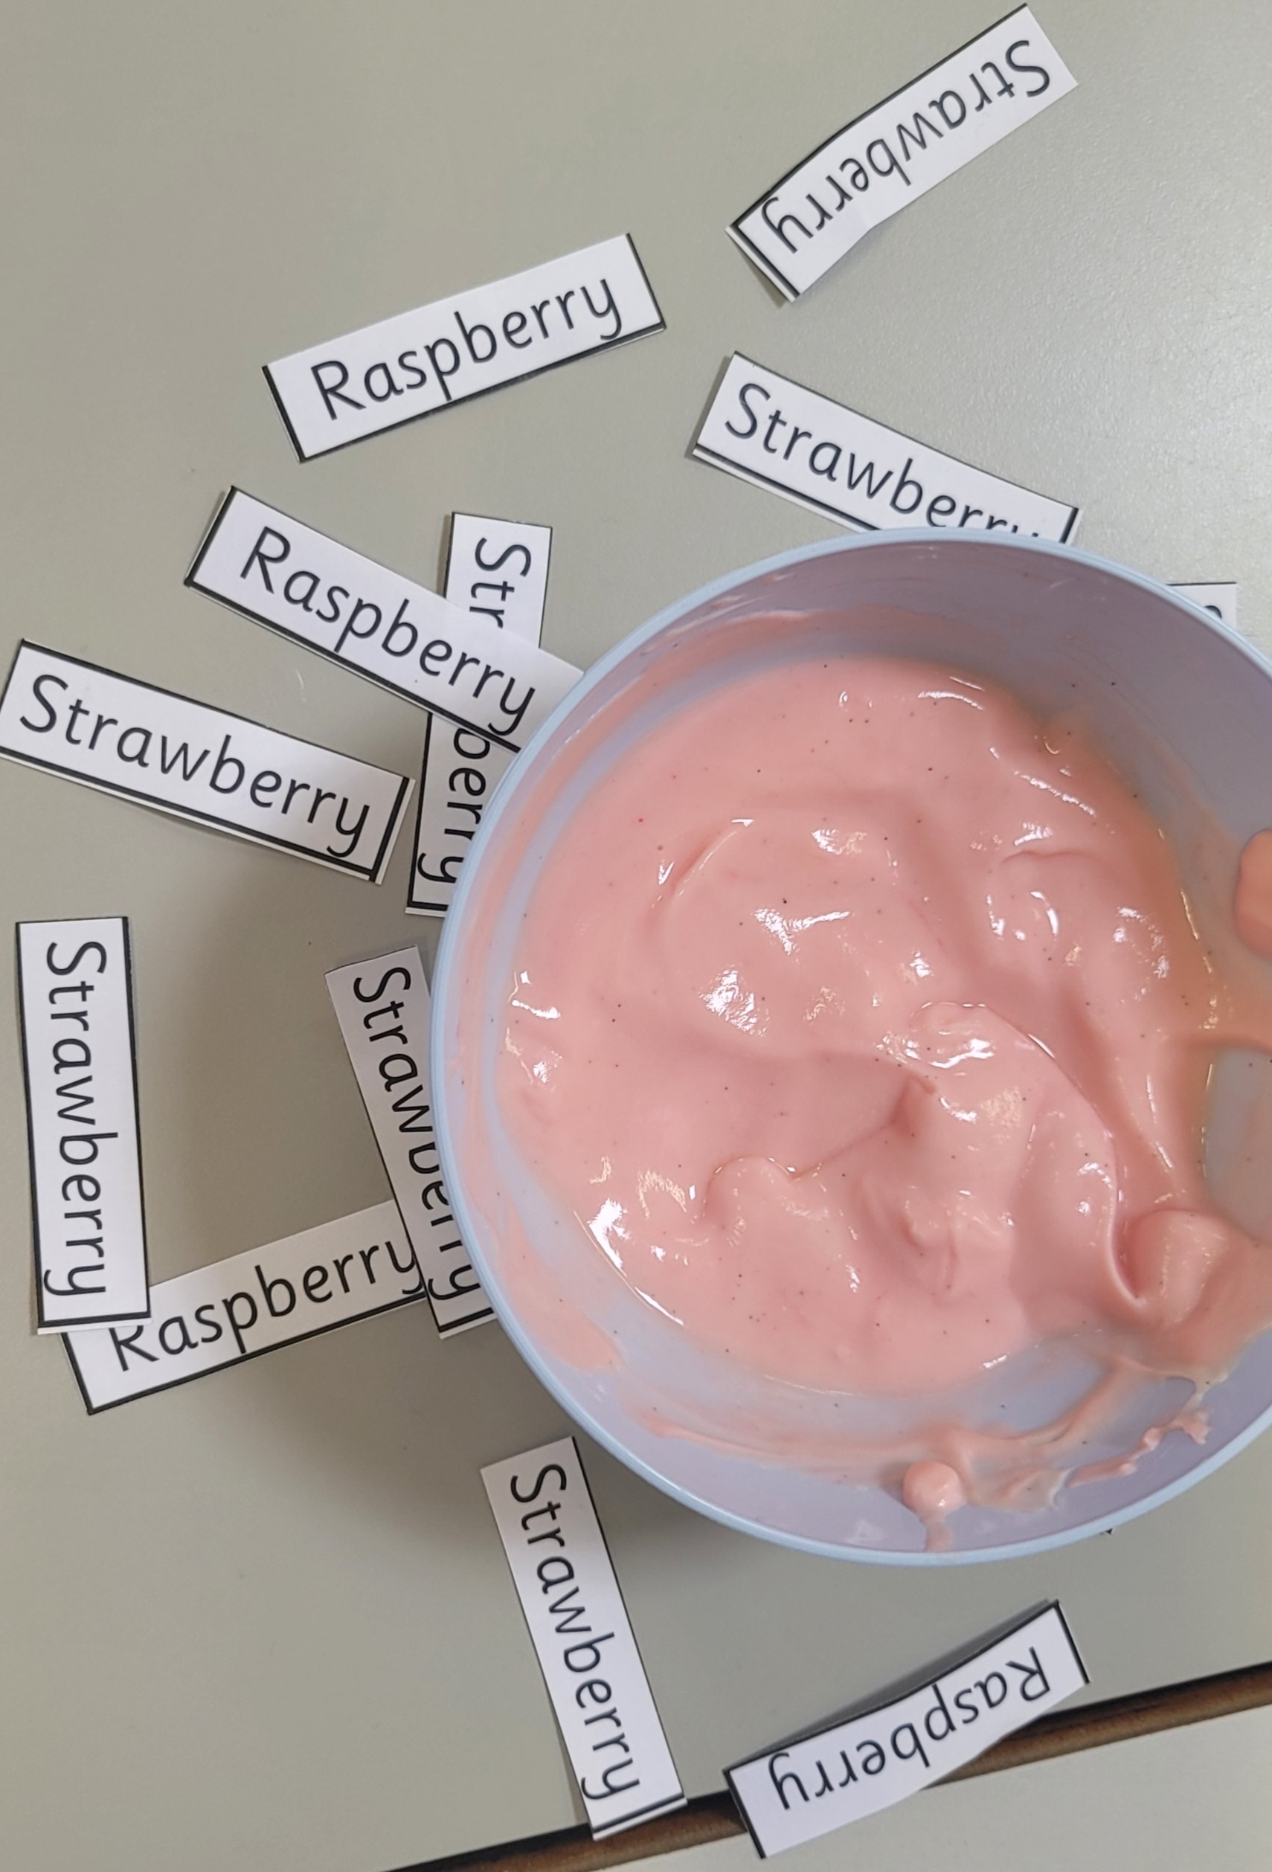
We had to put the correct flavour label next to the yogurt.
Some of us hated the blueberry. ☺
Our eyes tricked us because all of the yogurt was actually vanilla!
Luca and Luke

Slide 6
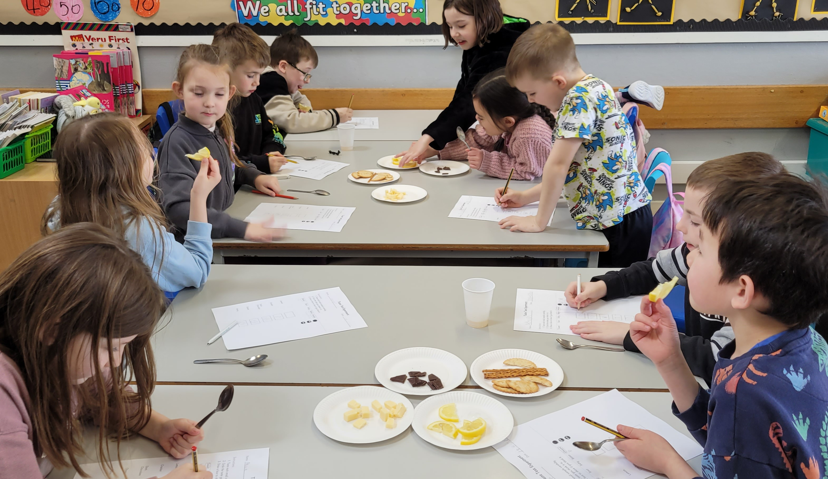
We discovered that eating a little bit of everything is the best way to keep healthy.
We tasted
sour
umami
bitter
sweet
salty
Aalia and Pixie
Tyler, Shay, Isaac

Slide 7
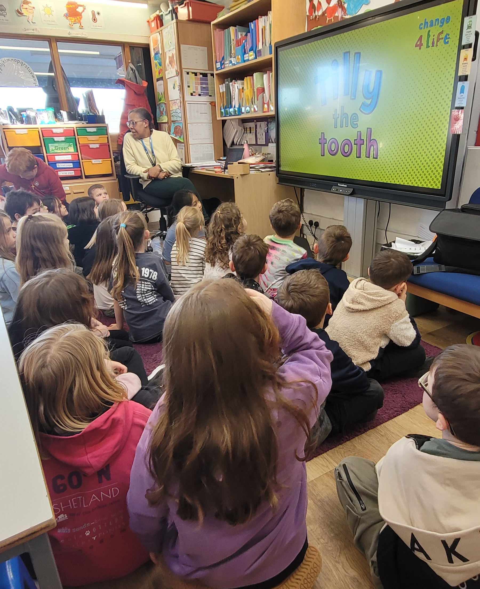
You should only eat sweet things after a meal.
Brush your teeth in the morning and at bedtime.
Kore and Lowrie
Shay, Olivia, Libby

Slide 8
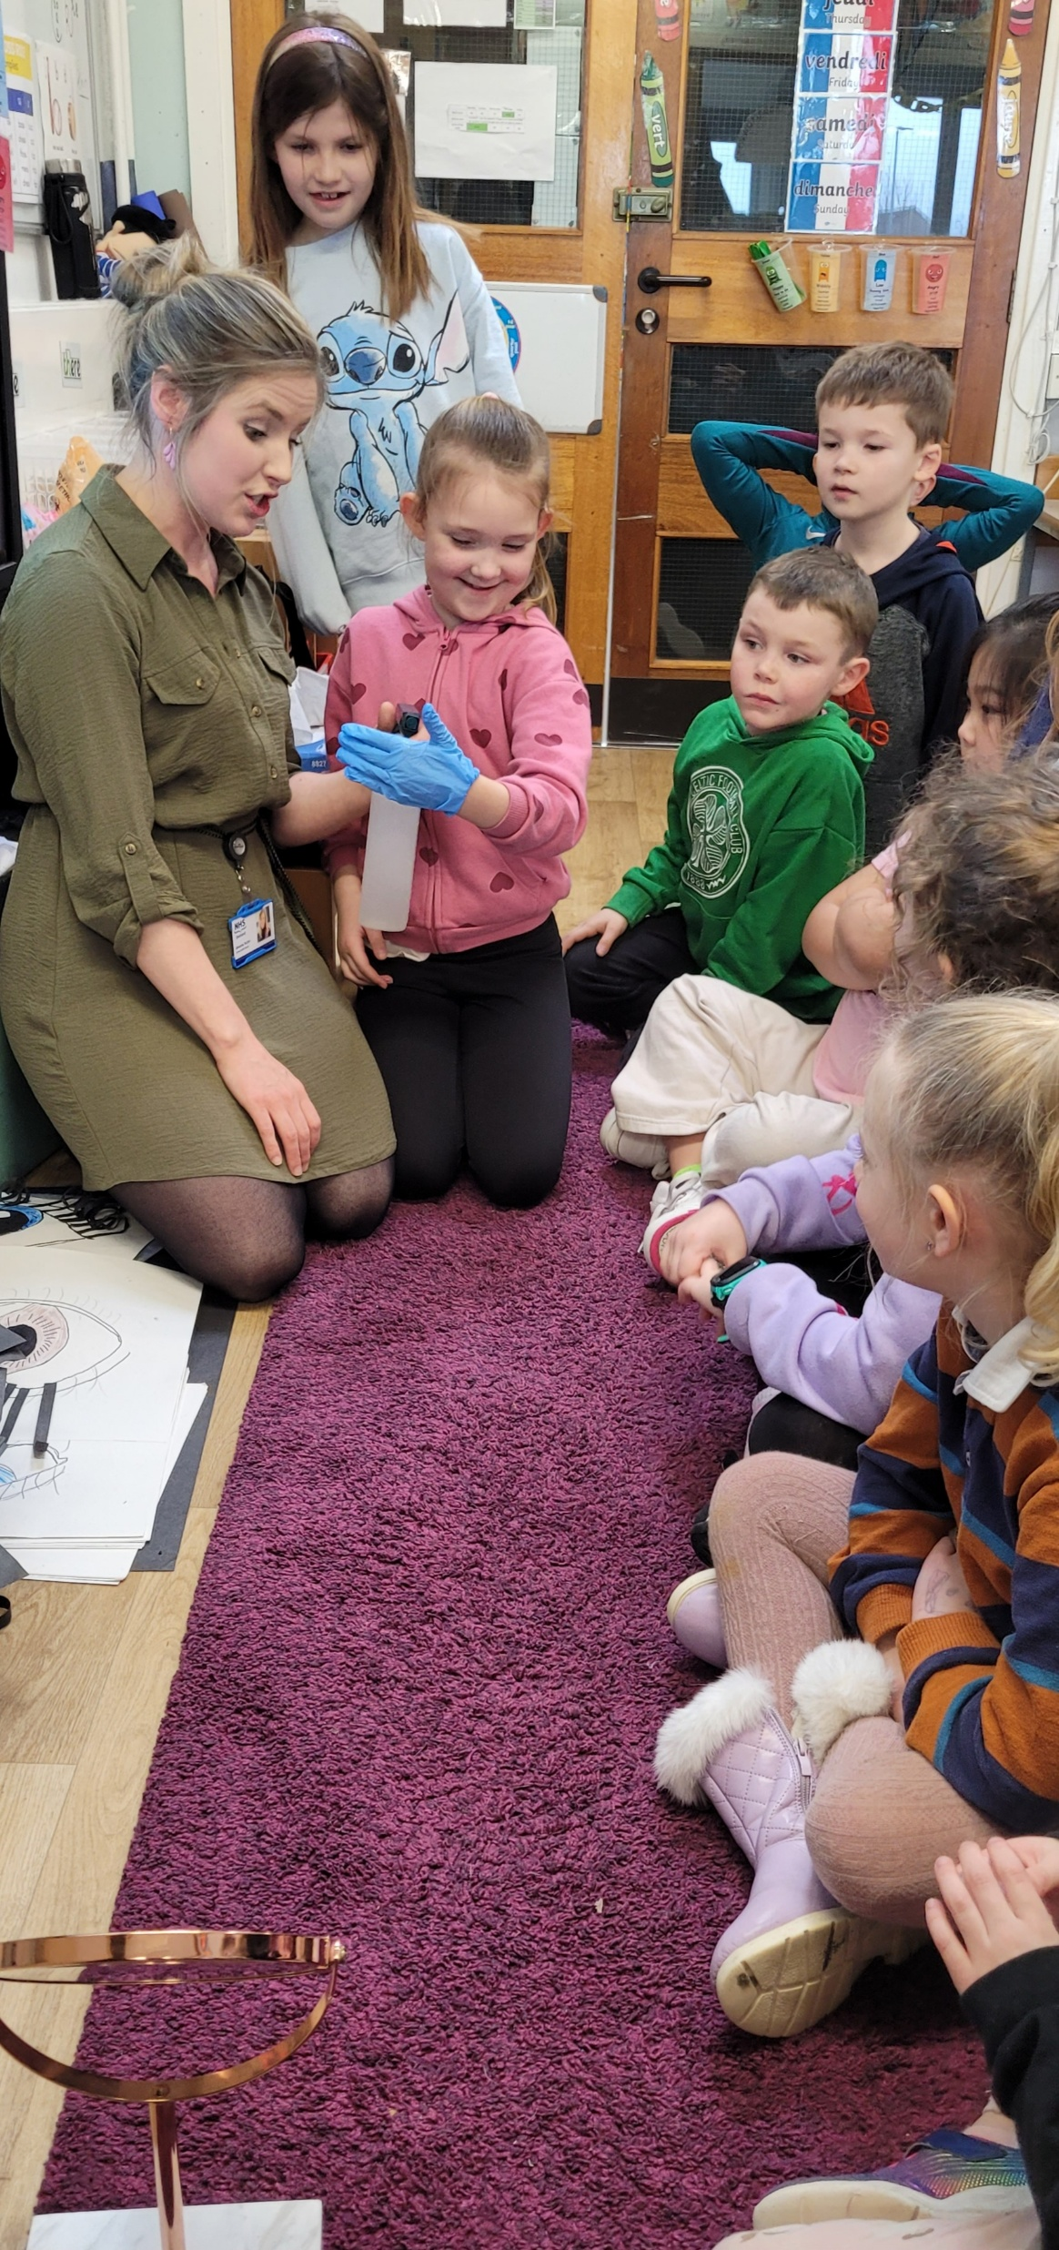
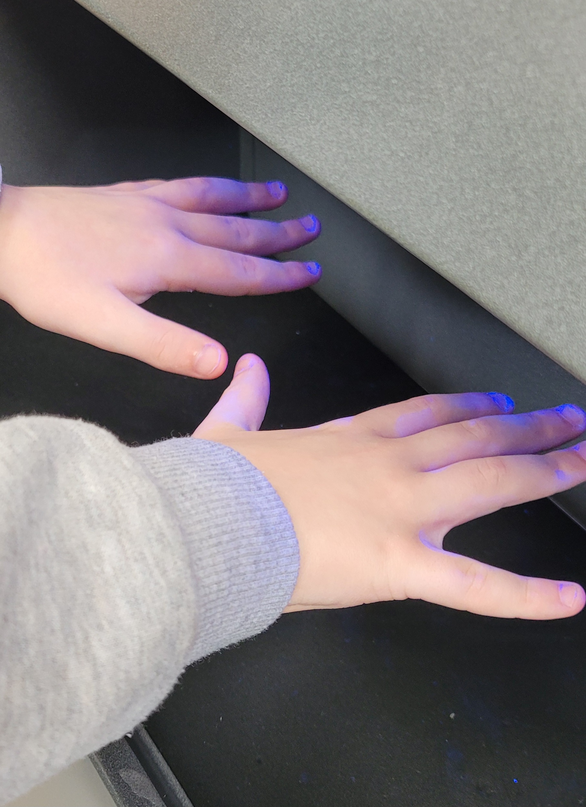
You should wash your hands for 20 seconds or sing happy birthday two times.
Mirrie Mollie Lauren

Slide 9
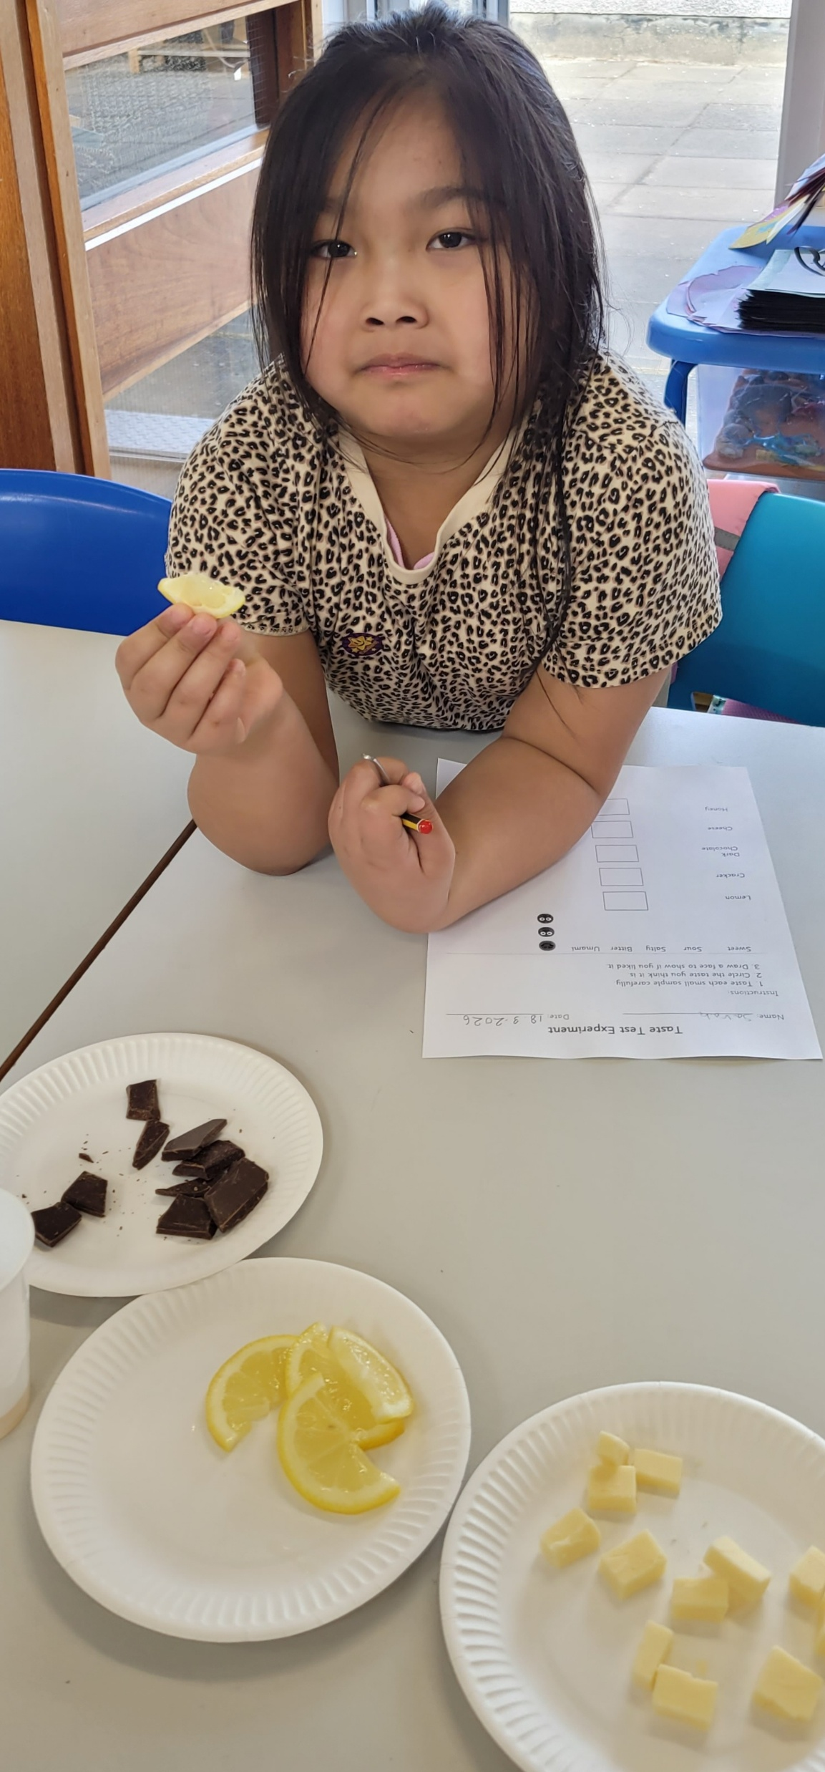
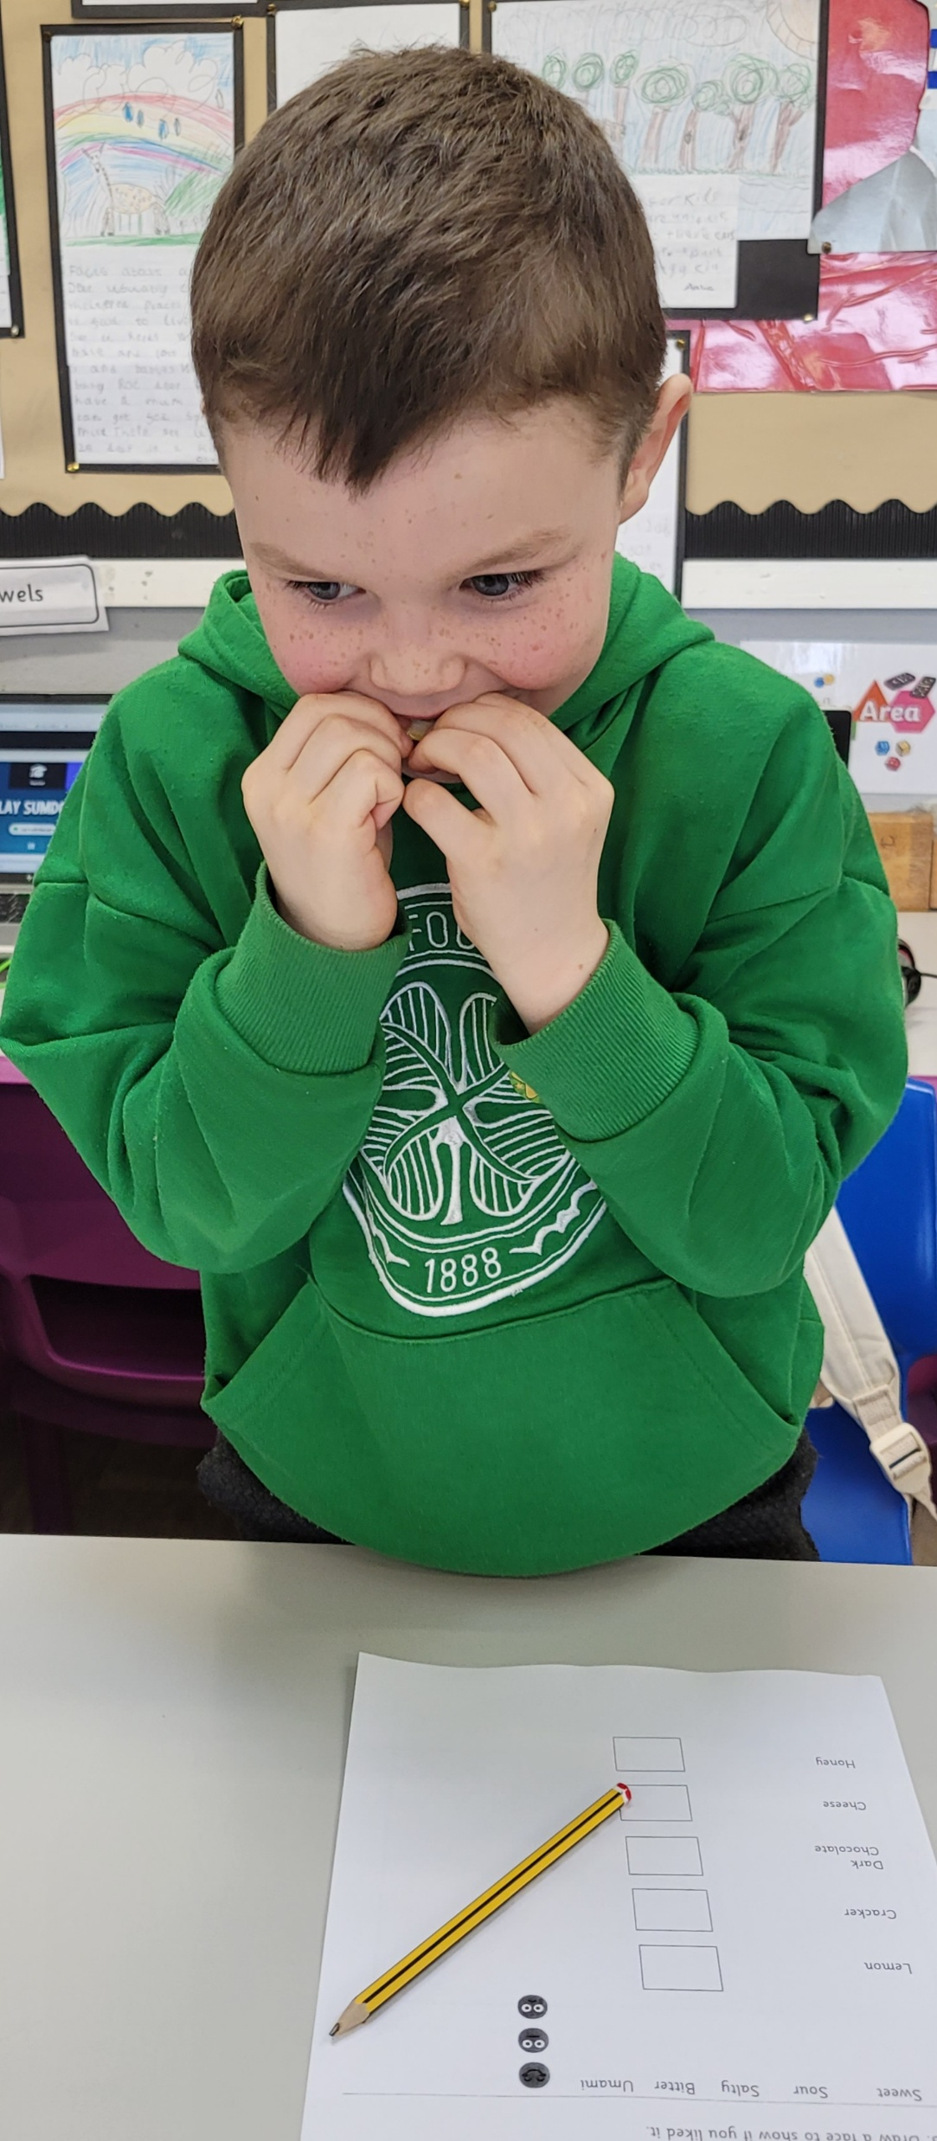
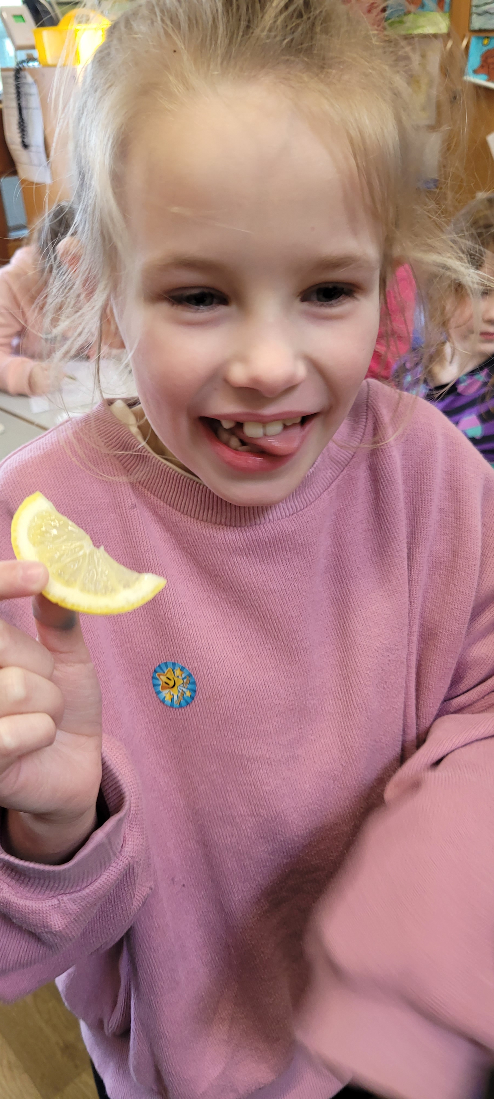
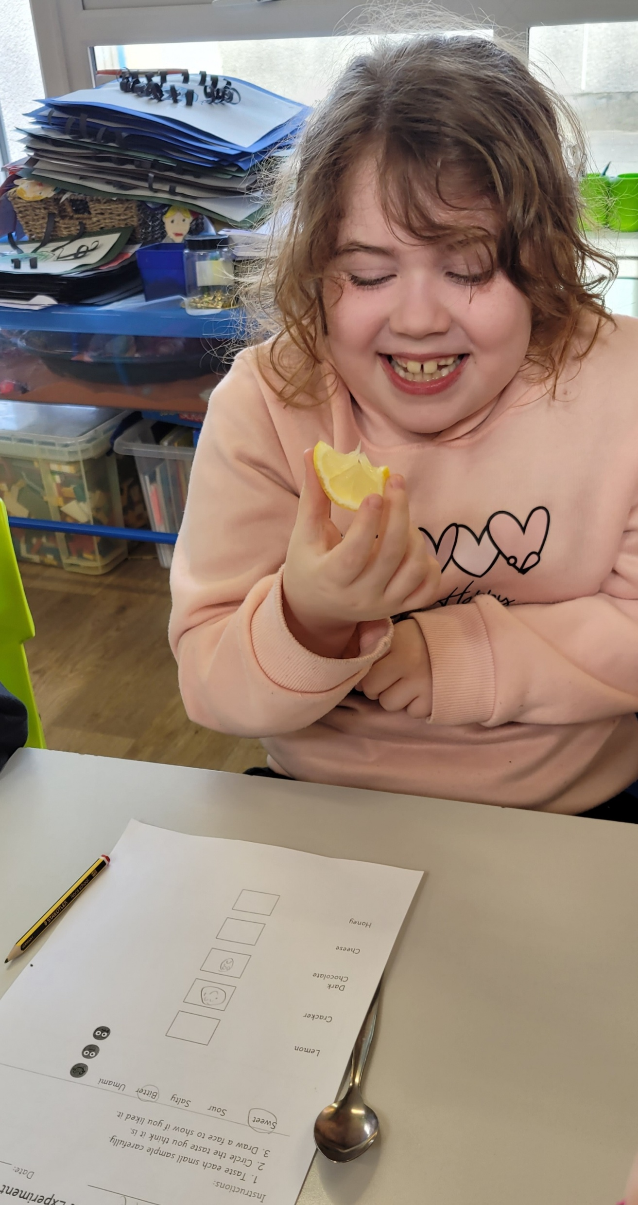
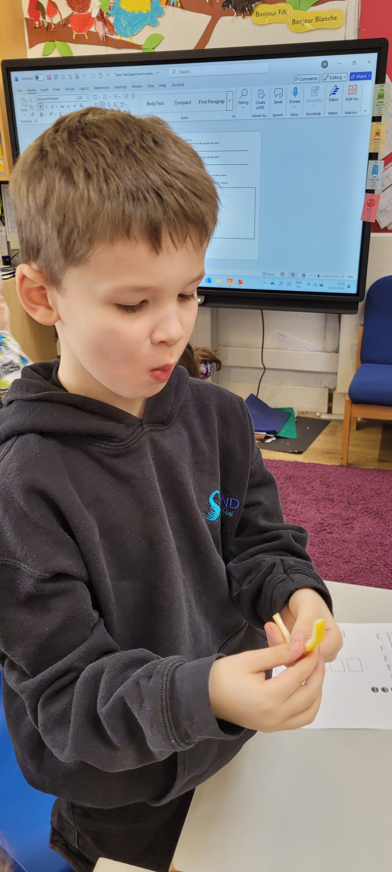
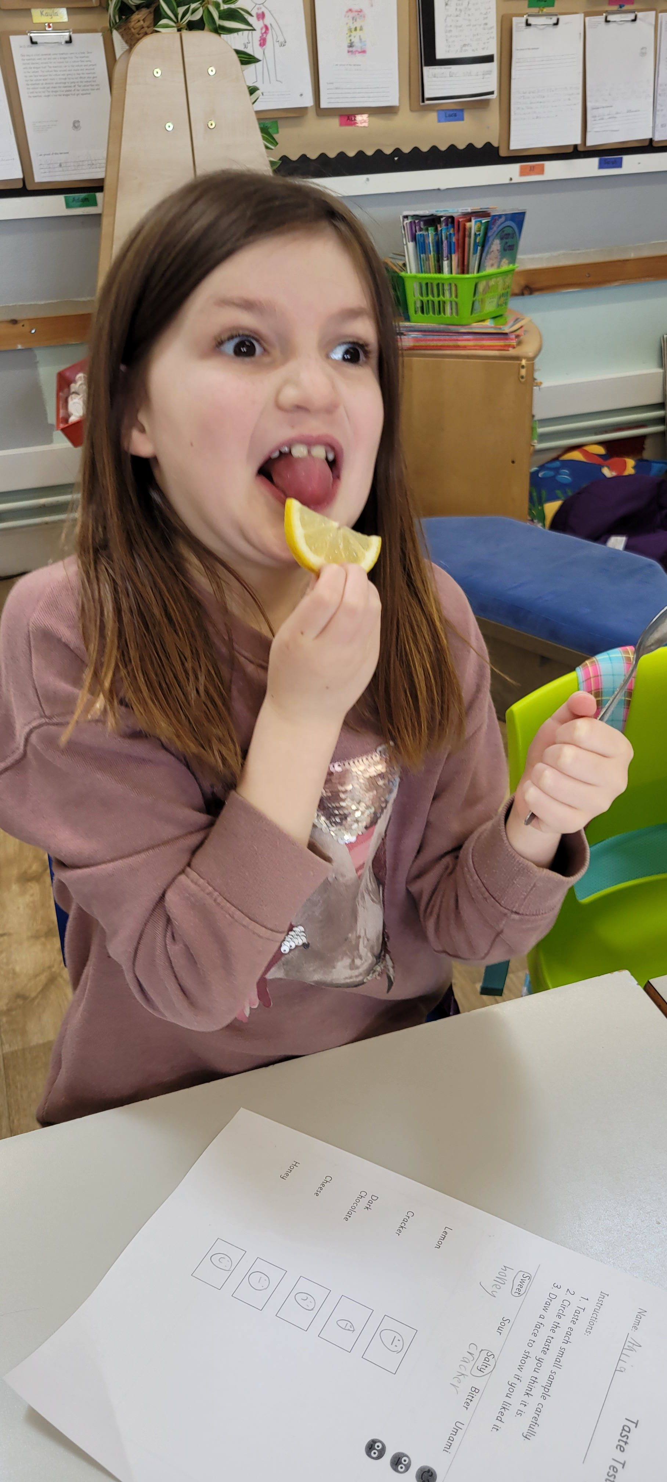
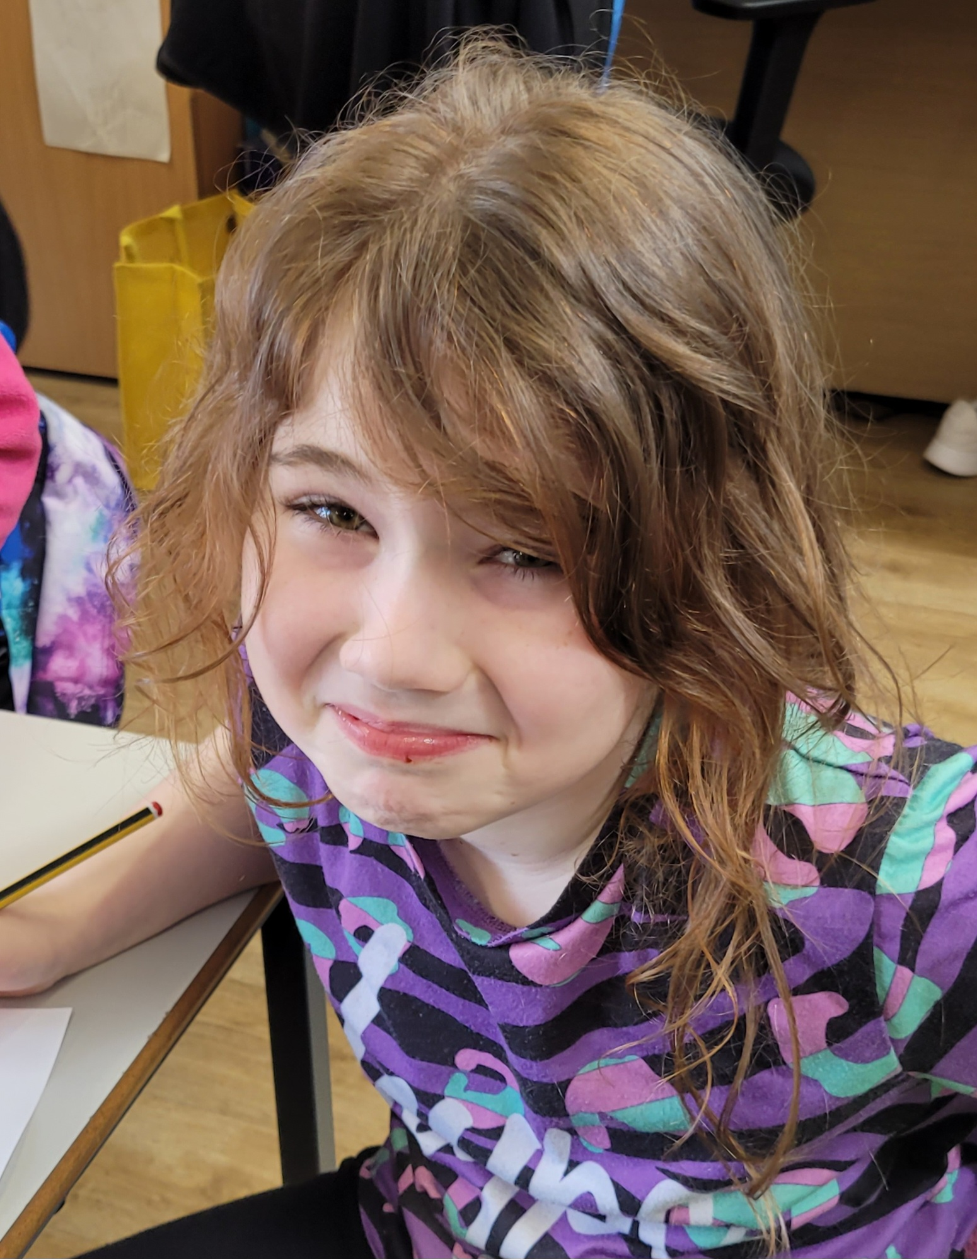
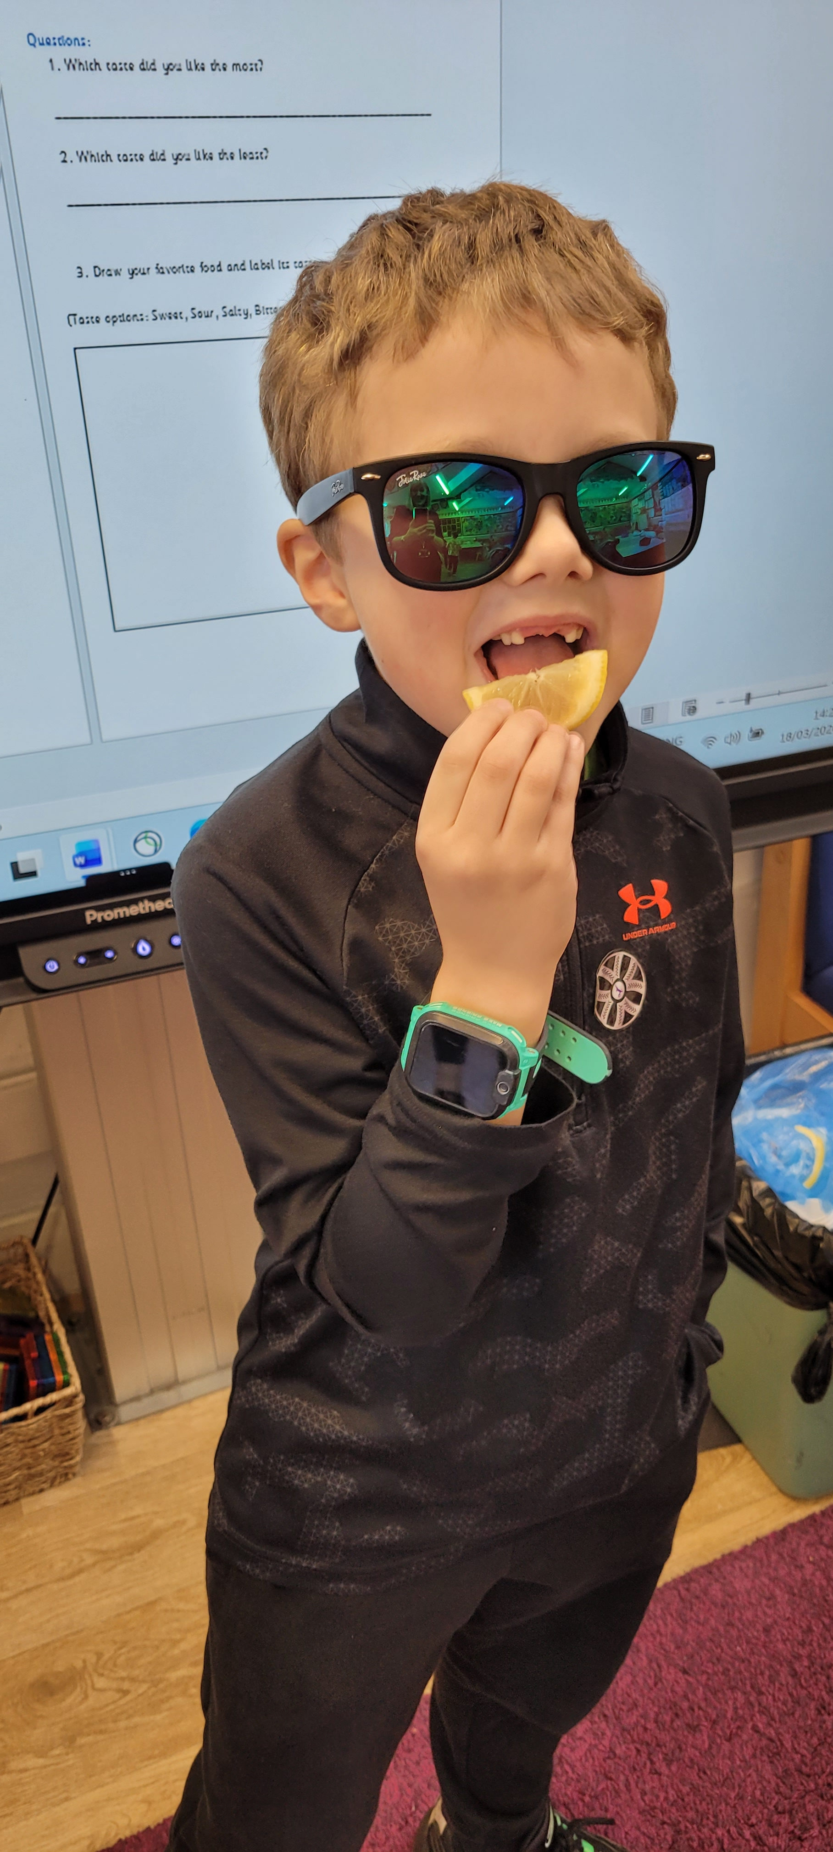
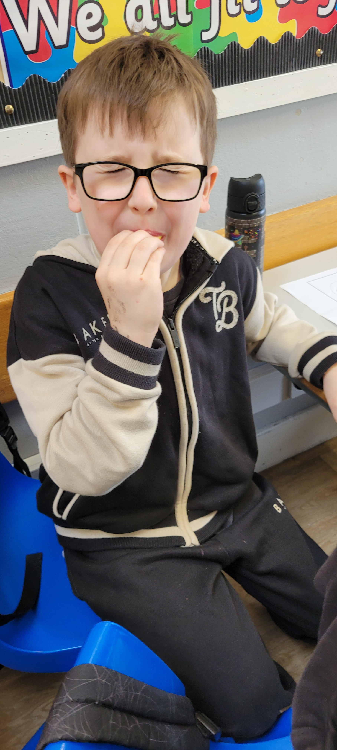
We did a fun taste test!
Don’t try this at home ☺!
Yuck!
Ava Libby Kore
Yummy!

Slide 10
Thank you for listening!

