Slide 2
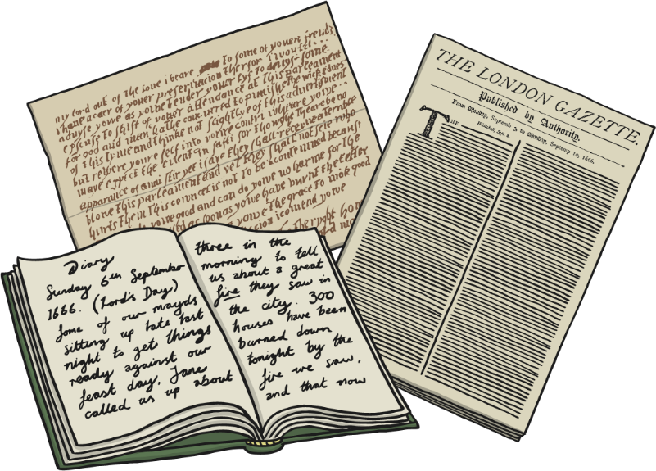
What is Burns Night?
Burns Night is a celebration often held in Scotland around 25th January.
It celebrates the life and work of a famous writer named Robert Burns.

Slide 3
All About Robert Burns
Robert Burns was born on 25th January 1759.
He was a poet and song writer and is famous around the world.
One of his most famous songs is Auld Lang Syne, which is often sung at New Year and Burns Night.

Slide 4
Burns Night
On Burns Night, many people have a traditional dinner called Burns Supper.
This usually includes eating haggis, which is a traditional Scottish food. It is often served with neeps (swede) and tatties (potatoes).
Poems written by Burns are often read aloud too.

Slide 5
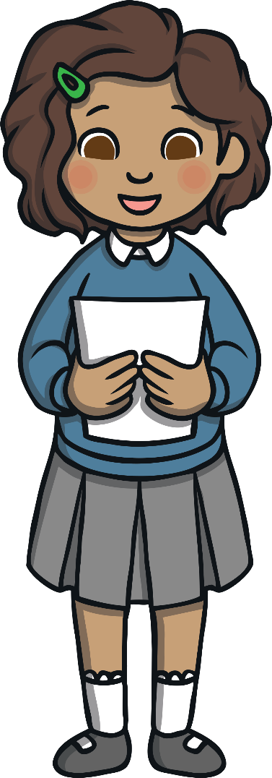
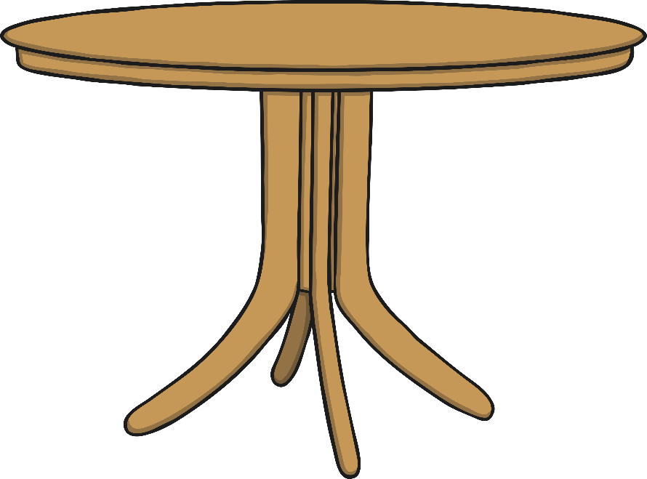
Burns Night
Before people start eating their Burns Supper, the Selkirk Grace is often said:
Some hae meat and canna eat,
And some wad eat that want it;
But we hae meat, and we can eat,
And sae let the Lord be thankit.

Slide 6
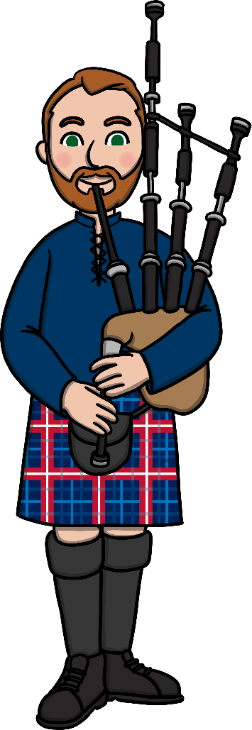
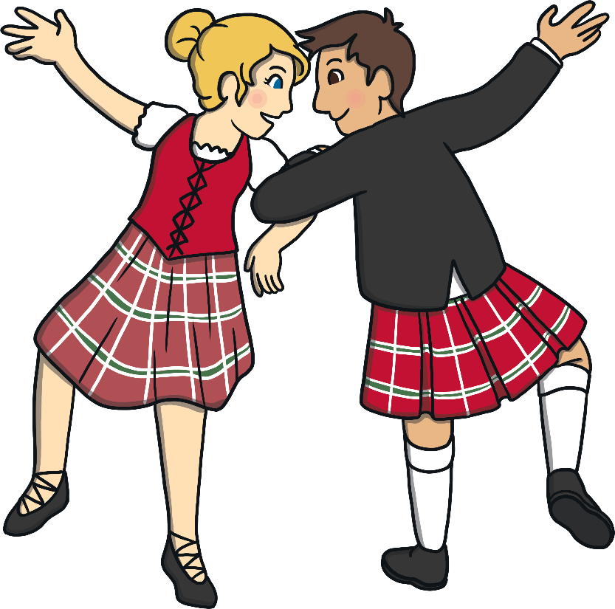
Burns Night
Bagpipes are often played during Burns Night celebrations. Bagpipes are instruments that are played by blowing into reeds and squeezing a bag of air. Have you heard bagpipes before?
There is also lots of traditional Scottish dancing. Many people wear clothes made of tartan fabric, including kilts.

Slide 7
A National Figure
Robert Burns is still very famous today. He has been voted ‘The Greatest Scot’ by the Scottish Public in a survey held by national Scottish television channel, STV.
There is also a Robert Burns Museum which is in the place where Robert was born.

