Slide 1
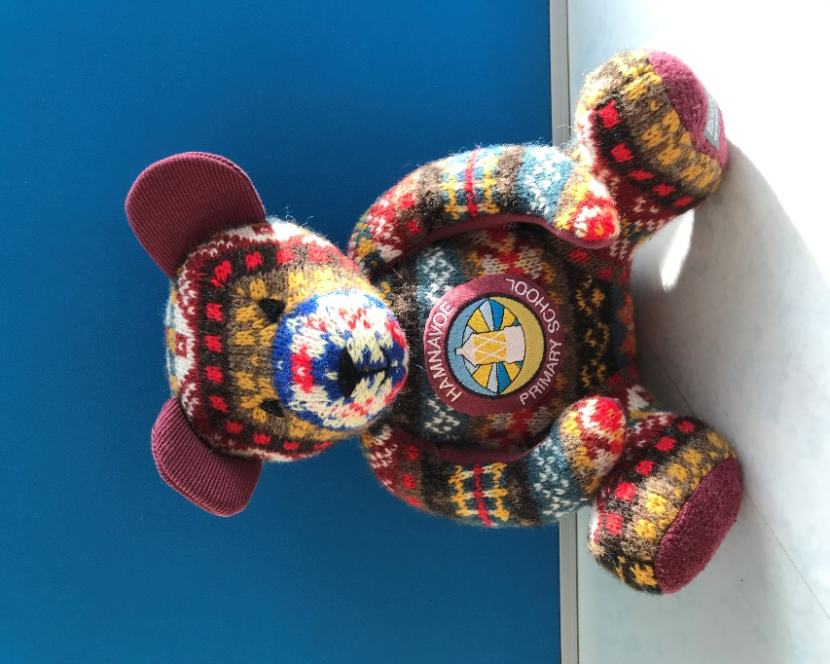
Hamnavoe Primary Safe
H ealthy, happy bairns
A lways active
V ery responsible
E veryone included and respected
N ever giving up, just doing our best!

Slide 2
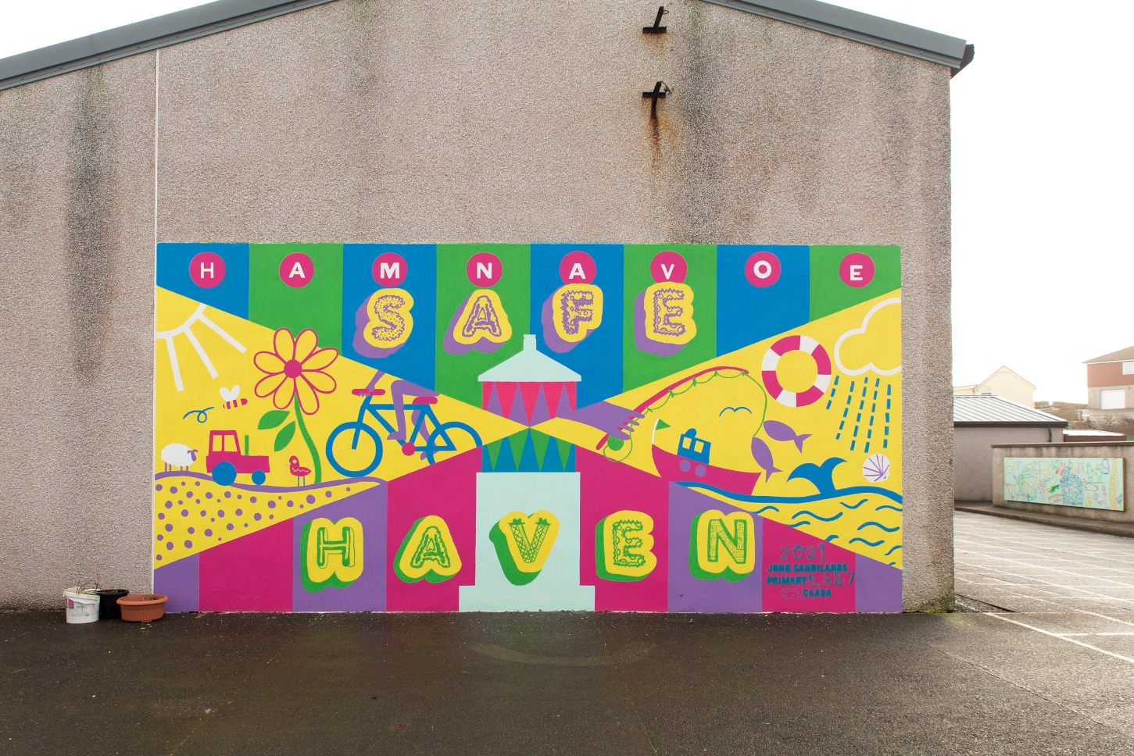
Playtimes

Slide 3
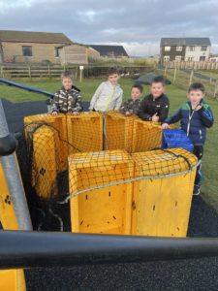
What we have found out about our playground
Pupils don’t feel safe
Pupils don’t resected
Pupils don’t feel included
Pupils feel they are active
Pupils feel they are responsible

Slide 4
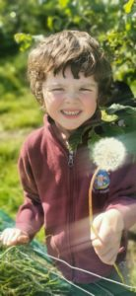
What are we going to do about it?
Split areas
More toys
More staff
No football on the grass in winter
Improvements to grounds

Slide 5
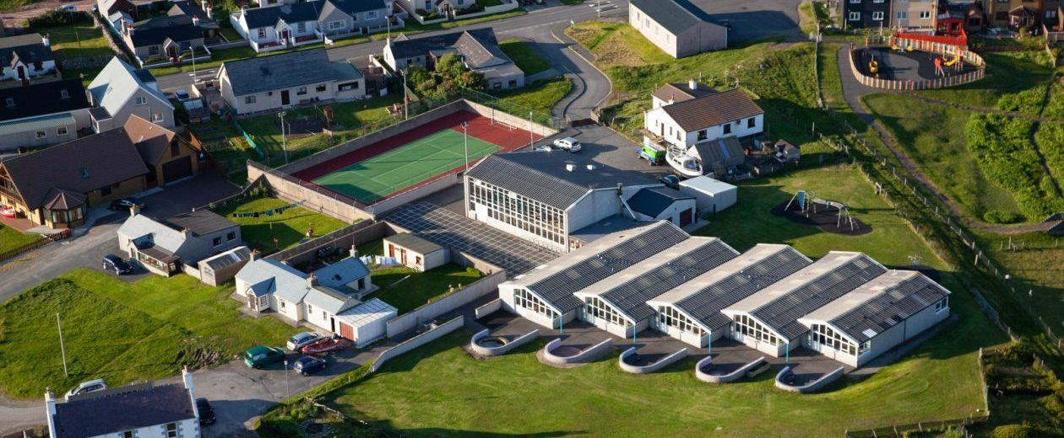

Slide 6
What can you do to help?
Volunteer to be a buddy
Keep to your area
Put the toys away
Look after the toys
Listen to the adults
Try to play new games
Seek help from the supervisors or a buddy if you don’t feel safe or are worried

Slide 7
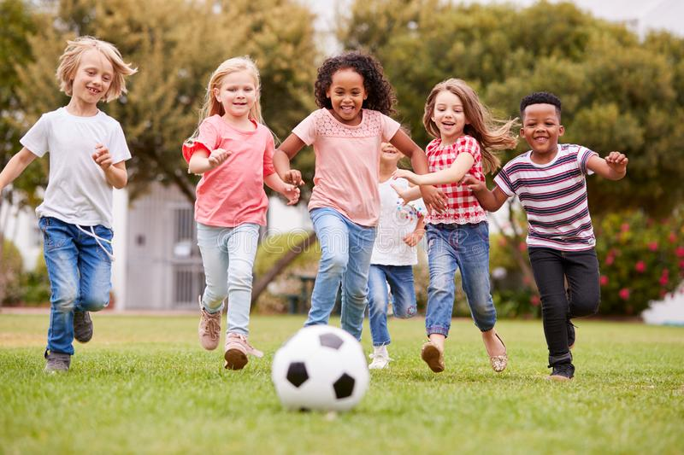
Article 31

Slide 8
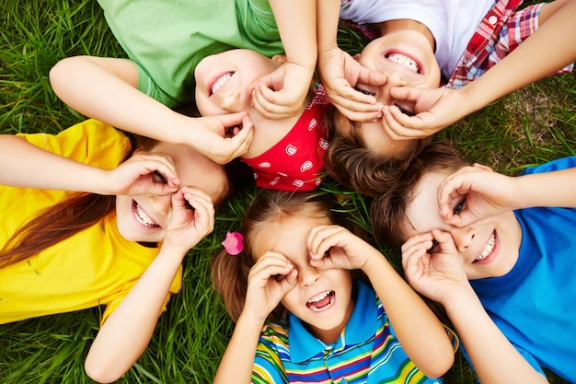
Article 19

