Slide 1
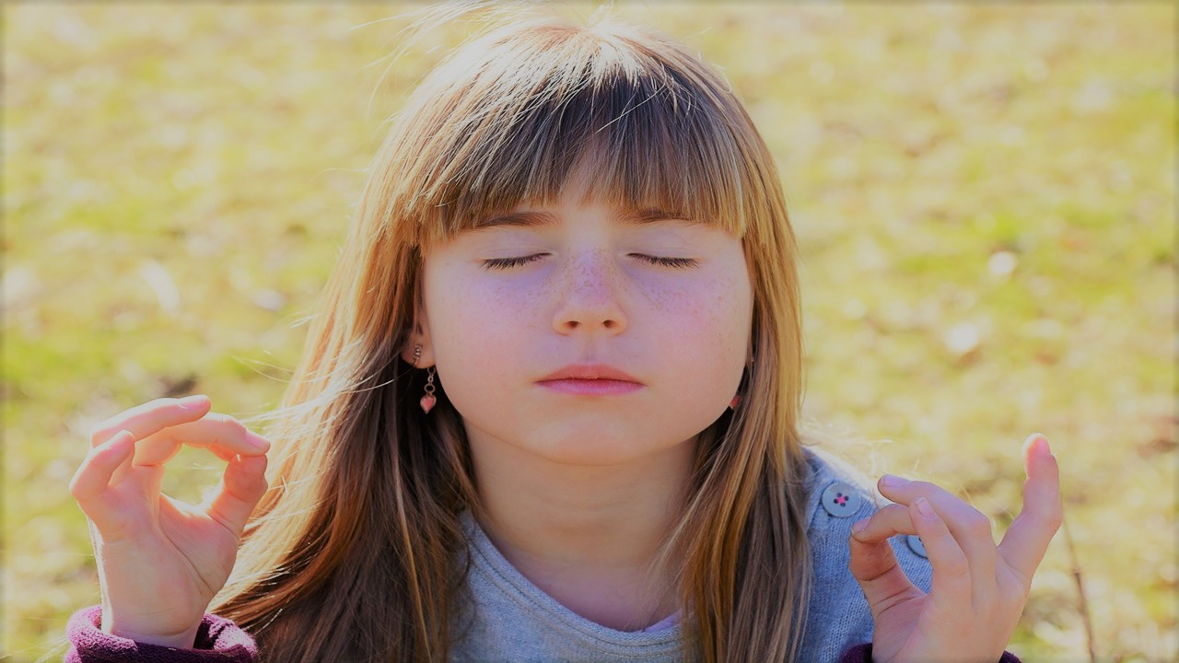

ZEN SCHOOLS
Mindful Schools
Shetland Islands Council
Children’s Services
Educational Psychology Service
SESSION FOR STAFF

Slide 2


From this training you will learn
Zen Schools: Session for Staff
What ZEN Schools is
What Mindfulness is (formal and informal practice) and when you can use it
The 6 principles we based our approach on
Myths and misconceptions
Automatic pilot vs Here and now
Benefits of Mindfulness

Slide 3
Introduction
Zen Schools: Session for Staff
It is a priority nationally and locally to develop positive mental health, develop resilience and promote wellbeing. Mindfulness is one way that we can promote this.
The Educational Psychology Service has developed a Mindfulness programmed called Zen Schools to deliver in schools. This training will give you an introduction to mindfulness, the resource, including activities to try.

Slide 4
Zen Schools: Session for Staff
What is Zen Schools?
A resource pack developed by Educational Psychology Service to introduce and/or embed mindfulness based practices in schools. The pack includes:
A twilight and written guidelines available for teachers and parents.
Activities for children – to help them become more aware of their thoughts, feelings, sensations and the world around them.
It is aimed at supporting a whole school approach, though the lessons can be used with individuals, small groups and whole classes.

Slide 5
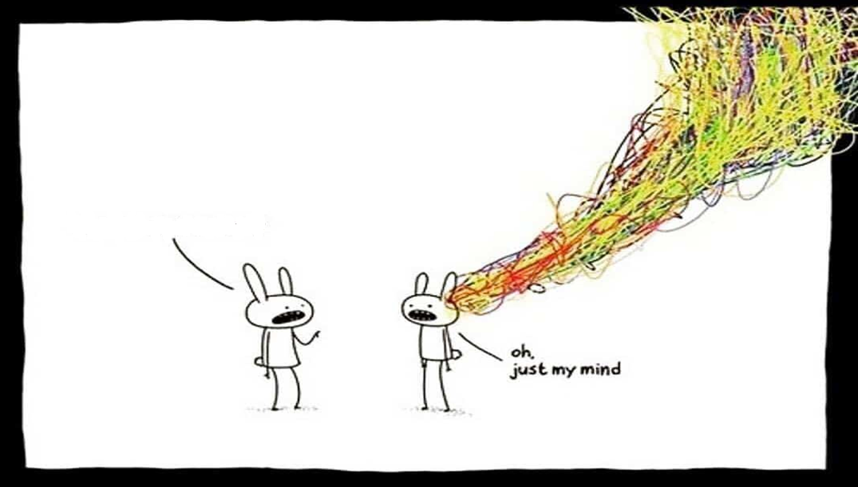
Zen Schools: Session for Staff
Ask yourself the following:
What do you think Mindfulness is?
Do you have your own Mindfulness practice?
What on earth is that?

Slide 6
Zen Schools: Session for Staff
Mindfulness involves paying attention…
On purpose, in the present moment, with curiosity and kindness, to things as they are (Kabat-Zinn, 1994)
Jon Kabat-Zinn is an American professor of medicine. He took Buddhist teachings and from it created mindfulness based interventions for use in hospitals for stress reduction and pain management. In doing this he removed any connections to Buddhism.
He has carried out a lot of research on the benefits of mindfulness, particularly in terms of stress and pain management.

Slide 7
Zen Schools: Session for Staff
Mindful activities can be used:
As a soft start or soft end to the day
To help settle children after break or lunch time
To support with relaxation at anytime the child needs it
Can be done in school or at home.

Slide 8
Zen Schools: Session for Staff
Mindfulness practice can be formal and informal
Formal practice
Informal practice
The formal practice of mindfulness includes an intentional commitment of time. These practices invite us to dwell with awareness on one thing – as if you are gently coming home to one moment - which might include our breath, an aspect of sensation or stillness or a focus on our whole body.
Bringing more mindful attention into our day is known as informal practice. This helps us to remember to come out of autopilot or overthinking and back to the present moment. We can do this by noticing the world around us, listening carefully to everyday sounds, being grateful, kind, etc…

Slide 9
Zen Schools: Session for Staff
The lessons in the pack are based on these 6 principles associated with mindfulness:
Awareness – paying attention to the present moment
Curiosity – responding curiously without judgment to our thoughts and feelings
Kindness – practising kindness to ourselves and others
Acceptance – of how things are without judgment and without trying to fix or change anything
Gratitude – being thankful for what we have. If we can bring gratitude to the present moment, we can feel more content, at ease, present and happy
Resilience – the ability to adapt to and cope with stress and adversity

Slide 10


Slide 11
Activity for you to try…gratitude jar
Zen Schools: Session for Staff
A great way to practice being thankful
1. All you need is a glass jar and post its!
2. Take some post its; write down things that you are thankful for and place them in the jar.
3. At the end of the day, look back at all the things you are thankful for in your life.
Gratitude increases happiness and helps us to appreciate what we have now, rather than what we don’t have and think we need.
It also creates positive emotions such as joy, love and contentment.

Slide 12
Zen Schools: Session for Staff
There are many common myths and misconceptions about Mindfulness. Are the following TRUE or FALSE?
Mindfulness is:
Religious
Paying attention to the present moment
Sitting on the floor cross-legged and humming
Positive thinking
Being grateful for what we have
Being kind to ourselves

Slide 13
Zen Schools: Session for Staff
Answers:
Mindfulness is:
Religious - False,
Paying attention to the present moment - True
Sitting on the floor crossed legged and humming - False
Positive thinking - False
Being grateful for what we have - True
Being kind to ourselves - True

Slide 14
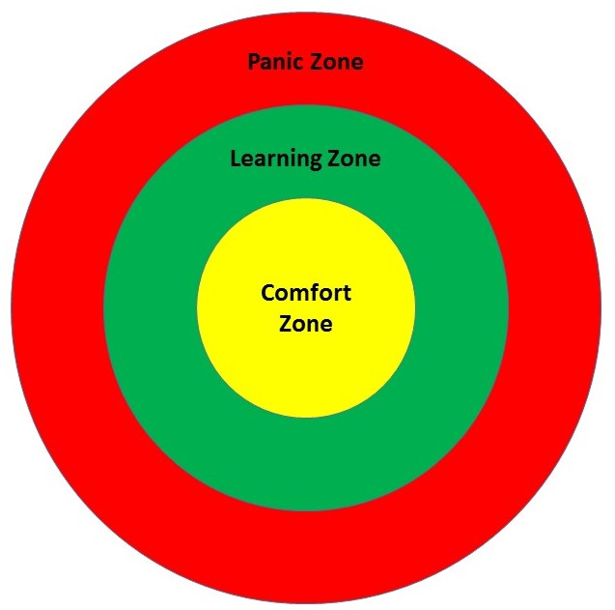
Zen Schools: Session for Staff
Levels of comfort / discomfort…
We can’t force people to be mindful!
Many people are not comfortable with silence, therefore, sitting in silence being mindful can be VERY uncomfortable and distressing for some people.

Slide 15
Zen Schools: Session for Staff
Think about the following:
Can you think of anyone in your school who might or does find mindfulness difficult?
How might you deal with that?

Slide 16
Zen Schools: Session for Staff
Can mindfulness be harmful to children?
Teachers or even parents might be concerned that mindfulness may do harm to children and young people.
Review of the literature show no cases of harm have been reported from mindfulness in schools. Mindfulness is simply attention and acceptance training. As such, if a difficult issue arises for a pupil, the issue will have been there already.
The act of training attention may highlight that issue, but the mindfulness practice is not the cause of it.
If pupils have experienced trauma or adversity, mindfulness practise may reduce the distractions that they usually employ to avoid or manage their symptoms.

Slide 17
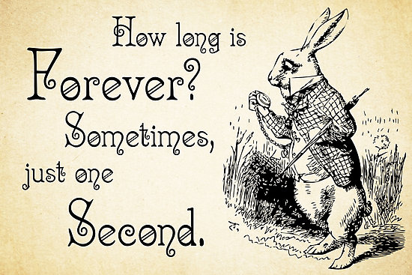
Zen Schools: Session for Staff
Practicing Awareness: how often are we in the present moment?
A second is powerful and can change our lives e.g. babies are born, people die, significant things happen to us in seconds and minutes but we pay little attention to them ticking by.
We spend our lives thinking in the past or in the future – but when we really think about it – all we have is now, this day and mindfulness encourages us to focus on that and the fact that this day and what we do with it can take our lives in all kinds of directions.
https://www.redbubble.com/people/contraststudios/works/16518723-alice-in-wonderland-quote-how-long-is-forever-white-rabbit-quote-0125?p=canvas-print

Slide 18

Zen Schools: Session for Staff
Below is a video included in the pack about learning how to control stressful energy. Have a listen…

Slide 19
Zen Schools: Session for Staff
Automatic Pilot…
How many of us drive without realising what we’re doing?
In the same way, we may not be really present, moment-by-moment, for much of our lives. We can often be miles away without knowing it.
By becoming more aware, from moment to moment, of our thoughts, feelings, and bodily sensations, as well as the world around us, we give ourselves the possibility of greater freedom and choice.

Slide 20
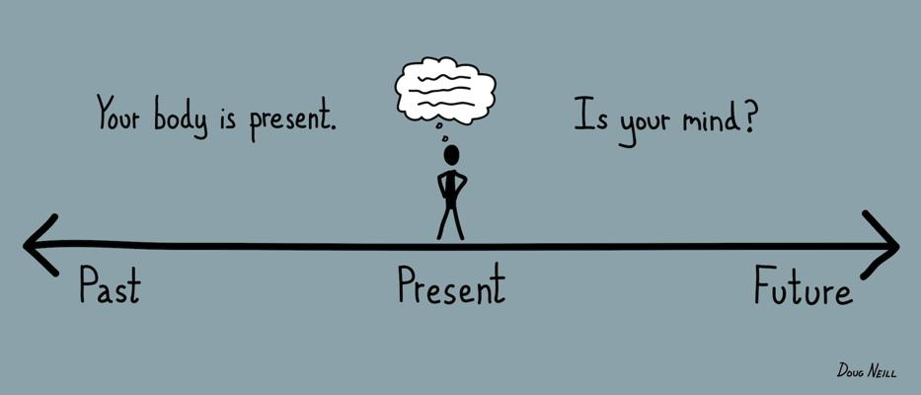
Zen Schools: Session for Staff
The more this happens the harder it becomes for us to genuinely experience the present and focus on what we are actually feeling and experiencing in the here and now.
We can go on holiday and the time flies by. We end up not really remembering or appreciating it at the time.
We need to be present in the here and now e.g. stop and smell the flowers.

Slide 21
Activity for you to try…practising awareness
Zen Schools: Session for Staff
Take a moment to ground yourself, be present and listen, see and be aware of what is happening around you.
1. Close your eyes if you feel comfortable doing so and listen for 1 minute to the sounds around you.
2. What did you hear? Were you more aware of sounds you hadn’t really heard before?

Slide 22

Activity for you to try…mindful eating
Helps us to appreciate and enjoy the little things
1. Hold a malteser in the palm of your hand and first look at it, observe it’s shape and colour.
2. Next, hold the malteser to your nose and smell it. What does it smell of? Is it sweet?
3. Place the malteser in your mouth but don’t eat it straight away. Instead, let it melt in your mouth. What does it taste like?
4. Finally, bite down on the malteser and hear the crunch.
What did you notice? Did the malteser taste different to the last time you had one?
Zen Schools: Session for Staff

Slide 23
Zen Schools: Session for Staff
Here and now…
This is in essence what mindfulness is – settling our minds positively in the present rather than negatively in the past or the future.
It’s this focus on the present that can reduce stress, bring about less reactivity to people and situations and introduce feelings of inner calm rather than anxiety.

Slide 24

Zen Schools: Session for Staff
Where and how you use your awareness in this next minute determines the very quality of your life – your ability to live joyfully, to accept the present conditions of the precious life you have, and to bounce back from life’s most challenging obstacles.
http://www.club.cc.cmu.edu/~cmccabe/blog_time_and_time_again.html

Slide 25
Zen Schools: Session for Staff
If we learn to be mindful, we may find a way to make different choices!
By doing this, we increase awareness and will be able to respond to situations with choice, rather than react automatically.
We can choose what we think, feel and how we act – which is similar to cognitive behavioural therapy.

Slide 26
Zen Schools: Session for Staff
Benefits of mindfulness
Strengthens and develops important cognitive skills related to learning (e.g. attention, concentration and memory).
Provides a foundational awareness, an understanding of thoughts, emotions, behaviours and how to self-regulate.
Reduces emotional reactivity, behavioural issues, anxiety and depression.

Slide 27
Zen Schools: Session for Staff
In the classroom mindfulness…
Can help children to settle in the morning.
Can help children to be ready to re-engage in learning after breaks.
Can be used as a de-escalation technique.
Teaches children to be kinder, grateful and non-judgmental.

Slide 28

Activity for you to try…random acts of kindness
Zen Schools: Session for Staff
1. Think about how you can be kind today, both to yourself and others
E.g. smile to someone, give a compliment, open a door, eat healthily, encourage yourself.
2. Commit to one act of kindness today and DO IT!

Slide 29
Below is a video used in the Zen Schools lessons to promote kindness. Have a listen…
Zen Schools: Session for Staff

Slide 30
Zen Schools: Session for Staff
Helpful tips for practicing mindfulness in schools and classes
Avoid conflict with other activities.
Choose a naturally quieter part of the day with less interruption.
Can be helpful as part of a nurture group or nurturing approach
Deliver in the context of safety and positive relationships (Trauma and Adversity - When helping a brain that has been organized by negative experiences we need to ensure that we focus on providing positive experiences in a more secure environment)

Slide 31
Zen Schools: Session for Staff
Today we have covered:
Mindfulness and how Zen Schools makes use of the approaches.
When best to implement the practice.
The benefits of delivering mindfulness within the school
Mindfulness activities to try in the classroom and/or home.

Slide 32

Zen Schools: Session for Staff
Thank you for taking part in this training.
If you are interested in delivering Zen Schools in your school or have any questions, please contact us at: psychological.service.admin@shetland.gov.uk

