Slide 1
Rainforest Songs
From Around The World

Slide 2
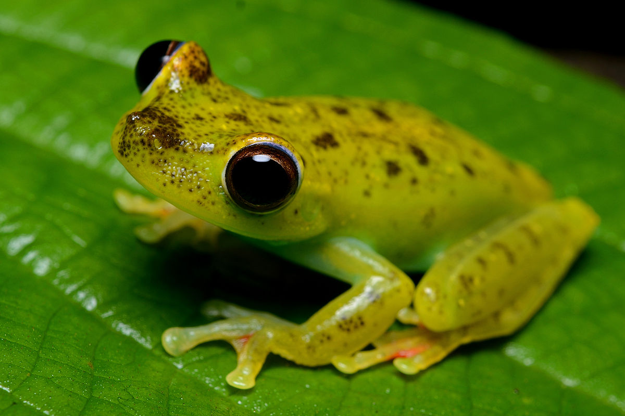
Kaeru
This is a traditional song about the tree frogs which live in the temperate rainforests of Japan.
The words in the last two lines imitate the croaking sound of the frog
Have a go at making your own rainforests sounds along with the music track after you have sung the song though twice. You could use your voice, body percussion or some homemade musical instruments to shake, tap, scrape and ting.
Kaeru no uta ga. (Ka-e-roo no oo-ta ga)
Kikoete kuru yo. (Kee-ko-ay-tay koo-roo yo)
Gwa gwa gwa gwa
Gero gero gero gero gwa gwa gwa

Slide 3
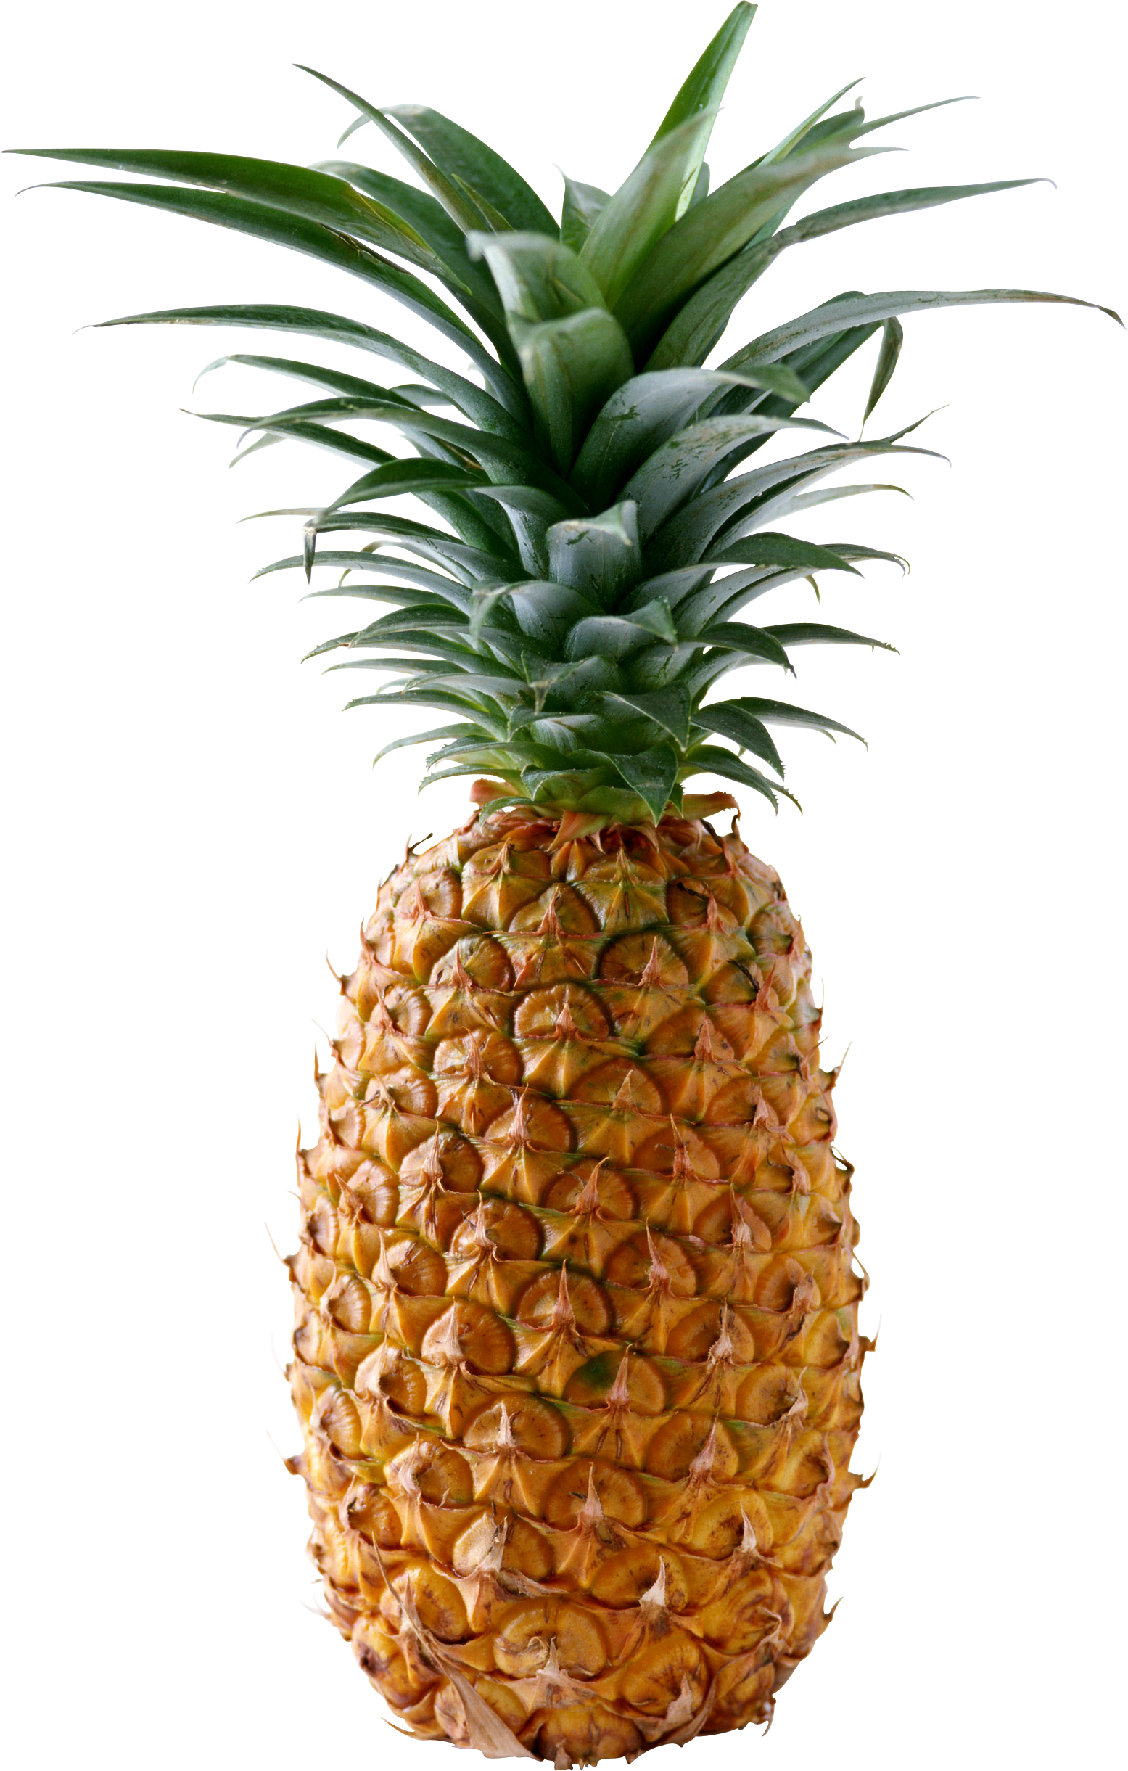
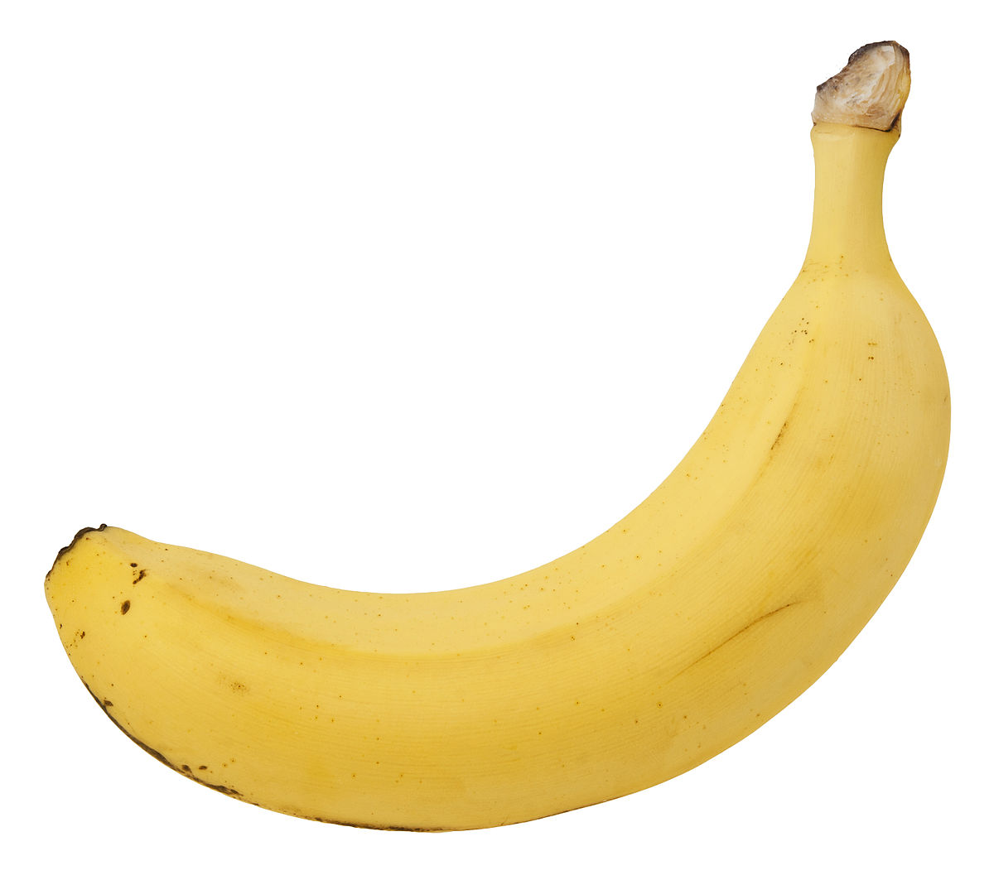
Si Si Si
This song is from the Katanga province in Southern Congo
The words mean “By the foot of the pineapple tree,
Yaku ladles a banana into his Aunt’s red hat.”
You will hear African drums in the sing-along track.
Listen out for the low notes on the double bass which comes in on the second time through the song
Si si si si dolada (See see see see do-la-da)
Yaku sine ladu banaha (Ya-koo see-nay la-doo ba-na-ha)
Banaha X X banaha X X
Yaku sine ladu banaha X X X=clap

Slide 4
Zum Zum Zum
This is a song from Brazil, sung in Portugese.
The song describes someone who is performing the traditional martial art of Capoiera – this is the “capoeirista”
The capoerista hears the buzzing of a wasp “zum zum zum” and wants to find the wasp and knock it down dead.
Song words: Translation:
Zum zum zum, capoeira mata um. X4 buzz, buzz, buzz, capoeira wants one
Ondeteim marimbondo, y zum zum zum. X4 where is the wasp? Buzz buzz buzz
O ay, o ay ey, ciero ver bater, ciero ver cair. X4 O ay, o ay ey, I want to see a hit,
I want to see a kill

