Slide 1
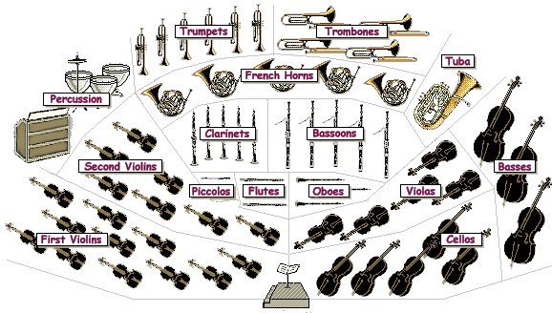
Peter and the Wolf
By Sergei Prokofiev
A guide to the instruments of the orchestra

Slide 2
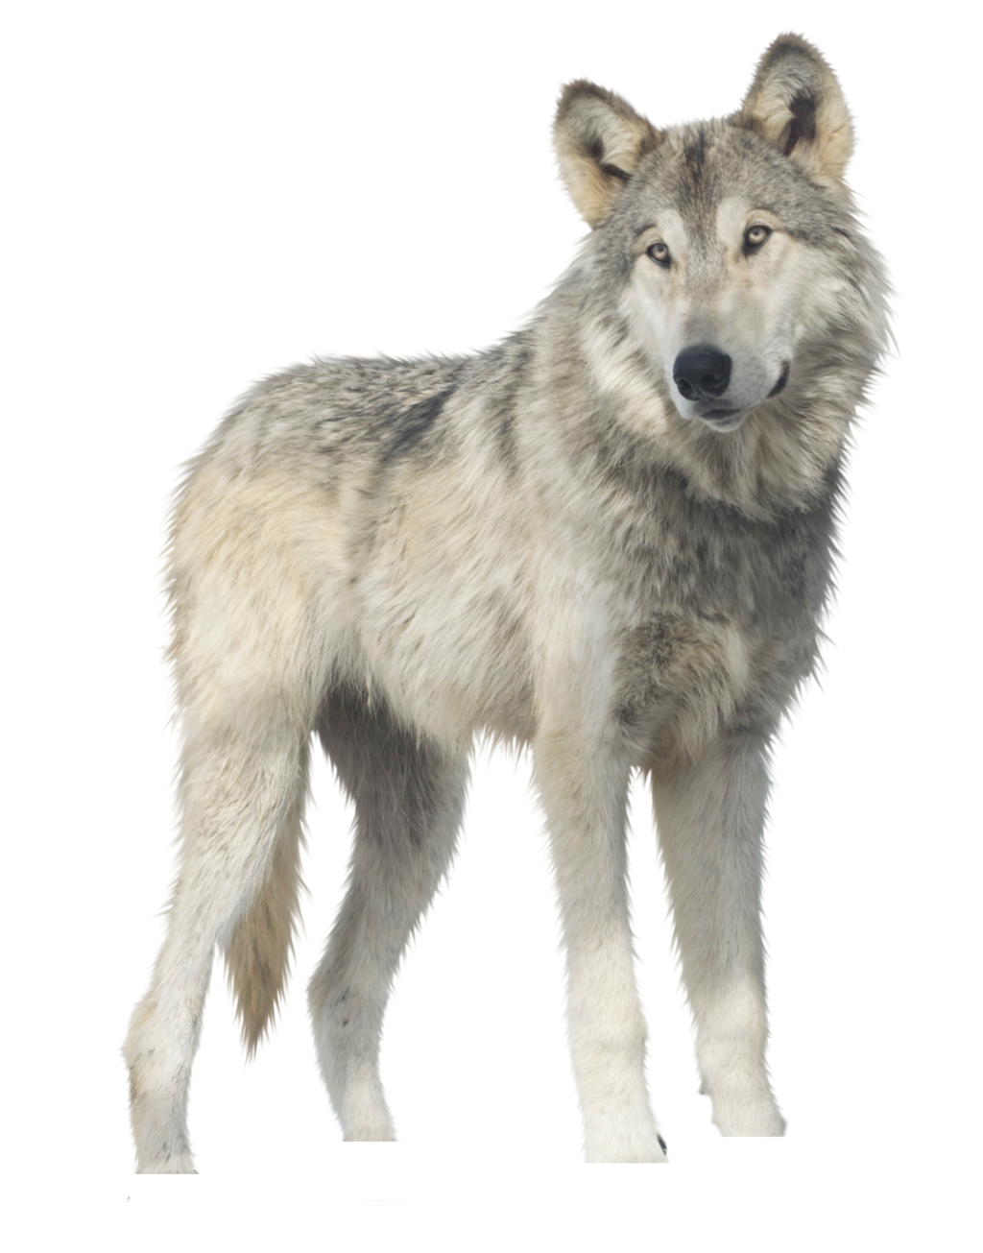
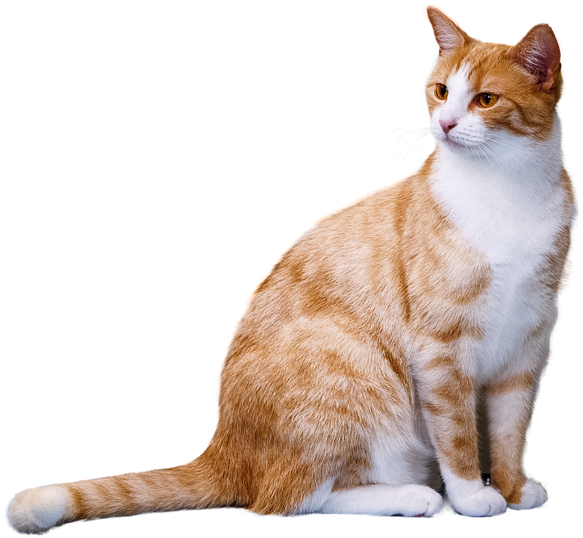
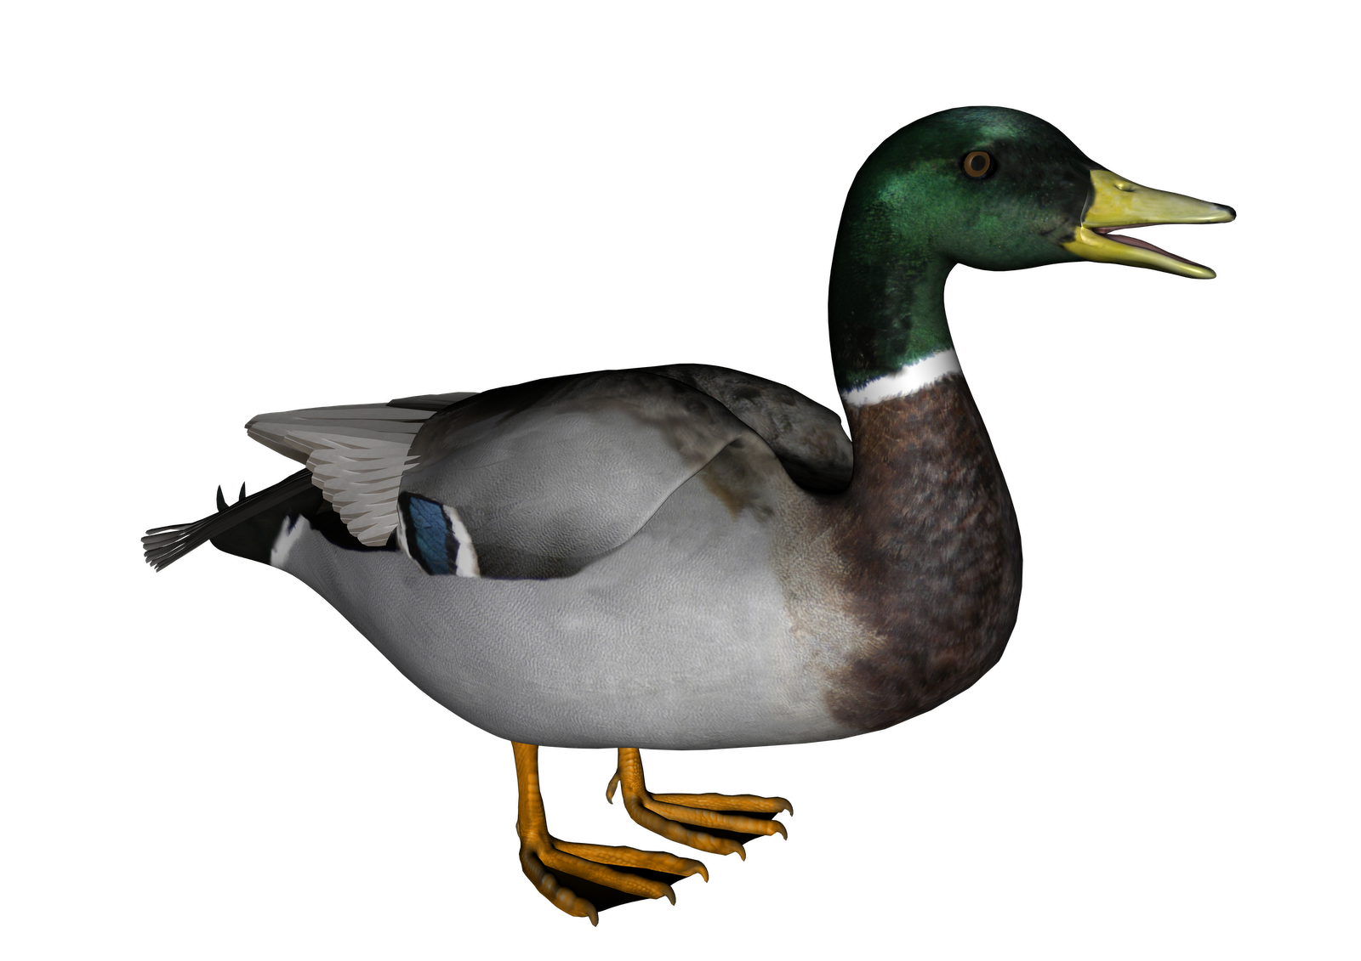
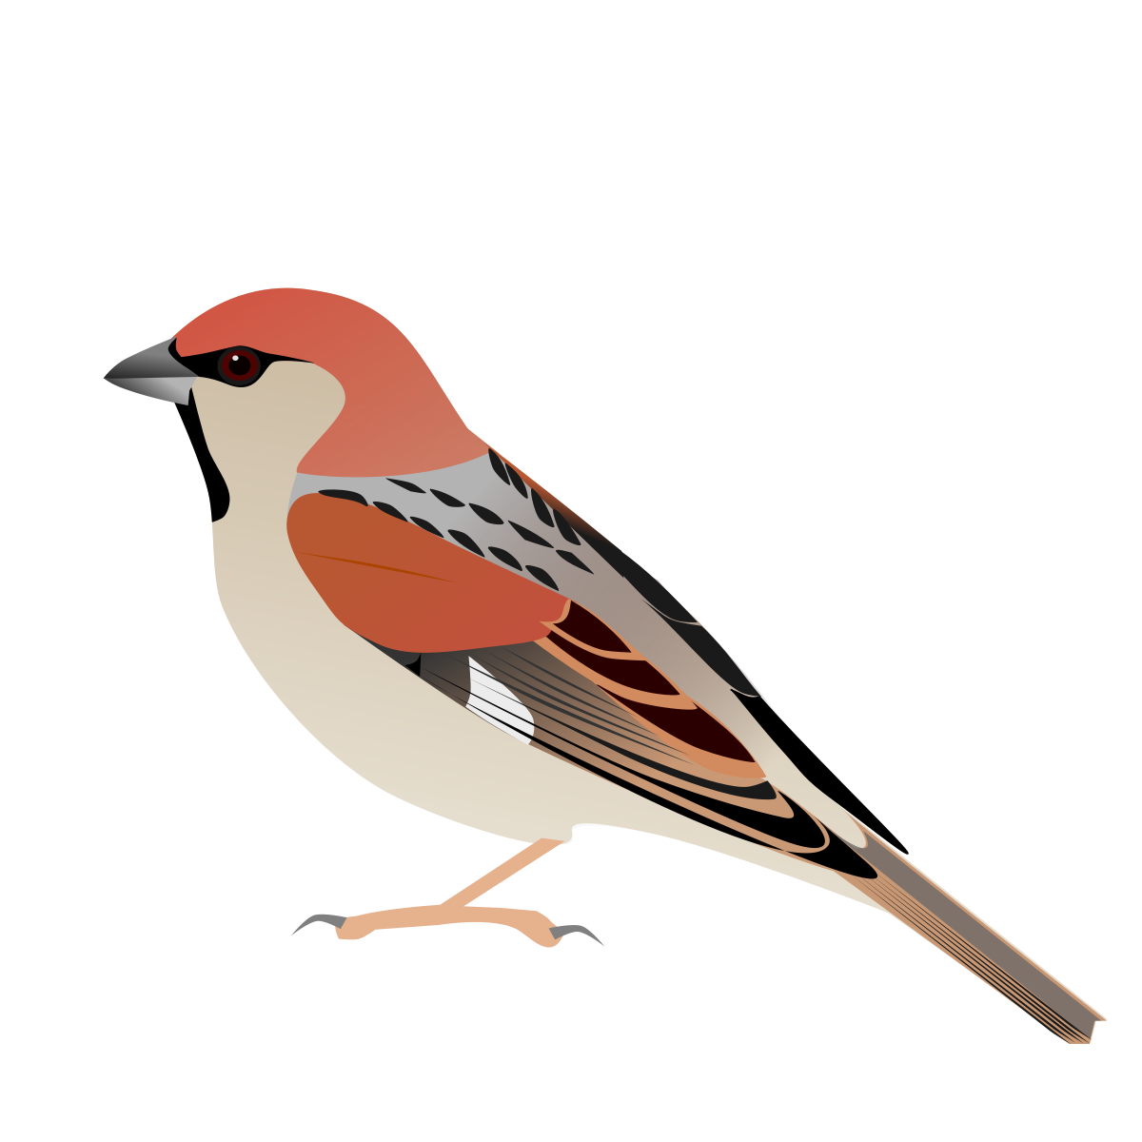
introduction
The Russian composer Sergei Prokofiev wrote the music for Peter and the Wolf in 1936. It was written as a child’s introduction to the orchestra and was first performed at a children’s theatre in Moscow.
Music which paints a picture or tells a story is called programme music. Each character in the story is represented by a musical theme played by an instrument or group of instruments chosen because their sound quality, or timbre, helps to evoke the character.

Slide 3
The story
The story is about a boy named Peter who lives with his grandfather. Grandfather does not want Peter going out of their garden because there are wolves around. One day Peter goes out, leaving the garden gate open, and sees a little bird. A duck goes for a swim in the pond in the meadow and the little bird flies down and gets into an argument with the duck. Peter sees a cat approaching and warns the little bird who flies up into a tree. Just then, Peter's grandfather comes outside and scolds Peter for going out of the garden. They go back into the garden and Grandfather locks the gate.
Soon a wolf does appear from the woods. The cat climbs a tree to escape, but the duck is swallowed by the hungry wolf. Peter gets a rope and climbs over the garden wall into a tree. The bird distracts the wolf by flying over his head while Peter lowers a noose and catches him by his tail. Hunters then come out of the woods and fire at the wolf, but Peter stops them. They all bring the wolf to the zoo and at the end, the duck can be heard quacking in the wolf's stomach!

Slide 4
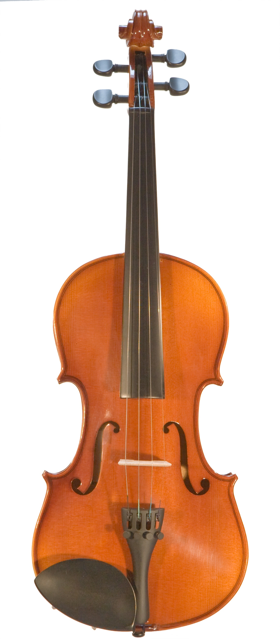
Peter’s Theme
Peter is represented by the string section of the orchestra - click on the sound icon to hear his theme.
How does this music make you feel? What kind of character do you think Peter is?
Find out more:
Can you find research the instruments in the string section of the orchestra?
Try drawing a labelled diagram of the different parts of a violin
One of the most famous pieces ever written for strings is Vivaldi’s Four Seasons. It is a group of four concerti (a concerto is a piece for orchestra with a showy solo part played by a virtuoso performer) depicting the seasons of the year. This music was written in 1717 and is one of the earliest examples of programme music. Antonio Vivaldi was one of the greatest composers of the Baroque Period in music history. You can see and hear an amazing performance of the thunder-storm from Summer here:
https://www.youtube.com/watch?v=YuF4oYRktcA

Slide 5
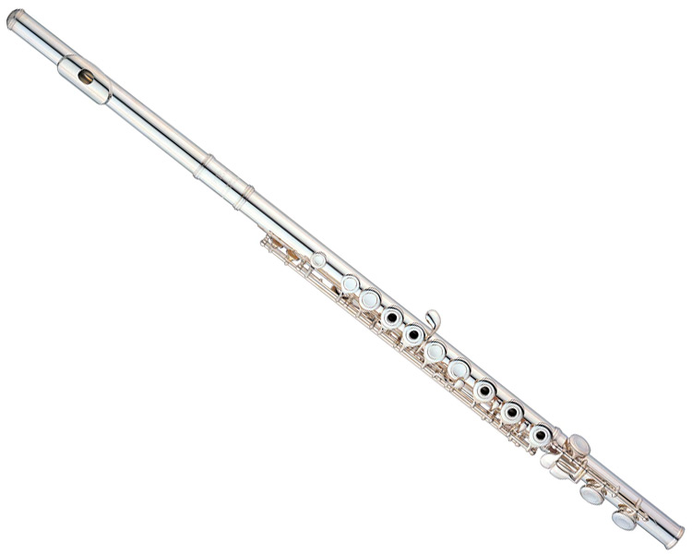
The Bird’s Theme
The bird is represented by the flute.
Listen to the music and see if you can imagine a little bird flitting around in the sky as the melody leaps around from note to note.
Can you design a cartoon character that is part flute and part bird?
Have a go:
Try blowing across the top of an empty glass bottle to make a sound like a flute.
Next add some water and see what happens to the sound - is the note higher or lower?
What happens if you add more water?
Try using several bottles to make a series of notes and make up a tune?
The French composer Claude Debussy wrote one of the most well-known flute solos at the opening of his impressionist piece Prélude à l'après-midi d'un faune.
You can see and hear it performed here:
https://www.youtube.com/watch?v=CipRfYTwd0s

Slide 6
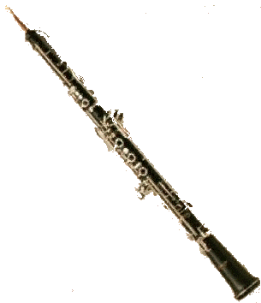
The Duck’s Theme
The duck is represented by the oboe.
Listen to the theme – do you think the oboe’s timbre evokes the quacking of a duck?
What kind of character do you think the duck is?
Can you design a cartoon character that is part duck and part oboe?
Find out more:
The oboe, and flute both belong to the woodwind family.
Can you do some research and create a fact file about the woodwind family?

Slide 7
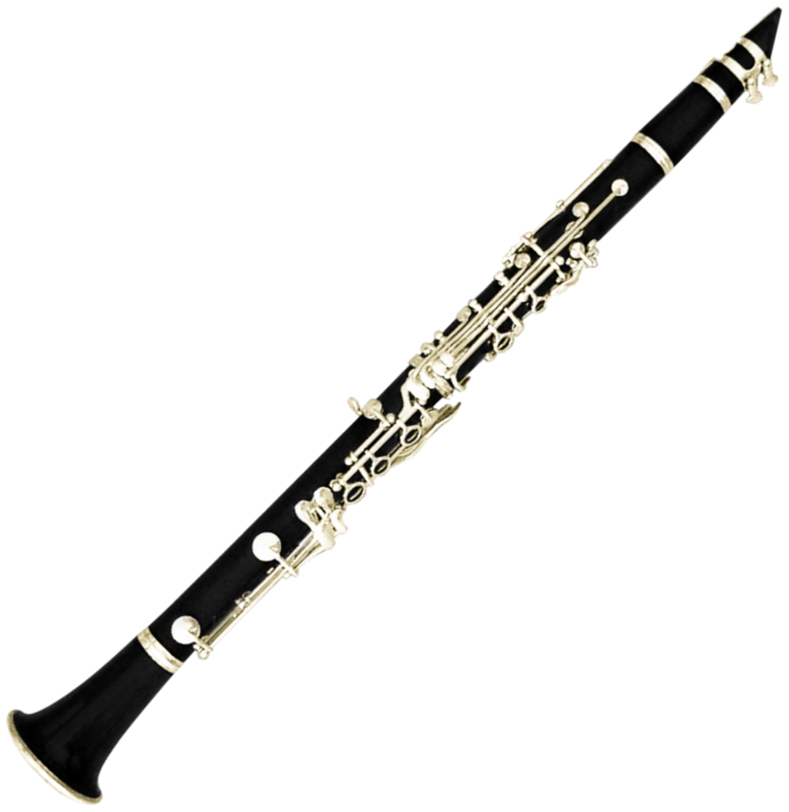
Cat’s theme
The cat ‘s theme is played by the clarinet.
Do you think Prokofiev’s choice of instrument makes the cat sound sneaky and stealthy as it tries to catch the bird?
Can you hear how the melody moves using a mixture of leaps and steps to twist and turn like the cat would? Try listening to the theme and doodling a line which follows the shape of the notes.
Amercian composer George Gershwin composed Rhapsody in Blue in 1924. It is a wonderful mixture of jazz and Classical musical styles and features a thrilling clarinet solo which you can listen to here:
https://www.youtube.com/watch?v=VAuTouBhN5k

Slide 8
Grandfather’s theme
Listen to the sound clip - why do you think Prokofiev chose the bassoon to represent the Grandfather?
Which features of the melody make it an effective portrait of the grumpy grandfather?
Is the music high or low?
Are the notes smooth and legato or short and spiky staccato?
Does the melody move in a smooth line or do the notes jump about?
Which member of the woodwind family makes a lower sound than the bassoon?

Slide 9
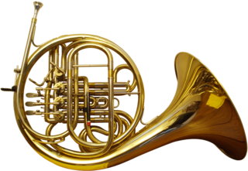
The Wolf’s theme
The Wolf’s theme is played by not one but three French Horns.
This theme is very menacing – have a listen…
Find out more:
Can you research the instrument family that the French Horn belongs to and create a fact file?
Wolfgang Amadeus Mozart, one of the greatest composers of the Classical Period, wrote 4 Horn Concertos. When they were written, during the 1780s, they were performed on natural horn which did not have the valves of the modern French Horn and was fiendishly difficult to play. The notes had to be controlled using a combination of lips, tongue and hand stopping. Watch a performance on the modern French horn here:
https://www.youtube.com/watch?v=0lIsXScysGQ&list=RDqcA7ivsSMWQ&index=3

Slide 10
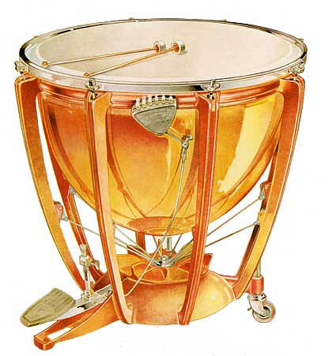
The gunshots
The gunshots fired by the hunters are played by the timpani and the big bass drum which are members of the percussion family. Listen to their spectacular sound…
What else can you find out about the percussion family?
Try making some percussion instruments out of pots, pans or junk from your recycling bin.
See if you can build a drum kit with different pitches and timbres…
For an impressive example of timpani playing check out Jupiter from The Planets Suite by Gustav Holst. This is a great showcase of all the instruments we have looked at. Listen out for the fabulous French horns, glittering string section and virtuosic woodwind and brass:
https://www.youtube.com/watch?v=BUM_zT3YKHs

Slide 11
And finally…
Well done - you have learned lots about all the different instruments.
Now sit back and enjoy this wonderful performance of Peter and the Wolf by the Vancouver Symphony Orchestra:
https://www.youtube.com/watch?v=MfM7Y9Pcdzw
This project was brought to you by YMI Scottish Borders

